Slide 1
Sociology 1001B
Introduction to Sociology
Tuesdays 2:35-4:25
Tamy Superle
Office: Loeb A701
Office Hours: Tuesdays 1-2 or by appointment

Slide 2
What is Sociology?

Slide 3
So, Sociology is...
Most generally: the study of society
More specifically… It’s the systematic study of human behaviour, collective action, interaction, and the consequences of these behaviours, actions and interactions.

Slide 4
What does Sociology Do?
More helpful to talk about what sociology does
Sociology is a particular way of seeing and studying the social world.

Slide 5
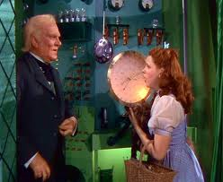
Looking behind the curtain

Slide 6
Why is Sociology Important?:
Goals of Sociology
Sociology helps us understand ourselves, our relationships, and our world.
Sociology gives us knowledge into:
  How societies work.
  How people are organized.
  How societies change.

Slide 7
What’s the Point?: Goals of this Course
To present an overview of sociological thinking
To introduce you to sociological concepts, terms, people and perspectives
Familiarize you with sociological paradigms, or ‘ways of seeing’ society
Challenge you to see the world around you in new ways
Develop critical thinking skills
Introduce you to university‐level expectations of reading, writing and comprehension skills

Slide 8
What good is sociology in the ‘real world’?: Sociological Skills
Ability to recognize trends and patterns
Ability to create concise reports and essays
Strong critical thinking skills
Research skills
Grant writing skills

Slide 9
Sociological Jobs
Work in the public sphere:
  Community and social services
  Education
  Health
  Government
  Criminal justice system.
In the business world:
  Marketing
  Advertising,
  Media
  Environmental
  Financial
  Work in corporations large and small

Slide 10
Some practicalities:

Slide 11

Textbook
Sociology in Our Times, Fifth Canadian Edition. 2011. Jane Lothian Murray, Rick Linden and Diana Kendall.
The text is available at The University Bookstore
Additional readings are on Webct.

Slide 12
Assignment | Weight | Due Date
Tutorial Attendance and Participation | 10% | Weekly
Online Participation | 5% | Ongoing
Critical Thinking Assignments I | 12% | October 9th
Midterm | 20% | October 16th
Critical Thinking Assignments II | 18% | November 13th
Final Exam | 35% | Formal Exam Period between December 6-19

Slide 13
TAs and tutorial groups
The room number of your tutorial is available on Carleton Central.
It is very important that you check which group you enrolled in and attend only that group. If you do not attend your assigned group, you will not get the participation marks for tutorial attendance.
Plan for tutorials to start next week.

Slide 14
Paul Menton Deadlines and Contact Information
Is responsible for the coordination of academic accommodations and support services for students with disabilities.
In-class tests— Request submitted PMC two weeks before the first in-class scheduled test, midterm, or exam.
Formal— November 11, 2011.
500 University Centre (top floor)
pmc@carleton.ca
613-520-6608

Slide 15
Volunteer Notetakers
The Paul Menton Centre is looking for a Volunteer Notetaker for this class. The criteria includes:
  Attending all assigned classes
  Taking complete and legible notes
  Typing up lecture notes and submitting them electronically within 48-hours after each class
  Maintain confidentiality
Email: volunteer_notetaking@carleton.ca or stop by the Notetaking Office located in 501 B University Centre.
Volunteers who successfully complete the term will receive volunteer certificates from the Paul Menton Centre.

Slide 16
Library Learning Commons
One-stop study-shop that combines research, IT and learning support services in one location:
  Research
  Study Skills
  Writing help
  Computer problems
Desks located on the first and fourth floor of the Library.

Slide 17
Other Useful Services:
Health and Counselling (located in the Carleton Technology and Training Centre)
Learning Support Services (4th floor of the MacOdrum Library)
Student Academic Success Centre (SASC) (302 Tory Building)
The Writing Tutorial Service (WTS) (4th floor of the MacOdrum Library)
The International Student Services Office (ISSO) (128 University Centre)

Slide 18
Other Stuff
The full syllabus (with information about accommodations, academic honesty, grades etc) is on WebCt;
PLEASE read the syllabus! Everything you need is there.
PLEASE check WebCT regularly;
Please do not record the lecture unless you discuss it with me;
Please turn off all cell phones, PDAs, MP3 or other music players and similar devices and place them out of sight for the duration of the class;

Slide 19
WebCT
Syllabus
Announcements
Contact with Me
Discussion Board (5%)
Connection with Peers
PowerPoint Slides
Some readings
Other academic resources
Grades
Other interesting and useful resources

Slide 20
WebCT
Any problems or questions can be answered by Carleton’s Computing Services (CCS) at (613) 520-3700
Email ccs_service_desk@carleton.ca.
If you have problems downloading files from WebCT check the FAQ sections for tips or contact CCS.

Slide 21
What will we be studying?

Slide 22
PART I: THE FOUNTATIONS OF SOCIOLOGY

Slide 23
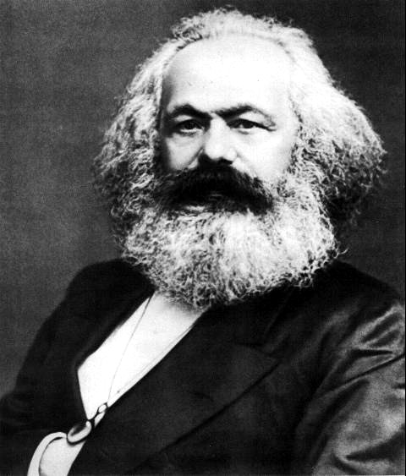
What is Sociology and Where Did it Come From? (weeks 2 and 3)
The beginnings of sociology, how it came to be and how we do it
  Sociological Imagination
The founders and influential thinkers of sociology
Karl Marx

Slide 24

What is Culture? (week 4)
Theories of culture
Language
Cultural Change
Values and Beliefs

Slide 25

How do we becomes members of society? (week 4)
Socialization
Social Interaction
Status, Roles and Identity

Slide 26
PART II: SOCIAL INEQUALITIES

Slide 27

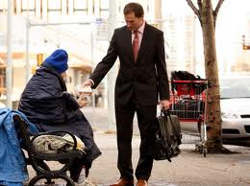
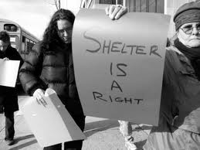
Class and Status Inequality (week 7)
Class Inequality
  Social Class
  Poverty

Slide 28
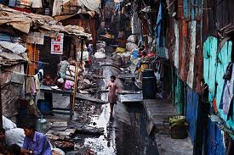
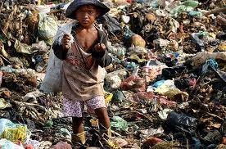
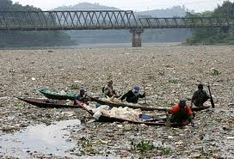
Class and Status Inequality: Global (week 8)
Global Inequality

Slide 29
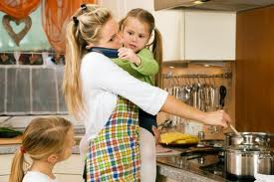
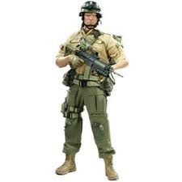

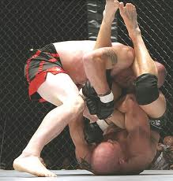
Gender Relations (weeks 9 and 10)
Women and Inequality
Men and Masculinity

Slide 30
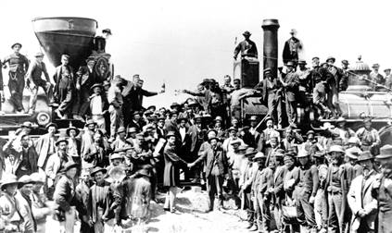
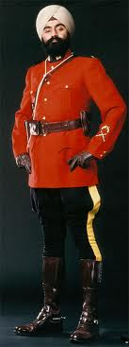
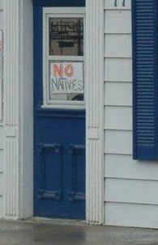
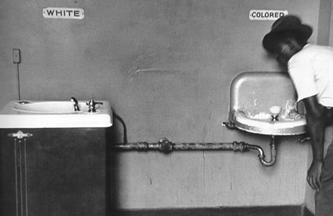
Race and Ethnicity (week 11)
Notes:
A ‘NO NATIVES’ sign was found this week taped to outside window of a Lakefield (near Peterborough) Ontario restaurant on Wednesday March 16, 2001. Lakefield-Peterborough police are investigating.

Slide 31
Song Suggestion
To set the mood I’m going to play some music before class.
Discussion board topic for suggestions.
Song suggestions should relate to the topic of the week.
No suggestions = you’ll be subjected to my musical tastes…

Slide 32
Wrap-up
No tutorials this week.
Plan to attend tutorials next week. Make sure that you check the room number of your tutorial group, I won’t be able to access that info.
Next week: Sociological Foundations I: What is Sociology and How do we do it?
Sociology in Our Times: Chapter 1: The Sociological Perspective

