Slide 1
November 2012
Last class
Review
Exam Prep.

Slide 2
The review slides and notes are meant to help you study, since you need to know something about objects in order to identify them. You cannot learn the history of art by memorizing random facts, and the comparisons on the slides and the notes will help you understand relationships, consistent themes, and significant changes in history. I am trying to get you to understand the “Big Picture” and how objects fit into it. Please do not think that the exam is going to contain all the images or that these are the only images on the exam. They are to help you learn to study.

Slide 3
There will be about 110-115 questions. About will be questions about the slides – artists if known, stylistic period, medium, subject, approximate date, purpose of the object, various terms

Slide 4
30% of the exam will concern material covered before the midterm.
You will need to be able to identify objects by their civilization prior to the Greeks. About 10 Slides and about 4 or 5 questions concerning very basic facts.
You will need to understand basic facts about Greek and Roman art and architecture. Know basic architectural terminology. About 10 questions/slides.
You will need to know general dates for some of the stylistic periods, both those before and after the midterm.
Know about the evolution of architecture during the Middle Ages. Know the basic differences between Romanesque and Gothic and between Italian and French buildings

Slide 5
The rest will focus on art we have studied since the mid-term. Weeks 8-12
Don’t forget:
Know what was occurring in representational art during the Middle Ages. Some of this is we covered first before the test, but you need to understand significant relationships to later work.
Know how Roman art influenced later periods, and why

Slide 6
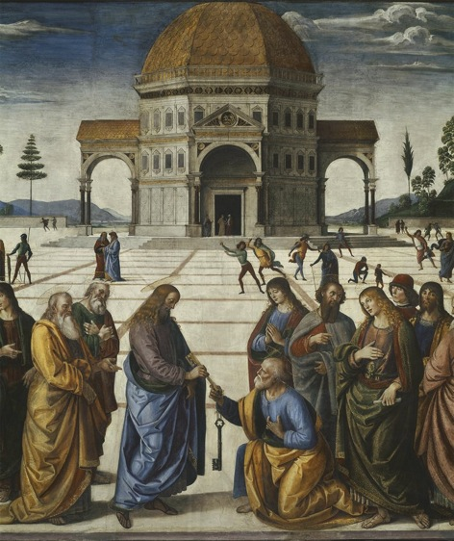
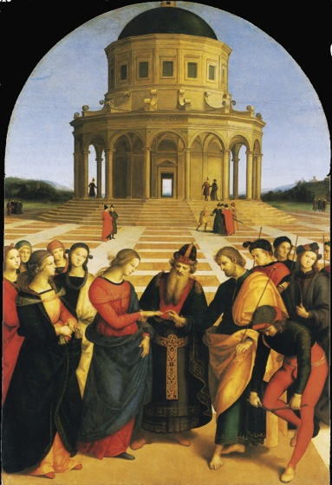
Perugino: Christ Giving the Keys
to Saint Peter. Vatican 1481
Raphael: Marriage of the Virgin 1504
Notes:
First class: what did you learn about looking at things very, very carefully? Why do you need to know what is represented to make sense out of the differences in these images? What do you need to know about the concept of creativity at this time (Italians called it “invenzione”, from last class) to understand what Raphael is up to? Finally, most people would say that Raphael's is really much better than Perugino’s even though Raphael depends on Perugino and has simplified a great deal. Why does that make the Raphael better? Three months ago you thought that Raphael ought to do something utterly unique to qualify as a great artist. Now we know that artists always have a relationship to what went before, and in order to understand that art we have to understand that relationship.

Slide 7
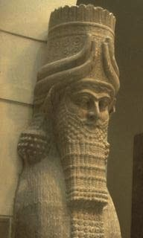
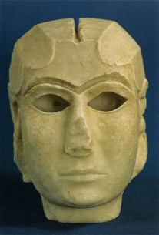
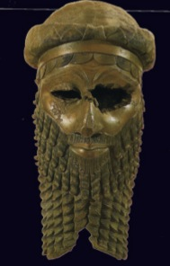
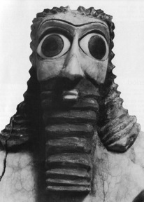
Mesopotamia
3500-3000 B.C
2700-2500 B.C.
2300 B.C
720 B.C
2.7
2.12/.13
2.16 a
2.29
Notes:
2nd class: what is the point of these comparisons among objects made over almost 2,000 years?

Slide 8
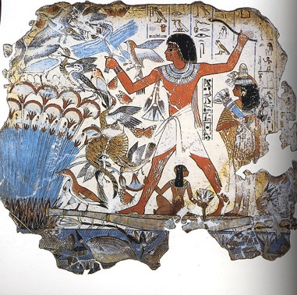
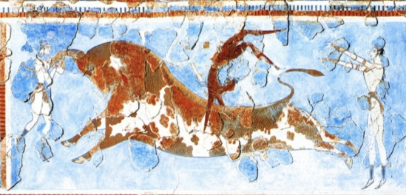
Knossos:
Toreador Fresco ca. 1500 4.6
Nebamun Hunting Birds 1390-1352 B.C.
3.35
Notes:
Lecture 3 review: the detail (next slide) helps for closer inspection, but this one is essential because both show figures of both sexes.

Slide 9
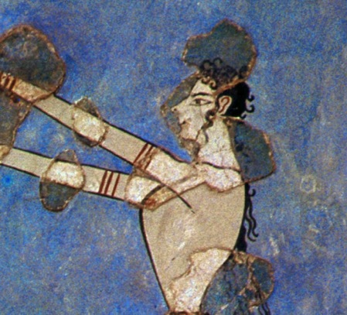
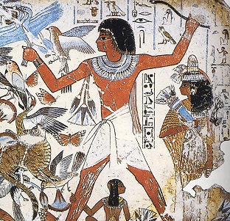
Knossos:
Toreador Fresco ca. 1500 4.6
Nebamun Hunting Birds 1390-1352 B.C.
3.35
Notes:
Lecture 3 review: Here is a question: knowing what is going to happen in Greek art during the classical period, what do these 2 have in common, that makes them different from Classical art?

Slide 10
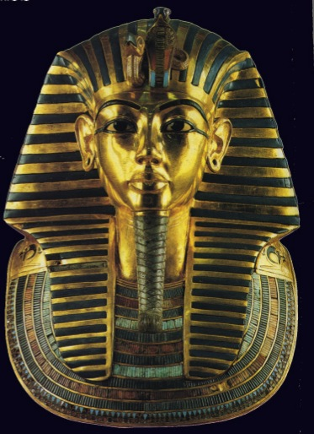
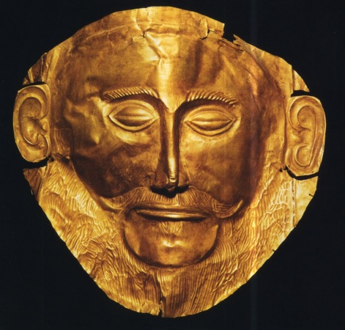
“Mask of Agamemnon” ca. 1500 B.C
4.26
Tutankhamon’s mask
ca. 1327 B.C.
3.41
Notes:
Lecture 3 review: these don’t look all that much a like, but the material and their uses clearly relate them to one another. As to dates, remember my emphasis on the fact that Egyptian art and religious and social practices stayed more-or-less the same for two thousand years, and the conventions start in the Old Kingdom, more than 1,500 years before this object. Knowing dates matters and this background helps, since you might think that the Mycenaean object influenced the Egyptian object. It did not.

Slide 11
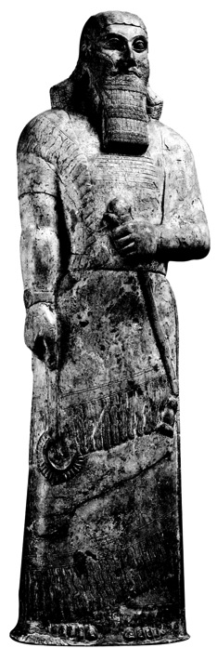
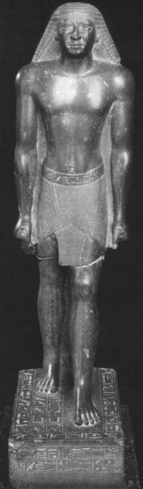
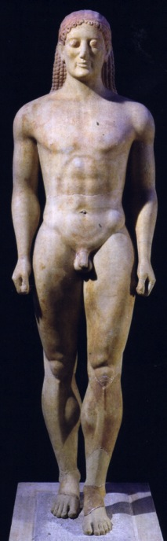
A
B
C
Notes:
Lecture 4 review: one or more of them might not be in the textbook, but considering what you see as the norms of art of their separate civilizations, can you identify them? Remember, we are looking at what is typical for the early periods

Slide 12
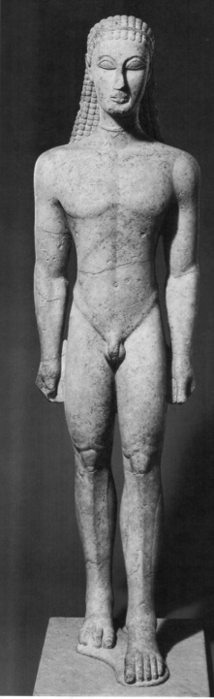

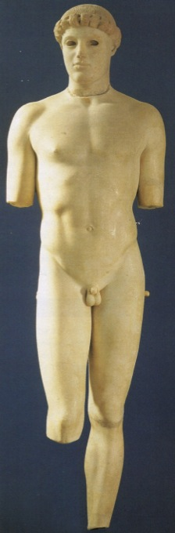
A
B
C
Notes:
Lecture 4 review: Greek art, earlier to later: using the language we have been using in class, what is happening here?

Slide 13
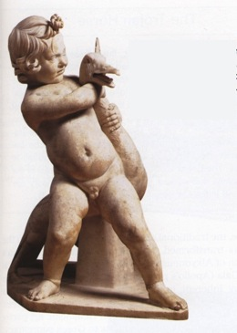
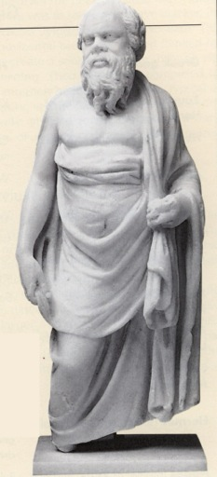
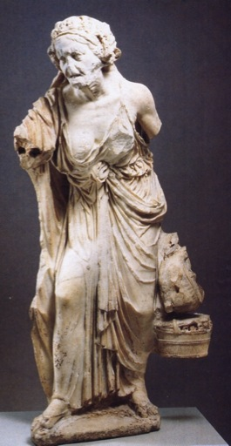
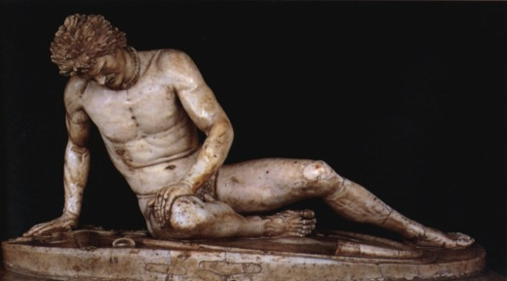
Notes:
Review 4: Hellenistic art and subject matter, this is basic to any understanding of the history of Greek art.

Slide 14
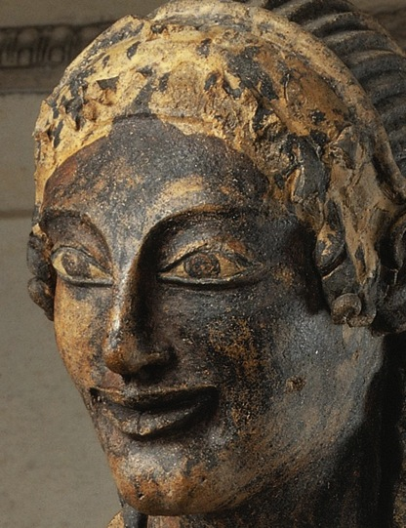
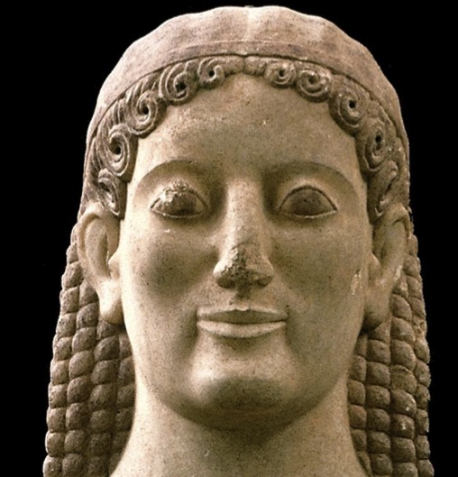
Etruscan
Greek
Notes:
Lecture 4: I used the similarity between these 2 objects in order to explain something about the relationship between the Etruscan and Greek civilizations and their art.

Slide 15
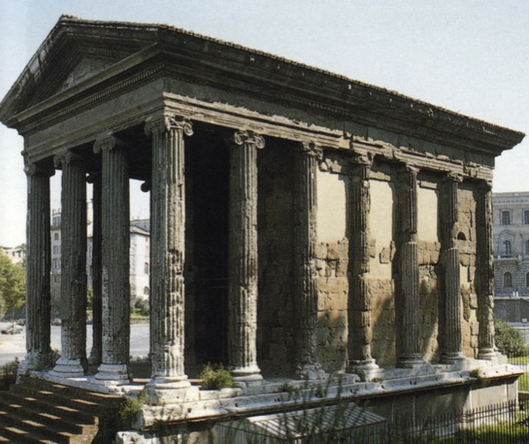
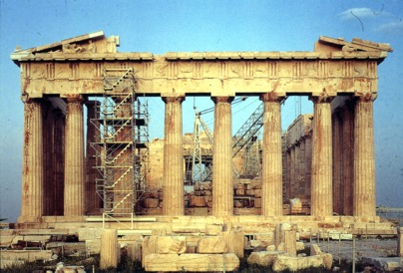
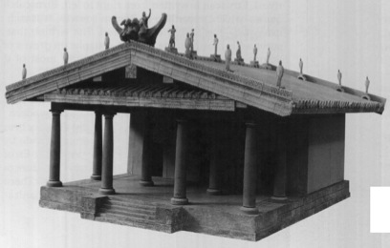
Greek
Roman
Etruscan
Notes:
Lecture 4: this comparison also explains relationships among the civilizations文明

Slide 16
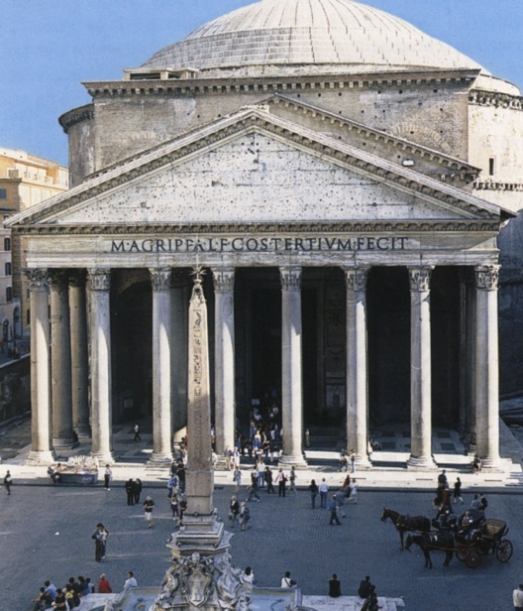
Pantheon, Rome, 117-125 7.26 - .29
Notes:
Lecture 4: What did the Romans borrow from the Greeks and what is the most essential innovation in Roman architecture that will have enormous influence on Romanesque and Gothic architecture?

Slide 17
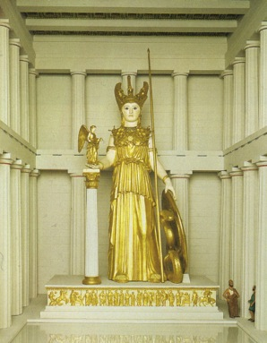
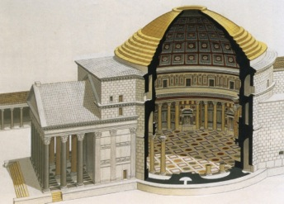
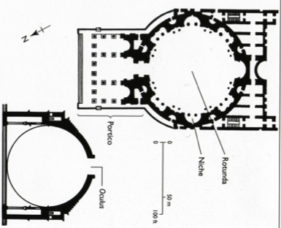
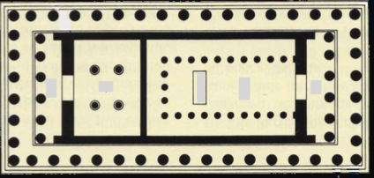
Pantheon
117-125 7.26 - .29
Parthenon
447-438 B.C. 5.45
Notes:
This might help answer the last question.

Slide 18
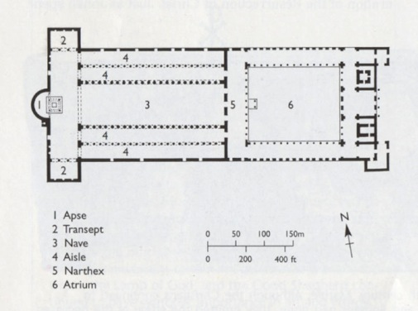
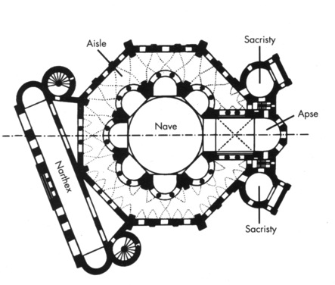
Church plans
Basilica
Central Plan
Old St Peter’s
330-390 8.7
San Vitale, Ravenna 540-547 8.17 - .25
Notes:
Lecture 5: Your textbook and I explain the sources of these 2 types of churches, and their practical and symbolic uses. Most churches and cathedrals throughout the middle ages develop out of the basilica plan, and you should understand that development. The central plan is very specialized, and this particular building strongly influenced only one particular building we have studied, which was also built as a private chapel for an Emperor. Why is that? You also have to know Brunelleschi returned to the more-or-less “pure” Early Christian basilica type in the Renaissance. What does that say about him and the Renaissance?

Slide 19
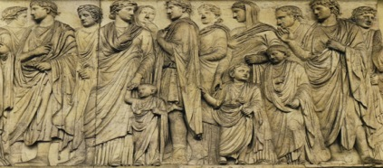
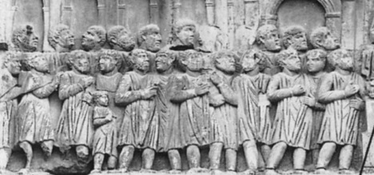
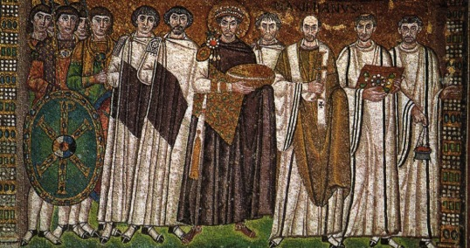
13 B.C 7-31
A
A.D. 313 7-40
B
A. D. 547 8-23
C
Notes:
Lecture 5. Knowing the characteristics of these means that you know what is typical of Roman Art that is a) heavily influenced by the Greek naturalistic tradition, B) the “strange” developments in late Roman Imperial art, and C) the beginnings of Byzantine artistic conventions, which will last for a long, long time

Slide 20
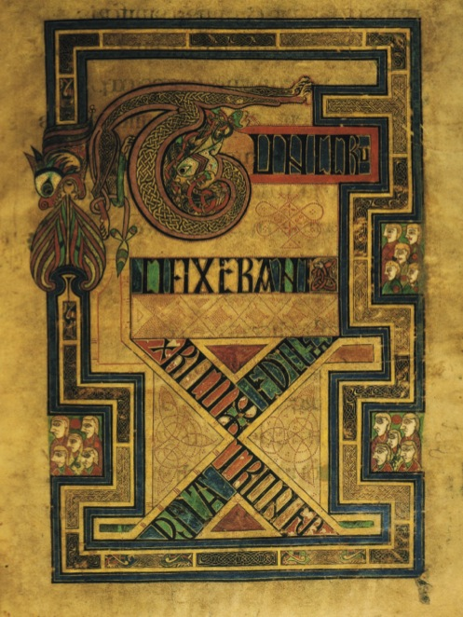
Book of Kells,
Tunc Crucixiserant, late 8th or early 9th century
9.23
Notes:
Lecture 6: this is so completely different from everything else we have studied in this class, and comes out of such a different artistic tradition, that Egyptian and Italian Renaissance art are stylistically closer to one another in every way, than they are to this. Of course, art becomes increasingly naturalistic throughout the middle ages – from this point onward – mostly because painters become interested in biblical narratives: they want to tell the stories in compelling and interesting ways. AND THEY DID GO BACK TO ROMAN MODELS, AND BYZANTINE NATURALISM, AT TIMES, TO UNDERSTAND HOW TO GO ABOUT THIS. That is why this is “art history” and not a series of incomprehensible and unrelated facts. There are relationships among all the artifacts we study

Slide 21
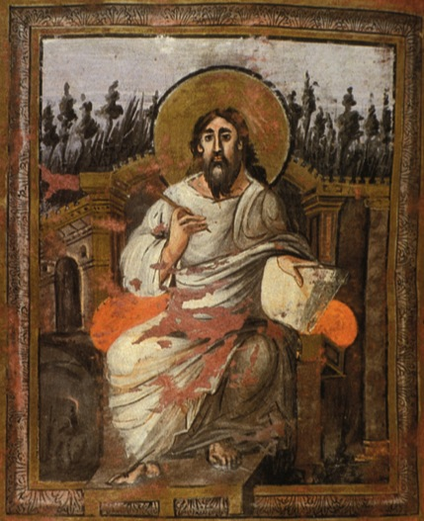
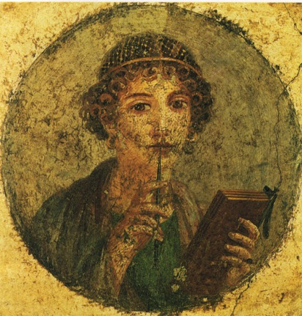
Girl with a stylus Pompeii,
1st century A.D 7.58
Saint John, Coronation
Gospels, 8th century 9.28
Notes:
Concerning the last slide, do these 2 images help you understand my frustration with the “random fact” approach to study?

Slide 22
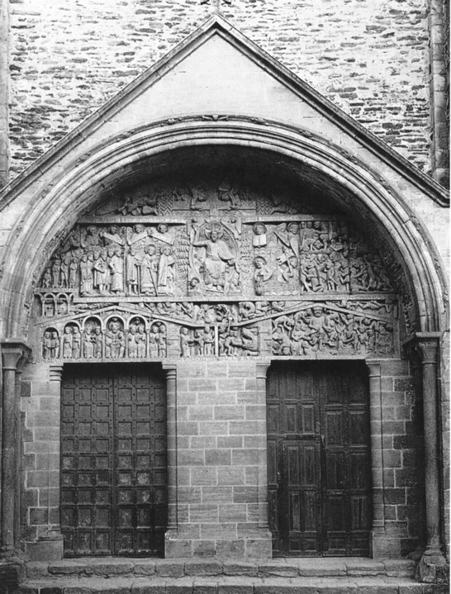
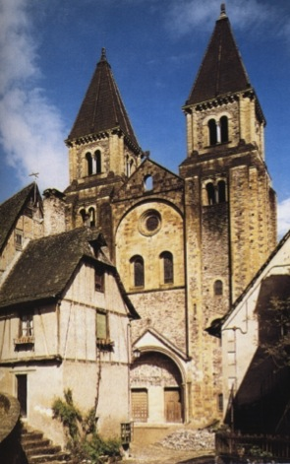
Conques, Last Judgment Portal 1130 10.9 - .11
Notes:
Lecture 7: Since the test. Try to study starting with the “Big Picture” and then learn how particular things fit into it. So, ask yourselves this: How were those on pilgrimages in the Romanesque period responsible for changes in the floor plans of churches, and in the decorations of churches. In what ways did the pilgrims’ needs and interests affect these changes?

Slide 23
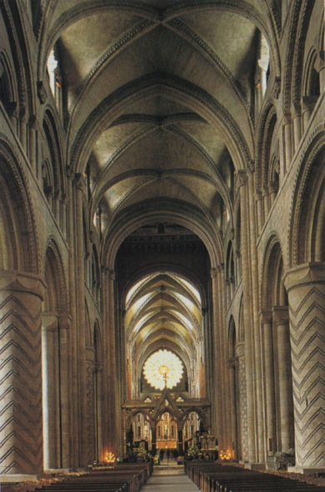
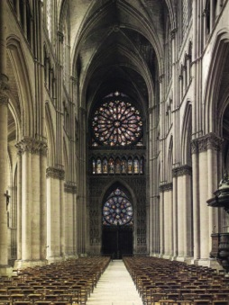
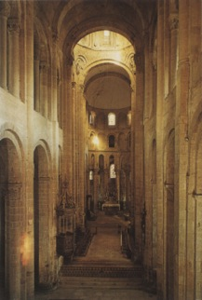
Conques
1050-1120
10.3 - .11
Durham begun 1093 10.41 -.43
Reims
1211- 1290
11.32-.34
Notes:
On the midterm test, remarkably few students understood the relationship of Romanesque to Gothic architecture. This just underscores the need for students to always start with relationships, and in the case of medieval architecture, the technical problems they resolve and the aesthetic reasons for this. Remember that relationships take various forms for various reasons, so it is essential to understand what artists and architects are trying to achieve.

Slide 24
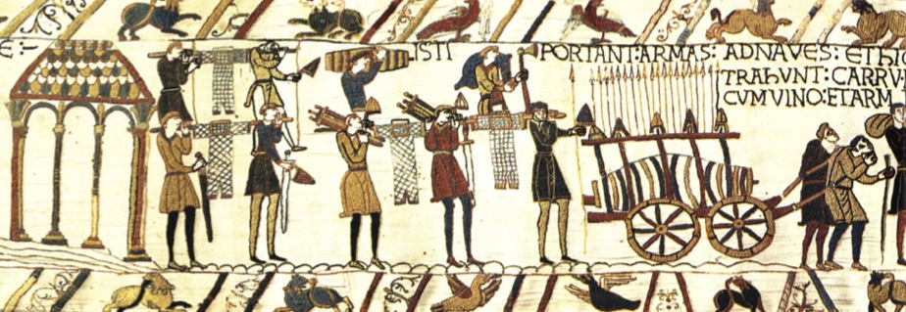
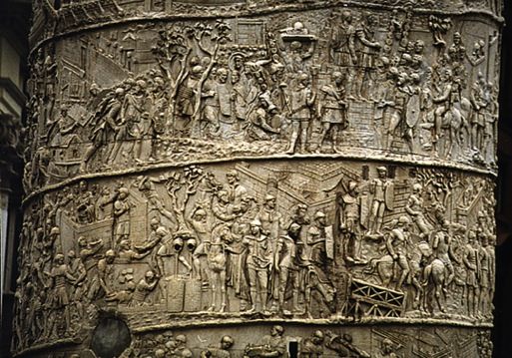
Bayeux Tapestry 1070-1080 10.35- .37 (detail not in the textbook)
Trajan’s Column
A.D. 113
7.33
Notes:
Need always to consider the “story” that is being depicted to understand relationships in representational art, audiences addressed, etc. to understand a work. It is not just a question of style.

Slide 25
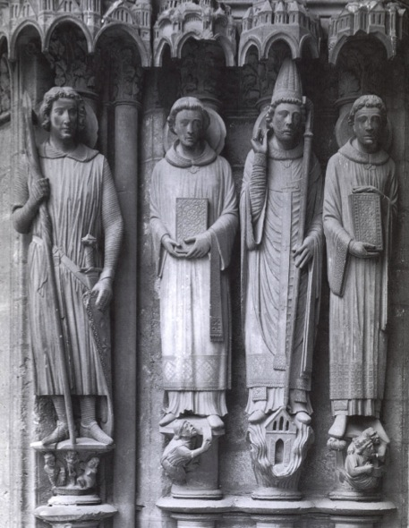
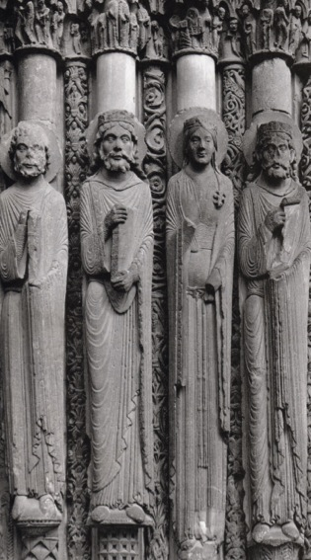
Jamb Sculptures, South Transept
Chartres 13th Century11.21
Jamb Sculptures West façade
Chartres1145-1170 11.19
Notes:
But style is extremely important. The differences between these 2 over a period of about 100 years tells us something about the way that medieval sculpture changed, and this direction of change continues right through to the end of the end of the course.

Slide 26
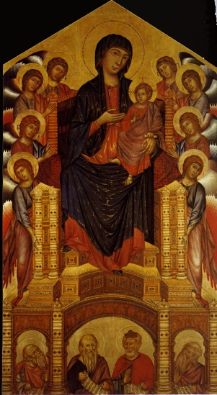
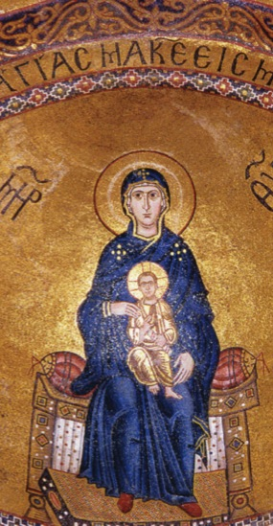
Virgin and Child, Hosios Loukas, Greece 1020 8.42
Cimabue: Madonnna Enthroned 128012.3
Notes:
Again, history as “story” what do these 2 slides (this one and the next one) tell us about how Cimabue was influenced and how he influenced others. How does this slide and the next one tell us about the ways that Italian artists of the this period and the Renaissance thought about what kinds of reactions they wanted from their viewers. Hint: they wanted to be admired. You figure out what for.

Slide 27


Cimabue: Madonnna Enthroned 128012.3
Giotto: Madonnna Enthroned 131012.4
Notes:
Something here about dates: We looked at Byzantine pictures made 500 years apart and thought that they looked a great deal alike. These are only 30 years apart and look quite different. This says something about different artistic cultures, and we can certainly think about Egypt and ancient Greece in terms of the changes that did and did not occur in their art

Slide 28


St-Étienne,
Caen 1067-1087
10.39-.41
Pisa Cathedral 1053-1272 10.31
Notes:
This slide says something about the BASIC differences between Italian art and the art of Northern Europe, throughout the middle ages and the Renaissance. It has to do with Italian’s interest in the past, for 2 basic reasons. 1) Buildings from the past are simply around the Italians, and so they are convenient models. 2) Classical, in all its forms, were greatly admired, first, by the Italians of the early Renaissance. They admired Roman art and architecture.

Slide 29


Siena Cathedral 128411.49
Reims 1211 11.32
Notes:
Gothic north and south of the Alps

Slide 30
Review of the last 2 classes

Slide 31


Colosseum A.D. 72-80
7.18 - .19
Alberti: Palazzo
Rucellai, 1446 13.30
Notes:
Influence

Slide 32



Alberti: Tempio Malatestiano, Rimini, 1450 13.31. & .32
Pantheon 125 7.26
Notes:
Influence

Slide 33



Temple of Portunus,
late 2nd c. B.C
7.22
Arch of Constantine
313
7.39 & .40
Sant’
Andrea,
1470
13.33 -.35
Notes:
Influence

Slide 34




Sant’ Andrea, 1470
13.33 -.35
Notes:
Terms

Slide 35


Pantheon 117-125
7.28
Alberti: Sant’ Andrea, 1470
13.33 -.35
Notes:
Influence

Slide 36

Brunelleschi:
Santo Spirito, 1434
13.8 & .9
Alberti: Sant’ Andrea, 1470
13.33 -.35
Notes:
influence

Slide 37




Sant’ Andrea, 1470
13.33 -.35
Reims, 1211- 1290 11.32-.34
Notes:
Why is it easy to recognize the interiors when you are familiar with the exteriors?

Slide 38


Reims, 1211- 1290
11.32-.34
Brunelleschi:
Santo Spirito, 1434
13.8 & .9

Slide 39


Chartres Sto. Spirito
Notes:
Electric lights in Chartres are on; no artificial lighting is necessary in Sto. Spirito during the day

Slide 40


Reims, 1211- 1290
11.32-.34
Brunelleschi:
Foundling Hospital
1419 13.7
Notes:
Review: always good to review by comparison and contrast

Slide 41



Brunelleschi: Santo Spirito, 1434
13.8 & .9
Ste. Foy,
Conques 1050
10.3
Amiens 12.20
11.26
Notes:
Review: know the terms for the different parts of the plan so that you can understand how they changes and why.

Slide 42

Brunelleschi: Santo Spirito, 1434
13.8 & .9
Amiens 12.20
11.26
Old St Peter’s
330-390
8.6 & .7
Notes:
Review

Slide 43



King’s College Chapel, Cambridge 1508-1515 11.49
Notes:
Why is the date interesting

Slide 44


Limbourg Bros:
Annunciation,
1413-1416 12.29
Robert Campin:
Merolde Altarpiece, 1425-1430 13.62
Notes:
Very Close in date, different chapters. Why is that?

Slide 45


Van Eyck: Arnofini Wedding Portrait,
1433
13.69 & .70
Masaccio: Holy Trinity 1425
13.20
Notes:
You have to sort out the differences between the north and the south

Slide 46


Van der Weyden:
Descent from the Cross, 1435
13.71
Masaccio: Holy Trinity 1425 13.20
Notes:
Another good way of showing the basic differences between the north and the south

Slide 47


Piero della Francesca:
Battista Sforza1475, detail 13.47
Van Eyck: Man in a Red Turban, 1433
detail 13.68
Notes:
Another good way of showing the basic differences between the north and the south

Slide 48


Ghirlandaio: Adoration of the Shepherds, 1485, detail
13.75
Van Eyck: Man in a Red Turban, 1433
detail 13.68
Notes:
Good way of sh owing how influence works over the course of the century

Slide 49



Gislebertus: Last Judgement, Saint-Lazare, Autun,
1120-1135 10.22
Van der Weyden:
Descent from the Cross,
1435 13.71
Notes:
Empathy versus fear, suggests that something fundamental is changing in religious experience, which demands different forms of representation

Slide 50


Lorenzetti: Good Government, Palazzo Pubblico, Siena 1348 12.20
Mantegna: Camera degli Sposi,
Palazzo Ducale, Mantua, 1470s 13.56
Notes:
patronage

Slide 51




300 B.C.
A.D 1400
5.66
11.19
12.28
13.28
Notes:
Big picture slides will help establish a framework for studying: studying them using the language and concerns we have been developing in class

Slide 52





300 B.C
A.D.1401
1120
AD 81
AD 313
1401
1000
Notes:
Naturalism is a relative term: why are some of these more naturalistic than others? Do we always know why?

Slide 53





1000
Western Europe about 800
Byzantium about 550 and 1000
Notes:
Influence is not linear: art does not change within a simple single trajectory

Slide 54




1300
1330
1425
1480
Notes:
Influence is not linear

