Slide 1
Lecture 2
Market system, circular flow and GDP
Market System (Chapter 2)
Circular Flow Model (Chapter 2)
GDP (Chapter 5)
Nominal GDP and Real GDP (Chapter 5)

Slide 2
Market System
 | North Korea | South Korea
GDP | 40 billion | 1.2 trillion
GDP per capita | 1,800 | 24,500
Exports | 1.3 billion | 326 billion
Imports | 2.7 billion | 309.3 billion
Agriculture as % of GDP | 30 percent | 3 percent

Slide 3
Market System
The pencil example
The “invisible hand”
Market failure and the need for government

Slide 4
The Circular Flow Diagram
Figure 2-2
$ COSTS
Factor
MARKET
$ INCOMES
FACTORS
OF PRODUCTION
INPUTS
BUSINESSES
HOUSEHOLDS

Slide 5
The Circular Flow Diagram
Figure 2-2
$ COSTS
RESOURCE
MARKET
$ INCOMES
FACTORS
OF PRODUCTION
INPUTS
BUSINESSES
HOUSEHOLDS
GOODS &
SERVICES
GOODS &
SERVICES
PRODUCT
MARKET
$ CONSUMPTION
$ REVENUE

Slide 6
Gross Domestic Product
Gross domestic product, GDP
  is the market value of the final goods and services produced in a country during a given period
Market Value
  Allows economists to aggregate the quantities of many different goods and services

Slide 7
Market Value: Country A’s GDP
Total Production: 4 million apples, 6 million pears and 3 million pairs of shoes
Price: $0.25 (apple), $0.50 (pear) and $20 (shoes)
GDP = ($0.25×4) + ($0.50×6) + ($20×3) = 64 million
The more expensive product (shoes) receives a higher weighting
Example 5.1: if total production changes to 3 million apples, 3 million pears and 4 million pairs of shoes?
GDP = ($0.25×3) + ($0.50×3) + ($20×4) = 82.25 million
Producing more shoes (higher value product) leads to higher GDP.

Slide 8
Measuring GDP
Nominal GDP
  Expenditure Approach
  Income Approach
Value Added Nominal GDP is market value of all final goods and services at current prices
Quarterly GDP and annual GDP

Slide 9
Final Goods and Services
Final goods or services
  e.g. bread
  Goods or services consumed by the ultimate user
  the end products of the production process
  Total final sales = GDP
Intermediate goods or services
  e.g. wheat in flour production ; flour in bread production;
  Goods or services used up in the production of final goods and services
  Not separately counted as part of GDP, in order to avoid double-counting

Slide 10
Example: The Hair Stylist and Her Assistant
Hair stylist charge $20 for a haircut
She pays her assistant $4
What counts towards GDP per haircut?
$20 is the final service
$4 contributes to the production, not the final service
$20 is the contribution of the hair stylist and her assistant to GDP

Slide 11
Value Added
Value added
  equals the market value of its product or service minus the cost of inputs purchased from others
  Example: Value Added in Bread Production
Firm | Revenue | - Costs of Intermediate Goods | = Value Added
Grain supplier | $0.50 | $0.00
Flour miller | $1.20 | $0.50
Bakery | $2.00 | $1.20
Total
$0.50
$0.70
$0.80
$2.00

Slide 12
The Expenditure Approach to GDP
Consumption expenditure (C)
Investment (Ig)
  Gross investment = Net investment + depreciation
Government expenditure (G)
  Transfer payments
Exports and Imports
  Net Exports Xn = X - M

Slide 13
Example : Measuring GDP by production and by expenditure
1 million automobile ($15,000 each)
700,000 consumer
200,000 business
25,000 exported
Unsold Inventory
50,000 government
We can measure GDP by total production or by expenditure

Slide 14
Example: Measuring GDP by production and by expenditure
Measuring GDP by production:
  $15,000×1 million = $15 billion
Measuring GDP by expenditure
  Y = C + I + G + NX
  Consumption: $15,000×700,000 = $10.5 billion
  Investment: $15,000×(200,000 + 25,000) = $3.375 billion
    Remember to include both business investment and inventory
  Government: $15,000×50,000 = $0.75 billion
  Net Export: $15,000×25,000 million = $0.375 billion
  GDP = 10.5 + 3.375 + 0.75 + 0.375 = $15 billion

Slide 15
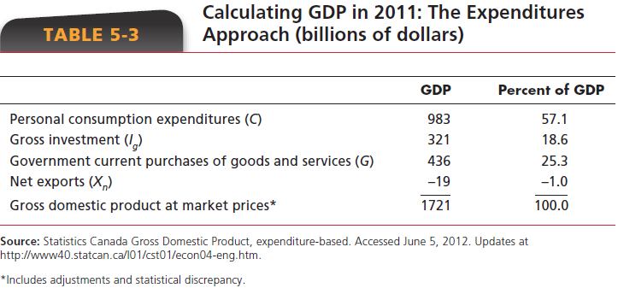
The Expenditure Approach
GDP as the sum of all the money spent in buying final goods and services.

Slide 16
Figure 5-1
Gross Investment, Depreciation, Net Investment, and the Stock of Capital
Net investment
Stock
Gross Investment
Depreciation
of
capital
Stock of capital
January 1
December 31

Slide 17
The Expenditure Approach
GDP as the sum of all the money spent in buying final goods and services.
GDP = C + Ig + G + Xn
For Canada in 2011 (in billions, from Table 5-3):
GDP = $983 + $321 + $436 - $19 = $1721

Slide 18
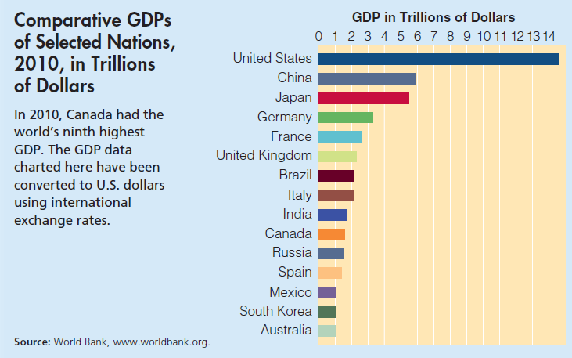
Global Perspective 5.1

Slide 19
The Income Approach
The Income Approach: adds up expenditures that are allocated as income to those producing the output
The Income Approach adds up
  Wages, salaries, and supplementary labour income
  Profits of corporations and government enterprises before taxes
  Interest and investment income
  Net income of farm and unincorporated businesses
  Indirect taxes less subsidies on products
  Depreciation: Capital consumption allowances

Slide 20
The Income Approach
Net domestic income at factor cost
  All the income earned by Canadian-supplied factors of production as wages, interest, rent, and profit.
Personal income (PI)
  The earned and unearned income available to resource suppliers and others before the payment of personal income taxes.
Disposable income (DI)
  Personal income less personal taxes.

Slide 21
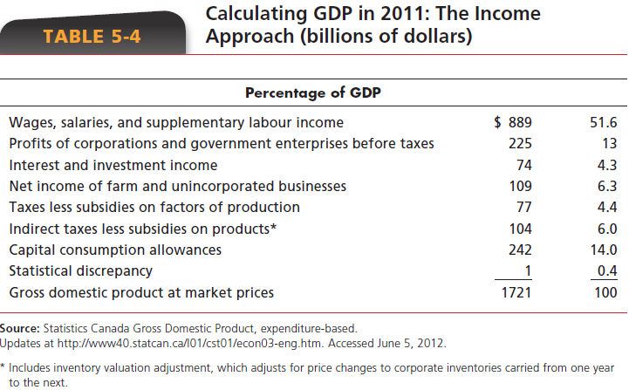
Income Approach

Slide 22
The Circular Flow of Income and Expenditure Revisited
wages received (labour income)
Canadian Labour Markets
• households supply labour
services
• firms hire labour services
wages paid
labour supplied
labour hired
wages paid
labour hired
government services
provided
government services
provided
Canadian Households
• sell labour
• purchase goods and services from firms
• pay with net taxes for services from government
Canadian Government
• government provides
services
• households and firms pay
for services with net taxes
(taxes minus transfers)
Canadian Firms
• produce and sell goods and
services
• hire labour
• pay with net taxes for
services from government
Net tax from household
Net tax from firms
government purchases goods and services
goods and services acquired by government
Canadian Product Market
• firms and government
provide goods and services
• households and governments
purchase final goods and
services
goods and services
acquired by household
goods and services
supplied by Canadian Firms
household spending on goods
and services
firm revenue from sale of
goods and services
foreign payments for Canadian exports
Canadian exports
Canadian imports
Canadian payments for imports
Rest of the World
• provides imports of goods
and services to Canada
• purchases Canadian exports

Slide 23
Nominal GDP Versus Real GDP
Nominal GDP is based on prices when output was produced
Real GDP is based on prices in some reference (base) year

Slide 24
Adjustment Process in a One-Product Economy
Method 1
find nominal GDP for each year
index numbers tell us whether prices are rising or falling

Slide 25
Calculating Real GDP
Year | Units of output | Price | Price Index | Nominal GDP | Real GDP
1 | 5 | $10 | 100 | $50 | $50
2 | 7 | 20 | 200 | 140 | 70
3 | 8 | 25 | 250 | 200 | 80
4 | 10 | 30
5 | 11 | 28
÷
X
X
300
300
100
X
280
308
÷
110

Slide 26
Adjustment Process in a One-Product Economy
Method 2
gather separate data on physical outputs
determine market value with base year prices
leads to the implicit price index, as follows:

Slide 27
Table 5-7
Nominal GDP, Real GDP and GDP Deflator
Year | Nominal GDP | Real GDP | GDP Deflator 1997=100
1980 | 315.2 | 576.4
1985 | 485.7 | 660.3 | 73.6
1990 | 679.9 | 762.4 | 89.2
1995 | 810.5 |  | 97.4
1997 | 882.7 | 882.7 | 100.0
2000 | 1075.6 |  | 105.5
2002 | 1154.2 | 1070.8
2005 | 1368.7 | 1157.4 | 118.3
54.7 = 315.2 / 576.4 x 100
54.7
832.1 = 810.5 x 100 / 97.4
832.1
1019.5 = 1075.6 x 100 / 105.5
1019.5
107.8 = 1154.2 / 1070.8 x 100
107.8

Slide 28
Shortcomings of GDP
GDP has several shortcomings, both
  as a measure of total output
  as a measure of well-being

Slide 29
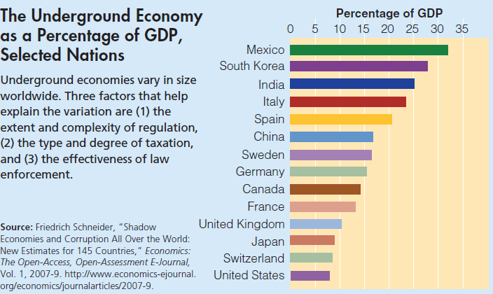
Global Perspective 5.2

Slide 30
Shortcomings of GDP
Measurement Shortcomings
  Non-Market Transactions
  The Underground Economy
  Leisure
Improved Product Quality
Well-Being Measure Shortcomings
  GDP & the Environment
  Composition & Distribution of Output
  Non-Material Sources of Well-Being

Slide 31
After today’s Lecture
Read Chapter 2, 4 and 5
Homework 2

