Slide 1
Lecture Three
Economic Growth
Measuring growth, inflation and unemployment
Rule of 70 and Rule of 72
Measuring economic growth
Productivity slowdown
Limits to growth

Slide 2
Assessing the Health of the Economy: Performance and Policy
In assessing the health and development of an economy, macroeconomists focus on:
Real GDP Growth
Unemployment
Inflation

Slide 3
Three Main Indicators in Macroeconomic Activity - Output
Output
  real gross domestic product (real GDP) measures output and income.
    it is the quantity of final goods and service produced in the economy in a specific time period
  Rate of growth of real GDP
  In 2003, real GDP was 1092 billion
  In 2004, real GDP was 1124 billion
Notes:
See Section 19-1 in the main text.

Slide 4
Three Main Indicators in Macroeconomic Activity - Inflation
The Price Level
  Is a measure of the weighted average of price of wide variety of goods and services
  Consumer Price Index (CPI)
  The Inflation Rate
  In 2003, CPI at 122.3
  In 2004, CPI at 124.6
Notes:
See Section 19-1 in the main text.

Slide 5
Three Main Indicators in Macroeconomic Activity – Employment
Employment
  a number of adults (15 years of age and older) employed full-time and part-time and self-employed
  The civilian labour force
  Unemployment rate
    Must be Looking for work
  In October 2005, Canadian labour force – 17.423 million
  In October 2005, total employment of 16.267 million
Notes:
See Section 19-1 in the main text.

Slide 6
Canadian Economic Performance
 | Canada | United States
Real GDP Growth Rate
1980s | 3.0 | 3.0
1990s | 2.5 | 3.0
2000-2005 | 2.5 | 2.6
Inflation rate
1980s | 6.5 | 5.6
1990s | 2.2 | 3.0
2000-2005 | 2.5 | 2.2
Unemployment rate
1980s | 9.4 | 7.3
1990s | 9.5 | 5.8
2000-2005 | 7.2 | 5.2

Slide 7
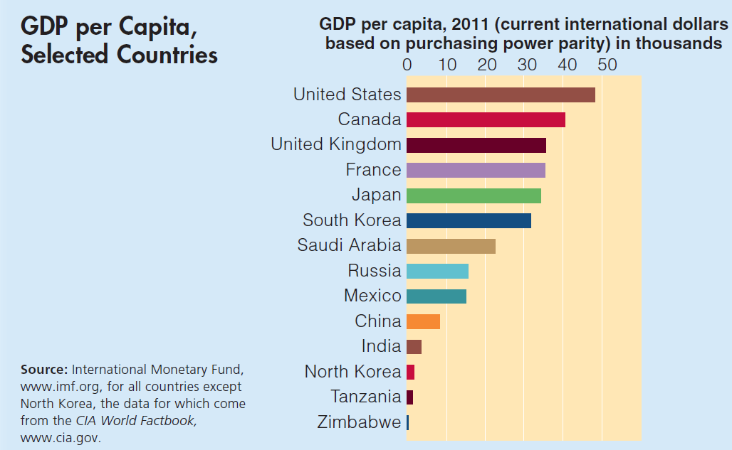
Global Perspective 4.1

Slide 8
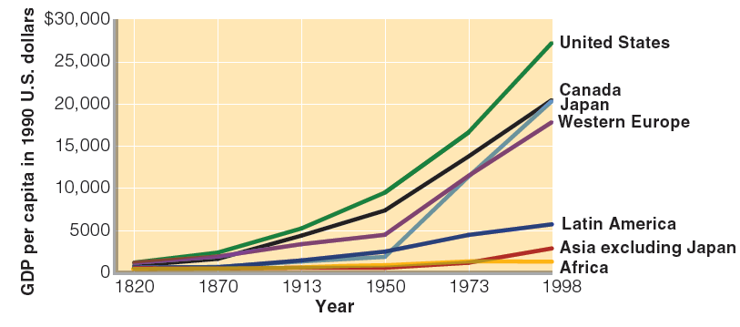
Figure 6-1
The Great Divergence in Living Standards
Source: Angus Maddison, The World Economy: A Millennial Perspective (Paris: OECD, 2001), p. 264

Slide 9
Why “Small” Differences in Growth Rates Matter
Small differences in annual growth rates can have large long-run effects
  Year after year compound growth
Compound interest is
  The payment of interest not only on the original deposit but on all previously accumulated interest
Power of Compound growth

Slide 10
Example :Compound interest
Suppose that in 1879 your great-great-grandfather deposited $10 in a savings account at 4 percent interest.
  The account was worth $10 in 1879;
  $10 × 1.04 = $10.40 in 1880,
  $10 × 1.04 × 1.04 = $10 × (1.04) ² =$10.82 in 1881;
  $10 × (1.04) ¹³⁰ =$1638.08 in 2009
Small change in interest rate leads to big differences in returns.
Interest rate (%) Value of $10 after 130 years
2 $131.22
4 $1638.08
6 $19 487.79

Slide 11
Rule of 72 (Rule of 70 in the textbook)
A rule of thumb stating that to find the number of years it takes a magnitude to double when it is growing at a constant rate, divide 72 by the growth rate.
  For example, if an economy’s GDP per person is growing at 1 percent a year, it will take approximately 72 years for the economy’s GDP per person to double.
  If an economy’s GDP per person is growing at 7.2 percent a year, it will only take 10 years for the economy’s GDP per person to double.

Slide 12
The Role of Average Labour Productivity
Real GDP (Y) per person is the product of
  average output of those employed,
  percentage of those employed in the population.
  Let
    Y = total real output
    N = number of employed workers
    POP = total population
    Then,

Slide 13
Real GDP Per Person and Growth
Real GDP per person can grow only to the extent that growth occurs in
  Worker productivity (Output per hour worked)
  Average working hours per worker
  The fraction of the population employed
In the long run
  The important factor has been increases in average labour productivity

Slide 14
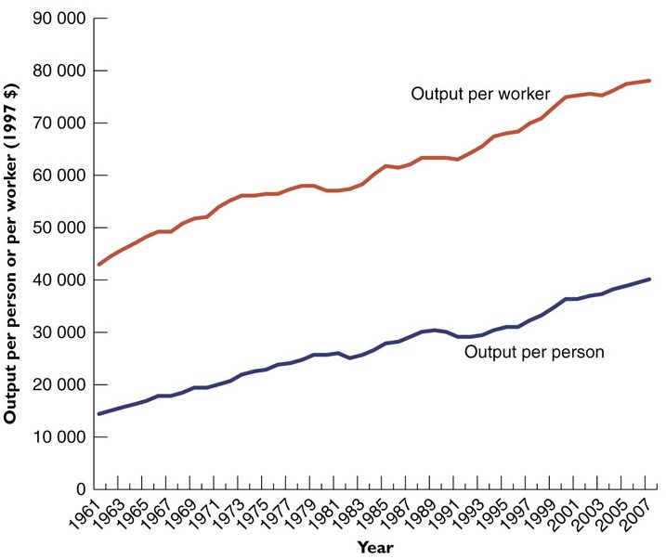
Real GDP per Person and Average Labour Productivity in Canada, 1960-2007
Notes:
- No change in working hours, output per person affected mostly by productivity

Slide 15
Determinants of Average Labour Productivity
Average labour productivity depends on:
  Human capital
  Physical capital
  Resources- Land and other natural resources
  Technology
  Entrepreneurship
  Political and legal environment
Notes:
- Human capital-education, training

Slide 16
Human Capital
Example : Paris and Nicole on the assembly line
Paris and Nicole have jobs wrapping chocolate candies
  Paris, can wrap only 100 candies/hour. Nicole, who has had on-the-job training, can wrap 300 candies/hour.
  Pairs and Nicole works 40 hours per week
Paris’s weekly productivity is (40 hours/week) × (100 candies wrapped/hour) = 4000 wrapped candies/week.
Nicole’s weekly productivity is (40 hours/week) × (300 candies wrapped/hour)= 12 000 candies/week.
As a team, their average weekly productivity is 8000 candies/week.
Their average hourly productivity as a team is (16 000 candies wrapped)/(80 hours of work) = 200 candies/hour.

Slide 17
Physical Capital
Example: Paris and Nicole get automated
Using a machine, an untrained worker can wrap 500 candies/hour.
  Paris, will be using the machine, can wrap 500 candies/hour. Nicole, can wrap only 300 candies/hour.
Paris’s weekly productivity is (40 hours/week) × (500 candies wrapped/hour) = 20000 wrapped candies/week.
Nicole’s weekly productivity is still 12 000 candies/week.
As a team, their average weekly productivity is 32000 candies/week.
Their average hourly productivity as a team is (32 000 candies wrapped)/(80 hours of work) = 400 candies/hour.
If there are two machines, they will be able to wrap 40000 candies, their average hourly productivity will be 500 candies/hour.

Slide 18
TABLE: Capital, Output, and Productivity in the Candy-Wrapping Factory
Number of machine (Capital) | Total number of candies wrapped per week (Output) | Total hours worked per week | Candies wrapped per hour worked (Productivity)
0 | 16 000 | 80 | 200
1 | 32 000 | 80 | 400
2 | 40 000 | 80 | 500
3 | 40 000 | 80 | 500
Law of Diminishing Returns

Slide 19
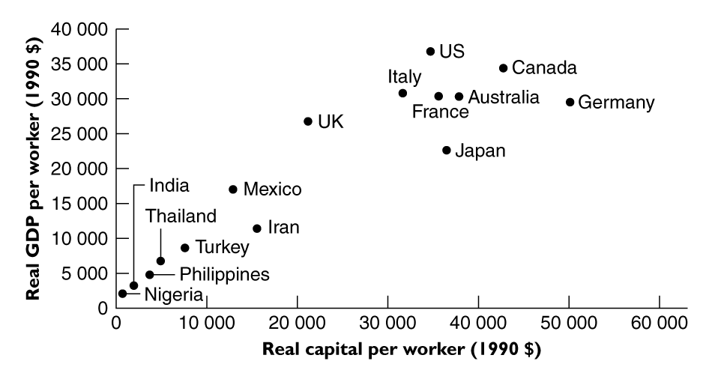
Average Labour Productivity and Capital per Worker in 15 Countries, 1990

Slide 20
Capital, Growth, and the PPC
Adding to the stock of physical capital in the current period causes the PPC in the future period to shift out more than it otherwise would
Next year’s PPC based on Y this year
Capital Goods
This year’s PPC
Y
Next year’s PPC based on X this year
X
Consumption Goods
Notes:
Ceterus parabus
-

Slide 21
Land and Natural Resources
An abundance of natural resources increases the productivity of workers in natural resource industries.
Land fertility was the key issue when society was primarily agricultural.
Many natural resources, such as petroleum and metals, can be obtained through international markets.

Slide 22
Technology
Ability to develop and apply new, more productive technologies will increase productivity.
  Examples: transportation
New technologies improve productivity throughout economy - not just where introduced
Single most important source of productivity improvement

Slide 23
Entrepreneurship
Behaviour that results in new products, services, technological processes, or organizational innovations.
Entrepreneurship can occur in the
  For-profit sector
  Not-for-profit sector
  Government sector
Does a society encourage entrepreneurship?

Slide 24
The Legal and Political Environment
Government can foster productivity growth by providing a legal and political environment that encourages people to behave in economically productive ways.
The political system can advance productivity growth by preventing extreme instability.
The political system that promotes the open exchange of ideas will speed the development of new technologies and products.

Slide 25
Production Function
Production function - describe the relationship between the amounts of inputs and outputs.

Slide 26
An Example of Production Function
An example of production function:
  If all the inputs K and L double, output also will double;
  It exhibits diminishing returns to capital/Labour

Slide 27
Productivity Since the 1950s
During the 1950s and 1960s most industrialized countries saw a rapid growth in real GDP and productivity
Since the mid 1970s productivity growth began to slow around the world

Slide 28
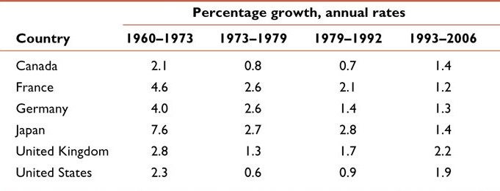
TABLE: Average Labour Productivity Growth Rates in Selected Countries, 1960–2006
Note: Productivity was still increasing – just with a slower rate of increase after about 1973.

Slide 29
Productivity Slowdown – Why ?
Technological depletion hypothesis
  Did high rates of productivity growth in 1950s & 1960s reflect a period of “catch-up” after the Depression and WWII?
    Backlog of technological breakthroughs was embodied in new investment
  In recent years there have been signs of a possible recovery in productivity growth in the English-speaking countries
    Technology revolution
    Technological depletion hypothesis

Slide 30
Productivity Slowdown and Real
Wage Stagnation
Over most of the twentieth century, real wages in Canada grew in line with labour productivity growth.
Canada’s experience of real wage stagnation during the 1977–1996 period.
  One hypothesis states that labour’s share of GDP fell because the bargaining power of labour deteriorated.
Since 1996, the downward trend of the labour income share seems to have ended, productivity growth has improved, real wages have grown slowly.

Slide 31
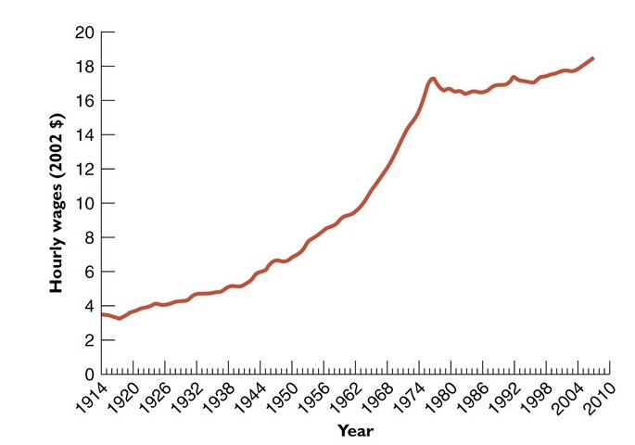
Average Real Hourly
Wage in Canada, 1914– 2007

Slide 32
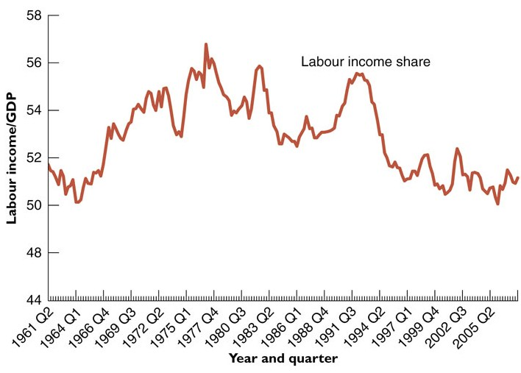
The Labour Income Share, Canada, 1961–2007

Slide 33
Two Possible Opportunity Costs of Economic Growth: Consumption and Leisure
Maximization of the economic growth rate is a questionable economic goal.
A higher rate of investment in new capital would require fewer resources devoted to consumer goods—a real economic cost.
Economic growth at a cost of reduced leisure time and, in some cases, workers’ health and safety.

Slide 34
Limits to Growth
Can economic growth continue indefinitely given that we have a finite world of natural resources?
Economic growth does give rise to environmental problems, and those environmental problems requiring international political solutions may be particularly difficult to solve.
However, not all concerns about limits to growth are equally valid.
  Increases in GDP do not necessarily mean increased demand for resources
  Greater wealth expands society’s capacity to protect the environment
  Pessimistic view of economic growth often ignores market responses

Slide 35
After Today’s Lecture
You may read chapter 4 and 6
Lab 3 on Lyryx
Extention for Lab 1 and Lab 2 on Lyryx
Sample Quiz 1

