Slide 1
Lecture One
Course Information
Introduction
Appendix to Chapter 1
Production Possibility Curve

Slide 2
Course Information
Course Outline
  Textbook (Connect)
  Lyryx
  Evaluation
  Questions?
Midterm and Final exams
How to study?

Slide 3
Macroeconomics and Microeconomics
Macroeconomics examines
  the whole economy
  the subdivisions or aggregates
Microeconomics examines
  individual units (household, firm or industry) and their decision making process

Slide 4
Example: How to Cure Inflation
Argentina is no stranger to inflation and has suffered frequent periods of devastating inflation since 1945. Despite recent praise from the International Monetary Fund for its economic growth, Argentina currently suffers from a 12.3% inflation rate (compared to only 2% in Canada).

Slide 5
Milton Friedman
Inflation is just like alcoholism, in both cases, when you start drinking or when you start printing too much money. The good effects come first; the bad effects only come later. That's why, in both cases, there is a strong temptation to overdo it, to drink too much and to print too much money. When it comes to the cure, it's the other way around, when you stop drinking or when you stop printing money the bad effects come first and the good effects only come later. That's why it's so hard to persist with the cure.

Slide 6
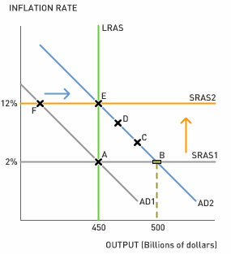
AD-AS model
David Romer

Slide 7
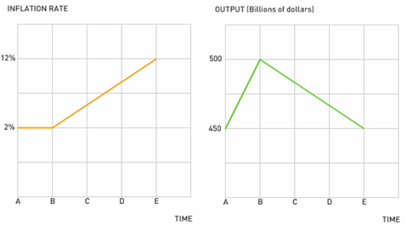
Inflation time path

Slide 8
Questions can be answered …
1. Despite the central bank's attempts to reduce inflation between times B and E, the inflation rate inevitably still increases. What can explain this?
2. Suppose the economy is at time E. What must Argentina's central bank do in order to reduce the inflation rate from 12% to 2%? Will this be politically popular?
3. Using the AD-AS model, explain what Friedman means by "When it comes to the cure, it's the other way around, when you stop drinking or when you stop printing money the bad effects come first and the good effects only come later. That's why it's so hard to persist with the cure."

Slide 9
Economic Models and Analysis
Example:
  Health Canada: model of the effect of smoking
Focusing on key elements
  Smoking = f(price of cig., peer pressure, messages, price of the “patch”)
Evidence…
Notes:
See Section 2-5 in the main text.

Slide 10
Fitting Lines Through the Scatter Plot
Figure 2.3 Scatter Plot of Cig. Sales and Prices (1981 – 1990)
Notes:
See Figure 2-7 in the main text.

Slide 11
Interpreting Linear Relationship
Define the line:
P =240-3Q
Intercept reflects the value of P when Q is zero
P = 240 - 3 x 0 = 240
Slope shows the effect of change in Q on change in P
1 unit change in Q
3 units change in P
Downward, negatively sloped
Intercept
240
Slope = 240/80 = 3.0
Price Index
Sales in Billions
80

Slide 12
Example 2
The relationship between income and consumption
Income | Consumption
0 | 50
100 | 100
200 | 150
300 | 200
400 | 250
Consumption
Intercept = 50
Slope = vertical change/ horizontal change
Slope = 50/100 = 0.5
Consumption Function
C = 50 + 0.5 Y
Income

Slide 13
The Production Possibilities Model
Assumptions:
full employment & productive efficiency
fixed resources
fixed technology
two goods
  pizzas symbolize consumer goods
  industrial robots symbolize capital goods

Slide 14
The Production Possibilities Curve
Pizzas (00,000s) | 0 | 1 | 2 | 3 | 4
Robots (000s) | 10 | 9 | 7 | 4 | 0

Slide 15
The Production Possibilities Curve
Pizzas (00,000s) | 0 | 1 | 2 | 3 | 4
Robots (000s) | 10 | 9 | 7 | 4 | 0
production
possibilities
curve

Slide 16
The Production Possibilities Table
Figure 1-2
A
B
attainable
C
W
attainable but
inefficient
unattainable
D
E

Slide 17
Production Possibilities
Law of Increasing Opportunity Cost
opportunity cost increases with amount produced
as we make more pizzas, the # of robots we have to give up (per pizza) increases
illustrated...

Slide 18
The Law of Increasing Opportunity Cost
Pizza (00,000s) | 0 | 1 | 2 | 3 | 4
Robots (000s) | 10 | 9 | 7 | 4 | 0
opportunity cost of 1st 100,000 pizzas = 1,000 robots
opportunity cost of 2st 100,000 pizzas = 2,000 robots
opportunity cost of 3st 100,000 pizzas = 3,000 robots
opportunity cost of 4st 100,000 pizzas = 4,000 robots
the more pizzas we make,
the more each one costs,
in terms of machines foregone

Slide 19
The Law of Increasing Opportunity Cost
Shape of the Curve
as we make more pizzas, the # of robots we have to give up (per pizza) increases
so production possibilities curve gets steeper and steeper

Slide 20
The Law of Increasing Opportunity Cost
Additional pizza unit costs 1, 2, 3, 4 robot unit
A
B
C
the more pizza we make
the more machines we give up
the steeper the curve
D
E

Slide 21
The Law of Increasing Opportunity Cost
Shape of the Curve
concave to the origin
Economic Rationale
resources are not completely adaptable to alternative uses

Slide 22
Optimal Allocation
Decide on optimal allocation by comparing Marginal (extra) Cost (MC) to Marginal Benefit (MB)
Marginal Benefit is the extra benefit associated with consuming one more unit
Marginal Cost is the extra opportunity cost of that extra unit

Slide 23
Figure 1-3
Optimal Allocation MB = MC
b
c
MC
Optimal allocation requires the expansion of a good’s output until its MC and MB are equal.
e
MB=MC
MB
a
b

Slide 24
Unemployment, Growth and the Future
A Growing Economy
  increases in factor supplies
  advances in technology

Slide 25
Economic Growth and the PPC
Figure 1-5
 | A’ | B’ | C’ | D’ | E’
Pizza | 0 | 2 | 4 | 6 | 8
Robot | 14 | 12 | 9 | 5 | 0
A’
B’
C’
D’
E’

Slide 26
Present Choices & Future Possibilities
FAVOURING
PRESENT GOODS
FAVOURING
FUTURE GOODS
Future
Curve
Future
Curve
Goods for the Future
Goods for the Future
Goods for the Present
Goods for the Present

Slide 27
Resource allocation
Resource allocation is crucial for a society
and is handled in different ways in different societies, e.g.:
  Command economy
  Invisible Hand (Free market )
  Mixed economy
Notes:
See Section 1-3 in the main text.

Slide 28
Market orientation
China
Sweden
USA
Hungary
Cuba
UK
Free
market
economy
Command
economy
Notes:
See Section 1-3 in the main text, and Figure 1-3.

Slide 29
After this class
Read Chapter 1, appendix to Chapter 1, and Chapter 4
Register at Lyryx, www.lyryx.com
Lyryx Lab 1

