Slide 1
Lecture Four: Business Cycles, Unemployment and Inflation
Business Cycles
Potential Output
Unemployment and Okun’s Law
Inflation

Slide 2
Fluctuations in Canadian Real GDP, 1926-2007
2001 slowdown
1990-92 recession
1981-82 recession
WWII
1953-54 recession
Great Depression begins

Slide 3
Recessions and Expansions
Recession (or contraction)
  A period in which the economy is growing at a rate significantly below normal
  “two-consecutive-quarters” rule
  Depression
    A particularly severe or protracted recession
Peak
  The high point of economic activity (GDP) prior to a downturn
Trough
  The low point of economic activity (GDP) prior to a recovery

Slide 4
Recessions and Expansions
Expansion
  A period in which the economy is growing at a rate significantly above normal
  Normally lasts longer than a recession
Boom
  A particularly strong and protracted expansion

Slide 5
Canada Recessions
Peak date (Start) | Trough date (End) | Approximate duration (Month) | Highest unemployment rate | % change in annual real GDP | Duration in subsequent expansion
Sept. 1947 | March 1948 | 6 | 2.8(1949) | - | 11
Feb. 1949 | July 1949 | 6 | 3.6(1950) | - | 11
June 1951 | Dec. 1951 | 6 | 2.9(1952) | - | 16
April 1953 | April 1954 | 12 | 4.6(1954) | -1.2(1954) | 36
April 1957 | Jan. 1958 | 9 | 7.0(1958) | - | 25
Feb. 1960 | Mar. 1961 | 13 | 7.1(1961) | 2.8(1960-61) | 108
Mar. 1970 | June 1970 | 3 | 6.2(1971) | - | 55
Jan. 1975 | Mar. 1975 | 3 | 7.0(1976) | - | 59
Feb. 1980 | June 1980 | 4 | 7.6(1981) | - | 13
July 1981 | Oct. 1982 | 15 | 11.9(1983) | -2.9(1981-82) | 90
April 1990 | April 1992 | 24 | 11.6(1993) | -1.9(1990-91) | 108+

Slide 6
Canada’s Real GDP Per Capita Growth Rate, 1927–2007
Average growth rate, 1940-1944 (9.1 percent)
Long-term average growth rate,
1927-2003
(2.3 percent)
Average growth rate,
1997-2007
(2.3 percent)
Average growth rate,
1929-1938
(-1.1 percent)
Average growth rate,
1962-1979
(3.3 percent)
Average growth
rate, 1980-1996 (1.2 percent)

Slide 7
“Cyclical” Fluctuations of Economic Activity
The term “Business Cycle” should not be read to imply that economic fluctuations are regular or inevitable
  Irregular in length and severity
Expansions and recessions usually are not limited to a few industries or regions but are felt throughout the economy .
Unemployment is a key indicator of short-term economic fluctuations
  Cyclical Unemployment
Inflation follows a typical pattern in recessions and expansions.

Slide 8
Canada’s Unemployment Rate and Pronounced GDP Slowdowns:1960-2007
The vertical blue lines indicate starting points of periods when the
GDP growth rate slowed sharply and unemployment rate rises.

Slide 9
Canadian Recessions and Inflation, 1960-2007

Slide 10
Characteristics of Short-run Fluctuations
Uneven in industrial impact
  Durable goods are much more sensitive to income and interest rate fluctuations
    Households can postpone purchases ?
      E.g., cars, houses, capital equipment
  Services and nondurables output is much less sensitive to fluctuations
    Hard to postpone consumption
      E.g., Food, hospitals, schools

Slide 11
Potential Output
Potential output, Potential real GDP, or Full employment output
  The amount of output (real GDP) that an economy could produce when using all its resources, such as capital and labour, at normal rates
  Potential output grows over time
    Capital & labor inputs increase + technology improves
  Usually denoted by Y*

Slide 12
Recessions and Potential Output
Why might the economy grow at less than its normal rate?
  Maybe actual output (Y) equals potential output (Y*), but potential output is now growing more slowly ?
  Actual output (Y) is less than potential output (Y*)
    i.e., a recessionary gap
    the usual explanation for short-term fluctuations
Output gap (Y – Y*)
  The difference between the economy’s potential output and its actual output at a given point in time
  Y* is potential real GDP
  Y is actual real GDP

Slide 13
Output Gaps
Recessionary gap (Y < Y*)
  A negative output gap - when potential output exceeds actual output
  Capital & labour resources are not fully utilized
Expansionary gap (Y > Y*)
  A positive output gap - when actual output is higher than potential output
  Resources are being “over-utilized”

Slide 14
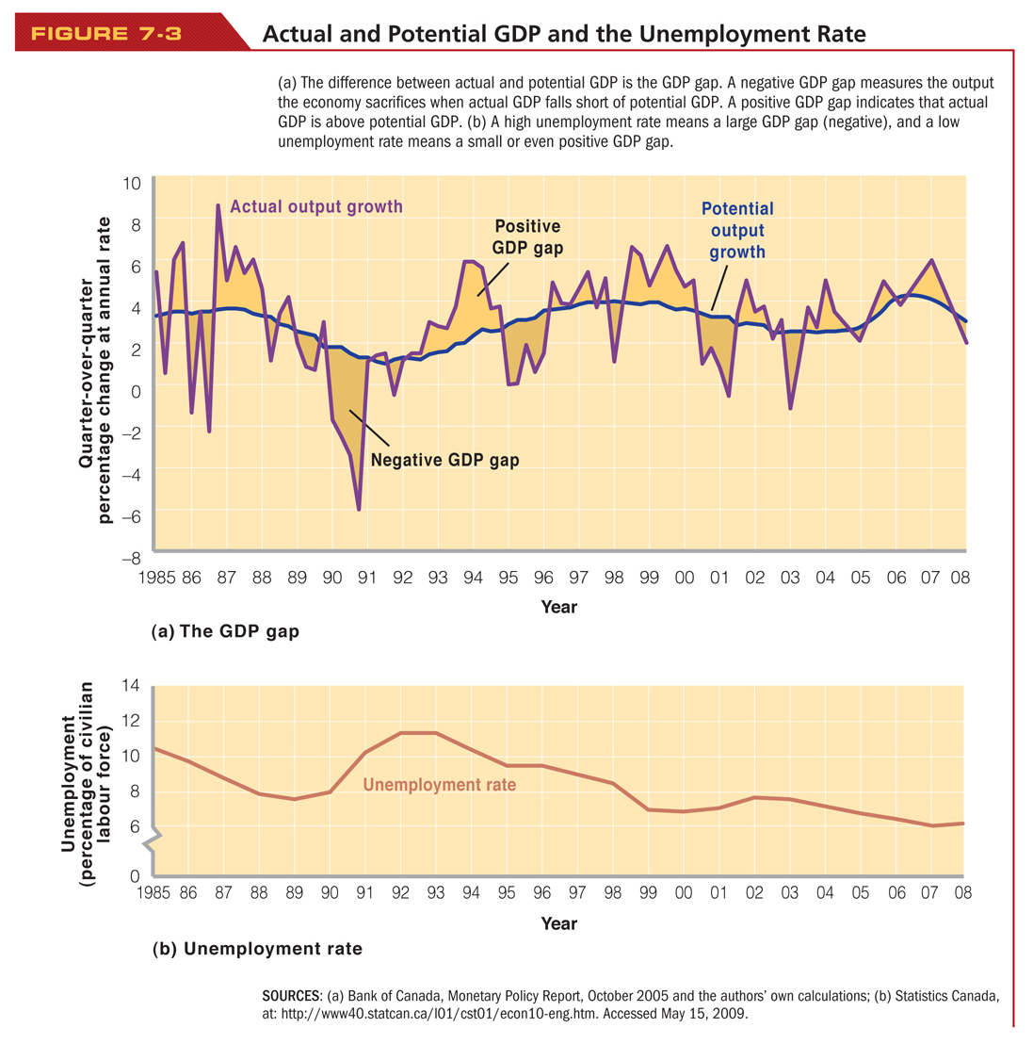

Slide 15
Output Gaps and Unemployment
Recessionary gap
  Output is falling below potential
  High unemployment rate
Expansionary gap
  Labour is being utilized at a rate greater than normal
  Low unemployment rate

Slide 16
Measuring Unemployment
The unemployment rate is calculated monthly, by Statistics Canada
  The number of unemployed people divided by the labour force
Each person 15 or older is asked:
  Did you do any paid work?
    If “Yes” – counted as “Employed”
    If “No” – then asked: “Did you look for work?”
      If “Yes” – counted as “Unemployed”
      If “No” – counted as “Not in the labour force”
  All persons of working age assigned to one of:
    “Employed” OR “Unemployed” OR “Not in Labour Force”

Slide 17
Types of Unemployment
Frictional
  Associated with short-term matching of workers and jobs
Structural
  Long-term chronic—mismatch of skills which workers have & skills required for jobs
Seasonal
  Predictable fluctuations in jobs and job search due to weather and seasons
Cyclical
  “Demand – deficient” unemployment, additional unemployment brought by recessions.

Slide 18
Natural Rate of Unemployment
Natural rate of unemployment [u*]
  Frictional + structural + seasonal unemployment
  The unemployment rate
    when cyclical unemployment equals zero
    when an economy has neither an expansionary gap nor a recessionary gap
  Full-employment rate of unemployment or non-accelerating inflation rate of unemployment (or NAIRU )
  The natural rate of unemployment could be lowered by measures such as structural policies

Slide 19
Cyclical Unemployment
Cyclical unemployment: u - u*
  Actual unemployment rate: u
  Natural rate of unemployment: u*
Recession
  u – u* is positive (u > u*)
  Positive cyclical unemployment gap
Expansion
  u – u* is negative (u < u*)
  Negative cyclical unemployment

Slide 20
Okun’s Law
Okun’s Law
  The relationship between an output gap and cyclical unemployment
  Each extra percentage point of cyclical unemployment is associated with a 2 percentage point increase change in output
  (Y*- Y)/Y* =2 ( U - U*).

Slide 21
Okun’s Law
The Effect of Growth in Real GDP on Unemployment
Change in u rate = 0.11 – 0.4234 (growth in Y – growth in Y*)

Slide 22
Okun’s Law and Canada’s Output Gap in 1994
1. 2. 3. 4. 5. 6. 7. 8.
Implied
Output gap Actual GDP Potential u - u* urate natural rate of
(1994$, (1994$, GDP (1994$, Percentage (%) u unemployment,
Source billions) billions) billions) output gap (%) u* (%)
IMF 37 773 810 4.6 2.3 10.3 8.0
Finance 45 773 818 5.5 2.8 10.3 7.5
HRDC 77 773 850 9.1 4.5 10.3 5.8
CCPA 109 773 882 12.4 6.2 10.3 4.1
Okun’s law tells us that the percentage output gap is double the percentage-point gap between the actual unemployment rate and the natural rate.

Slide 23
Economic Cost of Unemployment
Given for 1994:
  unemployment rate is 10.3%
  natural rate is 7.5%
  potential GDP is $818 billion
What is the GDP gap?
  10.3% − 7.5% = 2.8% (gap in % terms)
  2.8% X 2 = 5.6% (apply Okun’s Law)
  5.6% of $818 billion = $45.8 billion

Slide 24
Okun’s Law and Canada’s Output Gap in 1994
1994 – estimates of cost of recessionary gap range from $37 to $109 billion, for that one year
  1994 Canadian population = 29 million
  Even according to the lowest estimate, the output loss was around $1,276 per person or about $5,100 per family (1994 dollars)
Total cost of 1990s recession must be summed over entire period 1990-96
  see Pierre Fortin, “The Great Canadian Slump”

Slide 25
The Consumer Price Index: Measuring the Price Level
Price Level
  the overall level of prices at a point in time as measured by a price index such as the CPI
Consumer Price Index (CPI)
  for any period, measures the cost in that period of a standard basket of goods and services relative to the cost of the same basket of goods and services in a fixed year, called the base year

Slide 26
Monthly Household Budget of the Typical Family
Table 1: Base Year 2002
Item Cost
Rent, 2-bedroom aptment 500
Hamburgers (60 at $2 each) 120
Movie tickets (10 at $6 each) 60
Total Expenditure $680
Table 2: Year 2009
Item Cost
Rent, 2-bedroom aptment 630
Hamburgers (60 at $2.5 each) 150
Movie tickets (10 at $7 each) 70
Total Expenditure $850

Slide 27
Consumer Price Index
CPI measures changes in prices of a “typical” household consumption market basket.
Using Table 1 and 2
  CPI in 2009 = ($850÷$680)×100 = 125
  the cost of living in the year 2009 is 25 percent higher than it was in 2002

Slide 28
Consumer Price Index
Example
  Adding purchase item of 4 sweaters at $30 each in 2002 and $50 each in 2009
  In 2002, total expenditure changes to $680 + $30×4 = $800
  In 2009, total expenditure changes to $850 + $50×4 = $1050
  CPI in 2009 = ($1050÷$800)×100 = 131
  the cost of living in the year 2009 is 31 percent higher than it was in 2002

Slide 29
Inflation
Rate of Inflation
  the annual percentage rate of change in the price level
Calculating Inflation Rate 1972-1976
  Inflation rate between 1972 and 1973:
Year | CPI
1972 | 21.9
1973 | 23.6
1974 | 26.2
1975 | 29.0
1976 | 31.1

Slide 30
Deflation
Deflation
  a situation in which the prices of most goods and services are falling over time so that inflation is negative
  Example:
    Canada in early 1930s
    Japan in early 1990s

Slide 31
Adjusting for Inflation
Nominal quantity
  A quantity that is measured in terms of its current dollar value
Real quantity
  A quantity that is measured in constant dollar terms
Deflating
  The process of dividing a nominal quantity by a price index to express the quantity in real terms

Slide 32
Adjusting for Inflation
Comparing the Real Values of a Family’s Income in 2002 and 2007
  The calculations show that in real or purchasing power terms, the family’s income actually decreased by $673, or by about 1.3 percent of the initial real income of $50 000, between 2002 and 2007
Year | Nominal Family Income | CPI | Real Family Income =Nominal Family Income/CPI
2002 | $50 000 | 100 | 50 000
2007 | $55 000 | 111.5

Slide 33
Real Wage
Real wage
  The wage paid to workers measured in terms of real purchasing power
  Example
    the average hourly paid employee earned $16.67 per hour in 2002 and $18.02 per hour in 2006
    Real wage is $16.67 in 2002 (base year) and $16.52 in 2006
    2006 real wage = 100 × 18.02 / 109.1 (CPI in 2006)= $16.52

Slide 34
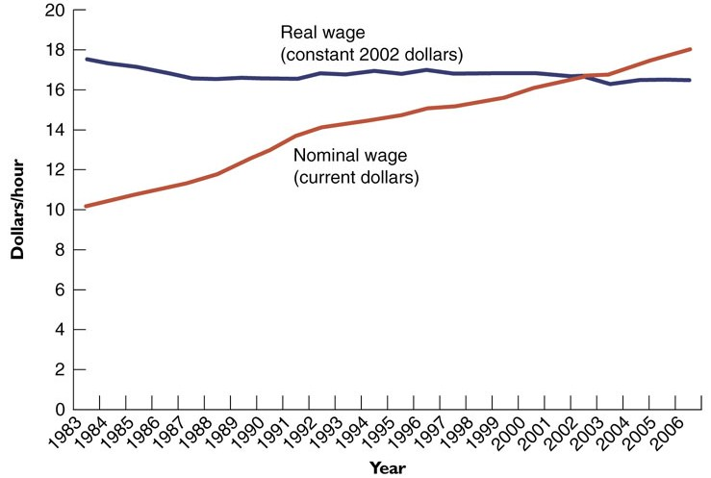
Nominal and Real Wages of Hourly Paid Employees in Canada, 1983-2006

Slide 35
Nominal vs. Real Interest Rates
Nominal interest rate (i)
  Price paid per dollar borrowed per year
Real interest rate (r)
  Nominal interest rate minus the inflation rate
  Can be negative or positive, depending on size of inflation rate

Slide 36
Example: Real Interest Rates in Recent Decades
Year | Nominal Interest Rate (%) | Inflation (%) | Real Interest Rate (%)
1970 | 6.0 | 3.4 | 2.6
1975 | 7.4 | 10.9 | -3.5
1980 | 12.7 | 10.1 | 2.6
1981 | 17.8 | 12.4 | 5.4
1987 | 8.2 | 4.4 | 3.8
1990 | 12.8 | 4.8 | 8.0
1995 | 7.0 | 2.2 | 4.8
2000 | 5.5 | 2.7 | 2.8
2003 | 2.9 | 2.8 | 0.1
2007 | 4.1 | 2.2 | 1.9

Slide 37
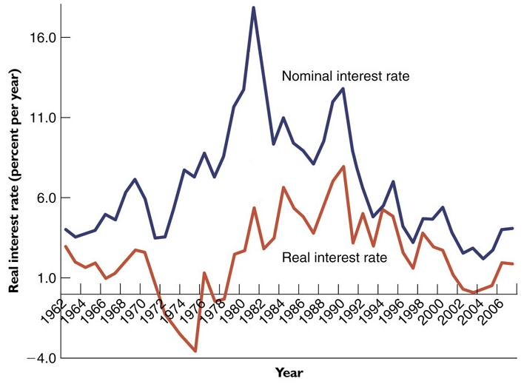
Inflation and Nominal Interest Rates in Canada, 1962-2007
Inflation

Slide 38
Anticipated and Unanticipated Inflation
Anticipated inflation
  When inflation fits people’s general expectations
  “Built Into” people’s decisions
Unanticipated inflation
  When inflation turns out to be higher or lower than was expected
    Debtors win when inflation > expected
      Because they repay loans with $ that have less purchasing power than they expected
    Debtors lose when inflation < expected
      Because they repay loans with $ that have more purchasing power than they expected

Slide 39
Fisher Effect
The tendency for nominal interest rates to be:
  high when inflation is high and
  low when inflation is low
WHY ?
  High inflation now makes people anticipate high inflation in the future
  Lenders raise their nominal interest rate so that their real rate of return is unaffected
  Borrowers are willing to pay more because the real cost of borrowing is the same

Slide 40
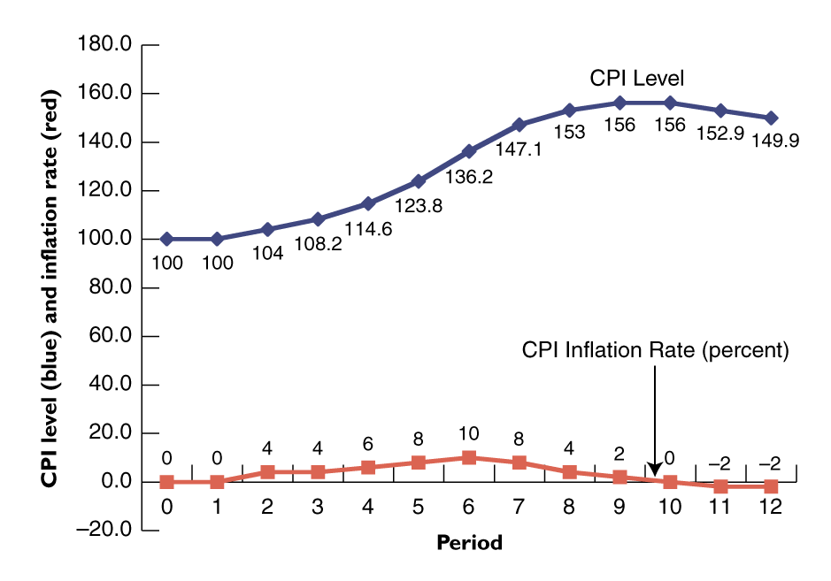
Different Levels of Inflation

Slide 41
Describing the Intensity of Inflation
Low inflation
  inflation between 1 and 3 percent per year
Moderate inflation
  inflation between 3 and 6 percent per year
High inflation
  inflation greater than 6 percent per year
Hyperinflation
  inflation greater than 500 percent per year

Slide 42
Types of Inflation
Demand-Pull Inflation
  excess demand
Cost-Push Inflation
  per-unit production costs
  supply shocks
Complexities

Slide 43
Effects of Inflation on Output
Cost-Push Inflation & Real Output
Demand-Pull Inflation & Real Output
Hyperinflation & Breakdown

Slide 44
After Today’s Lecture
Chapter seven
Homework 4

