Slide 1
Lecture 11
Bank of Canada
Bond price
Money demand and supply
Monetary Policy
The Monetary Transmission Mechanism

Slide 2
Functions of the Bank of Canada
Acting as the “Bankers’ Bank”
Issuing Currency
Acting As Fiscal Agent
Supervising the Chartered Banks
Regulating the Supply of Money

Slide 3
Bank of Canada Independence
Controversial
Voters hold Parliament responsible
Bank must be protected from political pressures

Slide 4
Table 13-1
Bank of Canada Statement of Assets and Liabilities, December 31, 2011 (in millions)
Assets |  | Liabilities
Advances to chartered banks | $ 0 | Notes in circulation | $59,729
Treasury bills of Canada | 19,171 | Government of Canada deposits | 1,966
Other securities issued or guaranteed by Canada | 43,026 | Chartered bank deposits | 25
Securities purchased under resale agreement | 520 | Other liabilities | 1697
Other assets | 607
Total | $63,417 | Total | $63,417

Slide 5
The Demand for Money Balance
Motives for Holding Money
  The Transaction Motive
  The Asset Motive
Quantity Demanded | Effect of Rise in
 | Price Level | Real Income | Interest Rate
Nominal Money | Rise in proportion | Rises | Falls
Real Money | Unaffected | Rises | Falls

Slide 6
The Demand for Money
+
=
Transactions
Demand, D_{t}(Y₀)
Asset
Demand, D_{a}(i)
Total demand
for money, D_{m}(Y_{0,}i)
i%
i%
i%
10
7.5
5
2.5
0
10
7.5
5
2.5
0
10
7.5
5
2.5
0
Interest Rate
D_{m}(Y_{0,}i)
D_{t}(Y₀)
D_{a}(i)
50 100 150 200 250 300
50 100 150 200 250 300
50 100 150 200 250 300
Amount of money
demanded (billions
of dollars)
Amount of money
demanded (billions
of dollars)
Amount of money
demanded (billions
of dollars)
100 + 100 = 200

Slide 7
The Demand for Money Balance
The demand for money balances: prices, real income, and interest rates
  D_{m} = kY₀ – hi (note: k and h are parameters)
D_{m} = kY₀ - hi
Money Demand is negatively related to the interest rate
i₂
i₁
Nominal Interest Rates
L₂
L₁
kY₀

Slide 8
Holding of M1 and M2 in Canada, 1995 and 2005
 | 1995 | 2005
Index of:
Nominal M1 | 100 | 291
Nominal M2 | 100 | 151
Consumer prices | 100 | 123
Real M1 | 100 | 237
Real M2 | 100 | 123
Real GDP | 100 | 140
Interest Rate Spread (%, between 3-5 year bonds and band deposits) | 6.01 | 3.80

Slide 9
Financial Market Equilibrium and Interest Rates
Nominal Money supply
  S_{m} = Money base × Monetary Multiplier
Real money supply, S_{m}/Price Index
Money demand
  D_{m} = kY₀ – hi (note: k and h are parameters)
Money market equilibrium
  Equilibrium interest rate

Slide 10
Bond Prices and Interest Rates
Bond
  Example: Government of Canada, 4.25, 2009-sep-01
  Marketable 4.25 percent bond with a maturity date September 1, 2009.
  4.25 is called coupon value, it pay its holder $4.25 for each $100 face value. $100 is the principal.

Slide 11
Interest Rates and Bond Prices
When the interest rate increases, bond prices fall; and vice versa.
Example
  A $1,000 bond pays $50 annual interest. Interest yield on this bond is ___
  $50/$1000 = 5%
  Interest rate rises to 7.5%, bond price will fall to ____
  $50/7.5% = $667
  Interest rate falls to 2.5%, bond price will rise to ____
  $50/2.5% = $2000

Slide 12
Equilibrium in the Money Market
D_{s0}
At lower interest rate
There is an excess demand for money balances
There must be a corresponding excess supply of bond
Bond price fall, raising bond yields and the opportunity cost of holding money balance
Revert to the equilibrium
Nominal Interest Rate i
E
i₀
i₁
Excess Demand for money balance
D_{m}
D_{s0}
D_{m1}
Real Money Balances

Slide 13
Change in Financial Market Equilibrium
D_{s1}
D_{s0}
Fall in Money Supply
Excess demand for money
Sell bond, bond price falls
Equilibrium is restored at higher interest rate
i₁
Nominal Interest Rate i
i₀
D_{m}
D_{s1}
D_{s0}
Real Money Balances

Slide 14
Change in Financial Market Equilibrium
D_{s0}
Rise in Real Income
Increase in demand for money
Sell bond, bond price falls
Equilibrium is restored at higher interest rate
i₂
Nominal Interest Rate i
i₀
D_{m1}
D_{m0}
D_{s0}
Real Money Balances

Slide 15
Goals and Tools of Monetary Policy
The Objective of the Bank of Canada’s Monetary Policy
Tools of Monetary Policy:
  Open-Market Operations
  Bank Rate

Slide 16
Open-Market Operations
Bank of Canada BUYS bonds from the chartered banks
  Chartered bank gives up bonds
  Bank of Canada pays chartered bank by increasing chartered bank’s reserves

Slide 17
Bank of Canada Buys Bonds from Chartered Banks
Bank of Canada
Assets
Liabilities and Net Worth
+ Securities
+ Reserves of Chartered Banks
(a) Securities
(b) Reserves
Chartered Banks
Assets
Liabilities and Net Worth
Securities (a)
+Reserves (b)
LO2
16-17
Notes:
As part of their open-market operations, the Fed will buy or sell government bonds. If they purchase the bonds from commercial banks, the commercial banks are in effect transferring part of their holding of securities to the Fed, which creates new reserves for the banks in their accounts at the Fed. By increasing the commercial banks’ reserves, the Fed has increased their lending capacity.

Slide 18
Open Market Operations
Bank of Canada BUYS bonds from the public
  Public gives up bonds for cheque
  Cheque is deposited in chartered bank
  Chartered bank’s reserves increase

Slide 19
Figure 13-2
The Bank of Canada’s Purchase of Bonds and the Expansion of the Money Supply
Bank of Canada buys $1,000 bond from a chartered bank.
New Reserves
$1000
Excess
Reserves
$5000
Bank System Lending
Total Increase in the Money Supply, ($5,000)
Notes:
When the Fed buys government bonds from commercial banks, it increases the assets of the Fed and increases the reserves of the commercial banks. This will increase the lending ability of the commercial banks.

Slide 20
Figure 13-2
The Bank of Canada’s Purchase of Bonds and the Expansion of the Money Supply
Bank of Canada buys $1,000 bond from the public.
New Reserves
$1000
$800
Excess
Reserves
$200
Required
Reserves
$4000
Bank System Lending
$1000
Initial
Checkable
Deposit
Total Increase in the Money Supply, ($5000)
Notes:
When the Fed buys government bonds from the public, the effect is much the same. The assets of the Fed increase, and as the public deposits the funds into a commercial bank, its reserves and lending ability will increase.

Slide 21
Open-Market Operations
Bank of Canada BUYS bonds
  Chartered bank’s reserves increase
  Banks increase lending
  Money supply increases
Bank of Canada SELLS bonds
  Chartered bank’s reserves decrease
  Banks decrease lending
  Money supply decreases

Slide 22
Bank of Canada Buys Bonds from Chartered Banks
Bank of Canada
Assets
Liabilities and Net Worth
- Securities
- Reserves of Chartered Banks
(a) Securities
(b) Reserves
Chartered Banks
Assets
Liabilities and Net Worth
+ Securities (a)
- Reserves (b)
LO2
16-22
Notes:
If the Fed sells government bonds to commercial banks, the opposite effect occurs. The banks lose reserves, which will reduce their lending capacity.

Slide 23
Open Market Operations
Bank of Canada SELLS bonds to the public
  Public pays bonds with cheque
  Cheque is cleared in chartered bank
  Chartered bank’s reserves decrease
The Bank of Canada bond sales of $1000 to the chartered banking system reduce the system’s actual and excess reserves by $1000.
But a $1000 bond sale to the public reduces excess reserves by $800

Slide 24
The Bank Rate and the Overnight Lending Rate
The bank rate is the interest rate the Bank of Canada charges on the loans to the chartered banks
Bank rate is set at the upper end of the Bank of Canada’s operating band for the overnight lending rate
Bank has a publicized target for the overnight lending rate

Slide 25
13.4 Targeting the
Overnight Lending Rate
The Bank of Canada sets a target level for the overnight rate, often referred to as the key policy rate or key interest rate .
Overnight lending Rate
  The interest rate charged by banks on overnight loans
Bank of Canada conducts open market operations to achieve the target

Slide 26
Figure 13-3
Targeting the Overnight Lending Rate
4.5
S_{f 3}
4.0
S_{f 1}
Federal Funds Rate, Percent
3.5
S_{f 2}
D_{f}
Q_{f3}
Q_{f1}
Q_{f2}
Quantity of Reserves
LO3
16-26
Notes:
In this example, we are assuming that the Fed desires a 4% interest rate. The demand curve is downward sloping because lower interest rates give banks greater incentives to borrow. The supply curve for Federal funds is horizontal at the desired rate because the Fed uses open market operations to manipulate the supply to keep it there.

Slide 27
Monetary Policy
Expansionary monetary policy
  Economy faces a recession
  Lower target for overnight lending rate
  Bank of Canada buys securities
  Expanded money supply
  Downward pressure on other interest rates

Slide 28
Monetary Policy
Restrictive monetary policy
  Periods of rising inflation
  Increases target for overnight lending rate
  Bank of Canada sells securities
  Increases money supply
  Increases other interest rates

Slide 29
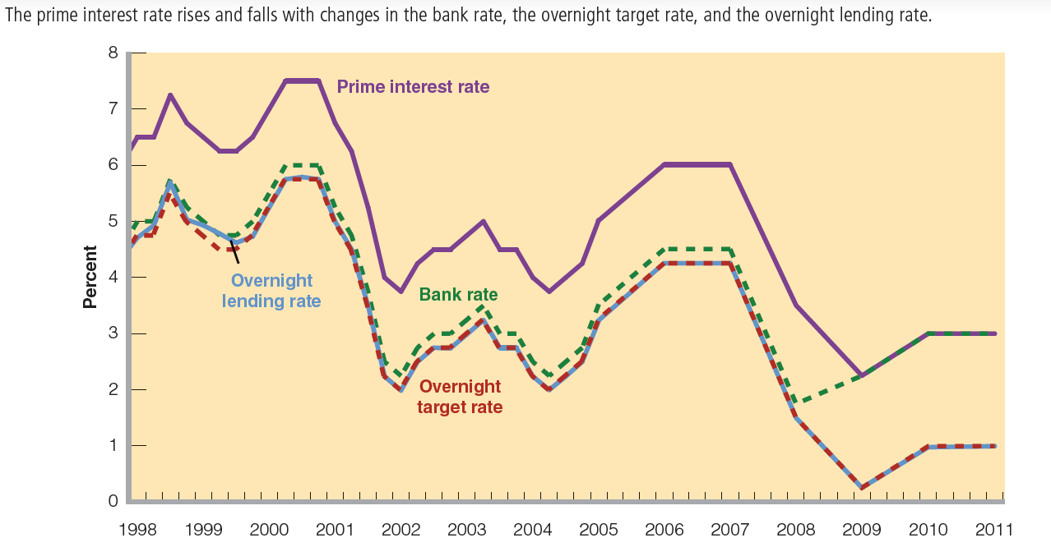
Figure 13-4
The Prime Interest Rate, the Bank Rate, the Overnight Target Rate, and the Overnight Lending Rate in Canada, 1998–2011

Slide 30
The Taylor Rule
If real GDP rises by 1% above potential GDP, the Bank should raise the overnight rate by 1.5 percentage point
If inflation rises by 1% above its target of 2 percent, the bank should raise the overnight lending rate by 1.5%
When real GDP is equal to potential GDP and inflation is equal to its target, the overnight rate should remain about 4%, implying a real interest rate of 2%.

Slide 31
Money, Aggregate Demand, and National Income
Transmission mechanism
  Links money, interest rates and financial markets to output and employment and prices
Money supply and demand affect consumption and investment through the real interest rate
  R = i - π

Slide 32
Money, Aggregate Demand, and National Income
Consumption Expenditure Revisited
  Wealth effect
  Durables and Consumer Credit

Slide 33
Interest Rates and
Consumption Expenditure
C₂
C₂ + cY
r₁
Consumption
Real Interest Rates
ΔC
Δr
r₂
C₁
C₁ + cY
ΔC
C₀
C₁
C₂
C
Y
Autonomous Consumption
Real GDP and Income

Slide 34
Money, Aggregate Demand, and National Income
Investment Expenditure
  Investment in Fixed Capital
  Inventory Investment

Slide 35
Interest Rates and
Consumption Expenditure
r₂
Δr
r₁
Investment
Real Interest Rates
I(r₀)
ΔI
I(r₁)
ΔI
I = I₀
I₁
I₀
I
Y
Planned Investment Expenditure
Real GDP and Income

Slide 36
Interest Rate and Net Exports
Net exports effects reinforce monetary policy
(1)Expansionary monetary policy | (2)Restrictive monetary policy
Problem: recession, slow growth | Problem: inflation
↓ | ↓
Expansionary monetary policy (lower interest rate) | Restrictive monetary policy (higher interest rate)
↓ | ↓
Decreased foreign demand for dollars | Increased foreign demand for dollars
↓ | ↓
Dollar depreciates | Dollar appreciates
↓ | ↓
Net exports increase (aggregate demand increases, strengthening the expansionary monetary policy) | Net exports decrease (aggregate demand decreases, strengthening the restrictive monetary policy)

Slide 37
Money, Aggregate Demand, and National Income
Transmission mechanism

Slide 38
The Transmission Mechanism
With prices constant, changes in money supply change nominal and real interest rates
Changes in real interest rates change consumption expenditure
Change in real interest rate also cause changes in planned investment expenditure
Changes in nominal interest rate also cause changes in exchange rates, which change the price competitiveness and profitability of trade.

Slide 39
The Monetary Transmission Mechanism
(a) Money Market
D_{s0}
D_{s1}
Nominal Interest Rate i
i₁
Δi
i₂
D_{m}
D_{s0}
D_{s1}
Real Money Balances

Slide 40
The Monetary Transmission Mechanism
(b) Expenditure and Real Interest Rate
r₁
Real Interest Rates
Δr
r₂
ΔA
C₀ + I₀ + NX₀
A(r₁)
A(r₂)
C
Autonomous Expenditure

Slide 41
The Monetary Transmission Mechanism
(c) Aggregate Expenditure and Output
AE(r₂)
AE(r₁)
A₀(r₂)
ΔA
A₀(r₁)
ΔY
Y₁
Y₂
Real Output and Income

Slide 42
The Monetary Transmission Mechanism
(d) Aggregate Demand and Supply
P
ΔAD
P₀
_{S}
ΔY
AD₁
AD₂
Y₁
Y₂
Real Output and Income

Slide 43
The Monetary Transmission Mechanism
(e) Short-run and Long-run Equilibrium
Y_{P}
P
AS₁
ΔAD
P₁
P₀
AD₁
AD₂
Y_{P}
Y₁
Y₂
Real Output and Income

Slide 44
After Today’s Lecture
Chapter 13
Open market operation
Understand the monetary transmission mechanism
Homework 11, 12

