Slide 1
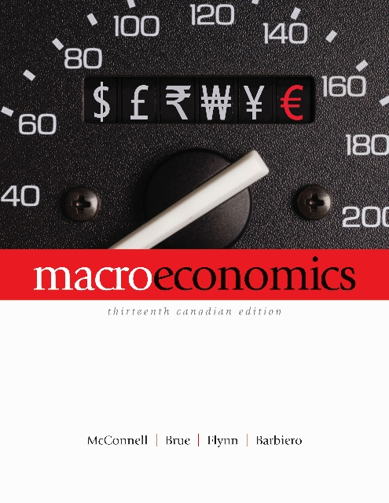
Lecture 10
MONEY, BANKING,
AND MONETARY POLICY
Prepared by Dr. Amy Peng
Ryerson University

Slide 2
The Definition and Functions of Money
“Money is what money does”
Medium of exchange
Measure of value
Store of value

Slide 3
The Components of the Money Supply
Money Definition M1
Currency: Coins + Paper Money
  token money
  Bank of Canada notes
Demand Deposits
  about 3/4 of M1
Institutions That Offer Demand Deposits
  chartered banks are the primary depository institutions
Two Qualifications:
  currency held by the Bank of Canada and chartered banks is excluded from M1 and other measures of the money supply
  also excluded from the money supply are any deposits of the federal government or the Bank of Canada that are held by chartered banks
3

Slide 4
The Components of the Money Supply
Money Definition M2
M1 + near monies
  Near monies are highly liquid financial assets that do not directly function as a medium of exchange but can be readily converted into currency
4

Slide 5
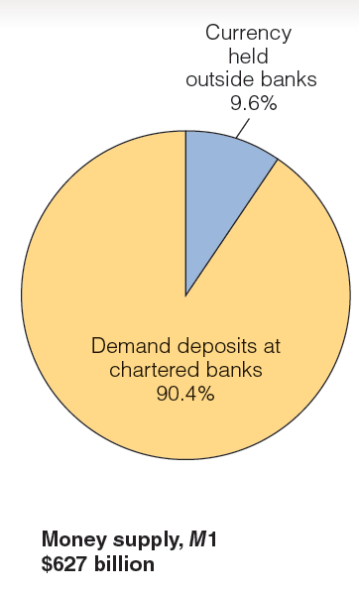
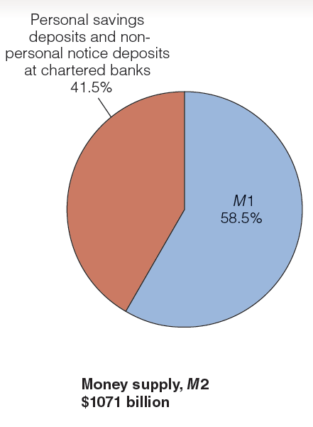
Figure 12-1
Components of Money Supply M 1, M 2, M 2+ , and M2++ in Canada

Slide 6
The Components of the Money Supply
Money Definition M2+
M2+ is M2 plus
  deposits at trust and mortgage loan companies
  deposits at caisses populaires & credit unions & other non-bank deposit-taking institutions
  money market mutual funds
Money Definition M2++
M2++ is M2 plus Canadian saving bonds and non-money market mutual funds

Slide 7
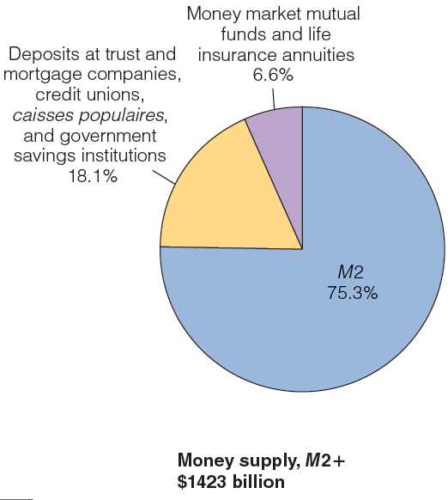
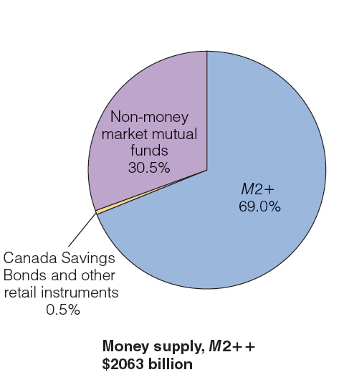
Figure 12-1
Components of Money Supply M 1, M 2, M 2+ , and M2++ in Canada

Slide 8
Table 12-1
Money in Canada, December 2011
Money | Billions of dollars
Currency held outside banks | $ 60
+ Demand deposits at chartered banks held by individuals and businesses | 567
= M1 | 627
+ Personal savings deposits and nonpersonal notice deposits at chartered banks | 444
= M2 | 1071
+ Deposits at trust and mortgage companies, credit unions, caisses populaires, and government savings institutions | 258
+ Money market mutual funds and life insurance annuities | 94
= M2+ | $1423
+ Canada Saving Bonds and other retail instruments | 10
+ Non–money market mutual funds | 630
= M2++ | $2,063

Slide 9
What Backs the Money Supply?
Money as Debt
Value of Money
  Acceptability
  Legal Tender
  Relative Scarcity

Slide 10
What Backs the Money Supply?
Money and Prices
  Purchasing Power of the Dollar
    D = 1/P
    If the price level is 1.0, then the value of the dollar is 1.
    If the price level rises to, 1.20, D falls to 0.833;
    A 20 percent increase in the price level reduces the value of the dollar by 16.67 percent.
  Inflation and Acceptability
  Stabilizing the Purchasing power of money
10

Slide 11
The Canadian Financial System
Canadian Chartered Banks
  A multi-branched, privately owned, commercial financial intermediary that has received a charter by Act of Parliament
  Fractional reserve banking system
    A banking system with a reserve ratio that is less than 100 percent of the deposit liabilities of a chartered bank
  Making Loans
    Prime rate

Slide 12
Table 12-2
The Balance Sheet of Canadian Chartered Banks, December 2011 (billions of dollars)
Assets |  | Liabilities
Reserves (currency and chartered banks’ deposits with Bank of Canada) | 0 | Demand deposits | 228
Loans (determined in Canadian dollars) | 721 | Savings deposits | 272
Canadian securities | 213 | Term deposits | 216
Mortgages | 857 | Foreign-currency liabilities | 186
 |  | Government of Canada deposit | 2
Other assets | 519 | Other liabilities | 1406
Total | 2310 | Total | 2310

Slide 13
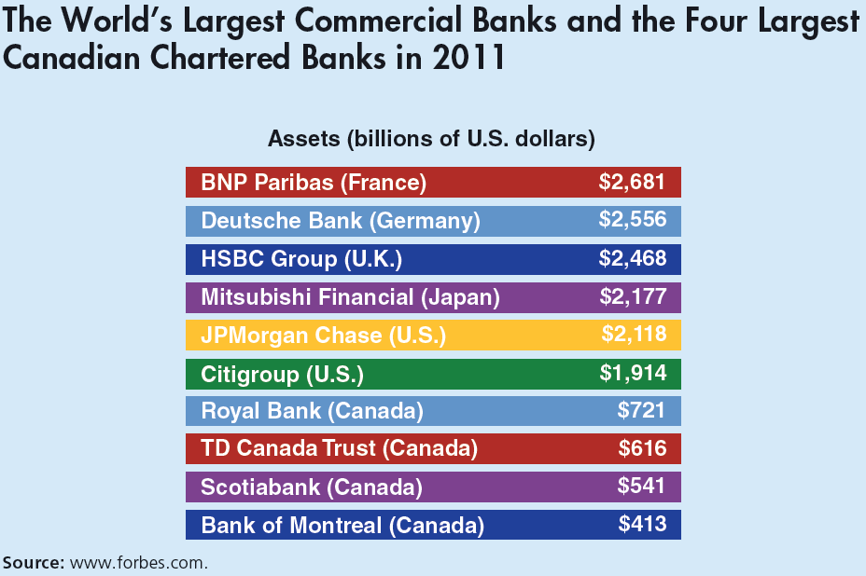
Global Perspective 12.1

Slide 14
Chartered Banks and the Creation of Money
The creation of money is done with the help of Canada’s chartered banks
The Fractional Reserve System

Slide 15
Illustrating the Idea: the Goldsmiths
Goldsmiths accepted gold deposits and issued paper receipts
Paper receipts were used as a medium of exchange
100% reserve system

Slide 16
Significant Characteristics of Fractional Reserve Banking
Fractional Reserve System
  Money creation and reserves
  Bank panics and regulation

Slide 17
A Single Charted Bank
Balance sheet
  Assets = Liabilities + Net Worth
  Both sides balance
Necessary transactions
  Create a bank
  Accept deposits
  Lend excess reserves

Slide 18
A Single Commercial Bank
Transaction #1
Vault cash: cash held by the bank
Creating a Bank
Balance Sheet 1: Bank of Vancouver
Assets
Liabilities and Net Worth
Cash
$250,000
Capital Stock
$250,000
LO1
15-18
Notes:
Investors have created a bank and organized it as a corporation by contributing a total of $250,000 cash to the bank in exchange for ownership shares in the bank worth $250,000.

Slide 19
A Single Commercial Bank
Transaction #2
Acquiring property and equipment
Acquiring Property and Equipment
Balance Sheet 2: Bank of Vancouver
Assets
Liabilities and Net Worth
Cash
$10,000
Capital Stock
$250,000
Property
240,000
LO1
15-19
Notes:
The business acquires a building and some equipment for cash. This did not affect the total net worth of the bank but was rather an exchange of one asset for another asset.

Slide 20
A Single Commercial Bank
Transaction #3
Chartered bank functions
  Accepting deposits of $100,000
Accepting Deposits
Balance Sheet 3: Bank of Vancouver
Assets
Liabilities and Net Worth
Cash
$110,000
Demand deposits
Property
$100,000
240,000
Capital Stock
250,000
LO1
15-20
Notes:
In this slide, the bank has actually increased its value by accepting deposits from customers. The deposits are recorded as liabilities of the bank, as the bank must return the money to the customers upon request. The assets of the bank also increase as the bank now has more cash.

Slide 21
A Single CharteredBank
Depositing reserves in the Bank of Canada
  Desired reserves
  Desired reserve ratio
Charted bank’s
Desired reserves
Desired reserve
ratio
=
Charted bank’s
demand-deposit liabilities
LO2
15-21
Notes:
Banks are not required to keep 100% of their deposits on hand at all times because the probability that all customers will ask for their money back at the same time is small. If all customers did return to demand their money at the same time, this would be referred to as a “run on the bank.”

Slide 22
Cash Reserves
Excess reserves
  Actual reserves - required reserves
Desired reserves
  Demand deposits x desired reserve ratio
Example:
  Demand deposits $100,000, actual reserves 110,000
  Reserve ratio 20%
  Excess reserves = $110,000 – ($100,000 x 20%)
  = 90,000

Slide 23
A Single Chartered Bank
Transaction #4
Clearing a cheque
  $50,000 cheque reduces reserves and demand deposits
Clearing a Cheque
Balance Sheet 4: Bank of Vancouver
Assets
Liabilities and Net Worth
Cash Reserves
$60,000
Demand Deposits
$50,000
Property
240,000
Capital Stock
250,000
LO2
15-23
Notes:
Now we see that when a customer writes a check against his balance, it reduces the reserves and the checkable deposits by the amount of the check.

Slide 24
Money Creating Transactions
Transaction #5a
Granting a loan
  $50,000 loan deposited to chequing
When a Loan is Negotiated
Balance Sheet 5a: Bank of Vancouver
Assets
Liabilities and Net Worth
Cash Reserves
$60,000
Loans
50,000
Demand Deposits
$100,000
Property
240,000
Capital Stock
250,000
LO3
15-24
Notes:
Now we are actually creating new money as opposed to just moving around old money. A bank’s loans are its assets. Having someone owe you money is a good thing (having them actually pay you is even better). Here both assets and deposits increased.

Slide 25
Money Creating Transactions
Transaction #5b
Using the loan
  $50,000 loan cashed
After a Check is Drawn on the Loan
Balance Sheet 5b: Bank of Vancouver
Assets
Liabilities and Net Worth
Cash Reserves
$10,000
Loans
50,000
Demand Deposits
$50,000
Property
240,000
Capital Stock
250,000
A single bank can only lend an amount
equal to its preloan excess reserves
LO3
15-25
Notes:
Here the customer with the loan wrote a check which came out of our bank and went into another bank. The other bank’s reserves would have increased while ours decreased by the amount of the check.

Slide 26
Money Creating Transactions
Transaction #6
Bank buys government securities from a dealer
  Deposits payment into chequing
Buying Government Securities
Balance Sheet 6: Bank of Vancouver
Assets
Liabilities and Net Worth
Cash Reserves
$60,000
Securities
50,000
Demand Deposits
$100,000
Property
240,000
Capital Stock
250,000
LO3
15-26
Notes:
Buying government securities has the same effect as lending: new money is created.

Slide 27
Government Securities
Bond purchases from the public by the chartered banks increases the money supply
Bond sales to the public decreases the money supply

Slide 28
Profits, Liquidity, and the Overnight Lending Rate
Bankers have two conflicting goals:
  Profit
  Liquidity
Overnight loans rate paid on overnight loans to cover temporary shortages of reserves

Slide 29
The Banking System:
Multiple-Deposit Expansion
A single bank can lend one dollar for each dollar of excess reserves
The banking system can lend (create money) by a multiple of its excess reserves

Slide 30
The Banking System’s Lending Potential
Multiple-deposit expansion
Assumptions:
  20% required reserves
  All banks “loaned up”
  Banks lend all of their excess reserves
  A $100 bill is found and deposited
  Multiple deposits can be created

Slide 31
The Banking System’s Lending Potential
Multiple-Deposit Expansion Process
Balance Sheet: Chartered Bank A
Assets |  | Liabilities and net worth
Cash Reserves | $+100 (a₁) | Demand deposits | $+100 (a₁)
 | – 80 (a₃) |  | + 80 (a₂)
Loans | + 80 (a₂) |  | – 80 (a₃)

Slide 32
The Banking System’s Lending Potential
Multiple-Deposit Expansion Process
Balance Sheet: Chartered Bank B
Assets |  | Liabilities and net worth
Cash Reserves | $+80 (b₁) | Demand deposits | $+80 (b₁)
 | –64 (b₃) |  | +64 (b₂)
Loans | +64 (b₂) |  | –64 (b₃)

Slide 33
The Banking System’s Lending Potential
Multiple-Deposit Expansion Process
Balance Sheet: Chartered Bank C
Assets |  | Liabilities and net worth
Cash Reserves | $+64.00 (c₁) | Demand deposits | $+64.00 (c₁)
 | –51.20 (c₃) |  | +51.20 (c₂)
Loans | +51.20 (c₂) |  | –51.20 (c₃)

Slide 34
Table 12-3
Expansion of the Money Supply by the Chartered Banking System
(1)
Acquired
Reserves
and Deposits
(2)
Required
Reserves
(3)
Excess
Reserves
(1)-(2)
(4)
Amount Bank Can
Lend; New Money
Created = (3)
Bank
Bank A $100 $20 $80 $80
Bank B $80 $16 $64 $64
Bank C $64 $12.80 $51.20 $51.20
Bank D $51.20 $10.24 $40.96 $40.96
LO4
15-34
Notes:
This table illustrates the creation of new money based on a single $100 deposit made into one bank. Each subsequent bank can lend a smaller portion of $100 after factoring in their reserve requirement, but overall total deposits in all banks will increase.

Slide 35
The Banking System
Table 12-3
Expansion of the Money Supply by the Chartered Banking System
(1)
Acquired
Reserves
and Deposits
(2)
Required
Reserves
(Reserve
Ratio = .2)
(3)
Excess
Reserves
(1)-(2)
(4)
Amount Bank Can
Lend; New Money
Created = (3)
Bank
Bank A
Bank B
Bank C
Bank D
Bank E
Bank F
Bank G
Bank H
Bank I
Bank J
Bank K
Bank L
Bank M
Bank N
Other Banks
$100.00
80.00
64.00
51.20
40.96
32.77
26.21
20.97
16.78
13.42
10.74
8.59
6.87
5.50
21.99
$20.00
16.00
12.80
10.24
8.19
6.55
5.24
4.20
3.36
2.68
2.15
1.72
1.37
1.10
4.40
$80.00
64.00
51.20
40.96
32.77
26.21
20.97
16.78
13.42
10.74
8.59
6.87
5.50
4.40
17.59
$80.00
64.00
51.20
40.96
32.77
26.21
20.97
16.78
13.42
10.74
8.59
6.87
5.50
4.40
17.59
$400.00
LO4
15-35
Notes:
This shows that, in total, the original $100 deposit will end up adding $400 in new money into the system.

Slide 36
The Monetary Multiplier
Definition
Maximum demand-deposit creation =
excess cash reserves × monetary multiplier
  D = E × M
Reversibility: the multiple destruction of money
Monetary
multiplier
1
1
=
=
Desired reserve ratio
R
LO5
15-36
Notes:
The money multiplier is a key measure in banking that helps to predict the money supply that will be available to drive economic growth. As you can see from the formula, if the reserve requirement is 20%, the money multiplier will be 1 divided by 0.2, which is 5. We can then use the money multiplier multiplied by the excess reserves to determine the maximum checkable-deposit creation that will be provided by the new money entering the system.

Slide 37
Figure 12-2
The Outcome of the Money Expansion Process, New Reserves

Slide 38
The Money Supply with both Currency and Deposits
Money supply = Currency held by the public + Bank deposits
Money supply = Currency held by public + (Bank reserves /Desired reserve ratio)

Slide 39
The Money Supply with both Currency and Deposits
Example: the money supply at Christmas
  Initially bank reserves are 500, the amount of currency held by the public is 500, and the desired reserve-deposit ratio in the banking system is 0.2.
  Money supply = 500 + (500/0.2) = 3000
  Because of Christmas shopping needs, the public increases its currency holdings to 600 by withdrawing 100 from commercial banks
  Money supply = 600 +(400/0.2) = 2600
When the public withdraws cash from the banks, the overall money supply declines significantly.

Slide 40
How Banks Create Money
Two key conditions
  The public is willing to hold and use bank deposit as money.
  Currency ratio
  The banks are willing to operate with cash reserves equal to some small fraction of their deposit liabilities.
  Reserve Ratio

Slide 41
The Monetary Base and the Money Supply
Monetary Base
Cash in Circulation C = cr X D
Banks’ Cash Reserves R = rr X D
Bank Deposits
Money Supply

Slide 42
How Big is the Money Multiplier?
Example: Banks hold cash reserves of $4.3 billion against liquid savings and demand deposit of $305.1 billion ⇨ rr = 4.3 / 305.1 = 1.4%
Public holds cash balances of $38.7 billion
⇨ cr = 38.7 / 3.501 = 12.7%
Monetary multiplier
Each $100 change in the monetary base results in a change in the money supply of about $800.
Money Supply = Money base × Monetary Multiplier

Slide 43
After today’s Lecture
Read Chapter 12
Understand the Balance Sheet and Money Supply
Lyryx Lab 10

