Slide 1
Lecture Nine
Government budget and Fiscal Policy
Cyclically Adjusted Budget
Public Debt

Slide 2
Fiscal Policy and the AD-AS Model
Since 1945, fiscal policy has been one of the government’s main stabilization policy tools
“active” if changes in government spending or taxes are at the option of the government
“non-discretionary” if independent of parliamentary action

Slide 3
Expansionary Fiscal Policy
Used when Recession Occurs
Options:
  Increased Government Spending
  Tax Reductions
  Combined Government Spending Increases and Tax Reductions
  May Create a Budget Deficit

Slide 4
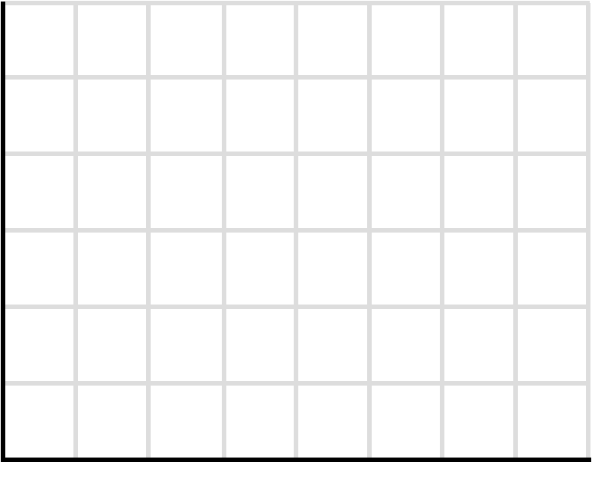
Figure 11-1: Expansionary Fiscal Policy
$5 billion
increase in
spending
Recessions
Decrease AD
AS
Full $20 billion
increase in
aggregate demand
Price level
P₁
AD₁
AD₂
$490
$510
Real GDP (billions)
Notes:
This figure shows the expansionary fiscal policy. Expansionary fiscal policy uses increases in government spending or tax cuts to push the economy out of recession. In an economy with a MPC of .75, a $5 billion increase in government spending, or a $6.67 billion decrease in personal taxes (producing a $5 billion initial increase in consumption), expands aggregate demand from AD₂ to the downsloping dashed curve. The multiplier then magnifies this initial increase in spending to AD₁. So real GDP rises along the horizontal axis by $20 billion.

Slide 5
Contractionary Fiscal Policy
Used to Combat Demand-pull Inflation
Options:
  Decreased Government Spending
  Increased Taxes
  Combined Government Spending Decreases and Tax Increases

Slide 6
Figure 11-2: Contractionary Fiscal Policy
$3 billion initial
decrease in
spending
AS
Price level
P₂
d
c
b
Full $12 billion
decrease in
aggregate demand
P₁
a
AD₄
AD₅
AD₃
$502
$510
$522
Real GDP (billions)
Notes:
This figure shows the effects of contractionary fiscal policy.
Contractionary fiscal policy uses decreases in government spending, increases in taxes, or both, to reduce demand-pull inflation. Here, an increase in aggregate demand from AD₃ to AD₄ has driven the economy to point b and ratcheted the price level up to P₂, where it becomes inflexible downward. If the economy’s MPC is .75 and the multiplier therefore is 4, the government can either reduce its spending by $3 billion or increase its taxes by $4 billion (which will decrease consumption by $3 billion) to eliminate the inflationary GDP gap of $12 billion (= $522 billion - $510 billion). Aggregate demand will shift leftward, first from AD₄ to the dashed downsloping curve to its left, and then to AD₅. With the price level remaining at P₂, the economy will move from point b to point c and the inflationary GDP gap will disappear.

Slide 7
Policy Options: G or T ?
To expand the size of government
  If recession, then increase government spending
  If inflation, then increase taxes
To reduce the size of government
  If recession, then decrease taxes
  If inflation, then decrease government spending

Slide 8
Built-In Stability
Net tax revenues vary directly with GDP
  Taxes rise when GDP rises, and vice versa
  Transfer payments fall when GDP rises, and vice versa
Leads to automatic stabilization over the business cycle.

Slide 9
Real GDP, Income and the Government BB
G =200
NT = tY = 0.2Y
BB = NT – G = 0.2Y -200
GDP | NT | G | BB
0
200
600
1000
1400
1800
GDP | NT | G | BB
0 | 0 | 200 | - 200
200 | 40 | 200 | - 160
600 | 120 | 200 | - 80
1000 | 200 | 200 | 0
1400 | 280 | 200 | + 80
1800 | 360 | 200 | + 160

Slide 10
Automatic or Built-In Stabilizers
A structure of taxation and spending that:
  Increases the deficit (reduces the surplus) during recession
  Increases the surplus (reduces the deficit) during inflation

Slide 11
Economic Importance
The stabilizers will automatically restrain economic expansion and cushion economic contraction.
Taxes reduce spending and aggregate demand.
Reductions in spending are desirable when the economy is developing inflationary pressures, whereas increases in spending are desirable when the economy is slumping.

Slide 12
Figure 11-3
Built-in Stability
T
Surplus
Government expenditures, G,
and tax revenues, T
G
Deficit
GDP₁
GDP₂
GDP₃
Real domestic output, GDP
13-12
Notes:
This figure shows built-in stability. Tax revenues, T, vary directly with GDP, and government spending, G, is assumed to be independent of GDP. As GDP falls in a recession, deficits occur automatically and help alleviate the recession. As GDP rises during expansion, surpluses occur automatically and help offset possible inflation.

Slide 13
Tax Progressivity
The built-in stability depends on:
Tax Progressivity
  Progressive
  Proportional
  Regressive
The more progressive the tax system, the greater the economy’s built-in stability

Slide 14
Evaluating Fiscal Policy
To evaluate fiscal policy stance, must
  Adjust deficits and surpluses to eliminate automatic changes in tax revenues
  Compare adjusted budgets to GDP

Slide 15
Cyclically Adjusted Budget
The cyclically adjusted budget shows what the budget balance would be if the economy were operating at full employment

Slide 16
Figure 11-4
Cyclically Adjusted Deficits
T
b
a
Government expenditures, G, and
tax revenues, T (billions)
G
$500
450
c
GDP₂
GDP₁
Real domestic output, GDP
(year 2)
(year 1)
Notes:
This figure shows the cyclically adjusted deficits in this graph. The cyclically adjusted deficit is zero at the full-employment output GDP₁. But it is also zero at the recessionary output GDP₂ because the $500 billion of government expenditures at GDP₂ equals the $500 billion of tax revenues that would be forthcoming at the full-employment GDP₁. There has been no change in fiscal policy.

Slide 17
Figure 11-4
Cyclically Adjusted Deficits
T₁
T₂
e
d
Government expenditures, G, and
tax revenues, T (billions)
G
$500
475
h
450
f
425
g
GDP₄
GDP₃
Real domestic output, GDP
(year 4)
(year 3)
Notes:
This figure shows cyclically adjusted deficits in this graph. Discretionary fiscal policy, as reflected in the downward shift of the tax line from T₁ to T₂, has increased the cyclically adjusted budget deficit from zero in year 3 (before the tax cut) to $25 billion in year 4 (after the tax cut). This is found by comparing the $500 billion of government spending in year 4 with the $475 billion of taxes that would accrue at the full-employment GDP₃. Such a rise in the cyclically adjusted deficit (as a percentage of potential GDP) identifies an expansionary fiscal policy.

Slide 18
Recent Canadian Fiscal Policy
Neutral to mildly expansionary in the early 1990s
Contractionary in late 1990s
Between 1995 and 2007, actual deficits have given way to actual surpluses
In 2008, “Canada’s Economic Action Plan” and the federal budget moved quickly to a deficit
In 2009, expansionary fiscal policy

Slide 19
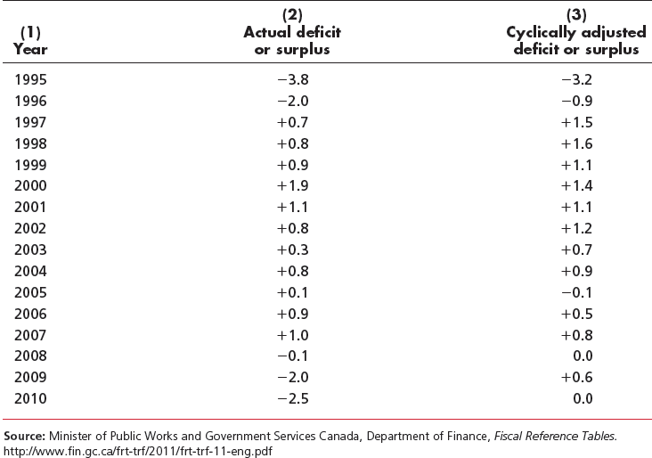
Table 11-1: Federal Deficits (-) and Surpluses (+) as Percentage of GDP, 1995–2010

Slide 20
Global Perspective 11.1
Cyclically Adjusted Budget Deficits and Surpluses
Percentage of Potential GDP, 2011
Deficits
Surpluses
-10
-8
-6
-4
-2
0
2
4
6
8
Denmark
New Zealand
Ireland
Canada
Norway
France
United States
United Kingdom
Japan
Source: Organization for Economic Cooperation and Development

Slide 21
Problems, Criticisms, and Complications
Problems of Timing
  Recognition Lag
  Administration Lag
  Operational Lag
Political Considerations
Future Policy Reversals
Offsetting Provincial and Municipal Finance

Slide 22
Problems, Criticisms, and Complications
Crowding-Out Effect
  Expansionary fiscal policy may lead to
  higher interest rates
  reduction in interest-sensitive spending
May not be significant in a recession
Fiscal policy can be accommodated by increases in money supply

Slide 23
Figure 11-5
Fiscal Policy: The Effects of Crowding Out and the Net Export Effect
With an upward-sloping aggregate supply curve, a part of the impact of an expansionary policy will be reflected in a rise in the price level rather than an increase in real output and
employment.
AS
c
P₁
a
b
Price level
P₀
AD₁
AD’₁
AD₀
0
GDP
GDP₁
GDP_{f}
Real domestic output, GDP
Notes:
This figure shows a decrease in aggregate demand that causes a recession. If the price level is downwardly inflexible at P₁, a decline of aggregate demand from AD₁ to AD₂ will move the economy leftward from a to b along the horizontal broken-line segment and reduce real GDP from Q_{f} to Q₁. Idle production capacity, cyclical unemployment, and a recessionary GDP gap (of Q₁ minus Q_{f}) will result. If the price level were flexible downward, the decline in aggregate demand would move the economy depicted from a to c instead of from a to b.

Slide 24
Current Thinking on Fiscal Policy
Most economists believe fiscal policy is a useful policy lever
  not for “fine-tuning”
  major discretionary fiscal policy should be held in reserve
  should be evaluated for impact on long-run productivity growth

Slide 25
Deficits, Surpluses, and the Federal Debt
Budget Surplus
Annual amount by which government revenues exceed government expenditures
Budget Deficit
Annual amount by which government expenditures exceed taxes
Public Debt
Accumulation of all past deficits and surpluses

Slide 26
The Public Debt: Facts and Figures
Debt and GDP
  relative size of the debt now decreasing
International Comparisons
  our debt is among lowest as % of GDP among world’s industrialized nations
Interest Charges
Ownership

Slide 27
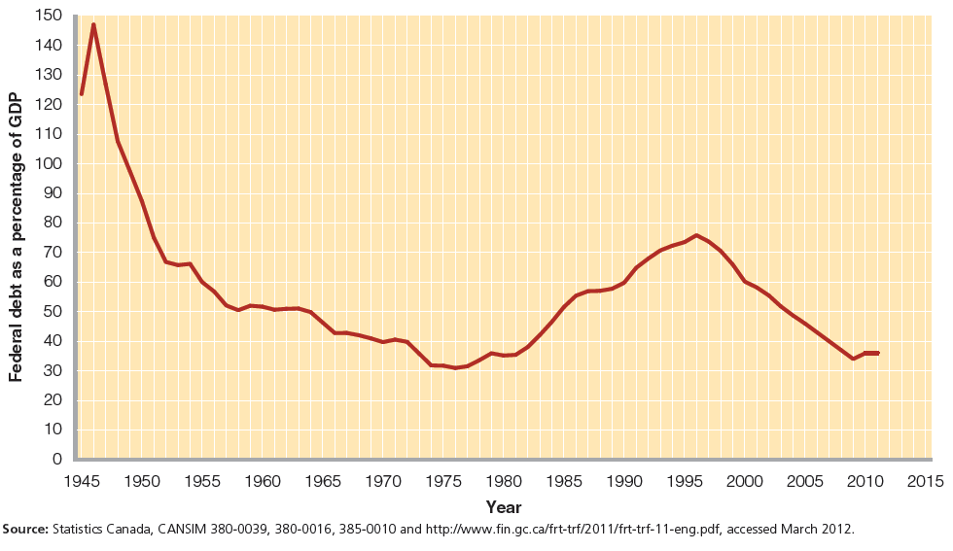
Figure 11-6
The Gross Federal Debt as a Percentage of GDP

Slide 28
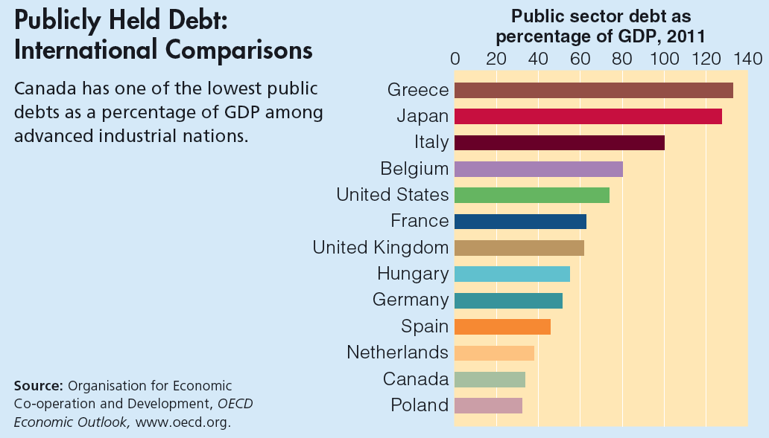
Global Perspective 11.2

Slide 29
Figure 11-7
Ownership of Canada’s Gross Public Debt in 2011

Slide 30
False Concerns
Bankruptcy
  Refinancing
  Taxation
Burdening Future Generations
  Canada owes a substantial portion of the public debt to itself

Slide 31
After today’s Lecture
Read Chapter 11
Understanding Government Budget and Cyclically Adjusted Budget
Lyryx Lab 9

