Slide 1
Lecture Eight
Aggregate demand and supply
AD, AS and equilibrium
Long run equilibrium
Equilibrium vs. full-employment GDP
Applications

Slide 2
The Aggregate Demand – Aggregate Supply Model
The aggregate demand—aggregate supply model
  Shows how economic factors and policies can simultaneously affect the overall price level as well as real output
  Deals with changes in the overall price level of the economy
    Consumer Price Index not inflation
    The general level of prices directly determines the purchasing power of money
    Stagflation was difficult to explain with the Keynesian cross model

Slide 3
Aggregate Demand (AD)
The amounts of real output that buyers collectively desire to purchase at each possible price level

Slide 4
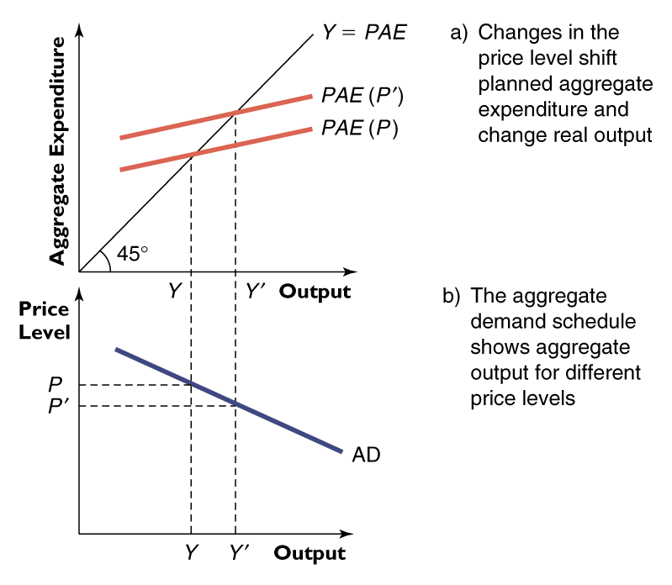
Planned Aggregate Expenditure and Aggregate Demand
If the Price Level rises or falls, will this affect the level of Planned Aggregate Expenditure?
  Price level falls
  P > P’
  Output level increase
  Y’ > Y
  Downward slope to AD (Aggregate Demand)

Slide 5
Aggregate Demand (AD)
Aggregate Quantity Demanded (Real GDP) and the Price Level are inversely related as follows:
Price Level
AD
Real GDP

Slide 6
Aggregate Demand (AD)
Slopes downward because of the following effects of a change in price level:
Real-balances Effect
Interest-rate Effect
Foreign Trade Effect

Slide 7
Changes in Aggregate Demand
AD Can Increase
shift RIGHT
Price level
AD₂
AD₁
Real domestic output, GDP

Slide 8
Changes in Aggregate Demand
Figure 8 - 2
AD Can Decrease
shift LEFT
Price level
AD₁
AD₃
Real domestic output, GDP

Slide 9
Determinants of Aggregate Demand
Consumer Spending
Investment Spending
Government Spending
Net Export Spending

Slide 10
Aggregate Supply
The level of real domestic output that will be produced at each price level
Production responses to price level changes differ in the long run & the short run

Slide 11
Aggregate Supply in the immediate short run
In the immediate short run, the aggregate supply curve is horizontal. The economy is producing at a preset price level.
AS_{ISR}
Price level
Real domestic output, GDP

Slide 12
Aggregate Supply in the Long Run
In the long run, the aggregate supply curve is vertical at the economy’s full-employment output (potential GDP)
AS_{LR}
Price level
Real domestic output, GDP
GDP_{f}

Slide 13
Aggregate Supply in the Short Run
In reality, nominal wages adjust only slowly to changes in the price level
Short-run aggregate supply curve is upward-sloping
AS
Price level
Real domestic output, GDP
GDP_{f}

Slide 14
Aggregate Supply in the Short Run
As the economy expands in the short run, per-unit production costs generally rise
The extent of the rise depends on where the economy is operating, relative to its capacity
  an economy operating below its full-employment output has idle capital & labour→little upward pressure on production costs
  when the economy is operating beyond its full-employment output, most available resources are already employed→per-unit production costs increase as economy expands

Slide 15
Determinants of Aggregate Supply
Change in input prices
  Domestic resource price
  Price of imported resources
  Market power
Change in productivity
Change in legal-institutional environment
  Business taxes and subsidies
  Government regulation

Slide 16
Equilibrium GDP
Equilibrium occurs at the price level that equalizes the amount of real output demanded and supplied
A price level too low would mean AD>AS, putting upward pressure on prices across the economy

Slide 17
Price Level Too Low
Figure 8-6
AS
Price
Level
AD
upward pressure
PL₁
Real
GDP
AS₁
AD₁

Slide 18
Equilibrium GDP
Similarly, a price level too high would mean AD<AS, putting downward pressure on prices across the economy

Slide 19
Price Level Too High
Figure 8-6
AS
Price
Level
AD
PL₂
downward pressure
Real
GDP
AD₂
AS₂

Slide 20
Changes in Equilibrium
Are caused by changes (shifts) in AD and/or AS

Slide 21
Increases in AD
For any initial increase in aggregate demand, the resulting increase in real output will be smaller the greater is the increase in the price level
Demand-pull inflation…

Slide 22
Increases in AD
Figure 8-7
AS
P₂
Output does not increase all the way to GDP1 because of inflation
Price level
P₁
AD₂
AD₁
Real GDP
GDP_{f}
GDP₂
GDP₁

Slide 23
Decreases in AD
Deflation is a rarity in the Canadian economy
Real output takes the full brunt of the decline in AD because product prices are “sticky” in the short run
  wage contracts
  morale, effort, & productivity
  minimum wage
  menu costs
  fear of price wars

Slide 24
Decreases in AD
Figure 8-8
AS
Price level
P₁
prices are sticky downwards
AD₁
AD₂
Real GDP
GDP₁
GDP_{f}

Slide 25
Decreases in AS: Cost-Push Inflation
Effects of a leftward shift in AS are doubly bad
  output decreases
  price level increases

Slide 26
Decreases in AS
Figure 8-9
AS₂
AS₁
P₂
Price level
P₁
AD₁
Real GDP
GDP₂
GDP_{f}

Slide 27
Increases in AS
Full Employment with Price-Level Stability
Increases in AD should normally lead to inflation
Recently, productivity growth has shifted the long-run AS curve to the right

Slide 28
Increases in AS
Figure 8-10
AS₁
AS₂
P₃
P₂
Price level
P₁
AD₂
AD₁
Real GDP
GDP₁
GDP₂
GDP₃

Slide 29
From the Short Run to the Long Run
Nominal wages and other input prices may remain constant in the short run, even though the price level has changed
Once contracts have expired & nominal wage adjustments have been made, the economy enters the long run

Slide 30
Short-Run Aggregate Supply
Figure 8-11
AS₁
a₂
an increase in price level increases profits & output, moving the economy from a₁ to a₂
P₂
Price level
a₁
P₁
GDP_{f}
GDP₂
Real domestic output

Slide 31
Short-Run Aggregate Supply
Figure 8-11
AS₁
a decrease in price level decreases profits & output, moving the economy from a₁ to a₃
Price level
a₁
P₁
a₃
P₃
GDP₃
GDP_{f}
Real domestic output

Slide 32
Long-Run Aggregate Supply
Figure 8-11
AS₂
AS_{LR}
AS₁
b₁
a₂
P₂
an increase in price level leads to increases in nominal wages, shifting short-run AS leftward→ new equilibrium at b₁
Price level
a₁
P₁
GDP_{f}
GDP₂
Real domestic output

Slide 33
Long-Run Aggregate Supply
Figure 8-11
AS_{LR}
AS₁
a decrease in price level leads to decreases in nominal wages, shifting short-run AS rightward→ new equilibrium at c₁
AS₃
Price level
a₁
P₁
a₃
P₃
c₁
GDP₃
GDP_{f}
GDP₂
Real domestic output

Slide 34
Equilibrium in the Long-Run AD-AS Model
AS_{LR}
AS₁
Price level
P₁
a
AD₁
GDP_{f}

Slide 35
Equilibrium Versus Full-Employment GDP
There is no guarantee, in the short run, that equilibrium GDP will be full-employment GDP

Slide 36
Recessionary Gap
A recessionary gap occurs when AD is too low, and equilibrium GDP is below potential GDP

Slide 37
Recessionary Gap
Figure 8-13
AS_{LR}
Potential GDP
Price level
AS
Recessionary
Gap = 20
P₀
P₁
AD₀
AD₁
490
510
Real GDP

Slide 38
Inflationary Gap
An inflationary gap occurs when AD is too high, and equilibrium GDP is above potential GDP

Slide 39
Inflationary Gap
Figure 8-13
AS_{LR}
Potential GDP
AS
Inflationary
Gap = 20
P₁
Price level
AD₂
P₀
AD₀
510
530
Real GDP

Slide 40
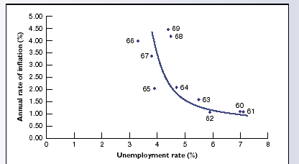
The Relationship between Unemployment and Inflation
Until the late 1960s, it looked as if inflation went up only when unemployment went down
  Economists thought there was a stable, inverse relationship
  The “Phillips Curve”

Slide 41
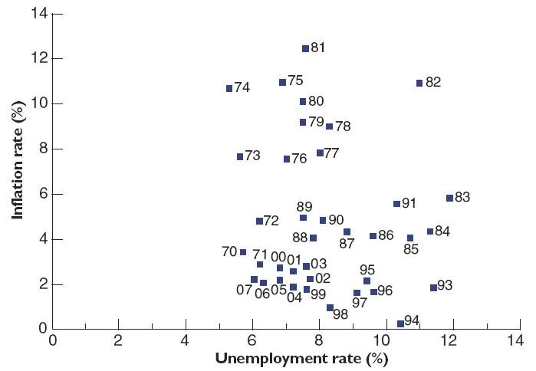
High Inflation changes expectations of inflation
In the 1970s, the stable “Phillips Curve” seemed to break down
Explanation:
  The “Short Run Phillips Curve” (SRPC) depends on a particular expectation of inflation
  SRPC shifts when expectations change

Slide 42
The Expectations Augmented Phillips Curve
Long-run Phillips curve:
  a relationship between the inflation rate and the unemployment rate in the long run
  the vertical long-run Phillips curve is drawn at the natural rate of unemployment
Short-run Phillips curve (SRPC)
  a relationship between actual unemployment and the inflation rate for given inflationary expectations
Expectations of inflation
  adaptive expectations of inflation a method of forming expectations about the inflation rate that involves looking to past experience

Slide 43
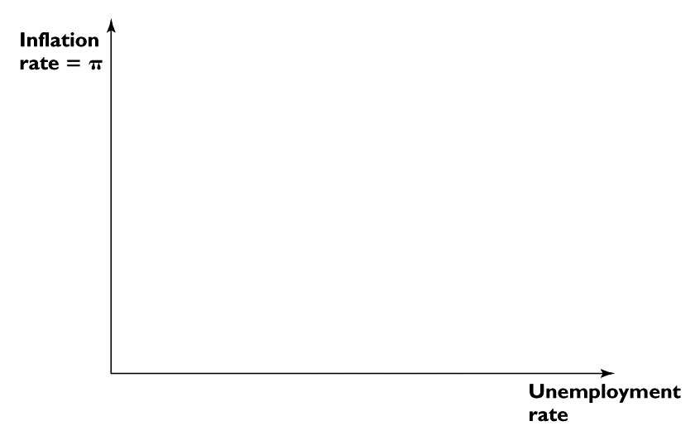
Lowering the Inflation Rate in the Phillips Curve Model
Long-Run Phillips Curve
Long-Run Phillips Curve
π = 4%
A
π = 4%
A
π′ = 3%
B
π′ = 3%
C
B
C
SRPC
SRPC
SRPC′
SRPC′
U* = 5%
U = 7%
U* = 5%
U = 7%
To decrease inflation, starting from A,
Increase in unemployment reduces inflation - along SRPC: A → B
Lower inflation reduces expectations of inflation: SRPC → SRPC’
Unemployment can now decline at new lower inflation rate: B → C

Slide 44
After today’s Lecture
Read Chapter 10 and 15.1, 15.2
Understand the graphs in the lecture
Homework 8

