Slide 1
Language Variation
Alds 1001
Lecture 2

Slide 2
Reminders
Weekly blog is activated
  See the description on CuLearn
  Half of you will post reflections until Wed midnight
  The other half post replies until Friday midnight
First guest lecturer will speak here on Jan 20, next Monday
Quiz 1 will be on January 22
Read chapter 3 for next session

Slide 3
Prescriptivism vs. Descriptivism
Prescriptivism
  Language pundits, English teachers, Grammarians, etc.
Descriptivism
  Linguists;
  Lexicographers?
    http://www.youtube.com/watch?v=a8I028xkBUI&feature=related

Slide 4
Standard Language
What is a standard language?
How does a language variety become standard?
What is standard language ideology?
What are some implications for and consequences of the hegemony of standard language?

Slide 5
Kinds of variation
Accent
Dialectical variation
  Idiolect
    http://www.youtube.com/watch?v=4TOd8hqQ3SE&feature=related
  Sociolect
  What is a dialect? (see your textbook, p. 32)
    Linguistic elements distinguishing dialects of a “language”
    Extra-linguistic aspects (Max Weinreich)
  Variety

Slide 6
Register
Definition: what is register? (see p. 35)
Diglossia
Question:
  At how many levels formal and informal registers are usually different? Provide an example for each level (sound, voc., gr., discourse).
    For the answer see Table 2.3 on page. 35 –Next Slide

Slide 7
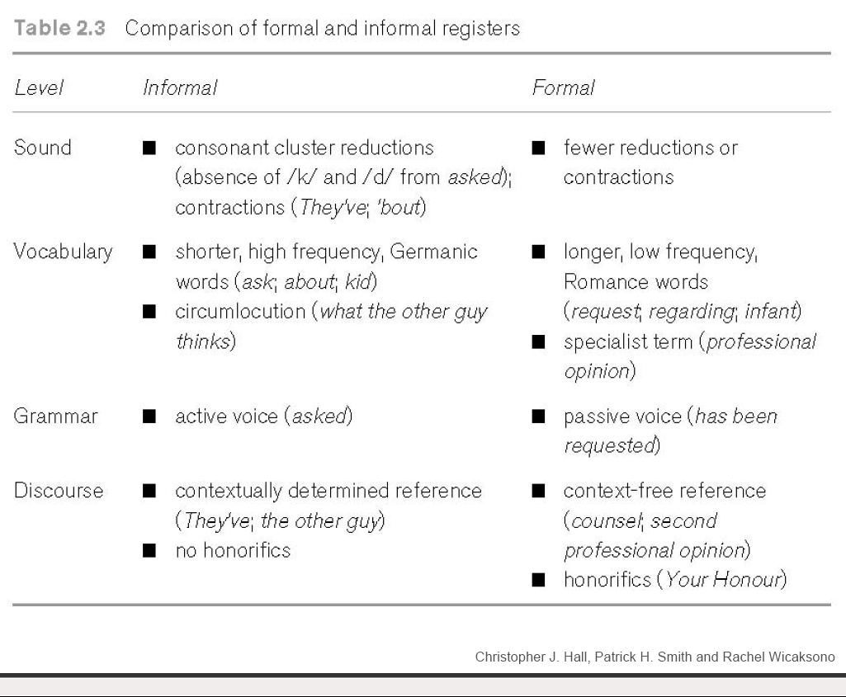

Slide 8
Pidgins and Creoles

Slide 9
World English(es)
“The Empire Strikes back”
http://digital.films.com.proxy.library.carleton.ca/PortalViewVideo.aspx?xtid=36931&psid=0&sid=0&State=&title=The Empire Strikes Back&IsSearch=Y&parentSeriesID=#
  Segment 13

Slide 10
What’s a pidgin?
Definition of a pidgin
Some features of a pidgin
What is a Creole?
Features of a Creole?
  Superstrate
  Substrate

Slide 11
Where are the pidgins and creoles of the world?
127 pidgins and creoles including
  Hawaiian creole, Gullah, Jamaican Creole, Krio, Tok Pisin, Papiamentu, Saramaccan, Russenorsk, Chinook Jargon, Bazaar Malay, Nigerian Pidgin English ….
  Film: The Empire Strikes Back
    http://digital.films.com.proxy.library.carleton.ca/PortalViewVideo.aspx?xtid=36931&psid=0&sid=0&State=&title=The Empire Strikes Back&IsSearch=Y&parentSeriesID=#
    Pidgins and Creols: segments 1, 2, 3, and 5, …

Slide 12
More terms
Language insecurity
  Does it exist in Canada? E.g., “accent reduction” businesses?
Language loss
  will talk more about this later
Accommodation
  The ability to modify one’s way of using language with interlocutors
    Convergence
    Divergence

Slide 13
Next session
Read Chapter 3 for next session
Reminder: Next week, the second session, you’ll write Quiz 1

