Slide 1
Applied Linguistics and Discourse Studies
AND
Ch. 1 of the Textbook
Jaffer sheyholislami

Slide 2
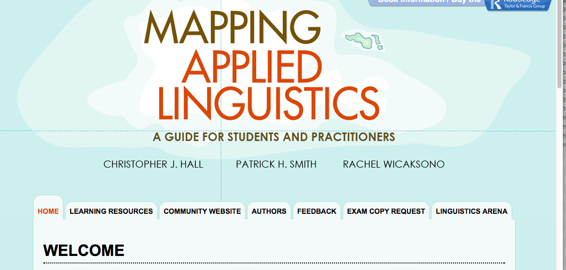
Housekeeping
Please note that there is a very useful website companion for your textbook: http://cw.routledge.com/textbooks/hall/

Slide 3
Also
Keep checking CuLearn for updates
Group project:
  A handout will be posted very soon
  You may submit the names of your group members a few days before we make up the groups (check the syllabus)
Online discussion/postings
  Look for updates under next week’s row (next to next week’s slides)
  It will start next week
  Last names A-I: post a reflection by Wed midnight; K-Z: post a reply to those reflections by Friday midnight; 250-300 words long.
  Wednesdays: the best reflection and best reply will be shown in class.
  Each TA will monitor the discussion board every other week
  Grading: 0=no submission; .5.=incomplete; 1=complete

Slide 4
Agenda for the day
How is Applied Linguistics different from Linguistics?
What is Applied Linguistics?
What is Discourse Studies?
Subfields of AL and DS
Ch 1 summary
Taking up possible questions

Slide 5
Comparing Applied Linguistics (AL) and Theoretical or Formal Linguistics

Slide 6
Basic assumptions of theoretical linguistics
  Innateness of language acquisition
  Universal features of all languages
  Ideal native speaker is the authority
  focus on competence vs. performance

Slide 7
Basic assumptions for applied linguistics
  Language is always changing
  Language is not a neutral form of communication
  Language is acquired in social contexts
  Performance is the most important evidence (vs. competence)
  Linguistic evidence is external.
  Meaning is emergent in language forms, rather than immanent.
  Real difference between TL and AL: performance vs. competence
Notes:
Language is a social thing. It is changing because we are always changing and evolving. The more I use language the way I do, the more enforce. Language cannot be learned or acquired outside social context. Performance is the most important key in applied linguistics. Theoretical linguistic deals with more internally (within the mind). Applied deals with the outside (what we speak or say). Performance constitutes the most important

Slide 8
Definitions of Applied Linguistics
“… providing the knowledge necessary for those who are responsible for taking language-related decisions …” (Wilkins, 1999, 7)
“… investigation of real-world problems in which language is a central issue” (Brumfit, 1997, p. 93)
“… solve some problem in the real world (Schmitt & Celce-Murcia, 2002, p. 1)
    “… trying to resolve language-based problems …” (Grabe, 2002, p. 9)
Notes:
Applied Linguistic: Providing knowledge to those who are responsinble with language making decisions.

Slide 9
Question you should be able to answer
What is Applied Linguistics?
What are the main differences between TL and AL?
What is the difference between competence and performance? How do these two concepts relate to applied and theoretical linguistics (i.e. their differences)? Or, which one is important for which?
Notes:
These questions will be on the tests.

Slide 10
What is Discourse Studies?
Discourse Definition
Common assumptions of discourse analysis/studies
  Discourse organizes and structures our lives
  The objective of DS is to “unravel and critique these acts of construction”
  DS takes a constructivist view of language
Notes:
Discourse: Originally meant “exchange”. In modern times, it means the entire communication. For this course, it means: any form of meaning making that we use in order to make sense for ourselves, our use, our identity, etc.
Common Assumptions about Discourse analysis: Critiquing and deconstructing. Another keyword: social-constructivism. Something that has not always been there but they were made by us.
Discourse Analysis: A multi layer attempt to and ravel and critique

Slide 11
Questions
What is discourse?
What are three assumptions of discourse analysis?

Slide 12
Summarizing the reading for today:
Textbook Ch. 1
Language is both biological and social
  For a detailed explanation see pp. 2-3
  For a summary, see the third paragraph on p. 2: “The answer is that, unlike the heart, …”

Slide 13
Ten ways we’re led astray in language and applied linguistics: You need to be able to summarize the main argument under each of the following headings: pp. 4-14
People think in language
Children are taught their first language
Written language is superior to spoken language
Some groups of people don’t use their language properly
Some people speak their language without an accent
The way groups use their language reflects their intelligence
People with two languages are confused
Languages get contaminated by influence from other languages
A nation has, or should have, one language
Languages exist independently of users and uses
Notes:
1 - May or may no be true.
2 - False. Children say sentences that don’t make sense. They speak from the words that they hear from here and there. If they were taught, they wouldn’t make grammatical mistakes.
3 -
10 -

Slide 14
Definitions to remember/understand
Descriptive linguistics, p. 15
Sociolinguistics, p. 15
Corpus linguistics, p. 15 (what is a corpus?)
Ideologies, p. 18
Epistemology, p. 18
Critical applied linguistics, p. 18
Just FYI: Linguistics applied vs. autonomous applied linguistics (se figure 1.5 at the bottom of p. 16)

Slide 15
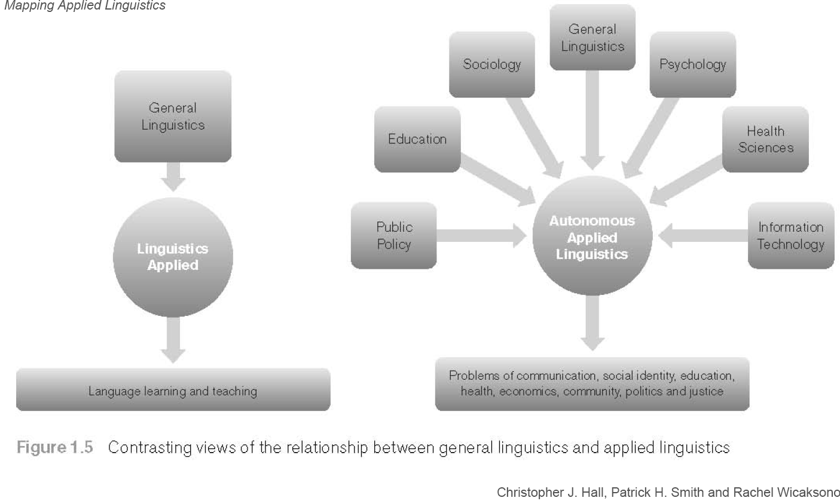
Linguistics Applied vs.
Autonomous Applied Linguistics

Slide 16
Activities
There are activities/questions at the end of each chapter
Look at them
Start thinking about how you would go about doing that one of the activities that involves empirical research. Hypothesize what results you may obtain from doing that activity
This will be a good practice and preparation for completing the group project
I can imagine those who have an early start on this end up leading their groups

Slide 17
Next Session
Read chapter 2 for next session
Read chapter 3 for the following session
Start familiarizing yourself with CuLearn:
  Post a message on the discussion board (introduce yourself)
See you!

