Slide 1
Welcome
To
ALDS 1001
Introduction to Applied Linguistics and discourse studies

Slide 2
Goal for today’s class
Introducing myself, your instructor
TAs
other people who you’ll see in this class (other than students)
Syllabus: highlighting some crucial points
Some introductory remarks about why language matters and how we study it (as applied linguists)

Slide 3
Instructor
  Jaffer Sheyholislami
  Office: PA 260
  Email me
    on CuLearn
    If you have to, can email jaffer_sheyholislami@carleton.ca
    from your Carleton account, or I may not reply (The same goes for the TAs; email them on CuLearn)
  Office hours: check the syllabus on CuLearn

Slide 4
TA
Lin Chen:
linchen2@cmail.carleton.ca
Christen Rachul: ChristenRachul@cmail.carleton.ca

Slide 5
Other people you may see in this class
  A PhD student
  Peggy Hartwick

Slide 6
PASS
Peer Assisted Study Sessions (PASS) program
Facilitator: Amma Poku-Dappah
(WahlPokuDapaah@cmail.carleton.ca )

Slide 7
Syllabus highlights
  The textbook
  CuLearn
  Evaluation:
    Quizzes
    Online postings
    Group project
  Guest lecturers: SLaLS’ short list for Assistant Professor position (and more)
  Academic accommodations
  Schedule (tentative)

Slide 8
Please note
Depending on the topic and reading of the week, lectures can be
  Very different from the reading, or
  A more straightforward reinforcement of the reading, or
  A combination of the two

Slide 9
How to do well in this course?
Do assigned readings before class
Be on time for class
Participate in class and online discussions
Take notes of lectures and presentations by me, guest lectures, TAs, etc. (and other materials presented in class, e.g., videos)
Work collaboratively with your classmates and group members
Complete assigned tasks and activities on time
Prepare for quizzes and tests ahead of time; do NOT wait until the night before.
Form study groups
Seek help when you need it (from me, the TAs, the PASS facilitator, SASC, etc.)
Take responsibility for your learning, e.g., discuss any issues relevant to the course with me ASAP
Pursue learning strategies that best suit your learning style and preferences, and which are compatible with the course expectations, at the same time
Do not hesitate to ask me or the TAs questions, any question; stay in touch!

Slide 10
What is language?
“Language is the medium through which a human being becomes a personality, in consequence of his membership of society and his occupancy of social roles.”
  (Halliday, 1978, p. 15).
Halliday, M. A. K. (1978). Language as social semiotic: the social interpretations of language and meaning.

Slide 11
What is language:
A comprehensive definition
The system of sounds, words, signs, grammar, and rules for (1) communication in a given speech community for spoken, written, or signed interaction; (2) storing, acting out, and developing cultural knowledge and values; and (3) displaying, analyzing, structuring, and creating the world and personal and social identity. Theoretically, language also can be seen as existing only in practice, when being used, created, and enacted.”
(Skutnabb-Kangas & McCarty, p. 5: Enc. Lang. and Edu.)

Slide 12
What is Applied Linguistics?
“…the theoretical and empirical investigation of real-world problems in which language is a central issue”
(Groom & Littlemore, 2011: 5)

Slide 13
What do you mean by “real-world problems in which language is a central issue”?
Language Teaching and Learning: How are languages taught and learned?
  For instance: What makes French immersion effective? Or, does it?
  What makes some language learners more successful than others?
  Is there a “best” method to teach an additional language?

Slide 14
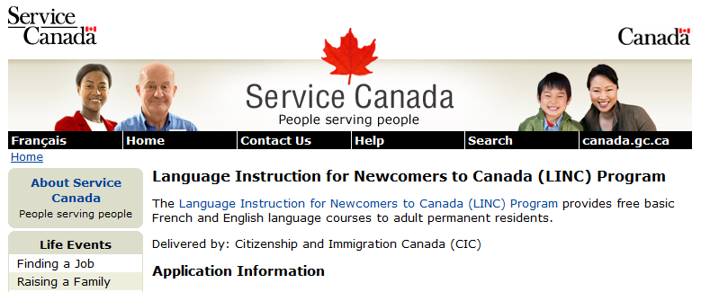
Certificate in the Teaching of English as a Second Language (CTESL)
You can obtain this certificate concurrently with your BA Honours in ALDS (or any other discipline)

Slide 15
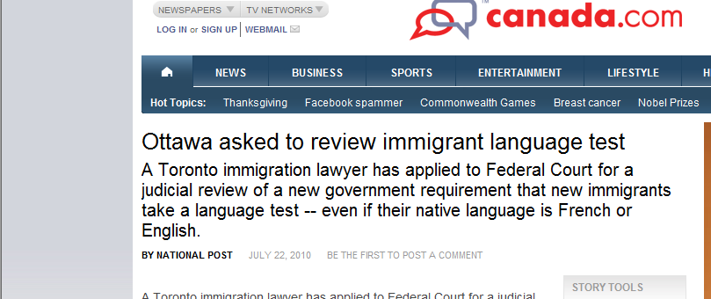
What do you mean by
“real-world problems in which language is a central issue”?
Language Assessment: How are language skills evaluated and language tests designed?

Slide 16
What do you mean by “everyday problems involving language”?
Writing: How do students learn to write and write to learn? How can written communication be made more efficient in the workplace?

Slide 17

What do you mean by “real-world problems in which language is a central issue”?
Language Policy and Planning: How can language policies protect endangered languages, and at the same time make sure everyone has access to the majority languages of a society?

Slide 18
How many Aboriginal languages are there in Canada?
About sixty
How many languages are there in the world?
6000 to 7000
How many of these are in danger of extinction?
1450-1950 half (6000) disappeared; Another half (3000) will disappear by the end of this century
Does it matter that languages disappear?
Identity, culture, world knowledge, human rights (language rights)
Why languages disappear?
Many reasons, mostly having to do with the lack of appreciation for what language really is; for not having effective language policy and planning

Slide 19
Discourse studies: How do we use language and why? What does discourse analysis show about cultural and social processes that lead language-related problems and solutions for our clients?
Forensic Linguistics: How is language used in the legal process (by the police, lawyers, judges, etc.)? How is language examined as evidence in the court of law?
Cross-cultural communication: To what extent speakers of different languages differ in their communication patterns and behaviours?

Slide 20
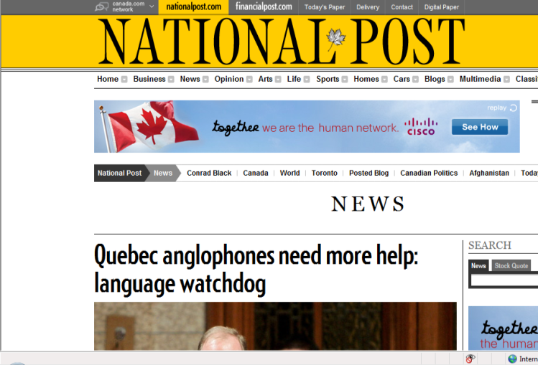
Language policy: Bilingualism, monolingualism, multilingualism?

Slide 21
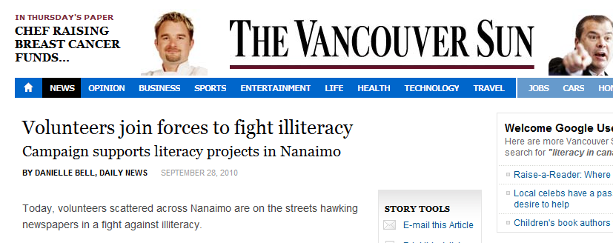
What do you mean by “real-world problems in which language is a central issue”?
Literacies: How can access to literacies be broadened?

Slide 22
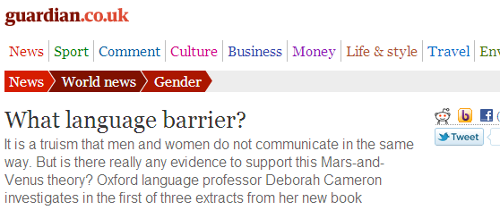
What do you mean by “real-world problems in which language is a central issue”?
Language in Society: How does language influence society, and how is it influenced by society?

Slide 23
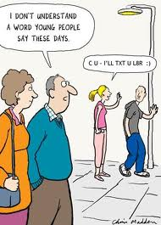
What do you mean by “real-world problems in which language is a central issue”?
Do you text more than you talk on the phone?
Do you text the way you talk, or the way you write?
Is texting a unique language?
Does it or will it affect our language? How and in what way?
What are the implications?

Slide 24

All Ads do three things
What do you mean by “real-world problems in which language is a central issue”?
Building images
Building relations
Building the consumer

Slide 25
Next session reading
Chapter 1 of the textbook
My lecture will be about:
  Applied Linguistics and Discourse Studies: Theoretical foundations

Slide 26
A friendly reminder
It is YOUR RESPONSIBILITY to read the outline carefully, and let me know if you have any questions.
It’s on CuLearn
I will be more than happy to answer your questions
The TAs are also here to help you
And, the PASS facilitator

Slide 27
Again, welcome to ALDS 1001
I’m looking forward to a very productive semester.
Questions?

