Slide 1
Chapter One
Introduction to Managerial Accounting
COPYRIGHT © 2012 Nelson Education Ltd.

Slide 2
Learning Objectives
Explain the meaning of managerial accounting
Explain the difference between managerial and financial accounting
Identify and explain the current focus of managerial accounting
Describe the role of managerial accountants in an organization
Explain the importance of ethical behaviour for managers and managerial accountants
Identify three accounting designations available in Canada.
COPYRIGHT © 2012 Nelson Education Ltd.

Slide 3
OBJECTIVE ➢
1
Explain the meaning of managerial accounting
1-3
COPYRIGHT © 2012 Nelson Education Ltd.

Slide 4
Managerial Accounting
Internal accounting system
Designed to support the information needs of managers
Not bound by any formal criteria such as GAAP (Generally Accepted Accounting Principles) or International Financial Reporting Standards (IFRS)
COPYRIGHT © 2012 Nelson Education Ltd.

Slide 5
Managerial Accounting
Three broad objectives:
To provide information for planning the organization’s actions
To provide information for controlling the organization’s actions
To provide information for making effective decisions
COPYRIGHT © 2012 Nelson Education Ltd.

Slide 6
OBJECTIVE ➢
2
Explain the differences between managerial and financial accounting
COPYRIGHT © 2012 Nelson Education Ltd.

Slide 7
Differences
Targeted Users
Financial Accounting
Management Accounting
Focuses on the external user
Focuses on the internal user
COPYRIGHT © 2012 Nelson Education Ltd.

Slide 8
Differences
Restrictions
Financial Accounting
Management Accounting
Must follow externally imposed rules
No guidelines that it must follow
COPYRIGHT © 2012 Nelson Education Ltd.

Slide 9
Differences
Type of Information
Financial Accounting
Management Accounting
Produces objective and verifiable financial information
May be financial or nonfinancial; much more subjective
COPYRIGHT © 2012 Nelson Education Ltd.

Slide 10
Differences
Time Orientation
Financial Accounting
Management Accounting
Reports on events that have already happened
Includes historical events, but focuses on future events
COPYRIGHT © 2012 Nelson Education Ltd.

Slide 11
Differences
Degree of Aggregation
Financial Accounting
Management Accounting
Focuses on overall firm performance
(a more aggregated viewpoint)
Focuses on performance of entities, product lines, departments, and managers
COPYRIGHT © 2012 Nelson Education Ltd.

Slide 12
Differences
Breadth
Financial Accounting
Management Accounting
Self-contained
Multiple disciplines: managerial economics, industrial engineering, management science, and many more
COPYRIGHT © 2012 Nelson Education Ltd.

Slide 13
Accounting System
Needs to be flexible enough to provide both financial and managerial accounting information
COPYRIGHT © 2012 Nelson Education Ltd.

Slide 14
OBJECTIVE ➢
3
Identify and explain the current focus of managerial accounting
COPYRIGHT © 2012 Nelson Education Ltd.

Slide 15
Current Focus
Developments in technology, transportation and communication have created the need for better information
In response to the need for better information, activity-based management accounting systems were developed
COPYRIGHT © 2012 Nelson Education Ltd.

Slide 16
Activity-Based Costing
Activity-Based Costing (ABC):
More detailed approach to determining cost of goods and services
Emphasizes cost of many activities or tasks that must be done to produce a product
COPYRIGHT © 2012 Nelson Education Ltd.
Notes:
Objective: Find ways to perform necessary activities more efficiently and eliminate those that do not create customer value

Slide 17
Customer Orientation
Advantage comes when company can create better customer value
What Customer Receives
What Customer Gives Up
Customer Value
=
-
COPYRIGHT © 2012 Nelson Education Ltd.

Slide 18
Increasing Customer Value
Two strategies:
Cost
leadership
Superior
products through
differentiation
COPYRIGHT © 2012 Nelson Education Ltd.
Notes:
Both strategies require an understanding of the firm’s Value Chain

Slide 19
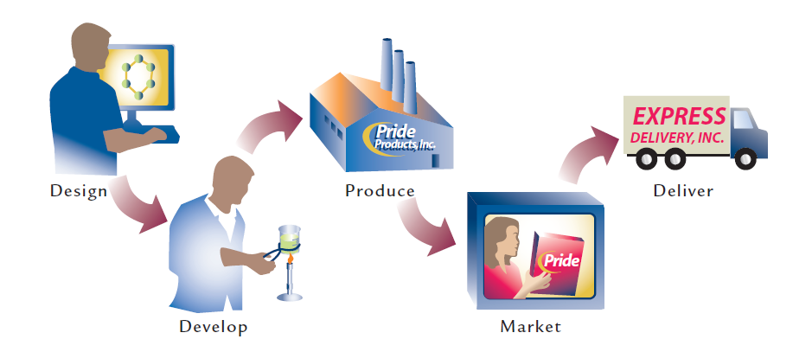

Value Chain
COPYRIGHT © 2012 Nelson Education Ltd.

Slide 20
Cross-Functional Perspective
Management accountant must understand many functions of the business to manage the value chain
A decision affecting one function affects the others
Allows management to see big picture and…
  Increase quality, reduce time, and improve efficiency
COPYRIGHT © 2012 Nelson Education Ltd.

Slide 21
Total Quality Management
“Acceptable quality” attitude is unacceptable
Philosophy of perfect products (zero defects)
Management accounting must provide both financial and nonfinancial information about quality
Continuous improvement is fundamental
COPYRIGHT © 2012 Nelson Education Ltd.

Slide 22
Time as a Competitive Element
Time is crucial in all phases of value chain
Companies try to eliminate non-value-added time
Managers must respond quickly and decisively to changing market conditions
COPYRIGHT © 2012 Nelson Education Ltd.

Slide 23
Efficiency
Both financial and nonfinancial measures are needed
Cost is a critical measure of efficiency
To be effective, cost must be:
  Defined
  Measured
  Assigned
COPYRIGHT © 2012 Nelson Education Ltd.

Slide 24
OBJECTIVE ➢
4
Describe the role of managerial accountants in an organization
COPYRIGHT © 2012 Nelson Education Ltd.

Slide 25
Structure of the Company
Staff position
Controller or chief accounting officer
  Responsible for internal auditing, cost accounting, financial accounting, and systems accounting
Treasurer
  Raises capital and managers cash and investments
  Responsible for credit & collection and insurance
COPYRIGHT © 2012 Nelson Education Ltd.

Slide 26
Sarbanes-Oxley Act of 2002
Passed by the U.S. Congress in response to corporate securities fraud and corporate misconduct
Established stronger government control and regulation of public companies through:
  Enhanced auditor independence
  Tightened regulation of corporate governance
  Control over management
  Manager/auditor assessment of the firm’s internal control
  Increased attention to corporate ethics
COPYRIGHT © 2012 Nelson Education Ltd.

Slide 27
OBJECTIVE ➢
5
Explain the importance of ethical behaviour for managers and managerial accountants
COPYRIGHT © 2012 Nelson Education Ltd.

Slide 28
Ethical Conduct
1. Honesty
2. Integrity
3. Promise keeping
4. Fidelity
5. Fairness
6. Caring for others
7. Respect for others
8. Responsible citizenship
9. Pursuit of excellence
10. Accountability
Choosing actions that are right, proper and just
10 Core Values*
*
COPYRIGHT © 2012 Nelson Education Ltd.

Slide 29
OBJECTIVE ➢
6
Identify three accounting designations available in Canada
COPYRIGHT © 2012 Nelson Education Ltd.

Slide 30
Society of Management Accountants of Canada (CMA Canada)
Certification available to management accountants
Established management accounting as a recognized professional discipline
Candidates must:
Pass an examination reflecting the needs of management accounting and underscoring its multidisciplinary nature
Meet an experience requirement
Participate in continuing education
Have a commitment to ethical principles
For further information visit www.cma-canada.org
COPYRIGHT © 2012 Nelson Education Ltd.

Slide 31
Canadian Institute of Chartered Accountants (CICA)
CICA confers Chartered Accountant (CA) designation which focuses on external financial reports and the auditing functions
CA is one of Canada’s most valued designations and is recognized internationally
Prepares leaders in senior financial, tax, advisory, and assurance roles
Candidates must:
Meet education and experience requirements
Participate in continuing education
For further information visit www.cica.ca
COPYRIGHT © 2012 Nelson Education Ltd.

Slide 32
Certified General Accountants of Canada (CGAAC)
CGA program provides broad-based education in accounting and financial management by regulating qualification, performance, and discipline standards
Candidates must:
Pass an examination
Be licensed in the province in which they practice
For further information visit www.cga-canada.org
COPYRIGHT © 2012 Nelson Education Ltd.
Notes:
In Ontario, the provincial professional accounting associations is the ICAO (Institute of Chartered Accountants of Ontario)

Slide 33
Management Accounting for Service and Not-for-Profit
Service industry and not-for-profit leaders and managers still have to develop basic skills in management accounting
Managers should learn how to generate financial reports, analyze data, and really understand the organization’s financial condition
In all organizations, managers and administrators are better equipped to deal
with work issues when they understand management accounting concepts
COPYRIGHT © 2012 Nelson Education Ltd.

