Slide 1
Introduction to Legal Studies: Canadian Law Enforcement
This weeks topic; Canadian law enforcement
My Method of lecture
  The use of the G20 case study to illustrate different processes occurring in Canadian law enforcement including those mentioned in this week’s readings;
    “Plural Policing: a comparative perspective - Canada” by Rigakos and Leung
    “police investigating police” by The Commission for Public Complaints against the RCMP
    The case Doe v. Metropolitan Toronto Commissioners of Police

Slide 2
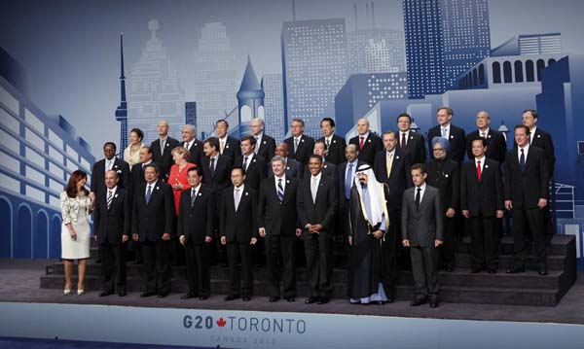
The June 2010 G8 and G20
    From June 25-27, 2010, the Canadian government hosted the G8 and G20 Summits.
    The political event involved the largest “peacetime” security operation in Canadian history
    resulted in over 1105 arrests, the largest mass arrest in Canadian history.
        http://www.youtube.com/watch?v=nOjGdvju-po&feature=related
Notes:
http://www.youtube.com/watch?v=D3gHsCk5uE0&feature=related
http://www.youtube.com/watch?v=2kcrEL-HHtA&feature=related

Slide 3

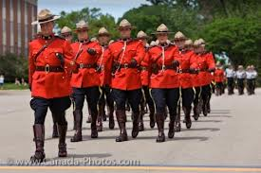
  Plural Policing: a Comparative Perspective - Canada by George Rigakos and Cherie Leung
The Mountie is a National Symbol in Canada
History
  Northwest Mounted Police; 1873
  Royal Northwest Mounted Police; 1904
  Royal Canadian Mounted Police; 1920

Slide 4
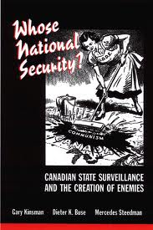
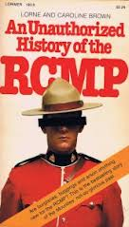
Critical History of the RCMP
  RCMP was established as paramilitary force that was central to British colonial expansion .
  RCMP has also been the instrument of some of the federal government's most authoritarian practices, (i.e. the aggressive social control and surveillance of aboriginals, labor unionists, homosexuals and socialist political movements)
  Kinsman (et al., 2000): since its birth the RCMP has targeted, monitored, and suppressed the activities of dissident domestic groups
    the extensive historical and contemporary surveillance of perceived Canadian dissidents not only violated people’s democratic rights but also had a dramatic impact on the socio-political fabric of Canada.
  In An Unauthorized History of the RCMP , Lorne and Caroline Brown reveal a long list of anti-democratic offences committed by RCMP since its creation

Slide 5


Plural Policing: a Comparative Perspective - Canada by George Rigakos and Cherie Leung
RCMP responsible for policing the largest part of the Canadian landscape
  More than half of RCMP officers provide policing services to provinces, territories or municipalities
    Québec and Ontario maintain their own provincial police forces. (i.e. Sûreté du Québec and The Ontario Provincial Police (OPP)
RCMP responsibilities: coordinating with Interpol, maintaining a centralized national police criminal database, national security and terrorism, coordinating efforts in drug trafficking, organized crime, and security for major international events, like the G20 Summit
  Foreign Missions and International Organizations Act (FMIOA) states that “The Royal Canadian Mounted Police has the primary responsibility to ensure the security for the proper functioning of any intergovernmental conference…”

Slide 6



Plural Policing: a Comparative Perspective - Canada by George Rigakos and Cherie Leung
Levels of public policing in Canada
  municipal, provincial, federal, and First Nations
  The five largest Canadian police forces:
    the RCMP, Metropolitan Toronto Police, OPP, Sûreté du Québec, and the Montréal Urban Community Police
      accounts for over 60% of all Canadian police officers.
  First Nations policing is governed by an assortment of direct policing agreements between aboriginal communities across Canada and the RCMP, the OPP, or the Sûreté du Québec

Slide 7

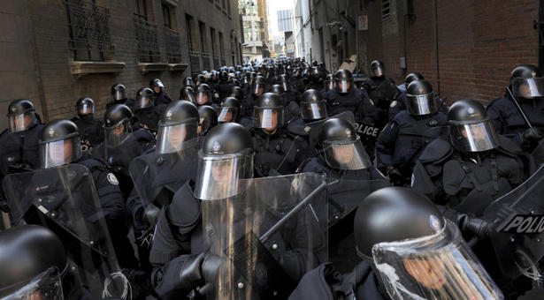
the G20 Integrated Security Unit
The RCMP established the G8/G20 Integrated Security Unit (ISU) as the “central coordinating body for the G8/G20 Summits security planning, operations and demobilization activities” under the direction of Chief Superintendent Alphonse MacNeil.
20,974 security personnel from 26 public police departments.
  Key agencies among these included Toronto Police Service (TPS), Ontario Provincial Police (OPP), Peel Regional Police. The ISU also incorporated the Canadian Forces, private security, and also the Canadian Security Intelligence Service (CSIS).
ISU publicly described itself as “a joint forces team comprised of security experts collaborating together to ensure the safety of the Heads of State, the community and minimize to the fullest extent possible, the potential impact of police security operations.”

Slide 8
Plural Policing: a Comparative Perspective - Canada by George Rigakos and Cherie Leung
structure of Canadian public policing as a decentralized-coordinated-multiple system (Bayley 1985: 57)
When a contracted provincial force or the RCMP is removed, another fills its place with limited jurisdictional overlap.
Structure of G20 ISU was a complex and extensive security network
  ’Whole of Government’ Approach

Slide 9
Plural Policing: a Comparative Perspective - Canada by George Rigakos and Cherie Leung
State expenditures on public policing personnel
  Public police agencies are becoming more expensive!
  Overall, in 2001, total policing expenditures in Canada totaled 7.3 billion which represents an increase of 6.9% from 2000
  In constant dollars, expenditures are up 4.2%, the fifth year in a row that costs have increased (Canadian center for Justice statistics 2002:57)
  Between the 1988-89 fiscal year and the 1994-5 fiscal year, the cost for public police services per Canadian rose from$163 to $198
  G20: security costs was approx. 510 million dollars

Slide 10
Plural Policing: a Comparative Perspective - Canada by George Rigakos and Cherie Leung
Why so expensive?
  Regionalization development
    move towards larger regional or provincially contracted detachments
    "equitable police financing“
    "effective and efficient" policing
    from 1962 to 1996, 153 police services were amalgamated into 11 regional police services providing policing to over 60% of Ontario's population.
    OPP a main benefactor
      As of 2003, the OPP was servicing 54 specialized contracts and providing quotes for an additional 24 municipalities.

Slide 11
Plural Policing: a Comparative Perspective - Canada by George Rigakos and Cherie Leung
Why so expensive?
  The war on terror effect
    An immediate $280 million anti-terrorism plan was announced in October 2001. Two months later, a new federal budget allocated $7.7 billion over five years for initiatives aimed at terrorism, including $1.6 billion for strengthened intelligence and policing.
    Promised to enhance information-sharing capabilities among policing services, intelligence, and military agencies, as well as increase the number of police and intelligence officers and better equip them for response and prevention to terrorist activity (Canadian center for Justice statistics 2002:21).

Slide 12
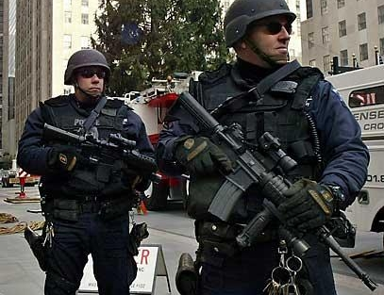
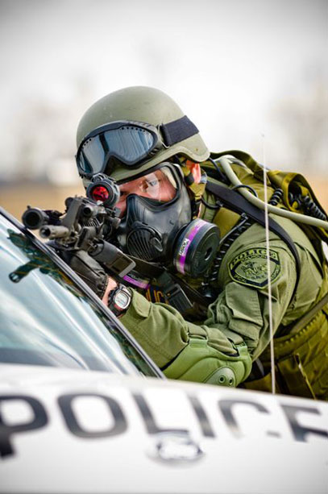
Post-9/11 Amplification of Police Militarization
Impact of 9/11 shifted attention and resources toward anticipating and managing risk in the context of globalization of crime and the threat of international terrorism.
It has rationalized and stimulated more aggressive, paramilitary proactive tactics of policing citizens

Slide 13
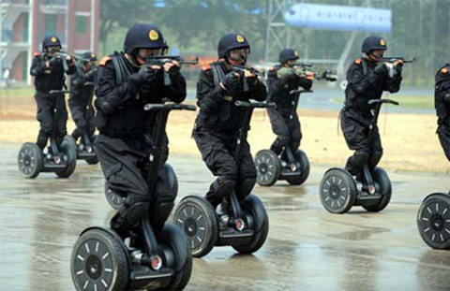
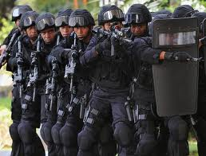
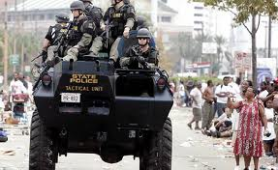
Pre-9/11 police militarization
Kraska demonstrated the rise and normalization of police militarization in U.S.
  a dramatic increase in the volume and activity of paramilitary police units (PPUs) aka SWAT teams
  police militarization: a process through which police adopt a “set of beliefs and values that stress the use of force and domination as appropriate means to solve problems and gain political power” (Kraska 1997)

Slide 14

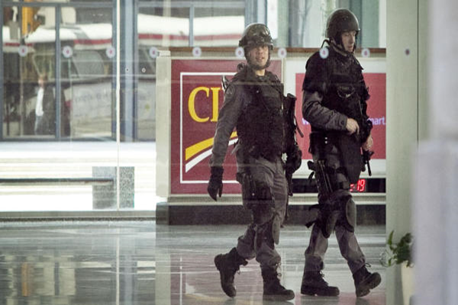
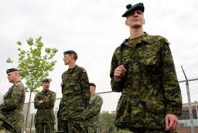
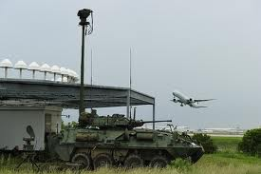
Police Militarization in Canada
a similar blurring of security responsibilities between military and police is occurring in Canada.
  Canada Command’s “mission within Canada”, “is to defend against threats and security challenges and support civilian authorities [i.e. public police] to enhance safety, security and stability”. This integration of military and police is, “the effective answer to the security challenges of the 21st century” such as providing “military support to major [domestic] security events”. (Department of National Defence website)
  During G20: Canadian Forces provided land, air, and water support

Slide 15
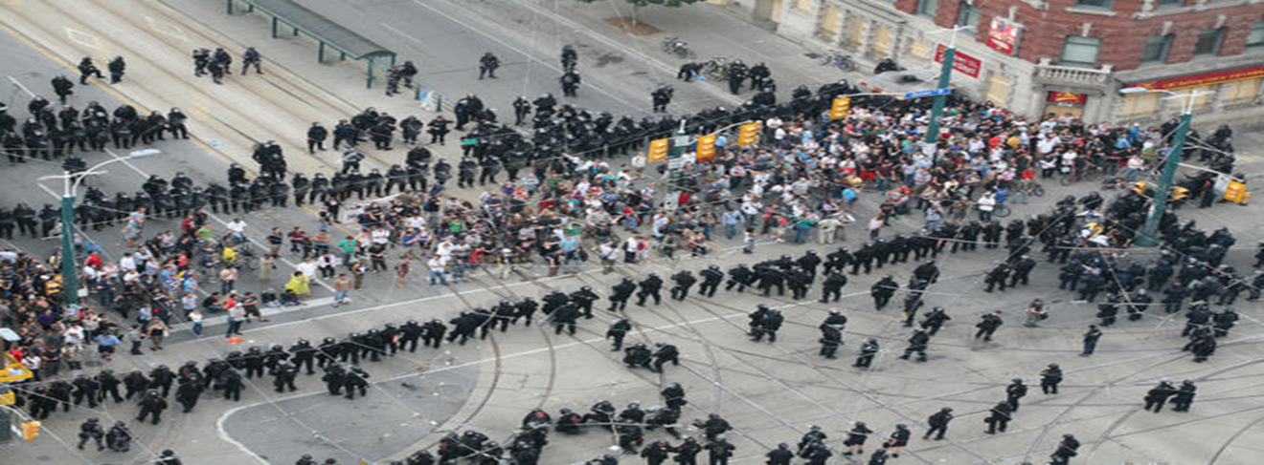
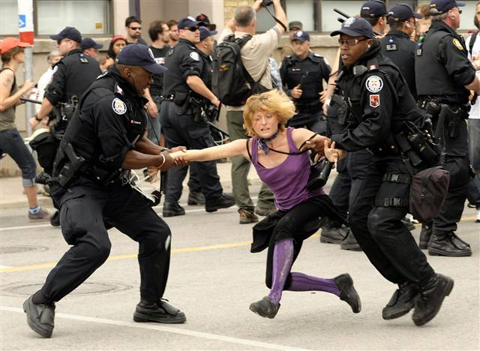
Paramilitary policing at the G20
G20 security operation deployed paramilitary police units to secure the June 2010 Summits
Pre-Summit paramilitary-style drills
  http://www.youtube.com/watch?v=fmbE7mP9Kjs&feature=player_embedded
Proactive, coercive Tactics to suppress dissent
- Ketteling; http://www.youtube.com/watch?v=yZbgz3eo4YI
- Snatch squads; http://www.youtube.com/watch?v=-GlJue_4wAY&feature=related
- undercover officers; http://www.youtube.com/watch?v=u6XgEI5dCrE

Slide 16

Plural Policing: a Comparative Perspective - Canada by George Rigakos and Cherie Leung
privatization of policing trend
  U.S private security guards now outnumber their public counterparts 3 to 1. In Canada 4:1 (Rigakos 2002)
  Cost a key factor
  During G20: Contemporary Security Canada (CSC) provided over a thousand security guards

Slide 17
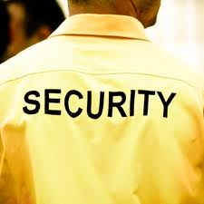
Plural Policing: a Comparative Perspective - Canada by George Rigakos and Cherie Leung
Regulating the private security industry
in the hands of provincial registrars
With the exception of British Columbia and Newfoundland, there are no minimum training standards for security guards across Canada.
death of Patrick Shrand
Change on the horizon?

Slide 18
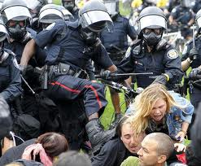
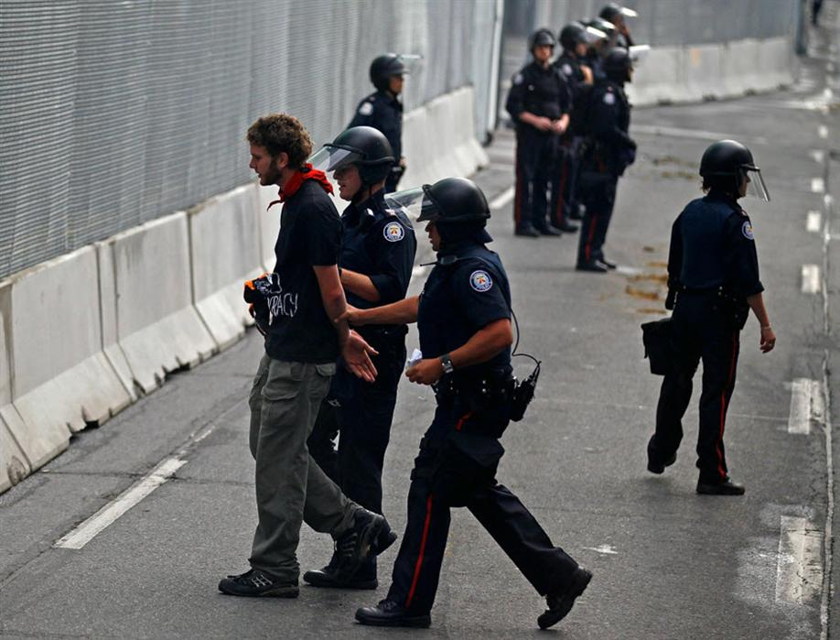
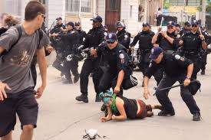
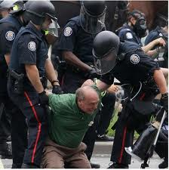
Police Discretion
a significant feature of law enforcement
“discretionary power officials can exercise in specific situations”
Always operative
based largely on a police officers subjective sense of what is happening, whether it matters, what might happen if it is left alone or if an arrest is made.
discriminatory practices based on race, ethnicity, gender, age, and class

Slide 19
Police Discretion not to enforce the law
the law is not taken seriously by government thus need not be enforced
the community is not concerned about the law being enforced
there are other, more pressing duties to be undertaken
an offender is contrite and promises not to do the act again
there are too few police officers available
the police officer sympathizes with the offender
a particular criminal act is so common within a particular group that does not warrant sanction
a belief that the victim can get restitution without arresting the offender
nonenforcement may be traded for information
the probable penalty is too severe
the arrest would unduly harm the offender's status

Slide 20
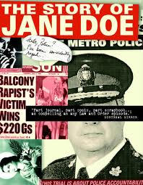
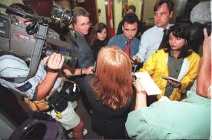
Doe vs Metropolitan Toronto Municipality Commissionaires of Police
Jane Doe (a pseudonym) sexually assaulted by the “balcony rapist” Paul Callow, who was sexually assaulting women living in apartment buildings in Toronto.
Doe sued The Metropolitan Toronto Police Force on two primary grounds
    that the Toronto police conducted a negligent investigation in relation to the balcony rapist and failed to warn women whom they knew to be potential targets of Callow of the fact that they were at risk.
    Secondly, the Toronto police did not protect her constitutional rights under section 15 of the Charter of Rights and Freedoms.

Slide 21
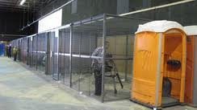
Doe vs Metropolitan Toronto Municipality Commissionaires of Police Continued
Distinguishing feature: that the Annex rapist differed from the balcony rapist because Davidson physically assaulted his victims in addition to sexually assaulting them
judge McFarland agreed that the balcony rapist was a "gentleman rapist" because he did not beat his victims while sexually assaulting them.
Toronto Police strategically did not warn women about rape incidences occurring in area
Judge: the conduct of this investigation and the failure to warn in particular, was motivated and informed by the adherence to rape myths as well as sexist stereotypical reasoning about rate, about women and about women who are raped.
The municipality of Metropolitan Toronto was found liable for the harms caused to Jane Doe by the police, and they were ordered to pay over $200,000 in damages.
  Police Sexual violence and harassment during the G20:
  https://www.youtube.com/watch?v=wAvZ06oePhQ

Slide 22
Next Week Readings
Law, Liberalism, and the Critics:
Case Book 6 (A) – (F)

