Slide 1
Introduction to Legal Studies - Access to Justice: Income Issues
Review: Fiss v. McThenia & Schaffer; Sargent
  Fiss: 4 arguments against settlement
    Distributional inequalities – poorer party may be forced to settle for financial reasons
    Difficulty securing judicial enforcement of out-of-court settlement
    Litigation is about social justice as well as legal justice
    Settlement precludes authoritative interpretation of the law
  Fiss may presume too great a link between courts and justice

Slide 2
Introduction to Legal Studies - Access to Justice: Income Issues
McThenia & Schaffer: Why settlement is good
  Courts are about legal justice, not resolution or reconciliation
  Settlement is not about expediency, it is about ownership of process and outcome
  Parties are better able to do justice than courts (most important justice is that which people give to each other)

Slide 3
Introduction to Legal Studies - Access to Justice: Income Issues
Sargent
  Critiques of mediation:
    Inadequate promise of mediation (Liberal critique)
      Mediation focuses on outcomes, not processes
      Mediation is system-appended, not a real alternative
      Mediation divorces conflicts from larger social structural context
    False promise of mediation (conflict perspective)
      Mediation is dyadic & thus ahistorical & apolitical
      Conflict is not just personal, it is political as well

Slide 4
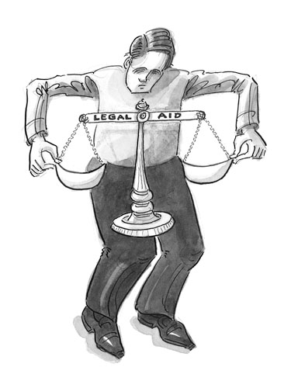
Introduction to Legal Studies - Access to Justice: Income Issues
This week: Access to Justice
  Glathercole, “Legal Services and the Poor”
  Ramsay, “Small Claims Courts: A Review”
  Small Claims in Quebec
  & Ontario

Slide 5
Introduction to Legal Studies - Access to Justice: Income Issues
Glathercole:
  Legal aid originally concerned not only with provision of legal services, but also with alleviation of poverty
  Two categories of legal aid delivery
    Judicare Model
    Legal Services Model

Slide 6
Introduction to Legal Studies - Access to Justice: Income Issues
Judicare Model:
  Basic philosophy that legal aid should provide the poor with access to the same legal services as are available to the rest of society

Slide 7
Introduction to Legal Studies - Access to Justice: Income Issues
Central characteristics of Judicare:
  Client chooses lawyer through fee-for-service structure with specified limits
  Legal profession responsible for the plan
  Services concentrate on serious criminal & civil actions in superior courts

Slide 8
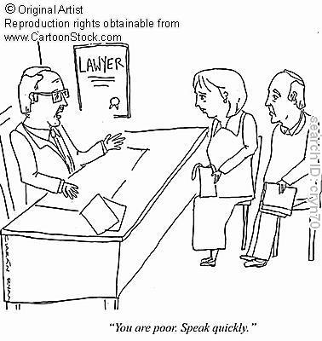
Introduction to Legal Studies - Access to Justice: Income Issues
Strengths of Judicare Model:
  Client interviews & hires own lawyer
  Client structures lawyer-client relationship
  Client is employer of the lawyer, not the plan

Slide 9
Introduction to Legal Studies - Access to Justice: Income Issues
Weaknesses of Judicare Model:
  Not always cost-effective
  Counsel may have limited knowledge of those legal problems common to the poor
  Criticized as more problem-solving than problem-preventing in its approach
  Too concerned with equality of legal services than social equality, the poor get their day in court, but not much more

Slide 10
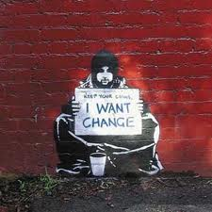
Introduction to Legal Studies - Access to Justice: Income Issues
Legal Services Model:
  Basic Philosophy that
  the goal of legal aid should
  be nothing less than the
  total eradication of
  poverty

Slide 11
Introduction to Legal Studies - Access to Justice: Income Issues
Central characteristics:
  “Store front clinics”
  Focus on legal problems of the poor – welfare, housing, etc.
  Legal aid has political/lobbying function
  Independent commission/board administers program

Slide 12
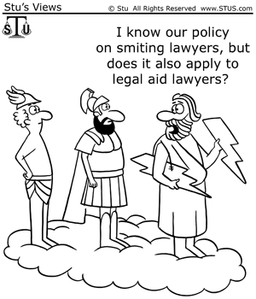
Introduction to Legal Studies - Access to Justice: Income Issues
Strengths of Legal Services Model:
  Accessibility as offices are located where their clientele reside
  Lawyers may not be specialists,
  but will be familiar with
  problems of poor

Slide 13
Introduction to Legal Studies - Access to Justice: Income Issues
Weaknesses of Legal Services Model:
  Lawyer-client relationship managed by plan
  Lawyer may be more concerned about the plan than an individual legal problem
  Lawyers are non-specialists
  Eradication of poverty may not be a realistic goal

Slide 14

Introduction to Legal Studies - Access to Justice: Income Issues
Challenges common to all legal aid plans:
  Expense
  Lack of Political Support
  Questionable Assumptions regarding ability of law to achieve positive social change

Slide 15
Introduction to Legal Studies - Access to Justice: Income Issues
Expense of Legal Aid:
  Program is a provincial responsibility, but federal government contributes financially
  Budget for 2013/14 Legal Aid Ontario increased by 4.6% (roughly 3.15 million)
  Overall budget for 2013/14: $70.9 million

Slide 16
Introduction to Legal Studies - Access to Justice: Income Issues
Legal Matters Covered for Qualified Applicants:
  Family Law, ie.:
    divorce and separation
    child custody and access
    support payments.
  Criminal Law, ie.:
    Generally for serious charges likely to result in jail time
    Youth offences which are serious and complex
  Immigration & refugee claims
  Some civil cases (ie., workplace safety, appeals of administrative boards/tribunals; Canada Pension appeals)
  Housing (ie., landlord & tenant)
  Government assistance (ie., ODSP; Ontario Works Program, EI)

Slide 17
Introduction to Legal Studies - Access to Justice: Income Issues
What kinds of Services? Examples:
  Family Law
    Full representation if applicant qualifies
    Duty Counsel
    Family Law Information Offices and Centres
    Summary legal advice (20 minutes free; 2 hours if domestic violence involved)
  Criminal Law:
    Representation if eligible
    Duty counsel
    Summary legal advice via Legal Aid Clinics

Slide 18
Introduction to Legal Studies - Access to Justice: Income Issues
Who is eligible for Legal Aid in Ontario?
  Determined by Asset and Income Tests
  Asset Test:
    Legal Aid will consider all assets (cash, stocks, bonds, RRSPs – anything that could be sold or converted into cash)
    Home ownership usually disqualifies
  Income Test:
    Legal Aid will consider all sources of income, including: Workers’ Compensation, EI, Pensions, Social assistance

Slide 19
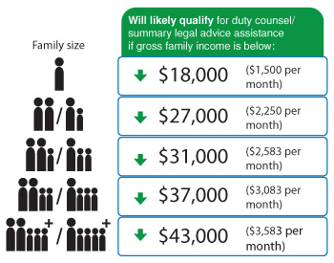
Introduction to Legal Studies - Access to Justice: Income Issues
What does eligibility look like?
-Summary legal advice
-Duty Counsel

Slide 20
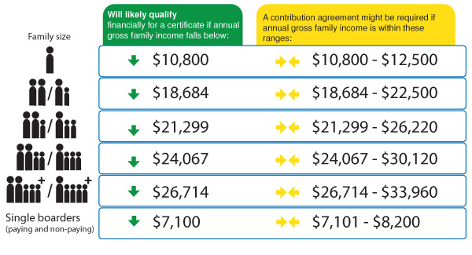
Introduction to Legal Studies - Access to Justice: Income Issues
- Legal Aid Certificate:

Slide 21
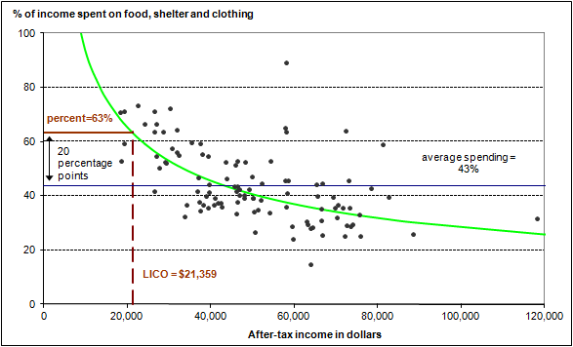
Introduction to Legal Studies - Access to Justice: Income Issues
Those most likely to receive funding are also living below the 2013 LICO:

Slide 22
Introduction to Legal Studies - Access to Justice: Income Issues
What does all this mean for You and Your Legal Problem?
If you wish fully-funded representation, you:
  Will be living below the LICO
  Will not own property
  Will not be able to contribute to your costs of legal representation
Your problem must be:
  A criminal charge likely to result in jail time (ie., assault, impaired driving causing bodily harm, etc.)
  A family law matter which is serious (ie., child protection, custody & access)
  An immigration or refugee matter (sponsorship & deportation appeals, detention reviews)

Slide 23
Introduction to Legal Studies - Access to Justice: Income Issues
What does all this mean for Legal Aid?
  Means Tests are such that only the poorest will qualify for full legal aid
  Those who fund the programs are least likely to benefit from them
  Strained budgets, targeted funding result in limited time and resources to dedicate to the larger goals of legal aid.

Slide 24
Introduction to Legal Studies - Access to Justice: Income Issues
  Lack of Political Support
    Limited voter support for ameliorating “problems of the poor”
    General climate of financial retrenchment
    Rise of ‘new-right’ values
  Questionable Assumptions regarding ability of law to achieve positive social change
    Can greater access achieve greater justice?

Slide 25

Introduction to Legal Studies - Access to Justice: Income Issues
Ramsay: Small Claims Courts
  Originally intended to provide an alternative to costly litigation for small businesses and consumers
  General characteristics:
    Replicates traditional court structure
    Less formal legal process
    Lawyers usually absent

Slide 26
Introduction to Legal Studies - Access to Justice: Income Issues
Goals of Small Claims Courts:
  Dispute settlement
  Social problem solving
  Effective debt enforcement
  Access to justice
Small Claims Courts differ across Canada
Notes:
…

Slide 27
Quebec:
  No lawyers
  Mediation as well as adjudication
  Relaxed rules of procedure
  Conciliation service available
  No appeals
  Jurisdiction limited to $7000.00

Slide 28
Introduction to Legal Studies - Access to Justice: Income Issues
Ontario:
  Resemble modified version of higher level courts
  Lawyers and agents may appear
  Jurisdiction limited to $25,000.00
  Include ‘settlement conferences’ before court
  Include actions in contract & tort
  Restrictions on costs

Slide 29
Introduction to Legal Studies - Access to Justice: Income Issues
Ontario small claims jurisdictional limitations
Common caseload – mostly debt collection!
Bias in clientele?
…And finally…
Notes:
Jurisdiction does not include:
Landlord/tenant issues involving evictions, repairs
Discrimination under Ontario Human Rights Commission
Employment standards (social assistance review board)
Most common cases involve claims by businesses against consumers – plaintiffs tend to be better-educated, middle class men & business groups (Vidmar)
Working poor most often as defendants and reportedly found process intimidating!

Slide 30

Introduction to Legal Studies - Access to Justice: Income Issues
THE CASE OF SEX, LIES AND HIV
Notes:
Cyril & Frankie date for a while
Consummate relationship
Both have been drinking, but not so drunk that ability to consent is questioned
Both consent to intercourse
No condom used
Don’t see each other again for some time after
Frankie discovers she is HIV positive
Discovers Cyril was HIV positive & did not disclose
QUESTION:
Has a crime been committed?
Is it sexual assault? Assault? Assault causing bodily harm?
Does Cyril’s status and non-disclosure nullify Frankie’s consent?

