Slide 1
COMM 1101: Exam Review
3 December 2012
Prof. M. Aronczyk

Slide 2
One more time…
Where: Alumni Hall (Raven’s Nest)
When: Tuesday 18 December @ 2 pm
What: 75 multiple choice questions (25% pre-midterm, 75% post-midterm)
Evaluation: 30% of semester grade
NOTE: You must write the final exam in both semesters in order to pass this course.

Slide 3
What to bring
Pencils, erasers, pencil sharpeners
Carleton ID
Do not bring valuables.
Food and drink are not permitted (water is OK).

Slide 4
Pre-midterm: Keywords
Representation
Context
Conventions
Semiotics (+ sign, signified, signifier) Polysemy
Denotation/Connotation
Ideology
Structuralism
Marshall McLuhan
Anti-environment
Active audience
Agency
Hypodermic needle model
Limited effects model
Uses and gratifications model
Agenda setting
Intended meanings
Dominant, negotiated, oppositional readings
Encoding/decoding
Product placement
Branded entertainment
Narrowcasting
Self-censorship
Consumer society
Planned obsolescence
Brand extensions
Marketing analytics
Internet as culture of sharing
Digital natives
Myth of photographic truth

Slide 5
29 October: Keywords
Journalism
News
Problems of representation (diversity issues)
Citizen journalism
Muckraking
Civil society
Gatekeeper
Myths
Watchdog press
Ideals of journalism
Democracy
News values/professional norms in journalism
Media convergence
Fortress journalism
Media consolidation
Link economy
Crowdsourcing
Search engine optimization
Paywalls, Freemium, Pay What You Want

Slide 6
5 November: Keywords
Public media, private media
Paradoxes of media ownership
Big 6
Vertical integration
Horizontal integration
The 4 “C”s
Net neutrality
Throttling

Slide 7
12 November: Keywords
Slacktivism
Global village (McLuhan)
Medium is the message (McLuhan)
Cultural imperialism thesis
Bollywood and Nollywood
Evgeny Morozov
The “New Cold War”
KONY 2012

Slide 8
19 November: Keywords
Culture
Fair Use
Intellectual property
Copyright
Peer-to-peer networks (file sharing)
James Boyle
PIPA and SOPA
Internet censorship
Piracy
Spotify

Slide 9
26 November: Keywords
Public sphere
Dominant discourses
Progressive discourses
Watchdog function of news
Search engine optimization
Huffington Post
Alternative media
Slacktivism
Ideals of journalism

Slide 10
Plus!
In-class examples (on slides)
Assignments 1 and 2
Thesis, Argument, Evidence
Readings (relative to slides/lectures)

Slide 11
How to study
Concepts IN CONTEXT

Slide 12
Concepts in Context
Ex. “IDEOLOGY”
Def. “The means by which certain values…are made to seem like natural, inevitable aspects of everyday life” -p. 23, Sturken & Cartwright
(17 Sept reading)

Slide 13
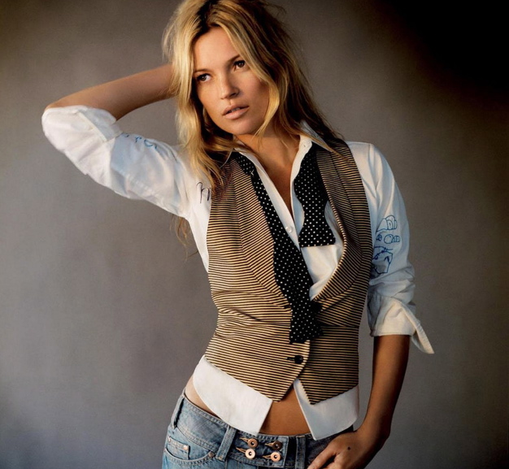

Slide 14
Pre-midterm: Keywords
Representation
Context
Conventions
Semiotics (+ sign, signified, signifier) Polysemy
Denotation/Connotation
Ideology
Structuralism
Marshall McLuhan
Anti-environment
Active audience
Agency
Hypodermic needle model
Limited effects model
Uses and gratifications model
Agenda setting
Intended meanings
Dominant, negotiated, oppositional readings
Encoding/decoding
Product placement
Branded entertainment
Narrowcasting
Self-censorship
Consumer society
Planned obsolescence
Brand extensions
Marketing analytics
Internet as culture of sharing
Digital natives
Myth of photographic truth

Slide 15
Pre-midterm: Keywords
Representation
Context
Conventions
Semiotics (+ sign, signified, signifier) Polysemy
Denotation/Connotation
Ideology
Structuralism
Marshall McLuhan
Anti-environment
Active audience
Agency
Hypodermic needle model
Limited effects model
Uses and gratifications model
Agenda setting
Intended meanings
Dominant, negotiated, oppositional readings
Encoding/decoding
Product placement
Branded entertainment
Narrowcasting
Self-censorship
Consumer society
Planned obsolescence
Brand extensions
Marketing analytics
Internet as culture of sharing
Digital natives
Myth of photographic truth

Slide 16
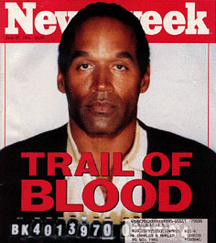
Semiotics = tools for decoding
Image = made up of signs that connote certain things
Mug shot = sign
Mug shot connotes guilt (so does the colour red, and the word blood…)
Mug shot, colour, words = codes and conventions

Slide 17
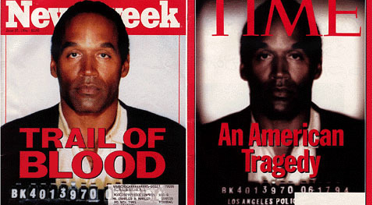
Ideology

Slide 19
How to do well on multiple choice exams
Skim the entire exam before starting to write
Read the question VERY carefully
Which answer best answers the question?
Review your answers; BUT…
NEVER choose an answer based on pattern: Yes, there can be 10 “E”s in a row!

Slide 20
Questions?
Email your T.A. with questions
FAQs will be posted on CULearn
PASS Review Sessions:
Monday December 3rd 10:30-11:30 --Tory Building 431
Tuesday December 4th 11:30-12:30 -- Loeb B243
Tuesday December 4th 4:30-5:30 -- Loeb B243
Mock Take Up
Sunday December 9th 12:00-2:00 -- Patterson 133
Tuesday December 11th 12:00-2:00 -- Loeb A720

