Slide 1
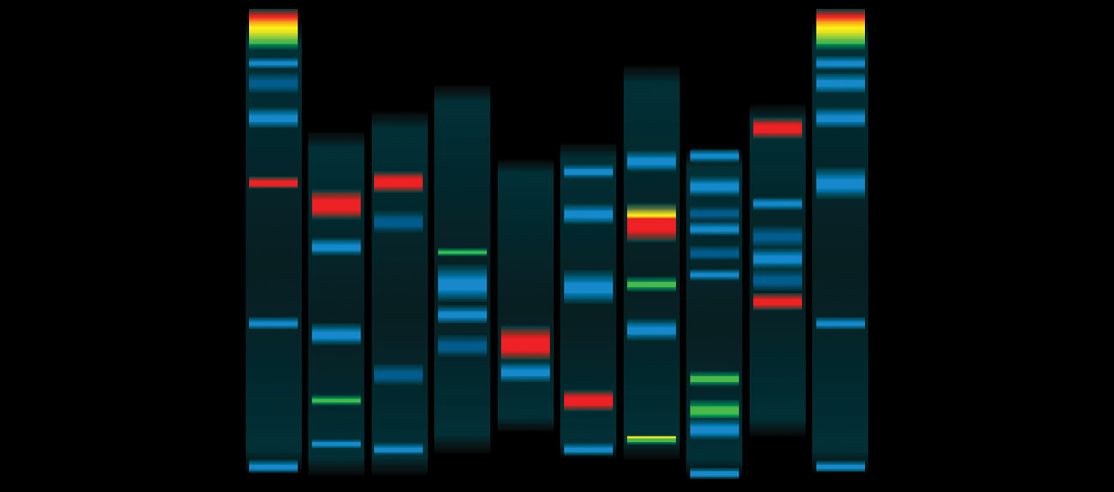
Chapter 3: Genetic Engineering Technology
work on bacteria and viruses in the 1970’s and 1980’s
led to development of recombinant DNA technology
and genetic engineering
Notes:
Work on bacteria and viruses in the 1970's and 1980's let to development of recombinant
Foreign dna could be manipulated and transferred into other organisms ( ey human dna > functions in bacteria )
If you give the bacteria a human sequence it will translate still / it doesnt know

Slide 2
Chapter 3: Genetic Engineering Technology
foreign DNA could be manipulated and transferred
into other organisms (e.g. human DNA functions in bacteria)
allowed for human genes to be isolated and the
proteins produced in bacteria
e.g. human insulin approved in 1982
for diabetes treatment (produced in bacteria)
Epogen- human erythropoetin (produced in
mammalian cell culture by Amgen)
Sales of $2.2 billion in 2013
Notes:
Allowed for humans to be isolated and the proteins produced in bacteria
Insulin approved in 1982 for diabetes treatment( produced in bacteria )
Before it was taken from pigs / problem the human and pig insulin gene were 2 amino acids off/ when you injected it over and over again you started to make antibodies / less side effects now
Epogen : human erythropoetin ( produced in mammalian cell culture by Amgen )
This hormone
What happens in bacteria cell and not ours : cDNA copy is put into the reading frame / there are post translating modifications that ocurr during process ( golgi) transform the protein, the bacteria does not do this ( red blood cell production )

Slide 3
Best selling recombinant DNA drugs (biological drugs)
Notes:
TNF - your body is under going inflammatory response , good if your sick , not if your not , goes after your cells otherwise
Embrel : helps with inflammation / joints ( famous golfer uses it )
Initial drugs made in mice , when injected into human antibodies were produced . So they had th fix it they modify it so that anti bodies // they become less effect over the year b/c your body startt to produced antibodies even after you change it w human aspect

Slide 4
Recently in the news (January 24, 2014):
http://www.bbc.co.uk/news/science-environment-25885756
Used genes from snapdragon and inserted into tomato genome to produce high levels of Anthocyanins (anti-oxidants)
Tumour prone mice fed extracts of these new tomatoes lived 30% longer than mice fed regular tomatoes.
Notes:
News
Purple tomatoes , purple is produced due to high levels of anthocyanins , engineered them to produce a higher level of flavanoid , turned skin purple / transcription factors that have been turned on / gene from a snapdragon
Tumor prone mice fed extracts of these tomatoes lived 30% longer than mice fed regular tomatoes / Why ? The high level of antioxidants helped ,

Slide 5
Enrichment of tomato fruit with health-promoting
anthocyanins by expression of select transcription factors
Eugenio Butelli, Lucilla Titta, Marco Giorgio, Hans-Peter Mock, Andrea Matros, Silke Peterek,
Elio G W M Schijlen, Robert D Hall, Arnaud G Bovy, Jie Luo & Cathie Martin
Dietary consumption of anthocyanins, a class of pigments
produced by higher plants, has been associated with
protection against a broad range of human diseases. However,
anthocyanin levels in the most commonly eaten fruits and
vegetables may be inadequate to confer optimal beneﬁts.
When we expressed two transcription factors from snapdragon
in tomato, the fruit of the plants accumulated anthocyanins at
levels substantially higher than previously reported for efforts
to engineer anthocyanin accumulation in tomato and at
concentrations comparable to the anthocyanin levels found
in blackberries and blueberries. Expression of the two
transgenes enhanced the hydrophilic antioxidant capacity
of tomato fruit threefold and resulted in fruit with intense
purple coloration in both peel and ﬂesh. In a pilot test,
cancer-susceptible Trp53–/– mice fed a diet supplemented
with the high-anthocyanin tomatoes showed a signiﬁcant
extension of life span.
NATURE BIOTECHNOLOGY VOLUME 26 NUMBER 11 NOVEMBER 2008 pgs:1301-1308

Slide 6
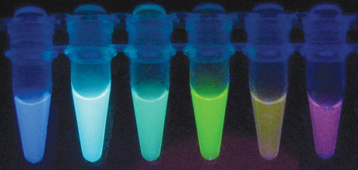
Nobel Prize in chemistry (2008): Drs. Shimomoura, Tsien
and Chalfie “for the discovery and development of the
green fluorescent protein, GFP”
http://www.youtube.com/watch?v=Py9zAUOYYLk
Notes:
Celery , break , rub on hand put out in to sun, turns red, anti pathogenic
Fluorescent proteins genetically engineered except for the green one ( taken from jelly fish )
Gave scientist a tool to monitor where protein go in real time , before you had to kill the cell but now you just image the cell and you are able to see
Transgenic pets

Slide 7
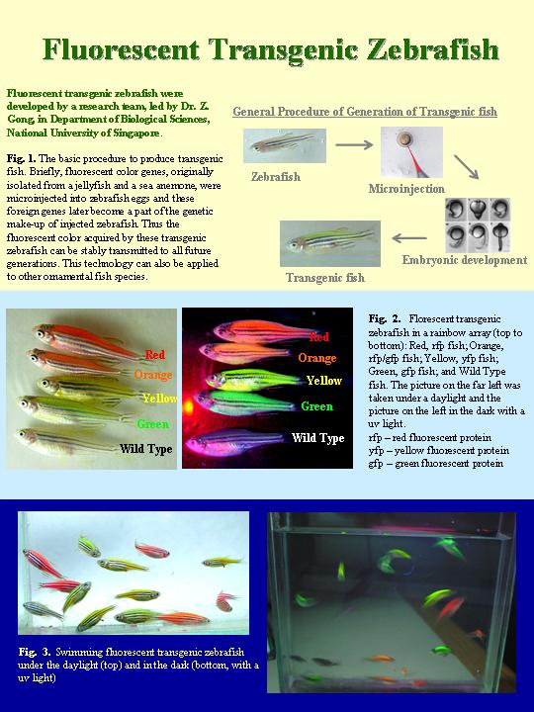
Transgenic Pets!!
Zebrafish expressing
Different fluorescent
Proteins (GFP, YFP, RFP)
http://www.glofish.com/buy.asp

Slide 8
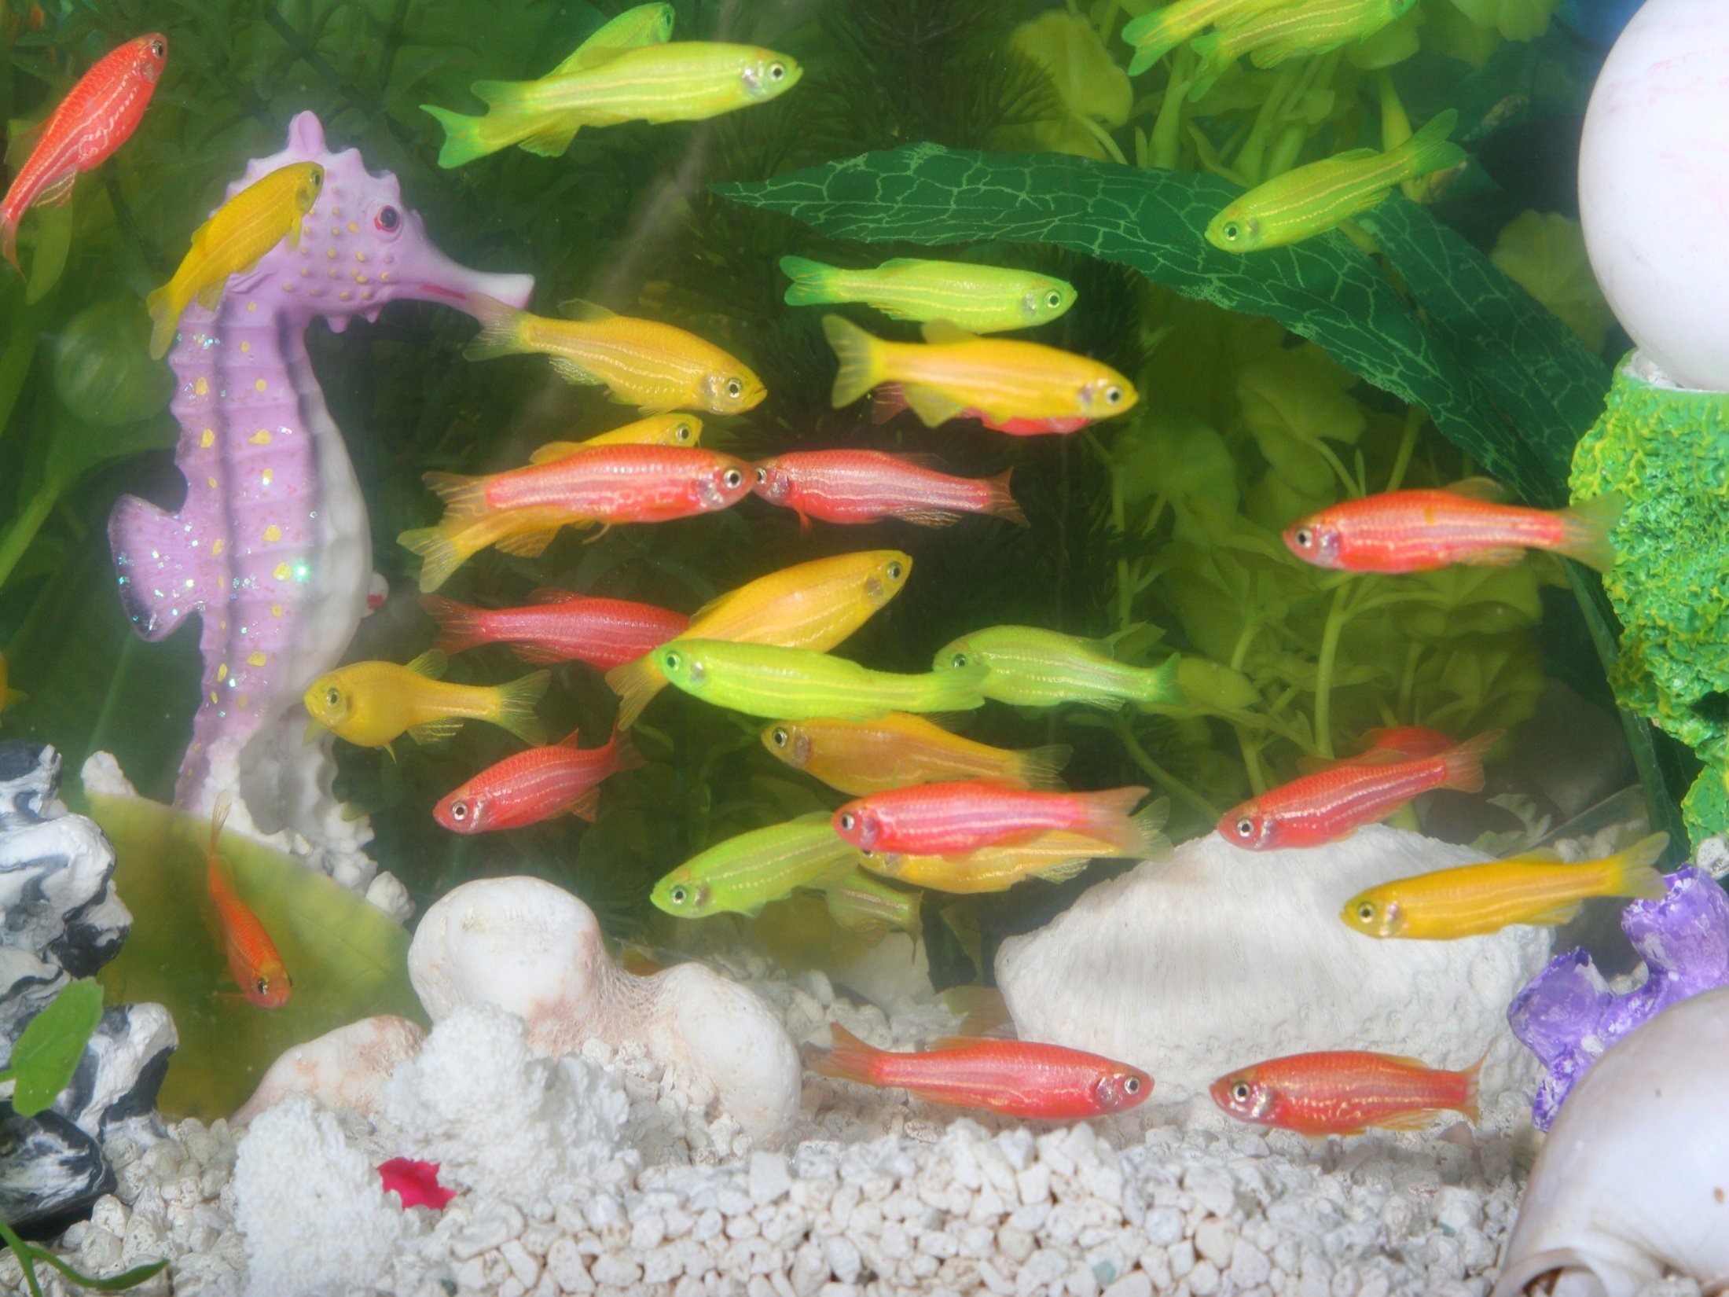

Slide 9
Terminology:
Cloning vector: circular dsDNA plasmid that is used
as a vehicle to transfer DNA into organisms
Foreign DNA can be inserted into vector using
restriction endonucleases and DNA ligase
all vectors have selectable marker and origin of
replication for appropriate host (bacteria, yeast)
Shuttle vectors: DNA plasmids that can be transferred
between different types of organisms (e.g. bacteria and yeast)
Reporter genes are used to measure the expression
levels of promoters and whether DNA was taken up by the
cell (e.g. β-galactosidase (LacZ), luciferase)
Notes:
Terminology
Cloning vector
Type of dna vectors
Plamid
Phage : virus that infects bacteria/ coming back in medicine
Cosmid
Artificial chromosomes
Depends on the size of the dna fragment in use

Slide 10
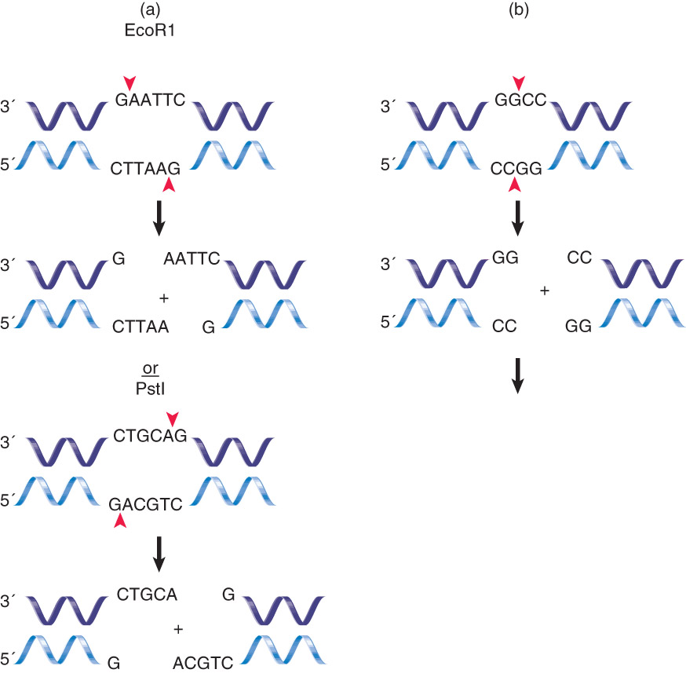
Figure
3.2
Can leave “sticky” or “blunt “
ends
Restriction endonucleases

Slide 11
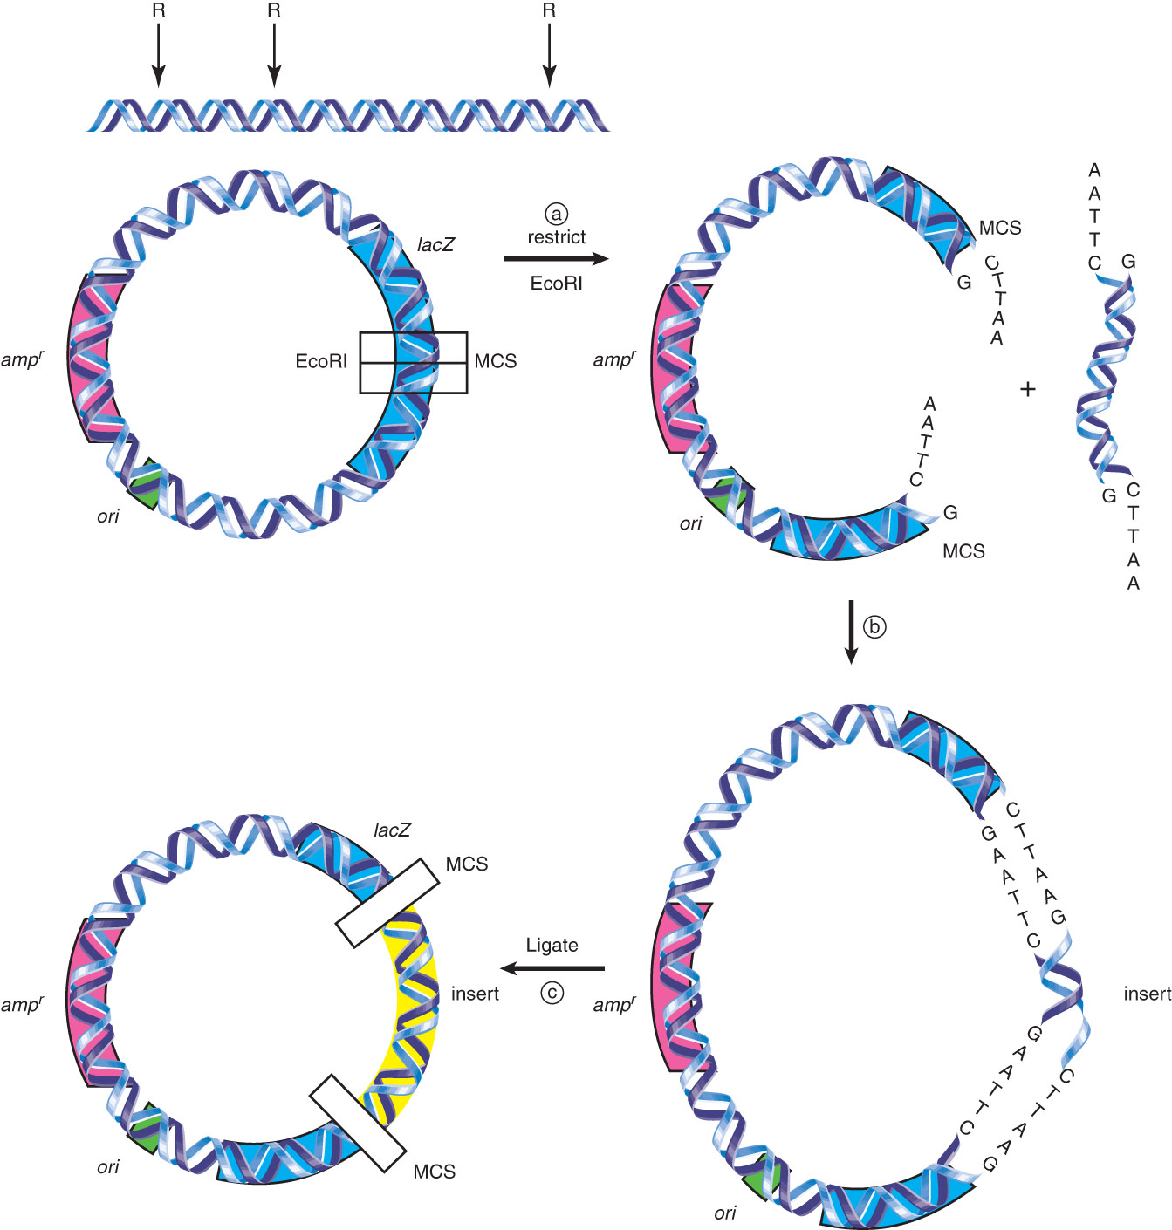
Figure
3.4
Cloning
procedure

Slide 12
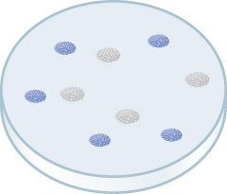
Lac Z reporter gene
Figure 3.5
Allows for detection of which cells have been transformed
by DNA vector

Slide 13
Types of DNA vectors:
Plasmid: used for bacteria, yeast and mammals
Phage: used for bacteria
Cosmid: combination of plasmid and phage; has phage
DNA sequences on plasmid and uses phage to infect
bacteria
Artificial chromosomes: bacterial (BAC) and yeast (YAC)
YAC’s have centromere and telomeres
type of vector chosen depends on size of DNA fragment

Slide 14
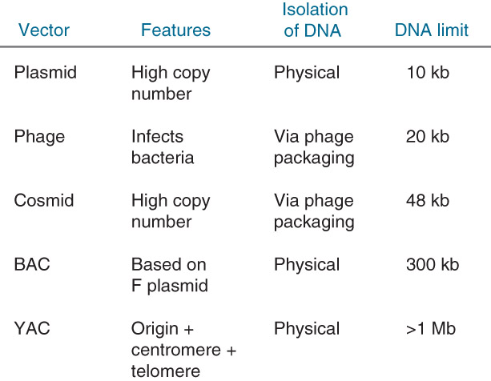
Not all vectors are the same!
Figure 3.6

Slide 15
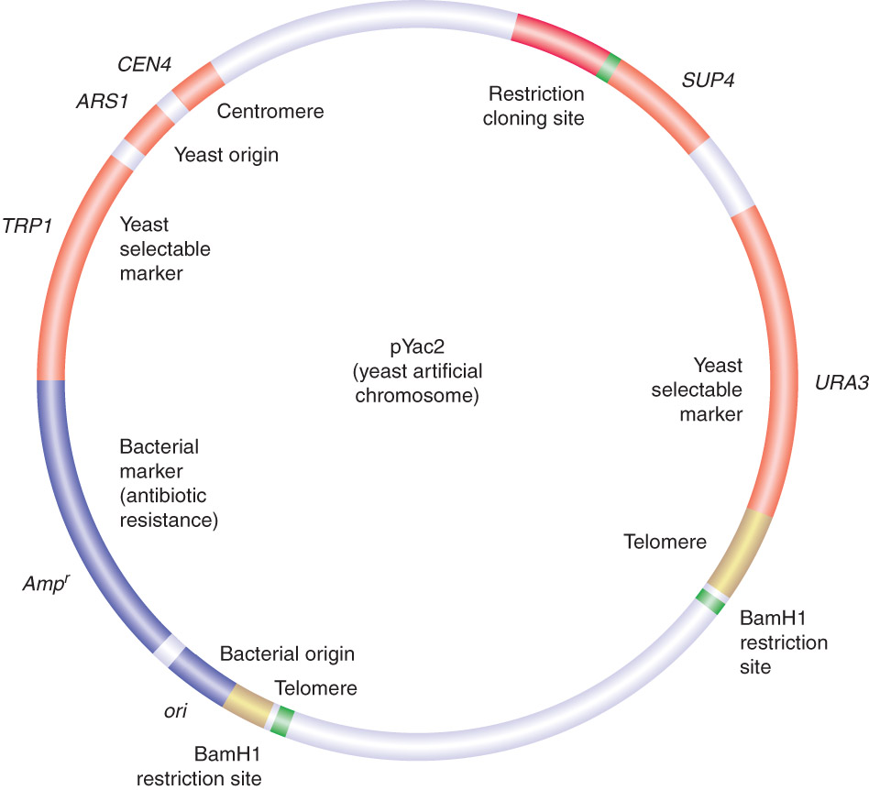
YACs are used
in genome
sequencing
projects
WHY?
Figure 3.7
Notes:
YAC
Yeast rgin of replication
Bacteria selectable marker, yeast selectable
Can be moved in and out of bacteria nd yeast
Telomeres , so when they translate it , it becomes linear ,
Why were YAC important : why are they better than plasmids
You cna cut the dna and then piece it together at the end ( 1 million bp ) total is 10 million bp
Incre in computing power ,
Whereas plasmids the pieces are smaller 10 kb more work ( 10 million bp )
Clone into plasmids
Dna se

Slide 16
Genome sequencing:
Why YACs are better than plasmids
DNA
10 million bp
1 million bp
Clone into YACs
DNA
10 million bp
10kb
Clone into plasmids
Notes:
THURSDAY MISSING THESE NOTES

Slide 17
DNA sequencing technology
primer
5’
3’
3’
5’
DNA
Add: A,G,C,T dNTPs and
A,G,C,T dideoxy ddNTPs (which terminate
the growing DNA chain)
Each ddNTP is fluorescently labeled with
different colours

Slide 18
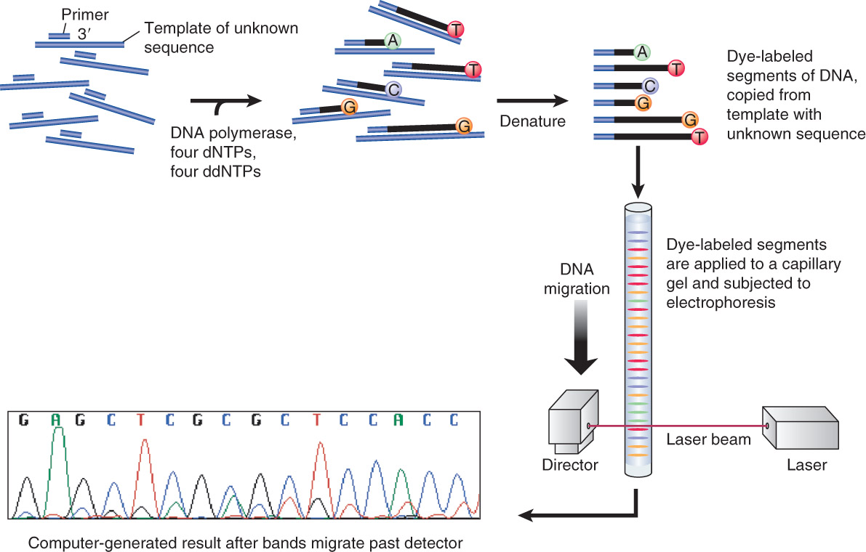
DNA sequencing
Fig. 3.17

Slide 19
How does 23andme sequence SNPs?
get individuals genomic DNA from cheek cells in saliva
use sequencing system developed by Illumina Corp.
Nature Genetics (2005) 37, 549
Nature Methods (2006) 32, 31
Use Infinium HD assay
Requires slide array with 1.2 million beads (3mm),
each containing one 50-mer primer containing one SNP

Slide 20
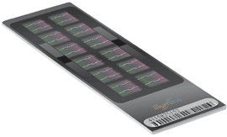
http://blog.23andme.com/23andme-and-you/behind-the-scenes-at-the-lab/

Slide 21
SNP- rs11868035
(A or G)
A
Chrom #17
G
Regions are
identical
between alleles

Slide 23
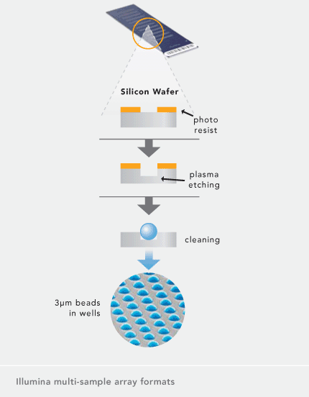

Slide 24
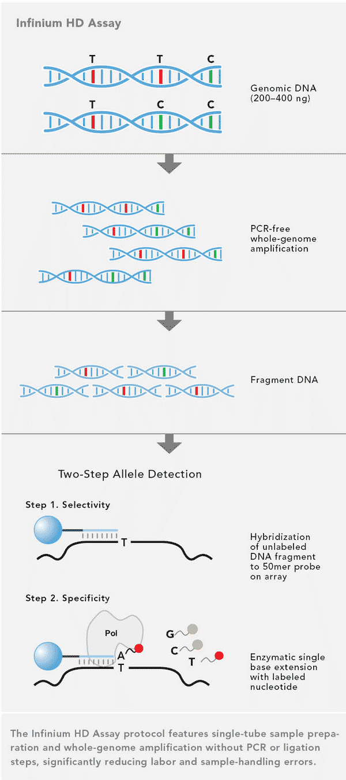

Slide 26
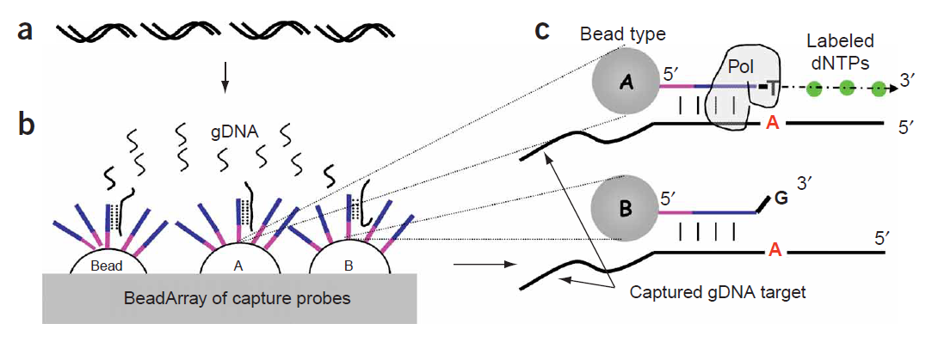

Slide 27
T-
C-
T-
A
T-
T-
C-
C-
C-
A
A
G
G
G
primer
DNA polymerase
bead
SNP #1
SNP #1
SNP #1
A-T homozygote
A-T/C-G
heterozygote
C-G homozygote
A
G
Genomic DNA possibilities for each SNP

Slide 28
1.2 million spots on each slide- each spot represents
one SNP

Slide 29
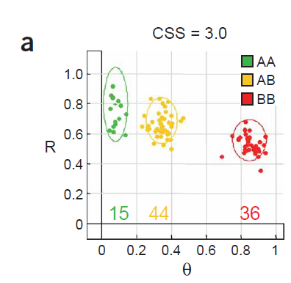
Results from SNP analysis
M-allele
P-allele
A and A
A and C
C and C

Slide 30
2013 Molecular Biology tool of the year?
…and the winner is….
Nanopore DNA sequencing
http://www.nanoporetech.com/
“2013 will see the first commercial nanopore DNA sequencers.”

Slide 31
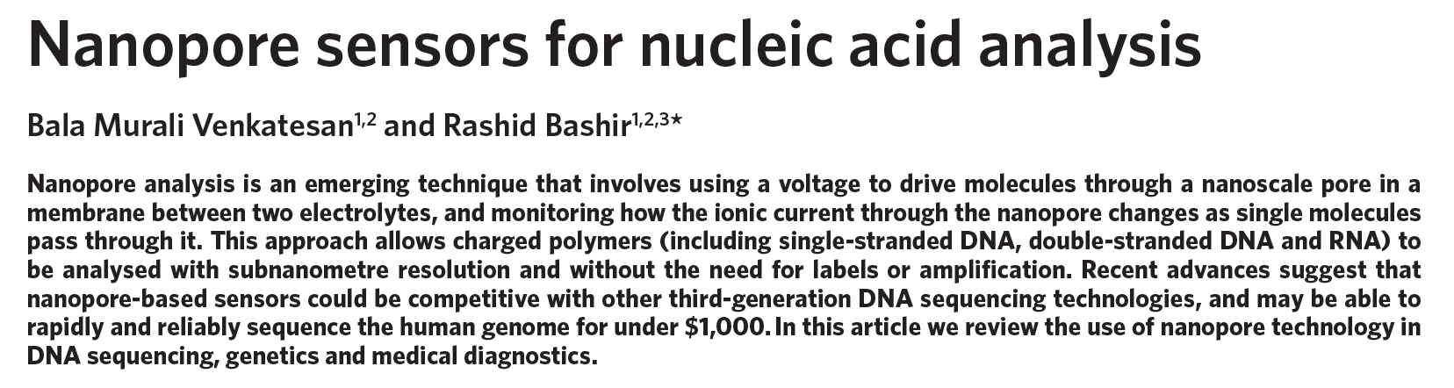
Nature nanotechnology (2011)

Slide 32
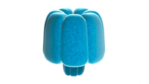
Types of nanopore sequencers:
Biological: uses pore-forming protein in a membrane
such as a lipid bilayer
e.g. channel pore proteins (α-hemolysin)
heptameric protein pore with an inner diameter of 1nm
Pore gives signal when interacting with DNA/RNA/protein

Slide 33
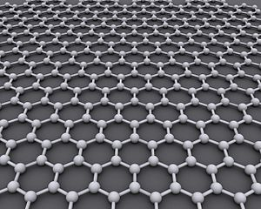
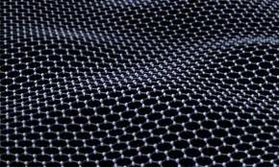
2. Solid state: Fabricated from synthetic materials
e.g. Graphene: pure carbon similar to graphite
(but only one atom thick)
100 times stronger than steel; conducts electricity better than copper
Nobel Prize for Physics (2010) Andre Geim and Konstantin Novoselov of Manchester University

Slide 34
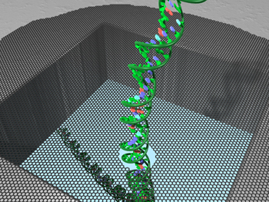
How does nanopore sequencing work?
single stranded DNA is fed through a hole (pore) in a graphene nanosequencer which has electrical sensor built into pore
electrical signal excited by each nucleotide as it
enters pore is different
differences in signal can be analyzed by computer
and converted into DNA sequence information

Slide 35
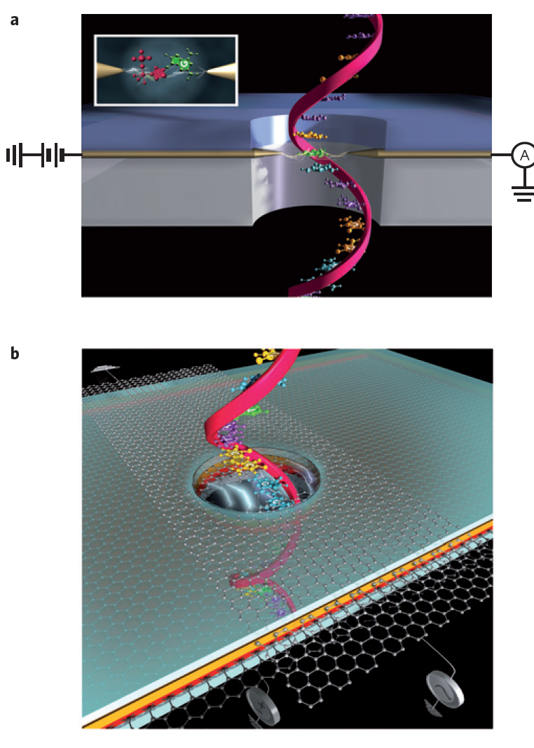

Slide 36
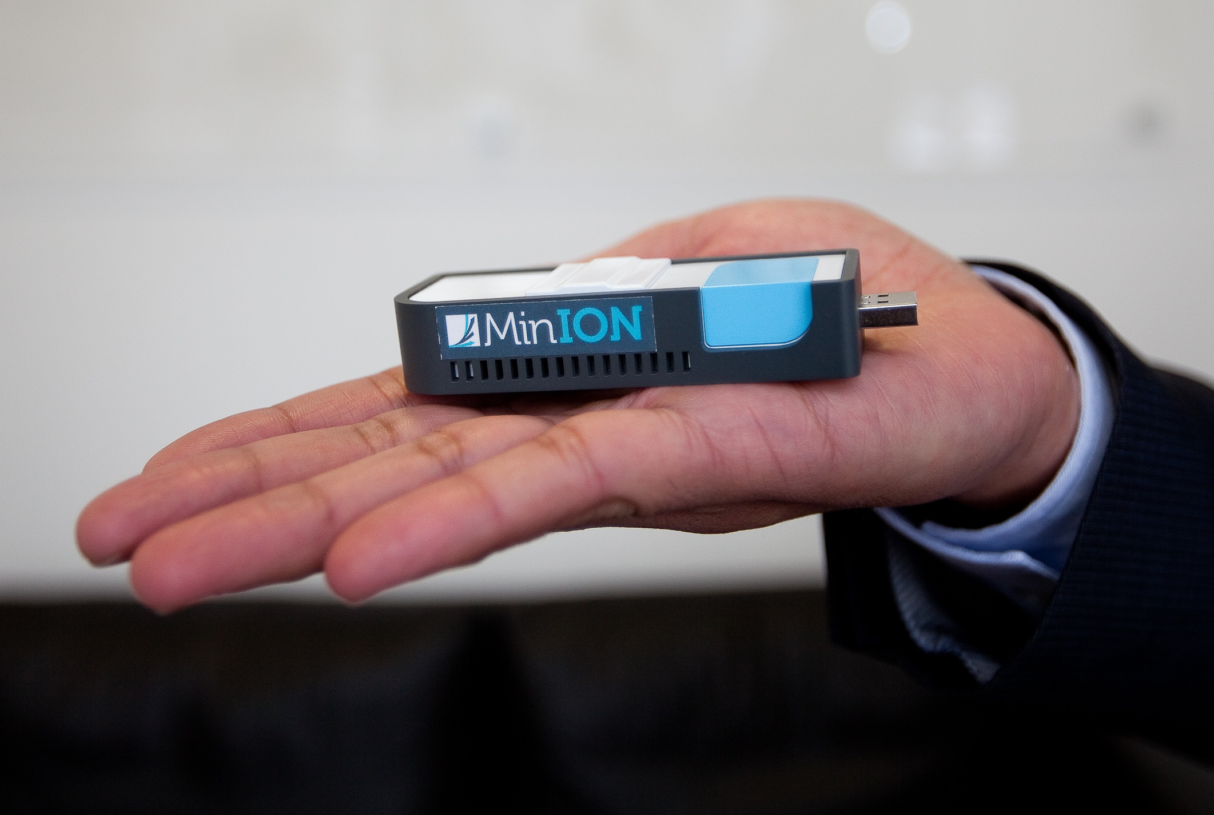

Slide 37
Advantages of nanopore sequencing:
fast (250,000 bp/sec)/pore!!
DNA is not degraded! Can re-sequence
cheap
Future advancements:
Disposable sequencers ($50)
8000 pores/device
How long would it take to sequence the human
genome with 8000 pore nanosequencer?

Slide 38
DNA sequencing technologies
Advantages
Disadvantages
reliable
inexpensive
Short sequences
DNA is degraded
Dideoxy termination
fast
inexpensive
scalable
Illumina
Gives only SNP data
DNA cannot be reused
DNA nanopore
very fast
inexpensive
High throughput
(long reads-genomic)
DNA is not degraded
Error rate is high

Slide 39
Microarray (DNA chip) technology:
Every gene from organism is spotted onto glass slide
(tiling array)
mRNA is isolated from different tissues and cDNA
is made with fluorescently labeled nucleotides
labelled cDNA from different tissues is used to probe
slide (e.g. cancer vs. normal)
differences in gene expression between tissues
can be measured
http://www.youtube.com/watch?v=VNsThMNjKhM

Slide 40
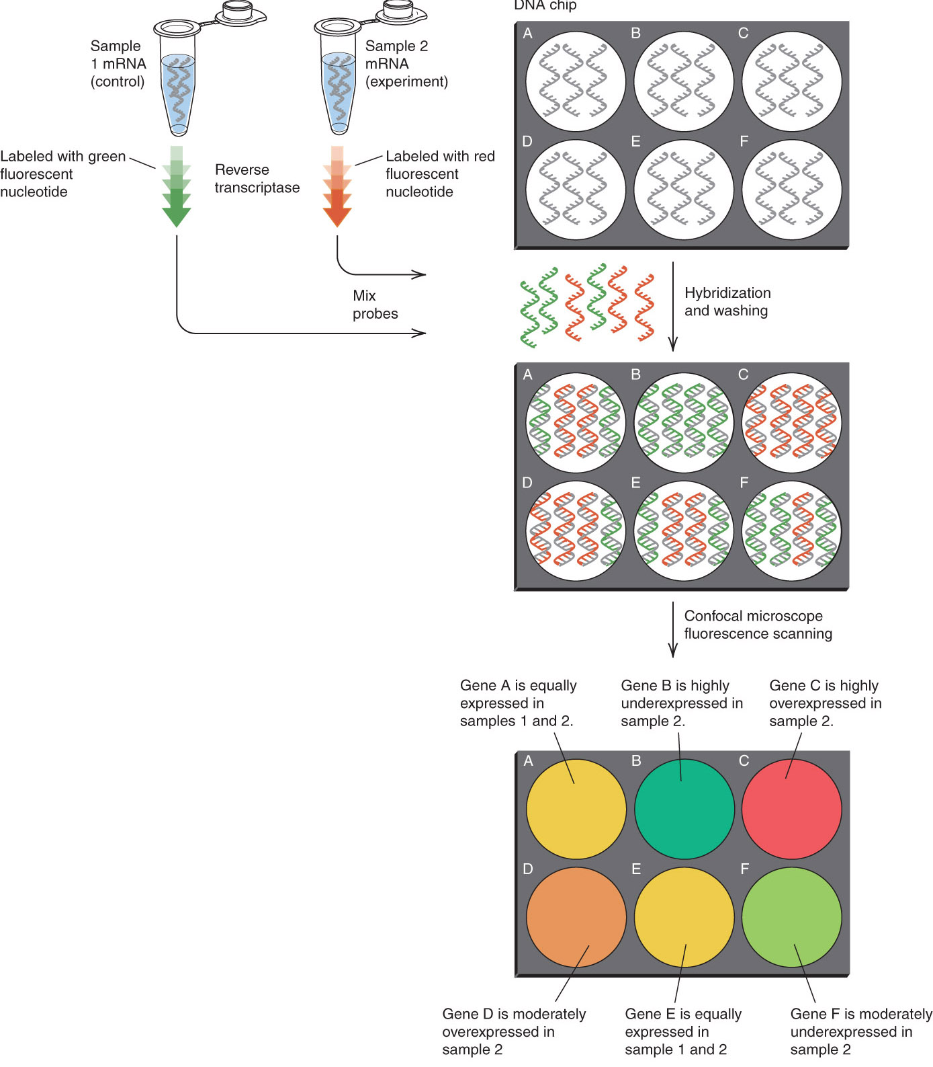
Figure
3.24

Slide 41
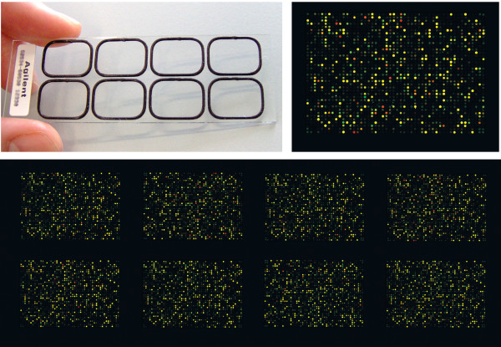

Slide 42
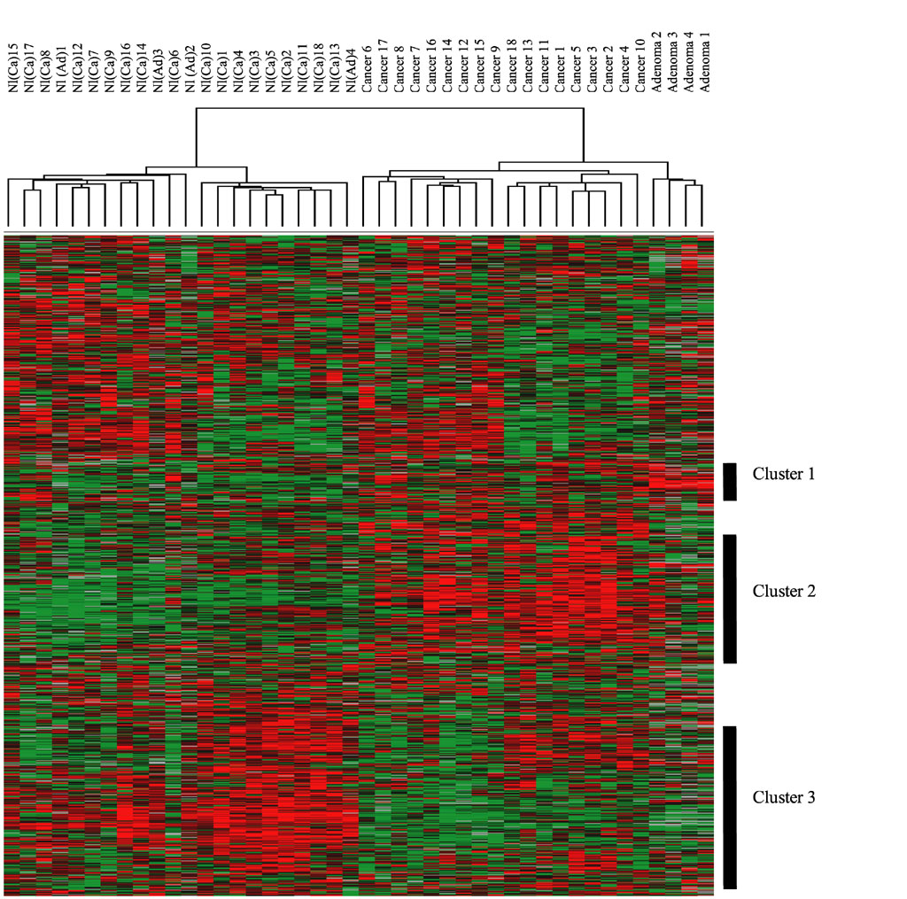
Microarray
analysis
for cancer
detection
and treatment
Already being
used in
hospitals

Slide 43
Molecular biology/genetic engineering technological
advancement continues to lead the way for new discoveries
and treatment of human disease which will affect your life

Slide 44
Types of DNA transformation:
Viral: virus vector to infect bacteria and inject DNA
Liposomes: DNA is coated with lipid membrane
And DNA/lipid complex fuses with plasma membrane
(used for mammalian cells)
Microinjection: DNA is injected into cells (usually
fertilized eggs)
Biolistics (nanospheres): DNA is coated on a bead
of gold or tungsten and fired into cell using gene gun
(plant cells)

Slide 45
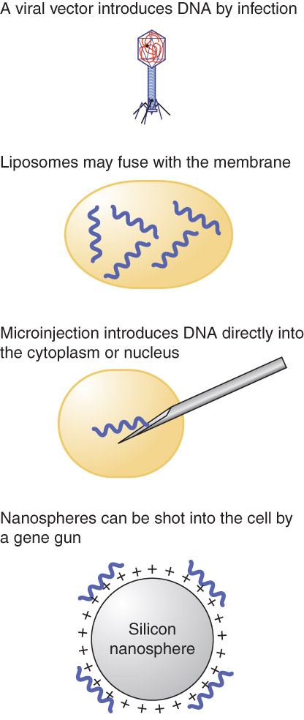
Figure 3.11

Slide 46
Nucleic Acid Detection:
to detect nucleic acids, they have to be denatured
nucleic acid probe of interest has to be labeled
radioactivity
fluorescently
nucleic acid is usually transferred from a gel to a
solid support (filter), probed, washed and then exposed
or probing can be done in cell (in situ hybridization)

Slide 47
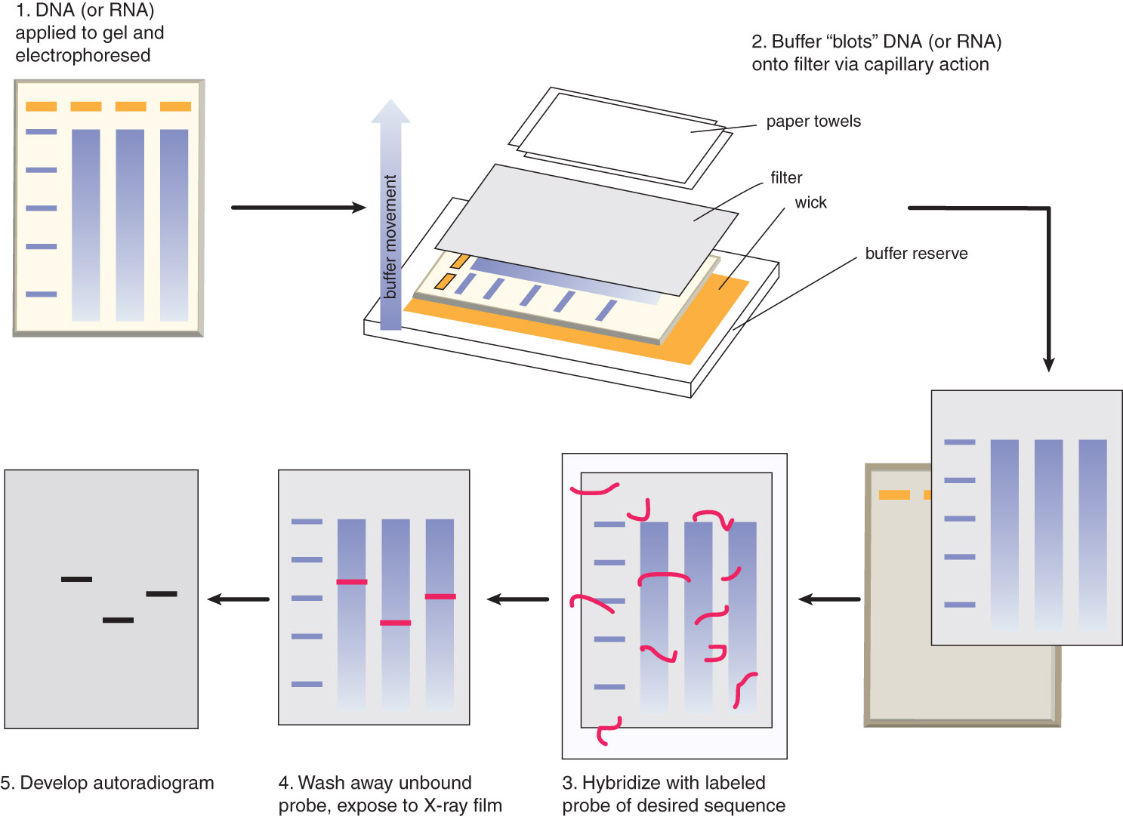
Southern Blotting procedure
Figure 3.21

Slide 48
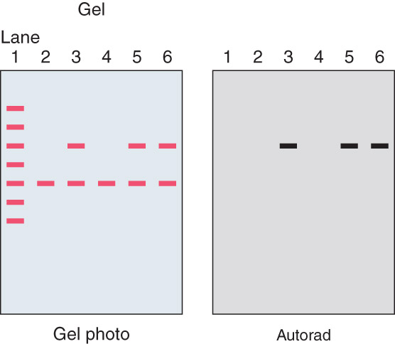
Figure 3.12
Southern Blot

Slide 49
Gene detection using hybridization:
if you have a gene that you want to identify its
location on a chromosome you use in situ hybridization
can take intact cells or mitotic chromosome spreads
and add denatured fluorescently labeled DNA probe.
Fluorescent In Situ Hybridization (FISH)

Slide 50
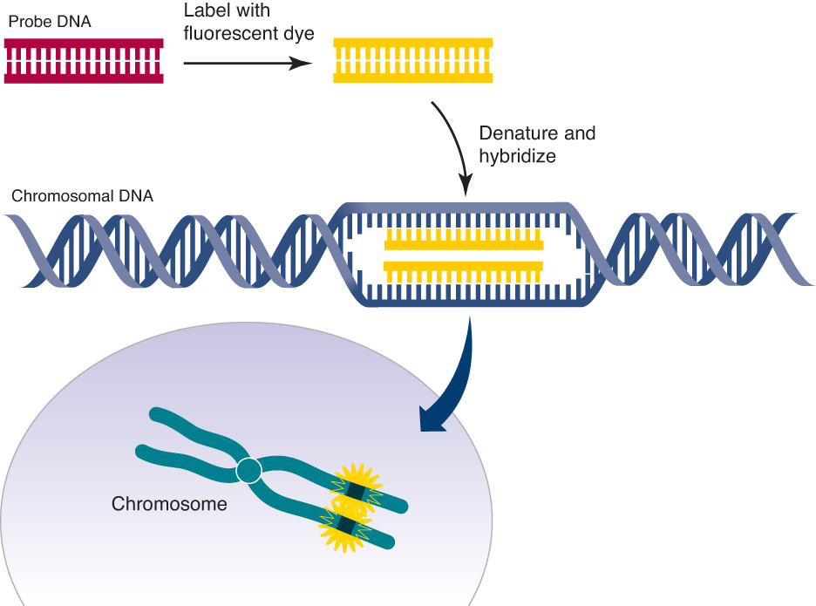
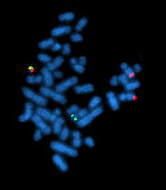
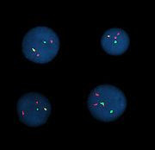
Mitotic
Figure 3.13
FISH
technique
Interphase

Slide 51
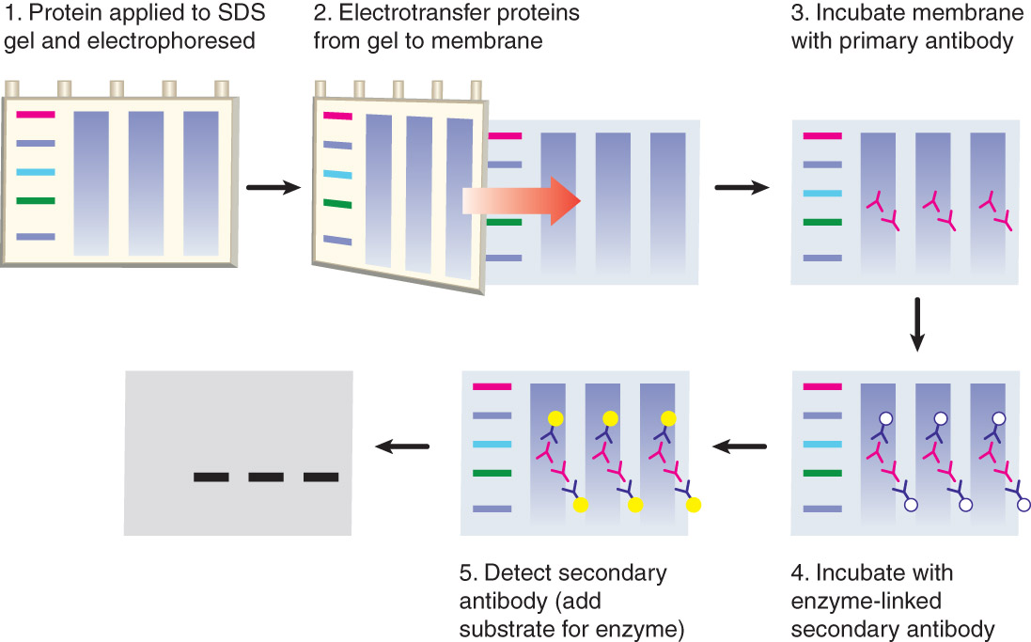
Western Blotting procedure
Figure 3.23

Slide 52
How are proteins visualized?
Chemiluminescence
Chemical generation of light
liquid
substrate
light
***
Enzyme
Horseradish
Peroxidase
(HRP)
2º Ab
1º Ab
Protein of interest

Slide 53
Western blot example

