Slide 1
55-213: Introductory Molecular Biology
Professor : Dr. Andrew Hubberstey
Office: Biology Building room 326
Email: please use CLEW site!
Office Hours: Wednesdays 1-3 PM
Starts January 15, 2014

Slide 2
Lecture Notes:
lecture attendance is critical
lecture notes for that week will be available on the web site
at the end of that week of lectures
Course Textbook:
Text Book: Lewin Genes XI (c 2014)
Author: Krebs, Goldstein, Kilpatrick
Publisher: Bartlett & Jones
All figures in lecture will be taken from Genes XI.
However, most are the same as in Genes X, so Genes X
should be fine for this course.

Slide 3
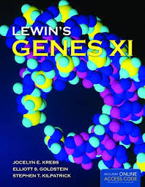

Access code is NOT required for this course

Slide 4
Course Grading
Midterm: 30% of the final grade
Tues. Feb. 11, 2014
Place: In class (additional rooms will be used)
Final Exam: 45% of the final grade
Thursday April 10th. 3:30PM Location:TBA
questions are multiple choice/short answer
going over mid-term exams will only be allowed for
two weeks following the exam
Lecture Assignment (5% total)
instructions to be given in class

Slide 5
Laboratories: 20%
Coordinator : Janice Tubman (tubmanj@uwindsor.ca)
Labs start week of January 13th
due to high students numbers, each lab will run on two
successive weeks (Weeks A and B)
therefore, students will be expected to come to lab
every other week
sign up for lab weeks (A or B) will be done on CLEW site
starting January 8th at 5PM!
go to sections in CLEW site
have to be in the officially signed in section
select either the week A or B section
deadline is Friday, January 10th by midnight

Slide 6
5 labs/semester held in Biology building room 303
if you cannot make a lab, you have to contact
Janice Tubman and arrange for an alternate time if
possible
Lab Marks:
lab component worth 20% of final grade
10% lab final exam (held in class, April 3rd)
10% (quizzes and/or assignments- 1/week)

Slide 7
Lab Sections
Section | # Enrol | Day | Time
51 | 50 | M | 2:30
52 | 35 | M | 6:30
53 | 50 | T | 8:30
54 | 46 | T | 6:30
56 | 50 | W | 2:30
57 | 21 | W | 6:30
58 | 39 | R | 6:30
*You have to sign up for a laboratory section!!
Use the wait list to try to enroll in another section*
Deadline for changing sections: Friday Jan. 10

Slide 8
Other course issues:
university policy for students to only use their
uwindsor email account when contacting professors
on course business and please use course web site for email
it is not permitted to post material from this class on
other web sites
please turn off cell phones prior to class starting
using computers for anything other than notes or
course work during lectures is prohibited

Slide 9
What I would like you to get out of this course:
why molecular biology is extremely important for your
lives
understanding of how your genome is organized and
functions
how molecular biology processes function in your cells
appreciation of how amazing these processes are and the
impact new molecular biology technology will have on
society

Slide 10
Why is molecular biology important to your lives?
molecular technology will revolutionize medicine in
the next 10-20 years and will affect everyone
understanding how diseases are caused
susceptibility genes for multigenic diseases (cancer,
heart disease, schizophrenia, autism)
everyone will have their own genome sequence
in the next decade

Slide 11
Your Genome:
How much DNA does each of your cells contain?
1 metre- 3 billion nucleotides
GACGTCTGCGTGGTCAGACT
GTGCCCACATGGGGCCCGGG
ACACCCAACTGCCGCCTGCT
CTACTCATACCTCAATGATA
GGCAGCGCCACGGGCTGGCC
How long would it take to read your genome?
57 years!

Slide 12

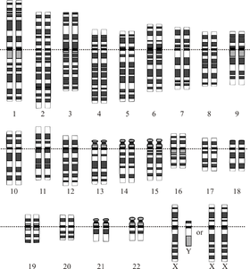
Human Genome project: completed April, 2003
entire nucleotide sequence of our chromosomes
20-25,000 genes
cost about $3 billion
Human genome: Quality assessment of the human
genome sequence. Nature 429, 365-368 (27 May 2004)

Slide 13
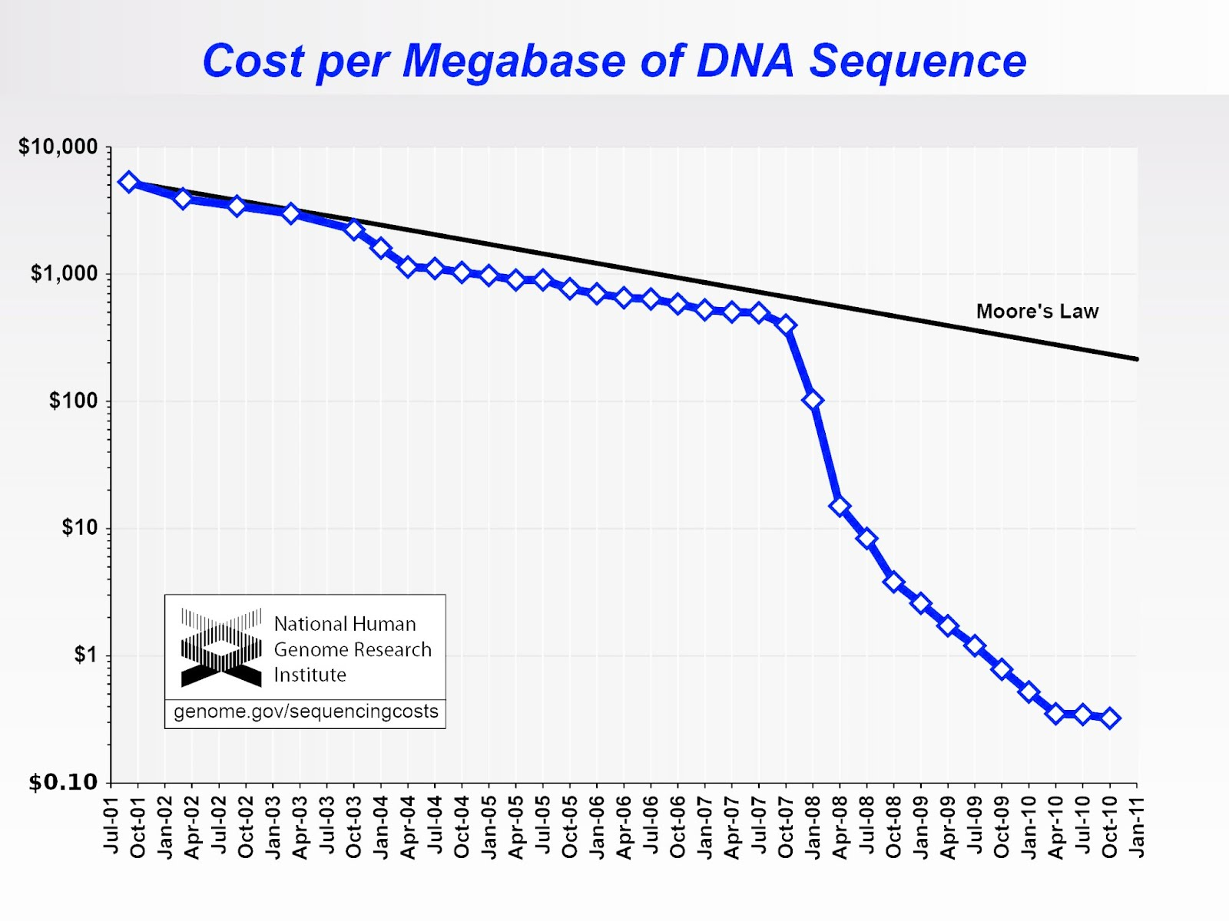

Slide 14
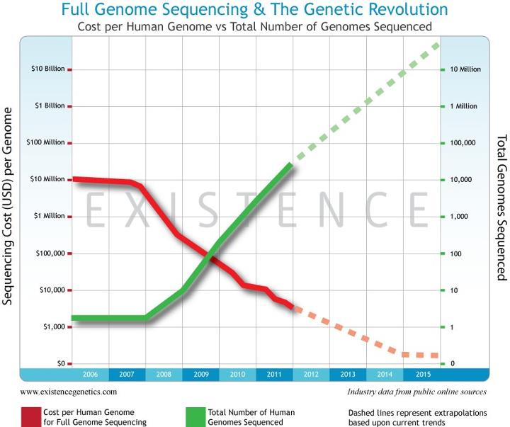

Slide 15
Personalized medicine:
Your individual genome sequence
~$100 within 3-5 years
determine susceptibility to disease
which medications you will respond to or react to:
32,000 deaths/year due to adverse side effects of
prescription drugs
will be used in doctor’s offices in next 10 years
important to understand what this information means

Slide 16
What can you get today for $99?
Not complete genomic sequence
Sequences of thousands of genetic markers,
>1,000,000 base pairs
https://www.23andme.com/
(Anne Wojcicki and Linda Avey)

Slide 17
Personalized medicine:
Using genomic information for disease discovery,
treatment and drug effectiveness (pharmacogenomics)
http://www.youtube.com/watch?v=K0YAeC4oeEY

Slide 18
Ethical questions:
What to do with this information without treatment for
some diseases?
Psychological impacts on individuals and their disease risks
Impacts on insurance policies and job security

Slide 19
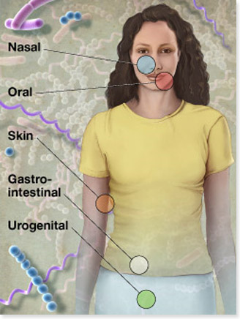

Other genome projects
How many of your own cells in your body?
20-30 trillion
How many total cells in/on your body?
150 trillion
Human
Microbiome
Project
http://nihroadmap.nih.gov/hmp/

Slide 20
Bacterial diversity on the human body
Very few bacterial species can be cultured in lab (<10%)
New DNA sequencing technologies can now identify
many unknown bacterial species without culturing
http://www.plosone.org/article/info%3Adoi%2F10.1371%2Fjournal.pone.0047712

Slide 21
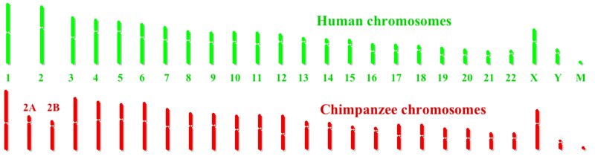
Genomes and Evolution
2.7% of genomes are different
some genes have been mutated or duplicated
FoxP2: differs by two amino acids
involved in speech development

Slide 22
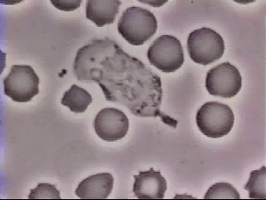
Molecular signals:
How do our cells respond to environmental signals?

Slide 23
http://www.youtube.com/watch?v=CaDgC0h8xYw

Slide 24
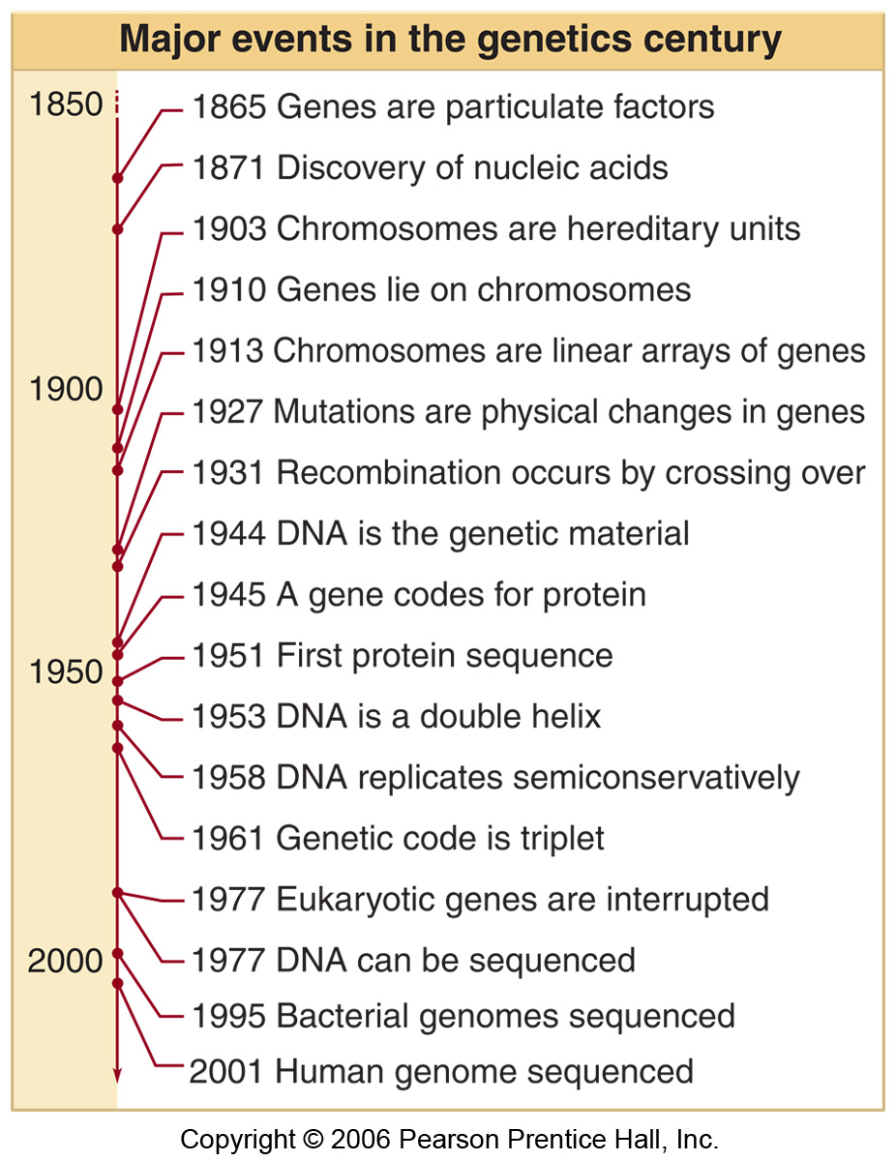
History of Molecular
Biology
Fig 1.1

Slide 25






Other genomes sequenced

Slide 26
5 questions
What is a gene?
What is an allele?
What is transcription?
What is translation?
What is a single nucleotide polymorphism?

Slide 27
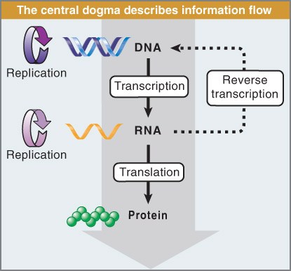
DNA replication:
DNA polymerase
dsDNA
dsDNA
Transcription:
RNA polymerase
dsDNA
ssRNA
Reverse Transcription:
Fig 1.19
Reverse transcriptase
ssRNA
dsDNA

Slide 28
What is the definition of a gene???
sequence of DNA that encodes a functional RNA molecule;
In protein coding genes, the RNA in turn codes for
protein
some genes encode RNA that is not translated into
protein
e.g.??
Ribosomal RNA (rRNA)
Transfer RNA (tRNA)
Micro RNAs (miRNA- 26-31 nucl.)
much more numerous than
first thought- play roles in
regulating gene expression
PIWI RNAs (piRNA- 21-24 nucl.)
Small inhibitory RNAS (siRNA)

