Slide 1
Chapter 15
Capital Investment Analysis

Slide 2
Objectives
Evaluate capital investment proposals using the present value method.

Slide 3

Capital Budgeting
Describes how managers plan significant outlays on projects that have long-term implications such as the purchase of new equipment and introduction of new products.

Slide 4
Time Value of Money
Payments now differ from payments in the future due to interest
Applicable to both personal and business decisions

Slide 5
Compound Interest Computations
Present value of a single amount
Future value of a single amount
Present value of an annuity
Future value of an annuity

Slide 6
Future Value of Single Amount
Known amount of single payment or deposit
Future Value
+ Interest =

Slide 7
Future Value of a Single Amount Example
If you invest $10,000 today @ 10% compound interest, what will it be worth 3 years from now?
invest
$10,000
Future Value?
Yr. 1
Yr. 2
Yr. 3
+ Interest @ 10% per year

Slide 8
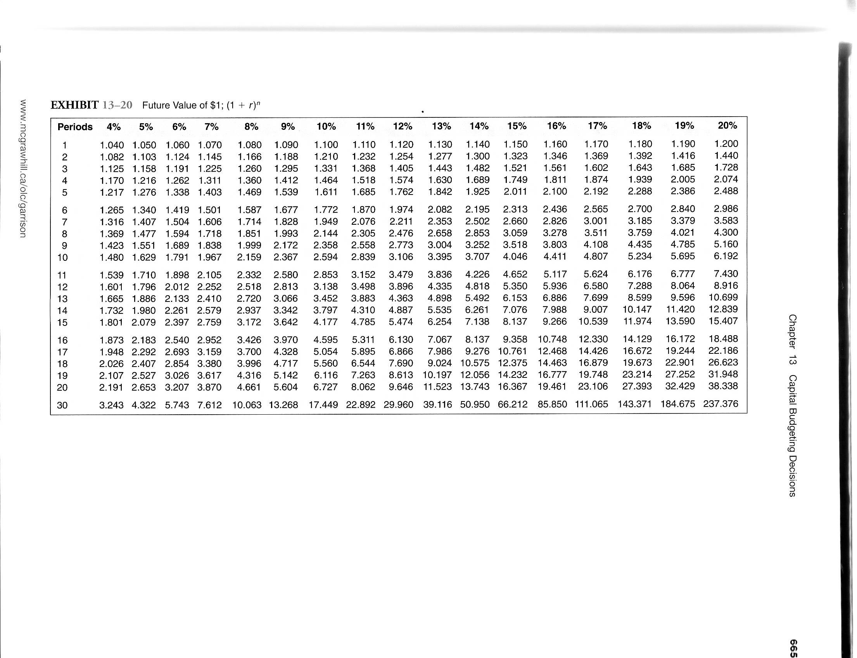
Future Value of a Single Amount Example - Using Formulas
n
FV = PV (1 + i)
3
= $10,000 (1.10)
= $13,310

Slide 9
Present Value of Single Amount
Known amount of single payment
in future
Present Value
Discount
34

Slide 10
Present Value of a Single Amount Example
If you will receive $10,000 in three years, what is it worth today (assuming you could invest at 10% compound interest)?
Present Value?
$ 10,000
Yr. 1
Yr. 2
Yr. 3
Discount @ 10%

Slide 11
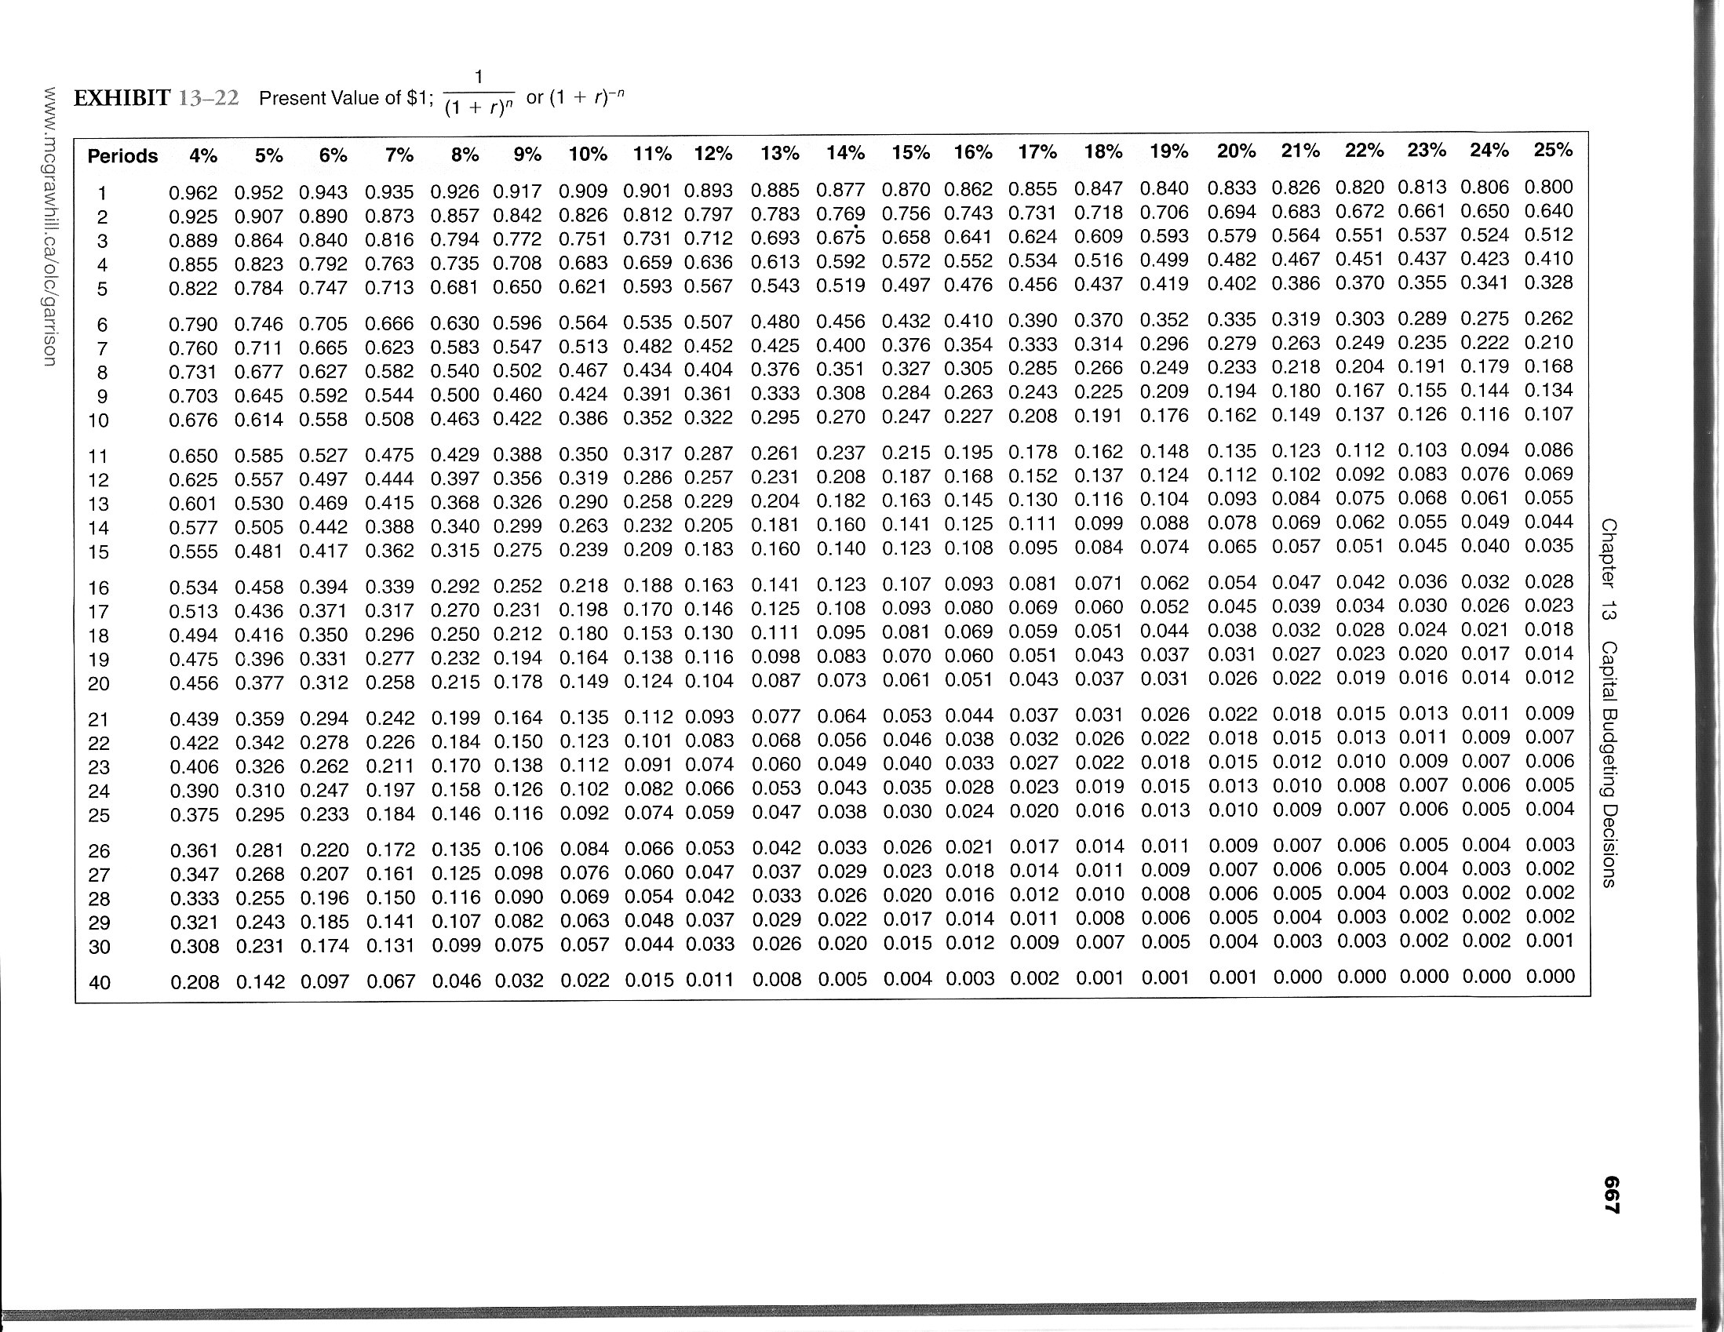
Present Value of a Single Amount Example - Using Formulas
-n
PV = FV x (1 + i)
-3
= $10,000 x (1.10)
= $7,513

Slide 12
Future Value of an Annuity
Periods
1 2 3 4
$0 $3,000 $3,000 $3,000 $3,000
+Interest
Future
Value?

Slide 13
Future Value of Annuity Example
If we invest $3,000 each year for four years at 10% compound interest, what will it be worth 4 years from now?
Yr. 1 Yr. 2 Yr. 3 Yr. 4
$0 $3,000 $3,000 $3,000 $3,000
FV ??

Slide 14
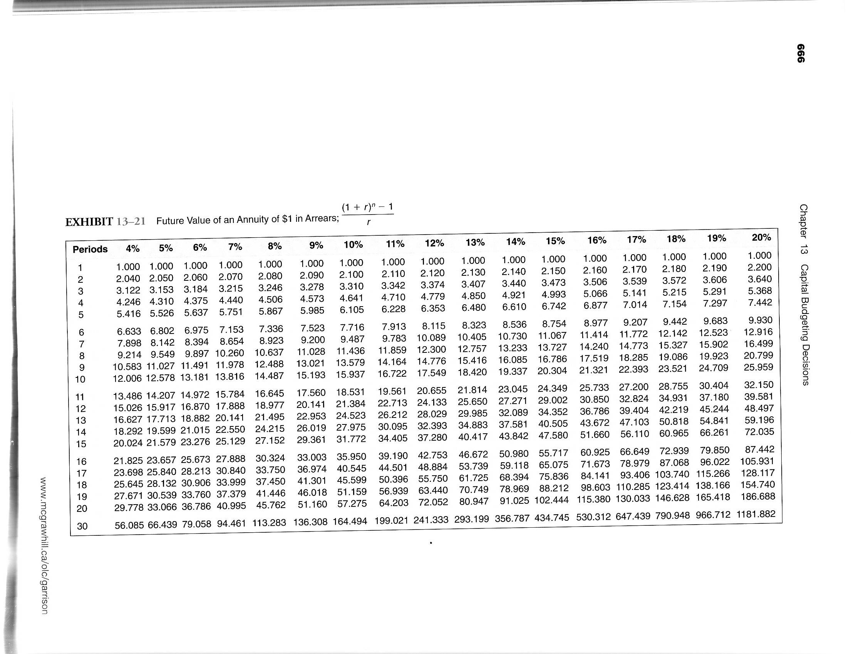
Future Value of Annuity Example
Using formula:
  R × (1 + i) ^{n} – 1
  i
  = $3,000 x (1 + 10%) ⁴ – 1
  10%
  = $13,923

Slide 15
Present Value of an Annuity
Periods
1 2 3 4
$0 $500 $500 $500 $500
Discount
Present
Value ?

Slide 16
Present Value of an Annuity Example
What is the value today of receiving $4,000 at the end of the next 4 years, assuming you can invest at 10% compound annual interest?
Yr. 1 Yr. 2 Yr. 3 Yr. 4
$0 $4,000 $4,000 $4,000 $4,000
PV ??

Slide 17
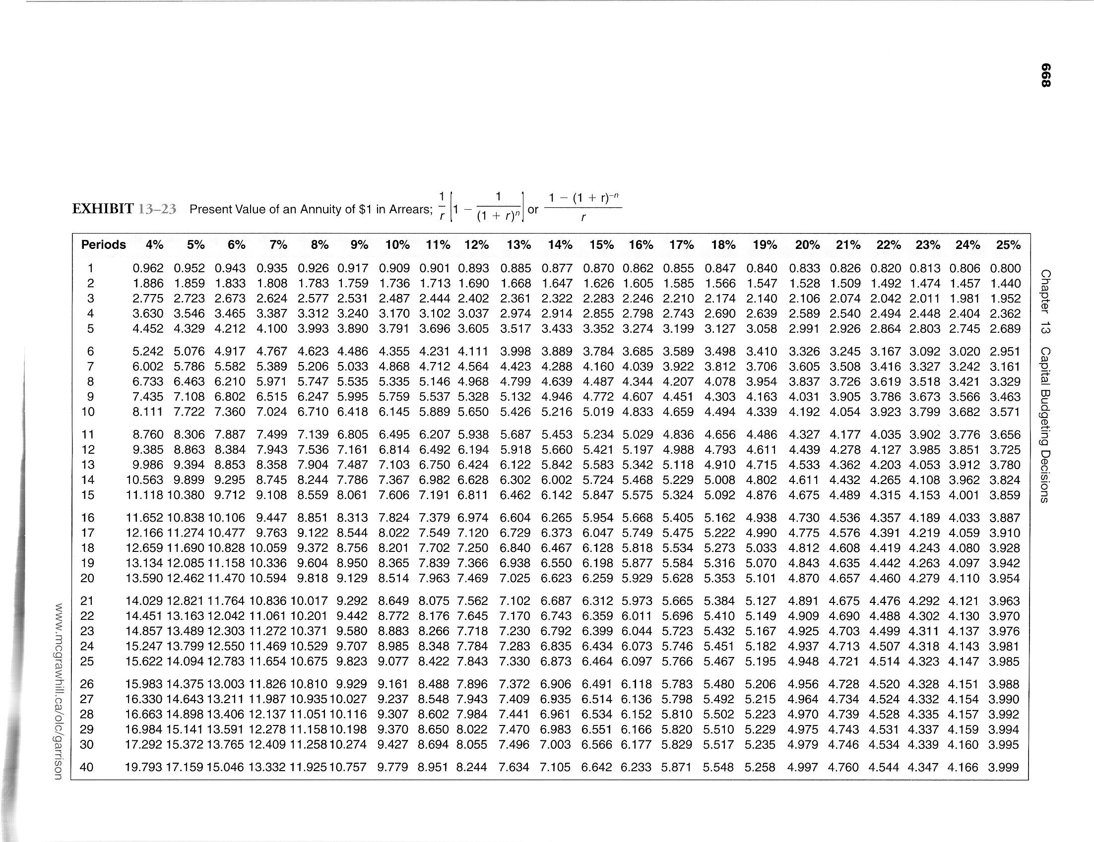
Present Value of Annuity Example
Using formula:
  R × 1 - (1 + i) ^{-n}
  i
  = $4,000 x 1 - (1 + 10%) ⁻⁴ 10%
  = $12,679.48

Slide 18
Typical Cash Outflows
Repairs and Maintenance
Increased operating costs
Initial Investment
Overhaul of equipment

Slide 19
Typical Cash Inflows
Salvage Value of Old Equipment Today
Salvage Value of New Equipment at End of Useful life
Reduction of operating costs
Incremental revenues

Slide 20

The Net Present Value Method
To determine net present value, we . . .
Calculate the present value of cash inflows
Calculate present value of cash outflows
Subtract the present value of the outflows from the present value of the inflows.

Slide 21
Choosing an Interest Rate
The firm’s cost of capital is usually regarded as the most appropriate choice for the discount rate.
The cost of capital is the average rate of return the company must pay to its long-term creditors and shareholders for the use of their funds.

Slide 22
The Net Present Value Method
General Decision Rule:
If the net present value (NPV) is | Then the project is
Positive (+) | Acceptable
Zero | Acceptable
Negative (-) | Not acceptable

Slide 23
Net Present Value
Chancellor Industries is considering making a new product:
Cost of equipment needed | $ 60,000
Salvage value of equipment in 5 years | 10,000
Annual cash revenue and costs:
Sales revenues | 200,000
Cost of goods sold | 125,000
Salaries, shipping, etc | 35,000

Slide 24
NPV
Annual net cash inflows from operations
Sales revenues | $200,000
COGS | 125,000
Salaries, shipping, etc | 35,000
Annual net cash inflows | $40,000

Slide 25
The Net Present Value Method
 | Yrs. | Cash flows | PV Factor | PV (at 5%)
Investment in new equip. | Now | $ (60,000) | 1 | $ (60,000)
Annual net cash inflows | 5 | 40,000 | 4.329 | 173,160
Salvage value of equip. | 5 | 10,000 | 0.784 | 7,840
Net Present Value |  |  |  | $ 121,000
Accept the project because the NPV is positive.

Slide 26
A General Model for
Net Present Value (NPV) Analysis
Calculate Net Present Value of
Initial Investment | (-)
Salvage value (of old) | (+)
Cost of Overhauls | (-)
Operating Costs | (-)
Net Annual cash inflows | (+)
Salvage Value in the future | (+)

Slide 27
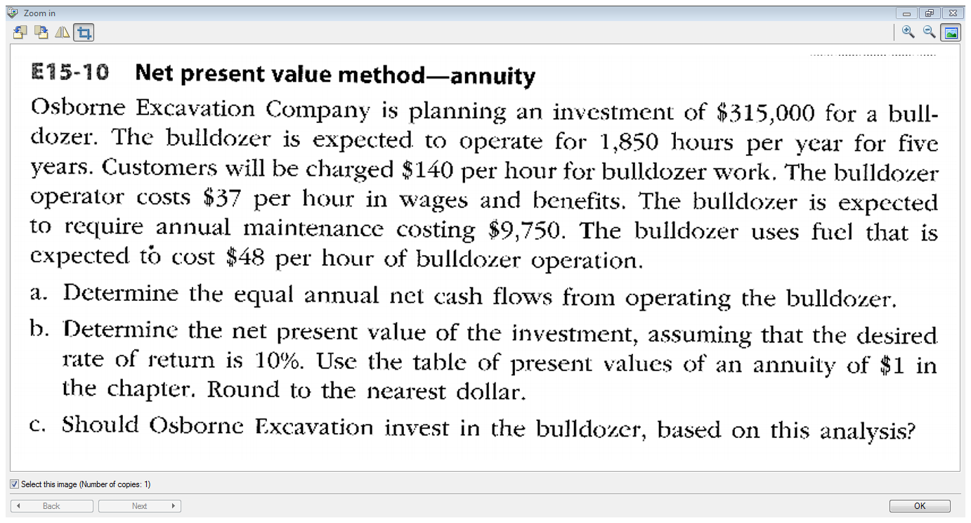

Slide 28
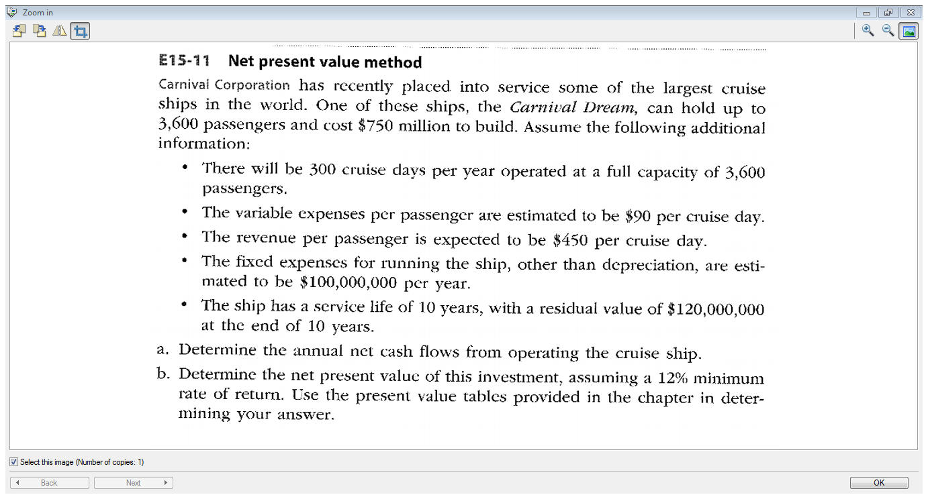
Notes:
28

Slide 29

End of the course!

