Slide 1
Chapter 14
Performance Evaluation for Decentralized Operations

Slide 2
Learning Objectives
Describe the advantages and disadvantages of decentralized operations.
Prepare a responsibility accounting report for a cost center.
Prepare a responsibility accounting report for a profit center.
Compute and interpret the rate of return on investment, the residual income, and the balanced scorecard for an investment center.

Slide 3
Centralized and Decentralized Operations
Centralized business – all major planning and operating decisions are made by top management.
Decentralized business – separating a business into divisions and delegating responsibility to unit managers.
  Divisions are structured around common functions, products, customers, or regions.

Slide 4
Decentralization in Organizations
Benefits of
Decentralization
Top management
freed to concentrate
on strategy.
Lower-level managers
gain experience in
decision-making.
Decision-making
authority leads to
job satisfaction.
Lower-level decision
often based on
better information.
Lower level managers can respond quickly to customers.

Slide 5
Decentralization in Organizations
May be a lack of
coordination among
autonomous
managers.
Lower-level managers
may make decisions
without seeing the
“big picture.”
Disadvantages of
Decentralization
Lower-level manager’s
objectives may not
be those of the
organization.
May be difficult to
spread innovative ideas
in the organization.

Slide 6
Responsibility Accounting in Decentralized Operations
Responsibility accounting is the process of measuring/reporting operating data by responsibility center.
A responsibility center is the area for which a unit manager is responsible.
Types of Responsibility Centers
Cost Centre $ | Profit Centre | Investment Centre

Slide 7
Types of Responsibility Centres
Cost Centre – Manager has control over the costs but not over revenues or investment funds.
Performance Evaluation – Budget Performance Report comparing actual controllable costs to budget data
 | Budget | Actual | Variance
Utilities | 4,500 | 4,600 | 100 U

Slide 8
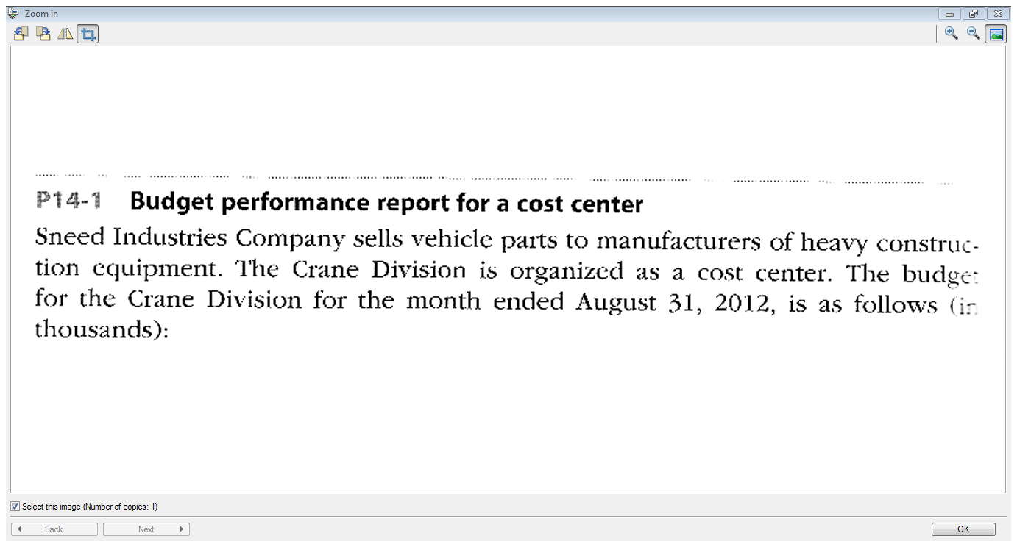
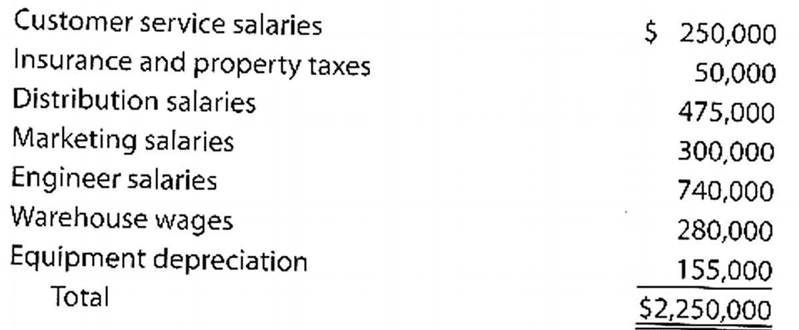

Slide 9
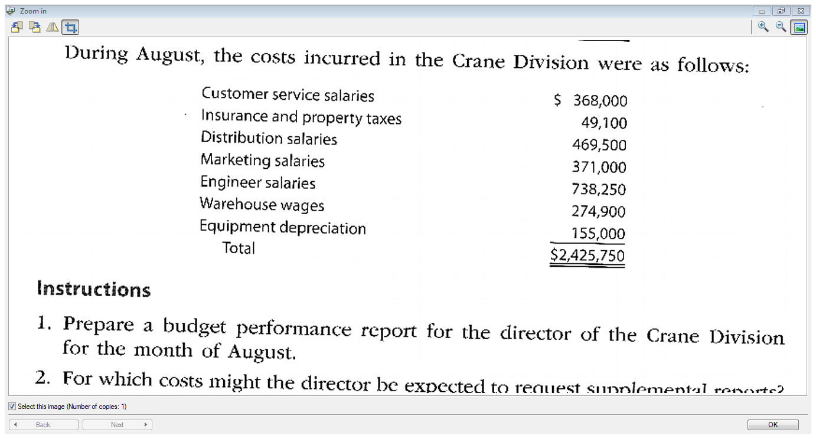

Slide 10
Types of Responsibility Centres
Profit Centre – A segment whose manager has has control over both costs and revenues but not control over investment funds
Performance Evaluation – Compare actual results to flexible budget
Revenues:
Sales
Interest
Other
Costs
Manufacturing Costs
Commissions
Salaries
Other
Profit

Slide 11
Types of Responsibility Centres
Investment Centre – A segment whose manager has has control over costs, revenues and investments in operating assets.
Performance Evaluation – Rate of Return on the Investment base or Residual Income

Slide 12
Evaluating Investment Centre Performance
ROI
= Income from Operations Invested assets

Slide 13
Return on Investment (ROI)
Jabot Cosmetics reports the following:
Operating Income $ 30,000
Invested assets 200,000
Sales 500,000
ROI = $30,000 = 15%
$200,000

Slide 14
Return on Investment (ROI)
We can modify our original formula slightly:
 | Profit Margin × Investment Turnover
ROI = | Income from Operations Sales | Sales Invested assets
= | $30,000 $500,000 | $500,000 $200,000
= | 6% | × 2.5
= | 15%

Slide 15
Residual Income (RI)
Residual Income
  = Operating Income
  – (Minimum rate of return × Invested Assets)
RI is net income above some minimum required return on operating assets

Slide 16
Residual Income (RI)
For example, Montgolfières Inc. has invested assets of $100,000 and is required to earn a return of 20% on these assets. In the current period, the division has operating income of $30,000.
Invested Assets | $100,000
Minimum rate of return | × 20%
Minimum return | $20,000
Operating Income | $30,000
Minimum return | $20,000
Residual Income | $10,000

Slide 17
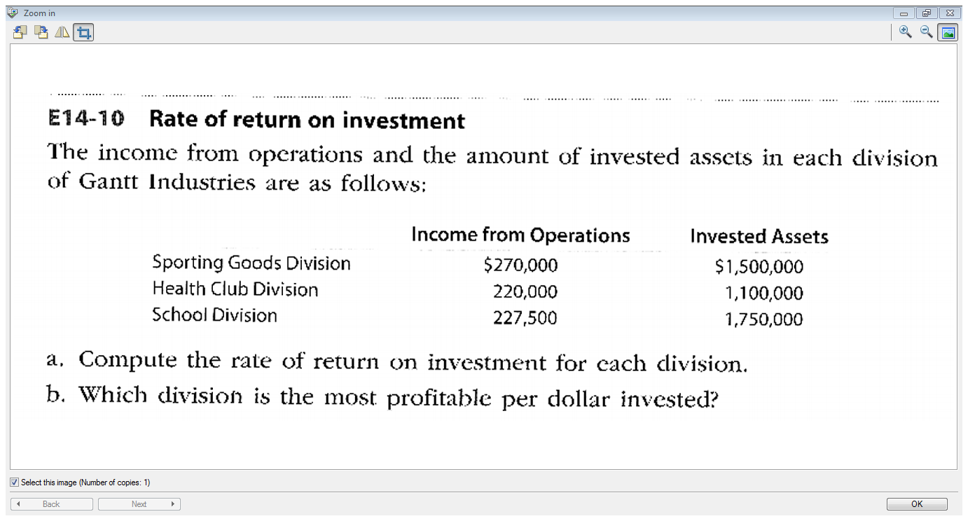

Slide 18
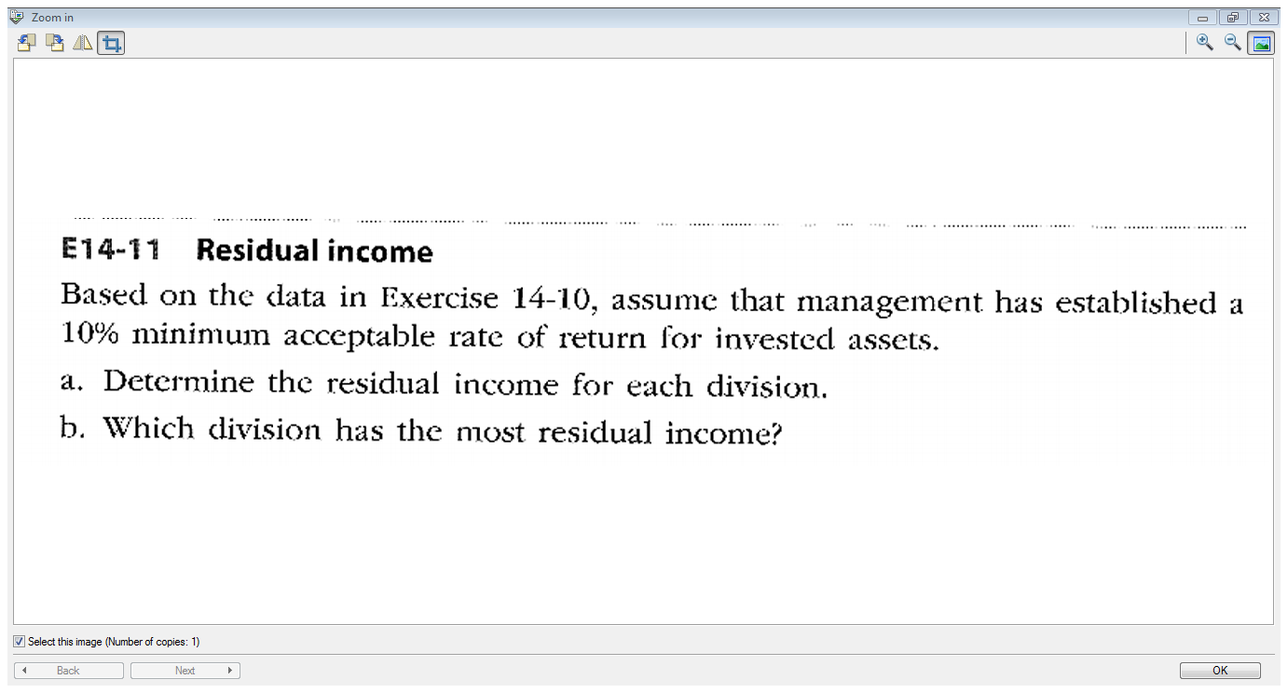
c. Each division is presented with an opportunity to expand. It will cost $100,000 and increase operating income by $10,000 each year.
  i) If the manager is evaluated based on Return on Investment, should they expand?
  ii) If the manager is evaluated based on Residual Income, should they expand?

Slide 19
End of Chapter 14

