Slide 1
Chapter 10
Accounting Systems for Manufacturing Businesses

Slide 2
Learning Objectives
Describe the differences between financial and managerial accounting.
Distinguish the activities of a manufacturing business from those of a merchandising or service business.
Define and illustrate materials, factory labour, and factory overhead costs.
Describe cost accounting systems used by manufacturing businesses.
Describe and illustrate a job order cost accounting system.
Use job order cost information for decision making.

Slide 3
Objectives, continued
Describe the flow of costs for a service business that uses a job order cost accounting system.
Describe just-in-time manufacturing practices
Describe and illustrate the use of activity-based costing in a service business.

Slide 4
Management Accounting
How much should we sell each glass for?
Should we buy a lemonade making machine?
Do we grow our own lemons or buy them?
We could sell lemonade at the soccer tournament at a special price.
If we sell 2 more glasses of lemonade, how much more profit will we make?
How many lemons do we need to buy next week?

Slide 5
Nature of Manufacturing Businesses
Service firms earn revenue from providing services.
Merchandising firms earn revenue from selling merchandise inventory.
Manufacturing firms…
  Earn revenue from manufacturing and selling finished goods.

Slide 6
Balance Sheet
Merchandiser
Cash
Receivables
Prepaid Expenses
Merchandise Inventory
Manufacturer
Cash
Receivables
Prepaid Expenses
Inventories
  Raw Materials
  Work In Process
  Finished Goods
Notes:
6

Slide 7
Manufacturing Cost Terms
Two broad categories of Manufacturing Costs:
  Direct – cost can be directly and conveniently traced to final product
  Indirect - cost can not be directly traced to final product or it may be insignificant or inconvenient to do so

Slide 8
Manufacturing Costs (Product Costs)
Prime Cost
Conversion Cost
Direct Labour wages of employees who are directly involved in assembly process
Factory Overhead
– all indirect costs
Direct Materials
cost of any material that is an integral part of the finished product
Notes:
8

Slide 9
Manufacturing Cost Terms
Direct |  | Indirect
Direct Materials | Direct Labour | Manufacturing Overhead
Sugar | Wages of those making the lemonade | Electricity
Lemons |  | Plant Manager’s Salary
Water |  | Insurance
 |  | Maintenance & Repairs on Equipment
 |  | Depreciation on Machinery
 |  | Rent

Slide 10
Product Costs vs Period Cost
Period Cost (all non-manufacturing costs)
  Expensed on the income statement in the period that they are incurred.
  Includes all selling & administrative expenses
    Selling costs – Example: advertising, travel, shipping, sales commissions, etc.
    Administrative costs – Example: Accounting, IT, executive compensation, etc
Notes:
10

Slide 11
Product Costs vs Period Cost
Product Cost (all manufacturing costs)
  Direct Materials, Direct Labour & Overhead
  Charged to inventory accounts until product is sold

Slide 12
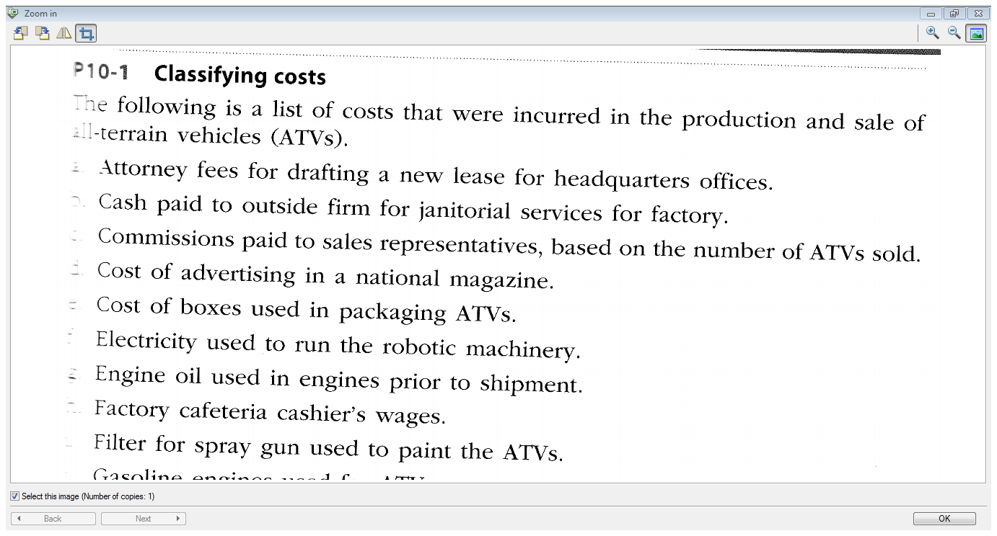

Slide 13
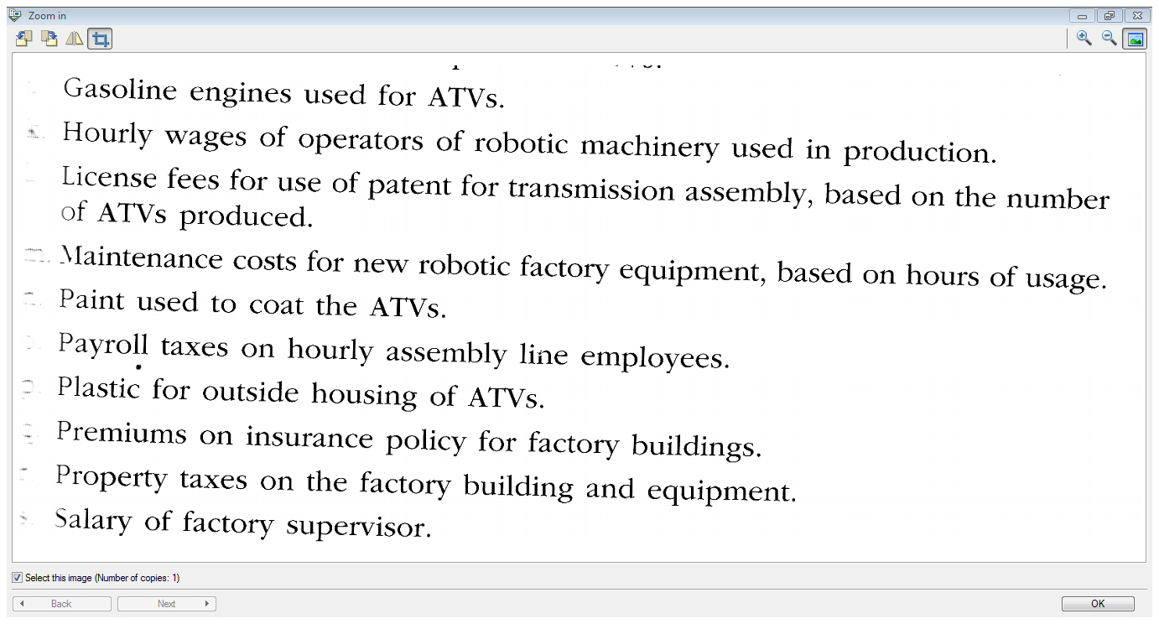

Slide 14
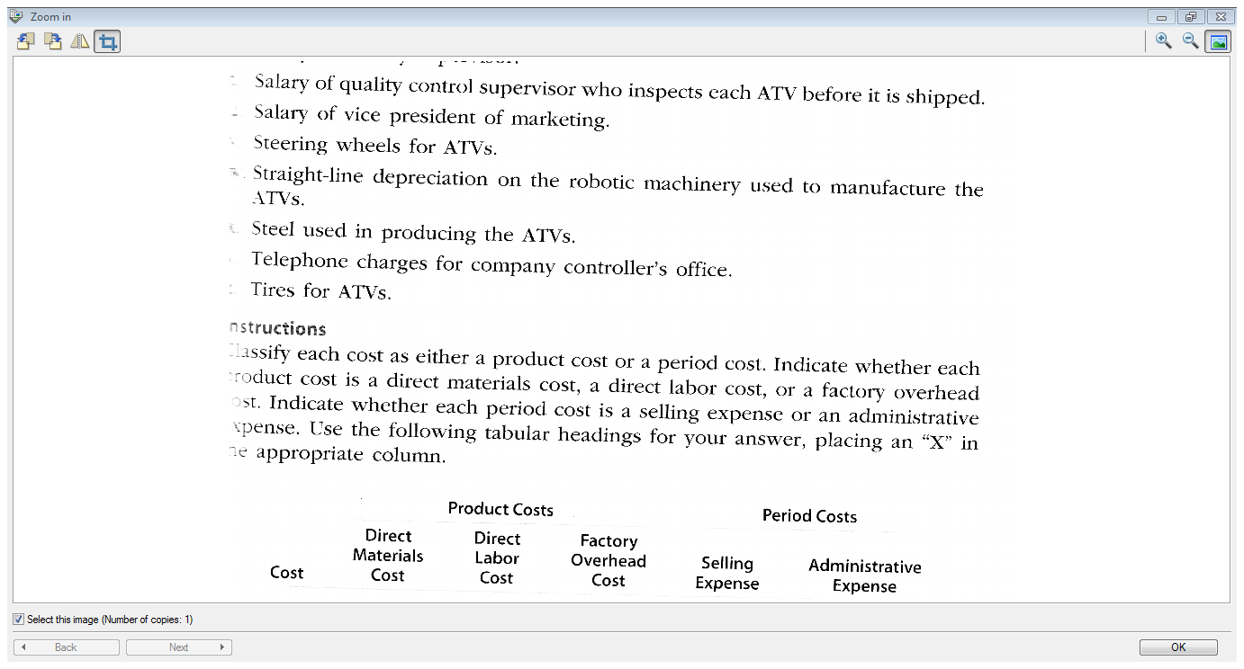

Slide 15
Cost Accounting Systems
Objective: accumulate product costs
Used to establish prices, control operations, and give price data
Two main types:
  Job order cost systems – Often used by companies that make custom products for customers or batches of similar products.
  Process cost systems – make units of product that are indistinguishable from each other

Slide 16
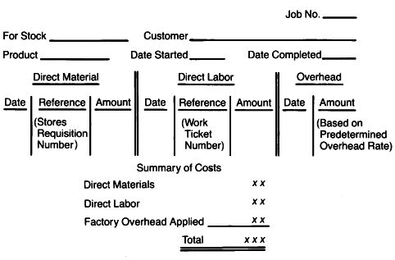
Job Cost Sheet

Slide 17
Manufacturing Cost Flows
Costs | Balance Sheet Inventories | Income Statement Expenses
Direct Materials
Raw Materials Inventory
Direct Labour
Work in Process
Manufacturing Overhead
Cost of Goods Sold
Finished Goods

Slide 18
Materials
Accounting for the purchase of materials on credit
A = | L | + E
Materials Inventory + $1,000 | Accounts Payable + $1,000

Slide 19

Requisitioning Materials
Flow of materials from the storeroom to production.
A = |  | L | + E
Materials Inventory - $9 | Work In Process + $9

Slide 20
Materials Requisition Form
Requisition # | A-143 | Date: November 1, 2013
Job # 2013-01 | Department: Stirring
Description | Quantity | Unit Cost | Total Cost
Sugar | 2 cups | $3.00 | $ 6.00
Eureka lemons | 6 | $0.50 | 3.00
 |  |  | $ 9.00
Signature:

Slide 21
Job Cost Sheet – update for materials requisition
2013-01
11/1/13
A-143
9.00

Slide 22
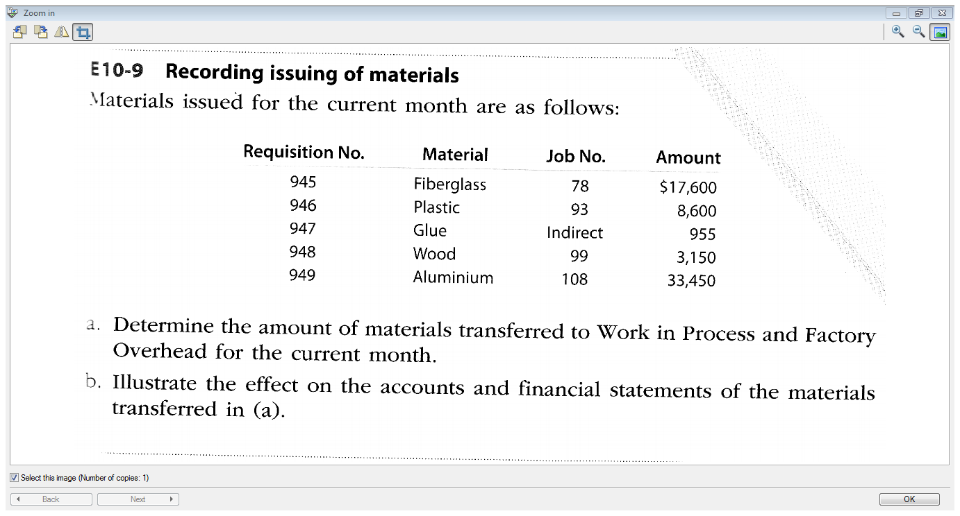

Slide 23
Employee Time Ticket
A = | L | + E
Work In Process + $40 | Wages Payable + $40
Two primary objectives:
  Determine the correct amount to pay each employee for each pay period.
  Properly allocate factory labor costs to factory overhead and individual job orders.
Notes:
23

Slide 24
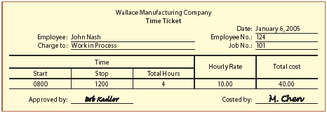
Employee Time Ticket
Indicates what jobs an employee worked on for the week, broken down by Job Number.
11/1/13
2013-01

Slide 25
Job Order Cost Sheet – update for time ticket
2013-01
11/1/13
A-143
9.00
11/1
Empl#124
40.00

Slide 26
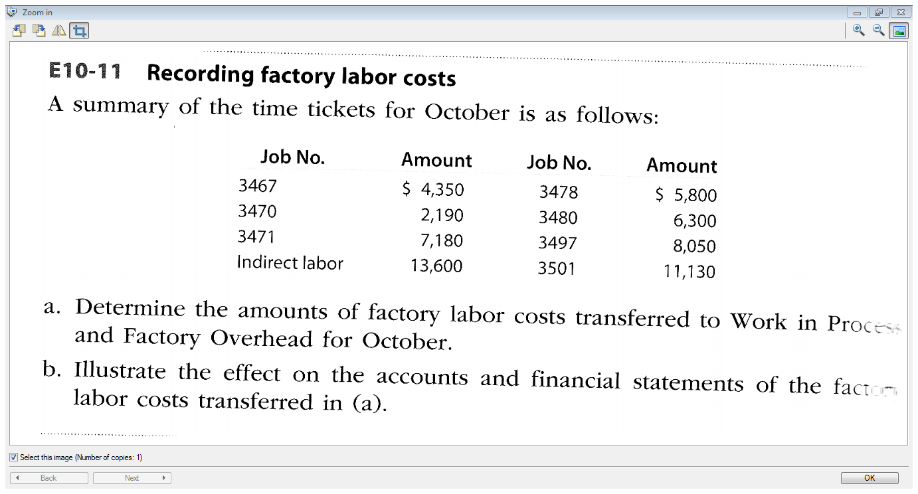

Slide 27
Factory Overhead Cost
Includes all manufacturing costs other than direct materials and direct labor.
Comes from various sources, including depreciation, indirect materials, indirect labor, and factory utilities.
A = |  |  | L |  | + E
Materials Inventory - $500 | Factory Overhead +$4,600 | Accum. Depreci-ation - $1,200 | Wages Payable + $2,000 | Utilities Payable + $900

Slide 28
Allocating Factory Overhead
Overhead gets assigned to jobs through cost allocation
The measure used to allocate overhead is called an activity base
  Should be a measure that reflects the consumption or use of overhead
  Examples: direct labor hours, machine hours, or direct material dollars

Slide 29
Predetermined Factory Overhead Rate
Estimated Total Factory Overhead
Estimated Total Level of the Activity Base
Overhead may be applied using a
Predetermined Factory Overhead Rate

Slide 30
Predetermined Factory Overhead Rate (PFOR)
Assume Julianne’s Lemonade Stand estimates $50,000 of total factory overhead for the year and the activity base to be 10,000 direct labor hours.
Estimated Total Factory Overhead
Estimated Total Level of the Activity Base
= $50,000
10,000 Direct Labour Hours
= $5/Direct Labour Hour

Slide 31
Why Use Predetermined Rates?
For timely information
Waiting until the end of a period when overhead costs are known would be accurate, but not timely for decision-making
Some companies use activity-based costing - it allocates overhead costs using multiple predetermined rates

Slide 32
Assigning Manufacturing Overhead to Each Job
So the Predetermined Overhead Rate is $5 per Direct Labour Hour.
In our example, the job incurred 4 direct labour hours.
We apply overhead to the job based on actual direct labour hours incurred by the job.
4 hours x $5/DLH = $20
Overhead applied = PFOR × Actual activity

Slide 33
Job Order Cost Sheet
2013-01
11/1/13
A-143
9.00
11/1
Empl#124
40.00
11/1
20.00
9.00
40.00
20.00
69.00

Slide 34
Applying Factory Overhead to Work in Process
The $20 of applied overhead is recorded as a transfer out of factory overhead into work in process.
A = |  | L | + E
Factory Overhead - $20 | Work In Process + $20

Slide 35
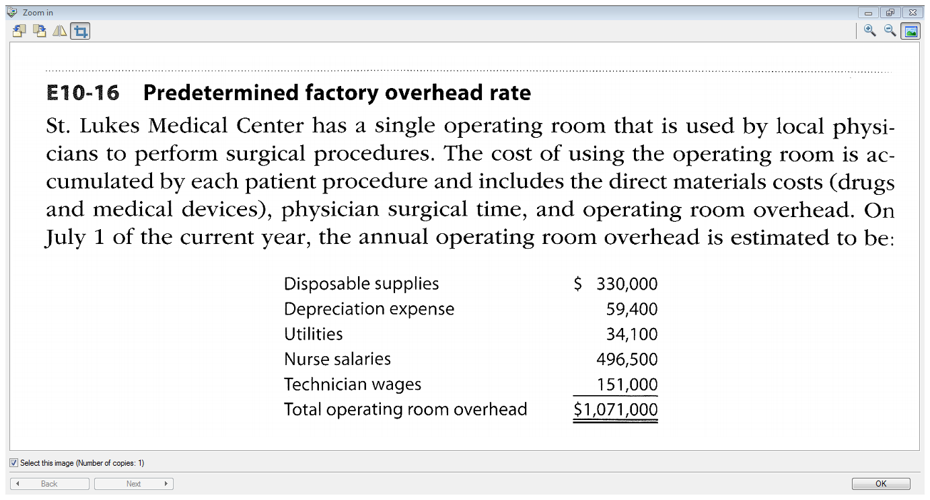

Slide 36
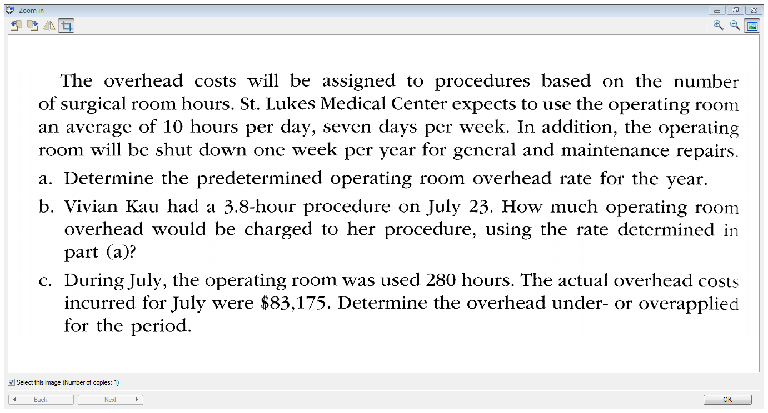

Slide 37
Actual Overhead vs. Applied Overhead
Actual factory overhead costs incurred will likely differ from the amount applied
Over-applied overhead occurs when the amount applied exceeds actual costs
Under applied overhead occurs when the amount applied is less than actual costs
Large under-/over-applied balances need to be investigated

Slide 38
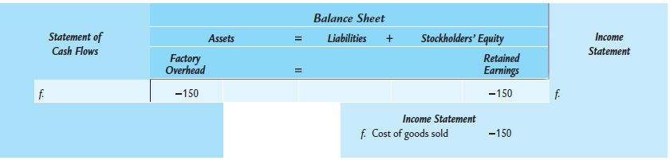
Disposal of Factory Overhead Balance
The balance in factory overhead is carried forward from month to month, but needs to be closed out at the end of the year.
One approach is to transfer the balance to cost of goods sold.

Slide 39
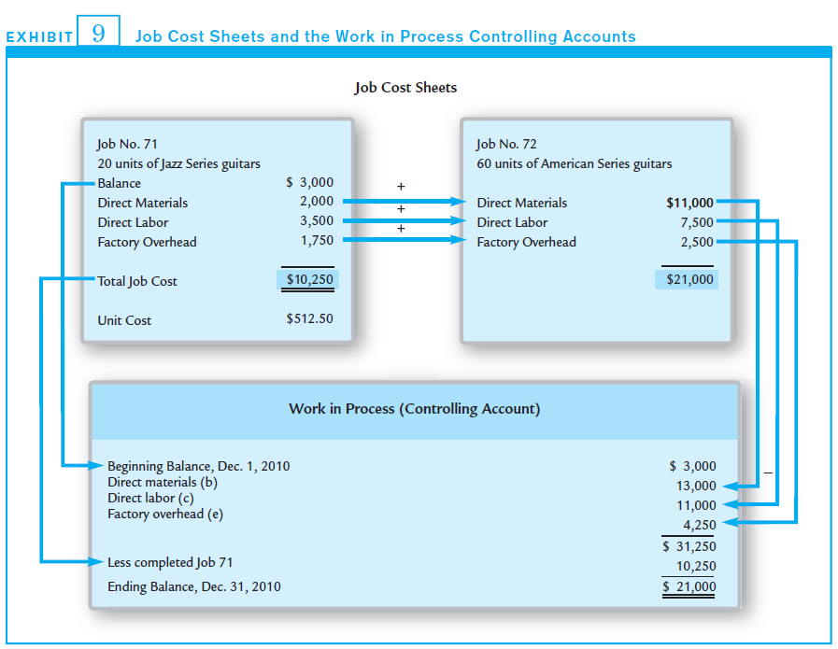
Work in Process
Costs incurred for various jobs are accumulated on job cost sheets and these jobs sheets represent work in process

Slide 40
Completion of Job 2013-01
A = |  | L | + E
Work In Process - $69 | Finished Goods + $69
When Job 2013-01 was completed, total manufacturing costs were transferred out of the work in process account and into the finished goods account.

Slide 41
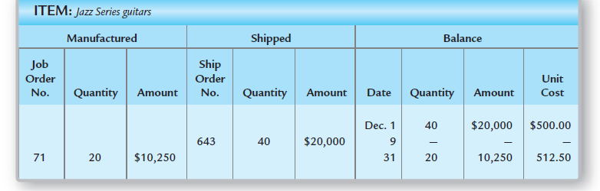
Finished Goods Ledger
Finished goods is a controlling account comprised of individual finished goods subsidiary ledgers.

Slide 42
Sales and Cost of Goods Sold (COGS)
Manufacturing business sales are treated the same as merchandising business sales.
Assume Julianne sold the lemonade in job #2013-01 for $110 (cost was $69 for the batch).
A = |  | L | + E
Cash +$100 | Finished Goods - $69 |  | Retained Earnings + $41
Sales | $100
COGS | 69
Net income | $41

Slide 43
Period Costs
Period costs are used in generating revenue during the current period, but are not involved in the manufacturing process.
Period costs are recorded as expenses of the current period as either:
  selling (advertising, sales salaries, commissions)
  or administrative expenses (office salaries, office supplies, depreciation on office building)

Slide 44
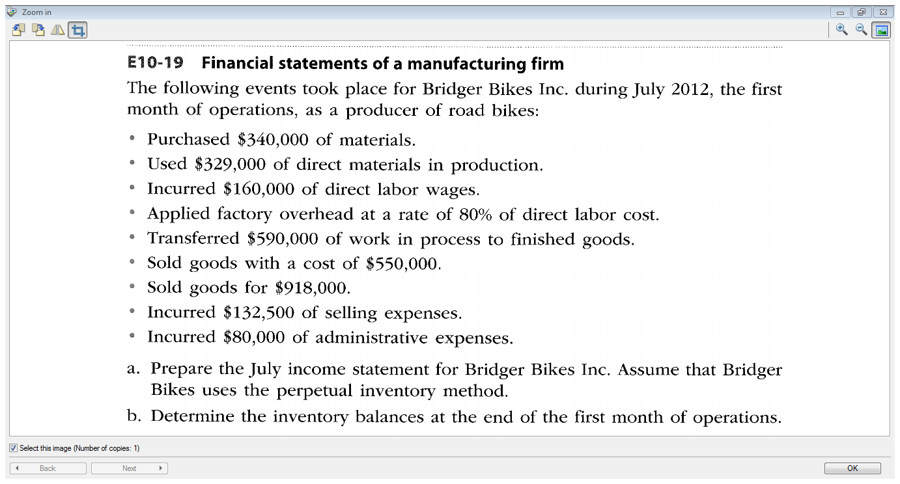

Slide 45
Job Order Cost Systems for Service Businesses
Useful for planning and controlling operations
Focus is on direct labor and overhead. They are accumulated in a work in process account
When jobs are completed, the cost of the job is transferred to a cost of services account (similar to COGS)

Slide 46
Job Order Costing for Decision Making
We’ve tracked the total cost of job #2013-01.
We can compare
  the total and unit product costs to similar jobs
  compared over time
  compared to expected costs
 | Budget | Actual
Direct Materials | $10 | $ 9
Direct Labour | 38 | 40
Overhead | 22 | 20

Slide 47
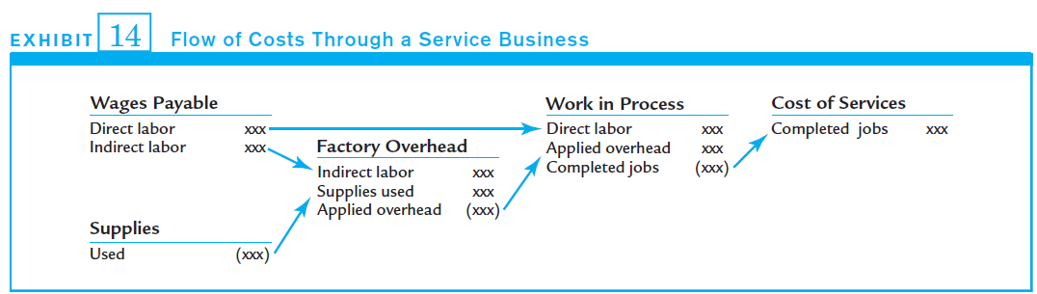
Job Order Cost Systems for Service Businesses
There isn’t a finished goods account since revenues are recorded after the service has been provided.

Slide 48
End of Chapter 10 !

