Slide 1
Chapter 7
Fixed Assets and Intangible Assets

Slide 2
Learning Objectives
Define, classify, and account for the cost of fixed assets.
Compute depreciation using the straight-line and double-declining-balance methods.
Describe the accounting for the disposal of fixed assets.
Describe the accounting for the depletion of natural resources.
Describe the accounting for intangible assets.
Describe how depreciation expense is reported in an income statement, and prepare a balance sheet that includes fixed assets and intangible assets.

Slide 3

Fixed Assets
Fixed Assets - are long-term or relatively permanent assets owned by a business and used it normal operations over several years
  May also be referred to as:
    Property, Plant & Equipment
    Capital Assets
    Long Term Assets

Slide 4
Recording Acquisition Cost
Cost Principle - All reasonable and necessary costs incurred in acquiring a long-term assets, placing it in its operational setting and preparing it for use
Acquisition Cost can include :
Purchase price | Non-refundable sales taxes
Transportation charges | Installation costs
Legal fees (in the case of land) | Interest charges - ONLY for money borrowed to finance construction

Slide 5
Land
Purchase Price
Sales taxes
Permits from the government
Broker’s commission
Land transfer tax
Surveying fees
Delinquent property taxes
Removal of unwanted buildings less any salvage
Grading and leveling
Paving a public street bordering the land
Legal fees

Slide 6
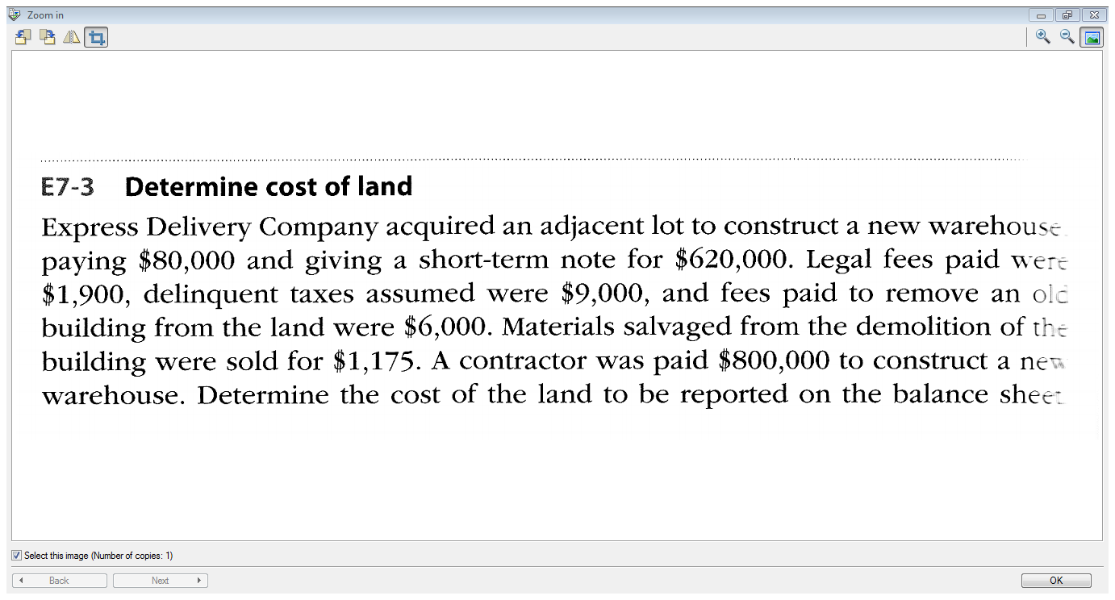

Slide 7
Repairs, Maintenance & Betterments
Asset Improvements and Extraordinary Repairs (Capital Expenditure) – increases an asset’s capacity or efficiency or extends its useful life
  May add this cost to amount shown on Balance Sheet
Ordinary Repairs & Maintenance Expense – maintains assets or restores asset to working order
  Record this expense on the Income Statement

Slide 8
Depreciation
Depreciation – process of allocating the acquisition cost of property, plant & equipment over their useful lives using a systematic and rational method
Follow the matching principle.

Slide 9
Depreciation
Balance Sheet Presentation:
Property, Plant & Equipment:
Equipment $1,000
Less Accumulated Depreciation (200)
800
Referred to as Net Book Value or Carrying Value
A = | L | + E
Accumulated Depreciation - $200 |  | Retained Earnings (Depreciation Exp.) - $200

Slide 10
Depreciation Methods
– Straight Line
Depreciation per year
= Cost – Residual Value
  Useful life in years
Example: The cost of a computer is $2,000 which will have a residual value of $100 in 4 years time.
Depreciation per year = $2,000 - $100
4 years
= $475

Slide 11
Straight Line Method
Yr | Annual Deprec. | Accum. Deprec. | Net Book Value $2,000 – Accum.Deprec.
1 | $475 | $475 | $1,525
2 | $475 | $950 | 1,050
3 | $475 | $1,425 | 575
4 | $475 | $1,900 | 100

Slide 12
Double-Declining-Balance Method
Compute straight-line depreciation rate per year.
  Ex. If useful life is 4 years, then the straight-line depreciation rate is ¼ per year or 25%
Double the straight line rate Ex. 25% x 2 = 50%
Multiply that rate by the capital asset’s net book value

Slide 13
Double Declining Balance
Example: The cost of a computer is $2,000 which will have a residual value of $100 in 4 years time.
Straight line rate = ¼ or 25% • Double that rate = 50%
    Year 1 Deprec.= $2,000 x 50% = $1,000
    Year 2 Deprec.= ($2,000 – $1,000) x 50% = $500
    Year 3 Deprec.= ($2,000-1,000-500) x 50% = $250
    Year 4 Deprec. = ($2,000 -1,000-500-250) x 50% = $125
    Year 5 Deprec. = $2,000 – 1,000 – 500-250-125) x 50%
              = $25 MAX
Maximum Deprec. = $1,900 in total ($2,000 - $100)

Slide 14
Double Declining Balance Method
Year | Depreciation Expense | Accumulated Deprec. | Net Book Value
1 | 50% x $2,000 = $1,000 | $1,000 | $2,000- $1,000 = $1,000
2 | 50% x $1,000 = $500 | $1,000 + $500 = $1,500 | $2,000 - $1,500 = $500
3 | 50% x $500 = $250 | $1,500 + $250 =$1,750 | $2,000 - $1,750 = $250
4 | 50% x $250 = $125 | $1,750 + $125 = $1,875 | $2,000 - $1,875 = $125
5 | 50% x $125 = $62.50 MAX = $25 | $1,875 + $25 = $1,900 | $10,000 – 1,900 = $100
Do not depreciate below residual value

Slide 15
Double Declining Balance Method

Slide 16
Summary
Method | Calculation | Amort. Exp.
Straight-Line | Cost – residual value Useful Life | Equal amounts each year
Double-declining balance | Book Value × (Straight Line Rate × 2) | Declining amts. Over time
Year | Straight Line | Double-declining balance
1 | $475 | $1,000
2 | $475 | $ 500
3 | $475 | $ 250
4 | $475 | $125
5 | 0 | $25

Slide 17

Method of Depreciation
To determine which method of depreciation to use, consider the differences in the bottom line and the matching principle.
Consider depreciation for tax purposes. Canada Revenue Agency allows Double-Declining-Balance method – but they set the rate.

Slide 18
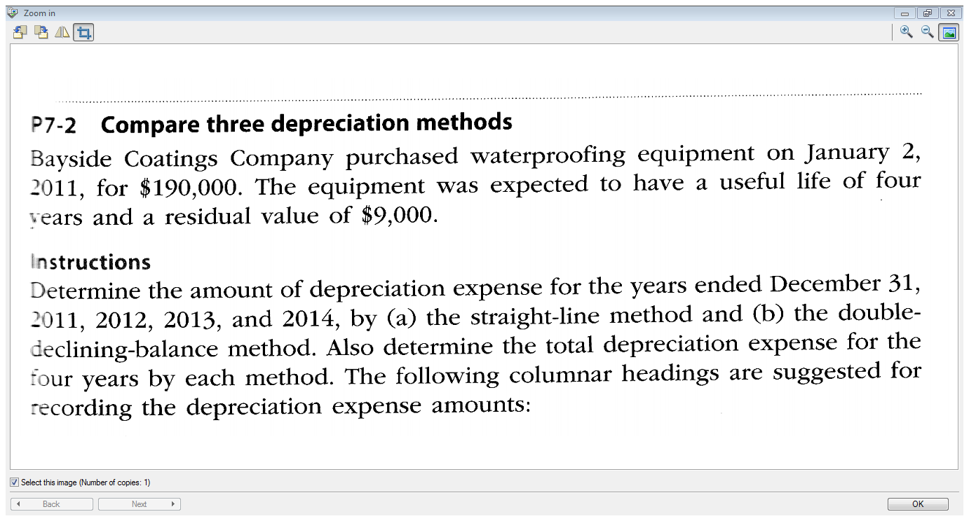

Slide 19

Depreciation for Partial Years
Compute depreciation for the year
Multiply annual depreciation by fraction of the year that the asset is held
Example:
Annual depreciation calculated to be $12,000.
Depreciation for one month will be $12,000 × 1/12 = $1,000

Slide 20
Disposal of Capital Assets
Asset may be sold
Asset may not be used in operations anymore
Asset may be destroyed
Bring depreciation up to date.
Calculate Book Value of asset and compare to proceeds of disposition.
Determine loss or gain (if any).

Slide 21
Disposal of Capital Assets
Example:
Chancellor Industries owns equipment costing $6,000.
The estimated residual value is $0 and its useful life is 10 years.
On December 31, 2013, the accumulated depreciation balance is $4,750.
On March 31, 2014, the equipment is discarded.

Slide 22
Disposal of Capital Assets
1. Bring depreciation up to date
  Depreciation for first 3 months of 2014
  = $6,000 – 0 × 3/12 = $150
  10 years
  Accumulated Depreciation now = $150 + $4,750 = $4,900
2. Compare Book Value to proceeds of disposition:
Book Value = $6,000 - $4,900 = $1,100
Proceeds of disposition = $ 0
3. Loss = $1,100

Slide 23
Disposal of Capital Assets
A = |  | L | + E
Equipment | Accum.Deprec. |  | Retained Earnings
 |  |  | Deprec. Exp. | Loss on Disposal
1) | - $150 |  | - $150
2) - $6,000 | 4,900 |  |  | -$1,100

Slide 24
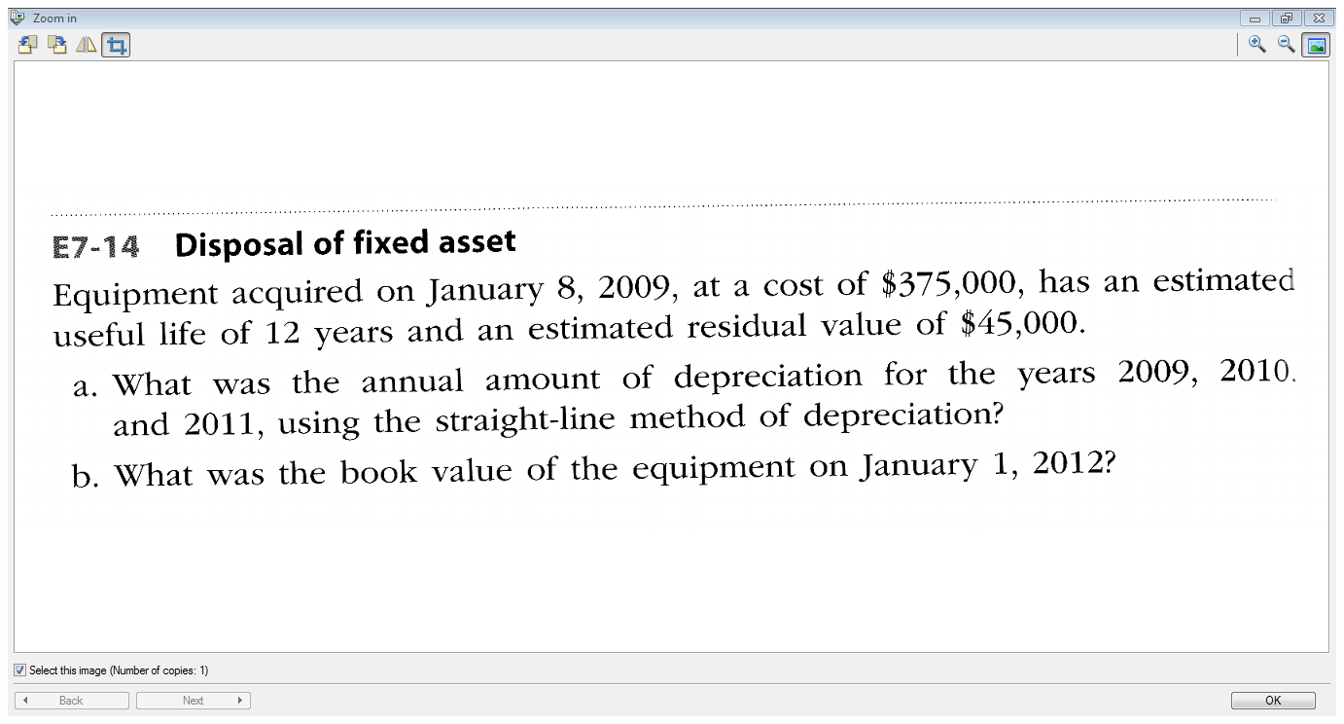

Slide 25
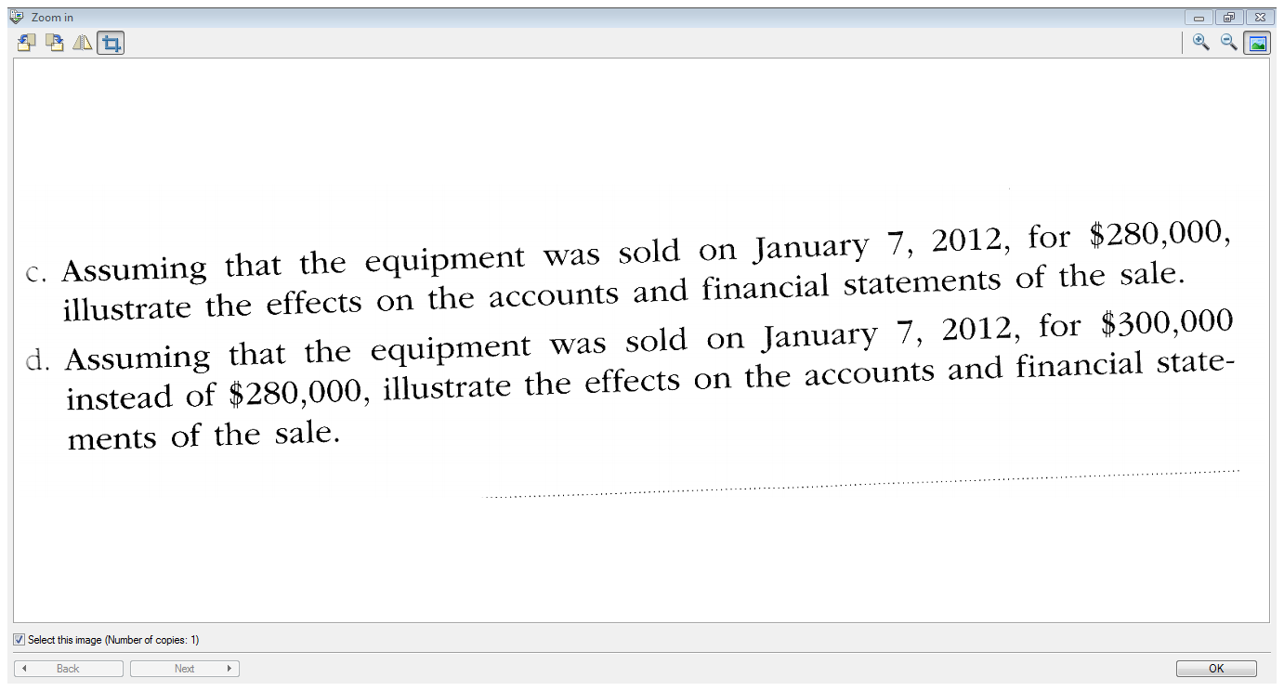

Slide 26
Intangible Assets
Long-lived assets lacking physical properties that are useful in the operations of a business and not held for sale; examples include
  Patents
  Copyrights
  Trademarks
  Goodwill.
Accounted for similar to fixed assets.
Cost is transferred to expense through amortization.

Slide 27
Amortization
Matching the cost of an intangible asset with its revenue over its useful (legal) life.
Amortization expense calculation is similar to straight-line depreciation:
Amortization = Cost – Estimated Residual Value
Estimated Useful Life

Slide 28
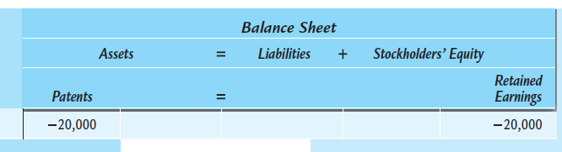
Patent Amortization
Assume a company acquires patent rights for $100,000. The remaining legal life of the patent rights is 14 years, however the company feels the remaining useful life is five years.

Slide 29
Goodwill
Created from favorable business factors
Only recorded if objectively determined by a transaction
Not amortized – impaired values are adjusted.
Goodwill is the most frequently reported intangible asset.

Slide 30
Financial Reporting
Depreciation and amortization should be reported separately
Description of computations should be disclosed
Income
Statement
Each class of fixed asset should be disclosed
Related accumulated depreciation should also be reported
Balance
Sheet

Slide 31
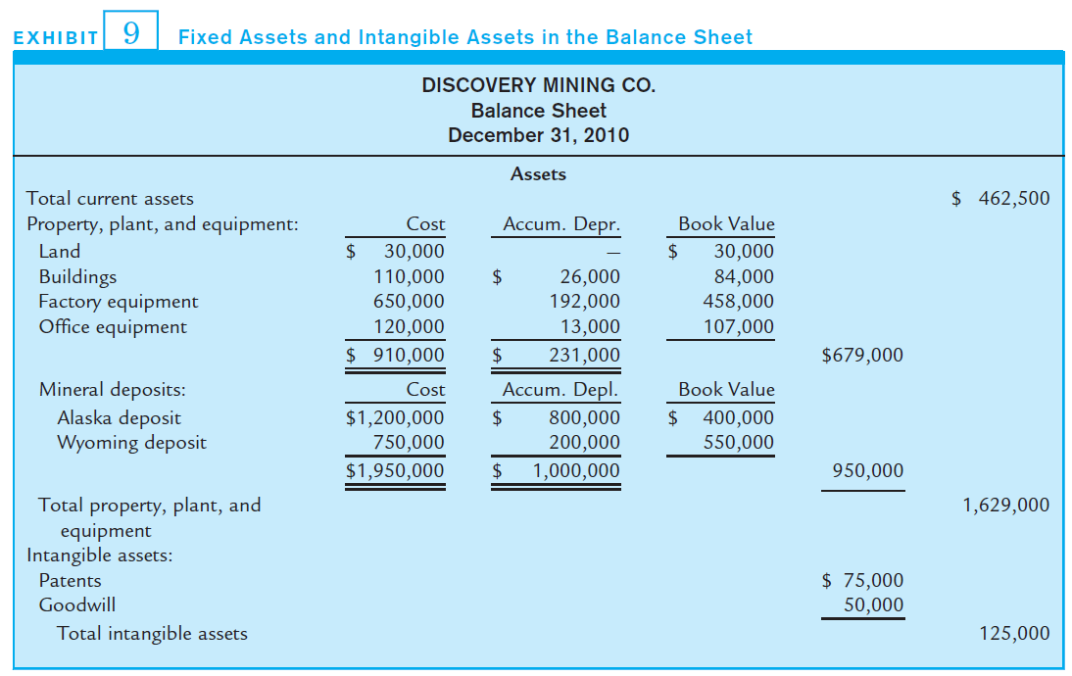
Financial Reporting

Slide 32
End of Chapter 7!

