Slide 1
Chapter 6
Receivables and Inventory

Slide 2
Learning Objectives
Describe the common classifications of receivables
Describe the nature of and the accounting for uncollectible receivables
Describe the direct write-off method of accounting for uncollectible receivables
Describe the allowance method of accounting for uncollectible receivables

Slide 3
Learning Objectives (continued)
Describe the common classifications of inventories
Describe TWO (not three) inventory cost flow assumptions and how they impact the financial statements
Compare and contrast the use of the three inventory costing methods
Describe how receivables and inventory are reported on the financial statements

Slide 4
Classifying Receivables
Accounts Receivable
  Credit terms extended to customers
Notes Receivable
  More formal agreement
  Includes a maker and payee
Other Receivables
  Can include interest receivable, taxes receivable, and receivables from employees or officers

Slide 5
Promissory Notes
Interest due on a Promissory Note =
Face Amount (Principal)
× Interest Rate
× Term (of the year)
Example: Sheldon owes Leonard $1,000 due in 3 months’ time. The annual interest rate is 4%.
Interest due = $1,000 × 4% × (3 months/12 months)
= $10
Notes:
)

Slide 6
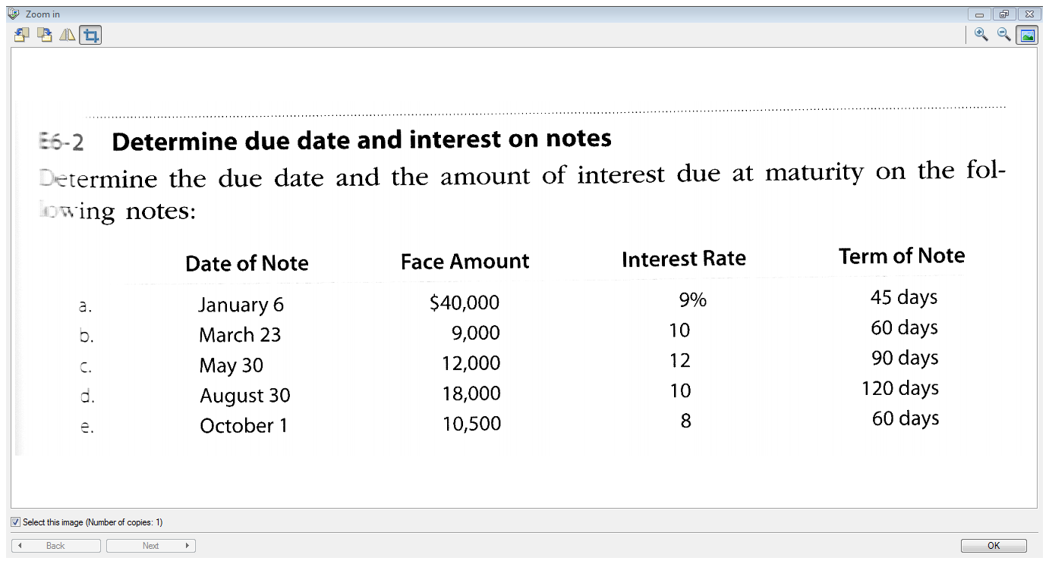

Slide 7
Accounting for Bad Debts
Bad debts result from credit customers who will not pay the business the amount they owe, regardless of collection efforts.

Slide 8
Accounting for Bad Debts
Direct Write-off Method – records Bad Debt expense only when an account is deemed to be worthless
Allowance Method – Set up Allowance for Doubtful Accounts based on an estimate
  Percentage of Credit Sales
  Aging of Accounts Receivable

Slide 9
1. Direct Write-Off Method
Bad Debt Expense is recorded and the receivable written off when the account is determined to be worthless.
A = | L | + E
Accounts Receivable - $200 |  | Retained Earnings (Bad Debts Expense) - $200

Slide 10
2. Allowance Method
A = | L | + E
Allowance for Doubtful Accounts - $30,000 |  | Retained Earnings (Bad Debts Expense) - $30,000
The company estimates that $30,000 of the Accounts Receivable balance will be uncollectible

Slide 11
Balance Sheet Presentation
ASSETS
Current Assets:
Accounts Receivable $200,000
Less Allowance
for Doubtful Accounts 30,000)
170,000
Net realizable value

Slide 12
Write-Offs to the Allowance Account
When a customer’s account is identified as uncollectible, it is written off against the allowance account
A = |  | L | + E
A/R | Allowance for DAs
- $1,000 | +1,000

Slide 13
Subsequent Collection
If payment is collected after the write-off:
  the write-off entry is reversed
  the cash collection is recorded.
A = |  |  | L | + E
Cash | A/R | Allowance for D.A.s
1) | + $1,000 | - $1,000
2) +$1,000 | - $1,000

Slide 14
Estimating Uncollectible Accounts
Based on past experiences and forecasts of the future
Two common methods:
  Percentage of Credit Sales
  Analysis of Accounts Receivable

Slide 15
1. Estimate Based on Percent of Sales
Newman Enterprises had credit sales of $1,000,000 in 2013. They estimate that 1% of credit sales will be uncollectible.
1% of $1,000,000 = $10,000
A = | L | + E
Allowance for Doubtful Accounts - $10,000 |  | Retained Earnings (Bad Debts Expense) - $10,000

Slide 16
2. Aging of Accounts Receivable
Divide the balance of Accounts Receivable into number of days past due: 1 to 30, 31 to 60, 61 – 90, Over 90 days
Estimate percentage of each category that will be uncollectible
Total Balance | 1-30 days | 31 – 60 days | 61 – 90 days | Over 90 days
$100,000 | $80,000 | $10,000 | $5,000 | $5,000
Estimated uncollectible | 0.5% | 2.0% | 10.0% | 50.0%
Balance x Percent | $400 | $200 | $500 | $2,500
Total Estimate Uncollectible = $3,600

Slide 17
2. Aging of Accounts Receivable
Compare the required balance of $3,600 to the actual balance in the Allowance For Doubtful Accounts.
Required balance (from aging analysis) | - $3,600
Actual balance in Allowance for Doubtful Accounts | - 100
Entry amount | - 3,500
A = | L | + E
Allowance for Doubtful Accounts - $3,500 |  | Retained Earnings (Bad Debts Expense) - $3,500

Slide 18
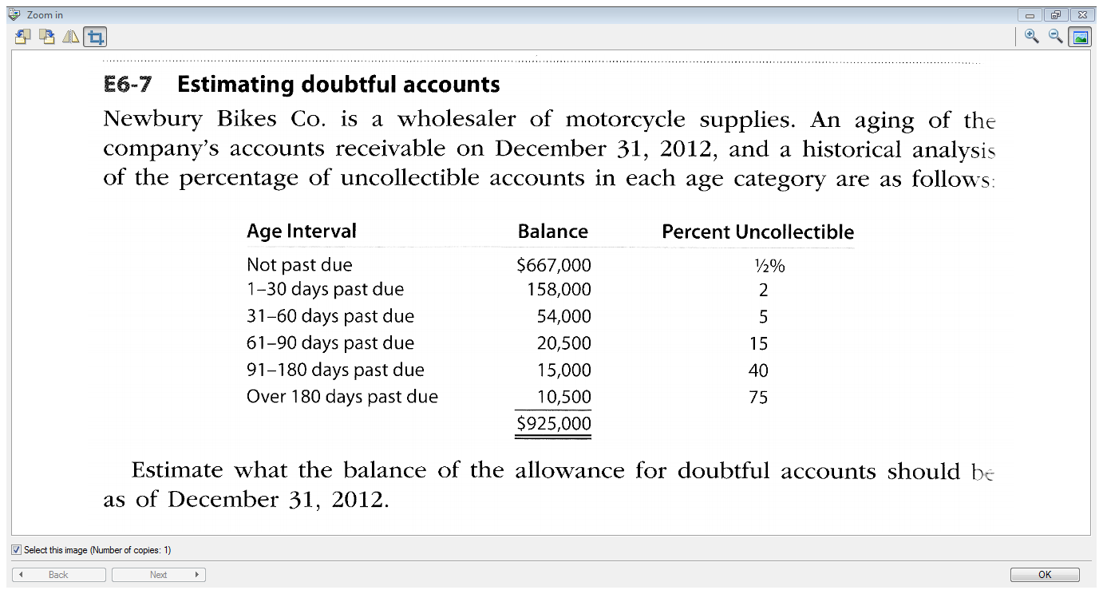

Slide 19
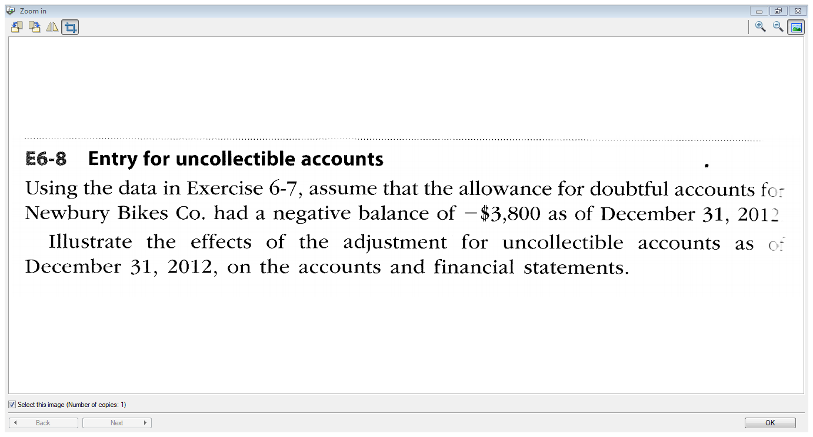

Slide 20
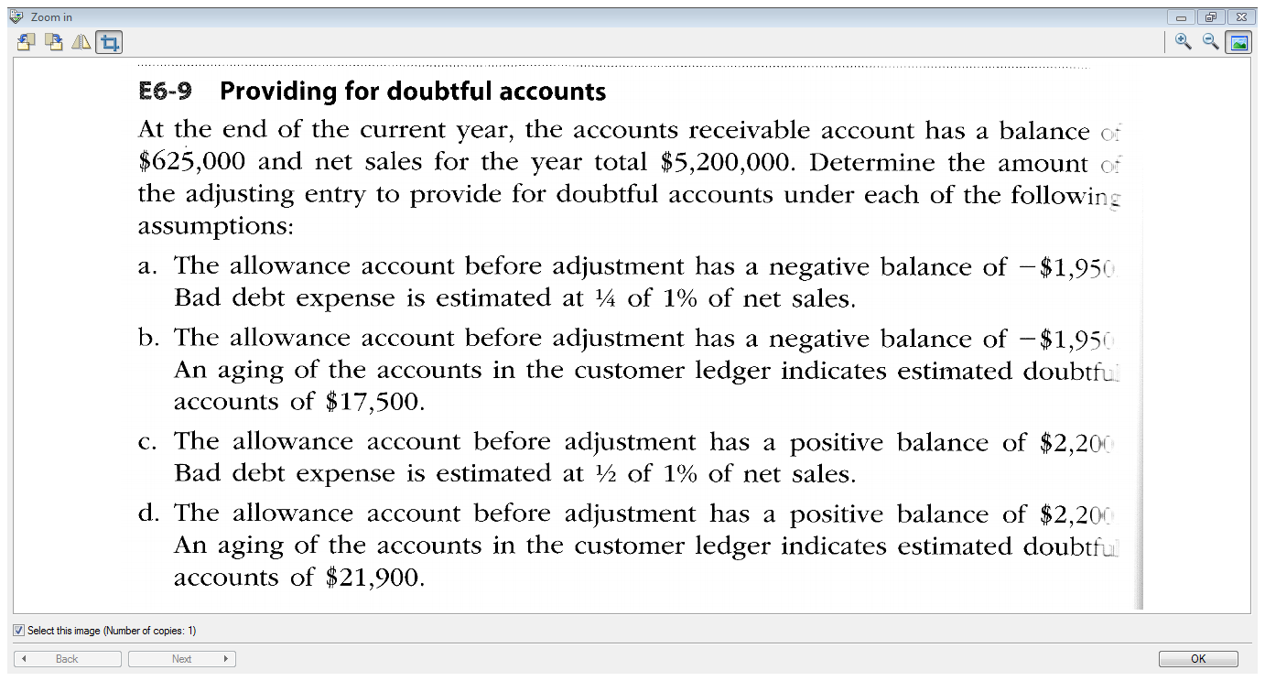

Slide 21
Inventory Cost Flow
Units Purchased
Units Sold
$19
$21
$23
$22
$??
Identical units purchased at different unit costs during a period
When units are sold, it is necessary to determine the cost of units sold
Cost of units sold can be determined using a cost flow assumption

Slide 22
Inventory Costing
Specific Identification – Record Cost of Merchandise Sold using cost of specific inventory item
Weighted-average cost – use average of all the costs
First In, First Out (FIFO) – use costs in the order that they were incurred

Slide 23
Specific Unit Cost
Identify the cost of the specific item of inventory you sell.
Example A jewelry store has 5 different diamond rings in inventory costing $1,000, $1,500, $2,500, $4,000 & $10,000.
It sells the diamond ring that cost them $10,000 for $15,000.
Only practical if each unit has a unique identification number (e.g., VIN for an automobile)

Slide 24
Inventory Transactions
Date | Purchases | Sales
Oct.12 | 10 widgets @$19 = $190
Oct.13 |  | 5 widgets
Oct.14 | 20 widgets @$22 = $440
Oct.15 |  | 20 widgets
Total | 30 widgets | 25 widgets
Ending Inventory = 10 + 20 – 5 – 20
= 5 widgets

Slide 25
First In First Out - FIFO
The oldest goods bought are the first ones to be sold.
Date | Purchases | Sales | Ending Inventory Balance
Oct.12 | 10 x $19 = $190 |  | 10 x $19 = $190
Oct. 13 |  | 5 x $19 = $95 | 5 x 19 = $95
Oct.14 | 20 x $22 = $440 |  | 5 x $19 = $ 95 20 x $22 = $440 Total = $535
Oct. 15 |  | 20 sold: 5 x $19 = $95 15 x $22= $330 Total $425 | 5 x $ 22 = $110
Total |  | Total = $520
$110 reported as Merchandise Inventory on Balance Sheet
Income Stmt: Use $520 as Cost of Merchandise Sold

Slide 26
Weighted Average – Periodic System
Calculate Average Unit Cost
= Cost of goods available (beg.inv.+purchases)
Units available for sale
= $190 + $440
30 units bought
= $ 21/widget
Cost of Goods Sold
= Sold 25 widgets x $21 = $525
Ending Inventory = 5 on hand x $21 = $105
Purch.Oct.12
Purch.Oct.14
Purchases in October

Slide 27
Manager’s Choice of Inventory Costing Methods
Income Tax implications – highest COGS
Choose a method that corresponds as closely as possible to the physical flow of goods.
Report an inventory cost on the Balance Sheet that is close the inventory’s recent cost.
Use the same method for all inventories having a similar nature and usage in the company.

Slide 28
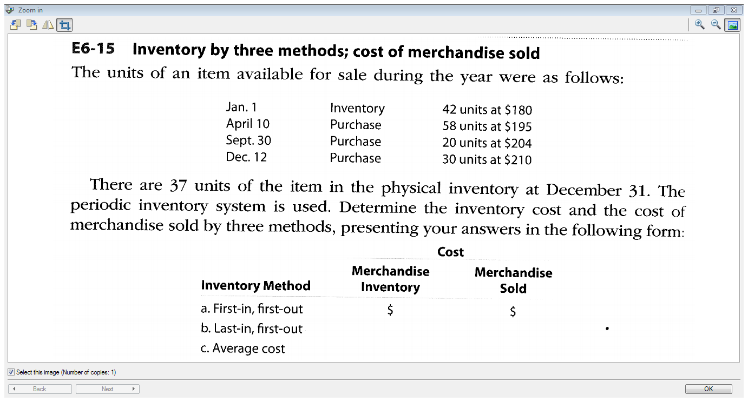

Slide 29
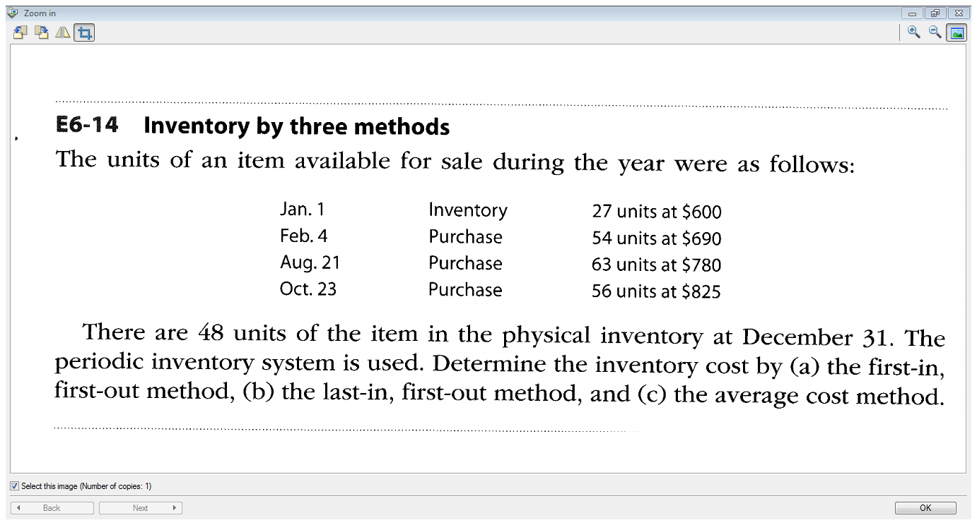

Slide 30
Valuation at Lower of Cost and Market (Net Realizable Value)
Lower of Cost and Net Realizable Value
  Net Realizable Value = selling price less any costs required to make the goods ready for sale
  Determine cost of inventory (individual items).
  Determine the net realizable value of the inventory.
  Compare the values and use the lower value to report inventory on the financial statements.

Slide 31
Lower of Cost and Net Realizable Value
Inventory Item | Cost | NRV | Lower of Cost & NRV
Scarves | $10,000 | $11,000 | $10,000
Hats | 20,000 | 17,000 | 17,000
Mittens | 8,000 | 9,000 | 8,000
Total | $38,000 | $37,000 | 35,000
$3,000 less
Reduce Inventory by $3,000
Reduce Retained Earnings (Cost of Merchandise Sold) by $3,000

Slide 32
Balance Sheet Presentation
Loblaw Companies Balance Sheet As at Dec. 29, 2012 and Dec.31, 2011 (in millions)
Assets | 2012 | 2011
Current Assets
Cash and cash equivalents | $ 1,079 | $ 966
Short term investments | 716 | 754
Accounts receivable | 456 | 467
Credit Card receivables | 2,305 | 2,101
Inventories | 2,007 | 2,025
Prepaid expenses and other assets | 74 | 117
Other current assets | 30 | 32
Total Current Assets | 6,667 | 6,462
Notes:
32

Slide 33
End of Chapter 6!

