Slide 1
Chapter 4
Accounting for Merchandising Businesses

Slide 2
Learning Objectives
Distinguish the activities and financial statements of a service business from those of a merchandising business
Describe and illustrate the financial statements of a merchandising business
Describe the accounting for the sale of merchandise
Describe the accounting for the purchase of merchandise
Describe the accounting for freight and sales taxes
Illustrate the dual nature of merchandising transactions
Describe the accounting for merchandise shrinkage

Slide 3


Service Businesses vs. Merchandise Operations
Service Businesses
  Revenue activities involve providing services to customers.
  Example: OC Transpo, your doctor, legal firm
Merchandise Operations
  Revenue activities involve the buying and selling of merchandise.
  Example: Home Depot Inc., the University Bookstore

Slide 4
– Multiple-Step Income Statement
Canadian Tire Corporation
Income Statement (adapted)
For the years ended December 29, 2012 and December 31, 2011
(in millions)
 | 2012 | 2011
Net Sales | $31,604 | $ 31,250
Cost of merchandise inventories sold | 24,185 | 23,894
Gross Profit | 7,419 | 7,356
Operating Expenses
Selling, General and Administrative expenses | 6,223 | 5,972
Operating Income | 1,196 | 1,384
Interest expense | 331 | 327
Earnings Before Income Taxes | 865 | 1,057
Income Taxes | 215 | 288
Net Income | $ 650 | $ 769

Slide 5
New Terms
Net Sales
= Sales – Sales Returns & Allowance
– Sales Discounts
Cost of Merchandise Sold – also referred to as Cost of Goods Sold (COGS): cost of merchandise sold to customers
Gross Profit = Net Sales – Cost of Merchandise Sold

Slide 6
New Terms
Operating Expenses
Expenses from regular line of business
Usually grouped into
  Selling expenses (sales salaries, depreciation of store equip’t, delivery exp, advertising)
  Administrative expenses (office salaries & supplies)
Operating Income = Gross Profit – Operating Expenses
Other Income and Expense – not related to primary operations of the business (interest income, rent, gains on sales, etc.)

Slide 7
Credit Terms – Sales Discounts
Example:
2/10, n30
Take a 2% discount if the invoice is paid within 10 days,
Otherwise, the entire amount is due in 30 days.

Slide 8
Accounting for Inventory
Periodic Inventory System – Inventory counted at least once per year (periodically) and adjusted in the accounting system
Perpetual Inventory System – Keeps a running record of inventory on hand and Cost of Goods Sold at all times

Slide 9
Periodic Inventory System
Cost of Merchandise Sold =
Opening Inventory
+ Net Purchases
Purchases
purchase returns and allowances
purchase discounts
+ Freight-In
- Ending Inventory

Slide 10
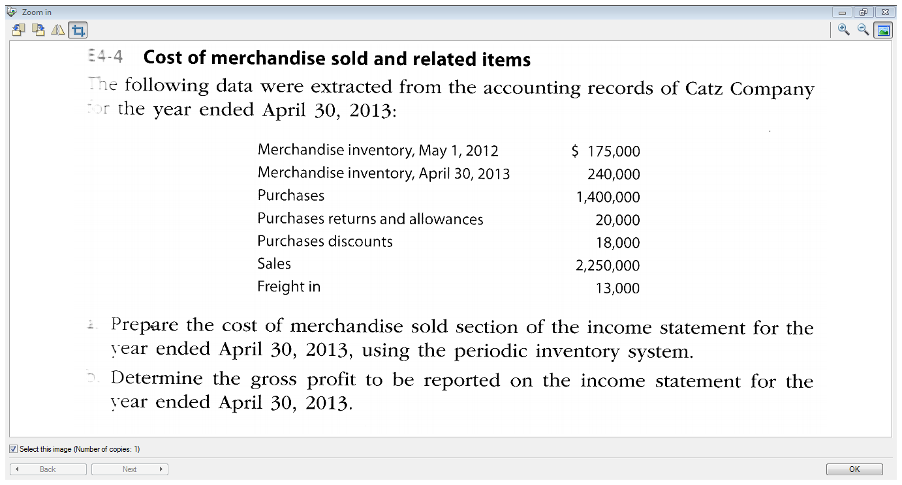

Slide 11
Loblaw Companies – Balance Sheet
Balance Sheet
As at December 29, 2012 and December 31, 2011
(in millions)
 | 2012 | 2011
Assets
Current Assets
Cash and cash equivalents | $1,079 | $ 966
Short term investments | 716 | 754
Accounts receivable | 456 | 467
Credit Card receivables | 2,305 | 2,101
Inventories | 2,007 | 2,025
Prepaid expenses &other assets | 74 | 50
Assets held for sale | 30 | 32
Total Current Assets | 6,667 | 6,462
Value of units on hand,
not sold

Slide 12
Sales Transactions - Cash
Loblaws sells merchandise for $200 cash. The cost of this merchandise was $150. The effect on the accounting equation is:
A = | L | + E
Cash +$200 |  | Retained Earnings -Sales +$200
Merchandise Inventory - $150 |  | Retained Earnings -Cost of Merchandise Sold - $150
Assuming Loblaws uses a perpetual inventory system

Slide 13
Sales Transactions – on Account
Loblaws sells merchandise for $200 on account with the terms 2/10, n30. The cost of this merchandise was $150.
A = | L | + E
Accounts Receivable +$200 |  | Sales +$200
Merchandise Inventory - $150 |  | Cost of Merchandise Sold - $150

Slide 14
Selling Goods & Services – An Invoice
INVOICE #1
My Lemonade Stand Ottawa, Ontario |  |  | Date: Sept.27, 2012
Sold to: Thirsty Soccer Players
Description
11 glasses of lemonade x $1/each |  |  |  | $11
Delivery |  |  |  | 2
 | Total |  |  | $13
TERMS: FOB shipping point |  | 2/10, n30

Slide 15
Receipt of Account Receivable
The customer pays within the discount period of 10 days and is entitled to a 2% discount off of the $200 invoice – that’s $4! Loblaws receives $196.
A = | L | + E
Cash +$196 |  | Retained Earnings - Sales Discounts -$4
Accounts Receivable - $200

Slide 16
Sales Returns and Allowances
Occurs when customers are given special price reductions (a sales allowance) or when they return merchandise (a sales return).
A = | L | + E
Accounts Receivable or Cash - $100 |  | Retained Earnings - Sales Returns & Allowances -$100
Merchandise Inventory – if merchandise is put back on the shelf

Slide 17
FOB Destination Point
Seller
Buyer
Title
Passes at
Destination
No sale or purchase until inventory reaches its destination
Seller responsible for inventory while in transit

Slide 18
FOB Shipping Point
Seller
Buyer
Title
Passes when
Shipped
Both sale and purchase recorded upon shipment
Buyer responsible for inventory while in transit

Slide 19
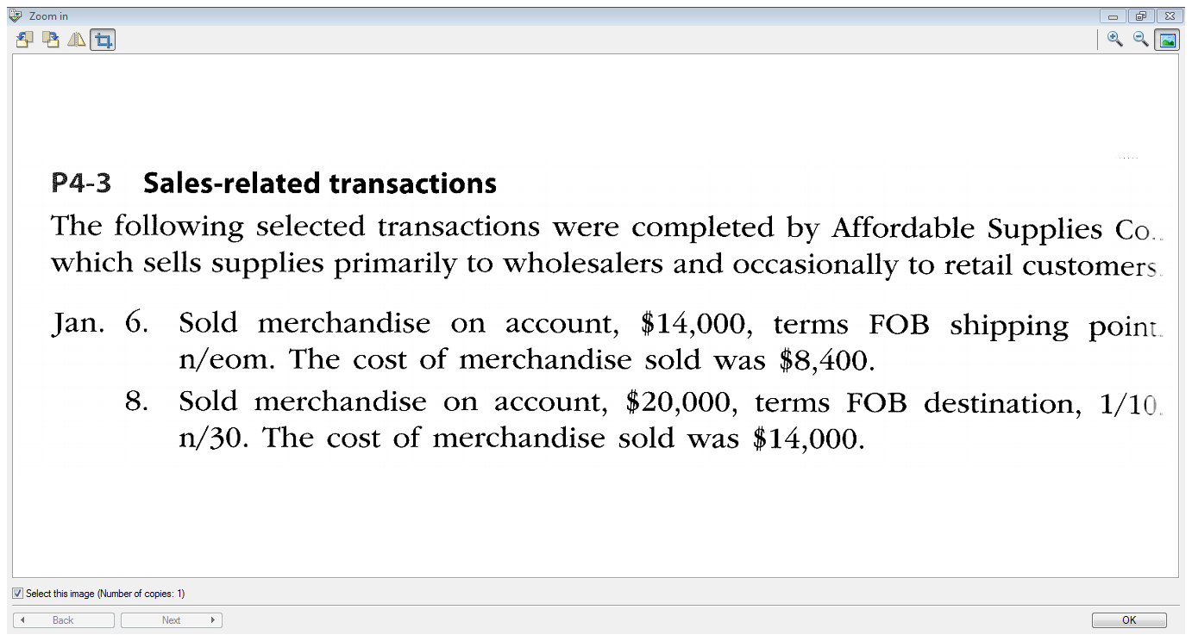

Slide 20
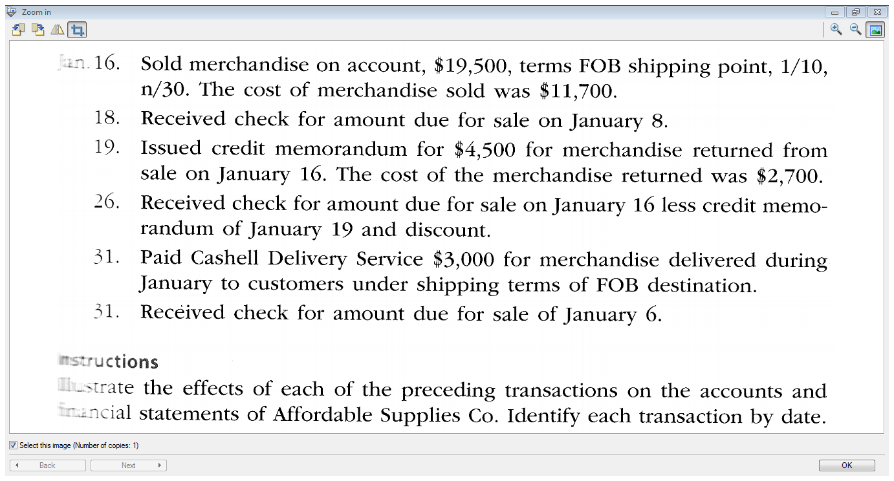

Slide 21
Purchase Transactions - Using the Perpetual System
When merchandise is purchased in a company that uses a perpetual inventory system, the purchase is recorded as either:
A = | L | + E
1) Inventory +$150 Cash - $150
2) Inventory +$150 | Accounts Payable +$150

Slide 22
Purchase Discounts
Deduction from invoice taken because buyer pays early
- Example- $150 invoice with terms 4/15, n30 is paid within 15 days – Loblaws can pay $6 less (4% of $150)
A = | L | + E
Inventory - $6 Cash - $144 | Accounts Payable - $150

Slide 23
Purchase Returns and Allowances
Purchase Returns – Decrease in inventory because buyer returns goods to the seller
Purchase Allowances – Decrease in cost of inventory granted by the seller because something is wrong with the inventory
- Example – Loblaws returns merchandise worth $50 back to their supplier
A = | L | + E
Inventory - $50 | Accounts Payable - $50

Slide 24
Transportation Costs
Freight-In (Transportation In)
– Cost paid by buyer to ship inventory to store/warehouse
- Example – Loblaws pays $25 to ship merchandise they recently purchased
A = | L | + E
Inventory + $25 Cash - $25

Slide 25
Sales Taxes
Sale is made, liability for sales tax recorded as an obligation of the seller
Payment is made to Province/Canada Revenue Agency
- Liability is paid
A = | L | + E
1) Cash + $113 | Sales Tax Payable + $13 | Sales +$100
2) Cash -$13 | Sales Tax Payable - $13

Slide 26
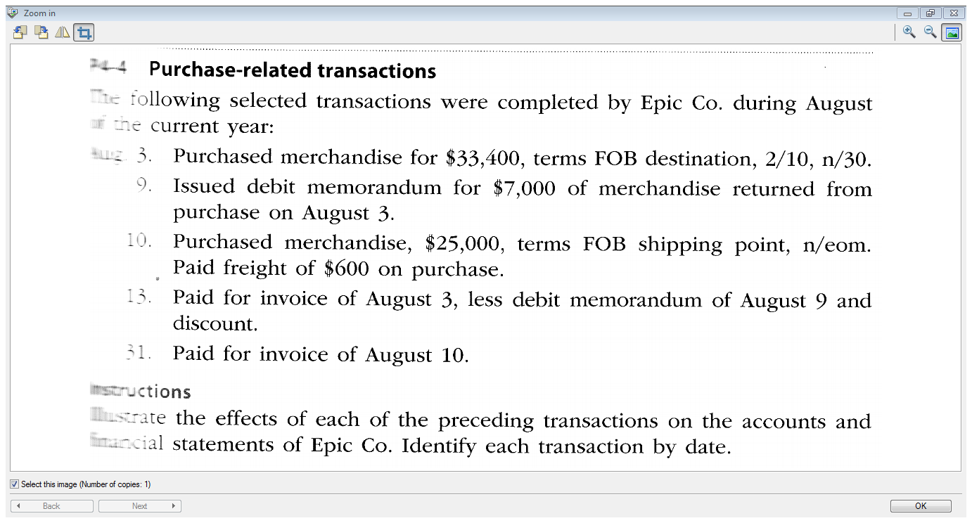

Slide 27
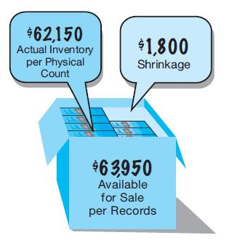
Merchandise Shrinkage
A = | L | + E
Inventory - $1,800 |  | Cost of merchandise sold - $1,800

Slide 28
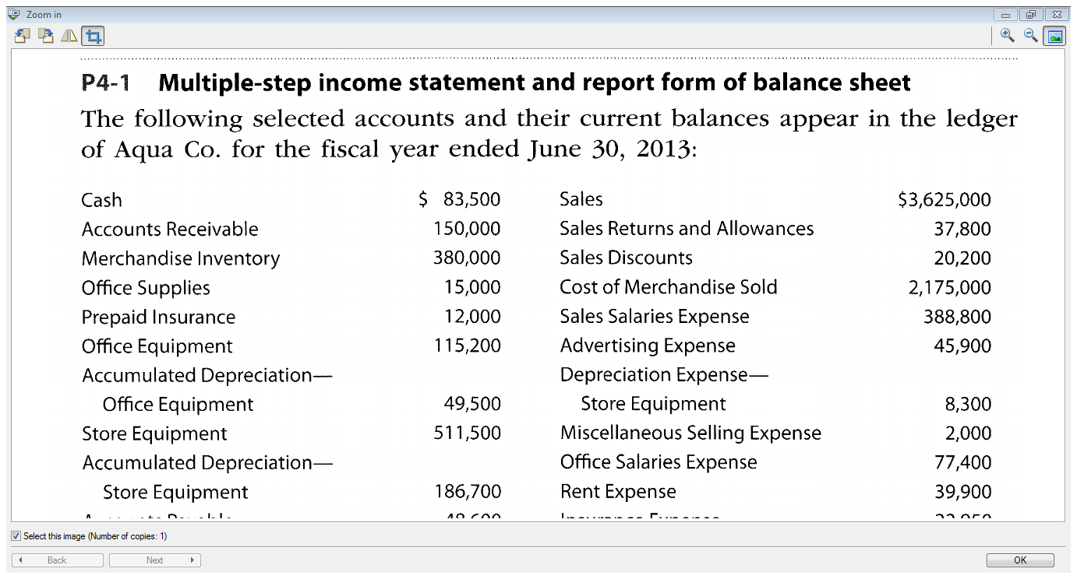

Slide 29
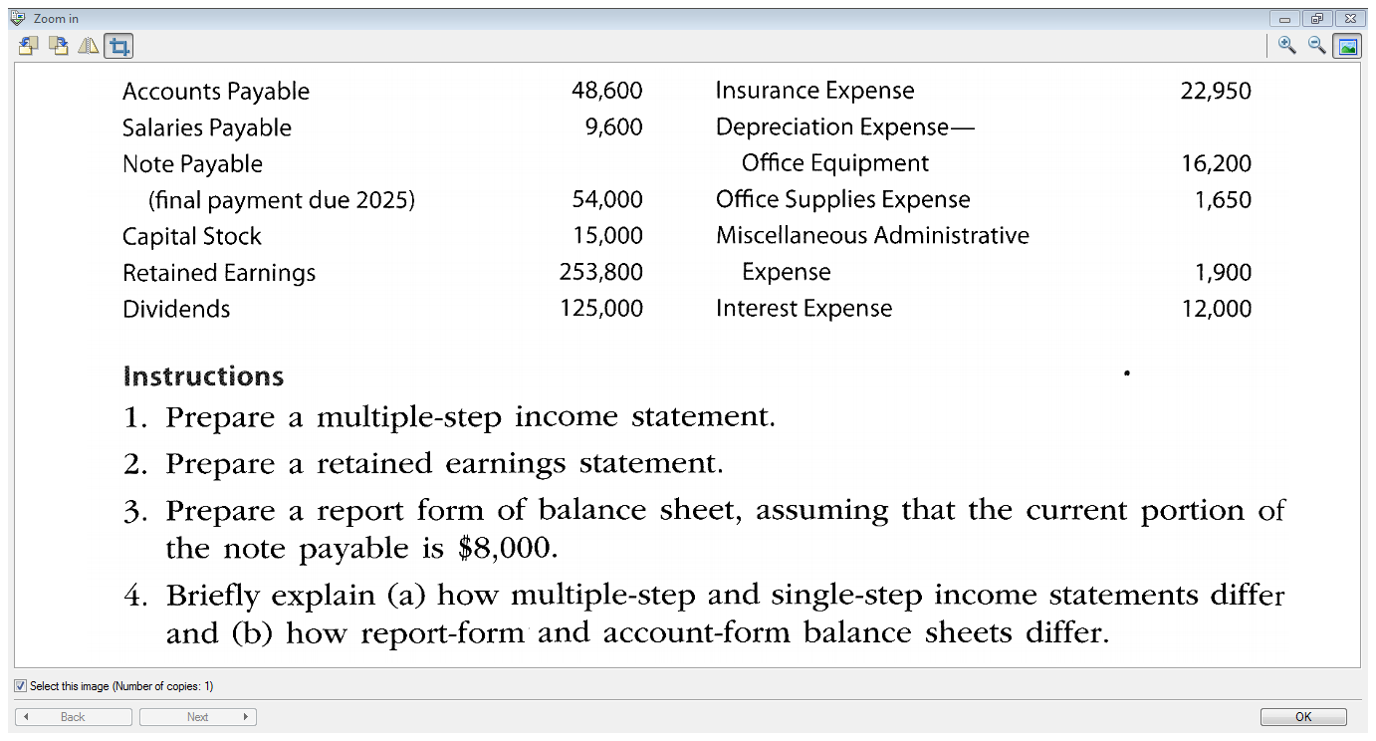

Slide 30
End of Chapter 4!

