Slide 1
Chapter 3
Accrual Accounting Concepts

Slide 2
Learning Objectives
Describe basic accrual accounting concepts, including the matching concept.
Use accrual concepts of accounting to analyze, record, and summarize transactions.
Describe and illustrate the end-of-period adjustment process.
Prepare financial statements using accrual concepts of accounting, including a classified balance sheet.
Describe how the accrual basis of accounting enhances the interpretation of financial statements.

Slide 3
Why is Accrual Accounting Needed?
Cash received
Cash received
Revenue earned
Cash paid
Expense incurred
Cash paid

Slide 4
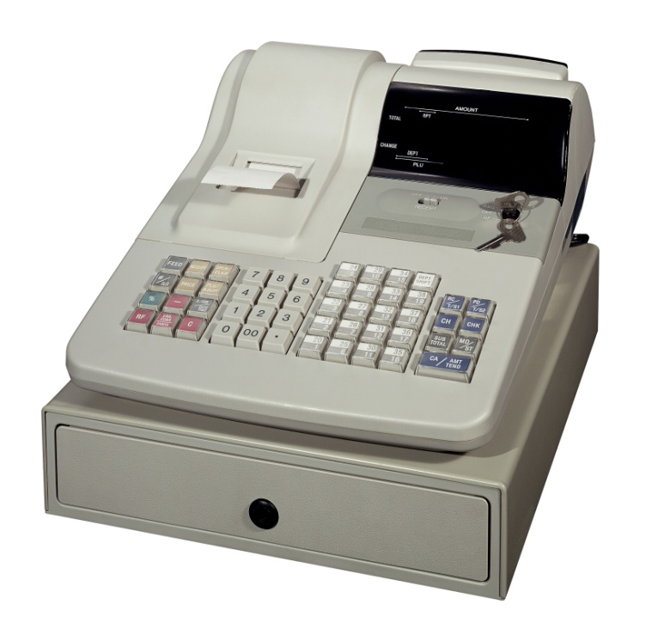

Matching Principle
Expenses incurred
to generate revenue
When revenues are earned and recorded, all expenses incurred in generating that revenue are also recorded.

Slide 5

Revenue Recognition Principle
You can recognize revenue when:
  The performance is achieved (deliver good or perform the service)
  The amount is reasonably measurable.
  The collection of cash is reasonably assured

Slide 6
Accrual Concepts – Julianne’s Lemonade Stand
Glasses of lemonade are sold to customers
Sometimes, payment is received in the future
Revenue is earned when the glass is provided to the customer
Expenses are incurred for items such as supplies where payment may be made in the future
Expenses are recorded as they help to generate to revenue, not as they are paid.

Slide 7
Revenue Received in Advance
Julianne signs a contract to sell 50 glasses of lemonade at a local soccer tournament. She’s given $50 in advance.
A = | L | + E
Cash goes up | We’ve haven’t yet earned the revenue (provided the lemonade). | .
Cash + $50 | Unearned Revenue (also called Deferred Revenue) + $50
Amount received reported as a liability until the revenue is actually earned.

Slide 8
Expenses paid in advance
Paid next month’s rent $20
A = |  | L | + E
- Cash goes down by $20. - By paying next month’s rent, we’ve also created an asset.
Cash - $20 | Prepaid Expense +$20
Amount paid is reported as a prepaid expense until the rent helps to generate revenue.

Slide 9
Expense paid in advance
Buy $10 worth of supplies “on account”.
A = | L | + E
-Supplies have increased by $10. Supplies +$10 | Liabilities have increased – we haven’t paid our supplier yet Accounts Payable +$10
Amount purchased is reported as an asset until the supplies are used in operations.
Amount purchased is reported as a liability.

Slide 10
Purchase of Equipment
Purchase equipment – total cost =$70. Pay $10 cash down payment and agree to pay 6 additional monthly installments of $10.
A = | L | + E
- Cash has decreased by $10. - Equipment has increased by $70. Cash Equipment -$10 +$70 | Liabilities have increased – we haven’t paid our supplier yet Accts. Payable +$60

Slide 11
Sold Lemonade “on account”
Sell 150 glasses of lemonade at an office summer barbecue. The company will pay us later.
A = | L | + E
Accounts receivable has gone up |  | Cptl.Stock Ret’d Earnings R/E goes up because revenue is recognized
Accounts Receivable +$150 |  | Sales +$150
Have supplied goods
Know the amount
Reasonably assured of collection

Slide 12
Sell lemonade
Served 100 glasses of lemonade at our road side lemonade stand. Receive $100.
A = | L | + E
Cash has been received |  | Cptl.Stock Ret’d Earnings R/E goes up because revenue is recognized
Cash +$100 |  | Sales +$100

Slide 13
Collection of Accounts Receivable
A = | L | + E
-Cash has increased by $150. -Accounts Receivable has decreased Cash Accounts Receivable +$150 -$150
Julianne received $150 from the office summer barbecue.

Slide 14
Pay Accounts Payable
We pay for the supplies that we bought on account earlier.
A = | L | + E
-Cash has decreased by $10. Cash -$10 | Liabilities have decreased – we have paid our supplier Accounts Payable -$10

Slide 15
Expenses Paid in Cash
A = | L | + E
Cash goes down |  | Cptl.Stock Ret’d Earnings R/E goes down because an expense is recognized
Cash - $40 |  | Wages Exp.- $4 Rent Exp. - $15 Adv.Exp. -$11 Utilities Exp. -$10
Incurred expenses for the month of October and paid cash for a total of $40.

Slide 16
Dividend
Mom gets another dividends - $4 this month!
A = | L | + E
Cash goes down |  | Cptl.Stock Ret’d Earnings R/E goes down because dividends are paid.
Cash - $4 |  | Dividends - $4

Slide 17
Summary
 | Assets |  |  |  |  | Liabilities |  |  | Shareholders’ Equity
Trans.# | Cash | A/R | Supp. | Pre-paid Rent | Equip. | A/P. | Bank Loan | Unearn’d rev. | Cptl. Stock | R/E
Bal. | $152 |  | $125 |  | $150 | $125 | $200 |  | $100 | $2
1. | +$50 |  |  |  |  |  |  | +$50
2. | -$20 |  |  | +$20
3. |  |  | +$10 |  |  | +$10
4. | -$10 |  |  |  | +$70 | +$60
5. |  | +$150 |  |  |  |  |  |  |  | +$150
6. | +$100 |  |  |  |  |  |  |  |  | +$100
7. | +$150 | -$150
8. | -$10 |  |  |  |  | -$10
9. | -$40 |  |  |  |  |  |  |  |  | -$40
10. | -$4 |  |  |  |  |  |  |  |  | -$4
Bal. | $368 | 0 | $135 | $20 | $220 | $185 | $200 | $50 | $100 | $208
Notes:
17

Slide 18
Deferrals and Accruals
Deferrals – created by recording a transaction in a way that delays (defers) the recognition of an expense or revenue
  Example: Pay rent in advance, receive money in advance of providing a service
Accruals – created when a revenue has been earned or an expense incurred but has not been recorded
  Example: unrecorded wages, revenue not invoiced

Slide 19
Deferred Expenses – Prepaid Rent
Adjustment #1 - As prepaid rent expires, the asset Prepaid Rent decreases.
A = | L | + E
- Prepaid rent has been “used up”. |  | Cptl.Stock | R/E
Prepaid Expense -$20 |  |  | Rent Expense -$20

Slide 20
Deferred Expenses – Supplies
Adjustment #2 - During November, $80 of supplies was used in operations leaving a balance of $55.
A = | L | + E
Supplies have decreased |  | Cptl.Stock Ret’d Earnings R/E goes down because an expense has been incurred
Supplies -$80 |  | Supplies exp. -$80

Slide 21
Fixed Assets and Depreciation
Equipment used to
generate
revenue over time
Equipment
purchased
Depreciation

Slide 22
Deferred Expenses – Depreciation
Adjustment #3 - The depreciation on the Equipment is calculated to be $10 per month.
A = | L | + E
Equipment has been “used up” |  | Cptl.Stock Ret’d Earnings R/E goes down because an expense has been incurred
Accumulated Depreciation -$10 |  | Deprec. exp. -$10

Slide 23
Deferred Revenue – Unearned Rent
Adjustment #4 - Julianne had received $50 for lemonade she was to provide at a soccer tournament. We recorded it as Unearned Revenue.
The tournament was held during the month and she provided 50 glasses of lemonade.
A = | L | + E
 | Unearned revenue has been earned | Cptl.Stock Ret’d Earnings R/E goes up because revenue has been recognized
 | Unearned Revenue -$50 | Sales +$50

Slide 24


Accrued Expenses – Wages Owed
Wages earned
Pay Day
Pay Day is some time next month
End of month

Slide 25
Accrued Expenses – Wages Owed
Adjustment #5 - The amount owed for wages not paid is $10.
A = | L | + E
 | Wages are owed to Julianne’s sister | Cptl.Stock Ret’d Earnings R/E goes down because an expense has been incurred
 | Wages Payable +$10 | Wages exp. -$10

Slide 26
Accrued Revenues – Lemonade Sold
Adjustment #6 - Julianne provided lemonade of $50 to a company who will pay her later. She has not yet invoiced them.
A = | L | + E
Customer owes money |  | Cptl.Stock Ret’d Earnings R/E goes up because a good has been provided.
Accounts Receivable +$50 |  | Sales +$50

Slide 27
Summary of Transactions for Julianne’s lemonade stand

Slide 28
Income Statement after Adjustments
Retained Earnings Statement after Adjustments
Classified Balance Sheet after Adjustments

Slide 29
Cash vs. Accrual Basis of Accounting
 | Cash Basis | Accrual Basis
Revenue is recorded | When cash is received | When revenue is earned
Expense is recorded | When cash is paid | When expense is incurred in generating revenue
Adjusting entries | Not required | Required in order to prepare financial statements

Slide 30
Importance of Accrual Based Accounting
Accrual based accounting provides a more accurate measure of company performance.

Slide 31
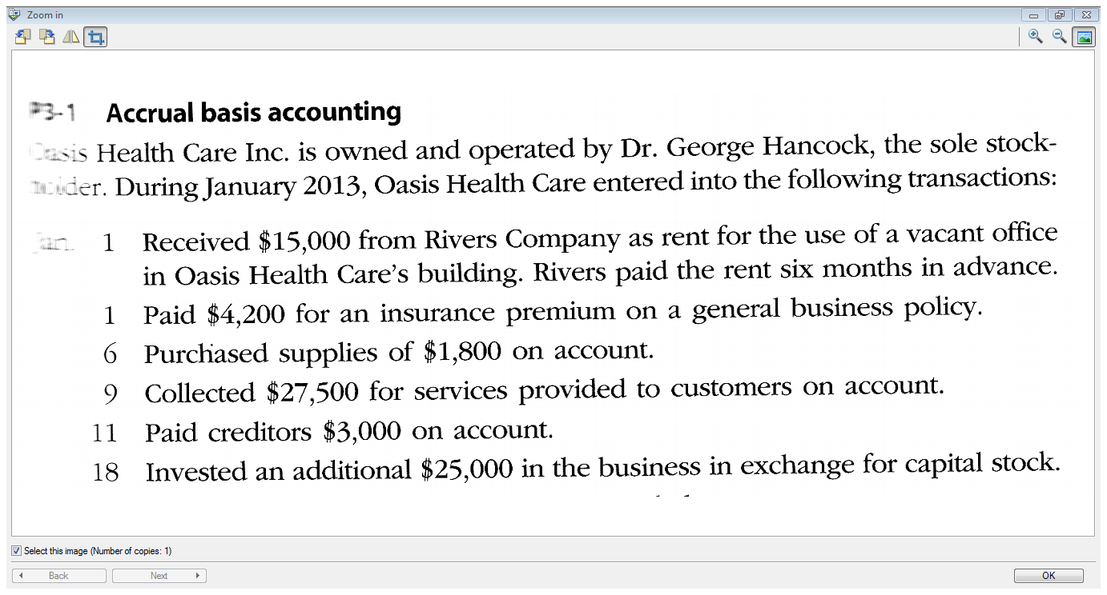

Slide 32
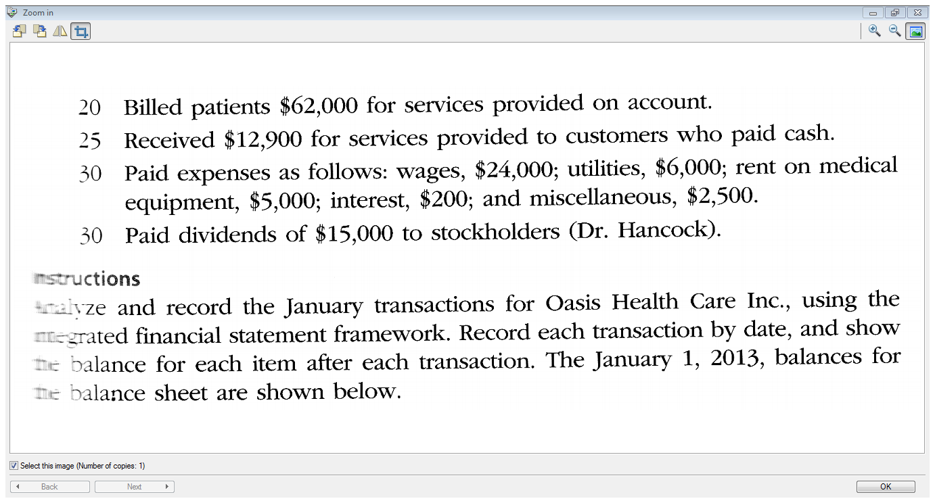
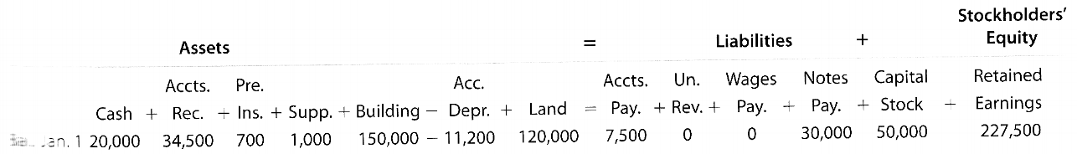

Slide 33
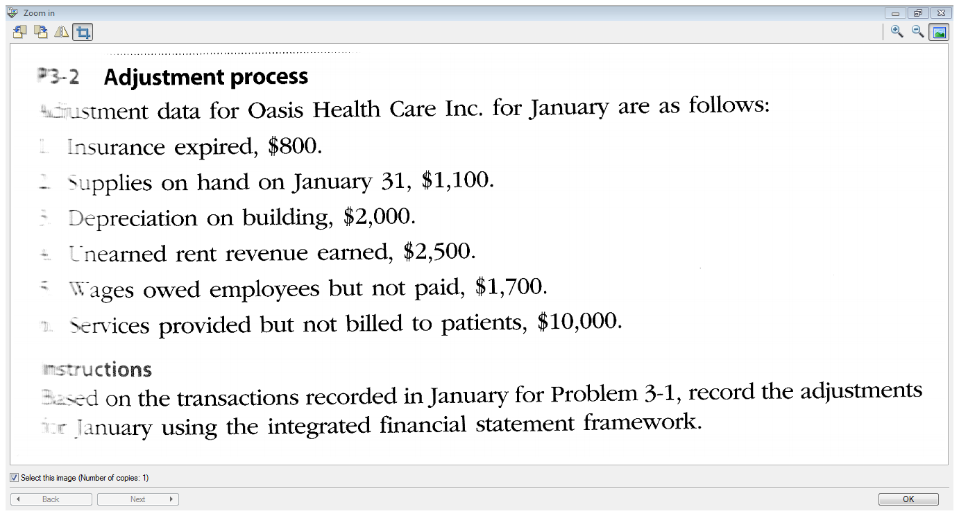

Slide 34
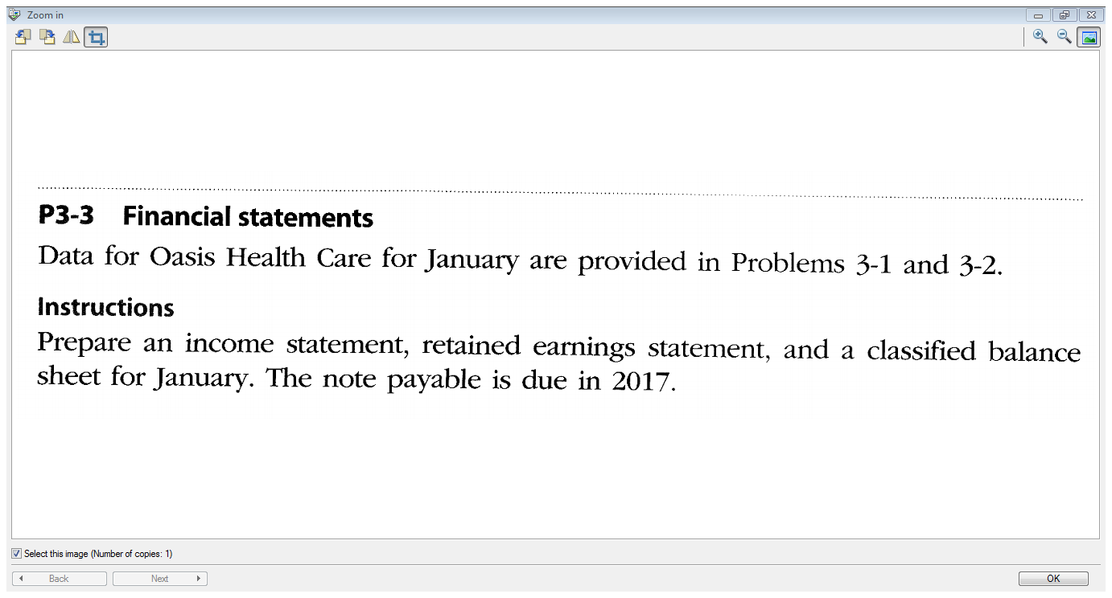

Slide 35
End of Chapter 3!

