Slide 1
Chapter 1
The Role of Accounting in Business

Slide 2
Learning Objectives
Describe the types and forms of businesses, how businesses make money, and business stakeholders.
Describe the three business activities of financing, investing, and operating.
Define accounting and describe its role in business.
Describe and illustrate the basic financial statements and how they interrelate.
Describe eight accounting concepts underlying financial reporting.

Slide 3
Types of Businesses?
Service Business
Manufacturing Business
Merchandising Business

Slide 4
Forms of Business
Proprietorship
Partnership
Corporation
Considerations in Choosing a Form of Business Organization
Ease of formation
Ability to raise capital
Legal liability
Taxation
Limitation on life

Slide 5
Decision Making & Business Stakeholders
Capital market stakeholders – shareholders, owners and banks
Product or service market stakeholders – customers and suppliers
Government stakeholders – CRA, Corporations Canada, Ontario Ministry of Government Services
Internal Stakeholders – employees and managers

Slide 6
Objectives of Financial Accounting
Sometimes called the “language of business”, Accounting is an information system that provides reports to stakeholders about the economic activities and condition of a business.
Essentially, it summarizes the financial performance of the firm for external users.

Slide 7
Two Major Objectives of Financial Accounting
Today, Sept.6/13
Dec.31, 2013
Financial Condition
As of a POINT IN TIME
Financial Condition
As of a POINT IN TIME
Financial Condition
Over a PERIOD OF TIME

Slide 8
Financial Statements
Income Statement – reports the change in financial condition due to operations. It’s a summary of revenue and expenses for a specific period of time
Retained Earnings Statement – summary of changes in the retained earnings in the business for a specific period of time. May also be called Statement of Changes in Shareholders’ Equity
Balance Sheet – list of assets, liabilities and shareholders’ equity as at a specific date.
Statement of Cash Flows – summary of cash receipts and cash payments for a specific period of time

Slide 9
FACEBOOK, INC.
STATEMENT OF INCOME
For the year ended December 31, 2012
(Adapted) (In millions)
Revenue |  | $ 5,089
Expenses:
Cost of revenue | $ 1,364
Marketing and sales | 896
Research and development | 1,399
General and administrative | 885
Interest expense | 51
Income taxes | 441 | 5,036
Net income |  | $53

Slide 10
Income Statement
Revenues – MUST
  Provide a good or a service
  Be assured of collection
  Know the amount
Expenses – MUST
  Help to generate revenues during the period reported on

Slide 11
Income Statement
  Uses the Matching Concept
  Expenses for the period are matched against revenues they generate for the same period
  Revenue – Expenses = Net Income

Slide 12
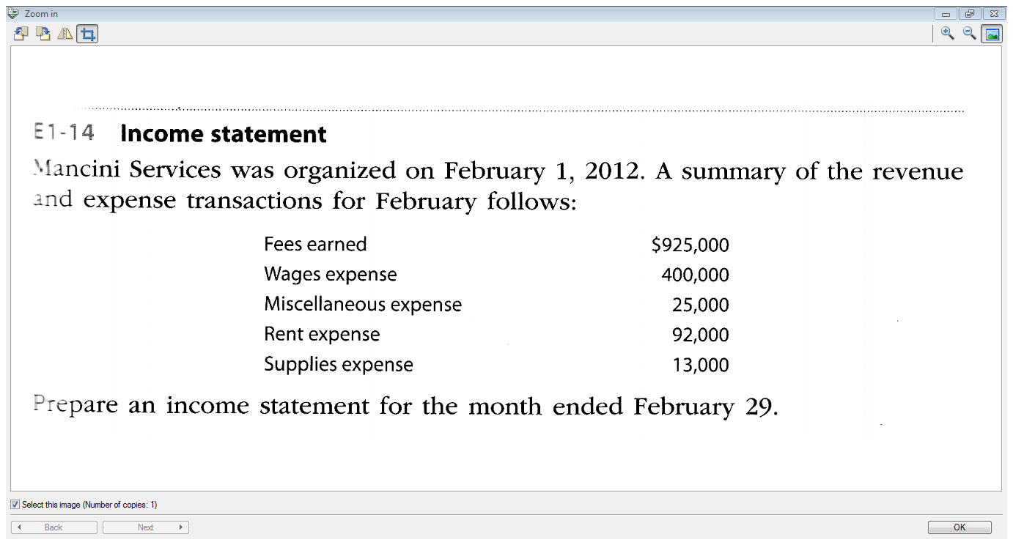

Slide 13
FACEBOOK, INC.
STATEMENT OF RETAINED EARNINGS
For the year ended December 31, 2012
(Adapted) (In millions)
Balance at December 31, 2011 | $ 1,606
+ Net income for 2012 | 53
- Dividends for 2012 | 0
Balance at December 31, 2012 | $ 1,659
Reports changes in financial condition due to changes in retained earnings during a period
Retained earnings is the portion of net income retained by the business. It is the accumulation of net income since incorporation less dividends paid to the shareholders.

Slide 14
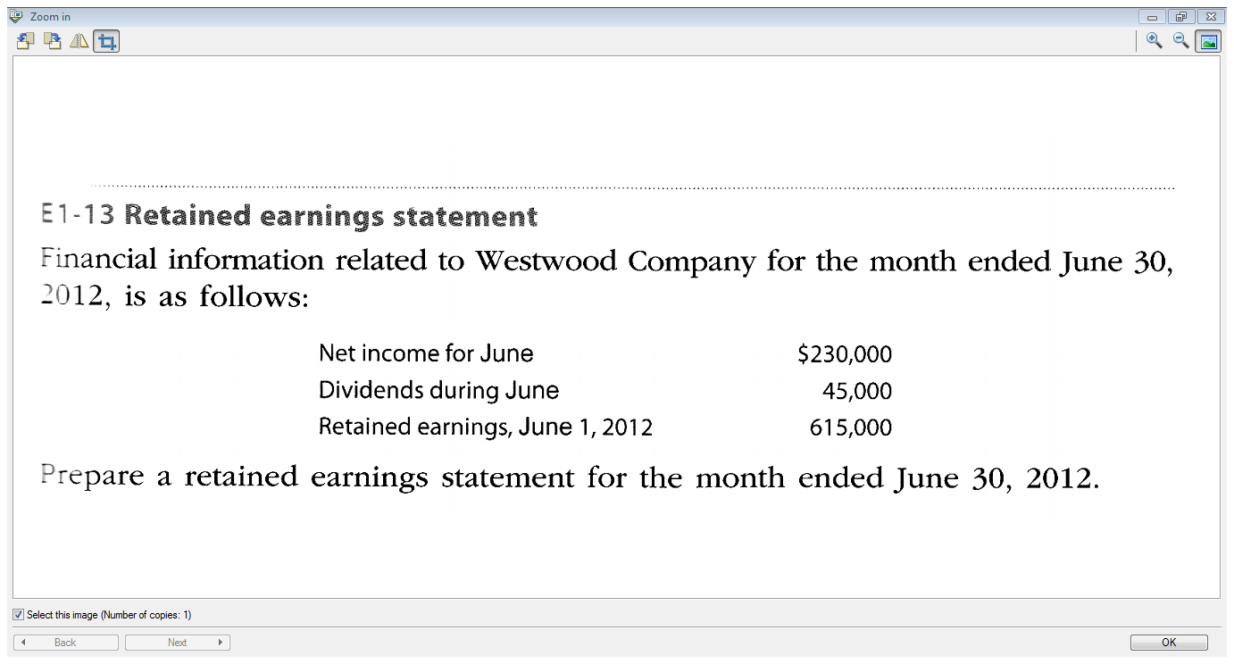

Slide 15
Balance Sheet
Reports financial condition at a point in time.
Measured by total assets and claims to those assets:
Assets =
Liabilities + Shareholders’ Equity

Slide 16
What assets do you have?

Slide 17
What liabilities do you have?

Slide 18
FACEBOOK, INC.
BALANCE SHEET
As at December 31, 2012
(Adapted) (In millions)
Assets
Cash and cash equivalents | $ 2,384
Marketable securities | 7,242
Accounts receivable | 719
Prepaid expenses & other current assets | 471
Property and equipment, net | 2,391
Goodwill and intangible assets, net | 1,388
Other assets | 508
Total assets | $15,103

Slide 19
Liabilities and stockholders’ equity
Liabilities
Accounts payable | $ 65
Platform partners payable | 169
Accrued liabilities | 423
Deferred revenue | 30
Capital lease obligations | 365
Other liabilities | 796
Long Term Debt | 1,500
Total liabilities | 3,348
Stockholders’ equity
Share Capital | 10,094
Retained earnings | 1,659
Other | 2
Total stockholders’ equity | 11,755
Total liabilities and stockholders’ equity | $15,103

Slide 20
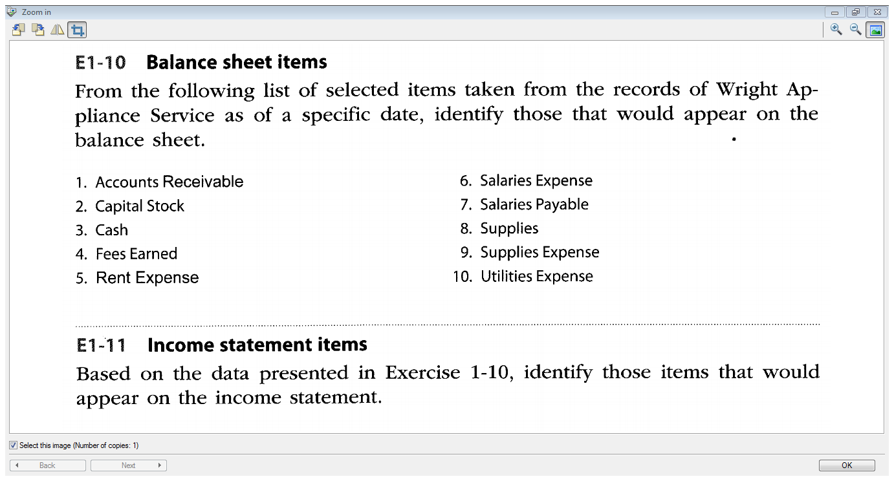

Slide 21
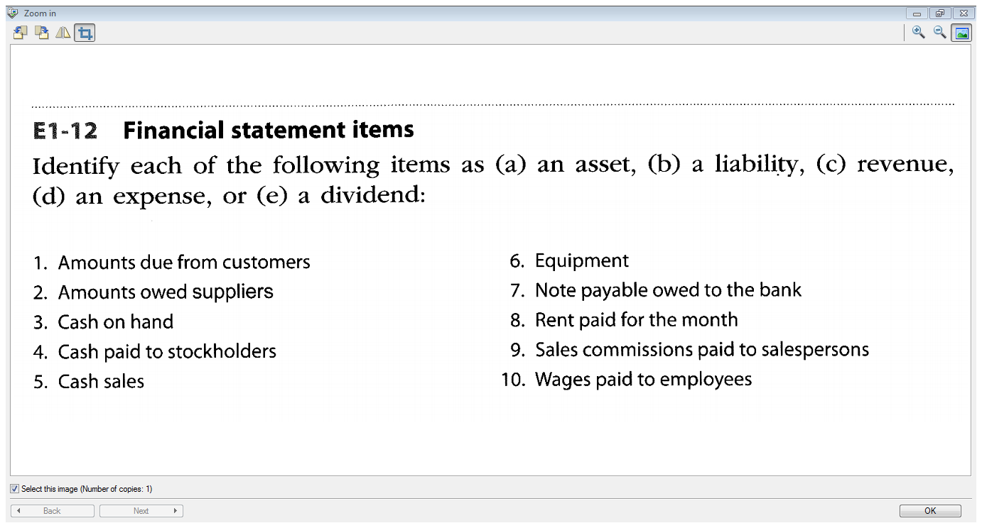

Slide 22
Statement of Cash Flows
Reports the change in financial condition due to the changes in cash during a period
STATEMENT OF CASH FLOWS
For the year ended December 31, 2012
(Adapted) (In millions)
Cash flows from operating activities
Net income | $ 53
Adjustments to reconcile net income to net cash provided by operating activities:
Depreciation and amortization | 649
Loss on write-off of equipment | 15
Share-based compensation | 1,572
Tax benefit from share-based award activity | 1,033
Excess tax benefit from share-based award activity | (186)
Changes in assets and liabilities: | (491)
Net cash provided by operating activities | 1,612

Slide 23
Cash flows from investing activities
Purchases of property and equipment | (1,235)
Purchases of marketable securities | (10,307)
Maturities of marketable securities | 3,333
Sales of marketable securities | 2,100
Investments in non-marketable equity securities | (2)
Acquisitions of business, net of cash acquired, and purchases of intangible and other assets | (911)
Change in restricted cash and deposits | (2)
Net cash used in investing activities | (7,024)
Cash flows from financing activities
Net proceeds from issuance of common stock | 6,760
Proceeds from exercise of stock options | 28
Proceeds from (repayments of) long-term debt | (250
Proceeds from sale and lease-back transactions | 170
Principal payments on capital lease obligations | (181
Excess tax benefit from share-based award activity | 433
Net cash provided by financing activities | 6,283
Effect of exchange rate changes on cash and cash equivalents | 1
Net increase (decrease) in cash and cash equivalents | 872
Cash and cash equivalents at beginning of period | 1,512
Cash and cash equivalents at end of period | $ 2,384

Slide 24
Integrated Financial Statements
Net Income on Income Statement
$ 53
Retained Earnings Statement
- Net Income of $53 used to calculate retained earnings of $1,659
Statement of Cash Flows – ending cash balance = $2,384
Balance Sheet
- Retained Earnings $1,659
- Cash $2,384

Slide 25
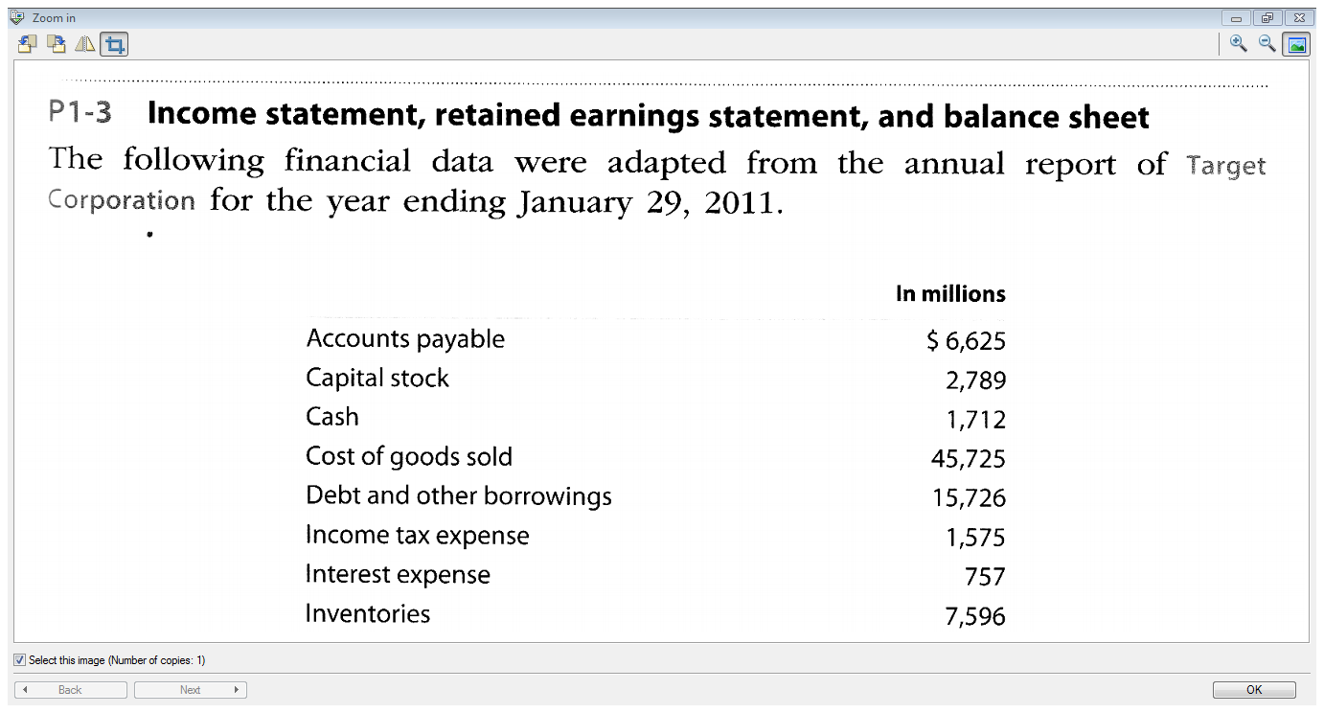

Slide 26
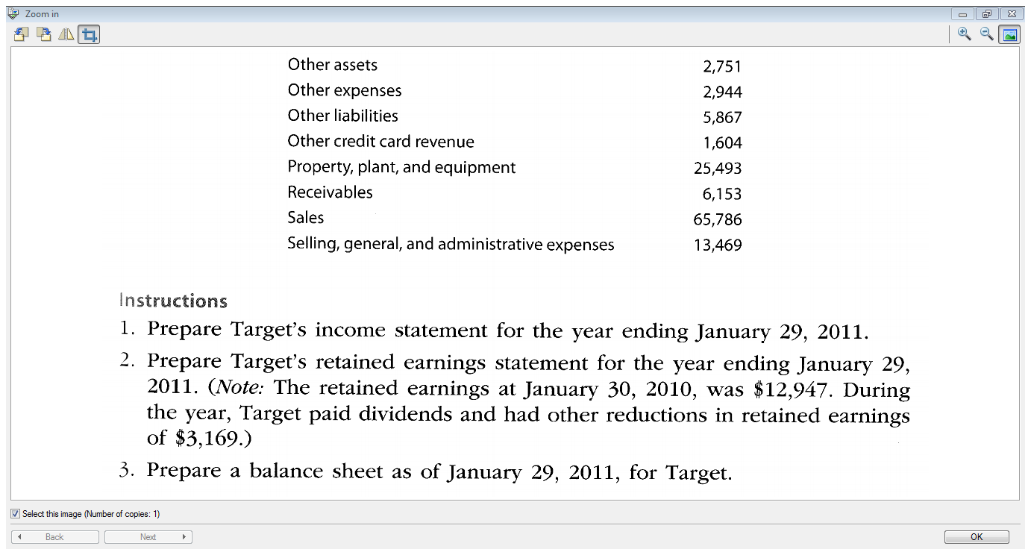

Slide 27

The Accounting “Rules”
Generally Accepted Accounting Principles (GAAP) are set by the Accounting Standards Board of the Canadian Institute of Chartered Accountants (CICA).
These accounting standards are published in the CICA Handbook.

Slide 28
Eight Concepts
BUSINESS ENTITY
COST CONCEPT
ACCOUNTING PERIOD
GOING CONCERN
ADEQUATE DISCLOSURE
MATCHING CONCEPT
UNIT OF MEASURE
OBJECTIVITY CONCEPT

Slide 29

End of Chapter 1

