Slide 1
Exporting
November 22 and 24, 2011

Slide 2
Exam Review Session
Wednesday, December 7th
5:30pm-7:30pm
701 Dunton Tower

Slide 3
Friday, November 25
Room: Loeb C246 (Tutorial)
Time: 1:35pm - 2:35pm
Order:
  Air Canada (3 – McLean, Mahmoud, Barill, Cowley)
  Apple (9 – Taguchi, Vaillancourt, Stafford, Perez-Yanez)
  Samsung (8 – McRae, Abraham, Marcantonio, Martin)

Slide 4
Saturday, November 26
Room: 701 Dunton Tower
Time: 10:00am – 12:00pm
Order:
  RIM (4 – Brown, Bor, Chapman, Cheung, Dundas)
  Coca-Cola (5 – Randall, Marlin, Georgieva, Chomyj)
  Nike (7 – Garvey, Clarke, Paradis, Fagan)
  Sony (6 – Perry, Hape, Rodriguez-Fournier, Gosal)

Slide 5
Friday, December 2
Room: 710 Dunton Tower
Time: 1:35pm - 2:35pm
Order:
  Adidas (2 – Shaw, Kindl, Paterson, McGuire)
  McDonald’s (1 – Lang, Gammie, Olson, Smith)
  Volkswagen (10 – Kropp, Winsor, Courtice, Commons)

Slide 6
Exporting
The role of exporting
Factors leading to the growth of exports
The burdens of exporting
Obtaining reliable information
Agents
  Direct exporting
  Indirect exporting
Notes:
The Role of Exporting. (slide 1)
Although we have talked about other means of conducting business in foreign markets, exporting remains a very important method for both large and small companies.

Slide 7
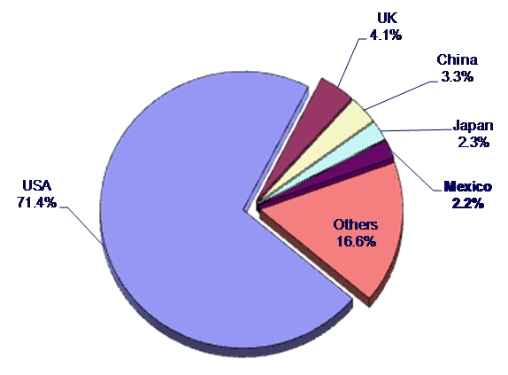
Canadian Export Markets
Total Exports 2010: $387 billion of US Dollars

Slide 8
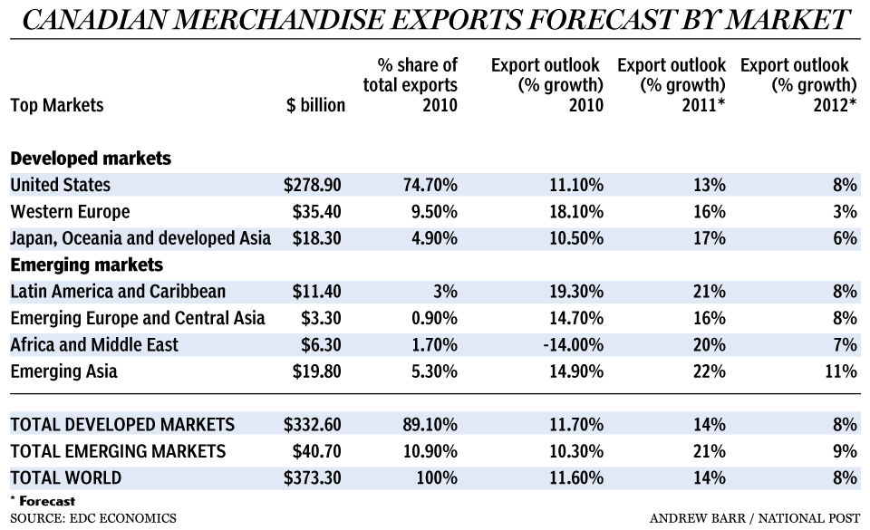
Canadian Export Markets
Notes:
The world will soon be a very different place for Canadian exports as traditional markets such as the United States and Europe take a back seat to emerging markets, which are forecast to account for half of all Canadian goods leaving the country by 2025.
That was the prediction Tuesday from Export Development Canada, which said emerging markets will account for 20% of Canadian exports in five years, before growing to half of all exports a decade later.
Emerging markets are certainly the most important growth story for Canada, but in the short term the country’s exports will continue to rely on the so-called traditional markets.
Canadian exports are currently 9% below their pre-recession levels in 2008. (The financial crisis that sent Canada’s economy spiralling into recession wiped out almost a quarter of Canada’s total international exports.)

Slide 9
Reasons for Exporting
Large firms
  Gain economies of scale
  Enter smaller markets
  Enter uncertain markets
  To exploit limited product lines
  To protect technology
Notes:
Large firms export for a number of reasons. (slide 2)
To gain economies of scale.
To go to countries where markets are not large.
To exploit products that are not expected to generate large sales or profits.
To test out markets.
To protect technology and other commercial secrets.

Slide 10
Reasons for Exporting
Small firms
  Tap foreign markets without too much risk or expense
  To exploit foreign markets for products with limited appeal
  To avoid saturated markets
All firms
  Allows some initial learning
  Allows an initial corporate presence
Notes:
Small firms. (slide 3)
It allows them to tap foreign markets without a great deal of expense and risk.
It allows them to exploit foreign markets for products that they would not normally have sold outside their home country.
Provides some basic knowledge.
Interaction with buyers.
Interaction with customs and other agencies.
Interaction with agents.

Slide 11
Factors Leading to the Growth of Exports
Decline in trade barriers
Outsourcing
Easier access to communication
Globalization
  Market saturation
  Increased competition
Notes:
Factors Leading to Growth of Exports. (slide 4)
Exports are growing around the world.
This is somewhat surprising given the increase in direct foreign investment.
Exports are growing for a number of reasons.
Decline in trade barriers.
In fact, recent developments in this area may have helped increase exports more than DFI.
Most countries welcomed DFI because it brought investment and jobs.
They were not so happy about imports because:
Balance of trade problems.
Competition for domestic producers.
The increasing importance of WTO rules meant that exporting was easier and cheaper.
Outsourcing.
If we have work done abroad and then bring it back to the home country this is seen as importing.
Companies in low wage countries who engage in this type of exporting may then go on to exporting on their own.
Easier access to communication.
The Internet has probably done more for small companies that wish to export than any other development.
They can easily display their wares to a customer almost any place in the world.
Email allows them to communicate with minimal cost and little delay.
This still leaves the problem of getting companies to notice you in the first place but it makes reaction much quicker and cheaper.
Globalization.
Greater awareness of foreign suppliers.
More developed transportation networks.
Increasing number of countries with market-based economies.

Slide 12
The Burdens of Exporting
May not be an ongoing relationship
Dealing with two legal systems
Payment generally takes longer
A great deal of paperwork
Notes:
The Burdens of Exporting. (slide 6)
While exporting is certainly desirable for many firms there are a number of issues which arise that are not really there for other types of international business. These pose problems for exporters. I’ll first discuss the problems of exporting and then indicate how transactions are structured to deal with them.
Often not an ongoing relationship.
Means that you do not have a trust relationship.
Have to rely more on legal system.
Dealing with two legal systems (at least).
If something goes wrong it may be difficult to collect.
The local legal system may not be sympathetic.
It may be costly. Since many export transactions are small the cost may be more than what one would gain.
Payment times tend to be longer than for domestic transactions.
This means the company has to carry its costs for longer.
It takes longer to collect so any delays make for a very long time without your money.
A great deal of paperwork.
Often in a foreign language.
Often with unknown regulations.
A fairly straightforward sale may have as many as thirty different documents associated with it.
With security considerations these are becoming more complex.

Slide 13
Information
May be difficult to find accurate information especially for small companies
Most countries and many states/provinces provide an information service for exporters
  About countries
  About industries
May also have lists of potential customers
Notes:
Information. (slide 7)
One of the factors that inhibits companies from exporting is the difficulty of obtaining accurate information.
One would think in this information age that would be relatively easy but this is not generally the case, especially for small firms.
Types of information necessary.
Who are potential customers?
Where are they located?
What is their financial situation?
Who are the important competitors in that country?
How are goods distributed?
How does the payment system operate?
What is the best way to approach customers?
Are reliable agents available?
Most industrialized countries and some of the states and provinces within them have services that provide this type of information on a general basis.
About countries.
About industries.
Sometimes they will also do searches into specific countries or industries.
Some also provide lists of potential customers.
Companies.
Industries.

Slide 14
Finding Customers
Government agencies
Trade fairs
Advertising in local media
Recommendations from other parts of the organization
Agents
Notes:
The Process of Exporting.
There are three basic phases in exporting. (slide 8)
Finding customers.
For passive exporters this is obviously not a problem because they wait for the customers to come to them.
For active exporters this is a continuing issue.
There are several methods that are employed.
Government agencies.
Almost all governments have an agency which is supposed to support companies in their efforts to export.
In Canada this is the Export Development Corporation.
Trade fairs.
These tend to be expensive.
May take a long time to show results.
Advertising in local media.
Need to find out which ones are appropriate.
Obviously this depends on the product.
It may also depend on regulations within the country.
For large companies divisions may make recommendations to other sections of the organization.
One may also employ local agents of various types.

Slide 15
Two Types of Exporting
Direct
  Sell into countries without using intermediaries
  Not necessarily to the end user
Indirect
  Working through and individual or company
  Several possible mechanisms
Notes:
In his discussion of exporting Hill talks about export management companies (EMCs).
In fact there are several different types of companies and services which may be involved in assisting companies with exports. It is useful to know the differences among them.
First we need to distinguish between two kinds of exporting. (slide 2)
Direct exporting means selling directly into a country. This does not necessarily mean selling to the end user.
Indirect exporting means working through a company which finds customers and delivers the goods.

Slide 16
Direct Exporting
Sales representatives
  May be our own employees
  Individuals or companies hired on a commission basis
Distributors or wholesalers
  Often industry focused
  May represent more than one company
Notes:
Direct exporting often utilizes two different types of intermediaries.
Sales representatives. (slide 3)
May be our own employees.
Normally, especially for a small company, will be someone hired to represent us in the target market,
Best if they represent only our company.
May represent other companies but not for products that compete with our lines.
Distributors.
Goods are sold to them and they sell them to customers in the country.
This is direct exporting because they buy the goods in the country.

Slide 17
Agents
Represent us in the target market
May use multiple agents for different goods
Usually agents have exclusive rights in territories
Often not desirable for goods which require service or follow-up
Notes:
Indirect exporting.
Agents. (slide 4)
Individuals or organizations who represent the company in a target market.
Usually are paid on a percentage basis.
Agents often represent more than one company in an industry (e.g. medical products).
This may lead them to ignore a company’s products if they are seen to be difficult to sell or do not generate sufficient revenue.

Slide 18
Export Management Company
Provides a variety of services
  Gathers information
  Checks companies’ credit
  Helps with promotion
  Makes shipping arrangements
  Manages customs clearance
Integrates all these services which saves time and money
Notes:
Export management company. (slide 5)
Provides a variety of services for a company which wants to export.
Gathers information, often through existing contacts.
Checks for credit worthiness.
Helps with promotion.
Makes shipping arrangements.
Manages customs clearance.
Relieves the exporting company of many of the technical matters in arranging exports.
Integrates all these which generally means smoother operations and lower costs than if they were all done by separate companies.
Obviously costs are higher than for agents.
For both agents and EMCs the problem is to find a reliable and committed individual or organization.

Slide 19
Export Trading Company
Adds functions to those provided by an EMC
Locating customers
Financing sales
Setting up distribution channels
May even process some products
Notes:
Export trading company. (slide 6)
Includes some of the functions of an EMC but adds several more.
Finance.
Finding customers.
Setting up distribution channels.
May even process some products.
This type of organization is most common in Asia.

Slide 20
Factors Affecting Type of Export Mechanism
Type of product
Need for service
Product image
Normal industry practice
Company’s familiarity with the target market
Characteristics of the target market
Notes:
The choice among these different possible approaches to exporting will depend on a number of factors. (slide 7)
Type of product.
Need for service.
Product image.
Normal industry practice.
The company’s familiarity with the target market.
Characteristics of the target market.

Slide 21
The Export Process

Slide 22
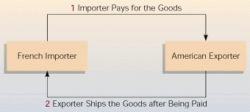
The Export Process – Exporter Preference

Slide 23
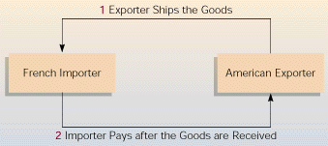
The Export Process – Importer Preference

Slide 24
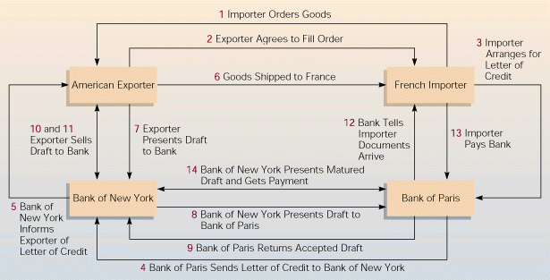
The Export Process

Slide 25
The Shipping and Payment Process I
Step 1 The importer places the order
Step 2 The exporter agrees to price and shipping date
Step 3 The importer arranges a letter of credit
Step 4 Letter of credit to exporter’s bank
Notes:
The Mechanisms of Shipping and Payment.
As Hill’s chapter indicates, the process of sending and collecting for an export transaction is a complicated one even though the essence of the sale is simple.
I want to walk you through this transaction.
Not because you need to know all the steps.
But because you need to know why it is structured this way.
And what part some of the various players have.
Step 1 The importer places an order with the exporter. (slide 8)
Step 2 The exporter agrees on a price and delivery date.
Step 3 In order to pay for the goods, the importer arranges a letter of credit.
A letter of credit is simply a promise by the bank, not the company that they will pay once the goods are delivered.
The bank may require some guarantee by the importer.
In any case they will charge a fee.
This is normally with their local bank.
It could be with a bank that the exporter also uses but since they are in different countries this seldom happens although it would make the transaction somewhat simpler.
Larger firms may use common banks because they often use several banks located in different countries.
Step 4 The importer’s bank sends the letter of credit to the exporter’s bank.

Slide 26
The Shipping and Payment Process II
Step 5 Bank informs the exporter the letter of credit has arrived
Step 6 Exporter ships the goods
Step 7 Exporter presents draft to bank
Step 8 Paperwork sent to importer’s bank
Step 9 Importer’s bank endorses draft and returns it to exporter’s bank
Notes:
Step 5 The exporter’s bank then advises the exporter that the letter has arrived. (slide 9)
This means that once the goods are shipped the exporter can be paid.
This is guaranteed by the two banks involved.
Both the banks take a fee, usually a percentage of the total transaction, for their services.
Step 6 Having received this guarantee of payment, the exporter ships the goods.
This is in the form of a draft.
It is usually also accompanied by a bill of lading from the shipper to prove that the goods have been consigned to the transportation company.
This does not mean that the company can get paid right away. Usually there is a 90-day wait perhaps even more.
Step 7 Exporter presents the draft to its bank.
The bill of lading goes along as proof of shipment.
The formal title of the goods now belongs to the exporter’s bank.
Step 8 The exporter’s bank ships the paperwork to the importer’s bank.
Step 9 The importer’s bank endorses the draft and returns it to the exporter’s bank essentially taking control of the goods and promising to pay for them.
The exporter’s bank does not get paid right away. It is a ninety-day note.
The exporter will get paid no matter what happens to the goods. Once the importer’s bank accepts the paperwork, they have agreed to pay.
Of course, if the goods prove defective or not what was ordered then the bank may take steps but assuming everything is as it should be the goods now belong to the importer, or more accurately, the importer’s bank.

Slide 27
The Shipping and Payment Process III
Step 10 Endorsed draft goes to exporter
Step 11 Exporter sells draft to bank at a discount (optional)
Step 12 Importer’s bank notifies importer paperwork has arrived
Step 13 Importer pays bank
Step 14 Importer’s bank pays exporter’s bank
Notes:
Step 10 The exporter’s bank sends them the endorsed draft. (slide 10)
Step 11 The exporter sells the draft to the bank at a discount as it is not yet due.
The company could, of course, hold on to the draft, wait for the ninety days and collect the full amount.
Many companies do not do this because:
They need the money.
It means that they no longer have responsibility.
They would rather have the bank deal with these bookkeeping functions than hire someone themselves.
This is especially true of smaller firms.
Step 12 The importer’s bank tells the importer that the papers have arrived.
Step 13 The importer pays the bank.
Step 14 The importer’s bank pays the exporter’s bank and the bill is retired.

Slide 28
Other Considerations
This leaves out:
  Warehouses
  Bonding companies
  Handling firms
  Customs
Complexity arises because both sides must be satisfied that the bargain will be upheld
Notes:
There are some observations that need to be made about this transaction. (slide 11)
This is the simple version.
I have left out:
Warehouses.
Bonding companies.
Storage companies.
Customs.
You should be able to see that this transaction, which is simply buying and selling goods, is really not complex.
What contributes to the apparent complexity is the fact that the two sides have to be assured that the other will fulfill its part of the bargain.
It is this complexity and the associated detail which discourages small businesses when they decide to export.
They generally do not have the expertise to handle all this paperwork.
They often, especially when they are beginning export, cannot afford to hire someone to do this.
This is the reason that so many companies exist to facilitate export transactions.

Slide 29
Exporting: What You Need to Know
Way Funky Swimwear
Australian swimwear label based in Melbourne
http://youtu.be/7AJLO1FdN9w

