Slide 1
The International Monetary System
November 15 and 17, 2011
Notes:
Chapter 10: The International Monetary System

Slide 2
The International
Monetary System
A brief history of exchange rates
The International Monetary Fund
Currency collapses
The Chinese yuan and world currencies
The World Bank

Slide 3
A Brief History of Exchange Rates
The gold standard
World War I
The Depression
World War II
Bretton Woods

Slide 4
What Was The Gold Standard?
The gold standard refers to a system in which countries peg currencies to gold and guarantee their convertibility
  dates back to ancient times
  later, payment was made in paper currency which was linked to gold at a fixed rate
  the gold par value refers to the amount of a currency needed to purchase one ounce of gold
Notes:
The Gold Standard.
At the beginning of the last century most of the world, at least the major trading countries, were on the gold standard.
The country’s currency was fixed against a certain amount of gold.
This was, in practice a set of fixed exchange rates since all were denominated to the same standard.
Early in this regime an individual could take his or her currency to the bank and exchange it for gold coins.
Countries later dropped this feature but they still kept a great deal of gold in their vaults.
With this system countries still had to change the value of their currencies from time to time. They simply changed their relationship to gold.

Slide 5
World War I
Worked well from the 1870s until 1914
  but, many governments financed their World War I expenditures by printing money and so, created inflation
People lost confidence in the system
By 1939, the gold standard was dead
Notes:
World War I.
During WW I most countries abandoned the gold standard.
Inflation, loss of confidence and war-related destruction altered both economies and the perception of their currencies.
Most of the countries involved in the war printed money that was not backed by gold. They could not afford to make it convertible.
There was what might be called a limited floating rate.
After the war, sometimes many years after, most countries returned to the gold standard as they believed that this was the best system.
It was, in the sense that it provided stability.

Slide 6
The Depression
Slump hit countries differently
Some countries began to devalue their currencies
Others followed suit
Investors sold currencies and bought gold
Most countries abandoned the gold standard
Notes:
The Depression.
When the Depression began in 1929 it hit different countries with differing degrees of severity.
This would have led, in any case, to a revaluation of some currencies.
However, countries began to devalue their currencies as a way of making their goods more attractive in other markets.
This soon turned into competitive devaluation.
Many investors turned to gold itself rather than the currencies which were supposed to be related to its value.
This meant that gold became more expensive and countries’ reserves came under pressure.
Most countries went off the gold standard again.
They tried to maintain fixed rates but there were many shifts and changes.
World War II.
World War II would have had the same effect as WW I except that most countries were already off the gold standard.
The shift in wealth from the main combatant countries to other nations, especially to the US, put enormous pressure on currencies.
As the war began to wind down concern about what would happen to exchange rates after the war was an important concern.
This was part of the same impetus that I mentioned when we discussed the GATT.

Slide 7
The Bretton Woods System
In 1944, 44 countries met to design a new international monetary system
Under the new agreement
  a fixed exchange rate system was established
  all currencies were fixed to gold, but only the U.S. dollar was directly convertible to gold
  devaluations could not to be used for competitive purposes
  a country could not devalue its currency by more than 10% without IMF approval
Notes:
A new international monetary system was established in 1944. Representatives from 44 countries met at Bretton Woods, New Hampshire with the goal of building an enduring economic order that would facilitate postwar economic growth.
Under the Bretton Woods system, the only currency that was to be convertible to gold was the dollar. Other countries set their exchange rates relative to the dollar.
So, the dollar was set against gold at $35 per ounce, and then each country determined its exchange rate relative to the dollar.
Devaluations were not allowed for competitive purposes, and a country couldn’t devalue its currency by more than 10 percent without IMF approval.

Slide 8
The Bretton Woods System cont.
Worked well until the late 1960s
Collapse due to welfare programs and the Vietnam War
Other countries increased the value of their currencies relative to the U.S. dollar in response to speculation the dollar would be devalued
However, because the system relied on an economically well managed U.S., when the U.S. began to print money, run high trade deficits, and experience high inflation, the system was strained to the breaking point – the U.S. dollar came under speculative attack
Notes:
How successful was the Bretton Woods system?
Bretton Woods worked well until the late 1960s when it began to collapse.
Under President Johnson, the U.S. began to finance increases in its welfare program and the costs related to the Vietnam War by increasing the money supply.
Recall that an increase in the money supply leads to price inflation. This led to a deterioration of the U.S. foreign trade position, and speculation that the dollar would have to be devalued.
However, remember that under the Bretton Woods system, devaluing the dollar meant that all other currencies would have to be revalued—a prospect that wasn’t appealing to other countries that would see the price of their products rise relative to American products!
In 1971, President Nixon announced that the dollar would no longer be convertible to gold, and that a 10 percent tariff on all imports would be implemented unless countries agreed to revalue their currencies.
The dollar was eventually devalued by about 8 percent, but problems continued to persist. The U.S. continued to expand its money supply, run high trade deficits, and experience high inflation.
The Bretton Woods system was only viable when the U.S. inflation rate was low, and the U.S. did not run a balance of payments deficit, and so it collapsed, and currencies began to float against each other.

Slide 9
International Monetary Fund
The International Monetary Fund (IMF) to maintain order in the international monetary system through a combination of discipline and flexibility
  requiring fixed exchange rates stopped competitive devaluations and brought stability to the world trade environment
  fixed exchange rates imposed monetary discipline on countries, limiting price inflation
  in cases of fundamental disequilibrium, devaluations were permitted
  the IMF lent foreign currencies to members during short periods of balance-of-payments deficit, when a rapid tightening of monetary or fiscal policy would hurt domestic employment
Notes:
As part of the Bretton Woods agreement, two multinational institutions were established.
The first, the International Monetary Fund or IMF, was designed to maintain order in the international monetary system.
The goal of the second, the World Bank, was to promote general economic development.
Why was the IMF important?
The IMF, using a combination of flexibility and discipline, was responsible for executing the main objectives of the Bretton Woods agreement, with the goal of avoiding the chaos that occurred during the time between the wars.
Let’s talk a bit more about the discipline imposed by the IMF.
The fixed exchange rate system provides discipline in two ways. First, the need to maintain a fixed exchange rate limits competitive devaluations and brings stability to the world trade environment.
Second, because the system imposes monetary discipline on countries, inflation is limited.
So, fixed exchange rates help control inflation and force economic discipline on countries.
Why was flexibility important?
Well, representatives at the meeting recognized that a rigid policy of fixed exchange rates would be too inflexible in a more global world.
So, instead, the IMF created a fund using contributions from members that gave it the ability to lend foreign currencies to members to tide them over during short term balance of payments deficits when implementing a rapid tightening of monetary or fiscal policy would harm the domestic employment situation.

Slide 10
The Functions of the IMF
Surveillance (like a doctor)
  Gathering data and assessing economic policies of countries
Technical Assistance (like a teacher)
  Strengthening human skills and institutional capacity of countries
Financial Assistance (like a banker)
  Lending to countries to support reforms

Slide 11
Governance of the IMF
IMF is accountable to its member countries.
Board of Governors: one governor from each member country. Meets once a year.
Day to day affairs are guided by the Executive Board: 24 Executive Directors. Managing Director of IMF is Chairman of Executive Board.

Slide 12
IMF Resources
IMF’s capital base consists of membership quotas, the financial contribution made by member countries. Total quotas amount to about US$320 billion, to be raised to about $750 billion.
Member’s quotas are determined by their economic weight in the global economy.
A member’s quota determines its voting power and size of loan a country can borrow.
Notes:
How member countries’ quotas are determined
When a country joins the IMF, it is assigned an initial quota in the same range as the quotas of existing members that are broadly comparable in economic size and characteristics. The IMF uses a quota formula to guide the assessment of a member’s relative position.
The current quota formula is a weighted average of GDP (weight of 50 percent), openness (30 percent), economic variability (15 percent), and international reserves (5 percent). For this purpose, GDP is measured as a blend of GDP based on market exchange rates (weight of 60 percent) and on PPP exchange rates (40 percent). The formula also includes a “compression factor” that reduces the dispersion in calculated quota shares across members.
Quotas are denominated in Special Drawing Rights (SDRs), the IMF’s unit of account. The largest member of the IMF is the United States, with a current quota of SDR 42.1 billion (about $68 billion), and the smallest member is Tuvalu, with a current quota of SDR 1.8 million (about $2.9 million).
Quotas play several key roles in the IMF
A member's quota delineates basic aspects of its financial and organizational relationship with the IMF, including:
Subscriptions (quota share). A member's quota subscription determines the maximum amount of financial resources the member is obliged to provide to the IMF. A member must pay its subscription in full upon joining the Fund: up to 25 percent must be paid in SDRs or widely accepted currencies (such as the U.S. dollar, the euro, the yen, or the pound sterling), while the rest is paid in the member's own currency.
Voting power (voting share). The quota largely determines a member's voting power in IMF decisions. Each IMF member’s votes are comprised of basic votes plus one additional vote for each SDR 100,000 of quota. The 2008 reform fixed the number of basic votes at 5.502 percent of total votes. The current number of basic votes represents close to a tripling of the number prior to the effectiveness of the 2008 reform.
Access to financing. The amount of financing a member can obtain from the IMF (its access limit) is based on its quota. For example, under Stand-By and Extended Arrangements, a member can borrow up to 200 percent of its quota annually and 600 percent cumulatively. However, access may be higher in exceptional circumstances.
CANADA 6,369.2 Million SDR or 2.68% of total and 64.4333 votes
US 42, 122 million sdr or 17.7% of total and 421,000 votes
CHINA 9,525,9 million SDR or 4$ of total and 96,000 votes

Slide 13
The Role of The IMF Today
Today, the IMF focuses on lending money to countries in financial crisis
  A currency crisis
  A banking crisis
  A foreign debt crisis
Notes:
Remember, the IMF was originally established to help maintain the exchange rate system that was set at Bretton Woods. Today, however, many of the original reasons for its existence are no longer there.
So, the IMF has redefined its mission, and focuses on lending money to countries that are in financial crisis. For example, the IMF lent money to several Asian countries in 1997.
What is a financial crisis?
A currency crisis occurs when a speculative attack on the exchange value of a currency results in a sharp depreciation in the currency, or forces the government to expend large amounts of international currency reserves and sharply increase interest rates in an effort to maintain the prevailing exchange rate.
A banking crisis refers to a situation in which a loss of confidence in the banking system leads to a run on the banks when everyone withdraws their deposits.
A foreign debt crisis is a situation in which a country can no longer service its foreign debt obligations.
Sometimes these crises occur simultaneously like they did in the 1997 Asian crisis and the 2000-2002 Argentinean crisis. IMF data show that developing countries are far more likely to experience a currency crisis than developed countries.

Slide 14
Criticisms of the IMF
“One-size-fits-all” approach
Exacerbating moral hazard
Introduces higher interest rates
Asks countries to cut social programs
Introduces free market mechanisms
Argues against protectionism
Accountability
Notes:
Criticism of the IMF. (slide 5)
The IMF has come under fire for its policies.
It has been accused of making economic problems more acute by demanding the countries impose certain programs. These include:
Higher interest rates to reduce borrowing and bring down inflation.
Cutting social programs to reduce government expenditure.
Introduction of free market mechanisms.
Pushing for reductions in protectionist policies.
Moral Hazard – party insulated from risk behaves differently then it would if it were fully exposed to the risk.

Slide 15
Factors Contributing to Currency Collapses
Inflation
External indebtedness
Decline of important markets
Investment bubble
Budget deficits
Foreign trade deficits
Notes:
Currency Collapses. (slide 6)
Before leaving our discussion of foreign exchange I would like to talk briefly about why countries have currency problems. There are quite a few possibilities but many of them are linked.
Inflation.
If inflation gets out of hand, and there are a number of underlying reasons for this, then the currency will be driven downward.
This, in turn, may make inflation worse as imported goods become more expensive.
External loans.
Government.
Private.
Collapse of important markets.
The currencies of countries which depend on particular markets may suffer if that market declines.
May be market for a particular good (oil).
Or it may be a geographical market.
Both China & Japan were very worried about being shut out of the US market.
Investment bubble.
Too much investment in a country which will not be able to supply an adequate return.
This is exacerbated if much of the investment comes from outside the country.
Budget deficits.
Because the government does not take in enough money.
Because too much of the government’s money is lost to corruption.
Because of subsidies.
Because of declines in tax revenue.
Declining economy.
Using tax breaks for political purposes.
Foreign trade deficits.
Quite often these problems appear together and exacerbate each other.

Slide 16
The Chinese Yuan and World Currencies
Pegged at a low value against the US dollar
Huge inflows of hard currency
Can contribute to inflationary pressures
Central bank buys dollars
Problems with moving to a floating currency
Some movement but only a little
Notes:
The Chinese Problem and World Exchange Rates. (slide 7)
Before finishing this lecture I want to turn to one of the more interesting foreign exchange issues the world faces at the moment, China’s yuan.
As we said the other day the Chinese have a currency which is pegged at a low value to the American dollar.
This has some big advantages.
Stability with its largest market.
A price advantage because of its undervalued currency.
This price advantage is not just in relation to the dollar but against most other currencies.
But it also has some disadvantages.
The potential for inflation.
Money from many different countries is flowing into China.
Much of this is in private hands.
So far inflation hasn’t been too much of a problem but it may become one.
As the dollar declines, the Chinese government buys American dollars to keep the rates in line. This has made China one of the biggest holders of American dollars which are decreasing in value.
If China were to go to a floating exchange rate then the yuan would fall and prices would becomes less competitive.
Businesses would fail.
People would lose their jobs.
The banking system is also a problem.
Too many underperforming loans.
Many made at the government’s suggestion.
The government is trying to fix this problem but progress has been slow.
If the currency were freely convertible, a lot of money would be taken out of the banks and changed into other currencies.
Sooner or later China will have to face this problem.
A direct move to a floating rate is unlikely.
Some limited moves to increase the value of the yuan have already been made.
More are likely in the future.

Slide 17
The World Bank
Set up by Bretton Woods
Lends money for projects rather than simply to support currency
Often asks for changes in the country’s economic policies
Promotes a market economy
Widely criticized
Notes:
The World Bank. (slide 8)
The World Bank, which was also set up at Bretton Woods, plays a rather different role in international monetary affairs.
When a country gets into trouble and its currency begins to decline, the IMF can lend it money to support the currency.
The World Bank can lend money so that a country can restructure its economy.
The World Bank usually follows a path of strict market economy. It prefers:
Few subsidies.
Smaller government sector.
Privatizing government businesses.
A balanced budget.
This has often led to hardship for both countries and their citizens, at least in the short term.
This has, in turn, led to resistance from some groups.
In recent years the World Bank has admitted that it may have been too strict at times but it has not changed its prescription very much.

Slide 18
Criticisms of the World Bank
Funding unnecessary programs
Ignoring corruption
Insisting on free trade solutions
Ignoring local knowledge and customs

Slide 19
Doing Business
The Doing Business Project provides objective measures of business regulations and their enforcement across 183 economies and selected cities at the subnational and regional level (http://www.doingbusiness.org/)
http://youtu.be/mR_sJWuoXUQ
Investing Across Borders (IAB) is a new World Bank Group initiative comparing regulation of foreign direct investment (FDI) around the world. It presents indicators on countries’ laws, regulations, and practices affecting how foreign companies invest across sectors, start businesses, access industrial land, and arbitrate commercial disputes. More specifically:
  Investing across sectors;
  Starting a foreign business;
  Accessing industrial land;
  Arbitrating commercial disputes

Slide 20











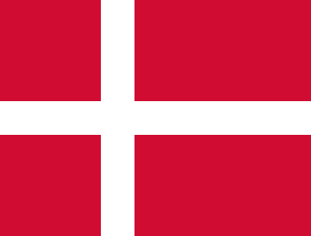


















Top 30 economies on the ease of doing business 2009/10
1. Singapore | 16. Korea, Rep.
2. Hong Kong SAR, China | 17. Estonia
3. New Zealand | 18. Japan
4. United Kingdom | 19. Thailand
5. United States | 20. Mauritius
6. Denmark | 21. Malaysia
7. Canada | 22. Germany
8. Norway | 23. Lithuania
9. Ireland | 24. Latvia
10. Australia | 25. Belgium
11. Saudi Arabia | 26. France
12. Georgia | 27. Switzerland
13. Finland | 28. Bahrain
14. Sweden | 29. Israel
15. Iceland | 30. Netherlands
20
Notes:
Singapore tops the ranking for 5 years in a row.
Change continued at the top. Among top 25 economies, 18 made it easier to do business this past year.
Among the top 25, Sweden improved the most, from 18 to 14 in rankings. It:
reduced the minimum capital requirement for business start-up
streamlined property registration
strengthened investor protections by increasing requirements for corporate disclosure and regulating the approval of transactions between interested parties

Slide 21
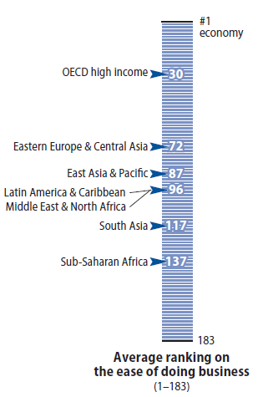
Which regions have the most business friendly environment in Doing Business?
Highest ranked economies by region
#1 East Asia & Pacific : Singapore
3 OECD high income: New Zealand
11 Middle East & North Africa: Saudi Arabia
12 East Europe & Central Asia: Georgia
20 Sub-Saharan Africa: Mauritius
35 Latin America & Caribbean: Mexico
85 South Asia: Maldives
21
Notes:
Globally, Doing business remains easiest in OECD high income economies. Sub-Saharan Africa and South Asia entrepreneurs have it hardest and property protection weakest.
On average, in SSA, simple transactions are still more complex. For example, while avg days to import fell from 45 to 38 days, in OECD high income, traders only face 11 days. In OECD high income, 4 documents are required for export compared to 8 in SSA.

Slide 22
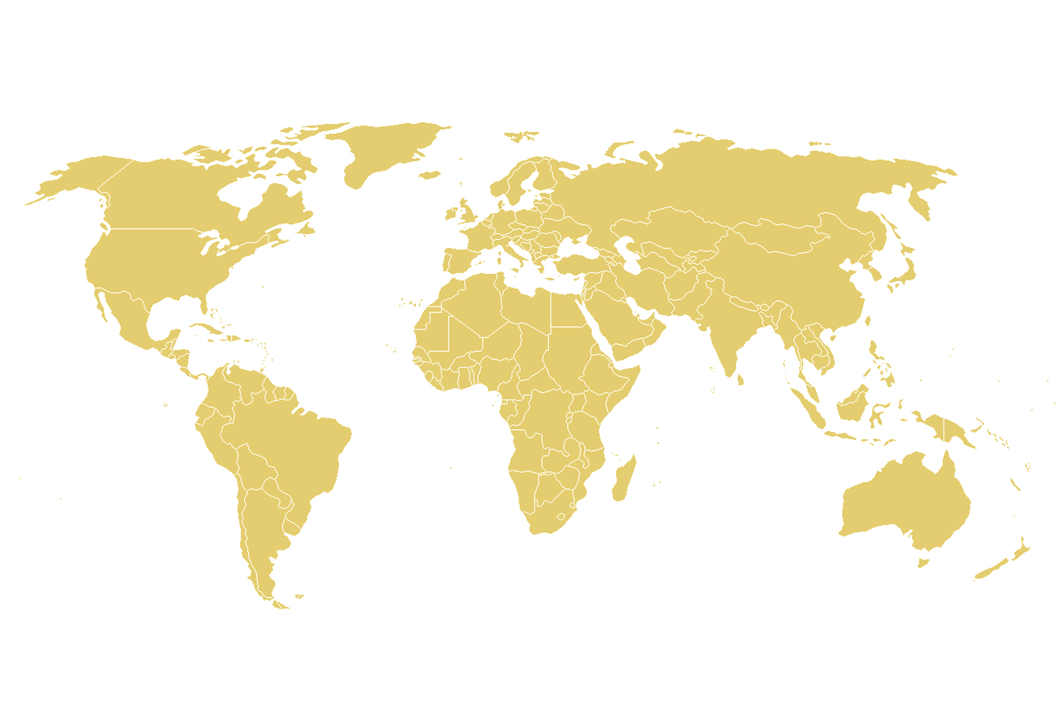
Percentage of countries with at least one positive doing business reform in 2009/10
Business regulation reforms high on many policy-makers’ agenda
Two-thirds of DB reforms took place in developing economies in 2009/10
Most change in Eastern and Central Europe for past 7 years
Pace picking up in East Asia and Pacific
84%
Eastern Europe and Central Asia
OECD high Income
67%
61%
75%
63%
47%
Middle East and North Africa
East Asia and Pacific
South Asia
Latin America and Caribbean
59%
Sub-Saharan Africa
22
Notes:
Through indicators get a rough sense of regulatory reforms around the world.
213 reforms in 117 economies in 2009/10
Today, the majority of business regulation reforms take place in developing countries. The past year, Eastern Europe and Central Asia were the fastest reforming region for the 7th year in a row. While 6-7 years ago, a lot of the regulatory changes were motivated by the prospect of access to the EU, last year, several economies implemented changes in response to the crisis.
Pick-up in regulatory reforms in Asia lead by Malaysia, Vietnam. Several emerging economies such as Indonesia, Malaysia and Vietnam took the lead easing start-up, permitting, and property registration processes for small and medium-sized firms, and improving credit information sharing. As a more recent trend, several Pacific island states overhauled their legal systems inspired by Australia and New Zealand. Samoa, for example, introduced new corporate and receivership laws in 2008 and completed a sweeping land registration reform in 2009. New insolvency legislation is pending in Tonga and Vanuatu, and new secured transaction laws just entered into effect in Solomon Island and Marshall Island.
Already last year, the economic crisis had motivated substantial reforms of insolvency proceeding. In Eastern and Central Europe, more than 60% of economies reformed their insolvency regimes over the past two years. In 2009/10 alone nine economies implemented insolvency reforms (of a total of 17 globally). Many reforms aimed at making insolvency proceedings more transparent and keeping viable firms in operation. Such efforts continue. Lithuania, for example, is in advanced stages of passing a new restructuring law. As many other economies in the region, Lithuania has little experience in reorganizations. Filings have already increased dramatically to 71 in 2009. Until then, since 2001, only 126 restructuring procedures had been filed. Insolvency reforms are timely in the region. Hard hit by the crisis the number of insolvent firms has increased. At the same time the average recovery rate as calculated by Doing Business is 32 cents on the dollar compared to 70 in OECD high income economies. Easing formal entry of new firms was the second most prominent reform with one third of economies reforming in this area.
Following Germany and France last year, several other OECD high income economies also reformed their insolvency systems: the United Kingdom, Czech Republic as well as Japan and Korea in East Asia. In the UK, in 2009, 19,077 companies were liquidated, up 22.8% compared Overall, 16 of the 27 OECD high income economies implemented 25 Doing Business reforms. The Czech Republic, Hungary and Sweden were the most active. Following Germany’s reform last year, Sweden reduced the minimum capital requirement for limited liability companies.
Last year 6 economies reformed: Albania, Estonia, Lithuania, Poland, Russian Federation, and Tajikistan.
Belarus, Estonia, Georgia, Latvia, Lithuania, Romania, Russian Federation, Serbia, Slovenia

Slide 23
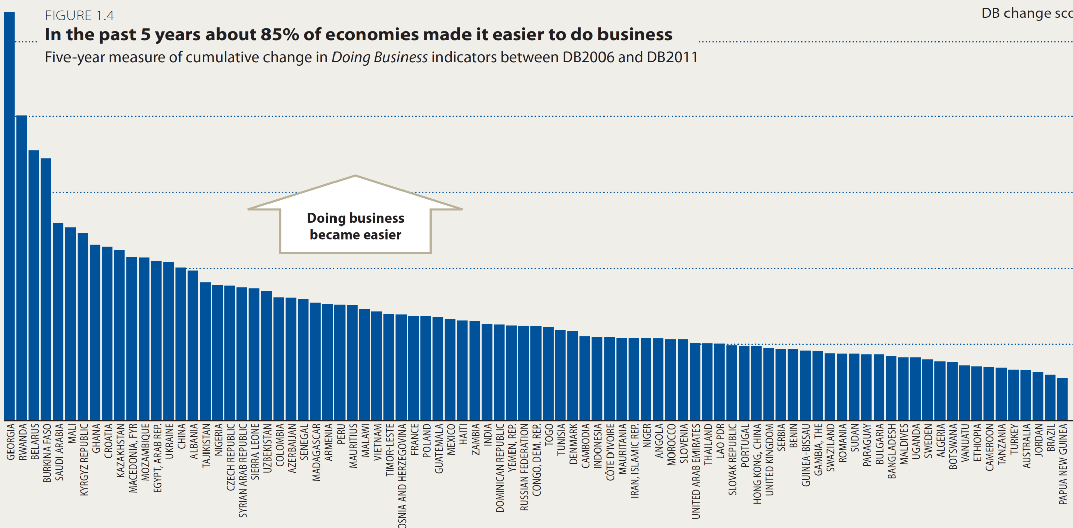
Over last 5 years, 85% of economies have made doing business easier
One third of top 30 are in Sub-Saharan Africa
Several large emerging markets such as China, Nigeria or India saw considerable change
The new measure illustrates the level of change of each economy’s business regulation as measured through the DB indicators over 5 years . It thus complements the relative DB ranking.

Slide 24
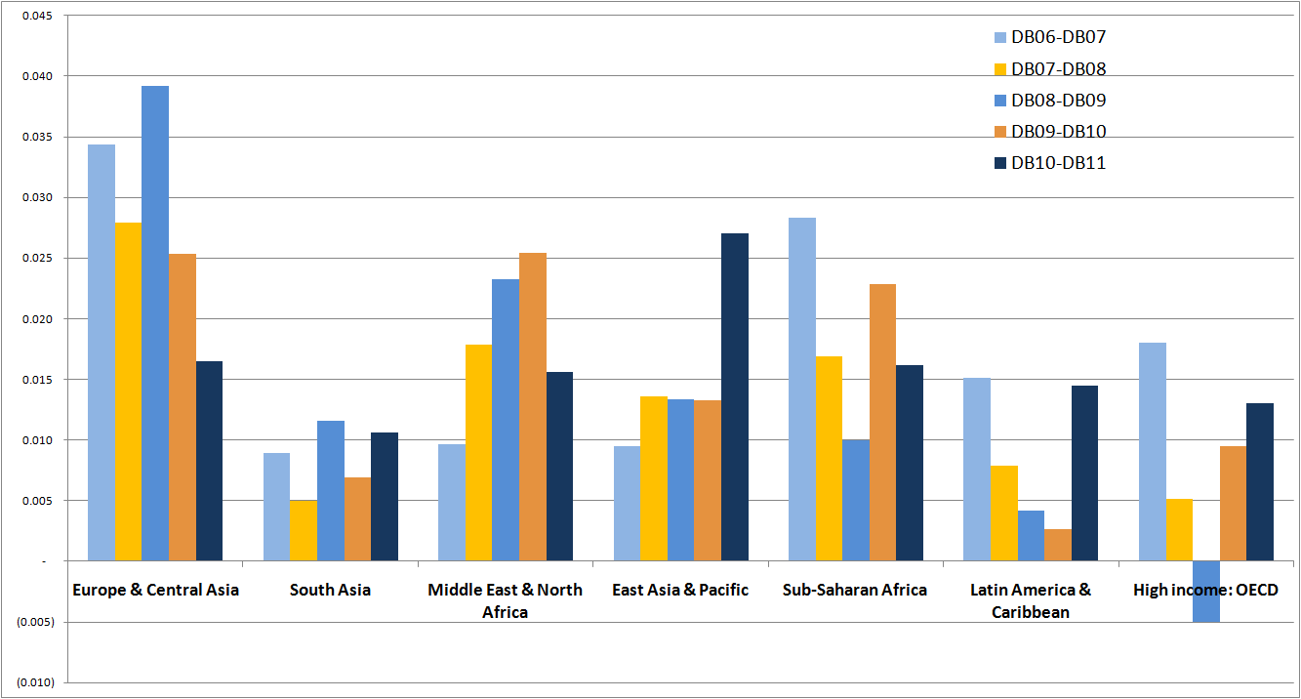
Greatest average improvement in Eastern and Central Europe
Average impact of reforms on all DB
Indicators every year per region
New metric 2
24
Notes:
This graph depicts the average improvement on DB indicators year by year for each region. This figure looks at the impact of reforms every year and not at the number of reforms in each region (which depends of the number of economies in each region).
This is useful to (1) compare regions and (2) see the evolution of each region over time.
In ECA, the average improvement on DB sub-indicators has very often been more important than in other regions since the beginning of Doing Business. In 2003/4: motivated by prospect of entering the EU. In 2008/10, increase in insolvency reforms as courts were struggling with the rise in cases as a repercussion of the crisis.
E.g. in ECA, 36 credit bureau reforms since 2004. Coverage of adult population increased from 3% to 30%. Since 2005, 93% have reformed business entry with 20 economies creating a one stop shop for start-up.
In DB11, reforms in EAP had on average had the biggest improvement on the DB sub-indicators than in the ECA region (3 important reforms in Vietnam and in Indonesia, 2 in Hong-Kong and India, 1 in Samoa (biggest improver on property), China, Thailand, etc.
Economies in Sub-Saharan Africa on average maintained their reform pace this year. As in the past, most focused on administrative reforms, easing start-up, licensing and trade. Two-third of this year’s trade facilitation reforms took place in the region. Many were motivated by regional integration as, for example, in X,Y,Z. It has only been for the past 4 years that increasing attention is being paid to business regulation. Going forward it will be interesting to see whether updating business regulations becomes an integral part of policy making as it is for rich economies (Economies such as Australia, Sweden or Netherlands systematically review regulations on a periodic basis.

Slide 25
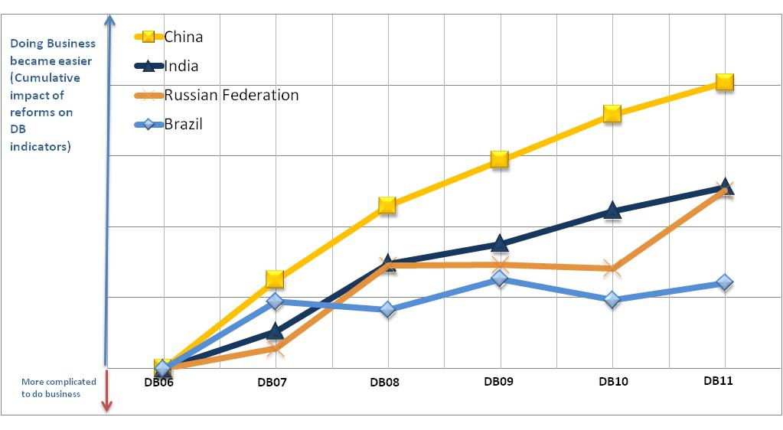
Among the BRICs, China has improved the most its business regulatory environment since 2005
Since DB06, China has made considerable efforts and is the front runner among the BRICs in terms of reforms
India’s reforms had an impact on Doing Business indicators in DB08.
In the Russian Federation, two main reforms in DB08 and DB11 made it easier doing Business.
Over the past 5 years, Brazil slightly changed its business regulation.
Notes:
This graph shows the extent to which and how the BRICs improved their business regulatory environment over the past 5 years (according to the 5 year measure of cumulative change). It shows the pace of reforms in China, Brazil, India and the Russian Federation from DB06 to DB11.
Over the past 5 years, China focused on building institutions to ease access to credit, particularly for small and medium size enterprises. In 2005, a new Company Law reduced what was one of the highest minimum capital requirements in the world (close to 20 times income per capita). In 2006, a new credit registry started operating. Since then, coverage of the adult population has risen to over 60% of the adult population. After a record 14 years of consultation, in 2007, a new Property Rights Law came into effect offering equal protection to public and private property, and expanding the range of assets that can be used as collateral. At the time, less than 15% of small-business financing was secured by movable property, compared to 70% in the U.S.. Over 30 million private businesses have been established during the past 3 decades of reform in China. Yet, as of year-end 2007, only 1.3% of the loans extended by state banks went to private enterprises. Only 4% of China’s commercial loans were financed by movable assets. It was estimated that China had about $2 trillion in dead capital – i.e. assets that could be used to generate loans to fund investment and growth owned by private firms. 80% of firms in China indicated that “access to credit” was their top business constraint.
Not all reforms had the desired outcome. China’s 2007 enterprise insolvency law, for example, unified the existing rules on insolvency, but did not provide a clear test for distinguishing between companies that should be liquidated and those that should be allowed to restructure. In an effort to save companies and jobs, such lack of clarity might be used to promote restructurings, even for companies that are no longer viable.
In India, in spite of electronic firm and tax registrations, starting a business still takes 13 procedures in Mumbai. Excessive bureaucracy also continues to be a challenge for firms in China. It still takes 14 interactions with outside officials to complete start-up formalities for a domestic LLC in Shanghai. This explains why China and India are still ranked 89th and 131st in the Ease of Doing Business.
Informal Finance in China: American and Chinese perspectives; Jianjun Li, Sara Hsu, 2009
Valerie Marechal, Pelin Tekin & Humay Guliyeva China’s new Property Rights Law—an important step towards improving access to credit for small and medium enterprises
See McGinty, Andrew and VC Leow. 2009. “China’s Insolvency Law Two Years On: Are Government-Driven Restructurings the New Trend?” Butterworths Journal of International Banking and Financial Law, Dec 2009: 689-92.
Among the BRICS, China is the economy which has improved the most its business regulatory environment since DB06.
In DB07, China reformed 4 areas of Doing Business (Starting a Business, Getting Credit - Public Credit Registry, Protecting Investors, Trading across Borders) which had an impact on DB sub-indicators. It kept reforming in DB08 with 3 major positive reforms (Dealing with Construction Permits ,Getting Credit - Legal Rights, Closing a Business) and in DB09 with 3 other reforms (Enforcing Contracts, Getting Credit - Legal Rights, Paying Taxes).
For information, in DB10, 1 reform in trade; in DB11, 1 reform in taxes.
India made efforts in DB07 (5 reforms in Starting a Business, Getting Credit - Legal Rights, Protecting Investors, Paying Taxes, Trading across Borders) but only 2 reforms had impact on DB indicators. Additional reforms were conducted in DB08 (Getting Credit - Private Credit Bureau, Getting Credit - Legal Rights, Trading across Borders) which improved India’s business environment.
In DB09, 1 reform in trade; in DB10, 1 reform in closing; in DB11, 2 reforms in taxes and starting.
Brazil conducted a limited number of reforms from DB06 to DB11 (on average one or two per year), which have slightly improved the Business environment.
Russia changed its business environment in DB08 and DB11 with 2 major reforms: one reform in getting credit in DB08 (the credit information index rose from 0 to 4) and a reform about building permits in DB11 (a one-stop shop for the land use cut 10 procedures out of 63).

Slide 26
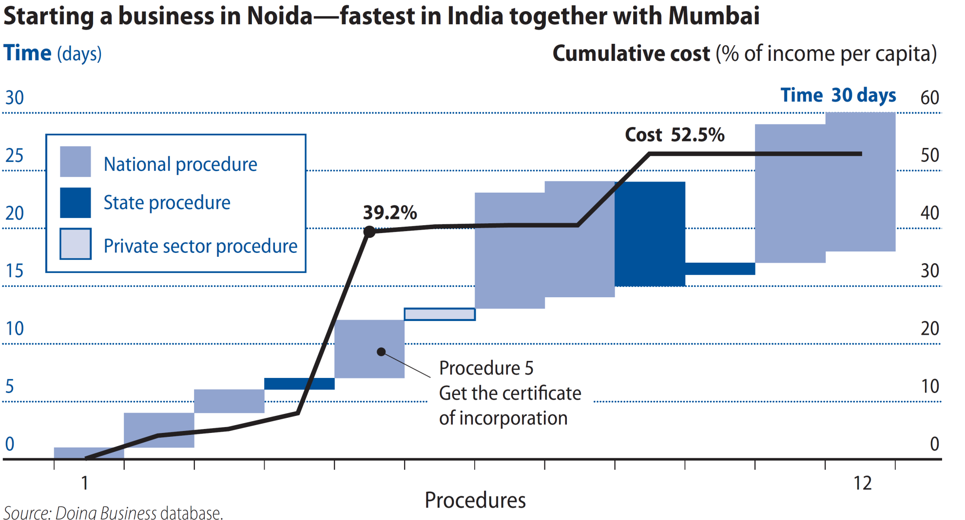
Entrepreneurs in large markets often encounter regulations on several levels
Notes:
=In India, in spite of electronic firm and tax registrations, starting a business still takes 12 procedures in Mumbai. Excessive bureaucracy also continues to be a challenge for firms in China. It still takes 14 interactions with outside officials to complete start-up formalities for a domestic LLC in Shanghai. This explains why China and India are still ranked 89th and 131st in the Ease of Doing Business.
In Mumbai, 12 steps, 29 days, 56.4% with a minimum capital requirement of 188.8%

Slide 27
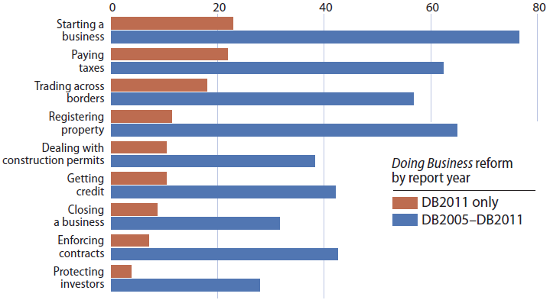
Easing business start-up, paying taxes, property transfer and trade popular around the world
Share of economies with at least 1 Doing Business reform making it easier to do business, by topic (%)
Notes:
- 85% of the economies worldwide reformed during the last 5 years.
This year two-thirds of developing economies improved business regulation; a doubling from only 6 years before
156 entry reforms in 140 countries over past 5 years.
Minimum capital requirement abolished in Sweden, Denmark

