Slide 1
Investing in the Bottom of the Pyramid
Tuesday, October 25, 2011

Slide 2
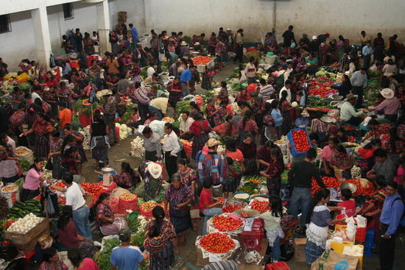
BoP Market
Notes:
Four billion people form the base of the economic pyramid (BOP) ó those with incomes below $3,000. Yet together they have substantial purchasing power as BOP constitutes a $5 trillion global consumer market.
This was stated in World Bank’s report “The Next 4 Billion”. The data compiled by the bank reveals that BOP population, though made up of very low income groups, is the largest consumers in food, transport, health, energy and water sectors in their economies.

Slide 3
The poor have always been seen as…
Victims to be rescued
Needy recipients of charity
Incapable of influencing their own destiny
Not capable of having any impact of destiny of others
And certainly not as producers of economic wealth

Slide 4
Nature of the Market
They have been ignored, locked out of the benefits of economic growth and globalization
They seem invisible from a market perspective because most of their consumption and economic contribution is unorganized and informal – therefore not measurable

Slide 5
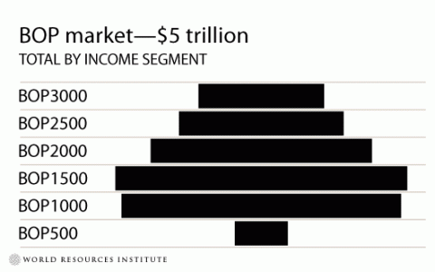
Market Potential
Below $8/day
(4 billion people)
Below $2/day
(2 billion people)
Below $1/day
(1 billion people)
Notes:
Four billion people form the base of the economic pyramid (BOP) ó those with incomes below $3,000. Yet together they have substantial purchasing power as BOP constitutes a $5 trillion global consumer market.

Slide 6
Market Potential
Asia has the highest number of potential BoP consumers and the largest potential market
In Africa, the BoP market accounts for 71% of purchasing power and 95% of the population
We cannot ignore this segment in doing business with these regions

Slide 7
Regional Dimensions of BoP Market

Slide 8
Regional Dimensions of BoP Market

Slide 9
Characteristics of BoP Market
Currently underserved
  Lack of access to basic services
  Revealed demand is likely to be significantly depressed at current market prices, choice, and access levels
Largely informal
  At the fringes of the market economy
  Fragmented
So that poor often pay more for services
  Either in cash or effort expanded
  The so-called BoP Penalty

Slide 10
The Business Sense of BoP Strategy
I. New Market:
Massive & growing under-
served market
(Prahalad & Hart, 2002;
Prahalad 2004; Hart 2005)
> $15,000/yr
Tier
1
~800 million
Tiers
2 & 3
$3,000 - 15,000/yr
~1.5 billion
II. Radical Innovation:
Incubation site for
“disruptive Tier 1 technologies”
(Hart & Christensen, 2002)
< $3,000/yr
Tier 4
III. Competitive Pre-emption:
Breeding ground for next-gen,
global-scale competitors
(Christensen, Craig, & Hart, 2001)
~4.0 billion
Global Population
Per Capita Income (PPP)

Slide 11
The MNC: Traditional Customer Base
“Tip” of the
Income Pyramid
> $15,000/yr
Cost structures, business models, & research methods based on a “Western infrastructure”
The
“ToP”
Customer
“Base” of the
Resource
Pyramid
85% of Global Resources

Slide 12
The BoP: Serving a Different Customer
Less than $3,000 per year
The
“BoP”
Customer
“Base” of the
Income Pyramid
Will require
cost structures,
business models,
& research methods
based on a different infrastructure.
“Tip” of the
Resource
Pyramid
15% of
resources

Slide 13



Many Companies are Beginning to Experiment with the BoP
Nutristar, Nutridelight (nutritional drink), Pur (water purifier)
Hindustan Lever (detergent for the poor in India and Brazil), Annapurna (iodized-Salt for the poor)
Making solar power affordable (India)
Banco Real, microcredit in Brazil
Vodacom community services in South Africa, joint venture between Vodafone and Telkom SA
Solar powered digital camera in India and community information systems
Program in South Africa to help entrepreneurs enter the supply chain and profit from new business ventures.
Water for all program to periurban areas in Brazil

Slide 14
First Generation BOP Strategy:
“The Child With a Hammer”
BOP 1.0
  Different price point
  Redesign packaging
  Low cost production
  Extended distribution
  Partner with global NGOs
BOP 2.0
  Deep dialogue
  Putting the last first
  Build capacity
  Leapfrog solutions
  Ecosystem of local partners
“Selling to the Poor”
“Creating Mutual Value”

Slide 15
The BoP Presents:
NOT a marketing problem
The “Sachet Mindset”
Food & Nutrition and FMCPs
NOT a technology problem
The “Killer Ap Mindset”
Water Purification, Distributed Energy and ICTs
…but a Business Model challenge

Slide 16
Co-Create the Business!
Engaging the BoP differently…
Customers
Partners
Clients
Colleagues
Requires a New Strategy &
Venturing Process…
Co-Venturing

Slide 17
Opportunity
“The aspiring poor present a prodigious opportunity for the world’s wealthiest companies. But it requires a radical new approach to business strategy”
The BOP is where we will:
  Find the most exciting growth markets of the future
  Incubate the sustainable technologies of tomorrow

Slide 18
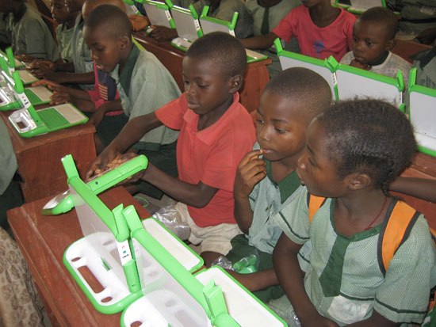
Innovations “Trickle Up”
One Laptop per Child (www.olpc.org)
  Design an inexpensive computer for children in developing countries
  Desired price point $100
Led to creation of the Netbook

Slide 19
Differences in Business Model
Developed Markets Business Model
Bottom of the Pyramid Business Model
Rapid Innovation
Obsolescence
Fine segmentation
High margins
Labour efficiency
Mass Media
Top down
Durability
Consistency
Course Segmentation
High volume
Capital efficiency
Direct selling
Bottom Up

Slide 20


A Tale of Two MNCs
Strategic Logic: Stagnating sales in primary markets
Target Markets: Low income consumers in
developing countries

Slide 21
Contrasting BOP Strategies
 | Nike | Unilever
Product | Nike World Shoe | Wheel
Structure | Integrated | Protected, “deep listening”
Pricing | 30% - 50% gross margins | Long-term growth
Problem-Solving | Existing marketing and manufacturing | 6-8 weeks in villages; local sales agents
Partners | Current retailers | Small retail outlets
Outcome | Failed to hit targets’ never reached the BOP | Path breaking growth; reach BOP

