Slide 1
Foreign Direct Investment
Tuesday, October 18, 2011

Slide 2
Final Exam Information
Thursday, December 15th
7:00pm to 10:00pm (3hrs)
Room: TBD

Slide 3
Foreign Direct Investment
What is FDI?
Types of FDI
The Flow of FDI
The Patterns of FDI
The Theories Approaches to FDI

Slide 4
What Is FDI?
Foreign direct investment (FDI) occurs when a firm invests directly in new facilities to produce and/or market in a foreign country
  the firm becomes a multinational enterprise
FDI can be in the form of
  greenfield investments - the establishment of a wholly new operation in a foreign country
  acquisitions or mergers with existing firms in the foreign country
The flow of FDI refers to the amount of FDI undertaken over a given time period
  Outflows of FDI are the flows of FDI out of a country
  Inflows of FDI are the flows of FDI into a country
The stock of FDI refers to the total accumulated value of foreign-owned assets at a given time

Slide 5
What Are The Patterns Of FDI?
Both the flow and stock of FDI have increased over the last 30 years
  Most FDI is targeted towards developed nations - United States and EU
    South, East, and South East Asia - China – and Latin America are emerging
FDI has grown more rapidly than world trade and world output
  firms still fear the threat of protectionism
  democratic political institutions and free market economies have encouraged FDI
  globalization is forcing firms to maintain a presence around the world
Gross fixed capital formation - the total amount of capital invested in factories, stores, office buildings, and the like
  the greater the capital investment in an economy, the more favorable its future prospects are likely to be
So, FDI is an important source of capital investment and a determinant of the future growth rate of an economy

Slide 6
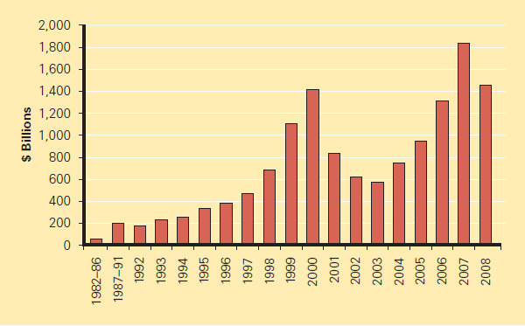
What Are The Patterns Of FDI?
FDI Outflows 1982-2008 ($ billions)

Slide 7
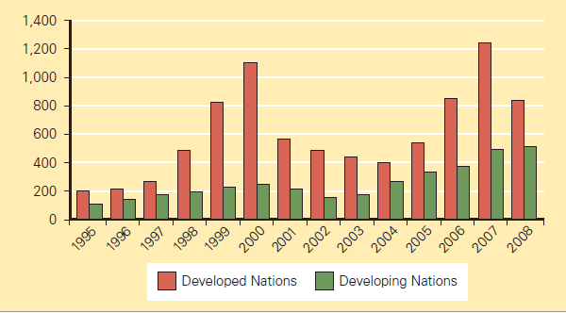
What Are The Patterns Of FDI?
FDI Inflows by Region 1995-2008 ($ billion)

Slide 8
What Is The Source Of FDI?
Since World War II, the U.S. has been the largest source country for FDI
  the United Kingdom, the Netherlands, France, Germany, and Japan are other important source countries
  together, these countries account for 56% of all FDI outflows from 1998-2006, and 61% of the total global stock of FDI in 2007

Slide 9
What Is The Source Of FDI?
Cumulative FDI Outflows 1998-2007 ($ billions)

Slide 10
Greenfield Investments
Building a new facility
Advantages
  Built to the company’s specifications
  Able to train staff
  Up to date technology
Disadvantages
  Takes time
  May involve foreign approvals
  Revenue stream delayed
  Requires considerable managerial resources

Slide 11
Mergers and Acquisitions
Purchasing or merging with an ongoing operation
Advantages
  Already up and running
  Ongoing revenue stream
  Utilize existing personnel
  Learning opportunities
Disadvantages
  Inherit personnel
  Resentment from locals
  Costly

Slide 12
Why Do Firms Choose Acquisition Versus Greenfield Investments?
Most cross-border investment is in the form of mergers and acquisitions rather than greenfield investments
Firms prefer to acquire existing assets because
  mergers and acquisitions are quicker to execute than greenfield investments
  it is easier and perhaps less risky for a firm to acquire desired assets than build them from the ground up
  firms believe that they can increase the efficiency of an acquired unit by transferring capital, technology, or management skills

Slide 13
Horizontal and Vertical FDI
Horizontal
  Similar operations in different countries
  Captures an existing advantage
Vertical
  Buying operations upstream or downstream from current process
  May be driven by strategy or cost concerns

Slide 14
Why Does FDI In Services Occur?
FDI is shifting away from extractive industries and manufacturing, and towards services
The shift to services is being driven by
  the general move in many developed countries toward services
  the fact that many services need to be produced where they are consumed
  a liberalization of policies governing FDI in services
  the rise of Internet-based global telecommunications networks

Slide 15
Why Choose FDI?
Exporting - producing goods at home and then shipping them to the receiving country for sale
  exports can be limited by transportation costs and trade barriers
  FDI may be a response to actual or threatened trade barriers such as import tariffs or quotas
Licensing - granting a foreign entity the right to produce and sell the firm’s product in return for a royalty fee on every unit that the foreign entity sells
Internalization theory (aka market imperfections theory) suggests that licensing has three major drawbacks compared to FDI
  firm could give away valuable technological know-how to a potential foreign competitor
  does not give a firm the control over manufacturing, marketing, and strategy in the foreign country
  the firm’s competitive advantage may be based on its management, marketing, and manufacturing capabilities

Slide 16
What Is The Pattern Of FDI?
Why do firms in the same industry undertake FDI at about the same time and the same locations?
Knickerbocker - FDI flows are a reflection of strategic rivalry between firms in the global marketplace
  multipoint competition -when two or more enterprises encounter each other in different regional markets, national markets, or industries
Vernon - firms undertake FDI at particular stages in the life cycle of a product
But, why is it profitable for firms to undertake FDI rather than continuing to export from home base, or licensing a foreign firm?
According to Dunning’s eclectic paradigm- it is important to consider
  location-specific advantages - that arise from using resource endowments or assets that are tied to a particular location and that a firm finds valuable to combine with its own unique assets
  externalities - knowledge spillovers that occur when companies in the same industry locate in the same area

Slide 17
What Are The Theoretical Approaches To FDI?
The radical view - the MNE is an instrument of imperialist domination and a tool for exploiting host countries to the exclusive benefit of their capitalist-imperialist home countries
The free market view- international production should be distributed among countries according to the theory of comparative advantage
  embraced by advanced and developing nations including the United States, Britain, Chile, and Hong Kong
Pragmatic nationalism - FDI has both benefits (inflows of capital, technology, skills and jobs) and costs (repatriation of profits to the home country and a negative balance of payments effect)
  FDI should be allowed only if the benefits outweigh the costs
Recently, there has been a strong shift toward the free
market stance creating
  a surge in FDI worldwide
  an increase in the volume of FDI in countries with newly liberalized regimes

