Slide 1
Modern Theories of International Trade
Thursday, October 6, 2011

Slide 2
Modern Theories of
International Trade
The Product Life-Cycle Theory
New Trade Theory
Porter’s Theory of National Competitive Advantage

Slide 3
Product Life-Cycle Theory
Developed in the US by Raymond Vernon
Noticed that trade advantages for certain products did not remain stable
Wanted to explain why different countries might have advantages over the same products
Four stages in the product life-cycle

Slide 4
Stage 1: The Development Stage
Product developed for domestic market
Low production levels
Price relatively high
Production done locally
Little or no export

Slide 5
Stage 2: Product Maturation
Production expands
Prices decrease
  Increased experience
  Economies of scale
Competitors emerge
Exports begin

Slide 6
Stage 3: Worldwide Demand
Demand in foreign (usually industrialized) countries increases
Production moved to some of these countries to be close to markets
Foreign competitors emerge
Production in original country may decrease

Slide 7
Stage 4: Standardization
Price becomes main point of competition
Move to low cost production sites
Imports into originating country
Production slows or ceases in original country

Slide 8
Challenges to the Product Life-Cycle Theory
More sources of innovation
Quicker diffusion of products
Simultaneous introduction in multiple countries
Still has some validity for truly innovative products

Slide 9
New Trade Theory: Economies of Scale
The more units made, the cheaper each unit will be
Countries with large domestic bases have an advantage
By combining their production countries can be more efficient and more wealthy

Slide 10
New Trade Theory: First Mover Advantage
Countries in which an industry first develops may have an advantage
Depends on barriers to entry
The more complex and capital intensive, the more difficult to replicate
There may be costs to being the first mover

Slide 11
Paul Krugman
http://www.youtube.com/user/PaulKrugmanBlog#p/u/21/ZjQlo2X0ZBA

Slide 12
Porter’s Theory of National Competitive Advantage
Four key factors
  Factor endowments
    Basic
    Advanced
  Demand conditions
  Related and supporting industries
  Firm strategy, structure and rivalry

Slide 13
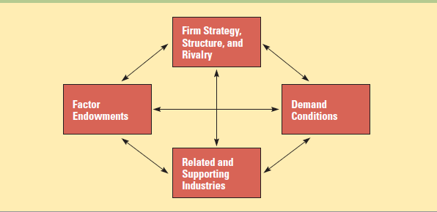
Porter’s Diamond Model

Slide 14
Factor Endowments
Basic Factors
  Natural Resources
  Climate.
  Demographics
  Location.
Advanced factors.
  Infrastructure.
  Trained labor.
  Research facilities.
  Knowledge

Slide 15
Demand Conditions
Wealth (like Vernon).
Sophisticated consumers.
Strong home country demand and demanding domestic consumers help produce strong international competitors

Slide 16
Related and Supporting Industries
Suppliers
  Obviously so they can supply components and materials as they are needed.
  But also because they may be a source of ideas or expertise.
Related Industries
  Those which produce complementary products.
  These may be used in the manufacturing process or may be purchased by the same type of customer.
  Exchange of employees.

Slide 17
Firm Strategy, Structure, Rivalry
Firm Strategy
  influenced by culture
    Role of engineers in Japan and Germany
Firm Structure
  Characteristic of countries
    loose conglomeration of Japanese and Korean companies as opposed to more hierarchical companies in the U.K. and France.
Rivalry
  Innovation, efficiency, employees

Slide 18
Implications of Porter’s Model
Government can influence trade
  Increased competition
  Providing factors of production
  Encouraging clusters
Countries should specialize
Countries should foster existing industrial groups

Slide 19
The Utility of Trade Theories
All have some utility even if just explaining their fallacies
Not all explain the same phenomenon
Becoming more dynamic
Becoming more complex
More emphasis on national efforts to encourage trade

Slide 20
Porter’s Diamond Model
Option 1: France and Germany
Option 2: Taiwan and South Korea
Use a variety of websites
Determine which of the two countries is more competitive overall in the global marketplace based on the four factors
“The Global Competitiveness Report 2010-2011”

