Slide 1
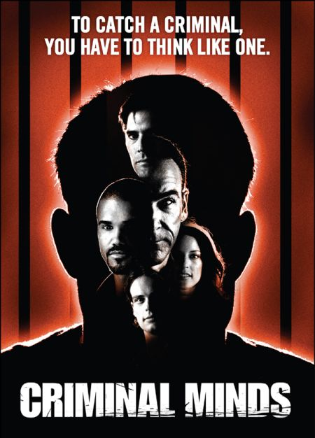
Chapter 3
Criminal Profiling

Slide 2
Questions from my last lecture
Youth (12-17 years) in Ontario are not required to have an adult with them during an interrogation
  Given the right to contact their parents or counsel prior to the interview
More information in the Youth Criminal Justice Act (http://laws-lois.justice.gc.ca/eng/acts/Y-1.5/index.html)

Slide 3
ViCLAS Research
(Martineau & Corey, 2008)
One of two fictitious crime scenarios:
  Homicide (n = 116)
  Sexual assault (n = 121)
Complete ViCLAS booklet

Slide 4
Results of Martineau & Corey (2008)
Inter-rater reliability
  79.30% for the homicide scenario
  87.70% for the sexual assault
Some categories much lower (e.g., weapons, biological evidence)
ViCLAS training did not affect accuracy

Slide 5
Today you will learn about…
History of criminal profiling
Types of profiling
Potential problems with profiling
Types of polygraphy
Accuracy of polygraphy

Slide 6
Criminal Profiling
Criminal profiling is a technique for identifying the personality and behavioural features of an offender based on an analysis of the crimes they have committed
Used in serial crime investigations
What + Why = Who

Slide 7
The Goals of Profiling
Criminal profiles are used for a variety of purposes:
  To prioritize suspects
  To develop new lines of enquiry
  To flush out offenders
  To determine risk
  To provide interrogation advice

Slide 8
Pseudoscience & Law Enforcement
Pseudosciences are disciplines that possess the superficial appearance of science but lack its substance
  Do not play by the rules of science
  Can easily mislead untrained observers into concluding that they possess scientific merit
Not about what is being studied, but how

Slide 9
Some warning signs
Evasion of peer review process
Ignoring negative evidence
Absence of safeguards against confirmation bias
Overreliance on testimonial and anecdotal evidence
Use of hypertechnical language
Lack of falsifiability

Slide 10
History of Criminal Profiling
Late 1800’s – Jack the Ripper investigation
1950s – New York Mad Bomber investigation
1970’s – Criminal Profiling program developed at the FBI
Today - Similar programs developed internationally (e.g., RCMP)

Slide 11
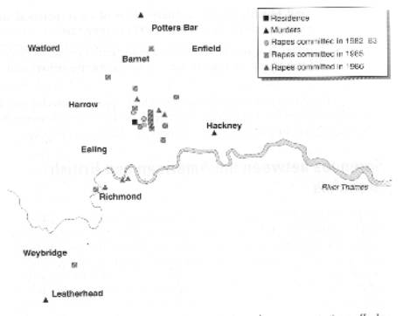
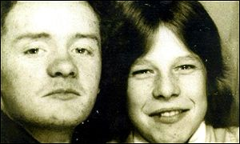
Case Example: John Duffy & David Mulcahy (Railway Rapist)

Slide 12
Case Example
North London: Kilburn Area
3 Murders and 26 rapes
1982 and 1986
Women, early 20’s
Strangers
Attacked during night
On or near railway
Used mask & conversation
Violent rapes
Used a knife
Talked to victim after rape
Questioned victims about where they lived
Varied description of rapist by victims
Greeted victims as he passed and then attacked from behind
Restrained victims by fastening hands behind their backs
Gave victims instructions on how to get home

Slide 13
Main points of Canter’s profile | Characteristics of offender
Lived in area near to area of first crimes (1983) | Lived in area suggested
Probably lives with woman | Recently separated from wife
Aged mid-to late-20s | Aged late 20s
Right-handed | Right-handed
Semi-skilled or skilled job with weekend work, but relatively isolated work | Travelling carpenter
Knowledge of railways | Worked for British Rail
Previous criminal record for violence (maybe arrested between October 1982 and January 1984) | Raped wife at knife point
Be a loner, with few friends | Had only two male friends (one was co-offender David Malcahy)

Slide 14
Main points of Canter’s profile | Characteristics of offender
Physically small, with feelings of unattractiveness | 5’ 4” with acne
Interest in martial arts | Member of a martial arts club
Needs to dominate women | Attacked wife
Fantasies about rape and bondage | Tied up his wife before sex
Fascination for weapons, especially swords and knives | Had Kung Fu weapons at home
Fantasies about sex and violence | Had hard-core porn videos
Keeps souvenirs from crimes | Had 33 door keys from victims

Slide 15
Types of Profiling
In general, there are two approaches to criminal profiling:
  Deductive profiling: Profiling an offender from evidence relating to that offender’s crimes
  Inductive profiling: Profiling an offender from what is known about other offenders who have committed similar (solved) crimes

Slide 16
Deductive Profiling
Body of a female victim is found in a locked warehouse in busy waterfront section
Offender can easily access warehouse and feels comfortable in the area

Slide 17
Inductive Profiling
80% of serial killers who attack people in parking lots are white males
Our offender has attacked three people in parking lots, therefore it is likely that our offender is a white male

Slide 18
Potential Problems with Profiling
Criminal profiling is often criticized on the following grounds:
  It lack a strong theoretical base
  Profiles are too ambiguous to be useful
  Professional profilers are not accurate

Slide 19
1. Theoretical Base
Many forms of profiling are based on a model of personality that lacks strong empirical support -- the classic trait model
  incorrectly assumes that internal traits are the sole determinant of behaviour and it disregards situational influences

Slide 20
Organized-Disorganized Model
The most widely known inductive profiling approach is the organized-disorganized model developed by the FBI

Slide 21
Organized Behaviours | Organized Characteristics
Planned offence | High intelligence
Restraints used on victim | Skilled occupation
Use of vehicle in the crime | Maintains residence
Little evidence at scene | Lives with partner
Pre-death sexual assault | Sexually adequate
Body not taken | Geographically mobile
No post-mortem mutilation | Lives and works far from crimes
 | Maintains residence & vehicle
 | Follows crimes in media

Slide 22
Disorganized Behaviours | Disorganized Characteristics
Spontaneous offence | Low intelligence
No restraints used on victim | Unskilled occupation
No vehicle used | Does not maintain residence or vehicle
Evidence left at scene | Lives alone
Post-mortem sexual acts | Geographically stable
Post-mortem mutilation | Sexually inadequate
Body (or parts of) taken | Lives and works close to crimes
 | Little interest in media

Slide 23
Assumptions of the Organized-Disorganized Model
Crime scenes can be categorized as organized (methodical) or disorganized (chaotic)
Background characteristics can be categorized as organized (high functioning) or disorganized (low functioning)
Personality determines behaviour

Slide 24
2. Ambiguous Profiles
Profiles often contain ambiguous predictions (e.g., the offender will be a “social misfit”)
Purpose is to prioritize suspects
  Can’t be used if too broad
Biased interpretation
  Can make the profile fit the offender

Slide 25
3. Accuracy of Profilers
Professional profilers do not always produce profiles that are more accurate than profiles produced by non-professionals
  Mixed results in research

Slide 26
Measure | Profilers | Psychologists | Police | Students | Psychics
Cognitions | 3.20 | 2.27 | 2.49 | 2.03 | 2.60
Physical | 3.60 | 3.63 | 3.43 | 3.42 | 2.80
Offence | 4.00 | 4.03 | 3.09 | 3.64 | 3.65
Social | 3.00 | 2.63 | 2.60 | 2.94 | 2.25
Personality | 24.6 | 34.03 | 22.03 | 26.84 | 27.70
Total | 13.80 | 12.57 | 11.60 | 12.03 | 11.30

Slide 27
What do profiles contain?
(Alison et al., 2003)
Analyzed 21 criminal profiles
880 statements that contained predictions about the characteristics of the unknown criminal

Slide 28
Type of Statement | Frequency
Unsubstantiated (no grounds, warrant, backing, modality or rebuttal) | 82.0%
Substantiated (claim + grounds) | 15.5%
Illogical (claim + non-sequitor grounds) | 1.2%
Justified claim (claim + grounds + warrant) | 1.4%

Slide 29
Research Summary
No compelling evidence to suggest criminal profiling is reliable, valid, or useful
Research on empirically validated models is in its infancy

Slide 30
Why is Profiling Used?
Cover all bases
  Victim, public, etc.
Feel their nothing to lose
  Ignore potential for harm!
Actually believe profilers can help with uncertain investigation
  Confirmation bias
  Successes are reported
  Many advocate for its use

Slide 31
Why is Profiling Used?
Presentation as experts
It is accepted by others
  Internalize belief
  Contagion
Mistaking fiction for fact

Slide 32
Used because police find it helpful? (Snook et al., 2007)
Interviews 51 police officers in Canada who worked in major crime divisions

Slide 33
Statement | Strongly Agree/ Agree | Neutral | Strongly Disagree/ Disagree
Profiling is a valuable investigative tool | 88.2% | 7.8% | 3.9%
Profilers help solve cases | 94.2% | 3.9% | 2.0%
Profilers should be used as evidence in court | 33.3% | 21.6% | 44.1%
There is no risk of a profiler misdirecting an investigation | 5.9% | 15.7% | 78.4%

Slide 34
Geographic Profiling Systems
Geographic profiling systems rely on mathematical models of spatial behaviour
Assign probability values to locations surrounding linked crimes
Probabilities correspond to the likelihood that the offender resides in those areas

Slide 35
What does the research say about geographic profiling?
Some research found that, with some training, students are about as accurate as geographic profiling
Questions the cost-benefit of these systems

Slide 36
Handwriting analysis
The use of handwriting to infer personality or psychopathological characteristics (graphology)
Advocates of posit that specific handwriting “signs” are linked to psychological traits
  E.g. ,people who cross their ts with small “whips” are especially sadistic
  E.g., if a married woman pens her signature with larger capitals on her given name than on her husband's surname, she betrays an unhappy marriage
Scores of studies suggest that graphology is virtually useless as a personality assessment or crime detection technique
Virtually no evidence to support its validity

Slide 37
Handwriting Analysis
Character reading
Whatever metaphors the features of an individual's script bring to mind are descriptive of the writer

Slide 38
What do the following denote?
Words drift up
Words drift down
Wide spacing
Crowded words
Variable letter slants

Slide 39
What do the following denote?
Large capital “I”
Low writing pressure
Ragged upper loops
Break between lower and upper portions of letters
Bulbous loops below the lines

Slide 40
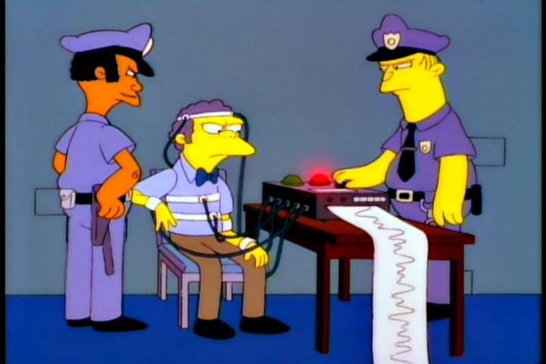
Polygraph
Based on the belief that deception is related to physiological change
Measures:
  Respiration
  Heart rate
  Sweating

Slide 41
Uses of Polygraph
Helps in criminal investigations (suspect is asked to take a polygraph test)
Verify a crime has occurred (victim is asked to take a polygraph test)
Monitoring sexual offenders on probation (United States)
Pre-employment screening for security agencies and police

Slide 42
Admissibility of Polygraph
Did not pass general acceptance test when first admitted as evidence in court (Frye v. United States, 1923)
Currently allowed in some States if agreed by both prosecution and defence
Not admissible into evidence in Canadian courts (R. v. Beland, 1987)

Slide 43
Types of Polygraph Tests
There are two main types of polygraph tests:
  Comparison Question Test (CQT)
  Concealed Information Test (CIT)

Slide 44
1. Comparison Question Test (CQT)
Includes three types of questions:
  Irrelevant
  Relevant
  Comparison
Deception is assessed by comparing physiological responses between relevant and comparison questions

Slide 45
Phases of the CQT
Pre-test interview
  Interview with suspect to develop the comparison questions
Polygraph exam
  Questions are asked while suspect’s physiological responses are measured
Scoring
  Polygraph examiner scores the physiological responses to determine if the suspect is truthful, deceptive, or inconclusive
Post-test interview
  If a suspect is judged deceptive they are pressured to confess

Slide 46
Comparison Question Test:
Sample Questions
Question | Purpose | Example
Irrelevant | Used to obtain a baseline | Are you left handed?
Relevant | Deal with the crime | Did you assault Sam Smith on March 11th?
Comparison | Deal with prior antisocial behaviour | Before age 25, did you ever verbally threaten to hurt anyone?

Slide 47
Possible Outcomes of CQT
Truthful
Deceptive
Inconclusive

Slide 48
2. Concealed Information Test (CIT)
Assesses if suspect has information that only the criminal would know
Asks suspects multiple-choice questions, one option is correct
Assumes if the suspect is guilty they will react strongly to correct information

Slide 49
Use of CIT
Used less frequently
More difficult to create a good test
Would have to test information not available in the media

Slide 50
Types of Polygraph Studies
Field Study
Ground truth is not known
Lab Study
Ground truth is known
Not real-life situations
Real-life situations
Actual suspects
Volunteers

Slide 51
Types of Error
 | Actually Innocent | Actually Guilty
Found Innocent | Accurate | False Negative
Found Guilty | False Positive | Accurate

Slide 52
Accuracy of the CQT
In field studies:
  84% to 92% guilty correctly identified
  9% to 24% false positive errors

Slide 53
Accuracy of CIT
In lab studies:
  Very accurate at identifying innocent participants
    Up to 95% correctly identified
  Less accurate at identifying guilty participants
    75% to 85% correctly identified
In field studies:
  94% to 98% of innocent correctly identified
  42% to 76% of guilty correctly identified

Slide 54
Countermeasures
Both physical and mental countermeasures dramatically reduce the effectiveness of the CQT
The CIT does not appear to be effected by anti-anxiety drugs

Slide 55
Next Class
Chapter 4 -- Deception

