Slide 1
MKT 100-051
Week 3 - situation analysis & metric 2
Welcome to
Anthony
Francescucci
Assistant Professor, Marketing
Please ensure all electronic devices are in “silent mode”, “vibrate mode” or “turned off”

Slide 2
Agenda for Today
Review Chapters 2 & 3
Metrics Mastery 2
Discuss Wireless Industry SWOT
Review Written Assignment Details

Slide 3
Chapter Learning Objectives
Chapter 2
  LO2 Conduct a SWOT analysis and explain its use in marketing planning
Chapter 3
  LO5 Identify and discuss important trends affecting marketing decisions today
Notes:
These questions are the learning objectives guiding the chapter and will be explored in more detail in the following slides.

Slide 4
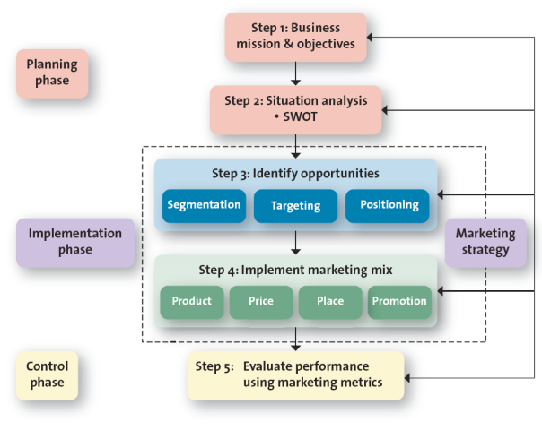
The Strategic Marketing Planning Process
Notes:
There are three phases of a strategic plan: planning, implementation, control. Instructors should make the point that the steps involved in strategic planning are not likely to be sequential, since, planning entails an iterative process and is affected by market shifts, new research findings, and/or the introduction of new products. Thus, rarely will the process follow the identified steps neatly.
Regarding the importance of planning. Sergio Zyman, former CMO of Coca-Cola, points out in his book The End of Marketing as We Know It that no one would ever go to the airport and say “I have $200—where can I go?” Instead, they say, “I need/want to go to San Francisco; how much will it cost me?” The same is true for marketing planning; you must know your final destination to get there. Planning and executing the plan are crucial to success.
A poorly executed plan leads to failure, regardless of how good or solid the plan is. The world is full of good plans poorly executed. When initially introduced, diapers designed differently for boy and girls bombed because the market was not ready for the product; through improved execution, the diaper manufacturer ultimately found success. However, even well-executed plans require monitoring and updating, because the needs of any market constantly change.
Explain to students that the marketing plan should be a written plan yet many companies do not write it down. Ask students why companies tend to not write down marketing plans. The most likely answer is that they don’t take the time or haven’t organized the strategy.

Slide 5
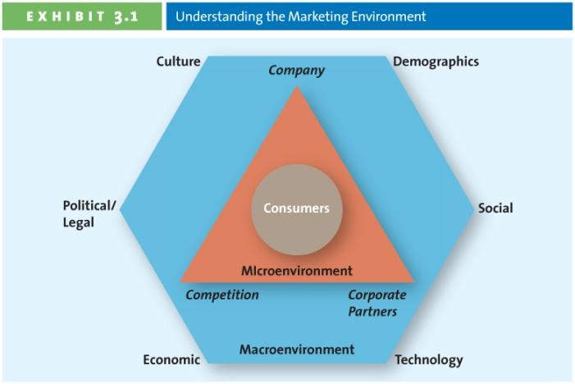
Environment Analysis Framework
Acronym: CDSTEP
Acronym: PESTL
Notes:
In all marketing activities, the consumer is at the centre. Anything that affects consumers affects marketers. Any change in one of these environments likely requires an adjustment to the firm’s marketing mix. By identifying potential environmental trends, firms often can take proactive steps. The next few slides can be used to expand on micro and macroenvironmental factors.

Slide 6
Macro Environmental Factors
CDSTEP
PESTL
Culture
Demographic
Social
Technological
Economic
Political/Legal
Political
Economic
Socio-Cultural (incl. Demo)
Technological
Legal

Slide 7
Environment Scanning and Analysis
Political Legal
Government policies, structures, and regulations
Political trends
Taxation issues
Current domestic legislation
Future legislation
Environmental regulations
Employment law
Consumer protection
Industry specific regulations
Competitive regulations
Shareholder/stakeholder needs/demands
Economic
Domestic economic trends
Global economic trends
Taxation issues
Market and trade cycles
Market distribution trends
Disposable income
Job growth/unemployment
Inflation
Consumer confidence index
Internal finance
Internal cash flow
Notes:
7

Slide 8
Environment Scanning and Analysis
Socio-cultural
Consumer values, attitudes and opinions
Media views
Laws affecting social factors
Brand, company, technology image
Consumer buying patterns
Demographics
Lifecycle changes
Population shifts
Education
Trends / Fads
Living standards
Technological
Competing technology development
Research funding
Associated/dependent technology
Replacement technology/solutions
Maturity of technology
Manufacturing maturity and capacity
Information and communications
Consumer buying mechanisms/technology
Technology legislation
Technology access/licensing/patents
Intellectual property issues
Rate of obsolescence
Software innovations and changes
Notes:
8

Slide 9
Now What?
Now that we have identified trends in our Micro & Macro Environments, how do we make sense of it?

Slide 10
SWOT Analysis
Strategy Planning Methodology (Stanford U)
Helps to organize your thoughts to develop your company goals and strategies
Start with;
What is your objective?
What are you trying to decide?
What are you attempting to solve for?
E.g. Competitive analysis, product analysis, process analysis

Slide 11
SWOT Profile
Controllable
SWOT
Internal
to the company
Weakness
External
to the company
Opportunities
Strengths
Threats
Uncontrollable

Slide 12
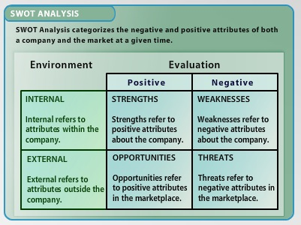
SWOT analysis

Slide 13
IN DEVELOPING SWOT ANALYSIS
Evidence (information) to support claim
Customers (feedback, surveys, mkt research)
Employees
3rd party data
From / About
MICRO-ENVIRONMENT
(Company, Competition, Corporate Partners)
Capabilities
Resources (Money, brand, assets)
Processes
(Value Chain, or Value delivery process)
Internal (Strengths & Weaknesses)

Slide 14
SWOT Analysis & Strategic Planning
Strengths (examples to consider)
Process competitive advantages
Strong partners
Strong brand reputation
Resources, patents, assets, people
Experience, knowledge
Deep pockets
Excellent distribution reach
Processes, systems, IT, communications
Team based culture (open to change)
Company politics and values
Notes:
14

Slide 15
SWOT Analysis & Strategic Planning
Weaknesses (examples to consider)
Process competitive disadvantages
Weak partners
Weak brand reputation
No resources, patents, assets, people
Inexperience, lack of knowledge
No pockets
Poor distribution reach
Processes, systems, IT, communications
Bureaucratic cultural, attitudinal (resists change)
Company politics and values
Notes:
15

Slide 16
IN DEVELOPING SWOT ANALYSIS
External (Opportunities & Threats)
Evidence (information) to support your claim
Environmental Scan
(CDSTEP OR PEST)
3rd Party Data,
(Stats Can, News Reports, Industry trend reports, trade associations)
From / About
MACRO-ENVIRONMENT

Slide 17
SWOT Analysis & Strategic Planning
Opportunities (examples to consider)
Industry or lifestyle trends
Technology development and innovation
New global supply chains
Increase in input costs such as oil
Notes:
17

Slide 18
SWOT Analysis & Strategic Planning
Threats (examples to consider)
Political, Regulatory, Economic, Nature
Falling market demand
Changing consumer preferences
New competitive entries, new substitutes
Notes:
18

Slide 19
SWOT Continued
As you identify each of the S.W.O.T., you also need to state the implication for your decision.
How do you capitalize / leverage that strengths
How do you address those weaknesses
How to you take advantage of the opportunities
How do you mitigate /minimize the threats

Slide 20
SWOT example
Developing a new product that will be introduced to an existing target segment that we already market to, and
We identify that we have strong brand recognition within this segment, the implication for our product introduction is?
We can leverage the existing brand recognition in the building awareness to stimulate sales of the new product
If you cannot state the implication for your decision/objective/ business, then it probably is not relevant in your analysis

Slide 21
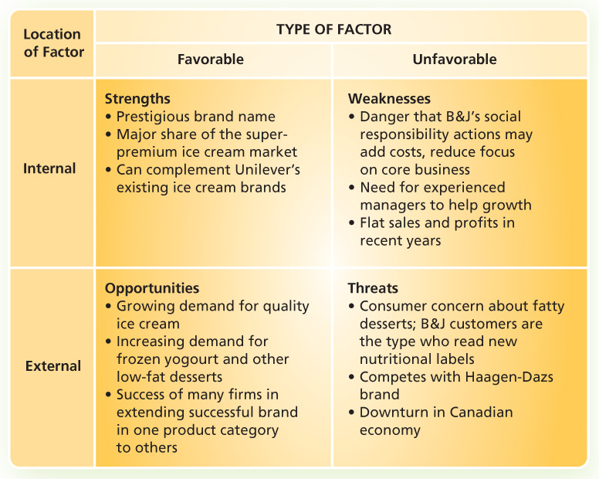
Ben and Jerry’s Canadian SWOT
Notes:
21

Slide 22
Now What?
Now that we have identified our S.W.O.T.
what do we do?

Slide 23
Prioritize for Goal & Strategy Development
High
Probability
Determine
Impact to business / plan if it occurs
Probability of it occurring during plan period
2
1
Develop
Contingency
Plans
Focus of the Plan Goals,
Strategy or Decision
Low Impact
High Impact
Ignore
Watch List
4
3
Low Probability

Slide 24


Let’s look at an example
See “Grewal/McGraw Content / Chapter 2 / Interactive Toolkits” on Blackboard

Slide 25
Written Assignment
Due Wednesday
October 23rd, 2013 by 11:59pm
Assignment must be posted to blackboard
&
Peer group evaluation completed in blackboard
See course outline for late penalties

Slide 26
Preliminary details
Description of requirements can be found on blackboard at;
Written Assignments / Written Assignment Description
Must work in pairs of 2 people
You MUST select your own groups & register your group on blackboard
Complete only 1 of the 3 options;
SWOT analysis and recommendation
Scenario 1 – Loblaw’s Buys Shopper Drug Mart
Scenario 2 - Apple iWatch
Scenario 3 - Blackberry

Slide 27
Assignment rubric
Description | Marks
Overall Set-up - Title page, Page number | -5 if missing
Situation Analysis - Strengths | 15
Situation Analysis - Weaknesses | 15
Situation Analysis - Threats | 15
Situation Analysis - Opportunities | 15
Recommendation | 15
Overall Organization - Sentence structure, argumentation, writing style, etc. | 10
Appendices - SWOT Table, Prioritization Table, Competitive Analysis Table | 15
Deductions - Improper APA referencing, if peer evaluations not submitted | -5 each if missing or incorrect

Slide 28
Formatting
1.5 – spacing minimum
Put your charts / tables in appendices
Save the body of the report for text
In body, make sure you refer to the appendices
APA formatting for in-text citations and references list (See the Ryerson Library for APA style guide references:
http://www.ryerson.ca/library/subjects/style/index.html).

Slide 29
STANDARD FOR WRITTEN WORK
Students are expected to use an acceptable standard of business communication for all assignments. You are encouraged to obtain assistance from the Writing Centre (www.ryerson.ca/writingcentre) for help with your written communications as needed.

Slide 30
Separate your thoughts on;
Analysis required for Assignment
From
Report write-up required for Assignment

Slide 31
analysis
Analysis Process
Identify applicable trends about P.E.S.T.L. environment, Competitive & Channel Analysis
Determine & state implications of each point
Determine if points are S.W.O.Ts and populate SWOT matrix
Prioritize key points from SWOT to develop your Prioritization Table
Determine recommendations based on outcome of prioritization
based on impact to business & probability of occurring
ask so what does this mean for my decision, business or plan
develop & use competitive analysis table to uncover differences between your company & competitors

Slide 32
report Writing
Report Writing Process
Develop Tables (include all relevant points in prioritization order - HP-HI, HP-LI, LP-HI, LP-LI)
Write each section based on prioritization table order (HP-HI, HP-LI, LP-HI, LP-LI)
Don’t worry if you run out of space, in your write-up, for all your points
Don’t forget to include citations for claims you may make in your report (you need evidence)
You must use APA referencing for in-text citations and reference list
Eg. In strength section, start by discussing HP-HI, then HP-LI, then LP-HI and finally LP-LI
S.W.O.T. table (just point form, save implications for write-up section).
Prioritization Table
You will have covered the important ones
Don’t forget to include the implications for each point. State point and implication together in write-up.
Competitive Analysis

Slide 33
Don’t Forget
To include a Title page, & pages numbers
Make it easy for marker to read (it should read as one report)
Support your claims with evidence by indicating the source (i.e. either from article or from external research)
Only one group member needs to submit the assignment report to blackboard (see assignment section)
Each group member must submit an electronic peer evaluation on blackboard (see assignment section)
Penalties for submitting late
No late submissions. Penalties for not submitting.

Slide 34




Any Questions

Slide 35
For Wireless industry Articles
You are asked to READ ALL of the articles included in the readings.
(see Course Info & Materials – Week 3 for articles)
Consider the
situation analysis
of the various competitors in the wireless industry within Canada.
Come prepared
to discuss
The ALL SWOT points from competitor point of view.

Slide 36
SWOT Exercise
We will be discussing the Wireless Industry
You will be formed into twelve groups
Each group to identify respective SWOT trends for competitors in wireless industry
3 Strengths (Grps 1,5,9)
3 Weaknesses (Grps 2,6,10)
3 Opportunities (Grps 3,7,11)
3 Threats (Grps 4,8,12)

Slide 37
STrengths
Competitor | Strength & Implication

Slide 38
Weaknesses
Competitor | Weakness & Implication

Slide 39
Opportunities
Competitor | Opportunity & Implication

Slide 40
Threats
Competitor | Threat & Implication

Slide 41
Metrics Mastery 2
Percentage Change

Slide 42
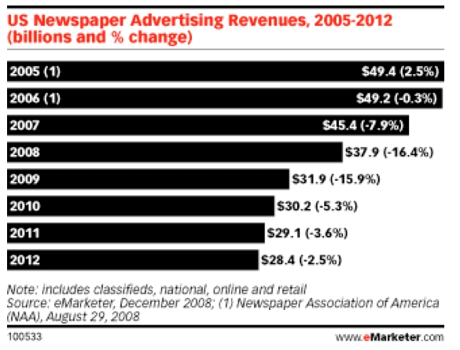
Percentage Change
Notes:
Percentage change is a way to express a change in a variable.
It represents the relative change between the old value and the new one.
It allows marketers to compare performance indicators such as revenue over different periods.
In this particular case, the chart indicates the shrinking of US Newspaper Advertising Revenues and the percent change year-over-year.

Slide 43
Percentage Change – Example 1
Last year we had sales of did $300,000, this year our sales are $400,000.
What is the percentage change in sales, year over year?
%
Change
+ 33.3 %
New
Amount
$400,000
Old
Amount
$300,000
100 %
Old
Amount
$300,000
%
Change
New
Amount
Old
Amount
100 %
Old
Amount

Slide 44
Percentage Change – Example 2
Last year we had sales of $300,000, this year sales are $150,000.
What is the percentage change in sales?
%
Change
-50 %
New
Amount
$150,000
Old
Amount
$300,000
100 %
Old
Amount
$300,000
%
Change
New
Amountntt
Old
Amount
100 %
Old
Amount

Slide 45
Any Questions

Slide 46
Let’s look at the worksheet
Metrics Mastery Worksheets 2

Slide 47
Reminders for next week
Chapter 17 and 4
Review LearnSmart Chapters 2 & 3
Review Metric 2 Quiz on Blackboard
Read Chapter 17 and 4
Additional Interactive SWOT Exercises at;
Course Info & Materials / Lecture Materials/Week 3 / Additional SWOT Exercises
Notes:
47

Slide 48
Before you leave today
Hand In:
Front of the Class
name cards

Slide 49




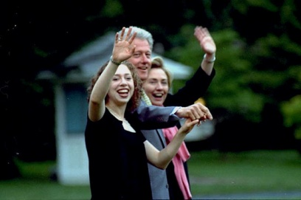


See you next Week

