Slide 1
Lecture 4
Ch 2 (Continued)

Slide 2
How to interpret standard deviation
Small std little variability between data
Big std large variability (spread) between data.
Example: Compute std for and compare hourly wages and revenue data (see minitab)

Slide 3
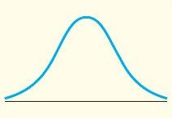
The normal curve (Bell shaped)
It represents a symmetric population. Data are symmetrically distributed around the mean. At any point, the area under the curve represents the cumulative frequency of the population up to that point.

Slide 4
Practical interpretation: Empirical rule
If a population can fairly be described by a normal curve, then about
68.25% of population are within one standard deviation of the mean.
95.44% of population are within two standard deviations of the mean.
99.73% of population are within three standard deviations of the mean.

Slide 5
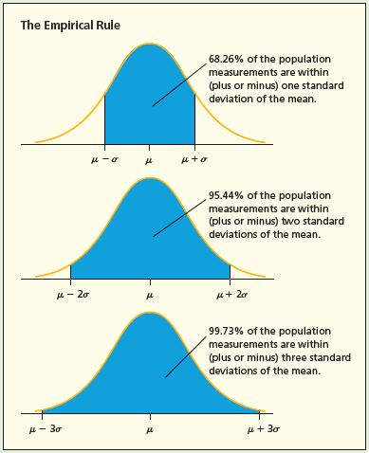
Empirical rule in a picture

Slide 6
Example of the use of empirical rule
Consider the DVD price data (see minitab)
Is it fair to consider the data as symmetric (bell shaped)?
compute mean and standard deviation.
68% of prices are between what values?
95% of prices between what values?
Almost all prices are between what values?

Slide 7
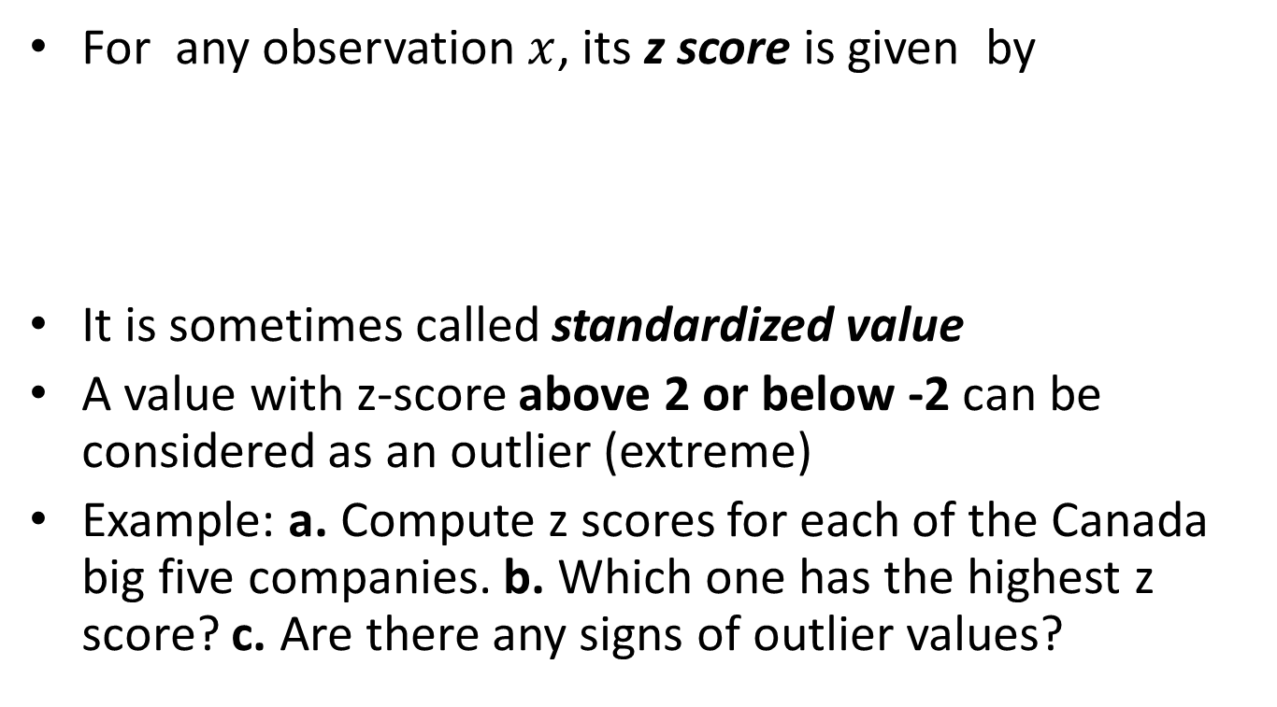
z-score
For any observation $x$, its z score is given by
It is sometimes called standardized value
A value with z-score above 2 or below -2 can be considered as an outlier (extreme)
Example: a. Compute z scores for each of the Canada big five companies. b. Which one has the highest z score? c. Are there any signs of outlier values?

