Slide 1
Physics 1003/BIT 1203
Fall 2012
Lecture 06
Contact and Non-Contact Forces
Application of Newton’s Laws

Slide 2
Weight: The Force of Gravity

Slide 3
Weight
The weight of an object is the force due to gravity exerted on an object.
Near the surface of the Earth, the gravitational acceleration is g, and so Newton’s Second Law becomes
Equation 5-8
The gravitational force and the acceleration both point in the same direction, towards the centre of the Earth

Slide 4
More on Weight
The weight of the object is constant even if the object is at rest.
If the object is at rest, then there must be an equal and opposite force pushing in the other direction.
The net force is then zero, and there is no acceleration, so the object can either be stationary or moving with constant speed

Slide 5
Mass is Not Weight
Do not confuse mass and weight.
The mass of an object is constant
The weight of an object varies depending on the strength of the local gravity field (i.e. the value of the value of “g” at that location)

Slide 6
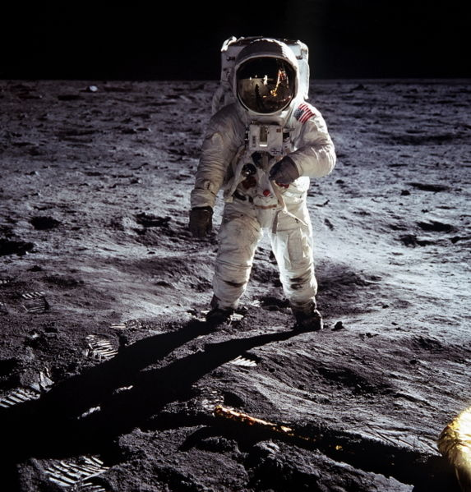
Buzz Aldrin, Apollo 11, 1969
His mass is the same on the Moon and the Earth.
His Moon weight is only 1/6th of that on Earth.
http://www.youtube.com/watch?v=fE3kAFOd5Z8

Slide 7
Contact Forces
A contact force is only applicable when the object is in contact with a solid object
The two main contact forces we have to deal with are
The Normal Force
The Friction forces between two objects

Slide 8
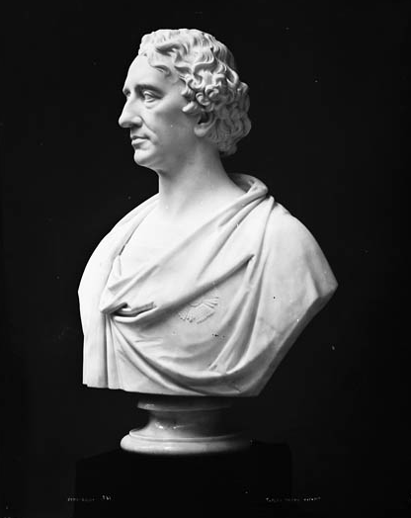
The Normal Force
The forces acting:
On the bust of Sir John A Macdonald
  The weight (force of gravity on the bust) is acting downwards
  The table is pushing back on the bust with a normal force F_{N}
F_{g}
F_{N}
F_{N}
An equal and opposite force F_{N} must be exerted by the bust on the table

Slide 9
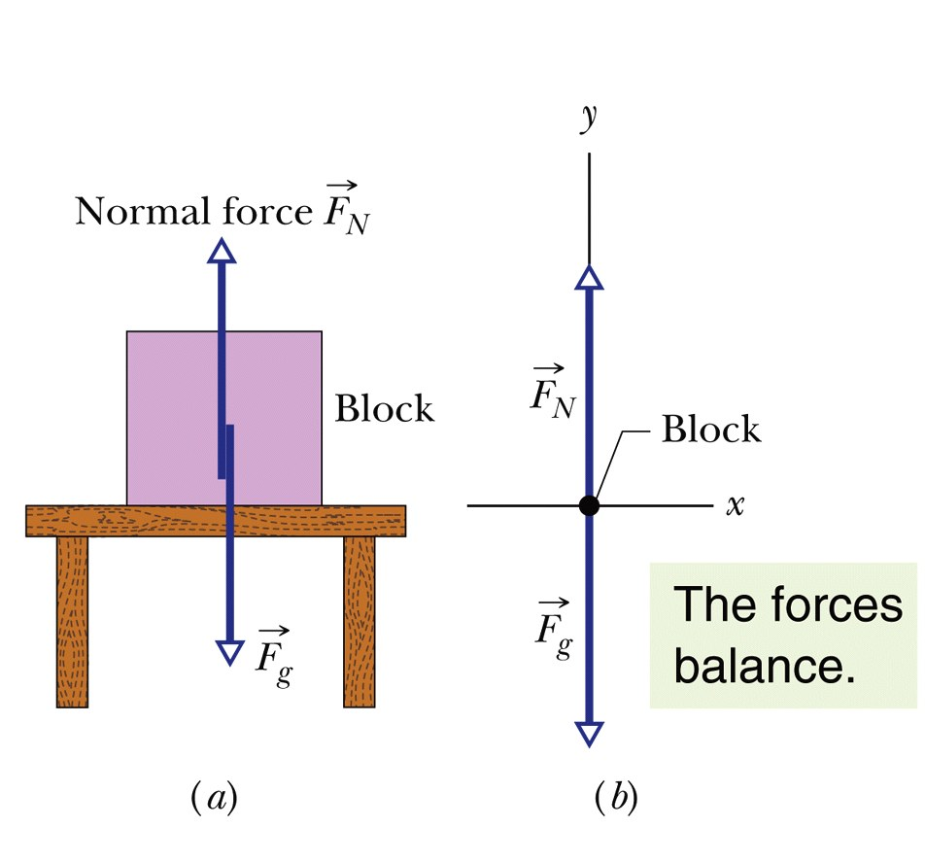
Magnitude of the Normal Force
If there are no other forces acting in the vertical direction, then the normal force is exactly equal in magnitude to the weight of the box
Eqn. 5-14

Slide 10
The Origin of the Normal Force
The normal force is actually an elastic force generated by the bonds between atoms in the solid material of the table (or whatever is stopping the motion).
The bonds can be considered as springs, and they do deform very slightly when an object is set down on them (a bit like a mattress).
The deformation is usually extremely small and can be treated as negligible

Slide 11
External force causes distortion
Elastic forces resist the external force

Slide 12
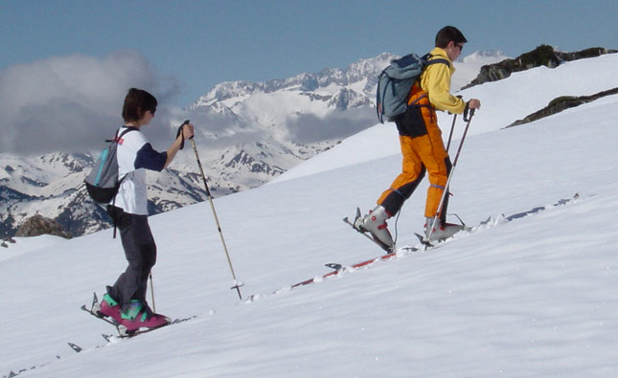
The Normal Force is Not Always Vertical
The normal force exerted by a surface is always perpendicular to the surface.
If the surface is inclined, then the Normal Force is not in the vertical
Normal Force
For the skier, the weigh acts vertically downwards; the normal force is perpendicular to the slope
Weight

Slide 13
The Normal Force is a Contact Force
If the object is not in contact with a solid surface, there is NO normal force!
While the block is on the table top, there is a normal force
As soon as it falls off the table top, there is no longer a normal force

Slide 14
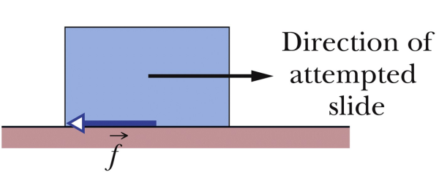
Friction Force
Friction is a contact force
It always opposes motion

Slide 15
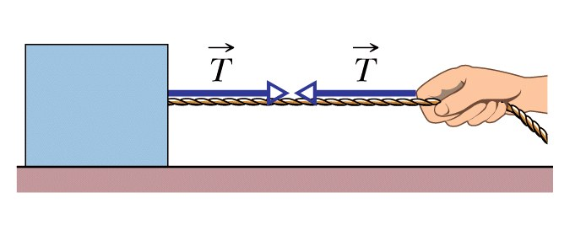
Tension
If a cord (or cable, rope, string, wire etc.) is attached to a body and pulled taut, then the cord pulls on the body with a force T, directed away from the body and along the cord
A force T is exerted by the cord on both hand and block

Slide 16
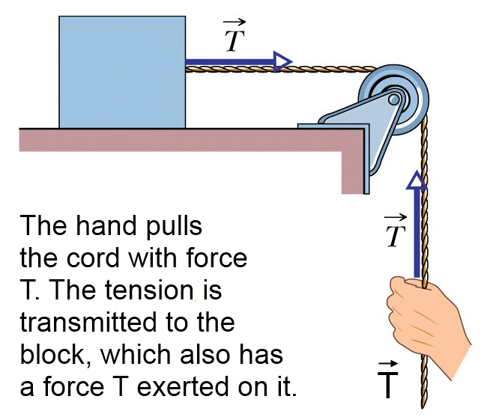
Pulleys may be used to change the direction of the tension force

Slide 17
The cord is often said to be massless and unstretchable.
This means that
  the mass of the cord does not have to be taken into account when calculating acceleration produced for a given force.
  The length of the cord does not change as a function of applied Tension

Slide 18
Newton’s Third Law of Motion
Whenever one body exerts a force on a second body, the second body exerts an oppositely directed force of equal magnitude on the first body
Often called the “Action-Reaction” law
  For every action, there is an equal and opposite reaction
Notes:
18

Slide 19

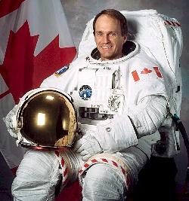
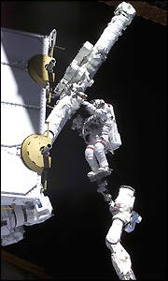
Steve Maclean- Second Canadian Space Walker, September 2006
If Steve pushes on the space station with a force P Newtons
then the space station exerts a force –P Newtons on him
+P action
-P reaction
Notes:
19

Slide 20
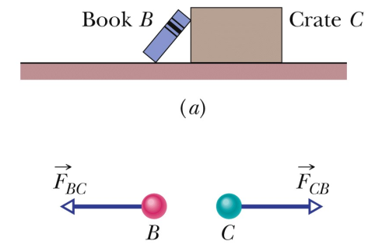
Newton’s Third Law
It is very important to realise that the pair of forces described by Newton’s Third Law are acting on different objects
  If they were acting on the same object, they would just cancel each other out

Slide 21
Example: Mass on a String
Mass, m₁ kg is hanging from a (massless) string. It is stationary. Consider the mass as the object. Draw the free body diagram and apply Newton’s Second Law
Tension Force in String, pulls up on the mass
m₁
+y
Force of Gravity acts downwards on the mass
+x

Slide 22
Apply Newton’s Second Law
Since the mass is stationary, a_{y} = 0
No acceleration in x

Slide 23
Suppose the String Had Mass
More realistic, allow string to have mass m₂
Tension Force in String, pull up on the mass
Force due to gravity due to the mass of the string acts downwards
Force of Gravity acts downwards on the mass

Slide 24
Apply Newton’s Second Law
Since the mass is stationary, a_{y} = 0
No acceleration in x

Slide 25
Compare the Tensions
Massless String
String with Mass
Tension T
Tension T₂
Tension T₂ is greater than tension T, as it has to support an increased mass. If the mass of the string is small compared to the mass of the object, then it is reasonable to neglect it

Slide 26
Non-Equilibrium Problems
Sometimes we have situations where the net force is non-zero, and the system is accelerating.
We still analyze the system using a free body diagram, but now we must account for the non-zero net force

Slide 27
Example: The Fish
A fisherman pulls a fish vertically out of the water with an acceleration of 2.50 m/s², using very light fishing line that has a breaking strength of 22.0 N. Unfortunately, the fisherman loses the fish as the line snaps. What can you say about the mass of the fish? (N.B. Writing “The fish was too heavy”, will not get any marks!)

Slide 28
Using Newton’s Second Law
Draw the free body diagram
F_{T} = T j
+y
known
Maximum tension known
F_{g} = -mg j

Slide 29
Rearrange the Newton’s Second Law equation to find the unknown m (as T is the maximum possible value, the value of m represents the maximum mass before the line breaks)

Slide 30
Putting the numbers in
The fish must have had a mass of greater than 1.79 kg, because the line broke

Slide 31
Forces and Acceleration of Masses Moving Together
Blocks 1 and 2 are glued together, and being pulled across a smooth (frictionless) surface.
  The rope is attached to block 2
  Consider the problem with the 2 blocks together
  Then consider block 1 in isolation
  Find the equation describing the motion (i.e. Write Newton’s Second Law for it)
m₁
Tension force in rope
m₂

Slide 32
Blocks 1 and 2 Together
Force T acts on both blocks
Use the combined mass
Tension force in rope = T
m₁
m₂
As both blocks are fixed together, their acceleration must be the same

Slide 33
Block 1 Isolated
Block 1 moves because of the force exerted on by block 2 not directly from the tension T
This is a contact force
Is this the same as the previous result?
We can also analyse the motion of block 2 in isolation to find out

Slide 34
Block 2 Isolated
If block 2 exerts a force on block 1, then block 1 exerts and equal and opposite force on block 2 (Newton’s Third Law)
Net force acting on m₂

Slide 35
Combine the Results for Both Blocks
Block 1
Block 2
Eliminate F₁₂
Accelerations are the same as both blocks are fixed together
Same result as before

Slide 36
If There Was No Glue
The result would be different, as now block 1 and block 2 exerts no forces on each other
m1
m2
http://www.youtube.com/watch?v=cuG8sIiV8iQ

Slide 37
External and Internal Forces
On the free body diagram, only the External forces need to be considered
Internal forces are those which hold an object together
  The glue, when both objects are considered together
  Interatomic forces, chemical bonds
The net force in Newton’s Second Law ALWAYS refers to the NET EXTERNAL FORCE

Slide 38
Motion on an Inclined Plane: Using Components
This sled on an inclined plane has three forces acting on it
  Friction
  Gravity
  The Normal Force
+y
+x
f
F_{N}
F_{g}
θ

Slide 39
Co-ordinate system chosen to be parallel and perpendicular to slope because 2 of the 3 forces are parallel and perpendicular.
You will get the same numerical answers if you choose the horizontal and vertical directions, but then you have to resolve two vectors into components, so more chance of an error.
+y
f
F_{N}
+x
F_{g}
θ

Slide 40
Draw the Free Body Diagram
The weight, F_{g} needs to be resolved into components along the chosen axes
+y
F_{N}
f
θ
+x
F_{g}
θ

Slide 41
90-θ
θ
θ
Force of gravity in component form

Slide 42
Apply Newton’s Second Law
Negative because it is up the slope

Slide 43
Resolve the vectors in the Newton’s Second Law Equation into Components
In x-direction
In y-direction

Slide 44
Consider the x direction
The acceleration down the slope

Slide 45
Now consider the y-direction
In the y-direction, we know that there is no motion – the velocity is constant, the position in y is constant, hence the acceleration must zero

Slide 46
We can’t solve this problem yet, because the magnitude of the friction force is unknown

Slide 47
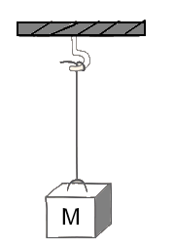
In Class Problem 06
Suppose the string is rated as being able to hold up to 43N of force before breaking.
What mass can you hang off it before it breaks?
Mass at rest

Slide 48
Draw the Free Body Diagram
If the mass is stationary, then the net force must be zero
Hence T = mg
1
T
+y
F_{g} = mg
1
1
1

Slide 49
At the breaking limit T= 43 N
1
1

Slide 50
If you went to the moon, where g = 1.5 m/s²
You can use the general result derived earlier (assuming of course that the tensile strength is the same in an airless environment!)
1
1

Slide 51
Deduct one mark for each incorrect force on the free body diagram (either extra forces or omitted forces).
Deduct 2 if there is no FBD
Deduct 1 for incorrect number of sig. figs.
Deduct 1 for incorrect or no units.
Marked out of 6 (it would be part of a question on an exam)

Slide 52
ICP 06 Grading
Score | Grade
6 | A
5 | B
4 | C
3 | D
0-2 | F

