Slide 1
Introduction to Business Information and Communication Technologies
Lecture Six

Slide 2

Media Reports
Team Co.

Slide 3
Today’s Agenda
Flattener # 4
  Uploading: Harnessing the Power of Communities
Excel I
  Datasets and Tables

Slide 4




Flattener # 4
Uploading: Harnessing the Power of Communities

Slide 5
Excel I
Chapter 5

Slide 6
Problem Solving Process
Analysis
Problem Statement
Analysis
Problem
Recognition
Solution
Analysis: Using data to make decisions depends on an organization’s ability to collect, organize, and otherwise transform data into information that can be used to support those decisions

Slide 7
Analyzing the Problem
Analysis
Problem Statement
Problem
Recognition
Data Gathering
Pre-processing
Cleansing
Filtering

Slide 8

Analyzing the Solution
Problem Statement
Analysis
Solution
Understanding the Problem
Formulating a Solution Plan
Implementing the Solution
Evaluating the Solution

Slide 9
Chapter 5 Objectives
Freeze rows and columns
Print large datasets
Understand table design
Create a table
Apply a table style
Sort data
Notes:
The objectives of Chapter 4 include to:
Freeze rows and columns
Print large datasets
Understand table design
Create a table
Apply a table style
Sort data

Slide 10
Chapter 5 Objectives (continued)
Filter data
Use structured references and a total row
Apply conditional formatting
Create a new rule
Sort and filter using conditional formatting
Notes:
Additional objectives include to:
Filter data
Use structured references and a total row
Apply conditional formatting
Create a new rule
Sort and filter using conditional formatting

Slide 11
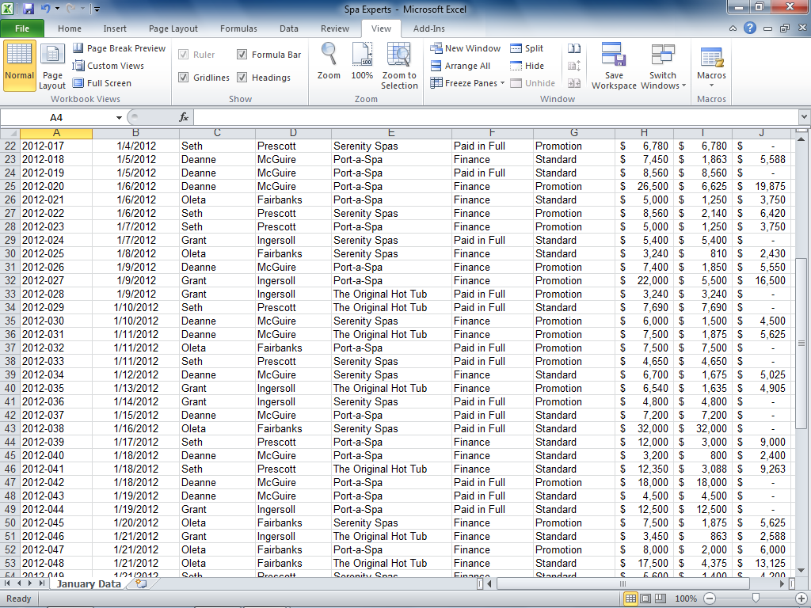
Large Datasets
A large dataset can be difficult to read
  Row and column headings may scroll off the screen
Notes:
A large dataset may be challenging to read as row and column headings often scroll off the screen. Figure 4.1 illustrates this problem as it relates to Spa Experts’ January sales transactions.

Slide 12
Freezing Rows and Columns
Freezing keeps rows and columns visible during scrolling
Option | Description
Freeze Panes | Keeps both rows and columns above and to the left of the active cell visible.
Freeze Top Row | Keeps only the top row visible.
Freeze First Column | Keeps only the first column visible.
Notes:
Freezing is the process of keeping rows and/or columns visible onscreen at all times, even when scrolling through a large dataset. Table 4.1 lists common freeze options available from the Freeze Panes option, found in the Windows group on the View tab.

Slide 13
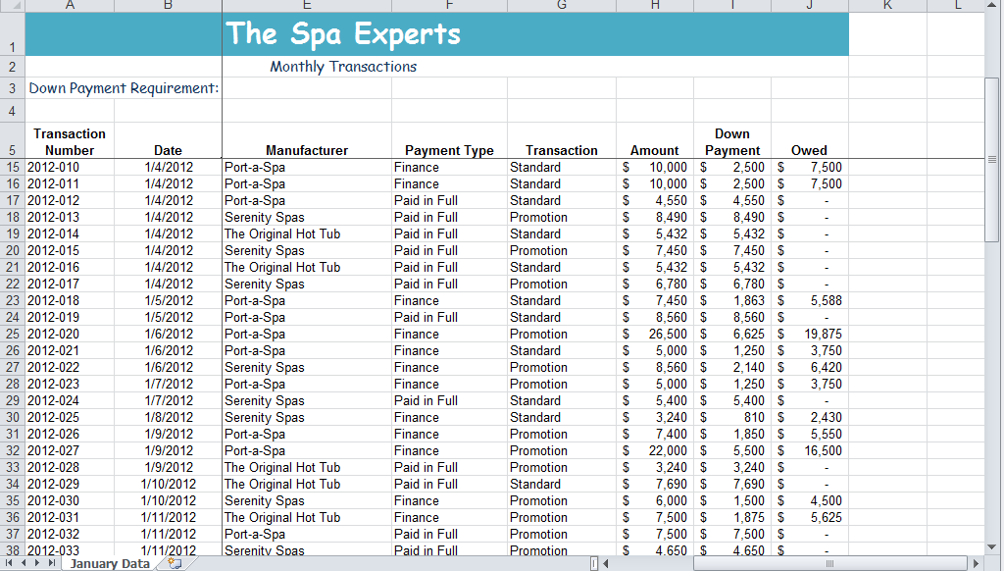
Freezing Rows and Columns
Figure 4.2 illustrates the effect of freezing rows 1 – 5 and columns A – B
Notes:
To freeze one or more rows and columns, use the Freeze Panes option. Before selecting the option, make the active cell one row below and one column to the right of the rows and columns you wish to freeze. To unlock the frozen rows and columns, click Freeze Panes in the Window group of the View tab and select Unfreeze Panes.
Figure 4.2 illustrates the effect of freezing the top 5 rows on the worksheet as well as columns A through B.

Slide 14

Printing Large Datasets
The Page Layout tab offers options to help print large datasets:
  Page Breaks
  Print Area
  Page Titles
Notes:
A large dataset may require several pages to print all of the rows and columns. As shown in Figure 4.3, the Page Layout tab offers several options to aid in this process.
A page break indicates where the printer should begin a new printed page. A print area defines the range of data to print. Page titles are row or column headings to be printed on each page.

Slide 15
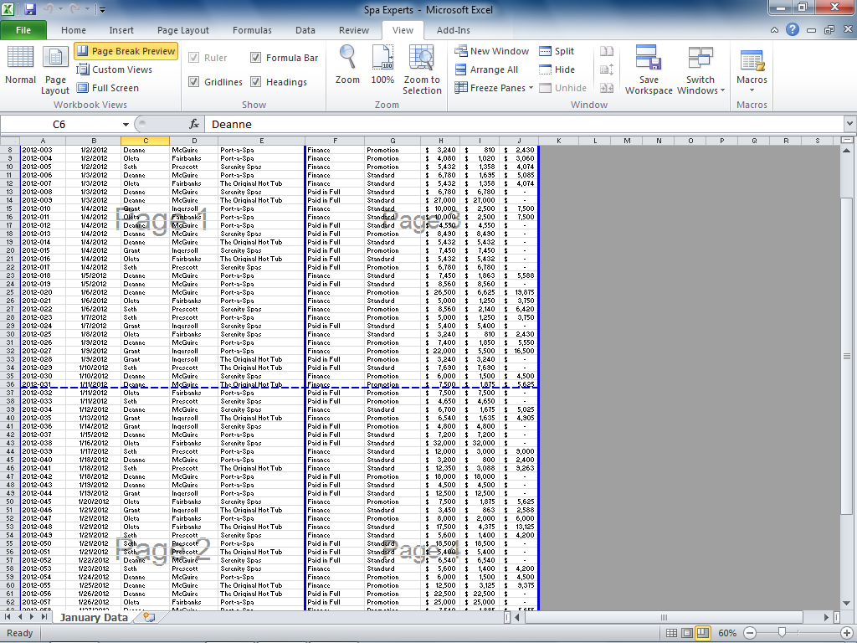
Manual Page Breaks
A page break indicates where data will start on a new printed page
Notes:
Automatic page breaks, as determined by Excel, can be seen by clicking Page Break Preview on the status bar or in the Workbook Views group on the View tab.
A manual page break is set with the following steps:
Click the cell you wish to be first on the new page.
Click the Page Layout tab.
Click Breaks in the Page Setup group and then select Insert Page Break.
Figure 4.4 illustrates an automatic page break at row 37 and a manual page break at column F.

Slide 16
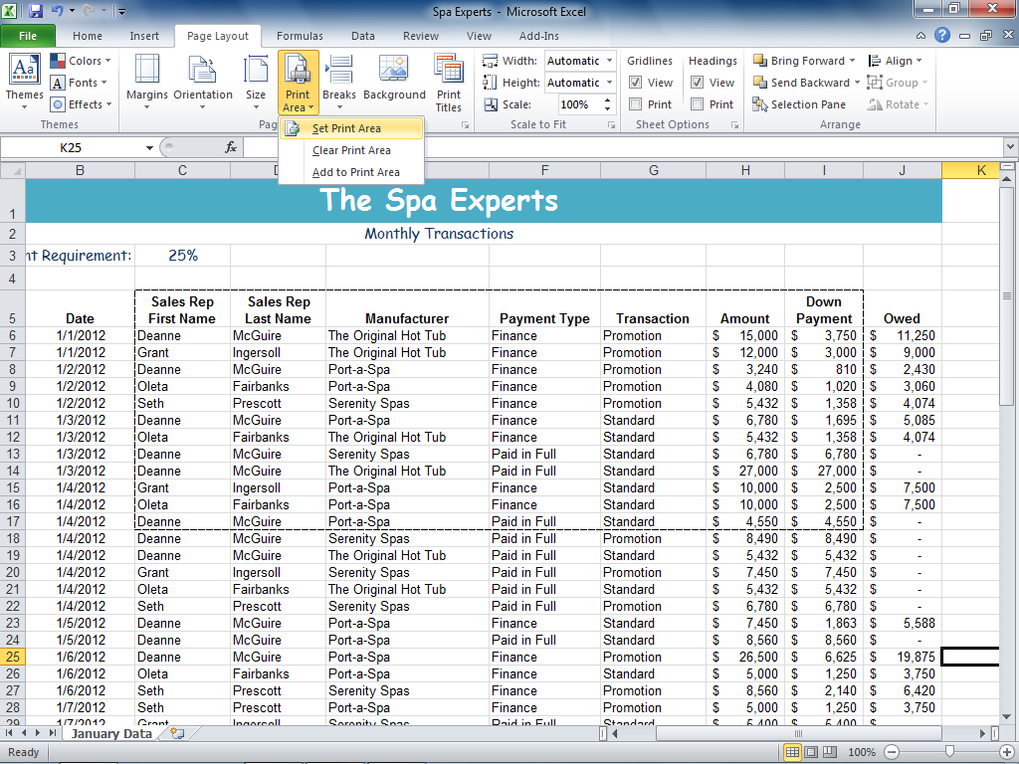
Setting a Print Area
A page area defines the range of data to print
Notes:
A page area defines the range of data to print.
A print area is set with the following steps:
Select the range you wish to print.
Click the Page Layout tab.
Click Print Area in the Page Setup group.
Figure 4.5 illustrates a print range set selected as C5:I17. To clear a print area, click Print Area in the Page Setup group, and then select Clear Print Area.

Slide 17
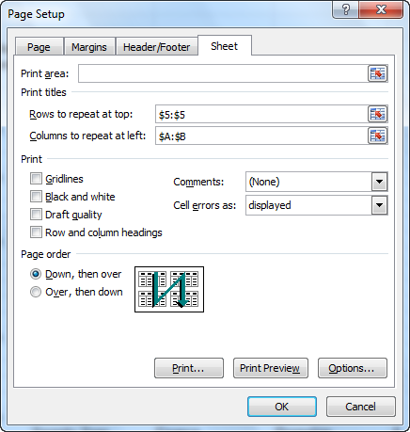
Print Titles
Print titles indicate some rows or columns that will repeat at the top or side of each printed page
Notes:
Print titles indicate some rows or columns that will repeat on each printed page.
Print titles are set with the following steps:
Click the Page Layout tab.
Click Print Titles in the Page Setup group to open the Page Setup dialog box.
Figure 4.6 illustrates the selection of row and column headings to print on each page.

Slide 18
Excel Tables
A table is a structured range of related data formatted to enable data management and analysis
Excel tables offer many features not available to regular ranges
Notes:
A table is an area in the worksheet that contains rows and columns of related data formatted to enable data management and analysis. Tables offer many features not available to simple data ranges. Column headings remain onscreen without need for freezing. Filter drop-down lists permit the table to be filtered to show only a subset of that data satisfying certain conditions.
Predefined table styles enable easy formatting. Calculated columns cause a formula or function written in a column to be automatically copied to every cell in the column. A total row permits quick use of statistical functions at the bottom of a column. Structured references permit use of the column header name to reference a column.

Slide 19
Table Design
A field is an individual piece of data
  Field names appear in the top row as column headings
  Field names should be short, but descriptive
A record is a complete set of data for an entity
  Each record is listed in a row of the table
  Do not insert blank rows in the table
Notes:
A field is an individual piece of data, such a person’s name or zip code. Field names should be entered in the top row of the table, appearing as column headings. Use short, but descriptive, names and be sure each field name is unique. A record is a complete set of data for an entity—for example, an employee record using name, street, town, state, and zip code fields.
Each record should use one row of the table with no blank rows. If multiple tables are used in a single worksheet, they should be separated from each other by blank rows and columns.

Slide 20
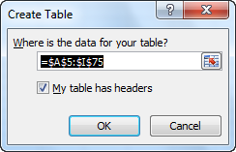
Creating a Table
A table can easily be created from existing data
Notes:
Use the following steps to create a table from an existing range of data:
Click anywhere within the range of data.
Click the Insert tab.
Click Table from the Tables group.
Figure 4.12 illustrates the Create Table Dialog Box. Determine that the proposed table range is correct and the check box concerning the table header row is checked.

Slide 21
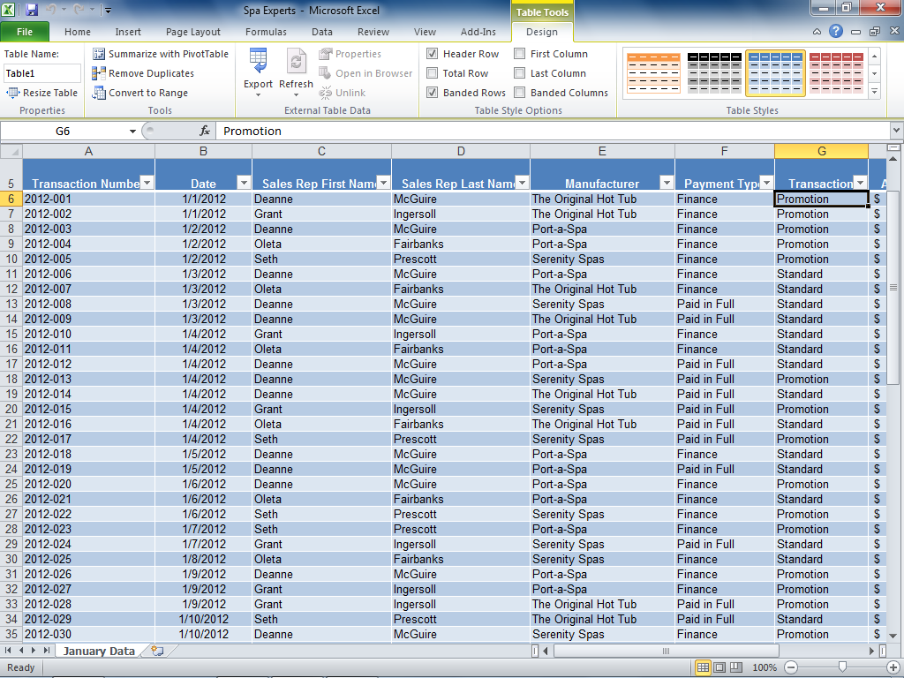
Creating a Table
The Design tab on the Table Tools contextual tab opens when the table is selected
Notes:
The Design tab on the Table Tools contextual tab appears whenever a cell within the table is selected. Many table-related formatting and design commands are offered, including table name and table styles.
Table 4.13 shows an Excel table in Default Format.

Slide 22
Adding Records
Add a new record at the bottom of the table by clicking in the row under the table
Add a new record within the table by clicking in the record below the insertion point
  Click the Home tab
  Click the Insert arrow in the Cells group
  Select Insert Table Rows Above
Notes:
When a new record is entered into the blank row under a table, the table is automatically extended to include it. New records can be inserted in the middle of a table by clicking the row under the insertion point and issuing the Insert Table Rows command from the Cells group of the Home tab.

Slide 23
Editing and Deleting Records
Data within a table record can be edited using the same techniques as those for a regular cell
Deleting a record removes it from the table
  Click the Home tab
  Click the Delete arrow in the Cells group
  Select Delete Table Rows
Copyright © 2011 Pearson Education, Inc. Publishing as Prentice Hall.
Notes:
Data within records can be edited using the same techniques as those used for a regular Excel cell. A record can be removed from a table by clicking within the row and issuing the Delete Table Rows command from the Cells group of the Home tab.

Slide 24
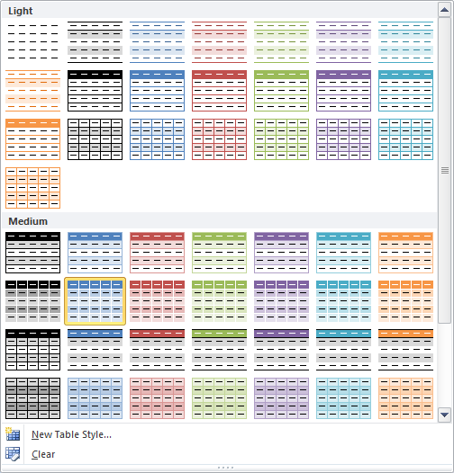
Applying a Table Style
A table style controls the fill color of the header row, columns, and records
Notes:
Excel offers a variety of table styles as shown in Figure 4.15. A table style controls the fill color of the header row, columns, and records.

Slide 25
Table Style Options
The Table Styles Options group on the Design tab contains check boxes to further format the table
Check Box | Action
Header Row | Displays the header row at the top of the table.
Total Row | Displays a total row at the bottom of the table.
First Column | Applies a different format to the first column.
Last Column | Applies a different format to the last column.
Banded Rows | Displays alternate fill colors for even and odd rows.
Banded Columns | Displays alternate fill colors for even and odd columns.
Notes:
After selecting a table style, you can further format the table using check boxes available in the Table Styles Options group on the Design tab. See Table 4.2 for a description of these check boxes.

Slide 26
Sorting Data
Sorting arranges records in a table
  Sort on one column
  Sort on multiple columns
Records can be sorted in ascending or descending order
Notes:
Sorting arranges records in a table by the value in either one field or multiple fields. An ascending sort arranges records from low to high, while a descending sort orders from high to low.

Slide 27
Sorting by One Column
Excel offers several ways to sort a single column
Data type | Options | Explanation
Text | Sort A to Z | Arranges data in alphabetical order.
 | Sort Z to A | Arranges data in reverse alphabetical order.
Dates | Sort Oldest to Newest | Displays data in chronological order.
 | Sort Newest to Oldest | Displays data in reverse chronological order.
Values | Sort Smallest to Largest | Arranges values in sequential order.
 | Sort Largest to Smallest | Arranges values in descending order.
Notes:
Use any of the following techniques to sort on a single field:
Click Sort & Filter in the Editing group on the Home tab.
Click Sort A to Z, Sort Z to A, or Sort in the Sort & Filter group on the Data tab.
Right-click the field to sort, point to Sort from the shortcut menu, and select the type of sort desired.
Table 4.3 lists sort options by data type.

Slide 28
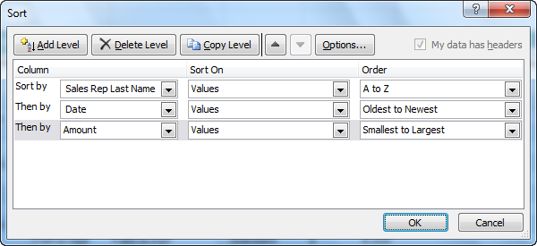
Sorting by Multiple Columns
Multiple level sorts permits differentiation among records with duplicate data in the first sort
Notes:
After a sort on a single column, often called a primary sort, there may be records with the same value. As illustrated in Figure 4.21, use the following technique to sort on multiple fields.
Click in any cell in the table.
Click Sort in the Sort & Filter group on the Data tab to display the Sort dialog box.
Select the primary sort level by clicking the Sort by arrow and selecting the column to sort by. Then click the Order arrow and then select the sort order from the list.
Click Add Level, select the second sort level by clicking the Then by arrow and selecting the column to sort by. Then click the Order arrow and then select the sort order from the list.
Continue to click Add Level and add sort levels.

Slide 29
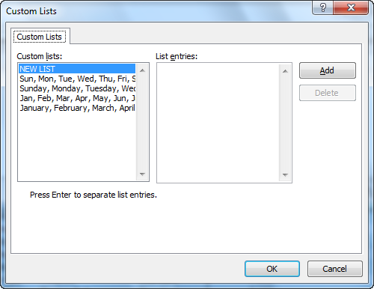
Creating a Custom Sort
A custom sort can be created to arrange values in a customized fashion
Notes:
Excel arranges data in either ascending or descending fashion. For text entries, ascending sort is alphabetical order. A custom sort can be used if you wish to arrange values in a particular fashion, such as days of the week, months of the year, or in a customized ordering.
Figure 4.22 illustrates the Custom Lists Dialog Box.

Slide 30
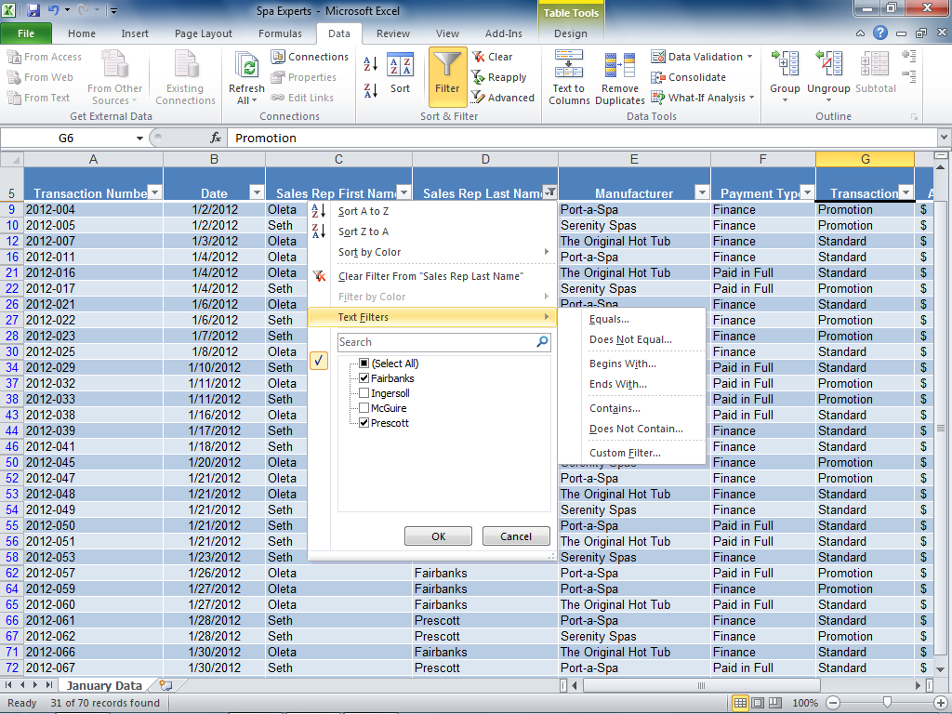
Filtering Data
Filtering is the process of displaying only records that meet specific conditions
Notes:
Filtering is the process of specifying conditions to display only those records that meet the conditions. To filter records by a particular field, click the column’s filter arrow and select the values of interest. Records that match the values in the filter display, and other records are hidden from view.

Slide 31
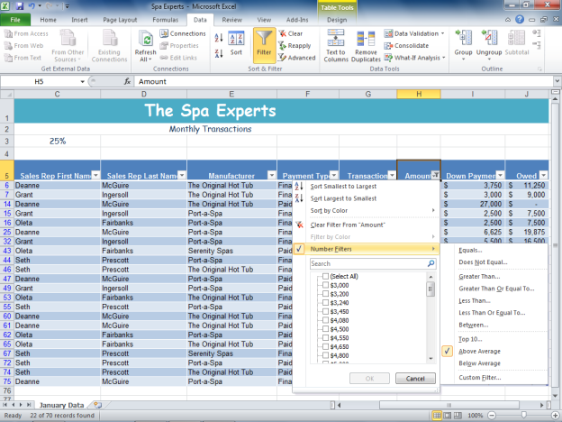
Filtering Numeric Data
Numeric filters can be applied to display a range of values
Notes:
When you filter a column of numbers, you can specify specific numbers, a range, or values in the Top 10, above or below the average.
Figure 4.24 illustrates choices regarding numeric filters.

Slide 32
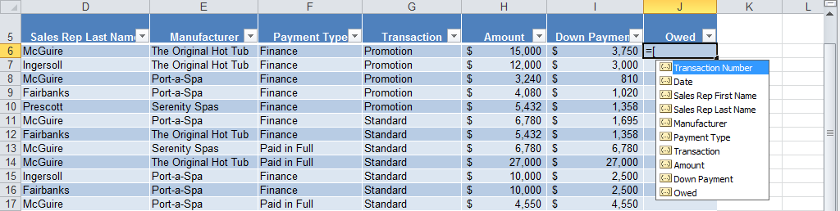
Using Structured References
A structured reference is a tag or table field name used in a formula or function
Notes:
Rather than using cell addresses, structured references can aid in formula creation and clarity. For example, in Figure 4.28, the formula in cell J6 can be written as =[Amount]-[Down Payment]. Structured references are enclosed in square brackets.

Slide 33
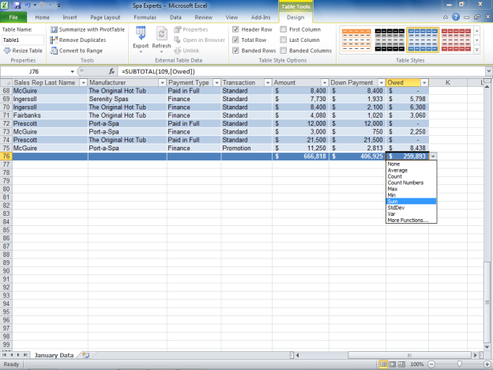
Creating a Total Row
A total row appears as the last row of a table and offers statistical functions
Notes:
A total row can be added to a table by checking the Total Row check box in the Table Style Options group in the Table Tools Design tab. Excel automatically adds the SUM function to the last column if it contains numeric data and the COUNT function if it contains text data. Click in any cell of the total row and select the statistical function of interest.
Figure 4.29 shows the active total row with totals applied to the Amount and Down Payment columns.

Slide 34
Conditional Formatting
Conditional Formatting | Description
Highlight Cell Rules | Highlights cells with a fill color, font color or border if the cell value satisfies the rule.
Top/Bottom Rules | Formats cells with values in some top number or percentage.
Data Bars | Applies a gradient or filled bar in which the width of the bar represents the cell’s value with respect to other cells.
Color Scales | Formats different cells with different colors, assigning one color to lowest and highest groups and gradient colors in between values.
Icon Sets | Inserts an icon in a cell to indicate values compared to each other.
Notes:
Conditional formatting applies special formatting to highlight and emphasize cells that meet certain conditions. Use the following technique to apply conditional formatting.
Select the range of data to which the conditional format will be applied.
Click Conditional Formatting in the Styles group on the Home tab.
Select a conditional format from the list or click New Rule to create a customized rule.
Table 4.5 describes Conditional Formatting Options.

Slide 35
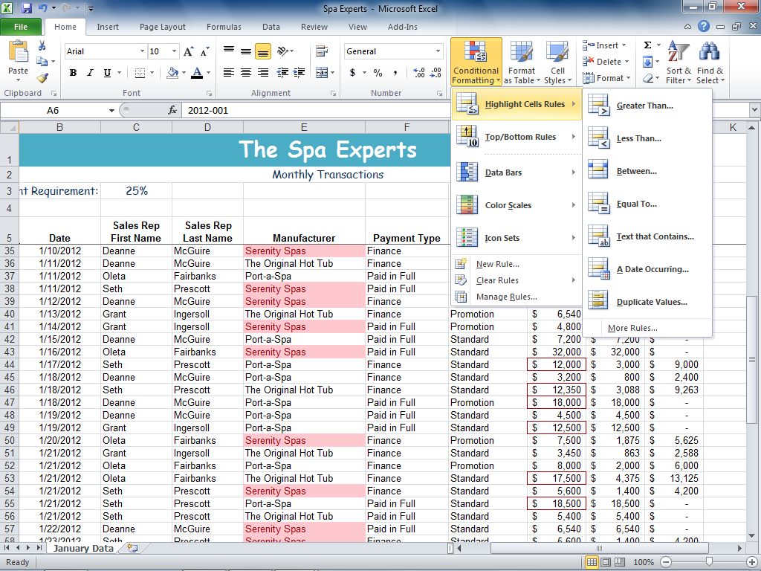
Applying the Highlight Cells Rule
Notes:
The Highlight Cells Rules enable you to highlight cells within a range that satisfy a certain condition or equal a particular value. Figure 4.39 illustrates one conditional format on the field Manufacturer highlighting text “Serenity Spas”, and another on the field Amount highlighting values between “$10,000 and $20,000”.

Slide 36
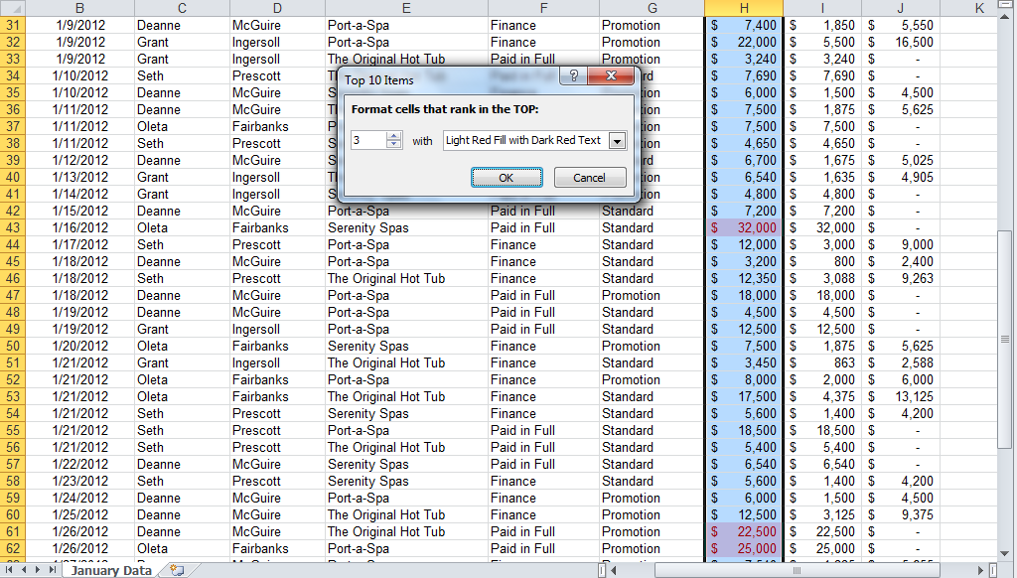
Applying the Top/Bottom Rules
Notes:
The Top/Bottom Rules enable you to highlight cells that fall in the Top 10, Top 10%, Bottom 10, Bottom 10%, Above or Below Average groups. It is also possible to select a customized condition.
Figure 4.40 illustrates a conditional format applied to the Top 3 values in the Amount column.

Slide 37
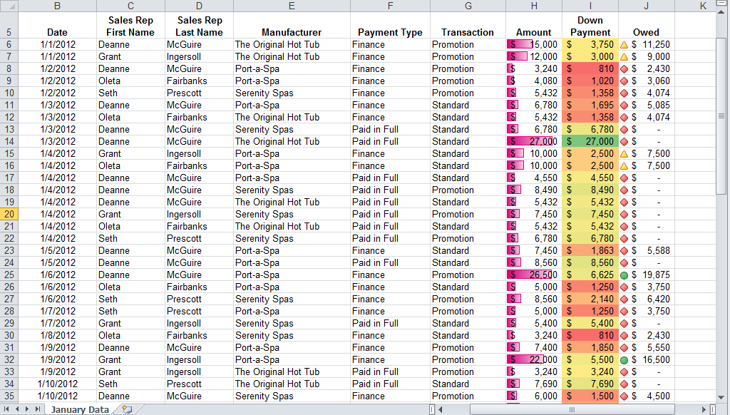
Displaying Data Bars, Color Scales, and Icon Sets
Notes:
Other conditional formats include data bars, color scales, and icon sets. A data bar is a horizontal bar indicating the size of a cell compared to others in the range.
A color scale uses a range of colors to rank values in the range. An icon set uses a set of symbols to rank values in the range.
Figure 4.41 illustrates the Data bars conditional format applied to the Amount column, Color scales to the Down Payment column, and an Icon set to the Owed column.

Slide 38
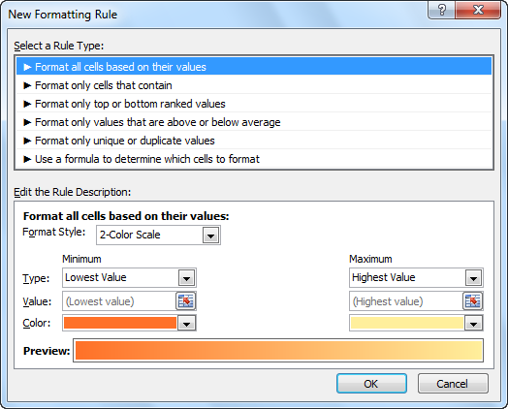
Creating a New Rule
The New Formatting Rule dialog box is used to create a customized rule
Notes:
Use the following alternate techniques to create a customized rule, using the Conditional Formatting command in the Styles group on the Home tab.
Select New Rule.
Select Manage Rules to open the Conditional Formatting Rules Manager dialog box, and select New Rule.
Select a rule category, and then select More Rules to open the New Formatting Rule dialog box.
Figure 4.42 illustrates the New Formatting Rule dialog box.

Slide 39
Sorting and Filtering Using Conditional Formatting
It is possible to apply sorting and filtering commands to data using a conditional filter
  Use the Sort by Color option to group highlighted records
  Sort the field in ascending order to arrange data bars
  Use the Filter by Color option to display only highlighted records
Notes:
Once conditional formatting has been applied to a column, sorting and filtering commands can be used. If the conditional format uses a color, the Sort by Color option orders highlighted records together. To apply the sort, display the filter arrows, click the arrow for the conditionally formatted column you wish to sort, point to Sort by Color, and then click the desired fill color.
If the conditional format uses data bars, sorting the column by value will arrange the data bars in ascending or descending fashion. Applying the Filter by Color command applies a filter to display only highlighted records.

Slide 40
Chapter 5 Summary
In this chapter, you have learned to manage large datasets by freezing rows and columns and controlling print options.
You understand table design and can create and format a table.
You can sort and filter data in a table.
You can use structured references in formulas and apply statistical functions in a total row.
You can apply conditional formatting to add emphasis to records.
Notes:
Chapter 4 has studied the creation and manipulation of large data sets and Excel tables. In this chapter, you have learned to manage large datasets by freezing rows and columns and controlling print options. You understand table design and can create and format a table. You can sort and filter data in a table. You can use structured references in formulas and apply statistical functions in a total row. You can apply conditional formatting to add emphasis to records.

Slide 41
Next week
Flattener # 5
  Outsourcing: Y2K
Excel II:
  Subtotals, Pivot Tables, and Pivot Charts
  What-if Analysis

