Slide 1

Perception
CGSC 1001
Mysteries of the Mind
by Jim Davies
jim@jimdavies.org
Notes:
Image of an ocelot, a South American wild cat.
US Fish & Wildlife Service, Image Archive. Through Wikimedia commons.
You can learn more about the ocelot at http://en.wikipedia.org/wiki/Ocelot

Slide 2
What is Perception?
The process by which agents interpret and organize sensation to produce a meaningful experience of the world.
From a cognitive science perspective, it means turning information from one form into new, meaningful representations.

Slide 3
Typical Sensory “Modalities”
Physical signal | Perceptual modality
Light | Vision
Air vibrations (sound) | Audition (hearing), echolocation
Physical pressure | Haptics (touch)
Chemicals | Taste and olfaction (smell)
Body position | Kinesthetics / proprioception
Atypical: senses in the bowel, stomach, pain receptors, heat receptors, etc.

Slide 4
Illusions Give Us Clues As To How Our Perceptual Systems Work
Here’s a fun quiz that demonstrates illusions. I’ll need 20 volunteers to come to the computer and do one question each. Volunteers will be rewarded by their own dopamine system.
http://www.bbc.co.uk/science/humanbody/body/interactives/senseschallenge/senses.swf

Slide 5
Human Vision
Extramission Theory
  Rays of light emanating from the eye in combination with light in the world allow us to see
Intromission Theory
  visual perception is accomplished by rays of light reflected from objects into the eyes
Notes:
Thanks to Jolie Bell, a Ph.D. student at the Institute of Cognitive Science, for gathering much of the information on these slides.
Further Reading: http://en.wikipedia.org/wiki/Emission_theory_%28vision%29

Slide 6
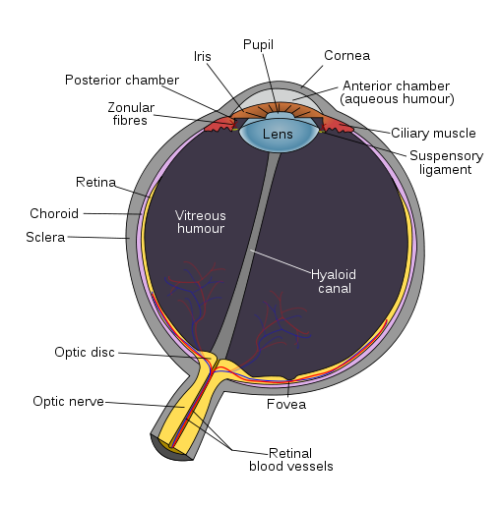
Human Eye
  Light is reflected into the eye and focused on the retina
  Light stimulates the rod and cone receptors
  Transduction of light into electricity
Notes:
By Rhcastilhos [Public domain], via Wikimedia Commons

Slide 7
Rods and Cones on Retina
The image is severely distorted and inverted.
Rod: the most light sensitive photoreceptive cells in the retina (night vision); 100 times more sensitive then cones; information is received by a convergence or pooling from many rod cells resulting in a loss of visual acuity; convergence of information makes peripheral vision sensitive to movement (seeing something vague out of the corner of your eye).
Cone: three types, correspond to Short (blue), Medium (green) and Long wavelengths (red); works best in bright light; fewer cone cells exist for peripheral vision

Slide 8

Depth Perception
Size
  We know how big things are
Perspective
  Things are smaller on the fovea as they get farther
Occlusion
  When one thing is in front of another
Texture, Shading, Saturation
  Closer things are more saturated. Texture gradients.
Focus
Multiple Images
  Including motion and binocular vision
Mnemonic: SPOT FM
Notes:
The pictured cobblestone shows how a texture gradient can be used as a depth cue.
Cobblestoned road from Guzów to Oryszew (en:Masovia, en:Poland). It is 2.4 kilometres long.
Picture licensed under the
GNU Free Documentation License

Slide 9
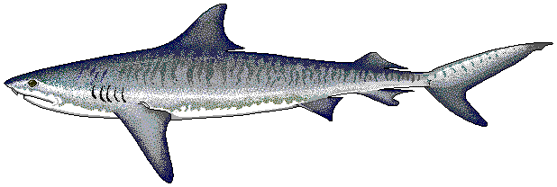
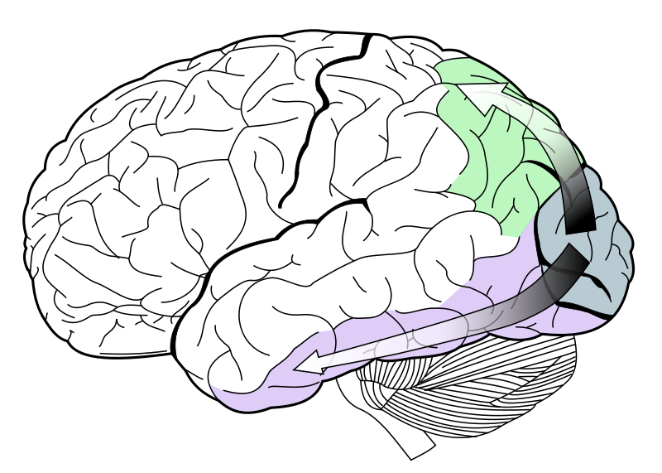
Dorsal and Ventral Streams
Dorsal Stream: “Where” Pathway; associated with motion, representation of object locations, and control of the eyes and arms, especially when visual information is used to guide saccades or reaching.
Ventral Stream: “What” Pathway; associated with form recognition and object representation. It is also associated with storage of long term memory.
Notes:
Tiger shark (Galeocerdo cuvier). Drawing by former FishBase artist Robbie Cada. Public domain image.
Remember that the dorsal stream is on top by thinking of the dorsal fin of a shark.
Image of ventral and dorsal streams under GNU Free Documentation License, v 1.2

Slide 10
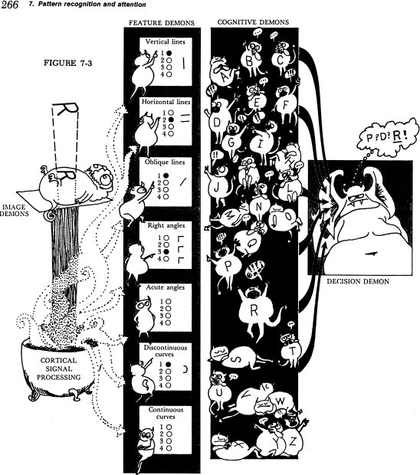
Pandemonium Model of Perception

Slide 11
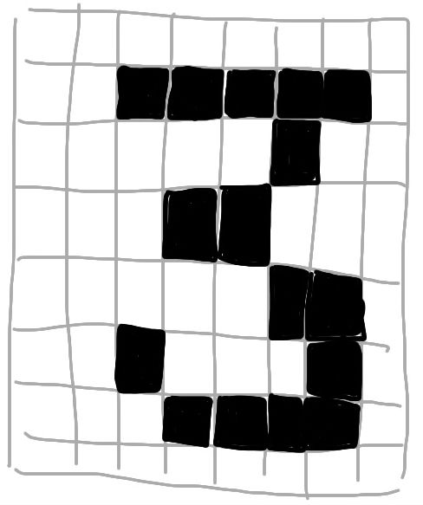

Template matching perception
Looks for overlap of pixels

Slide 12
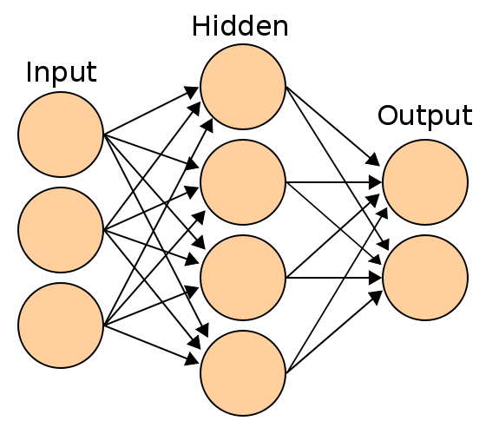
Neural Network Perception
Pixels activate
Input layer
3
Output layer
Identifies
4
Etc.
Notes:
Neural net image Image By en:User:Cburnett [GFDL (www.gnu.org/copyleft/fdl.html) or CC-BY-SA-3.0 (www.creativecommons.org/licenses/by-sa/3.0/)], via Wikimedia Commons

Slide 13
Microsoft Kinect
Watch http://youtu.be/ho8KVOe_y08
Kinect is a depth-finding camera system made for the Xbox 360, but has been used by many other people for lots of fun stuff, some serious, most not.

Slide 14
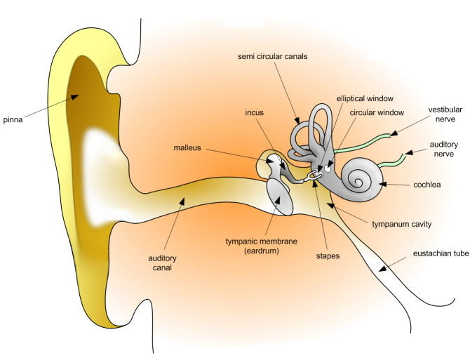
Audition (Hearing)
Notes:
Vibration is transferred to fluid in the cochlea, the hairs in which move, transducing the energy into nerve signals.
By User:Dan Pickard [Public domain], via Wikimedia Commons

Slide 15
How Audition Works
Acoustical energy (sound waves) vibrate the eardrum (in air) or bones (underwater or through your own body, as when you hear your voice)
Localization is done by examining the differences between the sounds in the two ears, somewhat like how depth is done with binocular vision

Slide 16
Echolocation
Biosonar: send out sound, determine spatial information from echo
Bats, toothed whales, dolphins, and two kinds of bird
Humans: http://www.break.com/usercontent/2008/3/The-boy-who-sees-without-eyes-468241
(10 minutes)

Slide 17
Using Touch to See
http://youtu.be/TCM4UBM8wTM
(10 minutes)

Slide 18
Haptics (Touch)
Critical for manipulation of objects, particularly in combination with proprioception.
Sensors are in the skin.
Active perception
  Haptics
  Vision

Slide 19
Olfaction (smell)
Detection of chemicals– no clear energy continuum as there is for light and sound waves.
Some similar chemicals smell different; some different chemicals smell the same.
Much of what we experience as taste is actually smell.
  This is why food tends to taste bland when you have a stuffy nose.
Smelly T-shirt studies
  Women detect immune system compatibility
  Men detect ovulation
Notes:
Cilantro has no taste, only smell.
Wedekind, C., Seebeck, T., Bettens, F., & Paepke, A. J. (1995). MHC-dependent mate preferences in humans. Proceedings: Biological Sciences, 260(1359), 245-249.
Miller, S. L., & Maner, J. K. (2011). Ovulation as a male mating prime: Subtle signs of women’s fertility influence men’s mating cognition and behaviour. Journal of Personality and Social Psychology, 100(2), 295-308.

Slide 20
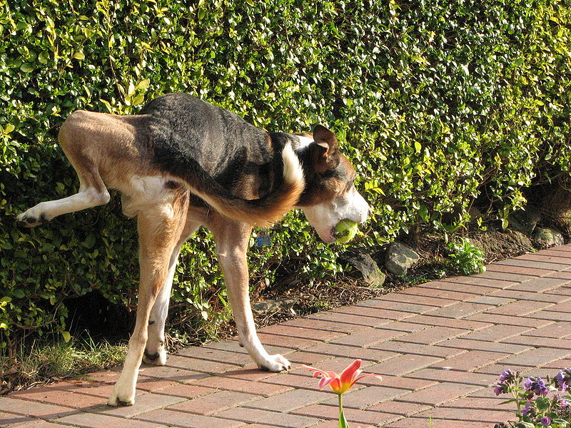
Smell for Animal Communication
Territory
Fertility
Ant pheromone traces
Notes:
Why do male dogs lift their legs to urinate?
By Glen Bowman [CC-BY-2.0 (www.creativecommons.org/licenses/by/2.0)], via Wikimedia Commons

Slide 21
Gustation (Taste)
Chemical receptors in taste buds last for a week or two then wear out.
The tongue detects flavours such as salty, sour, bitter, umami, and sweet.
Pain receptors react to spicy foods.
The experience of food is very complex, involving feel, temperature, taste, smell, and pain.

Slide 22
Kinesthesia, Proprioception, and the Vestibular system
Proprioception and Kinesthesia are how you know where your body parts are and how they are moving
Sensors are in the inner ear, and in muscles.
Phantom Limb
Motion sickness and the vestibular system

Slide 23
Interoception
Perception of hunger, need for digestive elimination, heart rate, the need to sneeze, breathe, or cough, etc.

Slide 24
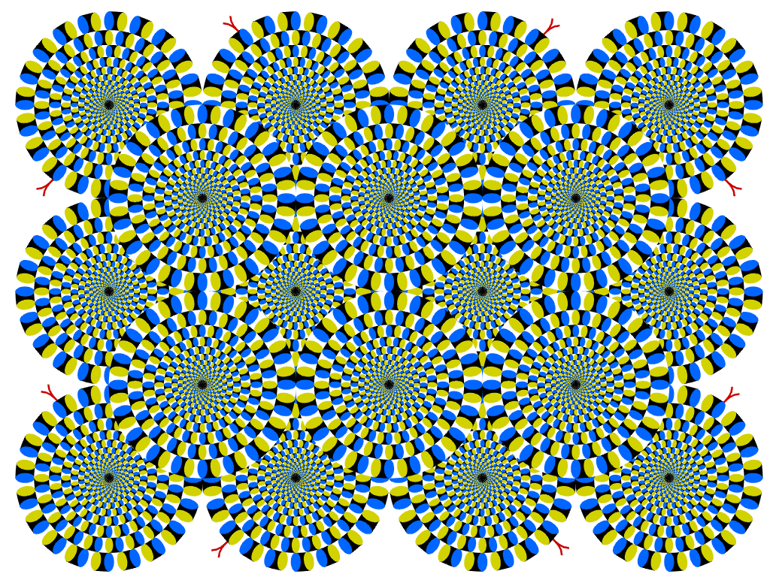
Optical Illusions
Notes:
This thing is not moving!

Slide 25
Beau Lotto TED talk on Optical Illusions
17 minutes
http://www.ted.com/talks/beau_lotto_optical_illusions_show_how_we_see.html

