Slide 1
10
Central Banking & Monetary Policy
Macroeconomics
Curtis, Irvine © 2013

Slide 2
In this chapter we will explain
Central banking and the Bank of Canada
Central banking operating techniques
Monetary policy targets and instruments
Monetary policy rules
The long-run neutrality of money
Monetary policy indicators

Slide 3
Central Banking and the Bank of Canada
A Central Bank:
  is not profit oriented.
  is responsible for design and conduct of monetary policy
Monetary policy objectives:
  Price stability or inflation rate control
  Real GDP = potential GDP
Monetary policy tools:
  Money base control or
  Interest rate setting

Slide 4
The Balance Sheet of the Bank of Canada, 2011
(year-end, millions of dollars)
Assets
Liabilities
Government of Canada securities
Treasury bills 18,546
Government bonds of maturity
<= 3 years 21,178
> 3 years 22,375
Notes in circulation 61,029
Deposits
Government of Canada 1,512
Banks & other CPA members 107
Other 862
Foreign central banks −
Advances to members of the
Canadian Payment Association 81
Securities from Resale Agreements 1,448
Foreign currency deposits 12
Other assets 607
Foreign currency liabilities −
Other liabilities 737
Total 64,247
Total 64,247
Source: Statistics Canada , CANSIM Table 176-0010 and author’s calculations

Slide 5
Central Banking and the Bank of Canada
The central bank:
  Is the source of monetary base, MB
  Creates MB by buying bonds & issuing central bank liabilities (notes & central bank deposits)
Bank of Canada balance sheet shows:
  Govt bonds = 90+% of assets
  Notes in circulation = 90+% of liabilities (largest part of MB)
Bank of Canada:
  Also promotes stability in financial markets, e.g.
  “purchase and resale agreements” to provide liquidity when needed.
  Guidance on future course of interest rates
  Comments on financial matters like household indebtedness etc.

Slide 6
Central Bank Operating Techniques
To control Monetary Base (MB) & Money supply (M)
  Reserve requirements
    Legally Required Reserve Ratio (rr = rr*)
    Determines money multiplier in money supply function
  Open-market operations
    Buy or sell govt bonds
    Determine monetary base (MB) in money supply function
  Bank rate setting
    Sets cost of borrowing monetary base (MB)
    Signals monetary policy change

Slide 7
Central Bank Operating Techniques
Open Market Operations
Central bank purchase or sale of govt bonds in open financial markets:
  Open market purchase → ↑assets & ↑liabilities →↑monetary base (MB)
  Open market sale →↓assets & ↓liabilities → ↓monetary base (MB)
Open market operations: main instrument for longer term management of monetary base (MB)

Slide 8
Central Bank Operating Techniques
An Open Market Purchase
Central Bank |  | Commercial Banks
Assets | Liabilities | Assets | Liabilities
1. Open-market purchase: $100 million govt bonds from a pension fund
Govt bond +100 | Cheque +100 | No change
2. Pension fund deposits proceeds of bond sale in a commercial bank
No change | Central bank cheque +100 | Pension fund deposit acct +100
3. Central bank cheque clears giving commercial banks $100 million cash
No change | Cheque o/s -100 | Central bank cheque -100 | Pension fund deposit acct 100
 | Cash issued +100 | Cash reserves +100
If rr = 0.05,
excess reserves +95

Slide 9
Central Bank Operating Techniques
An Open Market Purchase (cont’d)
Central Bank |  | Commercial Banks
Assets | Liabilities | Assets | Liabilities
4. Commercial banks increase lending and create new deposits
No change |  | Loans +1900 Deposits +1900
5. Final effect of central bank open market purchase
Govt bond +100 Cash (ΔMB) +100 | Cash reserves +100 Loans +1900 +2000 | Deposits +2000
6. Change in Money Supply
ΔM = ΔMB/rr = $100/0.05 = $2,000

Slide 10
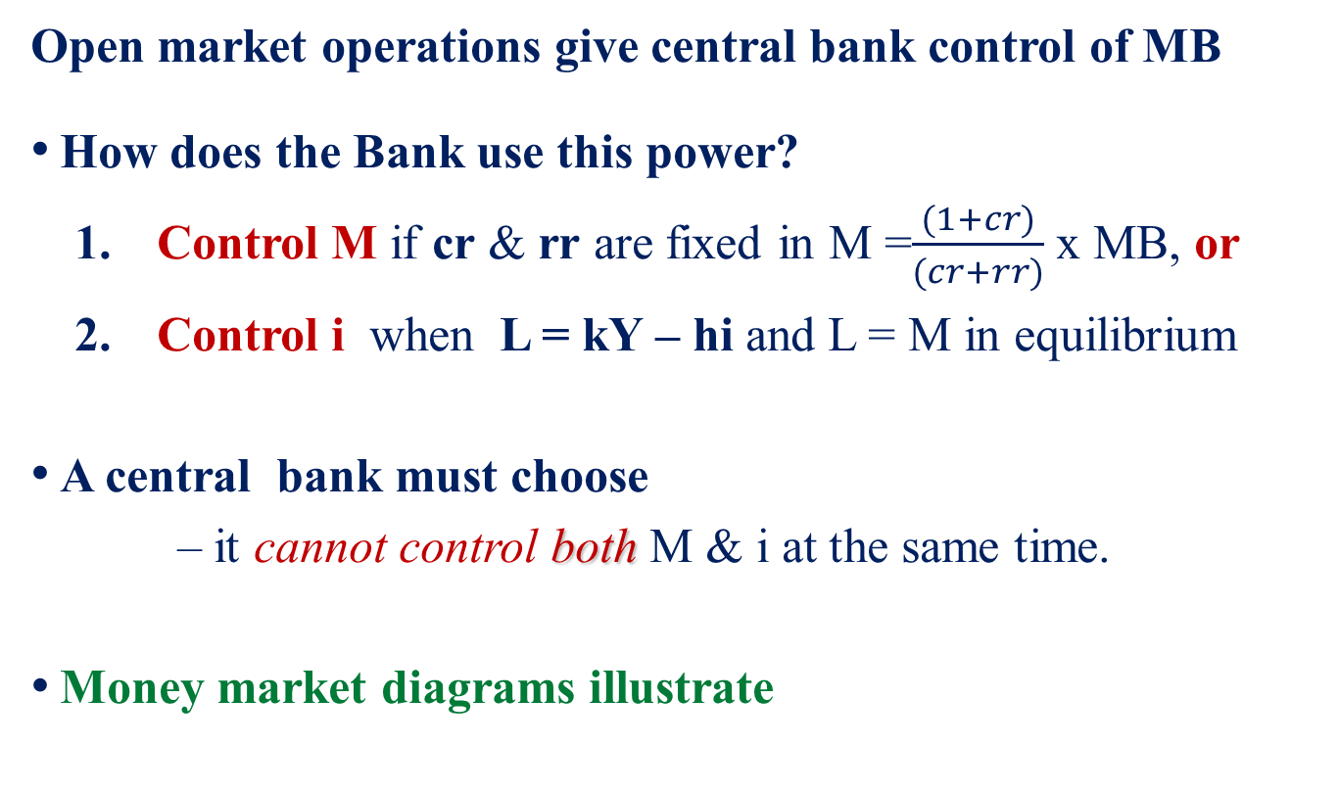
Central Bank Operating Techniques
Money Supply Control or Interest Rate Control
Open market operations give central bank control of MB
How does the Bank use this power?
  Control M if cr & rr are fixed in M =$\frac{(1+cr)}{(cr+rr)}$ x MB, or
  Control i when L = kY – hi and L = M in equilibrium
A central bank must choose
– it cannot control both M & i at the same time.
Money market diagrams illustrate

Slide 11
Central Bank Operating Techniques
Money Supply Control
Interest Rate i
A money supply fixed by the central bank results in an interest rate determined by the demand for money ∆L →∆i
M₀/P
i₁
∆i
i₀
∆L
L(Y₁)
L(Y₀)
Set M₀/P
M/P

Slide 12
Central Bank Operating Techniques
Interest Rate Control
Interest Rate i
An interest rate fixed by the central bank results in a money supply set by the demand for money.
∆L → ∆M
∆L
Set i₀
M/P
∆M
L(Y₁)
L(Y₀)
M₀/P
M₁/P
M/P

Slide 13
Monetary Policy Targets and Instruments
Three potential targets:
  Control the foreign exchange rate (er), or
  Control the money supply (M), or
  Control the inflation rate (π)
A central bank must choose:
    It can only pursue one of these targets at a time.

Slide 14
Monetary Policy Targets and Instruments
Exchange rate target:
Central bank buys/sells foreign exchange to fix the exchange rate.
Foreign exchange operations → ∆MB, ∆M & ∆i
Money supply target:
Central bank sets i & MB to fix M
Inflation target:
Central bank sets i & MB → π* the target inflation rate.

Slide 15

The Bank of Canada’s monetary policy target:
  An inflation rate (π*) = 1% - 3% on the CPI
The Bank of Canada’s monetary policy instrument:
  The overnight interest rate (onr)
  The overnight rate is the interest rate large financial institutions receive or pay on loans of MB from
  one day until the next

Slide 16
Monetary Policy Targets and Instruments
Bank of Canada Monetary Policy:
Set the overnight rate → AD required for inflation target π*
Set operating band for overnight rate = onr +/- 25 basis points. (100 basis points = 1%)
Overnight rate set by Bank drives commercial bank prime rates, mortgage rates, rates on business and home equity lines of credit

Slide 17
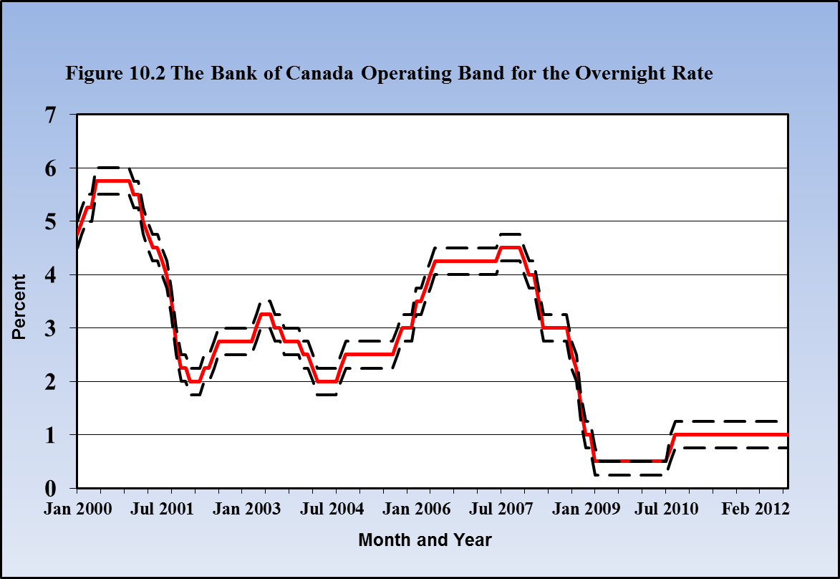
Monetary Policy Targets and Instruments
The Overnight Rate in Canada
Overnight rate
Operating band
Source: Statistics Canada, CANSIM Series V 39076, V39077, V39079

Slide 18
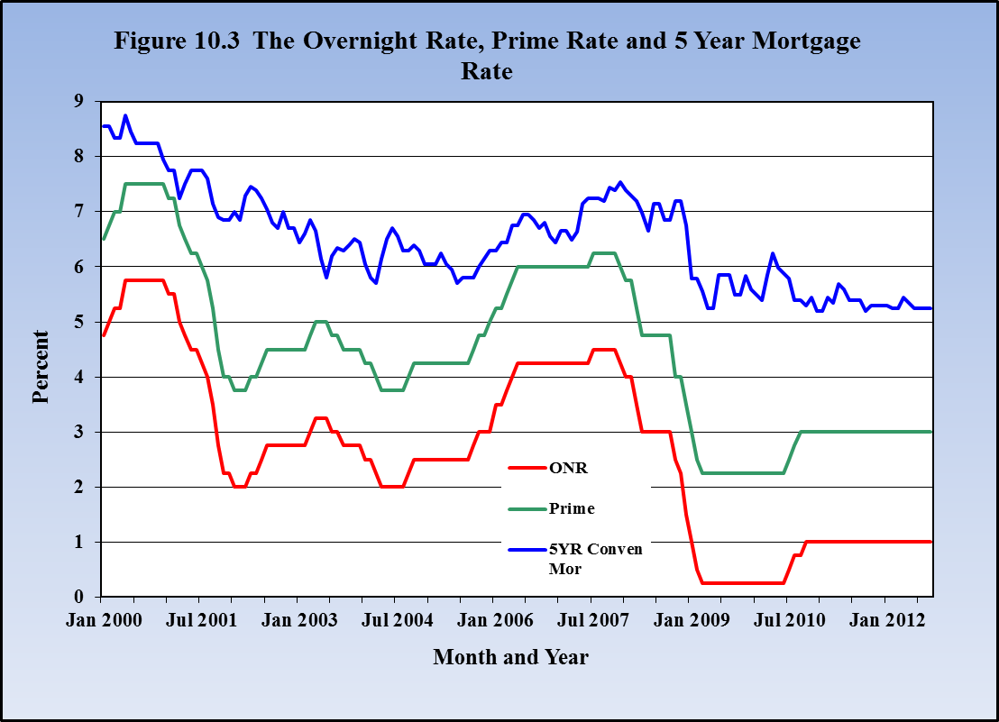
Monetary Policy Targets and Instruments

Slide 19
Monetary Policy Targets and Instruments
The Market for Overnight Money:
Zero settlement balance in Bank of Canada required for banks
Settlement balance < 0 banks must borrow:
  From other banks @ onr, or
  From Bank of Canada @ Bank Rate = onr + 25bp
Settlement balance > 0 banks may:
  Lend to other banks @ onr, or
  Hold in Bank of Canada @ Deposit Rate = onr – 25bp
Bank Rate-Deposit Rate spread→ market for overnight funds

Slide 20
Monetary Policy Targets and Instruments
The Market for Overnight Money:
Bank of Canada sets ONR and intervenes in overnight market to maintain ONR within its target band:
To offset upward pressure on the rate:
SPRA: special purchase & resale agreement
Buy securities today, sell back tomorrow
Price difference → onr
Temporarily increases monetary base, MB
To offset downward pressure on the rate
SRA: sale and repurchase agreement
  Sell securities today and buy back tomorrow
  Price difference → onr
  Temporarily reduces monetary base, MB

Slide 21
The Market for Overnight Money:
Bank of Canada sets overnight rate target onr₀
Short term increase in demand for MB
Upward pressure on overnight rate
SPRA to offset the upward pressure
Temporary (overnight) increase in MB → MB₁
SRA would offset downward pressure on overnight rate.
Interest Rate
MB₀
MB₁
Bank Rate
Overnight rate
onr₀
Deposit rate
SPRA
D₁
D₀
MB₀
MB₁
Monetary Base (MB)

Slide 22
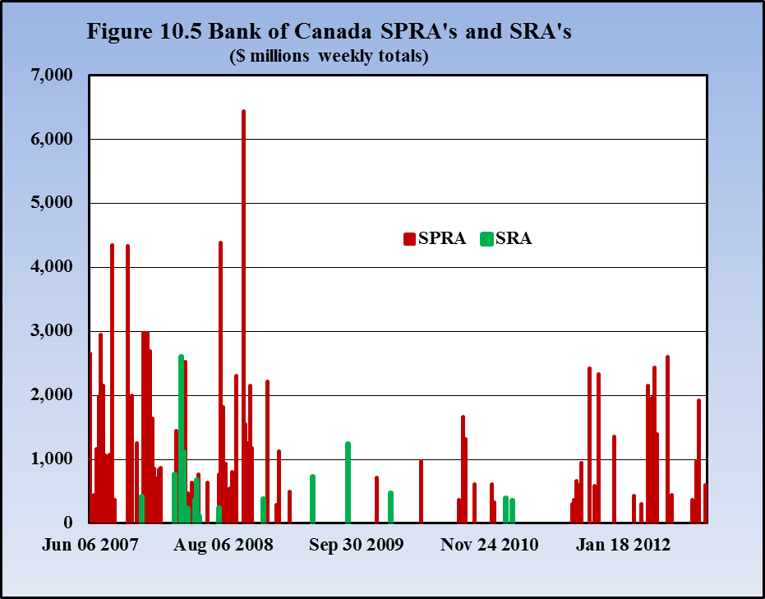
Source: Statistics Canada, CANSIM Table 176-0073

Slide 23
Monetary Policy Rules
Policy rules:
  describe how a central bank sets its policy instrument to achieve its policy target(s)
Central Bank policy target(s):
  pursue Y = Y_{P} and/or π = π*
Policy instrument is the interest rate
Policy actions:
  set interest rate based on knowledge of transmission mechanism → AD → Y = Y_{P} (when equilibrium π = 0)
  ∆i to offset ∆A → stabilize AD → Y @ Y_{P}

Slide 24
Monetary Policy Rules
A Simple ‘Taylor Rule’ when equilibrium π = 0:
  Policy target: Y = Y_{P} (assumes equil π = 0)
  Policy instrument: i ≡ ONR
  Current conditions set i = i₀ → AD required for Y = Y_{P,}
  React to transitory ∆A by ∆i to stabilize AD
  React to fundamental ∆A by resetting for i₀
Then set: i = i₀ + β(Y – Y_{P})
  If Y = Y_{P} → i = i₀
  If Y≠ Y_{p} → ∆i = β(Y – Y_{P})
  If persistent ∆A → ∆i₀

Slide 25
Monetary Policy Rules
A Taylor Rule in action: i = i₀ + β(Y – Y_{P})
1) To offset a transitory increase in A by ∆A to A’
Interest rate setting
Y & AE
i
Y_{p}
AE
Y_{P}
Y=AE
AE’(i₀)
i = i₀ + β(Y – Y_{P})
AE(i₀)
AE’(i₂)
i₂
i₀
β(Y₂-Y_{P})
A(∆i)
A’(i₀)
∆A
A’(i₁)
A(i₀)
∆Y
∆Y
∆Y
45⁰
Y_{p}
Y₂
Y
Y_{P}
Y₂
Y
As time passes after i ↑→ i₂ , ∆A → 0, Y → Y_{P} & i → i₀
2) To offset a persistent ∆A reset i₀→i = i₁ + β(Y – Y_{P}) to keep Y = Y_{P}

Slide 26
Monetary Policy Rules
A ‘Taylor Rule’ when equilibrium π > 0:
Policy targets: π = π* and Y = Y_{P}
Policy instrument: i ≡ ONR
Then set i = i₀ + a(π – π*) + β(Y – Y_{P})
  i₀ ‘equilibrium’ onr for π = π*, Y = Y_{P}
  a and β are the weights Bank gives to π* and Y_{P} targets
  (Y – Y_{P}) is also an indicator of future ∆π

Slide 27
Monetary Policy Rules
The Effective Lower Bound (ELB)
The interest rate policy instrument is constrained by an effective lower bound (ELB) i.e.
i ≥ 0
Monetary policy in deep financial crisis &/or recession:
    Lowering i is first policy response
    If i → 0 but crisis/recession continues --
    Additional policy instruments needed

Slide 28
Monetary Policy Rules
The Effective Lower Bound (ELB)
As the onr → 0 additional policy instruments a needed, e.g.:
  Moral suasion – assure financial markets of continuing central bank support
  Quantitative easing – increase financial market liquidity by expanding central asset holdings → putting more cash into the financial system
  Credit easing – provide central bank liquidity to specific markets by targeted purchases of assets from those markets e.g. commercial paper and mortgage markets

Slide 29
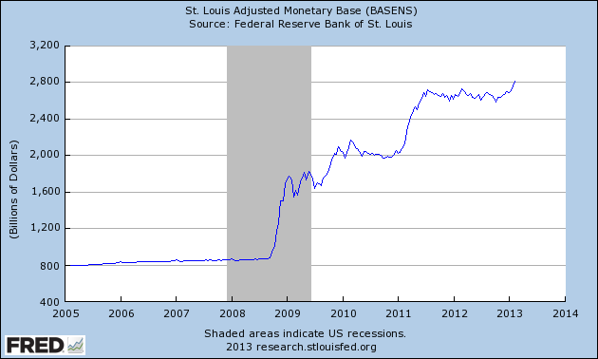
US Monetary Policy at the Effective Lower Bound (ELB)
Quantitative Easing:
Once the fed funds rate had been reduced to the effective lower bound in 2008
Fed used ‘Quantitative Easing’, large scale purchases of government bonds to
increase the Monetary Base to try to stimulate the economy
In ‘normal times’, pre 2008, the Fed increased the monetary base slowly to meet
the demand for money at its target interest rate as the economy grew.

Slide 30
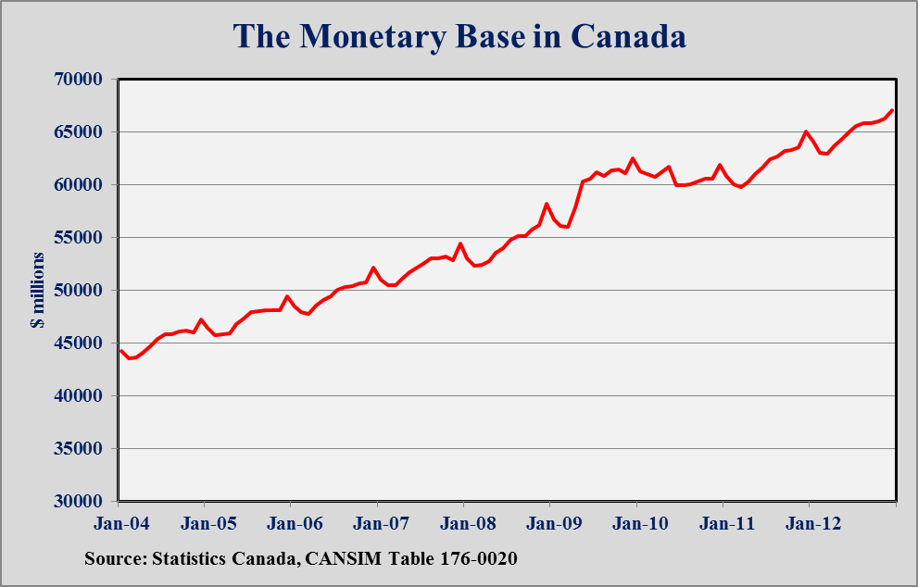
Unlike the US Fed:
Bank of Canada did not need to use Quantitative Easing.
The Canadian economy recovered more quickly after 2008-09
Monetary base grew as needed to meet the demand for money
at the onr’s set by the Bank.

Slide 31
The Long-Run Neutrality of Money
Money is neutral if:
∆M has no effect on output or other real variables.
The ‘Quantity Theory of Money’: MV = PY
  M ≡ money supply
  V ≡ velocity of circulation of money (1/k)
  P ≡ price level
  Y ≡ real GDP
Assume V & Y constant in long run
∆M → ∆P but ∆Y = 0 → money is neutral
Monetary policy can change P & π but not Y_{P}

Slide 32
Monetary Policy Indicators
  Indicate the monetary stimulus or restraint on AD
Some monetary policy indicators:
Nominal & real interest rates [(i) & ( i – π)]
Exchange rates [er]
Rates of growth of money aggregates [∆M1+/M1+ & ∆M2+/M2+]
Money supply growth minus GDP growth [∆M/M - ∆Y/Y]

Slide 33
Chapter Summary
Central banks operate to affect behaviour of commercial banks and financial markets
Central banks have responsibility for monetary policy
The Bank of Canada is Canada’s central bank. It is the source of the monetary base and acts as banker to banks and government.
Monetary policy in Canada is the responsibility of the Bank of Canada. The Bank uses its control of the monetary base and interest rates to promote economic stability at Y_{P} and π*
Central banks have three main operating techniques: reserve requirements, open-market operations, and bank rate setting.
Central banks can control monetary base or interest rates but not both simultaneously

Slide 34
Chapter Summary
The Bank of Canada sets an inflation rate target and uses the overnight interest rate as its policy instrument.
The Bank of Canada uses SPRAs and SRAs to maintain its overnight rate setting
A monetary policy rule like a Taylor Rule for setting i provides a useful description of central bank policy actions
Changes in the policy instrument (i) change AD through the
transmission mechanism
Quantitative easing: central bank securities purchases to increase the monetary base and financial system liquidity
Credit easing: central bank purchases of assets to provide liquidity to specific markets
In the short run fixed or sticky prices allow the central bank to change real interest rates, AD and Y

