Slide 1

Factorial Designs:
Understanding RTs with Ease
(if you please)
Research Methods
PSYC/NEURO 2001 Mon and Weds 14:30-17:30
Jordan Schoenherr
Carleton University

Slide 2
Overview of Lecture
Review of Paradigms (and Change)
The history of (additive) factors
Factors in the modern experimental context

Slide 3
Scientific Change (Reviewed)
“Those who don't know history are destined to repeat it.”
- Edmund Burke

Slide 4
Paradigm Change
Previously, we considered psychology emergence as a science from other areas of research
  Philosophy,
  Physiology and Medicine,
  Linguistics
We also noted that psychological research progresses through the introduction of new ideas and instruments

Slide 5
Paradigm Change

Slide 6
Laudan’s (1977) Theory of
Paradigm Change
Method
Data
Theory
… RTs begin to suggest that processing speed increases with time.
… of recording time introduced and improved creating a ‘temporal knife’.
… specifically, RT allows for the inference of stages of processing…

Slide 7
What’s a Factor
In order to understand what a factor represents, we will consider the development of chronometer, the measurement of time,
The history of concepts adopted by chronometer will demonstrate why we are so concerned with factors and what they represent.

Slide 8
A (Brief) History of Response Time
“Those who don't know history are destined to repeat it.”
- Edmund Burke

Slide 9
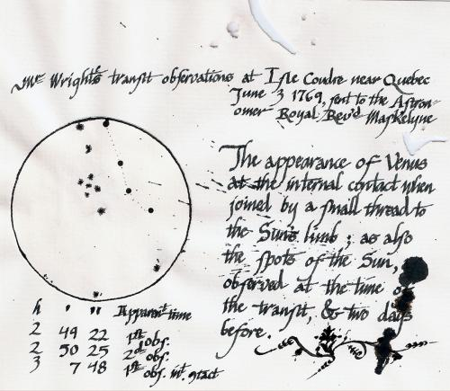
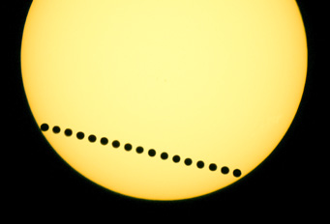
Intersubjectivity and Calibration
In 1823, Friedrich Wilhelm Bessel noted an ‘involuntary constant difference’.
  First recorded in his log of observations: “…it will be necessary to make allowances for those Errors where [my assistance] Observations… are intermixed with mine,” (August, 1795)
This notion became known as the personal equation

Slide 10
The Personal Equation
An understanding of this difference would become central to experimental psychology (Boring, 1950).
  Initial belief that there was a ‘right method’ for observation that would eliminate errors,
  Sufficient training would result in accurate observations.
In the context of psychology, systematic deviation (or miscalibration of) observers could be used as evidence of general underlying psychological processes and individual difference.

Slide 11
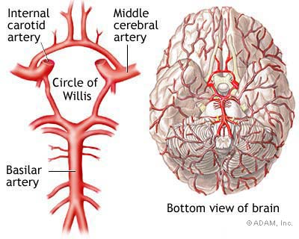
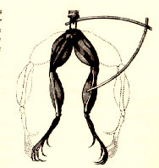
From Dualism to Monism
Researchers began to shift from a dualism in the study of mind-brain and began to understand the relationship of neuronal impulses (and conductance) to thought and behaviour (e.g., Willis c.1664 and Galvani – c.1771),
Animal spirits as intermediary concept allowing for retention of dualism.

Slide 12
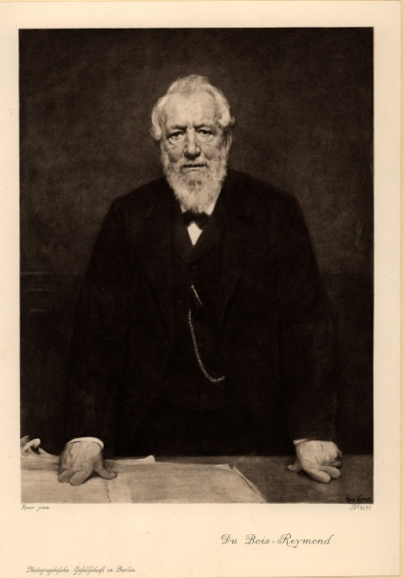
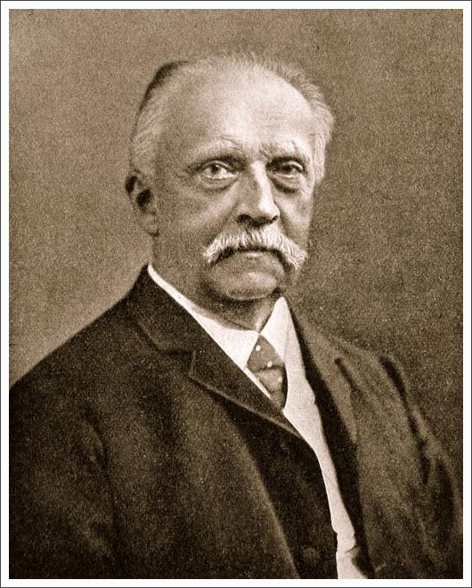
Early Studies of Physiological Time
1835: Johannes Müller – nerve conductance small and could not be measured;
1845: du Bois-Reymond – developed a general technique for measuring conductance;
1849: Hermann von Helmholtz – implemented variant of technique.

Slide 13
Helmholtz’s Mental Measurements
Method 1: Two nerves were stimulated (in a frog), varying in their distance for a nerve-muscle junction. Time that the muscles took to contract was measured and the difference between the contractions determined conductance.
Method 2: Skin was stimulated (in humans) at varying distances from the brain and participant responded with a gesture. Difference between gesture time determined conductance.

Slide 14
Donder’s Method
Donder’s questioned whether “…it ever be possible for the function of the mind to be included in the chain of transforming forces?” Concluding that “[a]s far as we can see now, there is no prospect of this” (p. 413);
For Donder’s “In form and nature mental function has a character completely of its own…” (ibid).
Donder’s notes that physiology, can provide insight - processes of chemical reaction;
  There are multiple stages, each feeding into another
  e.g., starch → sugar → ethanol

Slide 15
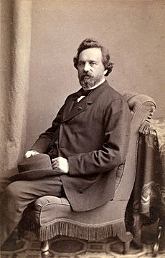
Donder’s Method
Donder’s reasoned that motor/sensory conductance experiments could be paralleled with experiments examining the speed of thought;
Donder’s then outlines the succession of stages (12) that must occur from sensation, to perception, to ‘will’, and then to ‘movement’.

Slide 16
Donder’s Method
He assigns the global time and thereby seeks a meaningful decomposition…. But how can this be done in a principled way?

Slide 17
Donder’s Subtraction Method
Donder’s basic observation was that task complexity was related to response time:
Response!
Respond!
Response!
Recognition!
Respond when X!
Response!
Recognition!
Choice!
X or Y?

Slide 18
Physiological Time: Historical Side Note
Adolphe Hirsch, an astronomer at Neuchâtel observatory, used the Hipp Chronoscope and the subtraction method to measure physiological response,
He was the first to refer to physiological time, the time ‘between the stimulation and the beginning of the movement’ – the precursor to our use of reaction time.
  Wilhelm Wundt would later adopt this term himself in the first (formal) textbook of psychology

Slide 19
Use of Subtraction Method
Donder’s method was widely used for several decades - relatively unchallenged (Sternberg, 1969)
Not surprisingly, it provided the foundation for studies that used introspective observation,
  The method was criticized (and jettisoned) due to this relationship,
  It was later revived during the rise of early cognitive methods.

Slide 20

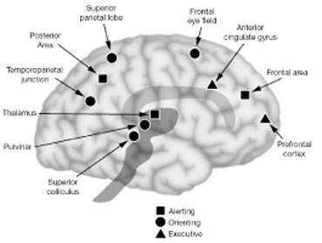
Contemporary Theories
The notion of ‘controlled’ operations as a unitary phenomena has also been challenged,
  Posner (who also used the subtraction method) has sought to dissociate various kinds of attention:
    Orientation, Switching, and Executive

Slide 21

Contemporary Methods
Attentional Network Test (ANT)
  Participants respond to central arrow target that points left or right,
  Congruent condition – target and flankers require same response,
  Incongruent condition – target and flankers require different response
For instance, to get a measure of executive control you would subtract the congruent condition from the incongruent condition to get a measure of conflict.

Slide 22
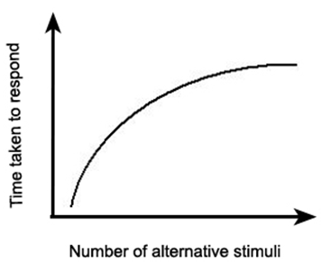
Later Extensions: Hick’s Law
Hick’s (1952) Law notes that the number of response alternatives matters, and RT represents a logarithmic function.

Slide 23
Later Extensions: Hick’s Law
  Conclusion: Upper limit to how many alternatives can be considered, after which no increases in RT are observable.
  …but… is there a single set of mental stages that are only affected by one factor?

Slide 24

Later Extensions: Additive Factors Method
Sternberg noted that many kinds of tasks could be adequately described by an additive factors approach
  Each stages builds on another, each takes additional time depending on the relevant features of the task
  i.e., motor deficits will interfere with a motor stage, ‘noise’ will interfere with the detection stage.

Slide 25
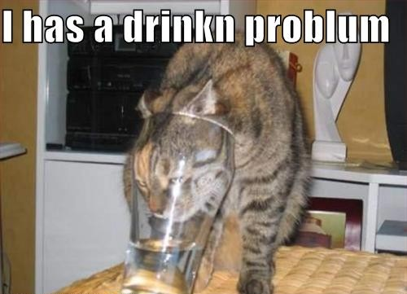
Later Extensions: Additive Factors Method
Problem with the subtraction method: stimulus features can interact if they are processed by more than one stage,

Slide 26
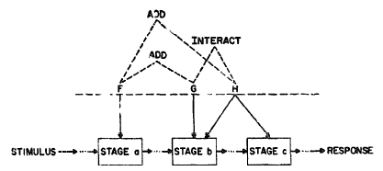
Later Extensions: Additive Factors Method
Factors are additive if they have an independent effect, and do not influence a common stage (e.g., F),
Factors can non-additive when they interact, influencing more than one stage (e.g., H).

Slide 27
Later Extensions: Additive Factors Method
Non-additive factors are considered overadditive (i.e., they are values over those that you would expect with additivity).

Slide 28
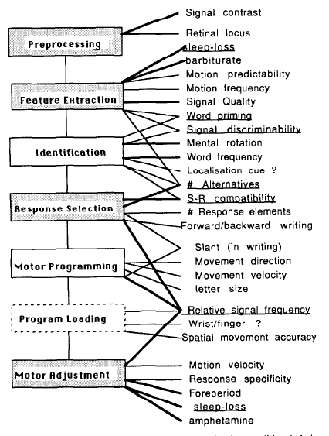
Sanders (1990)
Sanders (1990) has noted numerous factors that are additive and non-additive,
For instance, signal quality makes it harder to see(/hear/etc.) something but once we have processed the signal, that property no longer affects other cognitive processes.

Slide 29
Sanders (1990)
In contrast, the number of response alternatives (e.g., A or B vs. A or B or C or D) interacts with more than one stage
  It takes us longer to extract and compare features as there are more possible matches,
  It (also) takes us longer to respond because the number of possible correct answers is greater.

Slide 30
Example: Music and Multiple Choice
Imagine that we want to examine the effect of music on your ability to answer multiple choice questions while taking a quiz,
First, we want to consider three different levels of difficulty (Factor 1):
  One blank (to fill in),
  Two blanks (to fill in),
  Three blanks (to fill in).
Second, we consider whether the presence or absence of music (Factor 2) affects your time to respond.

Slide 31
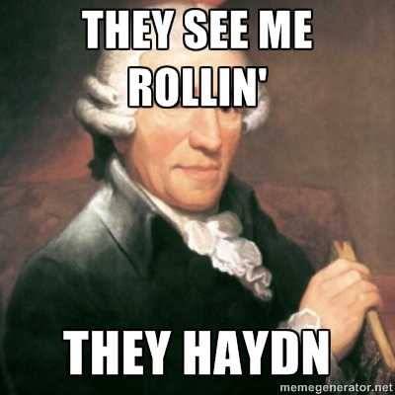
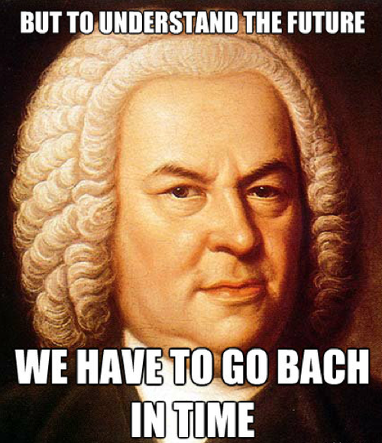
Example: Music and Multiple Choice
Imagine that we want to examine the effect of music on your ability to answer multiple choice questions,
First, we want to consider three different levels of difficulty (Factor 1):
  One blank (to fill in),
  Two blanks (to fill in),
  Three blanks (to fill in).
Second, we consider whether the presence or absence of music (Factor 2) affects your time to respond.

Slide 32
Additivity
In our first experiment, we observe that there is a constant, systematic increase in the time to respond when music is present
  This suggests that an additional stage of processing is involved, and
  That this stage of processing is associated additive.

Slide 33


Example: Music and Multiple Choice
Now, imagine that we think that specific genres of music (due to their rhythmic – or arrhythmic) complexity require more processing,
Again, we manipulate whether music is present or absent, this time we include acid jazz (or metal).
Notes:
http://www.lorenweisman.com/wp-content/uploads/2013/01/music-memes-musicbizmemes-music-consulting-batman-slap-music-consulting-millennium-music.jpg

Slide 34
Overadditivity
In our second experiment, we observe that there systematic increase in the time to respond when music is present but that the better is greater than predicted by additivity,
  This suggests that more complex music is affecting more than one stage of processing.

Slide 35
Contemporary Approaches
In terms of refining cognitive models, RT has been central (e.g., Schiffrin & Schneider, 1997; Logan, 1988),
Multiple process accounts of cognition use patterns of RT to distinguish between these two systems
  Automaticity – a shift from controlled (conscious) operations to automatic (unconscious) operations
    Defined by decreases in RT with training
Underaddivity also suggests a more complex pattern… people can sometimes respond faster with more complex tasks.

Slide 36
Contemporary Approaches
Saling and Philips (2007) noted an apparent conflation of physiological response time and (mental) reaction time in some models:
  They claim that some authors talk of ‘faster’ thinking,
  Instead, they note that automatic processing is more efficient: “although automatic behaviour is faster at a behavioural level, it is not faster at a neural level” (p. 10).

Slide 37
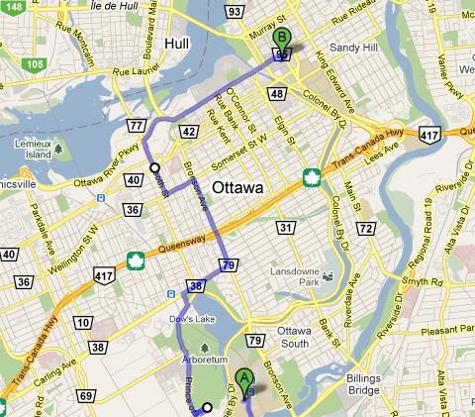
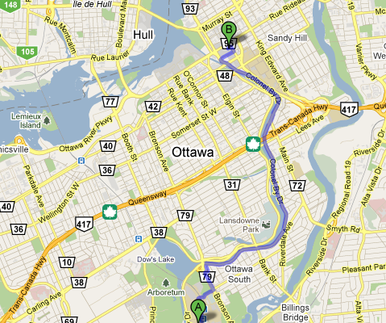
Current Models of Automaticity
Contemporary accounts have suggest that rather than FASTER processing, automaticity is best construed as more EFFICIENT (Saling & Philips, 2007)
  Consider driving from Carleton to the Rideau Centre: one day you might try one route (30 min) and the next another (14 min)
  The infrastructure (e.g., roads) is the same but you learn through feedback which path gives you the desired outcome

Slide 38
No Factor is an Island
Remember, factorial designs are everywhere and are not simply used in the context of cognition,
What factors could be manipulated in the context of these research areas….?
  Social and I/O Psychology,
  Personality,
  Neuroscience

Slide 39
No Factor is an Island
Social Psychology and Industrial-Organizational
Personality Psychology
Neuroscience

Slide 40
No Factor is an Island
Social Psychology and Industrial-Organizational | Group Size (e.g., small, medium, large) Affective states (e.g., neutral, aggressive, euphoric)
Personality Psychology | Personality traits (e.g., Big Five) Mindfulness/Attentiveness (e.g., high- or low-mindfulness) Social context (e.g., group v. individual)
Neuroscience | Neurotransmitters (e.g., Epinephrine, dopamine, etc. – present/absent) Brain injury (e.g., location (frontal v. occipital) or severity) Age (e.g., 16-20, 21-25, 26-30)

Slide 41
Factorial Designs
“A client is to me a mere unit, a factor in a problem.”
- Sherlock Holmes (Arthur Conan Doyle)

Slide 42
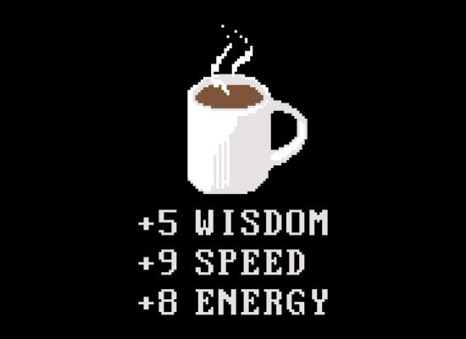
Experimental Factors
A study wherein only one factor has been manipulated is referred to as a single-factor design.
Any design that has more than one variable is referred to as having a factorial design.
Consider the studies we have examined thus far, what studies are single factor and what studies have a factorial design?

Slide 43
Experimental Factors
Single-Factor Design | Factorial Design

Slide 44
Experimental Factors
Single-Factor Design | Factorial Design
McGinnies – Critical Words / Non-Critical words | Dutton and Aron – Bridge crossed; Gender of experimenter.
Nairne et al. – Survival Processing | Our Experiment – (Validity); Ethical status; Ethical Focus.
Shepard and Metzler – Degree of rotation | Gaertner et al. – Negative Feedback; Self schema.

Slide 45
Experiments in Student Life
Liguori and Robinson (2001) wanted to assess the factors that affect response time (RT) during driving.
Examines the effect of
  Caffeine: decrease response time,
  Alcohol: increases response time.
What factors do we want to manipulate / control?

Slide 46
Experiments in Student Life
Liguori and Robinson (2001)
  Within-subject design, double-blind, randomized procedure,
  Consumed a caffeine pill and then alcohol,
  45 min elapsed between consumption and task,
  Performed a variety of tasks, e.g.
    Driving simulation,
    Choice reaction time, and
    Divided attention tasks.

Slide 47
Experimental Factors
 | No Caffeine | 200 mg Caffeine | 400 mg Caffeine
No Alcohol
Alcohol
Factor A: Amount of Caffeine
Factor B: Alcohol

Slide 48
Experimental Factors
 | No Caffeine | 200 mg Caffeine | 400 mg Caffeine
No Alcohol
Alcohol
2 Levels
3 Levels

Slide 49
Experimental Factors
 | No Caffeine | 200 mg Caffeine | 400 mg Caffeine
No Alcohol | 625 ms | 600 ms | 575 ms
Alcohol | 675 ms | 650 ms | 625 ms
Main Effect of Caffeine (Factor A₁):
650 ms
Main Effect of Caffeine (Factor A₂):
625 ms
Main Effect of Caffeine (Factor A₃):
600 ms
Do Not Consider Levels of Factor B

Slide 50
Experimental Factors
 | No Caffeine | 200 mg Caffeine | 400 mg Caffeine
No Alcohol | 625 ms | 600 ms | 575 ms
Alcohol | 675 ms | 650 ms | 625 ms
Do Not Consider Levels of Factor A
Main Effect of Alcohol (Factor B₁):
600 ms
Main Effect of Alcohol (Factor B₂):
650 ms

Slide 51
Experimental Factors
 | No Caffeine | 200 mg Caffeine | 400 mg Caffeine
No Alcohol | 625 ms | 600 ms | 575 ms
Alcohol | 675 ms | 650 ms | 625 ms
Interaction considers all factor-levels
RT for those with no alcohol or caffeine
RT with no alcohol and 200 mg caffeine
RT with no alcohol and 400 mg caffeine
RT with alcohol and no caffeine
RT with alcohol and 200 mg caffeine
RT with alcohol and 400 mg caffeine

Slide 52
Experimental Factors
 | No Caffeine | 200 mg Caffeine | 400 mg Caffeine
No Alcohol | 625 ms | 600 ms | 575 ms
Alcohol | 675 ms | 650 ms | 625 ms

Slide 53
Your Experiment’s Factors
Our experiment on the ethical reasoning also conforms to the same factorial design,
When we examine proportion correct (accuracy) we can determine what factor affected performance.
 | Self | Social | Principle
Ethical | 0.50 | 0.50 | 0.70
Unethical | 0.47 | 0.37 | 0.20

Slide 54
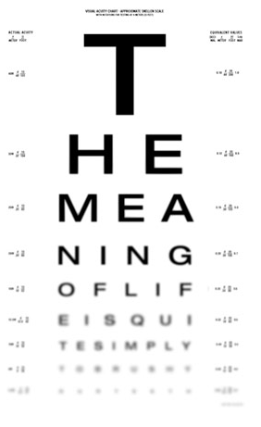
Experiments in Student Life
Liguori and Robinson (2001) obtained a
  Main effect of Caffeine: the RT between levels of caffeine differed (decreased).
  Main effect of Alcohol: the RT between levels of alcohol differed (increased).
  Interaction of Caffeine and Alcohol: the RTs differed from one another depending on BOTH the amount of caffeine consumed and the amount of alcohol consumed.

Slide 55
Types of Factorial Designs
‘Pure’ Designs: Between- or within-Subjects Factors.
Mixed Designs: Between- and within-Subjects Factors.
‘Combined Strategies’: True independent variable and quasi-independent variable.
  Participant (or stimulus) characteristics (e.g., personality; word frequency),
  Time.

Slide 56
W6L2 Review
Factorial designs represent a frequently used paradigm through the history of experimental psychology,
Response time has been frequently used to identify what factors affect cognition; factors can be seen as things that can be experimentally manipulated or controlled,
Factorial design can be communicated with numbers, e.g., 3x2x3

Slide 57
Announcements
After the lecture, I will post the survey for the review class
  General areas that you feel you need assistance in,
  Specific question that you would like addressed
Prior to next class, I will also post the corrections to quiz questions for your review.
Final exam date (Carleton) June 26th, 14:00

