Slide 1

Between- and Within-Subjects Designs:
More Bang for your participant buck
Research Methods
PSYC/NEURO 2001 Mon and Weds 14:30-17:30
Jordan Schoenherr
Carleton University

Slide 2
Announcements
Online survey will be released for review session Weds. Complete it by Sunday afternoon (14:00) so that we can address any questions you have.
  https://www.toofast.ca/takesurvey.php?SurveyID=6979
Course evaluation (online)
Supplemental quiz available (Friday, 17:00) will cover all the material up to the last lecture.
  I will take the last 5 quizzes you complete
  Only recommended for those that had an Internet problem

Slide 3
Overview of Lecture
Reasons for selecting different experimental designs.
Between-Subjects Design.
Within-Subjects Design.
Similarities and Differences.

Slide 4
Within- and Between-Subjects Design
“. Let it be your constant method to look into the design of people's actions, and see what they would be at, as often as it is practicable; and to make this custom the more significant, practice it first upon yourself.”
- Marcus Aurelius

Slide 5
Experimental Design
In an experimental design, we compare the scores from each treatment condition to examine a) whether there is variation between conditions, and b) whether that variation is systematically different (i.e., statistically significant).
In any given study, we might want to adopt a particular approach given the nature of the phenomena being studied.

Slide 6
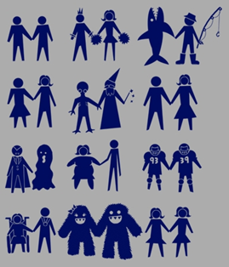
Population Characteristics
Recall our discussion of participant selection.
Ideally, we want to randomly sample from the general population and obtain a representative sample.
Consider Rubin’s study: What would happen…?

Slide 7
Population Characteristics
How we administer a treatment can radically affect our results.
Thus, when selecting a research design we need to be mindful of the manner in which we manipulate our independent variable.

Slide 8
Non-Experimental Design
Differential research | The comparison of pre-existing groups (e.g., male v. female)
Non-equivalent Groups | Groups are formed in advance (e.g., UofO v. Carleton)
Non-equivalent Control Groups (e.g.) | Groups are formed in advance, treatment is given to each group

Slide 9
Experimental Designs: Between-Subjects
Between-Subject Design
Within-Subject Design

Slide 10
Experimental Designs: Between-Subjects
Between-Subject Design | Comparing scores on a test or measurement scale from separate groups that are assigned to different treatment conditions.
Within-Subject Design

Slide 11
Experimental Designs: Between-Subjects
Independent Variable
Dependent Variable
Recall Total
Trees,
Social,
_____,
Sister.
e.g., 2 correct
Time
Words with ‘e’
Words with same meaning
For many experiments, the researcher has a choice. Will participants be tested in only one condition or will they be tested in all conditions?

Slide 12
Experimental Designs: Between-Subjects
Independent Variable
Dependent Variable
Group A
Recall Total
e.g., 2 correct
Words with ‘e’
Words with same meaning
Group B
Recall Total
e.g., 4 correct
Between-subjects or independent-measures experimental design. An experimental design using separate, independent groups of individuals for each treatment condition being compared.

Slide 13
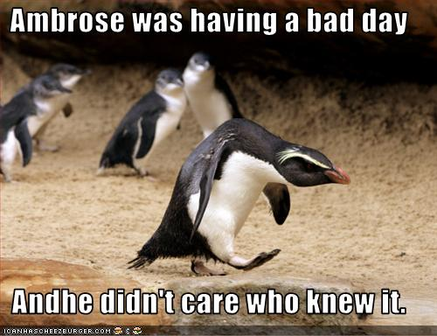
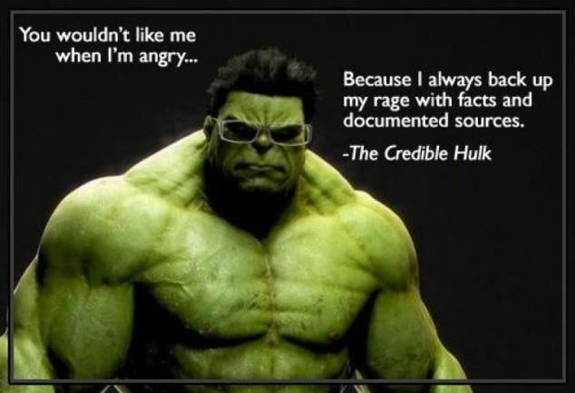
Between-Subjects Designs
Adoption of a between-subjects design is usually the result of reactivity to a treatment:
  Milgram’s experiments
    Participants relative location to experimenter varied
  Capilano Bridge and epinephrine experiments
    Participants required to walk across different bridges.
  Individual- v. Collective-Self
    Participants receive different feedback.

Slide 14
Advantages and Disadvantages of
Between-Subjects Design
Advantages | Might limit fatigue or boredom effects. No practice effects. Less likely to identify nature of study.
Disadvantages | Limited power (requires a larger number of participants than other designs: Type II Error, i.e., accidentally affirm null hypothesis). More expensive – more labour intensive. Individual differences and environment might inflate/hide effect.

Slide 15
Experimental Designs: Between-Subjects
Independent Variable
Dependent Variable
Recall Total
Trees,
Social,
_____,
Sister.
e.g., 2 correct
Words with ‘e’
Time
Rhyming
Words with same meaning
Theoretical motivation lead researchers to create designs with more than two levels of a given independent variable.

Slide 16
Experimental Designs: Between-Subjects
Between-Subject Design
Within-Subject Design | Comparing scores on a test or measurement scale from the same groups that are assigned to the same treatment conditions.

Slide 17
Experimental Designs: Within-Subjects
Independent Variable
Dependent Variable
Recall Total
e.g., 2 correct
All Participants
Words with ‘e’
Words with same meaning
Recall Total
e.g., 4 correct
Within-subjects or repeated-measures experimental design. A research design in which the different groups of scores are all obtained from the same group of participants.

Slide 18
Advantages and Disadvantages of
Within-Subjects Design
Advantages | The inclusion of multiple measures from each participant reduces the impact of individual differences. More power (requires a smaller number of participants than other designs). Less expensive – less labour intensive.

Slide 19
Advantages and Disadvantages of
Within-Subjects Design
Disadvantages | Cannot use for certain research questions. participants have to be blind to the hypotheses levels of the independent variable include participants from mutually exclusive groups (e.g. men and women, reading disability vs. control…) Designs more complex.

Slide 20
Threats to Internal Validity
If participants receive multiple treatments during an extended period, then multiple threats to validity arise:
  Environmental variables,
  History,
  Maturation,
  Instrumentation,
  Regression,
  Testing effects.

Slide 21
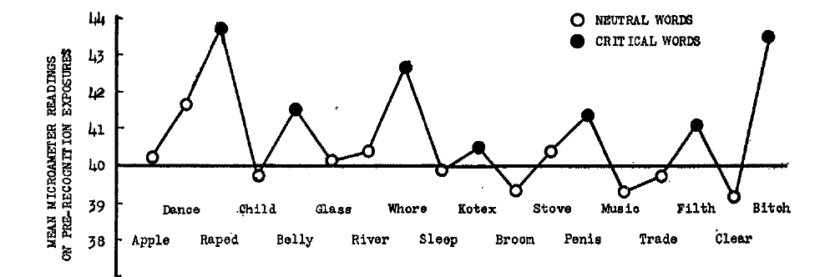
McGinnies (1949): Results
Notice that as we continue to present the stimuli to the participants, their responses decrease by the end of the session.

Slide 22
Impact of Time Scale on Validity
Unconscious defence mechanism and word presentation.
The impact of first trustworthiness ratings or ethical syllogisms on subsequent ratings.
The effect of treatment on scurvy.
  Environmental variables
  History
  Maturation
  Instrumentation
  Regression
  Testing effects

Slide 23
Impact of Time Scale on Validity
Unconscious defence mechanism and word presentation.
The impact of first trustworthiness ratings or ethical syllogisms on subsequent ratings.
The effect of treatment on scurvy.
No matter the time scale, researchers must worry about testing effects. Which level of the IV will be presented first?
  Environmental variables
  History
  Maturation
  Instrumentation
  Regression
  Testing effects

Slide 24
Counterbalancing
A within-subjects design is a procedure to minimize threats from order effects and time-related factors by changing the order in which treatment conditions are administered from one participant to another so that the treatment conditions are matched with respect to time.
The goal is to use every possible order of treatments with an equal number of individuals participating in each sequence.

Slide 25
Counterbalancing
Participants | Time 1 | Time 2
1 | Trust Ratings | Reasoning
2 | Reasoning | Trust Ratings
3 | Trust Ratings | Reasoning
… | … | …
n | Reasoning | Trust Ratings

Slide 26
Experimental Designs: Within-Subjects
Independent Variable
Dependent Variable
Group A
Recall Total
e.g., 2 correct
1
Words with ‘e’
2
2
Group B
Words with same meaning
Recall Total
e.g., 4 correct
1
Half of the participants would receive the shallow encoding instructions first, the other half would receive the deep encoding instructions first.

Slide 27
Increase in Number of
Possible Treatments
Number of treatments | Possible orders
2 | 2
3 | 6
4 | 24
5 | 120
6 | 720
n! = n x (n – 1) x (n – 2) x (n – 3)…

Slide 28
Counterbalancing and Latin Squares
Partial counterbalancing. A system of counterbalancing that ensures that each treatment condition occurs first for one group of participants, second for one group, third for one group, and so on, but does not require that every possible order of treatment conditions be used.
Latin square. An N×N matrix where each of N different items appears exactly once in each column and exactly once in each row. Used to identify sequences of treatment conditions for partial counterbalancing.

Slide 29
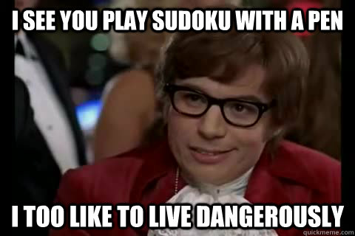
Latin Square Design
If we have three levels of a factor in a repeated measures design, we have 9 (3x3) possible order combinations!
  e.g., encoding schema
Instead of using all possible orders, we can use a latin square design.
 | Block 1 | Block 2 | Block 3
G1 | Meaning | Letter (‘e’) | Rhymes
G2 | Rhymes | Meaning | Letter (‘e’)
G3 | Letter (‘e’) | Rhymes | Meaning

Slide 30
Randomization
A system of stimulus presentation which randomizes the order of presentation of the stimuli for each participant.
It is used to minimize order effects in within-subjects designs.
  List all stimuli for an experiment
  Randomize the order of the stimuli
  Present the stimuli
  Repeat for each block and each participant

Slide 31
Comparing Between- and Within-Subjects Designs
“Hence, even in the domain of natural science the aid of the experimental method becomes indispensable whenever the problem set is the analysis of transient and impermanent phenomena, and not merely the observation of persistent and relatively constant objects.”
- Wilhelm Wundt

Slide 32
What’s in a design?
A prominent concern is the design-type effect (e.g., Erlebacher, 1977):
  The magnitude, or existence, of an effect is dependent upon the experimental design used to assess it.
Many experiments have demonstrated that design-type interacts with independent variable that is being manipulated.

Slide 33
Do Between- and Within-Subjects Design Always Differ?
Although design consideration will factor into what method we select, the most robust phenomena can be demonstrated in both kinds of studies.
Again, remember that individual differences will play a larger role in between-subjects designs relative to within-subjects designs.

Slide 34
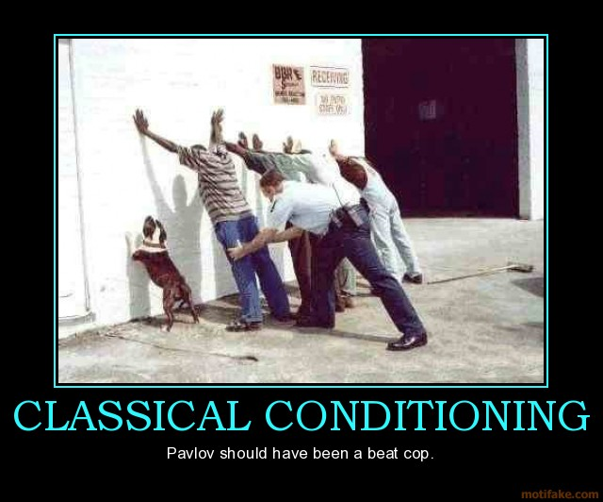
What’s in a design?
Grice and Hunter (1964) conducted an experiment on effects of conditioned-stimulus intensity and design type on the classically conditioned eyelid responses.
They examined whether there is a relation between stimulus intensity in classical conditioning and experimental design?

Slide 35
What’s in a design?
“Such use of the [within-subjects] design usually involves, often implicitly, the assumption that the treatment effects obtained are the same as would be obtained with a larger, less economical random groups design. As suggested in the case of stimulus intensity, this is not necessarily so.” (p. 248, Grice & Hunter, 1964)

Slide 36

Methods: Classical Condition
Classical conditioning (Pavlovian learning).
Unconditional stimulus (US) → Unconditional response (UR)
Talking to friends → Feel happy
Conditional stimulus (CS) + US → UR
Check Facebook + “Talking to friends” → Feel happy
CS → Conditional Response (CR)
Facebook → Feel happy

Slide 37
Methods: Grice & Hunter (1964)
Classical conditioning – Eyelid Conditioning
Unconditional stimulus (US) → Unconditional response (UR)
Air puff → eye blink
Conditional stimulus (CS) + US → UR
Buzz + air puff → eye blink
CS → Conditional Response (CR)
Buzz → eye blink

Slide 38
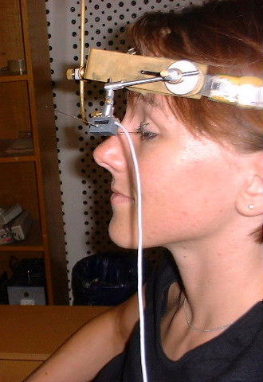
What’s in a design?
Participants randomly assigned to the following groups:
  Between-subjects: (100 trials)
    Group 1: soft buzz
    Group 2: loud buzz
  Within-subject: (50 trials/buzz)
    Group 3: soft buzz and loud buzz

Slide 39
Results (trials 41-100)
On these trials, participants receive either a soft or loud tone.
% conditional response

Slide 40
Results (trials 41-100)
On these trials, participants receive either a soft tone….
% conditional response
…or a loud tone.

Slide 41
Conclusions
Stimulus intensity has a great impact on classical learning in a within-subjects design, but not in a between-subjects design.
What does this mean? One must be very cautious when interpreting the results of a single study. Replication is highly desirable.

Slide 42
W6L1a Review
Design considerations are determined by the nature of the independent variable we are manipulating.
Between- and Within-Subjects designs have different strengths and weaknesses depending on the treatment.
Although Between- and Within-Subjects designs can yield the same results, there are instances where this is simply not the case.

Slide 43
Announcements
Final exam date June 26th, 14:00.
  I will post location information on CULearn once it is available.
Chapter on Single-Subject Research Design will not be on the final exam
  The content in the lecture slides that pertains to this will be examined

