Slide 1

Experimental Design:
From Chaos to Control
Research Methods
PSYC/NEURO 2001 Mon and Weds 14:30-17:30
Jordan Schoenherr
Carleton University

Slide 2
Exam Schedule
PSYC/NEURO 2001
  Wednesday, June 26th (14:00)
  Location TBA
  Considering eliminating a Chapter from the final exam

Slide 3
Overview of Lecture
History of the modern experimental design.
Basics of experimental design.
Simple and complex experiments.

Slide 4
The Continuum of Internal Validity
Experimental, Quasi-experimental and Non-experimental designs are located on a continuum based on the degree of control that we have over variables.
Experimental
Highest degree of control;
Confounds limited;
Meaningful conclusions can be drawn.
Quasi-experimental
Moderate control over variables;
Confounds present;
Can cautious interpret results.
Non-experimental
No control;
Many potential confounds;
Difficult to generalize results.

Slide 5
The Idea of a Controlled Experiment:
Scurvy to Crops
“It is the weight, not numbers of experiments that is to be regarded.”
- Isaac Newton

Slide 6
Why Isn’t Descriptive Research Enough?
As we noted in the last class, descriptive research has many factors that are varying simultaneously with those of interest.
In case studies, where a treatment or event occurs, there are many other events that could have also caused a change in behaviour.
  Thus, arguments made from case studies have low internal and external validity.
  Observations may be biased.
6

Slide 7
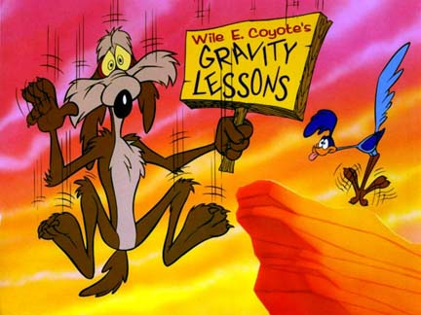
Experimental Research Design
Science is a method of knowledge acquisition that:
  addresses empirically solvable problems;
  uses systematic empiricism;
  allows its findings to be publicly verified.
Experimental research designs are the pinnacle of systematic empiricism.

Slide 8
Experimental Research Design
A research strategy that attempts to establish the existence of a cause-and-effect relationship between two variables by manipulating one variable while measuring the second variable and controlling all other variables.
  Rubin (1970) – Relation between love and gazing
Gaertner et al., (1999) – Individual self v. collective self
Nairne et al., (2007) – Encoding schema

Slide 9
The Case of Scurvy
One of the first records of a controlled experiment was that of Sir James Lind’s (1753) studies on scurvy (cf. Hughes, 1975).
  Starts with lethargy, depression, spots and progresses to open wounds, neuropathy, and death.
“On the 20th of May, 1747, I took twelve patients in the scurvy, on board the Salisbury at sea. Their cases were as similar as I could have them. They all in general had putrid gums, the spots and lassitude, with weakness of the knees. They lay together in one place…,” (p. 342).

Slide 10
Experiments in Scurvy:
Shiver Your Timbers
Importantly, Lind has participants with equivalent symptoms.
Lind then assigned two men to six different courses of treatment:
  “Two of these were ordered each a quart of cyder a day… Two others took two spoonfuls of vinegar three times a day… Two others had each two oranges and one lemon given them every day.,”(p.342)

Slide 11

Scurvy Scuttled
When Lind examines the outcome, he can draw a conclusion about which treatment has the greatest effect:
  “…the most sudden and visible good effects were perceived from the use of the oranges and lemons; one of those who had taken them, being at the end of six days fit for duty,” (p. 343)

Slide 12
Beer and Statistics: Use Responsibly
“He was a wise man who invented beer.”
- Plato (never said this)

Slide 13
Statistics: It’s Good for You!
Up to now, we have considered statistics as a de-natured technique, its principles would seem to be the product of a few abstract thinkers,
The development of statistical test has been repeatedly guided by real world problems,
Box (1987) noted that mathematics is generally guided by deductive logic, whereas statistics provides considerable inductive insight.

Slide 14
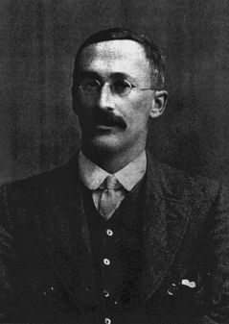

My Goodness, My Guinness!
Has the prospect of doing statistics driven you to drink?
Historically, drinking drove William Sealy Gossett to statistics (for money),
Although initially small, within 40 years Guinness had expand product to 1.5 million barrels, shipping them to both Ireland and England.

Slide 15
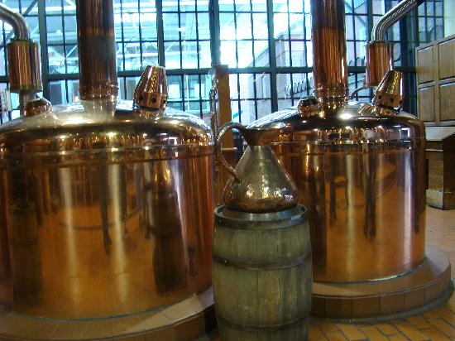

My Goodness, My Guinness!
Brewing was traditionally an apprenticeship, rigidly conforming to techniques,
With the needs of mass production, the Guinnesses decided to become scientific: hiring chemists
Qualities of the beer were used as guides:
  ‘rub’ and ‘condition’ of the hops,
  ‘texture’ of the barley
Certain quantitative properties of the barley (e.g., resin) where associated with the qualitative properties (e.g., condition).

Slide 16
From Quality to Quantity
The volume of data that they accumulated presented a problem when they noticed variation,
Gossett was faced with the problem of quality control when he started work at Guinness:
  Is the variation between Batch 1 and Batch 2 significant?
Gossett studied error
  How could Gossett apply error to testing?

Slide 17
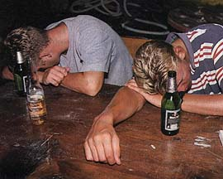

My Goodness, My Guinness!
In order to protect their business, Guinness had a no publication policy,
To get around this Gossett published his work as Student, giving it its name –Student’s T-Test

Slide 18
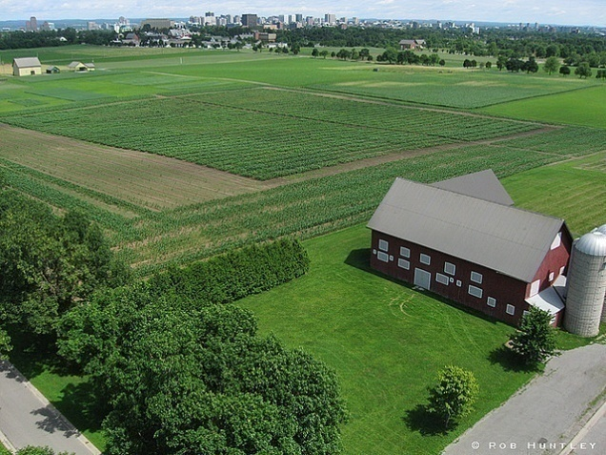
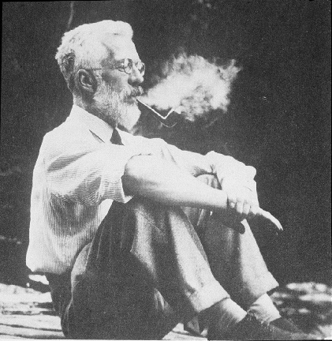
Ronald A. Fisher and the
Modern Experimental Method
Speaking of crops…
Crop yield is another area of experimentation,
  e.g., The Experimental Farm
R. A. Fisher was initially employed as a statistician to determine the factors that provided the best crop yields with existing data.

Slide 19
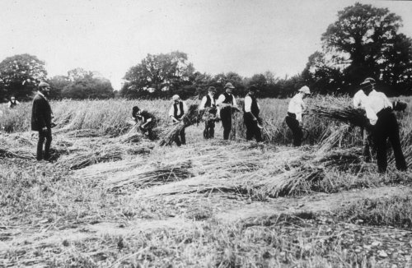
Ronald A. Fisher and the
Modern Experimental Method
His task was to simply eliminate the variation in yields due to confounding variables.
  Rainfall,
  Weather and temperature,
  Fertility of the soil.

Slide 20
Principles of Experimentation
Using existing techniques (e.g., regression) he soon came to realize that the variability resulting from confounds was larger relative to the variables he wished to study (Fisher, 1921).
In a follow-up study, Fisher (1922) elaborated on the themes of
  Experimental control rather than observation,
  Control of variability by systematic random assignment, and
  Analysis of variance (ANOVA).

Slide 21
Basic Experimental Designs
“Biologically the species is the accumulation of the experiments of all its successful individuals since the beginning.”
- H. G. Wells

Slide 22

Constants and Variables
In an experiment, our goal is usually to control all but a small subset of factors that affect the phenomena we are examining.
Factors that we are not manipulating, but are controlling, are referred to as constants (e.g., room temperature, lighting, presentation rate, experimental software).
Factors that we have control over or want to study are referred to as variables.

Slide 23
Independent Variables
Independent Variable: The variable controlled (and manipulated) by the researcher in order to ascertain a cause-and-effect relationship.
There are three broad classes of independent variables that we can manipulate:
  Environmental,
  Instructional, and
  Invasive.

Slide 24
Independent Variables (IVs)
IV | Properties
Environmental
Instructional
Invasive

Slide 25
Independent Variables (IVs)
IV | Properties
Environmental | Varying the physical or social environment, e.g., lighting levels, confederates.
Instructional | Varying the instruction or information that is available, e.g., encoding instructions, stimuli.
Invasive | Varying the physical state with an intervention, e.g., drugs, surgery, or stimulation.

Slide 26
Degree of Control
Not all factors can be controlled to the same extent.
Treatments or Factors: Can be manipulated on a trial-to-trial basis or in a condition with highest degree of control.
Blocks: Cannot be manipulated to the same degree. We can randomize order in which a treatment is given.
Covariates: Cannot be manipulated. Participants have a particular level (e.g., personality) that is fixed.

Slide 27
Dependent Variables (DVs)
Dependent Variable: The variable that is observed for changes in order to assess the effects of manipulating the independent variable.
Dependents include: i.e.,
  Physiological measures,
  Ratings scales and self-report,
  Behavourial measures.

Slide 28
Control Groups and Placebos
If we consider a given independent variable, it is presented to participants at certain levels, e.g.
  Subject matter: Ancient history or psychology,
  Difficulty of a question: low, intermediate, or high.
In some instances, we are not interested in the levels of a given variable but might simply want to see whether the presence or absence of a treatment has an effect.
  Presence = Treatment or Experimental Group.
  Absence = Control Group.

Slide 29
The Basic Logic of Control
Control of extraneous variables requires:
  Experimental control and/or
  Randomization.
If both requirements are met, a researcher can conclude that the level of a dependent variable is due only to those independent variables that were manipulated.
Reduce or eliminate the third variable problem when we control the presence/absence of a variable through manipulation.

Slide 30
Experimental Designs:
Depth of Processing
“It is not length of life, but depth of life.”
- Ralph Waldo Emerson

Slide 31
Independent and Dependent Variables
To illustrate the nature of independent and dependent variables, consider an encoding manipulation used in a memory study.
Consider Craik and Lockhart’s (1972) levels of processing account that we discussed previously.
If we want to conduct an experiment to determine whether we have two kinds of instructions we have to operationally define ‘shallow’ and ‘deep’ encoding.

Slide 32
From Constructs to Variable
Constructs to be Operationalized
…
[Shallow]
[Deep]
First, we determine two types of encoding instructions that we want to manipulate (i.e., present to participants).

Slide 33
Independent Variable
Independent Variable
We control for other word properties:
Word length;
Word frequency;
Positive / negative associations;
etc.
Words with ‘e’
Words with same meaning
Once we’ve identified our instructions, we then identify words that have certain properties.

Slide 34
Random Assignment
Independent Variable
Item Preference
Words with ‘e’
Short-term memory
Motivation
Words with same meaning
IQ
What about individual participant characteristics?
  Random assign to ensure we reduce the possibility that one group has certain characteristics that account for our results

Slide 35
Dependent Variable
Independent Variable
Dependent Variable
Recall Total
Trees,
Social,
_____,
Sister.
e.g., 2 correct
Time
Words with ‘e’
Words with same meaning
Now that we have a set of stimuli that we have control over and have randomly assigned participants, we can then examine how many words you can remember once we’ve had you rate words with the encoding instruction.

Slide 36
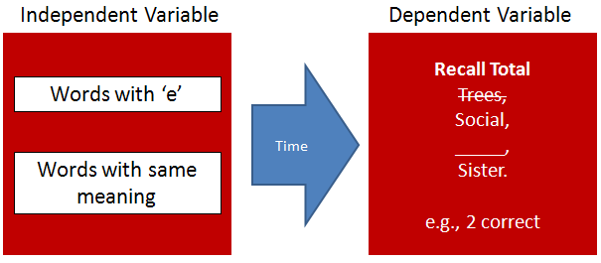
Statistical Control
Preference Ratings
To ensure that our results aren’t a product of another variable (e.g., preference for items) we could use your number recall performance to remove the variance from that variable.

Slide 37
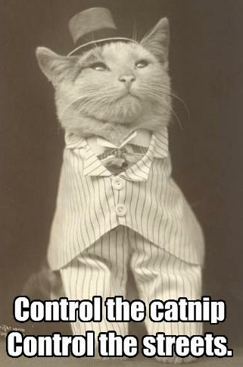
Environmental Variables:
The Limits of Control
Differences in the environment introduce variability.
  Time of day,
  Location,
  Conditions of testing room.
We cannot always control all factors but we can account for them (e.g., covariate).
We make the test conditions for each participant as similar as possible.

Slide 38
Experimental Designs:
Mental Rotation
“What I take from writers I like is their economy - the ability to use language to very effective ends. The ability to have somebody read something and see it, or for somebody to paint an entire landscape of visual imagery with just sheets of words.”
- Mos Def

Slide 39
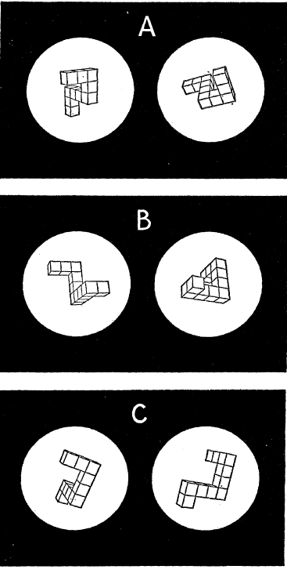
Mental Imagery
A ‘classic’ experiment that illustrates systematic manipulation of an independent variable is provided by Shepard and Metzler (1971)
Shepard and Metzler were interested in mental imagery – a type of mental representation.
What is mental imagery and how can we operationalize it?

Slide 40
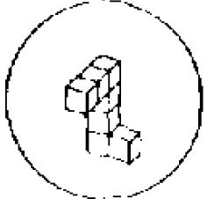
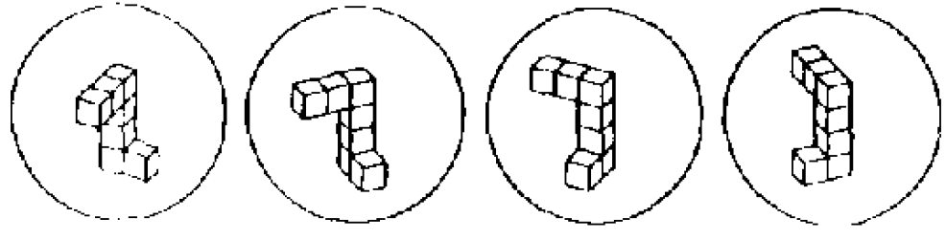
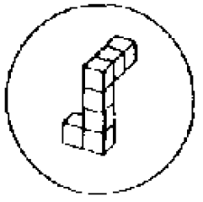
Mental Imagery
Is this image..
…the same as this?
YES!
Shepard and Metzler assume that this mental image can be manipulated and that manipulation takes a certain amount of time.
If mental representations are similar to the physical object they are based upon, then rotating times should be similar: the more rotation that is required, the more time it takes to rotate.

Slide 41
Mental Imagery
Is this image..
…the same as this?
YES!
Shepard and Metzler systematically manipulate the orientation of the object (i.e., degree of rotation) necessary for the participant to ‘check’ to see if two objects are the same.
  Same task used on each trial with same type of target.
  Same procedure used to present the stimuli on each trial.
  Same setting for the presentation of each trial.
  Only degree of rotation was changed.

Slide 42
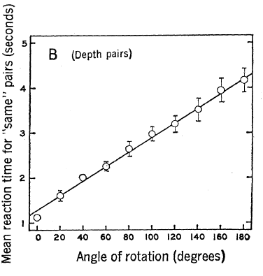
Mental Imagery
Shepard and Metlzer obtained their expected result:
  As the degree of rotation between the two comparison objects increased, so did the amount of time required for comparison.
They were able to conclude that mental rotation appears to be similar to physical rotation.

Slide 43
Types of Experiments
Experimental methods adopt different approaches depending on task requirements and availability of participants.
Next class, we will examine why and when we adopt a within- or between-subjects design.

Slide 44
Emotions:
Physiological Arousal or Intentional
“Any emotion, if it is sincere, is involuntary.”
- Mark Twain

Slide 45
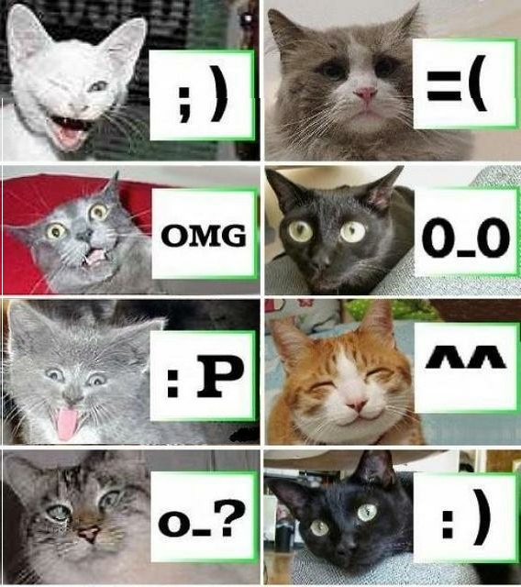
Classes of Variables:
An Emotional Example
Where do emotions come from?
  A physical state, and/or
  An intentional mental state (cognitive).
Schachter and Singer (1962) proposed a two-factor theory of emotion.

Slide 46

Emotion as Physiological Arousal
Evidence for physiological arousal as a source of emotional state was provided by Dutton and Aron (1974).
Male participants walked across Capilano Suspension Bridge or another nearby bridge that was more stable.

Slide 47
Method
Male participants walked across the bridge and were met by either a male or female experimenter and had to perform a thematic apperception test and contact experimenter after filling out the questionnaire.

Slide 48
Method
Dependent measure was the content of the stories participants produced on the TAT and the extent to which those in the high arousal condition would contact the experimenter for a ‘follow-up’.

Slide 49
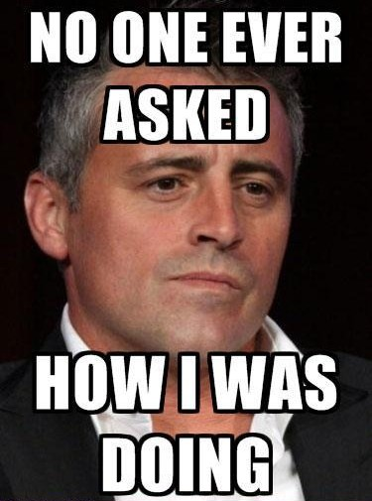
Results: A Bridge too Far?
“Sexual content of stories written by subjects on the fear-arousing bridge and tendency of these subjects to attempt postexperimental contact with the interviewer were both significantly greater. No significant differences between bridges were obtained on either measure for subjects contacted by a male interviewer,” (p. 510).

Slide 50
Schachter and Singer (1962): Purpose
In Schachter and Singer’s (1962) experiment they wanted to examine the contributions of
  Cognitive processes (instructional),
  Social factors (environmental),
  Physiological arousal (invasive).
Participants were told that they would be participating in a study of the effect of vitamin supplements on vision.

Slide 51
Methods
Invasive: Participants were injected with epinephrine in order to cause a state of physiological arousal or a placebo.
Cognitive: Participants were then told there would be:
  a change in arousal (accurate),
  numbness and itching,
  no effect.
Social: A confederate who would either act in:
  a euphoric manner , or
  an angry manner.

Slide 52
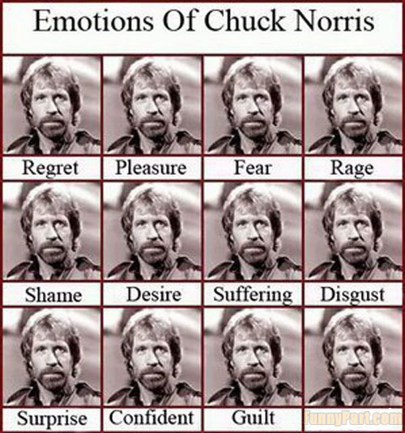
Results
They measure participants’ emotional state through:
  a one-way mirror, and
  self-report.
Participants in the epinephrine condition adopted mood of confederate.
Those in the placebo group did not demonstrate an effect.

Slide 53
Results
Those receiving the placebo felt no arousal.
Those misinformed about the injection effect adopted the mood of the confederate.
Those uninformed about the injection effect attributed it to the confederate.
Those informed about the injections effect attributed it to the injection and exhibited no ‘emotional contagion’.

Slide 54
W5L2 Review
Experiments require:
  Control and manipulation.
  Removal of confounds.
Independent variables are manipulated whereas dependent variables are recorded.
Three classes of independent variables exist.

Slide 55
Announcements
Chapter 14 “Single-Subject Research Designs” removed from testable material.
The concept of single-subject design is still fair game, but it will only consist of that material covered in last week’s lecture on case studies.

Slide 56
Announcements
Exam location information will be released June 15th. I will announce it on WebCT when I have the information.
The supplemental quiz will be released (at the latest) Thurs morning 10:00. Remember: I will keep the last 5 quizzes.
I am still considering dropping your lowest quiz. At present, the class average (Q1-Q4) is 6.5/10. I will be waiting until the supplemental quiz is complete to decide.

Slide 57
Announcements
I will be releasing a survey tomorrow evening to exam what areas you feel you want to know more about. We will cover that material in the second half of the last lecture.
Next ABSTRACT DUE FRIDAY, JUNE 15th (23:59)
Abstract: Follows the same format as last time. I will post an example as before. Use the references presented in-class in my discussion of the results of the Excel assignment (i.e., don’t reference me). Only submit the one page template.

