Slide 1

Correlations:
Drunken Monkeys and Regression Sponges
Research Methods
PSYC/NEURO 2001 Mon and Weds 14:30-17:30
Jordan Schoenherr
Carleton University

Slide 2
Overview of Lecture
More correlations… and monkeys!
Regression and Multiple Regression
Experiment 2 (in brief)

Slide 3
More Correlations
(than you can shake a stick at)
“The more the merrier; the fewer, the better fare.”
- John Palgrave

Slide 4
Explaining Alcoholism
Consider a practical case in abnormal psychology: why do people have addictions?
  They can be learned: My parents, friends, etc. did X and I follow their lead
  They can be innate: There is something about my genes that influences my neurochemistry that makes me more likely to be addicted to something
For our purposes, we’ll focus on an evolutionary argument that explains a particular type of addiction: alcoholism

Slide 5
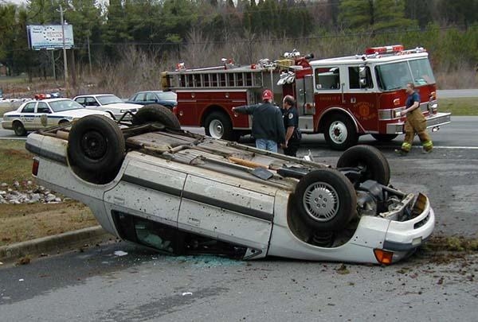
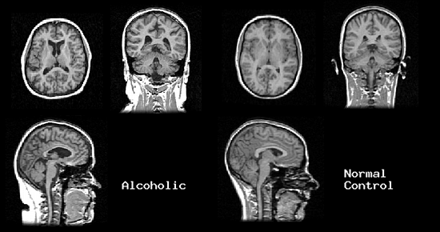
The Effects of Alcoholism
Social: Deaths associated with drunk driving, violent crime, sexual assault, sexual risk-taking behaviour; drain on health care system
Personal: Brain damage, mental disorders; alienation of friends and family, poverty.

Slide 6
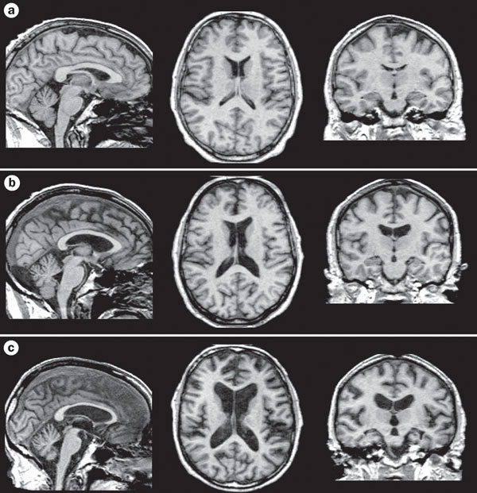
Zahr, et al. (2011):
Alcoholism and Secondary Effects
63 yo Male
Control
59 yo Male
Alcoholism
63 yo Male
Wernicke–Korsakoff syndrome (WKS)

Slide 7
Evolution, Genetics, and Addiction
If alcoholism is a product of innate tendencies (i.e., there is at least a partial genetic component; e.g., Johnson et al., 2006) then in order to find an explanation, we should consider factors that affect our genes.
Again, remember that evolution involved: variation, selection, and replication.
Why would alcohol preference be ‘selected for’ in the first place?

Slide 8
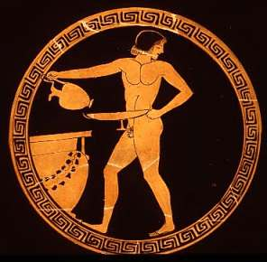
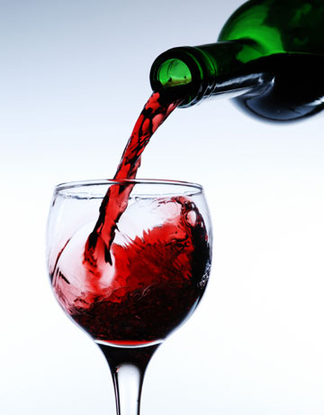
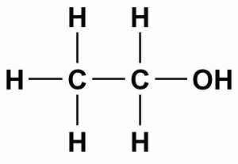
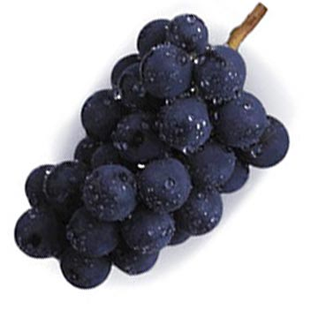
Things I learned in Research Methods:
Where Alcohol Comes From
Fruit (and other food stuffs) contain sugar
Over time sugars ferment, and are transformed into ethanol → alcohol
  Evidence dates back 9,000 bp
Although sugars break down naturally, humans have harnessed this knowledge to purposefully produce alcohol

Slide 9
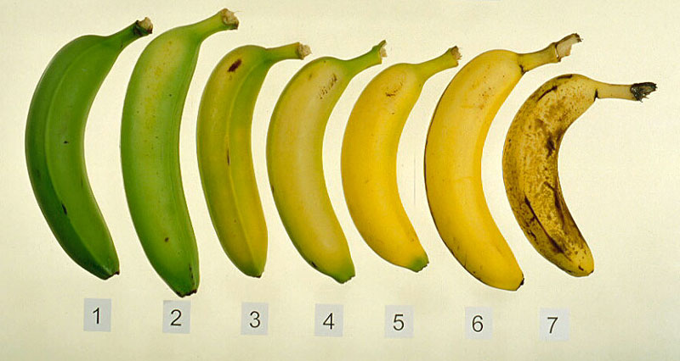
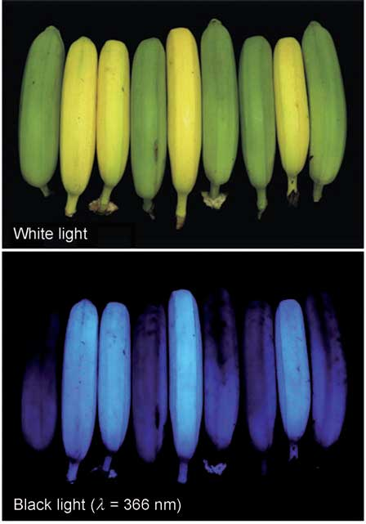
Going Bananas for Evolution
Insects can detect UV light; suggests ripe v. unripe fruit.
In the environment, it is critical to find food.
Animals seek cues to determine whether food is edible (or not)
  Colour, texture and sugar properties suggest that food is ripe
Notes:
Bernhard K. (2008). Blue luminescence of ripening bananas. Angew Chem Int Ed Engl., 47, 8954–8957. doi:10.1002/anie.200803189.

Slide 10
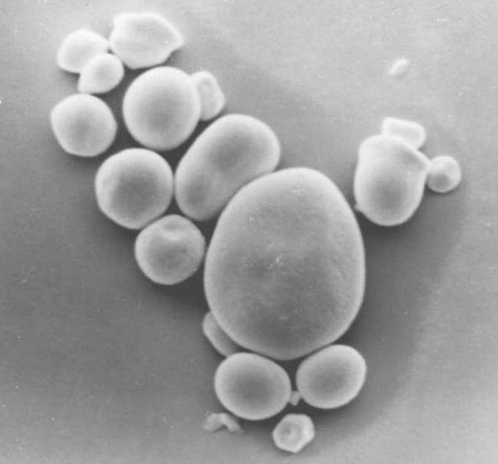
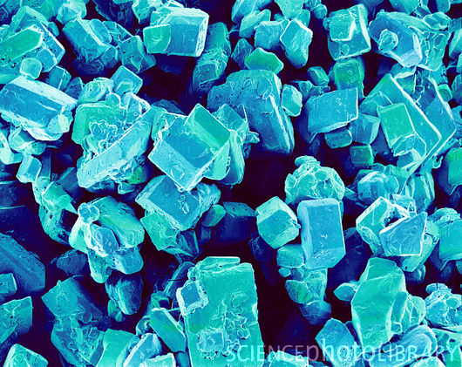
Starch to Sugar
Biochemical processes
Enzymes break down starches into sugars
Further break down results in sugars being converted in to ethanol

Slide 11
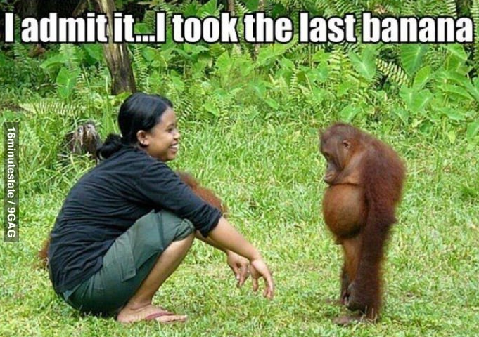
The Evolution of Fruit
When learning, animals create associations between a stimulus (e.g., fruit colour) and a response (e.g., mmmm Tasty)
  Over time, these behaviours could be selected for: those animals whose sensory system allow them to find food with sufficient nutrients and find it tasty will have more energy to produce offspring.
Notes:
http://www.arwrath.com/content/5/53056.jpg

Slide 12
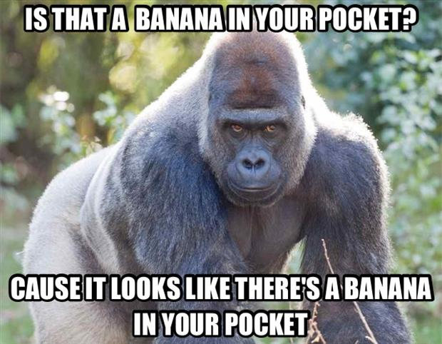
The Evolution of Fruit
Evolution does not select things because they are ‘good’, rather only those things that work are selected
  Sometimes, we get ‘free riders’: behaviour that isn’t necessarily advantageous in the long-run but is tolerable
  i.e., the notion of ‘selection’ is better understood as selecting against a maladaptive behaviour
Notes:
http://www.lolzhumor.com/wp-content/uploads/2013/05/is-that-a-banana-in-your-pocket.jpg

Slide 13
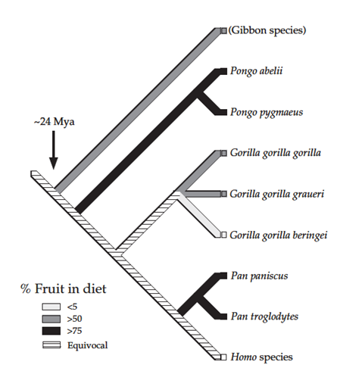
“Drunken Monkey Hypothesis”
Dudley (e.g., 2000, 2002, 2004) proposed that an explanation for alcoholism might be found in frugivory, the tendency of animals to eat plants
We are descended from a long line of frugivors and fruits and carbohydrates remain a staple of our diets

Slide 14
“Drunken Monkey Hypothesis”
Importantly, humans possess digestive enzymes that allow us to metabolize ethanol
Reduction in cardiovascular diseases in those that consume small amounts of ethanol,
“Possibly parallel consequences for reproductive fitness have not been evaluated, but this issue is none the less logistically tractable,” (p. 384)

Slide 15
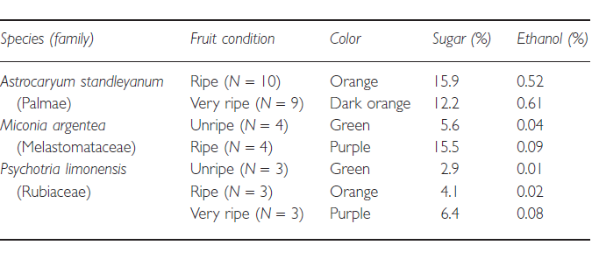
Colour-Sugar Association
First, note there would seem to be some association between changes in colour and sugar content
Thus, as a cue, colour would suggest that more sugar is contained within a fruit: [Bright Colour] = [Good]

Slide 16
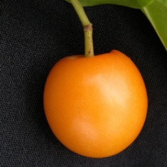
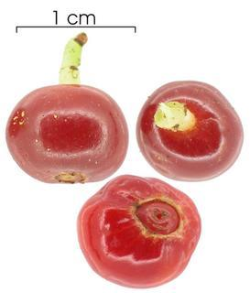
Ripeness-Ethanol Association
But notice as a fruit ripens, they have higher concentrations of ethanol as well so the association that we ‘learn’(i.e., that is selected for) needn’t be limited to just [Bright Colour] = [Good]
  The association with sugar can also be extended to ethanol content

Slide 17
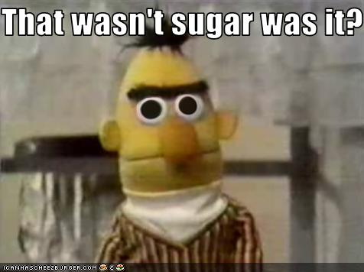
Sugar: It’s a Helluva Drug
The correlation between sugar and ethanol in the previous slide suggests that ‘selecting for’ a preference for sugary tastes might bring with it a preference for ethanol,
Given that all traits are on a continuum (e.g., extraversion) some will exhibit a greater than average preference for both sugar and ethanol.
Notes:
https://i.chzbgr.com/maxW500/1683376384/h6452B1CB/

Slide 18
Alcohol, Genes, and ‘Free’ Will
Although we have examined a plausible genetic basis for alcohol dependence/addiction, simply because there is a genetic component, does not mean that it is the only factor of importance:
  Genetic component can be mediated by other cognitive and social factors, lessening or increasing alcoholism;
  An intervening set of processes could account for alcoholism

Slide 19
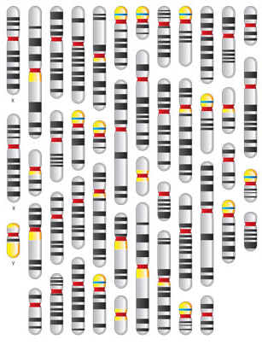
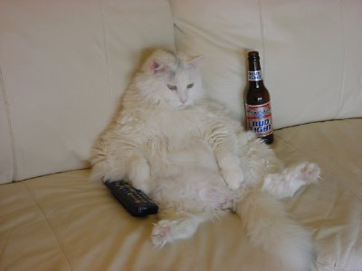
Intervening Factors
Desire for Social Interaction;
Imprinting from peers + relatives;
Self-medicating
In this case, we can imagine that your genes might make you want to increase social interaction, more susceptible to adopting the behaviour of others or have a mental disorder that you are self-medication.
In all of these cases, your genes aren’t making you an alcoholic, rather you’ve learned the behaviour.

Slide 20
Regression: The Statistical Sponge
“Prediction is very difficult, especially if it's about the future.”
- Niehls Bohr

Slide 21
Linear Regression
Another way of looking at the relation between two variables.
The best fitting linear function is estimated and then used to “explain” the changes in one variable using a second variable.
Criterion. The variable to be explained (an ‘y’).
Predictor. The variable used to predict, to “explain” (a ‘x’).

Slide 22
Regression Function:
y = mx + b
What is the corresponding value of y?
When we have a given value of x…

Slide 23
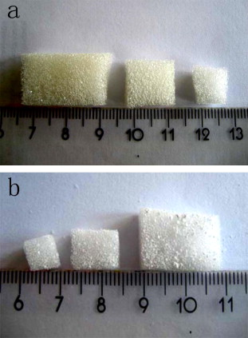
Regression and Sponges
One way to conceive of a regression equation and the variables within it is to consider each variable as a sponge, the variance of a dependent variable as water, and the equation as a bowl
As you place each sponge into the bowl, you soak up more variance!
Notes:
http://ars.sciencedirect.com/content/image/1-s2.0-S1387181107006142-gr1.jpg

Slide 24
Do You Know How Smart You Are?
Question: Can people accurately assess their own intelligence (IQ)? If so, can we use this as a proxy measure?
Paulhus, Lysy, and Yik (1998) wanted to examine whether self-report measures of intelligence could predict actual intelligence.

Slide 25
Do You Know How Smart You Are?
Previous research found only a weak correlation between overall estimates of IQ and IQ as measured on a test (r = .20-.25)
They examined whether previous results were simply a result of using a global measure rather than specific measures of IQ
  i.e., Asking someone how smart they are might not be as effective a means of getting at intelligence as providing them with their intelligence in specific domains

Slide 26
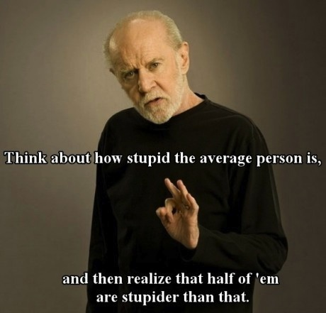
Intelligence Estimates
Paulhus et al., (1998) found that even when a variety of measures of estimated intelligence were included in their regression function, they were only capable of accounting for 10-16% of the variation
What might be the problem with this measure?

Slide 27
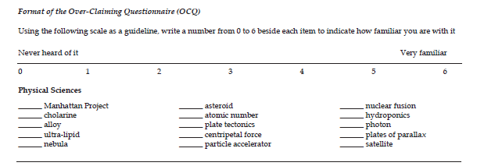
Intelligence Estimates: Control
In a follow-up study, Paulhus, Harms, Bruce & Lysy (2003) used a similar technique to study phenomena which they referred to as overclaiming
  A self-enhancement bias wherein people claim to have more knowledge than they do

Slide 28
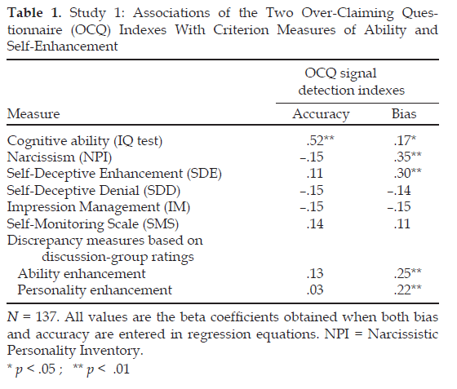
Intelligence Estimates: Control
In order to calculate an index of overclaiming…
Hits – you are right when you say you’re right,
False Alarms – you are wrong when you say you’re right
ACCURACY = P(HITS) – P(FA)
BIAS = P(HITS) + P(FA)

Slide 29
Intelligence Estimates: Control
After calculating an index of overclaiming, a regression analysis revealed that accuracy and biases were predicted by different variables,
  Cognitive ability predicted accuracy,
  Bias was determined by personality measures.

Slide 30
Multiple Regression
Regressions allow for multiple predictors.
Example: Suppose you want to explain grades using both IQ and number of hours of study.
Index | 1 | 2 | 3
1. Grades | 1.0 | - | -
2. Performance IQ | .65 | 1.0 | -
3. Hours of study | .34 | .01 | 1.0

Slide 31
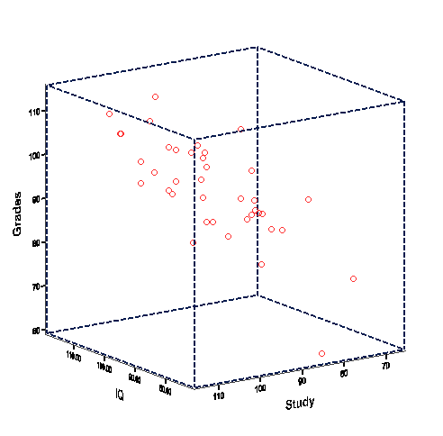
Multiple Regression
R:Measure of relation for multiple variable.
R²: The measure of effect size for multiple regressions.

Slide 32
Hierarchical Multiple Regression
What if I want to see the relation between study time and grades independently of IQ?
Mathematically, the variance explained by IQ is removed after step 1. Hence, the variance explained by study time is “unique”.
Represents variance of IQ AND Study Time.
Grade (Criterion)
Variable | R | ΔR2 | Final F
Step 1
IQ | .65 | .42*** | 26.82***
Step 2
2. Study Time | .73 | .12*** | 20.82***

Slide 33
Announcements
Experiment 2 will be launched after class,
It will consist of 3 short tasks
  Ratings exercise,
  Reasoning task, and
  Memory task,
The experiment will be conducted within the context of CULearn.

Slide 34
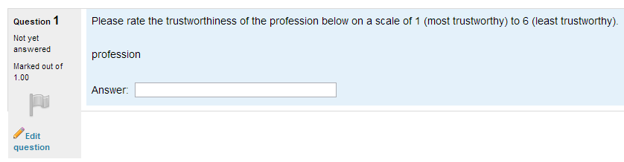
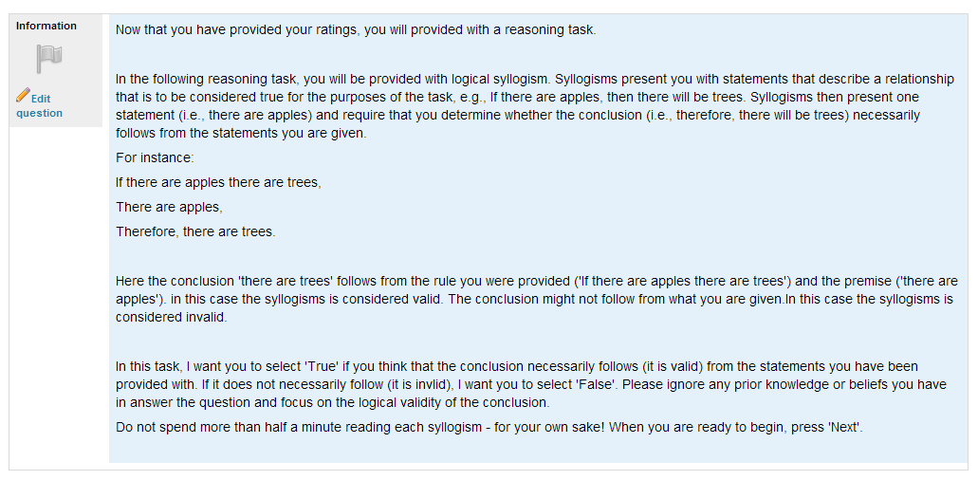
Experiment 2

Slide 35
W5L2b Review
In areas such as genetics and evolutionary psychology, correlational studies allow us to test hypotheses that would otherwise be impossible
Regression consists of using an equation that relates a predictor variable (x) to explain changes in a criterion variable (y).
Partialling out variance in a correlation or including variables in multiple regression can be understood as a sponge (variable) soaking of water (variance).

