Slide 1

Correlations:
Zombie Salmon and
Drunken Monkeys
Research Methods
PSYC/NEURO2001 Mon and Weds 14:30-17:30
Jordan Schoenherr
Carleton University

Slide 2
Overview of Lecture
Correlational Studies and Partial Correlations
Correlations and reliability of neuroscience studies

Slide 3
The Continuum of Internal Validity
Experimental, Quasi-experimental and Non-experimental designs are located on a continuum based on the degree of control that we have over variables
Experimental
Highest degree of control;
Confounds limited;
Meaningful conclusions can be drawn.
Quasi-experimental
Moderate control over variables;
Confounds present;
Can cautious interpret results.
Non-experimental
No control;
Many potential confounds;
Difficult to generalize results.

Slide 4
Correlational Research
“There thus appears to be an inverse correlation between recovery and psychotherapy; the more psychotherapy, the smaller the recovery rate.”
- Hans Eysenck

Slide 5
Correlational Research
The purpose of correlational research is to establish that a relation exists between variables and to describe the nature of this relationship.
  Rubin’s (1970) love scale and “being in love”
  Reliability coefficient is .87 to 1.0 (Bowker et al., 2009)

Slide 6
Pearson’s Correlational Coefficient
The Pearson correlation (r) coefficient is the statistic that indicates the degree to which two variables are related to one another in a linear fashion.
Range r is between – 1.00 and + 1.00
Positive correlation (r > .00). Positive, direct relationship between two variables
Negative correlation (r < .00). Negative, inverse relationship between two variables

Slide 7
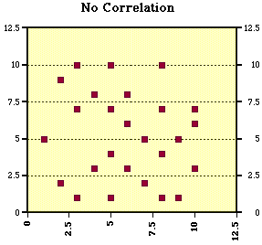
Correlation: No Relationship
Notes:
http://www.evl.uic.edu/aej/526/kyoung/Training-scatterplot.html

Slide 8
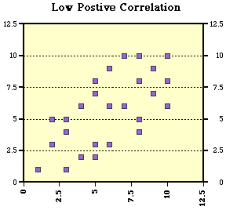
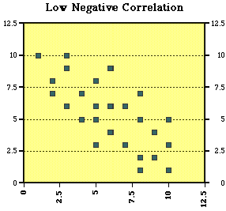
Correlation: Weak Relationship
Notes:
http://www.evl.uic.edu/aej/526/kyoung/Training-scatterplot.html

Slide 9
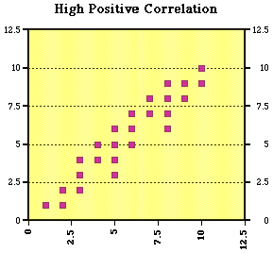
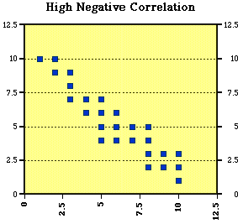
Correlation: Strong Relationship
Some researchers refer to this as moderate.
Notes:
http://www.evl.uic.edu/aej/526/kyoung/Training-scatterplot.html

Slide 10
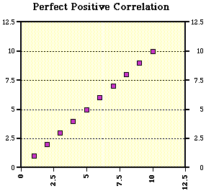
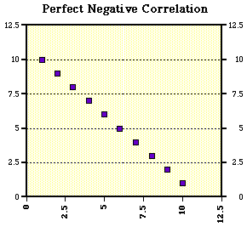
Correlation: Perfect Relationship
Notes:
http://www.evl.uic.edu/aej/526/kyoung/Training-scatterplot.html

Slide 11

How can we tell that a correlation is significant?
What is the probability that a “lucky result” was obtained?
The probability is calculated using the Student’s t statistic.

Slide 12
Correlation: Critical Values
Number of participants |  | Minimum r that is significant (for a p value of .05)
10 |  | .52
20 |  | .37
30 |  | .30
40 |  | .26
50 |  | .23
60 |  | .21
80 |  | .18
100 |  | .16
1000 |  | .05
Leary (2001, p. 148).

Slide 13
Correlation Matrix
When multiple correlations are used, the results are typically shown in a correlation matrix.
Index | 1 | 2 | 3
1. Grades | 1.0 | - | -
2. Performance IQ | .65 | 1.0 | -
3. Hours of study | .34 | .01 | 1.0

Slide 14
Correlation and Causality
Remember our mantra: Correlation does not imply causality!
Three criteria must be satisfied to conclude that one variable causes another:
  Covariation. There is a correlation between variables X and Y.
  Directionality. Variable X (the cause) precedes Variable Y (the effect).
  Elimination of extraneous variables. No other variable may be responsible for the relationship between X and Y.

Slide 15
The Problem of Directionality
Correlational studies do not allow us to determine which variable is the cause and which variable is the effect.
Conscientiousness
Estimated Grade
(Academic Achievement)
e.g., experience or a need for achievement

Slide 16
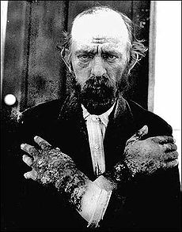
The Third Variable Problem
Although a correlational study may establish that two variables are related, it does not necessarily mean that there is a direct relationship between them.
Consider the case of pellagra, a disease that produces similar symptoms to leprosy.
  Skin lesions/dermatitis, aggression, light sensitivity, and confusion.
It was believed to be caused by a germ or toxin due to correlation between consumption of maize (corn).
Pellagra
Sanitary conditions
Notes:
http://upload.wikimedia.org/wikipedia/commons/thumb/1/13/Pellagra_NIH.jpg/230px-Pellagra_NIH.jpg

Slide 17
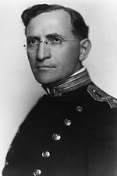
The Third Variable Problem
Dr. Joseph Goldberg conducting experiments with 11 prisoners
Goldberg noted a greater instance of pellagra in rural populations,
Diet was manipulated:
  Diet (time 1): Fruits and vegetables
  Die (time 2): corn
Initial onset was marked by a suppressed appetite and headaches eventually resulting in pellagra
Pellagra
Sanitary conditions

Slide 18
The Third Variable Problem
Dr. Joseph Goldberg identified that another variable, namely diet, was a better predictor of the disease (prisoner population)
Even Goldberg did not identify the exact cause of pellagra
Pellagra
Low carbohydrate,
Low protein diet
Sanitary conditions

Slide 19
Word Frequency Effects and
The Third Variable Problem
“Appearances are a glimpse of the unseen.”
- Anaxagoras

Slide 20
Memory and Language
Although some of our human language capacity appears to be a property of neuroanatomical structures of the brain (e.g., Broca and Wernicke’s areas), other elements of language must be learned.
How do we build a lexicon (the set of words that we know)? How is this information stored in memory?
As we’ve seen previously, Howes and Solomon (1950) were in the process of examining this phenomena when McGinnies (1949) conducted his psychological ‘defence’ experiment.

Slide 21
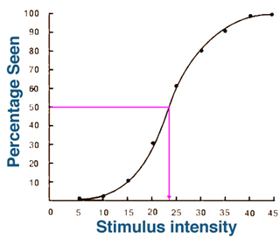
Sie Method of Ascending Limits
In psychophysics, we want to determine a response threshold of a participant
In these tasks, we can present a participant a stimuli very briefly (e.g., 20 ms) and increase the intensity until they begin to detect it (i.e., say ‘Yes’ it’s present).
  Method of Ascending Limits

Slide 22
Word Frequency: Continuous Variables
Howes and Solomon (1951) were examining what factors change this threshold.
They considered that probability of a word’s occurrence was important to determining the success with which someone could detect that word in an environment.
  We are less certain about improbable words and they will be harder to detect as a consequence

Slide 23
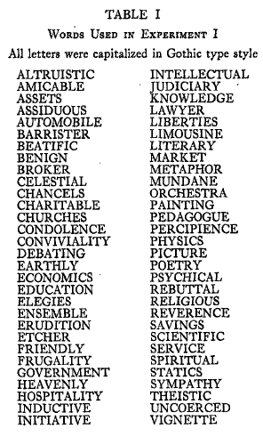
Word Frequency: Continuous Variables
Howes and Solomon (1951) used a ‘word count’ developed by Thorndike and Lorge (1944)
  One-half million words that appeared in magazine between 1927 to 1938
Participants were provided with these word using a T-Scope
The duration of presentation was increased until the participant could correctly identify the word

Slide 24
Word Frequency: Continuous Variables
“Correct responses began to occur with exposures ranging from 30 to 1,000 ms, depending on the individual S and on the word being exposed,” (p. 403)
If Howes and Solomon (1950, 1951) were correct, what pattern of results would we expect to obtain for any given word?

Slide 25
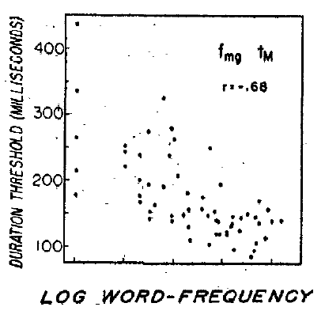
Word Frequency: Continuous Variables
What results have they obtained?
Howes and Solomon (1951) obtained a negative correlation between identification time (‘duration threshold’) and word-frequency
Thus, the time taken to identify a word is dependent on the frequency of its occurrence within our environment

Slide 26
A Time and a Place:
The Changing Linguistic Landscape
Word frequency counts are based on a given corpus of words.
Language evolves: the meaning of words, and the frequency of their usage change over time.
What is the effect of using a word frequency count from a set of word frequencies from another era?

Slide 27
Brysbaert and New (2009)
Brysbaert and New (2009) set out to develop a contemporary word frequency count .
Movie subtitles used as the basis for new word frequency counts:
  Movie dialogue is supposed to approximate real-world exchanges
  More contemporary sources relative to previous word counts
Does this prediction hold? Can a word frequency count using modern sources account for greater variance then older sources?

Slide 28
Brysbaert and New (2009)
To demonstrate this effect, we used these stimuli in a third year honours seminar course as an introductory experiment
Rather than a detection threshold, we examined the time taken for them to respond to the stimuli
We compared the correlation between a frequently used word frequency count (Kucera & Francis, 1967) and the Brysbaert and New (2009) count.

Slide 29
Brysbaert and New (2009)
From the available information, which word frequency count accounts for more variance in our sample?
  r_{KF} = -.576, p < .001
  r_{BN} = -.704, p < .001

Slide 30
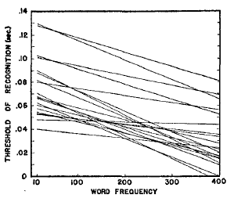
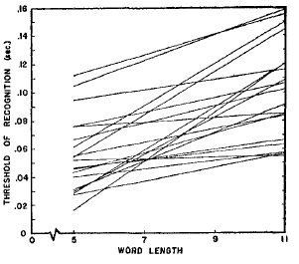
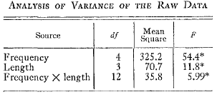
Return of the a Friend
(and a Problem)
Perhaps infamously, Howes and Solomon (1951) claimed that the length of a word had no effect on people’s ability to recall information
McGinnies (1952) suggested that word length would affect the time taken to identify stimuli
  We observe an interaction between our two main effects (of Frequency and Length)

Slide 31
Too Many Variables?
The third variable problem can also be examined in the opposite direction:
  Have we included MORE factors than are warranted?
  Should we collapse factors together for the sake of parsimony?
What type of measurement concept can we use to assess this?

Slide 32
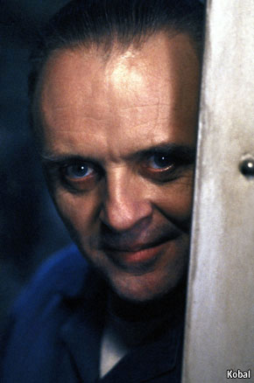
What’s in a(n Evil) Name?
Some researchers have claimed that there is a single, ‘dark’ personality and that personality components that are often distinguished are in fact the same.

Slide 33
The Dark Triad
Psychopathy (subclinical):
  High impulsivity, thrill-seeking, low empathy and anxiety.
Narcissism (subclinical):
  Grandiosity, entitlement,
  dominance, and superiority
Machiavellianism:
  Manipulative personality

Slide 34
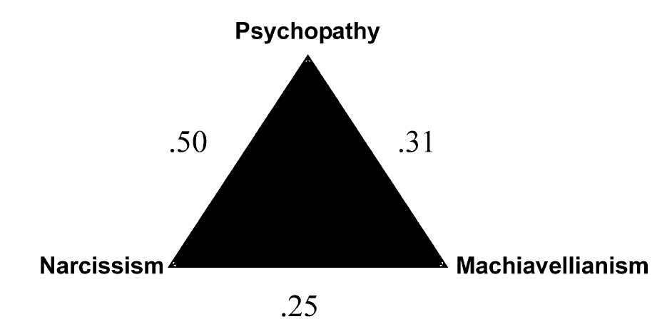
The Dark Triad
r² = .25
r² = 0.10
r² =.06
Paulhaus and Williams (2002) demonstrate that measures of the elements of the dark triad were not perfectly correlated,
An examination of also revealed differences in personality and cognitive ability.

Slide 35
Correlations and Neuroscience
“The brain is the organ of destiny. It holds within its humming mechanism secrets that will determine the future of the human race.”
- Wilder Penfield

Slide 36
Dead Salmon and Other Fairytales
Although neuroscience evidence can be impressive given the direct association between the brain’s activity and behaviour, we need to be critical of the methods used to obtain these results
Recently there has been considerable ‘backlash’ concerning the interpretation of results within neuroimaging studies
Consider the recent case of the zombie salmon…

Slide 37
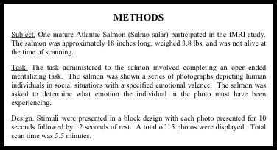
Dead Salmon and Other Fairytales
For full poster see: http://prefrontal.org/files/posters/Bennett-Salmon-2009.pdf

Slide 38
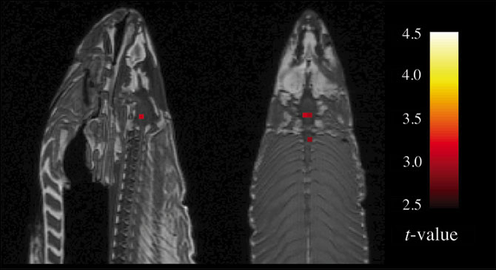
Dead Salmon and Other Fairytales
“By complete, random chance, we found some voxels that were significant that just happened to be in the fish’s brain,” Bennett said. “And if I were a ridiculous researcher, I’d say, ‘A dead salmon perceiving humans can tell their emotional state.’”

Slide 39
Roads to Nowhere?
Qualifying Correlations
If the brain gives rise to human behaviour, then the direct study of its function would seem to be the best approach to understanding cognition, emotion, and personality
Many of these studies rely on correlational logic and, as we’ve just seen, this can create problems
Vul, Harris, Winkielman, and Pashler (2009) recently considered the possibility that many of these correlations might be an artifact of the methods such as fMRI used to study it

Slide 40
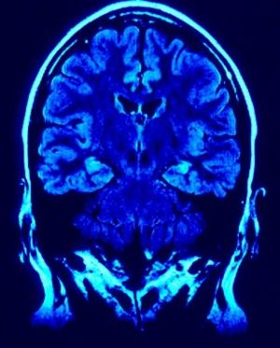
Roads to Nowhere?
Qualifying Correlations
Problem: Researchers often fail to report how these correlations were obtained
As you will recall for the results of our own in-class experiment and those reported in the study of the stability of personality traits over early childhood development (Lemery et al., 1999) high correlations are difficult to obtain
Notes:
http://www.neuromedia.eu/UserFiles/Image/300px-Brain_imaging.jpg

Slide 41
Roads to Nowhere?
Qualifying Correlations
Vul et al., (2009) note several characteristic patterns in their review of 55 fMRI studies: e.g.,
“Eisenberger, Lieberman, and Williams (2003), writing in Science, described a game they created to expose individuals to social rejection in the laboratory. The authors measured the brain activity in 13 individuals while the actual rejection took place, and they later obtained a self report measure of how much distress the subject had experienced. Distress was correlated at r = .88 with activity in the anterior cingulate cortex (ACC),” (p. 273)

Slide 42
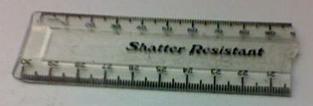
The Problem with High Correlations, or
Why Research Methods is Important
Vu et al., (2009) go on to say:
  “It is a statistical fact… that the strength of the correlation observed between Measures A and B reflects not only the strength of the relationship between the traits underlying A and B (r_{A,B}), but also the reliability of the measures of A and B, respectively,” (p. 275)
As we noted earlier, the reliability of a measure determines whether we can trust the inference from our results
Thus, if we can estimate the reliability of our respective measures, we can estimate the upper limit to which they can be related

Slide 43
The Problem with High Correlations, or
Why Research Methods is Important
How reliable are our measurement instruments and scales? How can we determine this?

Slide 44
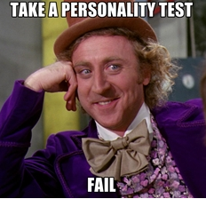
The Problem with High Correlations, or
Why Research Methods is Important
As we’ve seen previously, test-retest reliability is a important means at our disposal:
  Hobbs and Fowler (1974) assessment of MMPI: values r = .66 to .94
  Viswesvaran and Ones (2000) assessment of Big Five: values r = .73 to .78
Thus, a range of .8 would seem to be the upper limit

Slide 45
The Problem with High Correlations, or
Why Research Methods is Important
Less is known about the reliability of fMRI (Blood Oxygenation Level Dependent, or BOLD) but what information is available suggests that there is considerably less test-retest reliability
  Kong et al., (2006) assessment of the change in BOLD signal over several days in a finger tapping task: values r = .00 and .76
  Manoach et al., (2001) assessment of the Sternberg memory scanning task: values range r = .23 to .93
Thus, a range of .7 would seem to be the upper limit

Slide 46
The Problem with High Correlations, or
Why Research Methods is Important
Thus, if the strength of the relationship between two measures is given by their reliability we can determine their expected correlation:
r _{ObservedA, ObservedB} =
r_{A,B} x √(reliability_{A} x reliabilityB)
As Vu et al., (2009) note from their review, if personality tests have r = .8 and neuroimaging an r = .7, we can expect typical values not to exceed an r = .7

Slide 47
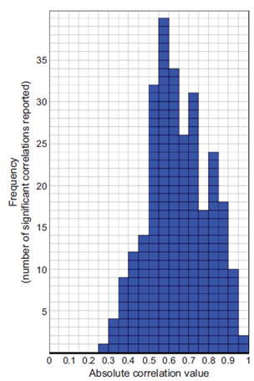
The Problem with High Correlations
Expected r
However, if we look for this cut-off in a selection of neuroimaging studies, we find that there are many studies reporting values greater than the average:
  “Puzzlingly High Correlations in fMRI Studies of Emotion,
  Personality, and Social Cognition”

Slide 48
The Nonindependence Error
If we’re looking at a portion of the brain that is activated, it could be activated simply because of noise or it could be because it’s involved in some brain function or it could be involved in the brain function of interest.
Researchers are selecting regions (voxel) based on previous activation. If this happened by chance AND we select the same areas for examination again, we are artificially increasing the correlation.

Slide 49
The Nonindependence Error
Consider a behavioural analogy:
  In a mall (or on the bus) have you ever bumped into someone?
  Now, let’s assume that once we’ve observed you doing this, we keep looking at this behaviour. We will find an artificially high correlation between you and your ‘anti-social’ behaviour simply because we are observing the same behaviour.
  In a sense, we have committed confirmation bias!

Slide 50
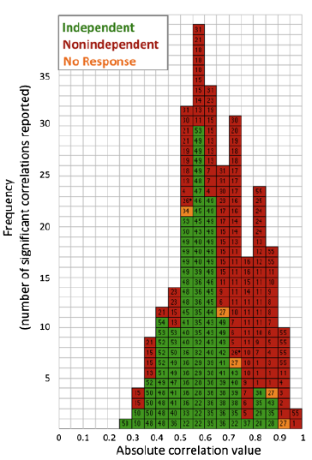
The Nonindependence Error
Vu et al. did some further exploration as to how these studies were conducted,
  Average or a single voxel,
  If it was an average, was it based on anatomy or previous activity observed within a voxel,
  If data was used to identify voxel, were they used to obtain the correlation?

Slide 51
The Nonindependence Error
Once we account for these ‘nonindependent’ neuroimaging readings (coloured red), we find that the actual number of correlations supporting various cognitive, emotional, and social phenomena decreases.
Important: This does not invalidate neuroscience methods. It simply means that we need to consider the methods we are using.

Slide 52
W5L1a Review
Correlational studies provides the basis for considerable research
Understanding the relationship between variables that are being correlated Is essential

