Slide 1

Case Studies and
Single-Subjects Design
Research Methods
PSYC/NEURO2001 Mon and Weds 14:30-17:30
Jordan Schoenherr
Carleton University

Slide 2
Overview of Lecture
Case Studies and Case Histories
Single-Case Design
Application in neuropsychology

Slide 3
Case Studies
“Society exists only as a mental concept; in the real world there are only individuals.”
- Oscar Wilde

Slide 4
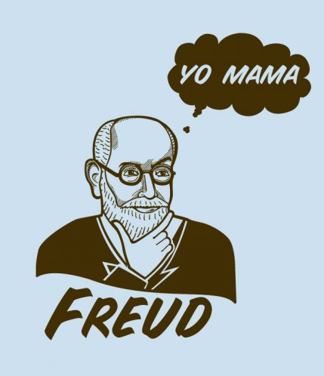
Case Studies and Case Histories
Case studies are intensive descriptions and analyses of a single individual (Shaughnessy, Zechmeister, Zechmeister, 2006).
Can be contrasted against case histories which do not provide a treatment
  i.e., they do not constitute a pretest-posttest design
4

Slide 5
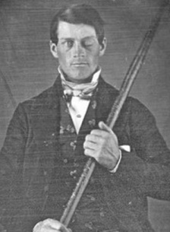
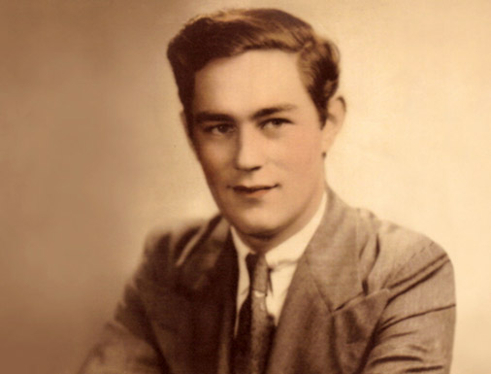
Famous Cases
Case histories and case studies have provided the basis for considerable advances in early neuroscience
  Phineas Gage (Damasio et al., 1994; Harlow, 1848)
  HM (Scoville & Milner, 1957)
  ‘Tan’ (Broca, 1861)
As we will see in the next lecture, this is close to the correlational logic
  Impaired function and neurological damage (co-occurrence)
5
Notes:
http://en.wikipedia.org/wiki/File:Henry_Gustav_1.jpg

Slide 6
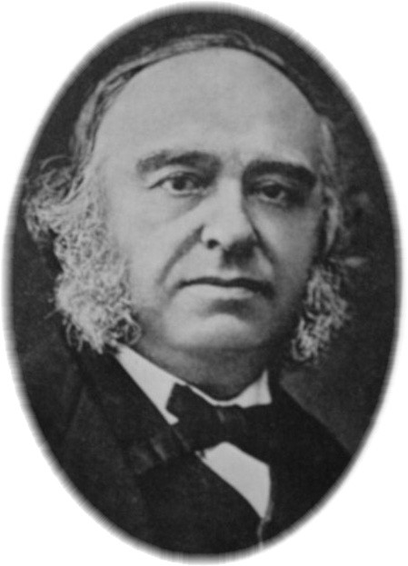
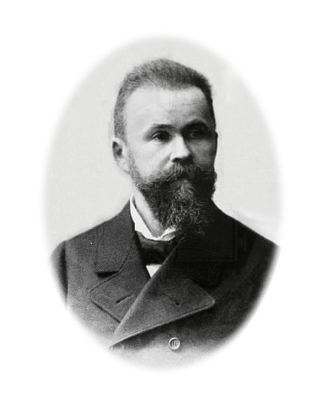
Case Histories in Neuroscience
One of the most prolific research areas to use quasi-experimental method is neuroscience
One of the earliest techniques to identify a consistent relationship between damage to an area of the brain and performance deficits
One of the most well studied are those provided by Paul Broca and Carl Wernicke

Slide 7
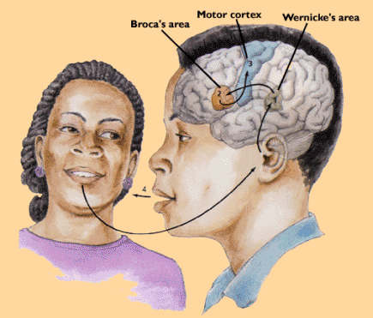
Speech Comprehension and Production
Together with the motor cortex, Broca’s and Wernicke’s areas create a circuit for speech production and comprehension, respectively
We cannot cause brain damage, the participants in the study are therefore not randomly assigned
Notes:
http://psychospaces.wikispaces.com/file/view/d_10_cr_lan_2a.jpg/272324762/d_10_cr_lan_2a.jpg

Slide 8
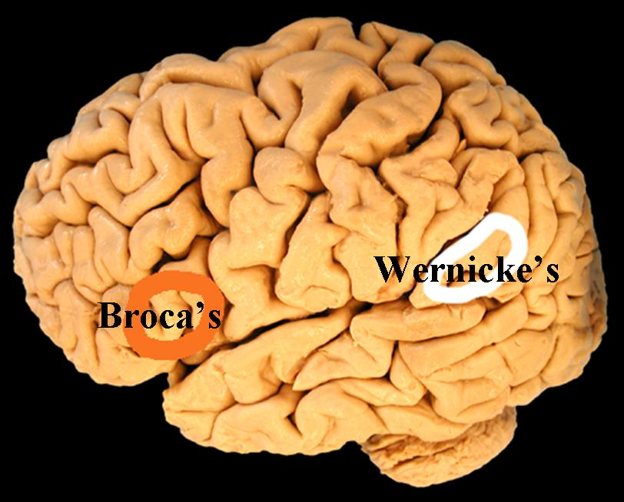
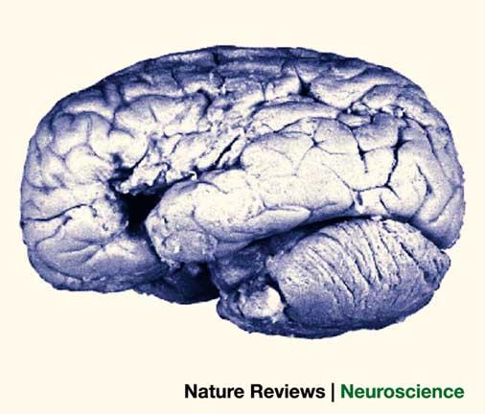
Tan: A Case History
‘Tan’ a 51 year old man (at TOD)
Loss of ability to produce speech 21 years prior
Only a single syllable could be produced on admittance to the facility, i.e., ‘tan’
Could do most other task normally and exhibited normal intelligence, understanding other’s speech
After 10 years, mobility was lost in right arm and, later, in his right leg
Notes:
http://www.andrewhillary.com/image.axd?picture=2011%2F8%2Fbroca_wernicke.jpg

Slide 9
Broca’s Post-Mortem
“The patient died April 17, 1861. At the autopsy… The frontal lobe of the left hemisphere was soft over a great part of its extent; the convolutions of the orbital region, although atrophied, preserved their shape; most of the other frontal convolutions were entirely destroyed. The result of this destruction of the cerebral substance was a large cavity, capable of holding a chicken egg, and filled with serous fluid. The softness had spread up to the ascending fold of the parietal lobe… it was the lesion of this last organ which was responsible for the paralysis of the movement of the two limbs of the right side,” (Broca, 1981)
Notes:
http://psychclassics.yorku.ca/Broca/perte-e.htm

Slide 10
Broca’s Conclusions
Broca (1861) concludes that “[T]his permits, however, the belief that, in the present case, the lesion of the frontal lobe was the cause of the loss of speech,”
Using the assumption that the brain controls the body, and that destruction of the brain would affect the body, Broca was able to infer that the ‘speech centre’ is located in the left hemisphere,
Although there was an event that caused the damage to Tan’s brain, we do not have a prior history for comparison. Thus, Broca’s study is more akin to a case history then a case study.

Slide 11
Advantages of Case Studies
They can be the source of extraordinary story telling,
They are a source of insight – they suggest future research,
They give researchers the opportunity to study rare phenomena,
Idiographic research vs. nomothetic research: studies on individuals vs. groups
  Can be used to assess typical vs. atypical individuals
11

Slide 12
Disadvantages of Case Studies
Arguments made from case studies have low internal and external validity: “One always fears that a case is ‘unique’, especially if it has such extraordinary features as those of [a given patient],” (Sacks, 1985)
Observations may be biased,
How can individual cases be transformed into experimental research?
12

Slide 13
Single-Case Design
“Judge a man by his questions rather than by his answers.”
- Voltaire

Slide 14
The Utility of Single-Case Design
With the difficulties in inferring from case studies, why would we want to use a single-case design?
Useful to monitor the progress of an individual receiving treatment
  Is it effective? Should we change treatments?
Useful for applied research
  Does it seem that the treatment would help other individuals?

Slide 15




Single-Case Design Basics
Single-case designs require repeated, systematic measurement of our dependent variable:
  Same behaviour measured repeatedly: before, during, and after treatment
  Determine consistency/reliability of measurement over time
  Accounts for variability due to external factors
e.g., Do you like Star Wars?
  At 5 yo? 10 yo? After the prequels have been released?
Notes:
http://cdn.screenrant.com/wp-content/uploads/Star-Wars-Blu-ray.jpg

Slide 16
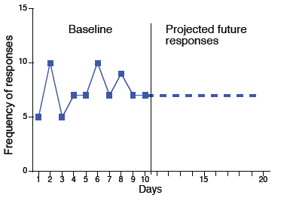
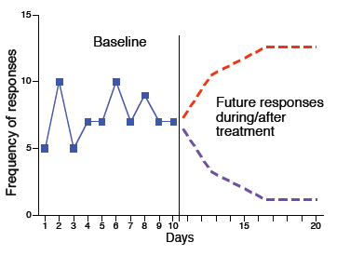
Assessing the Effect of Treatment
Baseline stage (observation stage): recording behaviour prior to intervention; usually the frequency of some behaviour
Treatment stage (manipulation stage): Once stable baseline for behaviour has been established, introduce intervention designed to change behaviour; measure occurrence of behaviour during/after intervention

Slide 17
Single-Case Design: Alphabet Soup
AB Design | Measure baseline response (‘A’) Administer treatment and measure (‘B’) Rapid assessment of treatment Leaves open possibility that ‘B’ is not cause
ABA(B) Design | After AB design, the treatment is withdrawn (another ‘A’ phase) Offers more reliability of measurement Might be a lingering treatment effect, Ethical concerns about removal of treatment
ACABCB Design | Alternate between one treatment (‘B’) and another treatment (‘C’) to see which has the greatest effect Can examine more than one variable Treatment effects are still present

Slide 18
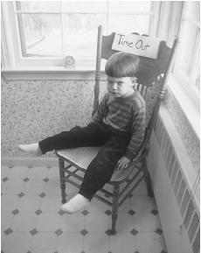
Spoon Wars: Revenge of the Bib
Although infrequent, single-case designs can be used to demonstrate the possible efficacy of a treatment,
Horton (1987) wanted to assess ways in which the behaviour of developmentally delayed children could be modified
  i.e., if there are cognitive impairments that prohibit ‘normal’ learning, can an alternative technique be used to reduce maladapative behaviours
Notes:
http://www.minddisorders.com/images/gemd_01_img0020.jpg

Slide 19
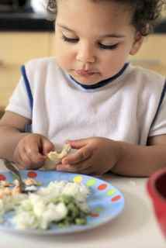
Spoon Wars: Revenge of the Bib
Facial screening (covering the face with a soft cloth) successfully used elsewhere,
  Self-injurious behaviour, &
  Stereotypy.
A 8 yo developmental delayed child participated engaging in sterotypic behaviour,
Study consisted of multiple baselines (‘no bang’) and treatments (‘no bang’ + face cover),
  Building a paired association between saying ‘No’ and facial screening

Slide 20
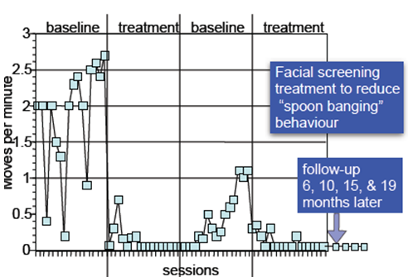
Horton (1987): Behaviour Modification
Horton (1987) found that facial screening technique was effective in reducing maladaptive behaviour,
We can observe a reduction in stereotypic behaviour during treatment AND during the follow-up.

Slide 21
Extensions of Single-Case
The line between a single-case design, multiple case studies and ‘full’ experimental designs is a blurry one
Many studies use small-n designs, e.g., psychophysics, neuroimaging, brain injury
These studies are more reliant on (extensive) repeated treatment rather than shorter periods of treatment

Slide 22
Neuropsychological Applications:
Idiographic and Nomothetic Testing
“We are all connected; To each other, biologically. To the Earth, chemically. To the rest of the universe atomically.”
- Neil deGrasse Tyson

Slide 23
Reversing Directions
Thus far, we have characterized the movement from nonexperimental to experimental designs as progressive, i.e., we want to exert more control
The results of experimental designs can also be used in situations where we have less control.
  e.g., we want to take what we know about an normal population to determine whether an individual is abnormal for treatment.

Slide 24
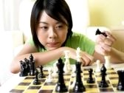
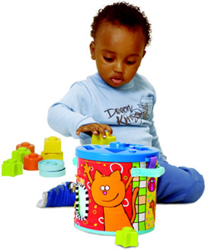
Psychomotor Skills
The relationship between physical movement and psychological function, or psychomotor skills, is a universal
We can use general findings of studies to asses individuals whether individuals require treatment
Notes:
http://us.cdn2.123rf.com/168nwm/eskay/eskay0506/eskay050600036/202988-a-young-woman-thinking-of-her-next-move-while-holding-a-chess-piece-in-her-hand.jpg
http://www.taftoys.com/Products/Fullsize/10865a.jpg

Slide 25
Psychomotor Skills
Gauggel and Fischer (2001) wanted to assess the effect of goal-orientation on patients with brain injury,
In order to do so, psychomotor tests were employed to assess the effects of a concussion
  One such method was the pegboard test

Slide 26
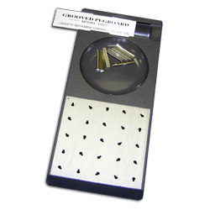
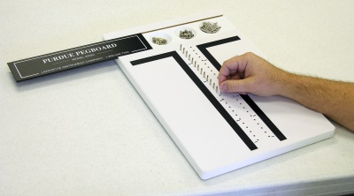
Grooved Pegboard Test
Grooved Pegboard Test
“This procedure measures performance speed in a fine motor task by examining both sides of the body, inferences may be drawn regarding possible lateral brain damage,”
Notes:
http://www.lafayettelifesciences.com/product_detail.asp?itemid=167

Slide 27
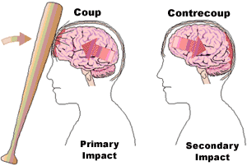
Methods for Rehabilitation
45 patients with brain injury participated in the study,
  Cerebrovascular accident (CVA) or Closed head injury (CHI)
Test performed prior to the experimental session revealed differences in motor response time. Explained in terms of:
  Small sample size, and
  “the heterogeneity of the brain-damaged patient,” (p. 37)
Notes:
https://www.google.ca/url?sa=t&rct=j&q=&esrc=s&source=web&cd=1&ved=0CEMQFjAA&url=http%3A%2F%2Fwww.apef.com.pt%2Fdownload.php%3Fpath%3Dpdfs%26filename%3DAPEF_20081008213212_Teste_de_Conexao_Numerica__Avaliacao_Encefalopatia_Hepatica.pdf&ei=CxKmUY2SNI7OyAHLyIGwDw&usg=AFQjCNHzUOzgCuyLsAS9TwNfFTwTS3WKPQ&sig2=Ax6SFjOFN3KWP8vdDWZFWQ&bvm=bv.47008514,d.aWc
http://www.braininjury.com/images/injured01.gif

Slide 28
Methods for Rehabilitation
45 patients with brain injury participated in the study,
  Cerebrovascular accident (CVA) or Closed head injury (CHI)
  “the heterogeneity of the brain-damaged patient,” (p. 37)
Patients were assigned to two conditions:
  High-Specific Goal: ““For the next trials you should try to work faster. During the last four trials you completed [the Pegboard Test] in an average of _ seconds. Now, we want you to improve your performance 20%. This means that you should finish the placement of all pegs in the next trial within _seconds.”
  Do Your Best: “These participants were told to work as fast as possible during each of the following trials.”
    They also received feedback

Slide 29
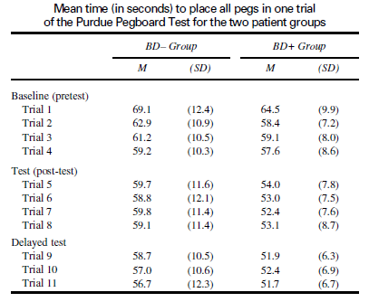
Bored of Boards
After a practice trial, 4 baseline trials were presented (pretest), followed by the instructions, then followed by additional trials (posttest)
Results demonstrate that the specific goal aided performance.
Remember: APs are ~2ms (.002s) in duration
‘Best’
Specific Goal
63.1
∆3.2
59.9
∆6.3
59.4
53.1
∆5.5
57.5
52
Goal instruction administered.

Slide 30
Bored of Boards
Note that if we hadn’t established the baseline (pretest phase), or performed a statistical test we might be reluctant to draw conclusions due to gains in performance as a result of practice,
Random assignment produced faster responses in the ‘Goal’ condition independent of the manipulation.
‘Best’
Specific Goal
63.1
∆3.2
59.9
∆6.3
59.4
53.1
∆5.5
57.5
52

Slide 31
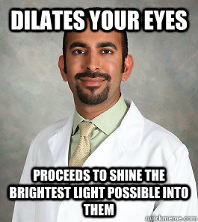
Bored of Boards
As a result of this study we can
  1) Use the pegboard as a tool to assess the existence of neurological trauma in an individual, and
  2) Identify useful forms of treatment that can be applied to specific patients.

Slide 32
W4L2b Review
When dealing with a special population or a rare condition, a case study can be conducted to examine factors that might have given rise to a condition,
A degree of experimental control can be exerted with a single individual in a single-case design,
There is a flow back and forth between the findings of individual cases and experimental studies

