Slide 1

Descriptive Research:
From Reading Books to
Hiding in Hospitals
Research Methods
PSYC/NEURO2001 Mon and Weds 14:30-17:30
Jordan Schoenherr
Carleton University

Slide 2
Overview of Lecture
Types of descriptive research
Observational research designs
Survey research designs
  Multidimensional Scaling

Slide 3
Descriptive Research
“A picture is worth a thousand words.”
- Napoleon Bonaparte

Slide 4
The Continuum of Internal Validity
Last lecture, we referred to a continuum of validity that all research techniques can be sorted into
In the following lectures, keep in mind the connection between each research method and that classification technique
Experimental
Highest degree of control;
Confounds limited;
Meaningful conclusions can be drawn.
Quasi-experimental
Moderate control over variables;
Confounds present;
Can cautious interpret results.
Non-experimental
No control;
Many potential confounds;
Difficult to generalize results.

Slide 5
The Continuum of Internal Validity
Descriptive research, surveys and case studies are typically considered non-experimental designs
Experimental
Highest degree of control;
Confounds limited;
Meaningful conclusions can be drawn.
Quasi-experimental
Moderate control over variables;
Confounds present;
Can cautious interpret results.
Non-experimental
No control;
Many potential confounds;
Difficult to generalize results.

Slide 6
Descriptive Research
Descriptive research only seeks to describe the characteristics and behaviour of a given sample population or individual
Unlike experimental and quasi-experimental research, descriptive studies do not necessarily test hypotheses
Types of Descriptive Studies
Archival | Observational
Survey Research | Case Studies

Slide 7
Archival Research: From Books to People
“It is my ambition to say in ten sentences what others say in a whole book.”
- Friedrich Nietzsche

Slide 8
Archival Research
In archival research, researchers analyze data pulled from existing records (Shaughnessy, Zechmeister, Zechmeister, 2006):
In combination with other methods, archival research can be used to test hypotheses with an emphasis on external validity.
census data | newspaper reports
court records | magazine articles
personal letters | government documents
8

Slide 9
Archival versus Library Research
A distinction exists between archival research and library research
  Archival research examines raw data such as the census, historical records, etc.
  Library research examines ‘processed’ data such as summaries, reviews, etc.
    Literature reviews and metaanalyses do not constitute archival research

Slide 10
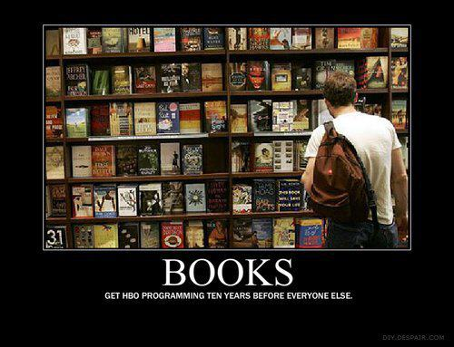
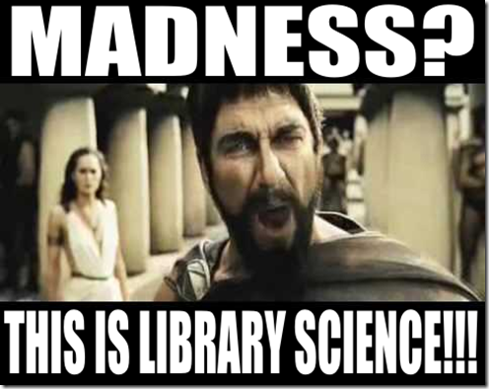
Advantages of Archival Research
Archival data have already been collected
  Time devoted to analysis
  Little to no ethical considerations
Archival data can contain a very large data set, examining a number of variables over a length period of time, e.g.,
  Census has numerous demographic factors across an individual’s life span
10

Slide 11
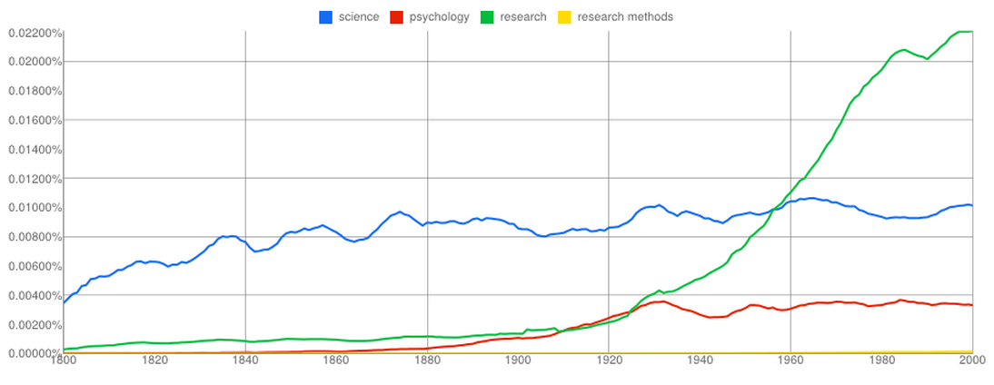
Basics of Archival Research
One approach that we’ve already encountered is a word count to determine how interest in a topic changes over time
Thus, we can see that interest in research and psychology have increased since the 1900s but at different rates whereas interest in science has remained stable
  http://books.google.com/ngrams

Slide 12

Disadvantages of Archival Research
Archival data may be limited due to selective deposit or selective survival.
Archival data are subject to errors in record-keeping
Relations between variables may be shown, but not causes.
12

Slide 13

Archival Research: Historimetrics
Dean Keith Simonton used various measures in his archival research of academic productivity and the impact of an individual in their profession
He would examine the number of times a book or article was cited or the number of times an individual was mentioned in books

Slide 14
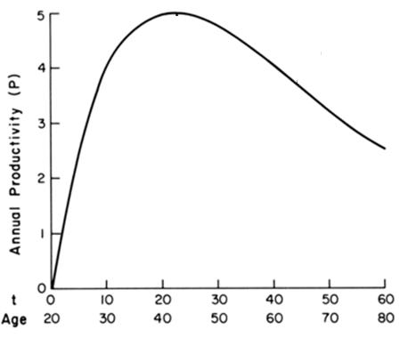
Simonton (1983): Academic Productivity
In general, creative productions are produced at a consistent rate by experts/professionals
Simonton (1983) notes that in the context of science, production reached an upper limit and declined after the late 20s
This data allows us to see a clear pattern, but what it does not provide us with causal factors.

Slide 15
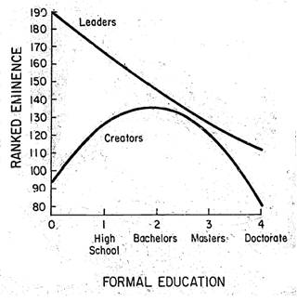
Simonton (1981): Contributions
Creators = scientists, philosophers, artists, composers
Leaders = politicians, admirals, reformers, religious innovators
Using these techniques, Simonton (1981) also noted that the impact of formal education can also reduce importance of an individual within a discipline
With too much formal education, scientists had a lesser impact on their field

Slide 16
Pit Stop: Epidemiological Research
A special case of archival and survey research studies the prevalence and incidence of diseases and psychological disorders
  Prevalence – number of individuals at a given time
  Incidence – rate of emergence of new cases
In psychology, the method is used to study depression, alcoholism, child abuse and personality disorders

Slide 17
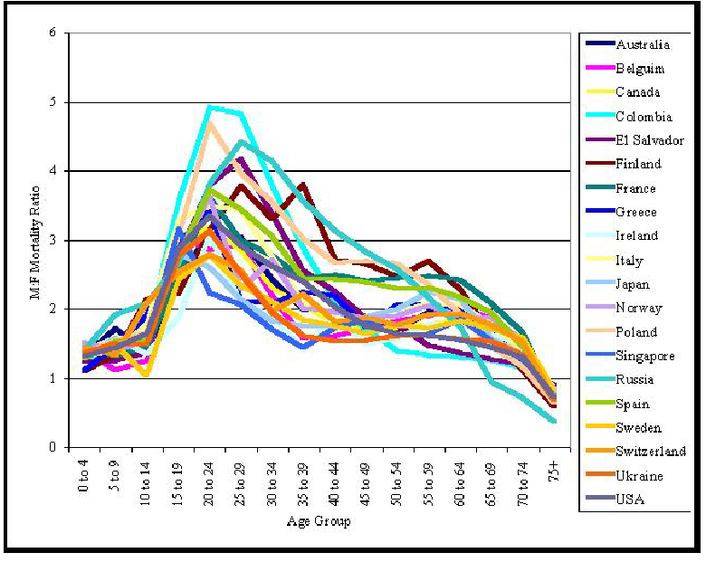
Epidemiological Research and Evolutionary Psychology
Kruger and Neese (2004) examined the male:female mortality rate across 20 countries
By examining internal and external causes, they associated the initial peak with external causes (i.e., risky behaviour) and the second peak with internal causes (i.e., disease)
They conclude that “being male is now the single largest demographic risk factor for early mortality in developed countries,” (p.80)
External: e.g., car accidents, drug use
Internal: e.g.,
Heart disease, cancer, smoking

Slide 18
The Strange Case of
Double-Function Words
Asch wanted to study the use of metaphor across cultures and across an individual’s lifespan.
Asch (1955; 1958) initially examined language to identify the presence of double-function words.
  Words that have more than one meaning. Specifically, one meaning referring to a physical property and another referring to a psychological property
    e.g., Warm-Cold; Tough-Soft; Bitter-Sweet

Slide 19
Methods
Asch and Nerlove (1960) then provided these words to children at various stages of development.
They assumed that people acquire the physical property meaning of a word first and only later develop an understanding of psychological meaning, and later an understanding of metaphor.
Children were given a word and then asked to define it. They were prompted to provide psychological meaning:
  “Are people sweet? Do you know any sweet people? How do you know they are sweet?”

Slide 20
Results
Asch and Nerlove (1960) examined the number of times words were correctly used.
They found that comprehension of psychological meaning and metaphorical meaning proceeded at different rates, suggests a continuous development of knowledge.
Age | Psychological Meaning | Dual-Meaning
3-4 | 7 | 0
5-6 | 10 | 4
7-8 | 47 | 17
9 | 72 | 32
11 | 77 | 62

Slide 21
Observational Studies
“You must understand that seeing is believing, but also know that believing is seeing.”
- Denis Waitley

Slide 22
Observational Research
In observational research, the experimenter does not manipulate a variable. They provide systematic observations of behaviour in a given context and seek to maintain ecological validity.
Researcher ensures that their observations do not affect the behaviour of those they are observing.
Provides a source of hypotheses for experiments.
In the last lecture, what highly cited researcher employed these techniques?

Slide 23
Methodological Considerations
Quantifying observations | Sampling observation
Frequency | Time
Duration | Event
Interval | Individual
Given that behaviour must be observed, inter-rater reliability is essential for drawing general conclusions
23

Slide 24
Participant Observation
One such descriptive method involves participant observations
Observation of behaviour in disguise that allows access to situations not usually open to scientific observation.
“Psychiatry was a fake science used as a system of political control to shore up a violent and collapsing society. […] Madness was simply a convenient label used to lock away those who wanted to break free.”
24

Slide 25
Participant Observation
Rosenhan (1973). On Being Sane in Insane Places
Can the sane can be distinguished from the insane?
“Do the salient characteristics that lead to diagnoses reside in the patients themselves or in the environments and contexts in which observers find them?” (p. 251)
25

Slide 26
Rosenhan (1973): Method
8 pseudopatients gained admission to 12 different hospitals (one graduate student, three psychologists, a pediatrician, a psychiatrist, a painter, and a housewife).
They complained that they had been hearing voices: "empty," "hollow,“ and "thud”.
The pseudopatients ceased simulating any symptoms of abnormality upon admission.
26

Slide 27
General Results
Diagnoses were schizophrenia (11 cases) and manic-depressive psychosis (1 case).
Length of hospitalization ranged from 7 to 52 days, with an average of 19 days.
Descriptions of patient behaviours consistent with diagnosis (note taking, being bored vs. being nervous, familial history).
All patients were released “in remission”.
27

Slide 28
General Results
Time spent with patients was minimal:
  Attendants – 11.3% of the time
  Nurses – 11.5 times per shift
  Physicians / Psychiatrists – 6.7 times per day
Depersonalization (No privacy, staff carries on as if the patients did not exist).
28

Slide 29
Dismissal of Patient Initiated Contact
Patient: “Pardon me, Dr. X. Could you tell me when I am eligible for grounds privileges?”
Physician: “Good morning, Dave. How are you today? (Moves off without waiting for a response.)” (p. 253)
29

Slide 30
Rosenhan (1973): Conclusion
Psychiatric diagnoses are not valid and they are harmful
One of the most controversial papers ever written on abnormal psychology
Spitzer (1975) had several objections
  Pseudopatients are behaving normally
  Diagnosis of pseudopatients is irrelevant
  The diagnosis “in remission” is rare
30

Slide 31
Structure or Contrived Observations
Observation of behaviour in settings arranged specifically to facilitate the occurrence of specific behaviours
  Staged to observe situations that would be difficult to capture under natural conditions
Consider the ‘Movie Perception Test’ (e.g., Levin & Simon, 1997)
31

Slide 32
Change Blindness
A phenomenon where a person viewing a visual scene apparently fails to detect large changes in the scene.
Simons et al. (2000) showed that 35.7% of people failed to detect a change.
Does this phenomenon have external validity?
32

Slide 33
Change Blindness
Simons and Levin (1998). Failure to detect changes to people during a real-world interaction
The “passing door” act was staged for 15 pedestrians (aged 20 to 65).
Despite clear differences in clothing, appearance, and voice, only 7 of the 15 pedestrians reported noticing the change of experimenters.
33

Slide 34
Survey Research
“For the wise man looks into space and he knows there is no limited dimensions.”
- Lao Tzu

Slide 35
Survey Research
As we noted last week, simply because a study does not manipulate factors does not mean that its findings are not meaningful.
Surveys are a useful means to obtain information about people’s beliefs, preferences and their association with other characteristics (e.g., demographic).
The experimenter selects a set of questions and responses are collected in terms of:
  Open-ended responses
  Restricted questions and rating scales (i.e., set number of response alternatives)

Slide 36
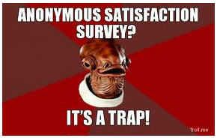
Survey Research
Surveys can be administered:
  Mail – convenient and anonymous, easy to administer
  Telephone – can be administered anywhere
  Internet – large number of participants and can be set-up to respond to participants’ responses
  In-Person and Interviews – Increased flexibility, assurance of 100% participation rate

Slide 37
Advantages and Disadvantages of Survey Research
The general approach of survey methodology can provide a useful description of people, ensuring anonymity, comfort, and relative ease in administration
Responses rates can be low, surveys can be time consuming and expensive and they are at risk for the introduction of numerous types of bias (e.g., nonresponse bias, interviewer bias)
Surveys are best seen as an exploratory method that allows us to reduce the possible factors that we wish to examine in further studies

Slide 38
Survey Research
One exploratory technique often used to assess people’s wants and desires without many prior assumption is preference scaling.
  Unidimensional - preference is assessed along one psychological dimension
  Multidimensional – preference is assessed along numerous psychological dimensions

Slide 39
Advantages of Multidimensional Scaling
In many situations, experimenters have prior assumptions about the nature of the stimulus set, e.g.
  Dogs and cats will both be classified as ‘mammals’, ‘pets’, etc.
Such bias can adversely affect interpretation of results
  MDS is seen as an exploratory technique

Slide 40
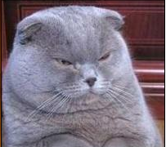

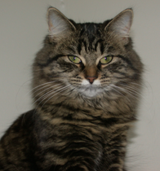
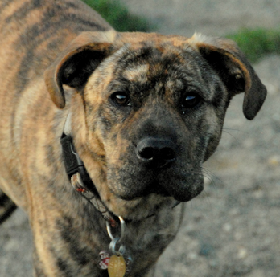
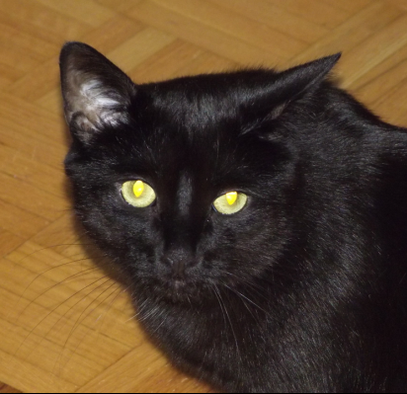
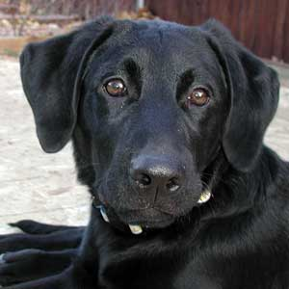
Multidimensional Scaling
Similar: Puffy, pet
Dissimilar: Species, colour, etc.
Similar: Short hair, colour
Dissimilar: Species, colour, etc.

Slide 41
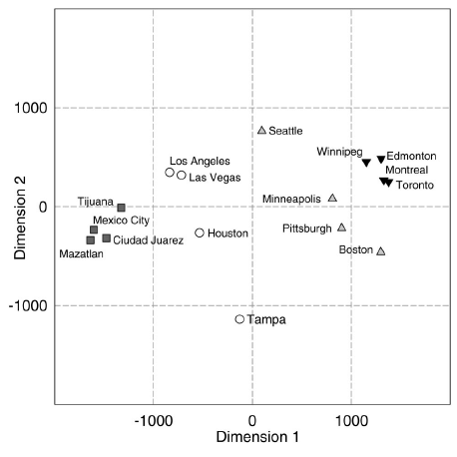
Friedman and Montello (2006)
A classic example of multidimensional scaling is to provide participants with pairs of city names.
A participant rates each pair in term of distance, e.g.,
  Boston-Toronto
  Pittsburgh-Mexico City
  Mexico City-Toronto
We can use these responses to recreate a map to see how people perceive the external world.

Slide 42
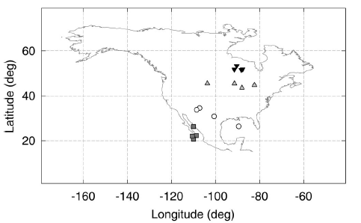
Friedman and Montello (2006)
To illustrate these distortions, Friedman and Montello (2006) plotted these on a map
Californian participants compressed more Canadian cities (Edmonton, Winnipeg, Montreal , & Toronto) relative to their own
We can use a similar technique to examine what people think about concepts and beliefs

Slide 43
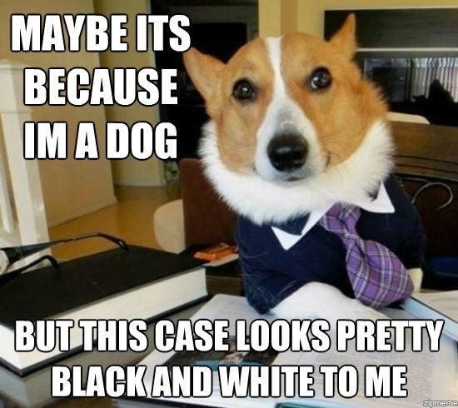
Multidimensional Scaling:
Robinson and Bennett (1995)
Robinson and Bennett (1995) wanted to develop a typology of deviant behaviours.
Harper (1990) notes that between 33-75% of employees engage in some form of misconduct including vandalism, fraud, theft, and absenteeism.
What underlying reasons could there be for this behaviour?

Slide 44
Defining Deviant Behaviour
As Robinson and Bennett (1995) note,
  “Employee deviance… [a] voluntary behavior that violates significant organizational norms and in so doing threatens the well-being of an organization, its members, or both. Employee deviance is voluntary in that employees either lack the motivation to conform to normative expectations of the social context or become motivated to violate these expectations,” (p. 556)
They go on to say that it can be distinguished from ethics in that the behaviour need not be considered in terms of right or wrong.

Slide 45
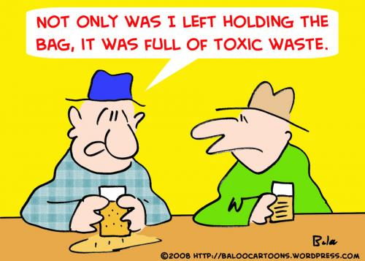
Differentiating Factors
The fact that an act can be both deviant or unethical, but need not be both implies that the two can vary independently of one another, e.g.,
  Dumping toxic waste: Highly unethical, conforms to organizational policy
  Reporting dumping of toxic waste: Highly ethical, contrary to corporate policy
Suggests that these might be two dimensions to define behaviour of individuals within an organization

Slide 46
Why Dimensions?
The purpose of identifying dimensions is ultimately to reduce the set of all possible contributing factors to a manageable number (i.e., although everything impacts behaviour, what is most important?).
Their typology provides “a useful starting point for developing a systematic, theory-based study of employee deviance,” (p. 557, Robinson & Bennett, 1995).
This rationale underpins all uni-/multidimensional scaling studies.
  We need to progress through several exploratory steps before we can begin

Slide 47
Materials
Phase 1: Participants recruited from a university office, industrial company, neighbourhood, MBA students, all were employed.
  Asked to note forms of misconduct
  Behaviours were then reduced to 45, e.g.
    Employee stealing customer's possessions.
    Boss verbally abusing employee.
    Employee sabotaging equipment.
    Employee coming to work late or leaving early.
    Employee gossiping about manager.
    Employee starting negative rumors about company.
    Boss sexually harassing employee.
    Employee physically abusing customer.

Slide 48
Materials
Phase 2: These forms of misconduct were then provided to another group of participants who had to rate how similar one behaviour was to another and provide criteria they used to rate items, e.g.,
    Boss verbally abusing employee.
    and
    Employee sabotaging equipment.
    1 9
    Very Similar Very Dissimilar

Slide 49
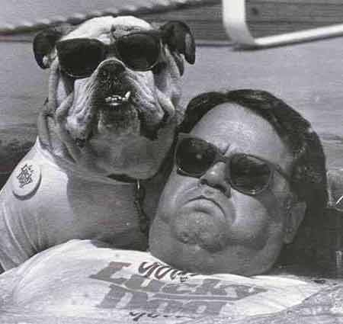
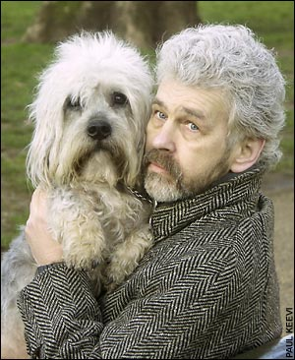
Similarity Results
Once we have obtained similarity ratings we can obtain the average similarity between any two forms of misconduct.
These average ratings give us a ‘distance’ in similarity multidimensional space, assuming that this is how close forms of misconduct are in our mind.

Slide 50
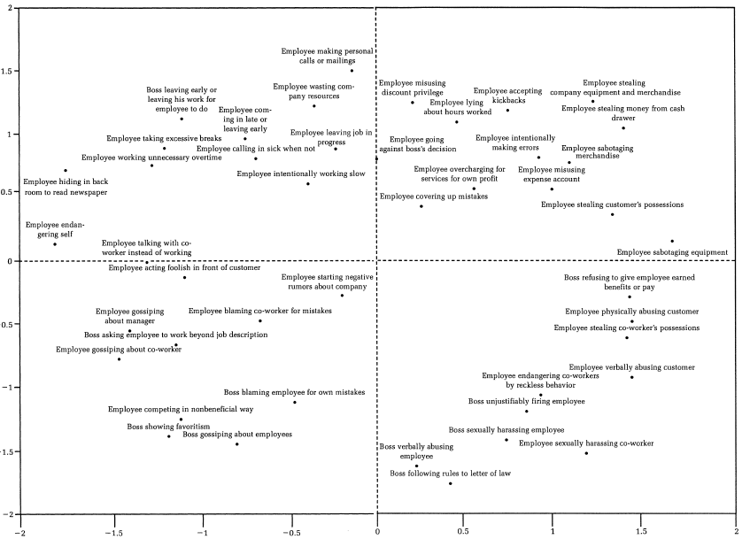
‘Working slow’
and ‘Covering up mistake ‘are reasonably close to one another. Suggests that they are similar.
Notice that we have left our dimensions unlabelled.
Unlike an experimental study, we need to interpret what these dimensions might be.
‘Verbal abuse’
and ‘Covering up mistake’ are reasonably far from one another. Suggests that they are dissimilar.

Slide 51
Phase 3 Results
The criteria information provided by the participants was then used to identify the dimensions along which misconduct was scaled.
The six most frequent criteria were then used as bipolar scales and given to new raters.
  Minor or Serious Deviance (Severity)
  Interpersonal versus Organizational Deviance (Ethical)
Thus, we were able to reduce a set of all possible behaviours to 45, and then to 2 dimensions.

Slide 52
W4L2a Review
Descriptive research is conducted using a variety of techniques.
Observational studies are used for ecological validity when context matters.
Many early developmental research studies employed descriptive research methods.
Survey results can be used to understand people’s beliefs and values; multidimensional scaling also allows us to see how people represent the world.

