Slide 1

Non-experimental and
Quasi-Experimental Designs:
Research Methods
PSYC/NEURO2001 Mon and Weds 14:30-17:30
Jordan Schoenherr
Carleton University

Slide 2
Overview of Lecture
General overview of research designs and the use of appropriate control groups
Cross-sectional and longitudinal designs
Moral Development from Piaget to Rest
Quasi-Experimental Design: Cognitive Anthropology

Slide 3
Non-Experimental Design
“What a man's mind can create, man's character can control.”
- Thomas A. Edison

Slide 4
Appropriate Controls in a Study
An experimental research design allows for the elimination of threats to internal validity by:
  the use of random assignment,
  the use of similar testing conditions.
Not all designs that appear experimental are experimental designs.
  The level of control of participant assignment to conditions and their characteristics need to be considered

Slide 5
The Problem with Experiments
We’ve spent a great deal of time discussing control of variables, operationalizing constructs, etc.
These are ideal settings but rarely do we find a phenomena conducive to study in this fashion, sometimes ecological validity matters or at least is inescapable.

Slide 6
The Problem with a Science of Humans
Put another way by Atran and Medin (2008):
  “Practically speaking, it may be impossible to disentangle [e.g., age, education, language, cosmology]. Suppose we could control for age, education, literacy, and the like in comparing Itza’ Maya and undergraduates. How do we represent what variables represent “culture” and therefore should not be controlled, and which variables do not and must be controlled? The Itza’ Maya practice agroforestry and also hunt and collect plants in the forest. Should these factors be controlled or are they part of the Maya culture?” (p. 54)

Slide 7
The Continuum of Internal Validity
Experimental, Quasi-experimental, and Non-experimental designs are located on a continuum based on the degree of control that we have over the variables of interest
Experimental
Highest degree of control;
Confounds limited;
Meaningful conclusions can be drawn.
Quasi-experimental
Moderate control over variables;
Confounds present;
Can cautious interpret results.
Non-experimental
No control;
Many potential confounds;
Difficult to generalize results.

Slide 8
Non-Experimental Design
Differential research | The comparison of pre-existing groups
One-Group Pretest-Posttest design | One group is measured before and after an intervention
Posttest-only nonequivalent control group design | One group is measured after a treatment while another is measured without having received a treatment

Slide 9
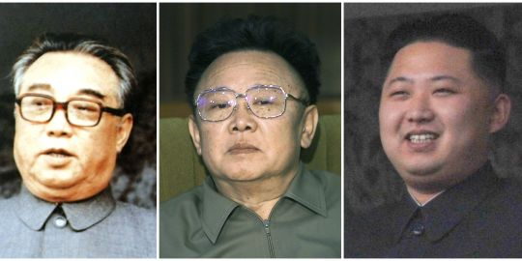
Non-Experimental Design
Longitudinal
t_{n}………………………………………………………………..t₁
Kim Jong-un
Kim Il Sung
Kim Jong-il
Cross
t₁
Secti
t₁
onal
t₁
Cross-sectional design. A developmental design comparing different groups of individuals, each group representing a different age.
Longitudinal design. A developmental research design that examines development by making a series of observations or measurements over time. Typically, a group of individuals who are all the same age is measured at different points in time.
Notes:
http://s1.lemde.fr/image/2011/12/19/540x270/1620400_3_8209_de-gauche-a-droite-kim-il-sung-kim-jong-il-et.jpg

Slide 10



The Time-Series Design
One of the best means to avoid spurious inferences from pre-test post-test designs, is to perform a time-series analysis
A number of observations are made of the participants or sample population being studied over time
This can either be a treatment (e.g., physiotherapy, reading lessons) or some other intervention

Slide 11

Changes from Fault to No-Fault Divorce
One behaviour that naturally affects many is divorce
  “Divorce has been viewed as one party accusing the other of failure to meet the obligations of a marriage contract. Only the innocent party can bring the divorce action; and final settlements are usually made at the expense of the guilty party,” (Mazur-Hart & Berman, p. 300)
  Identifying fault is difficult and does not generally reflect on one partner
Notes:
http://ceradubois.files.wordpress.com/2012/03/sexessign.jpg?w=529

Slide 12

Changes from Fault to No-Fault Divorce
Some have suggested that changes in divorce laws increase divorce rate (e.g., Doroghi, 1955; Mace, 1950)
In this case, we can use a time-series analysis to assess how divorce behaviour changes over time in Nebraska

Slide 13
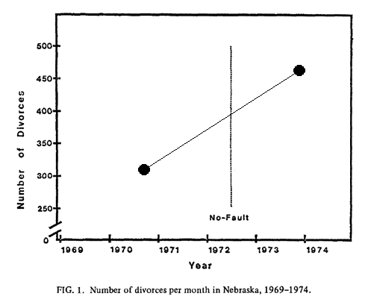
Yo-Fault to No-Fault Divorce
First, let’s consider their data averaged across time periods.
From this figure, does it seem that the introduction of no-fault divorce impacted divorce rate?
What might increased resolution tell us about whether this holds?

Slide 14
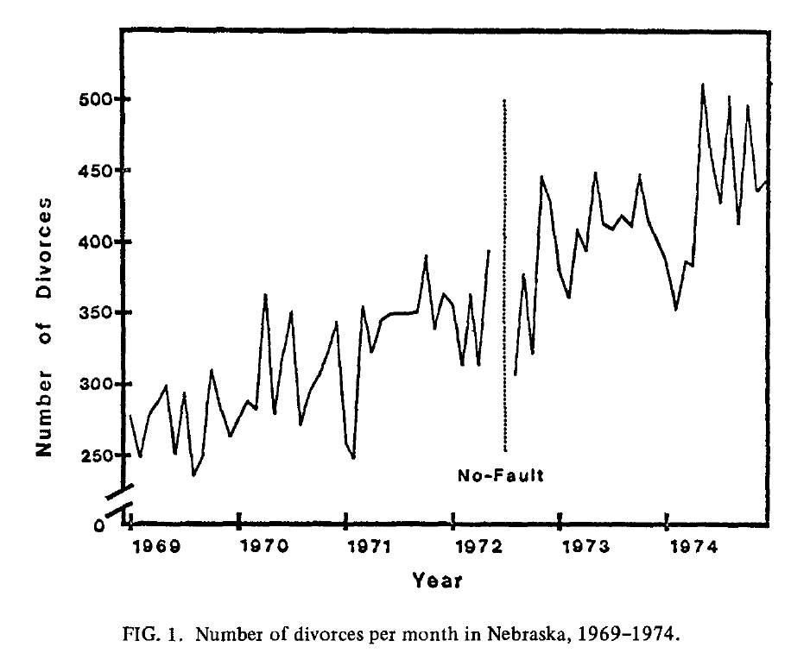
Yo-Fault to No-Fault Divorce
When we take more measurements (i.e., expand our time-series) we gain more information about the apparent impact on no-fault divorce
Now, does it seem that the introduction of no-fault divorce impacted divorce rate?

Slide 15
Issues with Cross-Sectional Design
The use of cross-sectional design brings with it one principle concern:
Cohort / Generational Effects: Individuals within a given age group might have been subjected to similar conditions outside of the experiment (e.g., 9/11; educational reform; changing social norms) and might exhibit changes for a reason other than our treatment

Slide 16
Developmental Studies:
A Survey of Methods
“Laws control the lesser man... Right conduct controls the greater one.”
- Mark Twain

Slide 17
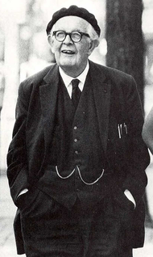
Cross-sectional Design:
Piaget’s Developmental Sequence
The classic cross-sectional design is likely that provided by Jean Piaget
Starting from observations of the development of his own children (longitudinal), Piaget believed that we passed through several developmental stages
Consisting of selecting children within these stages

Slide 18
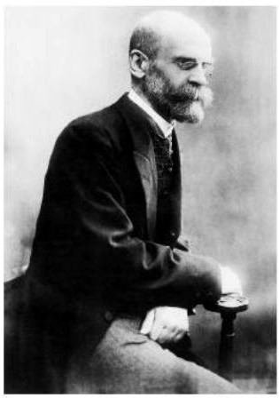
Cross-sectional Design:
Piaget’s Developmental Sequence
At the time, Emile Durkheim (1925) had proposed that society was the primary determinant of norms and values
  Child must conform to social values
Piaget believed that there were pre-determined stages of moral development that children must pass through within a social context
  He insists, in contrast to Durkheim, that morality develops beyond this mere adherence to social norms

Slide 19
Aspects of Stages
Qualitative differences
  Children should respond in a different manner depending on the stage they are currently within
Structured wholes:
  Children should respond consistently in the same manner, responding with the same reasoning on different items
Invariant sequence:
  Children should pass through these stages in a consistent manner (e.g., from Stage 1 to 2, from Stage 2 to 3)
  No stage is skipped, the order is the same for all children

Slide 20
Aspects of Stages
Hierarchic integration
  Children build on knowledge gained from one stage in the next stage, they do not regress
Universal sequence:
  All children go through these stages regardless of gender, race, cultural background, etc.

Slide 21
Piaget’s Developmental Sequence:
Methods
Piaget employed several methods:
Game of Marbles (and hide and seek): Examined children’s awareness of rules, the extent to which they cooperate, how rules are acquired.
Moral Stories: Children were told stories about fictional children who had committed an act (e.g., breaking a cup).
Stage 0
Stage 1
Stage 2

Slide 22
Cross-sectional Design:
Results Stage 0
Pre-moral (0 to 3 years): At this stage, children do not follow rules (moral or otherwise).
In games of marbles, children do not use any rules, take turns, etc.
When rules do exist, they are idiosyncratic at best and applied inconsistently.
Stage 0
Stage 1
Stage 2

Slide 23
Cross-sectional Design:
Results Stage 1
Moral Realism (5 to 9 yo): Child understands and uses rules. They take them to be inviolable and obey them regardless of their nature: rules are absolutes.
When children are presented with a scenario (e.g., a child breaks cups) they focus on consequences (outcome) not intentions (why the act occurred).
Breaking rules is assumed to result in punishment: if you break the rules, you will get caught.
Stage 0
Stage 1
Stage 2

Slide 24
Cross-sectional Design:
Results Stage 2
Moral Relativism (> 7 yo): Child now exhibits consciousness of the arbitrariness of rules. They can reason outside of those rules that they have been provided.
When children are presented with a scenario (e.g., a child breaks cups) they focus on intentions (why) and not the outcome (consequences).
Rule are considered to be secondary to fairness and justice.
Stage 0
Stage 1
Stage 2

Slide 25
Kohlberg: More Stages (Sort of)
Perhaps the most influential moral framework is that provided by Lawrence Kohlberg (for criticisms, see Gilligan, 1982).
He extends Piaget’s developmental stages across the lifespan.
Rather than an open-ended interview process, Kohlberg instead sought to provide participants with a variety of moral dilemmas and examine what considerations played into their reasoning.

Slide 26
The Heinz Dilemma
"In Europe, a woman was near death from a special kind of cancer. There was one drug that the doctors thought might save her. It was a form of radium that a druggist in the same town had recently discovered. The drug was expensive to make, but the druggist was charging ten times what the drug cost him to make. He paid $200 for the radium and charged $2,000 for a small dose of the drug.
The sick woman's husband, Heinz, went to everyone he knew to borrow the money, but he could only get together about $ 1,000 which is half of what it cost. He told the druggist that his wife was dying and asked him to sell it cheaper or let him pay later. But the druggist said: "No, I discovered the drug and I'm going to make money from it." So Heinz got desperate and broke into the man's store to steal the drug-for his wife. Should the husband have done that?" (Kohlberg, 1963).

Slide 27
The Heinz Dilemma: Responses
Kohlberg did not simply assess the ‘yes’ or ‘no’ response provided by the dilemma
Follow-up questions included whether Heinz:
  had a right to steal the drug
  was violating the rights of the druggist
  should be sentenced to prison and for how long
Kohlberg used multiple raters to assess the stage of moral reasoning thought to be maintained by the child
  Using this method, Kohlberg identified 3 stages

Slide 28
Kohlberg: More Stages (Sort of)
1. Pre-conventional: (self focus) < 10-13 yo
  1a. Punishment and Obedience
  1b. Self-interest
2. Conventional: (social focus) School to Middle Age
  2a. Interpersonal Accord and Conformity
  2b. Social order and Authority
3. Post-conventional: (justice focus) Middle Age (maybe)
3a. Social contract orientation
3b. Universal ethical principles

Slide 29
Kohlberg: More Stages (Sort of)
1. Pre-conventional: (self focus)
  1a. Punishment and Obedience
  Obeys rules
  Moral judgments are based on avoidance of punishment
  1b. Self-interest
  Concrete individual interest (i.e., accomplishing some task) are used to guide moral reasoning
  Moral judgments are guided by fulfillment of self-interest
“Interviewer: Why shouldn’t you steal from a store?
Subject: It’s not good to steal from the store. It’s against the law. Someone could see you and call the police,” (Kohlberg, 1976) >>> 10 yo

Slide 30
Kohlberg: More Stages (Sort of)
2. Conventional: (social focus)
  2a. Interpersonal Accord and Conformity
  Considers the expectations of others
  Moral judgments guided by desire to be included in a group
  2b. Social order and Authority
  Considers requirements of social system
  Moral judgments guided by respect for social hierarchy and authorities
“Subject: It’s a matter of law. It’s one of our rules that we’re trying to help everyone. It’s something that’s needed in our society. If we didn’t have these laws, people would steal…,” (Kohlberg, 1976) >>> 17 yo

Slide 31
Kohlberg: More Stages (Sort of)
3. Post-conventional: (justice focus)
3a. Social contract orientation
  Rules are maintained to be impartial toward all members of a society (utilitarian principle)
  Moral judgments guided by social respect
3b. Universal ethical principles
  Ethical principles are created by the individuals, even resulting in conflict with social norms (e.g., law)
  Moral judgments are guided by personal conscience
“Subject: It violates another person’s rights, in this case property….the law in most cases is based on what is morally right… (morally right means) recognizing the rights of other individuals, first to life and then to do as he pleases as long as it doesn’t interfere with somebody else’s rights,” (Kohlberg, 1976) >>> 21 yo

Slide 32
Contemporary Stage Theorists
Despite criticisms, Kohlberg’s theory is still widely used
One recurrent issue is that we need to rely on inter-rater reliability to identify stages
Rest (1979) devised an alternative Defining Issues Test:
  Participants were presented with 12 of these dilemmas and have to rate 12 alternatives
  Each of these responses was developed to correspond to 1 of the 6 stages

Slide 33
Rest’s DIT: Extending Kohlberg
Items are designed to be ‘fragments’ of the way that an individual thinks about the problem,
e.g., Item 1 is concerned with social order and authority (2b) whereas Item 2 is concerned with interpersonal accord and authority
DIT Items for Heinz Story
1. Whether a community’s laws are going to be upheld?
2. Isn’t it only natural for a loving husband to care so much for his wife that he’d steal?
5. Whether Heinz is stealing for himself or doing this solely to help someone else?
10. Whether the law in this case is getting in the way of the most basic claim of any member of society?

Slide 34
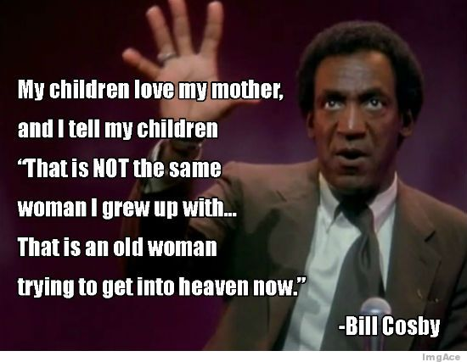
Longitudinal Design
Instead of taking a cross-section, we might need to monitor the development of someone over time,
The benefit to this approach is that we use the same participants and take repeated measures of the variable we are interested in,
e.g., Kohlberg’s (1976) replication.

Slide 35
Longitudinal Study of Personality
Recall from last class that personality traits (as opposed to states) are believed to be stable,
If this is the case, then an examination of how participants behave from one age to the next should be highly reliable,
  Act nomination
How can we analyze the results we obtain from the ratings provided for each child across their early lifespan?

Slide 36
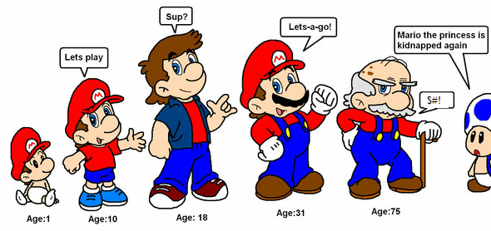
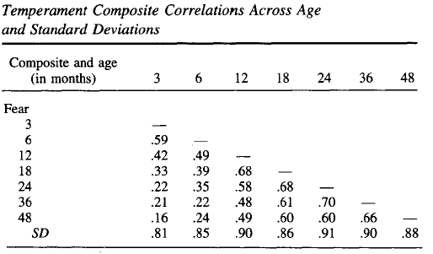
Longitudinal Study of Personality
Lemery et al., (1999) conducted just such a study analyzing children from 3 mo to 48 mo for a variety of behaviours: e.g.,
  Positive emotionality;
  Fear;
  Activity level.
The correlations they obtained suggest that behaviour, such as fear, showed a great degree of stability.

Slide 37
Naturalistic Decision-Making:
A Non-Experimental (Qualitative) Method
“When you have to make a choice and don't make it, that is in itself a choice.”
- William James

Slide 38
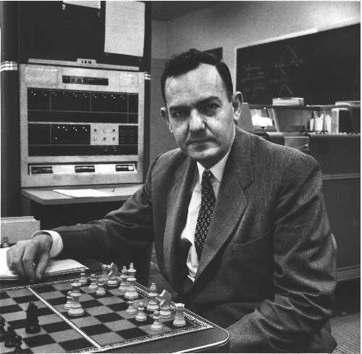
Decision-Making: Bounded Rationalities
It was long thought that the ‘faculty of reason’ was used to make decisions
  You simply sat back, thought about the features of a situation, and then took action.
Herbert Simon noted that people could be understood to rational if we considered the context:
  Bounded Rationality

Slide 39
Decision-Making: Bounded Rationalities
Simon (1956) notion of bounded rationality
  Optimization is not a realistic goal
  Objective of decision-making is satisficing
  Models of decision-making need to consider constraints of the environment (e.g., available information) and the individual (e.g., perceptual limitations and short-term memory).

Slide 40
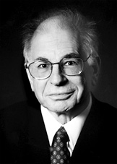
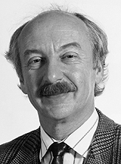
Decision-Making: Bounded Rationalities
Considerable debate over two contemporary approaches:
Heuristics and Biases (Tversky and Kahneman)
  We should use models of optimization as standards (e.g., homo economicus),
  Humans frequently err in their judgments.
Ecological Rationality (e.g., Gigerenzer, Thorngate)
  Optimization is neither realistic, nor desirable,
  Humans are accurate in a wide variety of situations.

Slide 41


Decision-Making: Bounded Rationalities
Both approaches tell us something about human behaviour,
  Heuristics and Bias: prescriptive (what we should do),
  Ecological rationality: descriptive (what we actual do).
These approaches typically study how people think in laboratory context,
Gary Klein conducted studies in the context of firefighting, military operations, and nursing.
Notes:
http://upload.wikimedia.org/wikipedia/commons/thumb/d/d6/USS_Vincennes_launching_SM-2MR_in
http://www.unb.ca/cel/programview/_resources/img/prof-dev/nurse.jpg_1987.jpg/170px-USS_Vincennes_launching_SM-2MR_in_1987.jpg

Slide 42
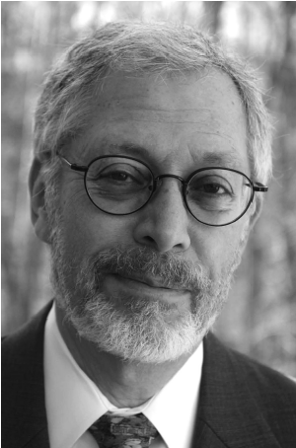
Decision-Making: Bounded Rationalities
Klein’s approach is fairly straightforward
  Participants are asked to recount a critical experience as a story,
  Two researchers
    One solicits the story (interviews),
    Another goes through a checklist to make sure relevant features that are being studied are assessed.
  Items that are recorded during the interview are later categorized.

Slide 43
Decision-Making: Bounded Rationalities
Type of Strategy | Number of Cases
Choosing from preselected options | 0
Comparative evaluation | 18
Novel option | 11
Recognitional decision | 127
Total decision points | 156
Adapted from Klein (1998)
How do we make decisions?
Klein looked for ‘decision points’, a point where options exist and an individual could have selected an alternative course,
Klein observed that firefighter commanders did not engage in deliberation; rather, they seemed to act without comparing alternatives.

Slide 44
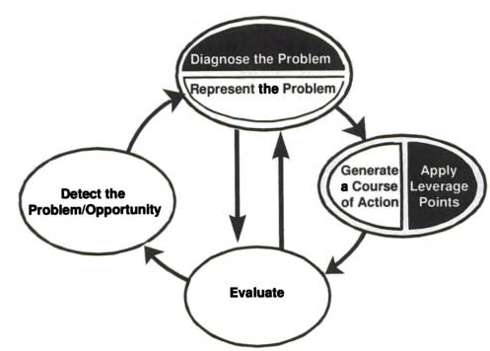
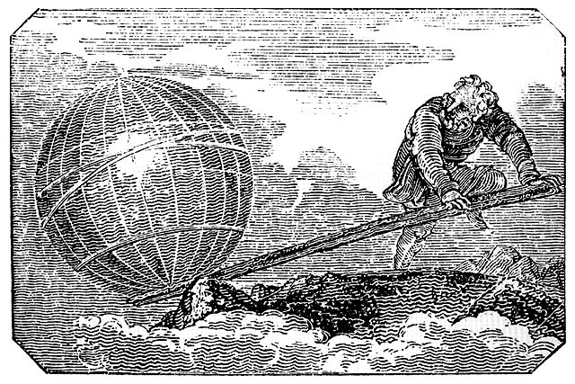
Naturalistic Decision-Making
Non-linear problem solving.
From their research, Klein and colleagues (e.g., Klein, 1998) proposed a model of decision-making: Recognition-Primed Model
In short,
  Individual recognizes situation in terms of whole or features as typical or atypical,
  Information is primed in memory,
  Mental simulation results where necessary.
Notes:
http://www.books-that-can-change-your-life.net/wp-content/uploads/2011/10/image.png
http://www.trainingforwarriors.com/wp-content/uploads/2011/08/Lever2.jpg

Slide 45

Limitations of Qualitative Research
Methods for collecting are useful for ecologically valid settings,
  They allow us to examine the numerous factors that affect our behaviour → rich dataset
In the case of Klein’s (and colleagues’) research, there are a few basic limitations,
1) Reliance on self-reports,
2) Reports are provided after the fact, and
3) Situation is outside our control.
Notes:
https://www.cfpsa.com/en/AboutUs/PSP/DFIT/Fitness/PublishingImages/firefighter%20pic%201.jpg

Slide 46
Quasi-Experimental Design
“Just cause you got the monkey off your back doesn't mean the circus has left town.”
- George Carlin

Slide 47
Quasi-Experimental Design
Definition: A research strategy that attempts to limit threats to internal validity and produce cause-and-effect conclusions (like an experiment), but lacks one of the critical components—either manipulation or control—that is necessary for a true experiment.
Typically compares groups or conditions that are defined with a variable that is not manipulated.
  School-based research
  Cross-cultural studies

Slide 48
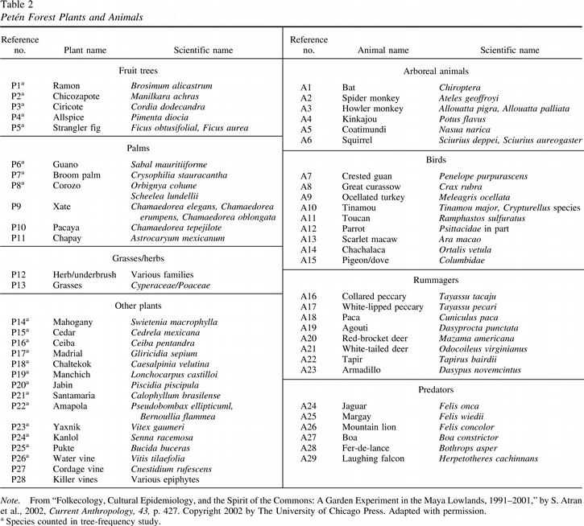
Cognitive Anthropology:
Naturalistic Experimental Designs
In the first lecture, I mentioned the divergence between folktaxonomies and scientific taxonomies,
One of the issues faced by cognitive anthropologists is that these animals are situated in a natural context, e.g., the jungle,
Removal of a specimen from its context might decrease the precision of a measure.
Arboreal
Bats,
Monkeys,
Squirrel.
Predators
Jaguars , boas and falcons.

Slide 49
Cognitive Anthropology:
Naturalistic Experimental Designs
In a study of ethnobotanical taxonomies by Brent Berlin (see Berlin, 1992), he addressed this issue
  Nonrandom sample selected:
    “The sample used… consisted of Itza’ Maya elders who speak Itza’ Maya. That fact alone makes the sample unusual and unrepresentative because Itza’ is a dying language,”(p.54, Atran & Medin, 2008)
  Identified several species of plants and varietals
    Plants necessarily grow in a certain ecological context but once we have an idea about what plants make up a species, we can select varieties to compare

Slide 50
Cognitive Anthropology:
Naturalistic Experimental Designs
In Berlin’s study we cannot control who has the knowledge nor the species and their taxonomical relationship (i.e., we can’t make a bat belong to arboreals or predators),
Previous studies had informants walk through the jungle and identify animals and plants as the researchers and guide encountered them,
We can control what is being presented to the informants and the order in which they are presented to make this more experimental.

Slide 51

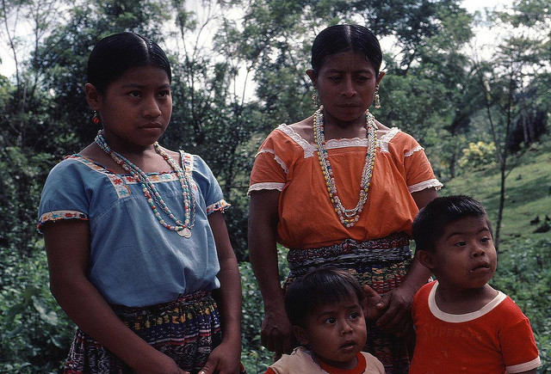
Cognitive Anthropology:
Naturalistic Experimental Designs
Berlin took his sample of plants from various species and placed them along a specified path,
Informants were taken along the path and asked to name each plant,
Berlin could now present a group of participants with the same species to obtain more, consistent observations.
Notes:
http://www.cs.utexas.edu/~moore/publications/zurich-05/jungle-path.jpg

Slide 52
W4L1 Review
Experimental and non-experimental designs exist on a continuum of internal validity
A subtle distinction exists between differential designs and correlational designs
Developmental studies are a special class of cross-sectional and longitudinal designs with time-series analysis
Quasi-experimental designs have considerable use when ecological validity is a necessity

Slide 53
Abstract
A template has been provided online: use it!
It contains:
  3 examples of abstracts (excellent, good and bad)
  The format that I want the abstracts in.
If you do not use the format provided in the template, you will lose marks (see template)
The due date has been extended to Monday, June 3rd, 23:59.

Slide 54


Abstract
Use Strunk and White for writing tips and your book for APA format
All the references you need are in the lectures from last week (and one from this week)
  You have considerable latitude for what you want to say but…
  Use Costa and McRae, and Goldberg references (in APA format) as they pertain to the theory and methods
Exchange with a few of your peers (that’s what we do in research).

Slide 55
Peer Review
Note that the Peer Review form needs to be included along with your first draft, and your final assignment in the same file (i.e., on a page that follows the final document).
The Peer Reviewed abstract and comments should be contained on a separate page, i.e.,
  Page 1: Final assignment (properly formatted),
  Page 2: Draft Abstract + Peer Review
    Simply Cut & Paste the draft into the form and locate it at the bottom.

Slide 56
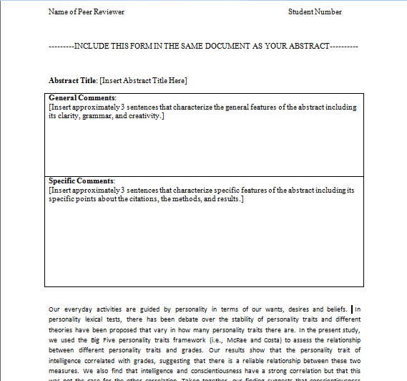
Peer Review
Remember: Give yourself time! The objective is to have a better product at the end than you started with.
You are include your original product so that we can see the change.
  Also, its ‘worth’ 2 points.

