Slide 1

Research Integrity and Ethics:
It’s All Good… or is It?
Part Deux!
Research Methods
PSYC/NEURO2001 Mon and Weds 14:30-17:30
Jordan Schoenherr
Carleton University

Slide 2
Animal Research Ethics
“The greatness of a nation can be judged by the way its animals are treated.”
- Mahatma Ghandi

Slide 3
Animal Models
Previously, we discussed how animals (including humans) evolve to develop adaptive traits that are:
  Homologous, or
  Analogous.
A suitable animal model is identified, and then tests are performed,
  What counts as suitable depends on the trait / characteristic that we are studying.

Slide 4
Contributions of Animal Research
Several key areas where animal models have been used (Domjan & Purdy, 1993):
  Biological bases of behaviour; Sensation and perception
  Motivation and Emotion
  Conditioning, Learning/Memory, and Forgetting
  Developmental Psychology
  Psychoactive Drugs and Drug Abuse
  Psychopathology and Treatment
Mitchell et al., (1984) note:
  “… cats and monkeys … provide an insight into the origins of the severe visual deficits associated with deprivation amblyopia….”
  They are analogous and homologous structures, respectively!

Slide 5
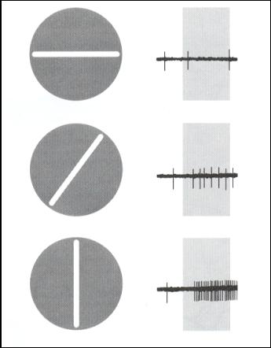
Cat Eyes: Orienting to Animal Research
By means of single cell recordings, researchers determined that we have neurons specialized to detect certain patterns in our environment (Hubel,1963 from Reisberg, 2001)
An invasive procedure required to obtain these recordings

Slide 6
Ethics and Animal Research
Animal research in Canada is regulated by the Canadian Council on Animal Care http://www.ccac.ca/en/CCAC_Main.htm
All research using animals should be evaluated to see if the following criteria can be applied
  reduction
  replacement
  refinement

Slide 7
Ethics and Animal Research
If animals must be used, they should be maintained in a manner that provides for their physical comfort and psychological well-being
Animals must not be subjected to unnecessary pain or distress. The experimental design must offer them every practicable safeguard, whether in research, in teaching or in testing procedures; cost and convenience must not take precedence over the animal's physical and mental well-being

Slide 8
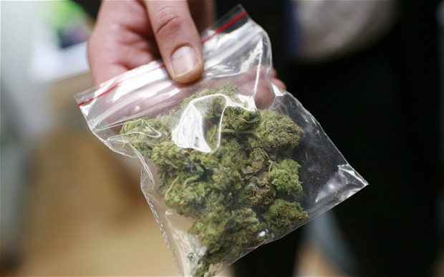
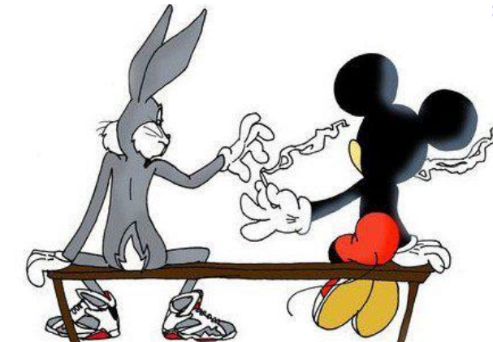
Oh Rats!
Animals have also participated in research on drug use,
For instance, Kucewicz et al. (2011) wanted to examine the effect of stimulating cannabinoid receptors on neural communication,
“In vivo electrophysiological recordings. All procedures were conducted in accordance with the UK Animals (Scientific Procedures) Act, 1986 and with the approval of the University of Bristol Ethics Committee. Six adult (300 – 400 g) male Long–Evans rats (Harlan) were chronically implanted with ... recording electrodes.” (p. 15561)

Slide 9
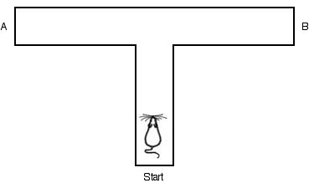
Experiments with Rats: You’ll be a-Mazed
Pre- / Post-test design,
Rats were injected with the cannabinoid,
  Trained on the T-Maze
Kucewicz et al. (2011) observed:
  Reduced accuracy,
  Impaired neuronal communication, and
  Impaired task-dependent activity.

Slide 10
W3L1b Review
Scientific integrity addresses a number of concerns that go beyond considerations of research ethics
Gross violations of scientific integrity, or misconduct, are rare but questionable practices are plentiful but hard to identify
Research ethics consists of principles and procedures to ensure the safety of our participants including both humans and animals

