Slide 1

Research Integrity and Ethics:
It’s All Good… or is It?
Research Methods
PSYC/NEURO2001 Mon and Weds 14:30-17:30
Jordan Schoenherr
Carleton University

Slide 2
Overview of Lecture
Defining Scientific Integrity and research ethics
Scientific Integrity and Misconduct
Basic Values and Principles of Psychology
Research Ethics

Slide 3
Professional Integrity
“It is curious - curious that physical courage should be so common in the world, and moral courage so rare.”
- Mark Twain

Slide 4
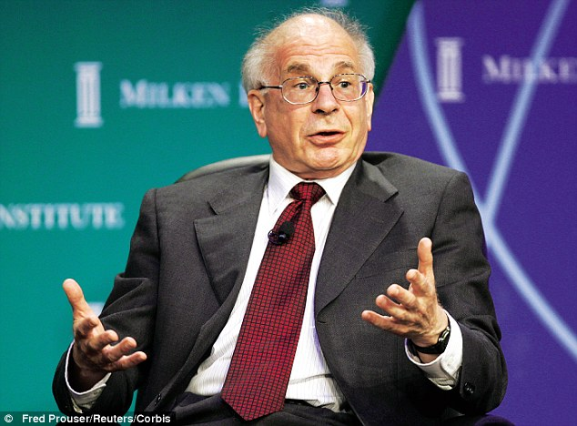
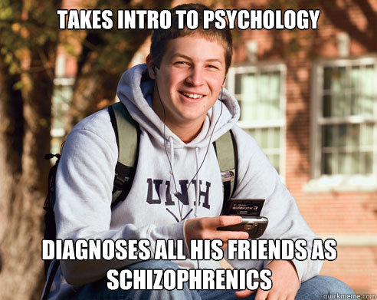
Psychology as a Profession
Psychology is a profession: we receive remuneration to engage in particular activities be it research, counselling, or consulting.
Number of research areas runs the gamut from natural sciences (e.g., neuroscience, psychophysics) to the social sciences (e.g., social, personality)
  For this reason we likely have the broadest set of considerations for conduct of our profession
A common thread in the sciences: we share similar norms in terms of how our profession conducts itself

Slide 5
Situating Research Ethics
Subordinate: research activities such as experimental design, statistical analysis, etc.
Issues generally transmitted through mentor/
supervisors
Some issues covered in institutional policies on research and COI as well as by statements from scientific societies
Basic: science practices such as authorship, publication, peer review, etc.
Superordinate:
Honesty, transparency, etc.
General standards covered by legal statutes

Slide 6
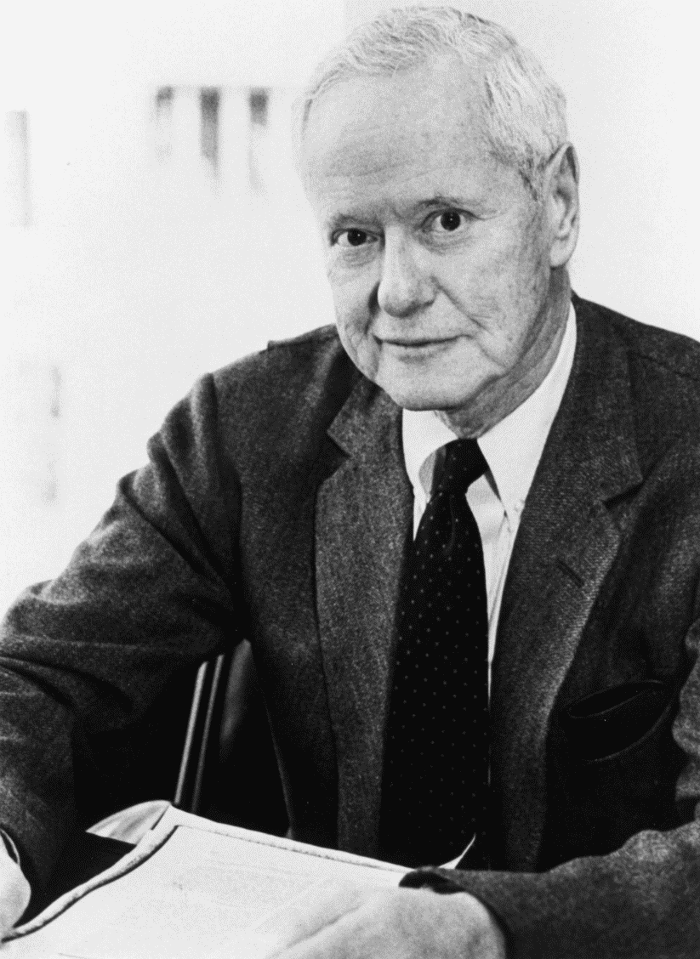
Normative Structure of Science
Mertonian (1942; 1951) norms most frequently cited
  Communality: scientists function as a community
  Universality: scientists seek to acquire generalizable knowledge about the nature of reality
  Disinterestedness: scientists must be free from bias
  Organized Scepticism: Scientists must not take research at face value and must be critically reflective of results and findings
Robert K. Merton
Notes:
http://archivosociologico.files.wordpress.com/2010/04/merton.gif

Slide 7

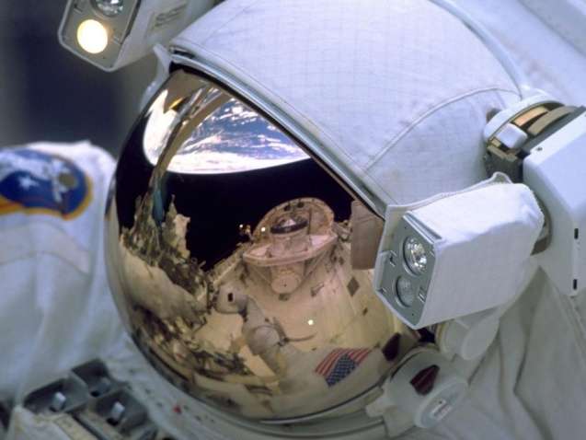
Normative Structure of Science
Later normative frameworks identified scientific norms as:
  Extension of general norms (Bronowski, 1965),
  Merton’s norms and counter-norms (Mitroff, 1974),
  Pragmatic responses to the context in which research is conducted (Ziman, 2000; 1996)
    proprietary, local, authoritarian, commissioned, and expert
Notes:
http://farm4.staticflickr.com/3394/3344904390_709a67edea_z.jpg
http://3.bp.blogspot.com/-yKybFP_LblY/Twb7YN4L6II/AAAAAAAAD24/_AxA7SCXRAU/s1600/emu-helmet-closeup.jpg

Slide 8
Ethical Principles of the APA
APA defines Five general Principles: (FIBJR)
  Beneficence and Nonmaleficence
    We perform our activities (e.g., research and counselling) to increase the wellbeing of those populations being studied and the general population.
  Fidelity and Responsibility
    Ensure that we maintain trust with clearly defined roles and obligations.
  Integrity
    Promote accuracy, honesty and truthfulness in the science, teaching and practice of psychology.

Slide 9
Ethical Principles of the APA
APA defines Five general Principles (FIBJR)
  Justice
    Strive for fairness and justice for all persons to access to and benefit from the contributions of psychology.
  Respect for People's Rights and Dignity
    Psychologists respect the dignity and worth of all people, and the rights of individuals to privacy, confidentiality, and self-determination.

Slide 10
Ethical Principles of the APA
What should be clear from these general principles is that they don’t always apply to the research process
  Again, the breadth of psychology requires more specific principles beyond that of research
The relationship of scientific integrity and research ethics can be understood as a subordinate one

Slide 11
What is Research Ethics?
Research ethics is frequently cited as essential to the research process.
  Are all ethical violations equal?
  Does research ethics apply to all facets of research from experimental design to conducting a experiment to reporting results?
  Is research ethics only applicable to humans?

Slide 12
Research Integrity and Misconduct
“We are what we repeatedly do. Excellence, then, is not an act, but a habit.”
- Aristotle

Slide 13
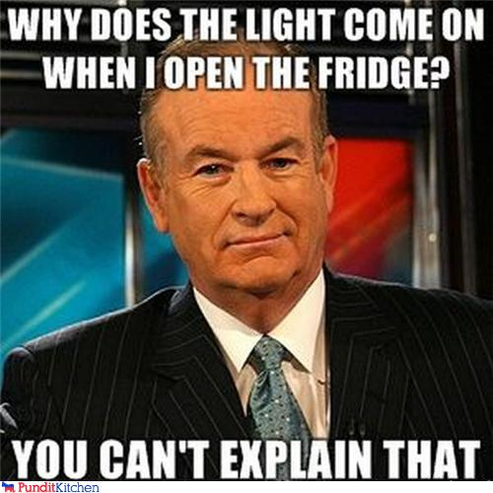
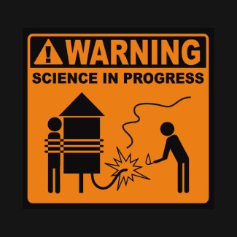
Integrity and Ethics
“Stop and look around, it's all astounding,
Water, fire, air and dirt,
F*ing magnets, how do they work?
And I don't wanna talk to a scientist,
Y'all mother*s lying, and getting me p*” - ICP
Scientists (7.1 M) requires public trust in order to obtain funds ($1T U.S.) and conduct studies (1.94 M publications in 2010),
Numerous pundits and pop-culture icons use some acts of misconduct and the inherent uncertainty associated with research as a rationale to attack science as a whole.
Notes:
http://royalsociety.org/policy/projects/knowledge-networks-nations/report/

Slide 14
Integrity and Ethics
One means to examine research ethics is to contrast it against broader concerns of integrity
Scientific integrity, the proper conduct of scientific activities, has been of considerable interest since the 1980s as a result of scientific misconduct, the gross violation of scientific norms

Slide 15
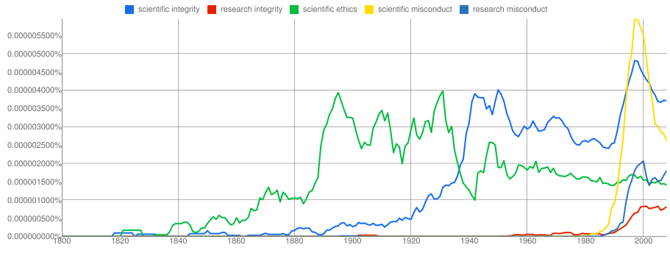
Scientific/Research Integrity
In general, greater interest in these areas is evidenced in the mid-1980s.
Research integrity has not always been a concern, nor have people been concerned with it to the same extent.
Notes:
Source: Google Ngram
As evidenced by Google Ngram corpus, research/scientific integrity has been a growing topic of interest

Slide 16
Ethical Violations v. Research Misconduct:
The Cyril Burt affair
Cyril Burt was a renowned psychologist:
  “as long as psychology remains a subject of scientific inquiry he will live in its halls of fame,” Hearnshaw (1972)
Conducted twins studies to examine heritability of intelligence over a number of years
Studies were considered to be fraudulent on three grounds

Slide 17
Difficulties with Studies: Accusations
Three aspects of the study suggested misconduct:
Extra 32 pairs of identical twins (reared apart) reported between Burt's articles initial publication in 1955 and a later analysis in 1966, were invented.
Two research assistants who supposedly collected the data on identical twins (reared apart) from 1955 to 1966 did not exist.
The IQ correlations were contrived because they remained invariant even though the sample sizes changed when the additional participants were added.

Slide 18
Difficulties with Studies: Rebuttals
Joynson, R. (1989). The Burt Affair. Routledge Chapman Hall, London.
  Response to 1: Most of these cases had been collected earlier but the data had been mislaid (not lost) during the wartime moves.
  Response to 2: Howard and Conway collected the data, not during the years of 1955 to 1966, but before the war, mostly in the 1920s and 1930s, makes it less surprising that the two assistants have been difficult to trace; moreover, some trace of them has been uncovered.
  Response to 3: The IQ data do not support this charge when comparisons are made between papers in which the sample size had truly changed.

Slide 19
Research/Scientific Integrity
Scientific integrity consists of a constellation of norms governing the conduct, analysis and communication of research whereas research misconduct consists of:
  Misreporting research results
    Fabricating or falsifying data set
    Manipulating figures and graphs
  Plagiarism (Self or Other)
  Duplicate publications
  Honourary/Gift authorship
  Failure to acknowledge the contributions of others (Ghost authorship)

Slide 20
Practical Effect of Misconduct
Although some practices like duplicate publication might seem like a benign practice to boost one’s publication record, it has deleterious effects on the scientific record, e.g.,
  Increases number of citations
  Increases likelihood of receiving funding
  Inflates effect sizes in metaanalysis
Conduct must be viewed along a continuum:
  FFP: Fabrication, Falsification and Plagiarism
  QRP: Questionable Research Practices
  RCR: Responsible Conduct of Research

Slide 21
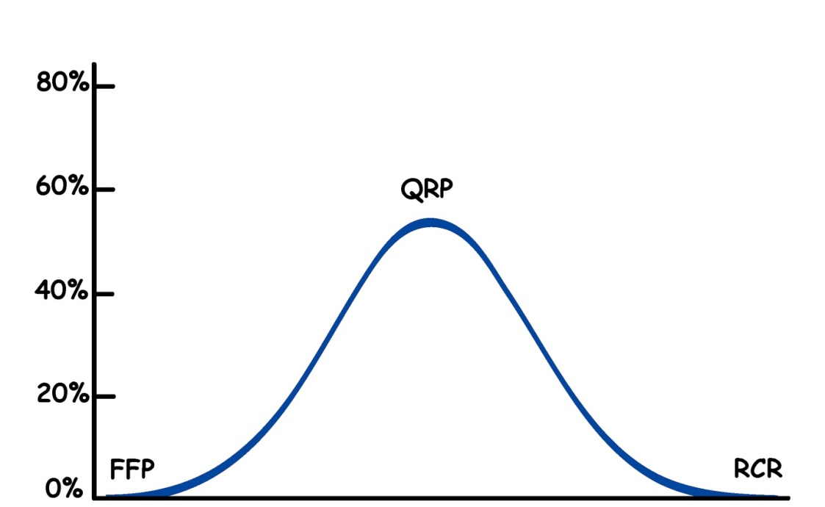
The Continuum of Scientific Conduct:
Misconduct Frequency
Are we in danger?
‘Best practices’ are rare, as are extreme cases of misconduct
Questionable Research Practices ~10% - 50%*
Fabrication, Falsification & Plagiarism
~1.5% - 0.001%*
Responsible Conduct of Research
Notes:
e.g., Fanelli D (2009) How Many Scientists Fabricate and Falsify Research? A Systematic Review and Meta-Analysis of Survey Data. PLoS ONE 4(5): e5738. doi:10.1371/journal.pone.0005738
http://www.plosone.org/article/info%3Adoi%2F10.1371%2Fjournal.pone.0005738

Slide 22
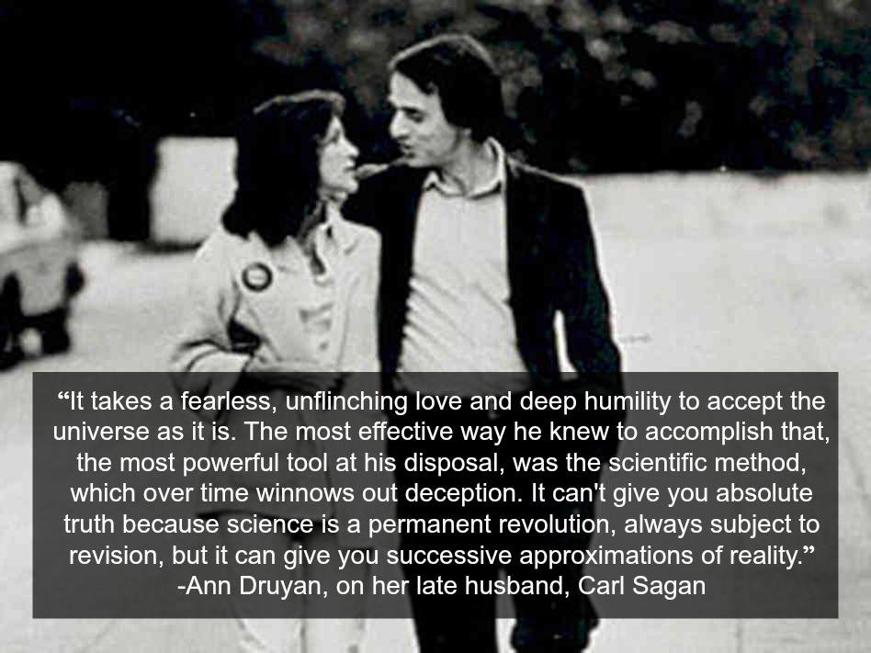

Slide 23
Research Ethics: Historical Antecedents
“I’m driven by two main philosophies: know more today about the world than I knew yesterday and lessen the suffering of others. You’d be surprised how far that gets you”
- Neil deGrasse Tyson

Slide 24
Ethics in Research: An Overview
Influences on contemporary research ethics naturally include philosophy and can be seen to date back to Hippocrates:
  “I swear by Apollo, the healer, Asclepius, Hygieia, and Panacea, and I take to witness all the gods, all the goddesses, to keep according to my ability and my judgment, the following Oath and agreement …
  I will use my power to help the sick to the best of my ability and judgement; I will abstain from harming or wronging any man by it.”
Our modern concerns are far more pragmatic

Slide 25
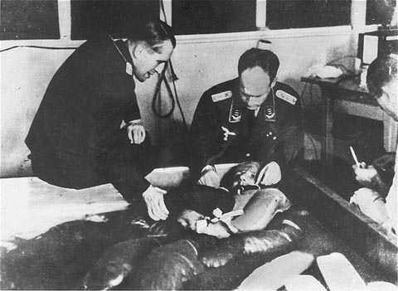
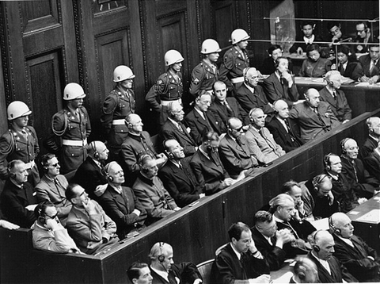
Nuremberg Trials
The Doctor Trials: transcript excerpt Leo Miechalowski
  Polish priest imprisoned by the Germans at Dachau concentration camp (1940 to 1945). Nazi doctors at Dachau intentionally infected Miechalowski with malaria to determine effectiveness of various anti-malarial compounds; also forced him to endure low temperatures to test the effects of hypothermia on the human body

Slide 26
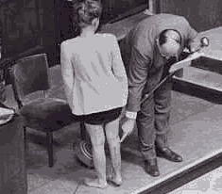
Nuremberg Trials Excerpt
Q: Father, do I understand you to say that you were injected with malaria in the middle of 1942?
A: It was approximately in the middle of 1942 when I was infected with malaria.
Q: And you were not asked your consent to the malaria experiment?
A: No. I was not asked for my consent.
Q: And you did not volunteer for this experiment?
A: No. I was taken in the manner which I have just described.
Woman who was subjected to
experimentation by Nazi doctors testifying at Nuremberg Doctor’s Trial

Slide 27
Nuremberg Trials
Exerpt from opening statement in Doctors Trial by Brig. General Telford Taylor (December 9, 1946)
  Whatever book or treatise on medical ethics we may examine, and whatever expert on forensic medicine we may question, will say that it is a fundamental and inescapable obligation of every physician under any known system of law not to perform a dangerous experiment without the subject's consent.

Slide 28
Nuremberg Code
The outcome of the Nuremberg Trial was the creation of the first code of ethics
Consisted of 10 points including
  Voluntary and informed consent,
  Termination of the experiment at the control of the subject
  Usefulness of the experiment,
  Avoidance of unnecessary risk or discomfort

Slide 29
Research Ethics in Psychology
Along with the medical sciences, psychology is also replete with ethical concerns
Laboratory examples:
  Test Performance – Participants frequently wonder what our studies say about them (e.g., tests of math and short term memory)
  Fatigue and Duress – Studies can take hours, days and often require intense concentration or manipulations of affect (emotion)

Slide 30
Research Ethics in Psychology
Previously we discussed the role that authority plays in knowledge creation
As noted in the APA principles, we occupy an important place in the community wherein we are given trust
One of the reasons for research ethics was the submission to authority observed in the world and how it is also present in the laboratory

Slide 31
Milgram Experiments:
A Shocking Background
Before the rise of cognition as a dominant experimental paradigm, learning studies generally ascribed to behaviourist principles
Classical conditioning experiments assumed that people could learn associations between items by reward and punishment
  Positive/ Negative Reinforcement
Could we use this paradigm to examine the lengths people would go to in order to obey authority?

Slide 32
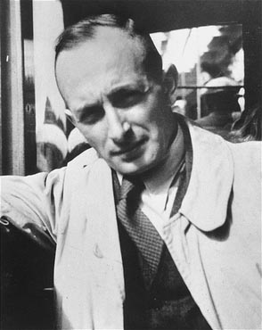
Milgram Experiments:
A Shocking Background
Milgram was influenced by the testimony of Adolf Eichmann, among others:
  “I was one of the many horses pulling the wagon and couldn't escape left or right because of the will of the driver.”
  “Now that I look back, I realize that a life predicated on being obedient and taking orders is a very comfortable life indeed. Living in such a way reduces to a minimum one's need to think.”
  “To sum it all up, I must say that I regret nothing.”
Adolf Eichmann
Notes:
http://www.nizkor.org/hweb/people/e/eichmann-adolf/images/Eichmann-1940.jpg

Slide 33
Milgram Experiments
Social psychologist Stanley Milgram conducted a series of studies in the 1960’s to examine the competing influences of obedience and concern for other’s well being
Advertised as an experiment in “learning & memory”
Participants required to administer shocks from shock range: 15-450 volts
  Participants given sample shock of 45 volts
  Labeled “Slight Shock” to “Danger: Severe Shock” to “XXX”
Notes:
Influenced by the trial of Nazi Adolph Eichmann in 1961

Slide 34
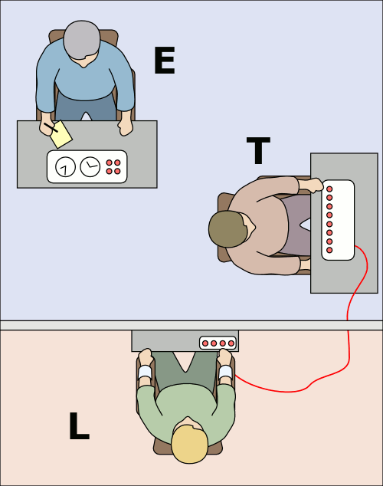
Milgram Experiments
“Learner” was presented a list of words by a “teacher”; “learner” is then tested for recall by “teacher”
“Teacher” instructed by “experimenter” to shock “learner” whenever a mistake is made during recall
Notes:
Provide Milgram paper

Slide 35
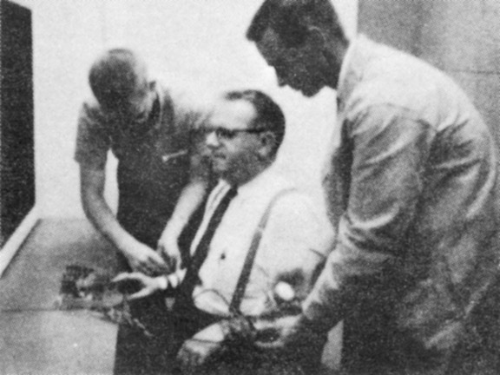
From Ordinary to Evil
(In Just 10 min a Day)
Warning: The video contains content that you might find disturbing (e.g., simulated torture).
Links present the original study as well as a recent (non-scientific) replication
Original
(1960s)
BBC
(2009)

Slide 36
From Ordinary to Evil
(In Just 10 min a Day)
Of the 12 people who participated in the study, 9 / 12 continued to the end of the session, thereby applying ‘Severe Shock’ and ‘XXX’
Thus, we can replicate the findings of Milgram’s experiment(s) today!
Original
(1960s)
BBC
(2009)

Slide 37
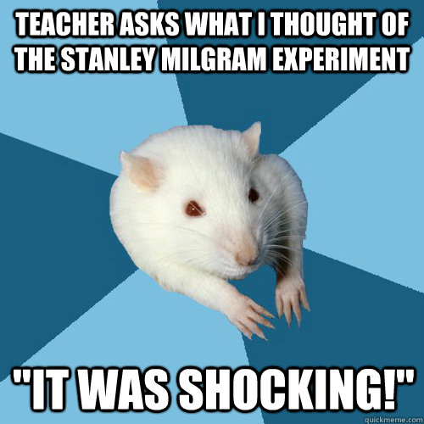
Milgram Ethical Considerations
Given what we know about Milgram’s experiment, what could he have done to examine the same phenomena without inducing such stress?
  Burger (2009)

Slide 38
Milgram Ethical Considerations
Years later, participants were interviewed about their experiences.
They indicated that they felt they were a better person and found out more about themselves by being involved in this study.
  Does this sound familiar?

Slide 39
Milgram Thoughts
Milgram (1981): “The paper failed in several respects. First, whereas I had hoped that the experimental paradigm it presented would be widely used as a general tool for the study of obedience, it became more a subject of citation than replication. Second, the controversies surrounding the experiment tended to deflect attention from the substantive issues of obedience to authority.”

Slide 40
Research Ethics: Procedures
“Relativity applies to physics, not ethics.”
- Albert Einstein

Slide 41
Modern Documents
U.S.: The Belmont Report (1979): Ethical Principles and Guidelines for the Protection of Human Subjects of Research
  justice
  autonomy (respect for persons)
  beneficence
Canada: Tri-Council Policy Statement: Ethical Conduct for Research Involving Humans (1998, with revisions 2005)
  http://www.pre.ethics.gc.ca/english/policystatement/policystatement.cfm

Slide 42
Ethics Review in Canada
Current practice is to review research proposals for ethical considerations
  the Canadian model for review of research proposals is similar to the U.S. model
    Canada: Research Ethics Board (REB)
    U.S.: Institutional Review Board (IRB)
  Generally, each institution (e.g., university) has at least one REB
    Carleton University Ethics Committee for Psychological Research

Slide 43
Ethics Review in Canada
REB “has responsibility for independent, multidisciplinary review of the ethics of research to determine whether the research should be permitted to start or to continue.”
Article 1.6: “The REB should adopt a proportionate approach based on the general principle that the more invasive the research, the greater should be the care in assessing the research.”
http://www.pre.ethics.gc.ca/english/policystatement/policystatement.cfm

Slide 44
General Considerations
Risks in psychological research
  physical harm
  stress
  loss of privacy and confidentiality
Potential benefits of psychological research
  educational benefits, new skill, or treatment for a psychological or medical condition
  material benefits
  personal satisfaction
Notes:
- Utilitarian principle

Slide 45
Tri-Council Ethical Principles
Tri-Council: Canadian government-funded granting agencies: NSERC, CIHR, & SSHRC
  respect for human dignity
  respect for free and informed consent
  respect for vulnerable persons
  respect for privacy and confidentiality
  respect for justice and inclusiveness
  balancing harms and benefits
  minimizing harm: non-maleficence
  maximizing benefit: beneficence

Slide 46
Research Ethics Boards
Exempt research
  research in which there is no risk of harm
Minimal risk research
  when the risk of harm is no greater than risk encountered in daily life or routine physical or psychological tests
Greater than minimal risk research

Slide 47
Research Ethics Impact on Research
Increased time for approval of study
Submissions often need to be revised or clarified
Very cautious about approving research

Slide 48
Informed Consent
Informed consent form
  explanation of the purpose of the research in clear language
  expected duration of the subject’s participation
  description of the procedures
  description of any reasonably foreseeable risks or discomforts and safeguards to minimize the risks
  description of any benefits to the individual or to others that may be reasonably expected from the research
  etc.

Slide 49
Debriefing
Opportunity for the researcher to deal with issues of withholding information, deception, and potential harmful effects of the participation
Explain why deception was necessary
Provide additional resources, if necessary
Make sure participant leaves the experiment without any ill feelings towards the field of psychology

Slide 50
Positive Aspects of Debriefing(?)
Positive aspects of debriefing
  provides an opportunity to explain the purpose of the study and anticipated results
  most participants report positive experience
  research suggests that it is effective
Studies have found that debriefing
  Need not be effective
  Is not believed
  Results in increased suspicion
Recall the study on PTSD Growth

Slide 51
Alternatives to Deception
Role-playing
  Ask participants how they would respond to a certain situation or to predict how others would respond
Simulation studies
  Variation on role-playing that involves simulation of a real world situation
Honest experiments
  Participants are made completely aware of the purposes of the research

Slide 52
Passive versus Active Deception
Passive Deception (omission): withholding relevant information about the nature of the study
Active Deception (commission): deliberately presenting false information about the nature of the study and their performance within it
Most active deception is relatively benign

Slide 53
Gaertner et al., (1999): ‘The Insult Study’
Gaertner et al. (1999) wanted to assess the motivational primacy of the selves
They assumed that the concept of self was composed of multiple subcomponents
  “Individual self” – who I am in comparison to all others
  “Collective self” – who I am in terms of a group identity

Slide 54
Gaertner et al., (1999): ‘The Insult Study’
Debate over the importance of collective self and individual self
  People alter their attitudes and behaviour in accordance with majority opinion (Asch, 1951; Stoner, 1968); Social facilitation during learning (Green, 1989; Zajonc, 1965)
  Self remains stable across time (Pelham, 1991); Self-relevance processing enhances recall (Markus, 1977)
Gaertner et al., (1999) assumed that participants would attempt to protect the self which they felt more attached to
  We need to find some way to offend people!

Slide 55
Gaertner et al., (1999): Method
128 female participants responded to a scale (BPI) related to ‘emotionality’ or ‘moodiness’
A collective identity was primed: “Previous research has indicated that one of the most important social groups to which people belong is gender.”
Participants also primed on the importance of the trait ‘Moodiness’: “inability to control one’s mood state. People who are moody experience frequent and inconsistent shifts in their feelings in response to various situational cues. Moodiness creates potential problems in social interactions, because others are unable to anticipate one’s mood state and behaviour.”

Slide 56
Gaertner et al., (1999): Method
Feedback was randomly assigned. Participants either received positive of negative feedback that either pertained to themselves, or their group.
e.g., Negative Feedback
  Individual Self: “The BPI indicates that participant # is excessively moody.”
  Collective Self: “We regret to inform you that the [University Administration] will not allow us to give you personalized feedback... The BPI indicates that [university] women are excessively moody.”

Slide 57
Gaertner et al., (1999): Results
Participants were then asked to rate the feedback
Perception of negative feedback was rated less favourably when it referred to the individual self then when it referred to the collective self;
  positive feedback was rated more favourable when it referred to the individual self then the collective self
Questions:
Would this study have obtained these results without active deception?
What are the consequences of NOT providing a debriefing form?

