Slide 1

Statistics by Proxy:
Using Excel to Save your Sanity
Research Methods
PSYC/NEURO 2001 Weds 14:30-17:30
Jordan Schoenherr
Carleton University

Slide 2
Overview of Lecture
Usefulness of software and theory
Demonstration
‘In-Class’ Experiment

Slide 3
Beyond the Logic of Statistics

Slide 4
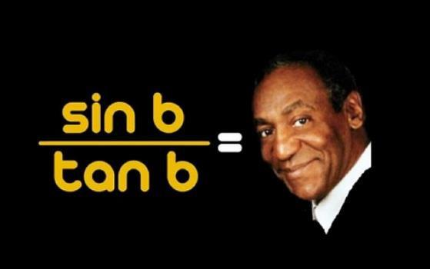
Fun with Numbers… Maybe
An understanding of basic mathematical operations is essential to everyday life, and higher education in particular
Even the best mathematicians can be aided by the use of powerful computation software such as:
  SPSS
  SAS
  Matlab
  Excel

Slide 5
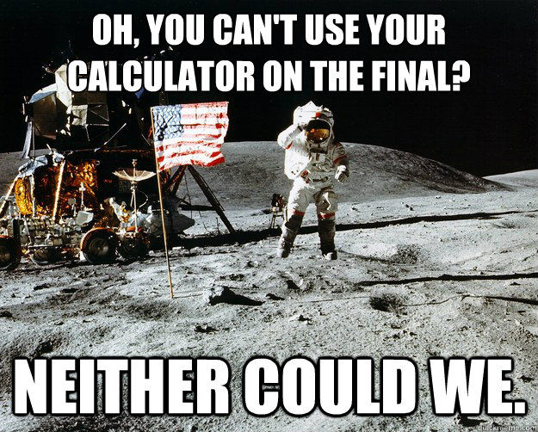
Important Note
Reliance on software, however, is ill-advised
Although we have powerful software that can analyze data for us, it is dangerous to use it without understanding a) how it works, and b) the principles of statistics that we are using
I’ve provided basic tips (to that end) but you will gain a more complete understanding from a stats course
  PSYC 2002
  PSYC 3000

Slide 6
Demonstration: Central Tendency

Slide 7
The Tree of Probability: No Buses
Let us again consider the central limit theorem
We want to determine whether our sample population occurred by chance
To illustrate how we can do this, we’re going to run a simulation
Getting out of the house
Catch Bus
p = 0.5
Catch Bus
p = 0.25
Miss Bus
p = 0.25
Miss Bus
p = 0.5
Catch Bus
p = 0.25
Miss Bus
p = 0.25
Miss Bus
p = 0.125
Catch Bus
p = 0.125
Catch Bus
p = 0.125
Miss Bus
p = 0.125

Slide 8
The Tree of Probability: No Buses
We want to determine whether a given sample set of events (catching a bus) approximates our probability of catching the bus on time
To do this, we assume that we either catch the bus (1) or we don’t (0)
Note the mean probability: p = 0.5!
Getting out of the house
Catch Bus
p = 0.5
Catch Bus
p = 0.25
Miss Bus
p = 0.25
Miss Bus
p = 0.5
Catch Bus
p = 0.25
Miss Bus
p = 0.25
Miss Bus
p = 0.125
Catch Bus
p = 0.125
Catch Bus
p = 0.125
Miss Bus
p = 0.125

Slide 9
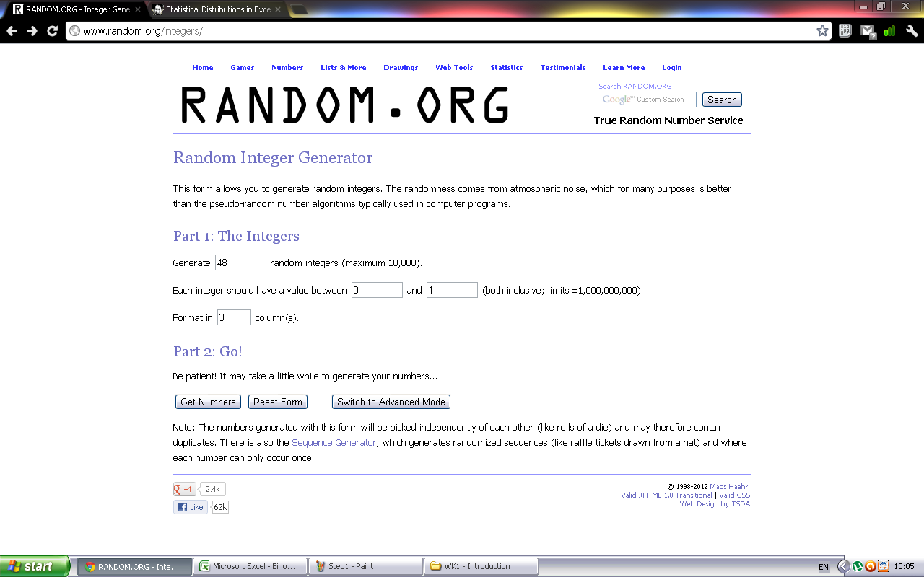
Step 1: Generating Events
First, I give the random generator the number of participants (n = 16) * the number of events (3).
Second, I give it the events:
0 = No Bus
1 = Bus

Slide 10
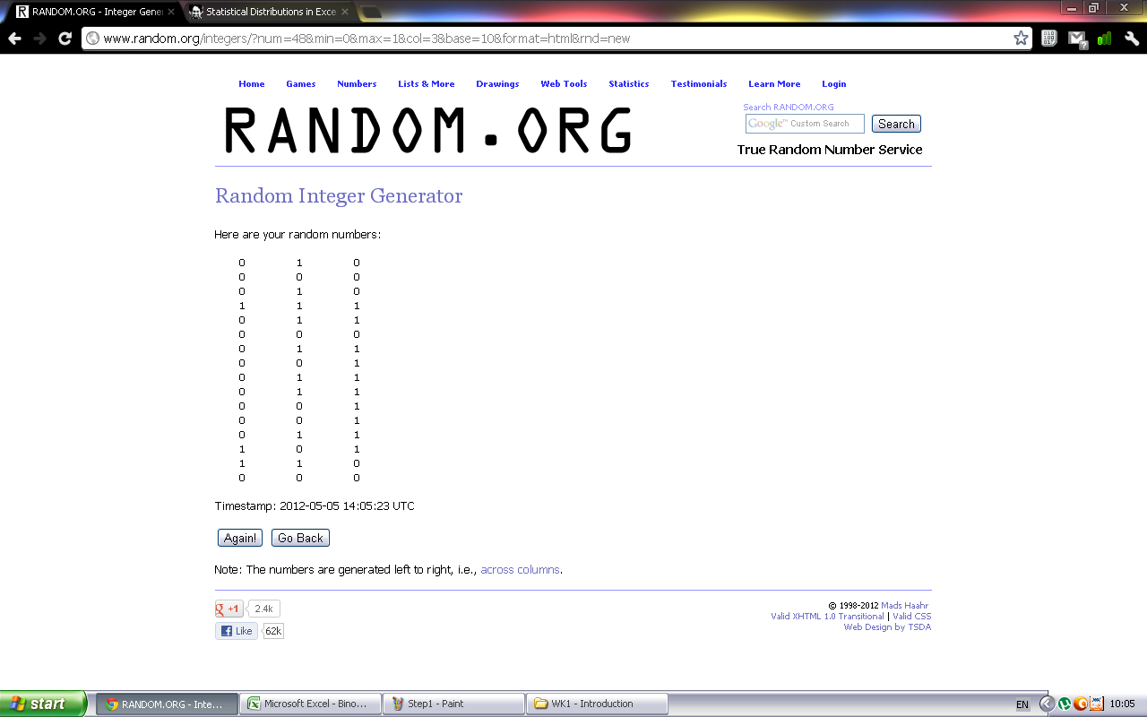
Step 2: Generating Events
Now, I have a sample of 16 participants.
Each row represents their experience. For example, the first person failed to catch their first bus on time, they caught their second bus on time but failed to catch the last bus on time.

Slide 11
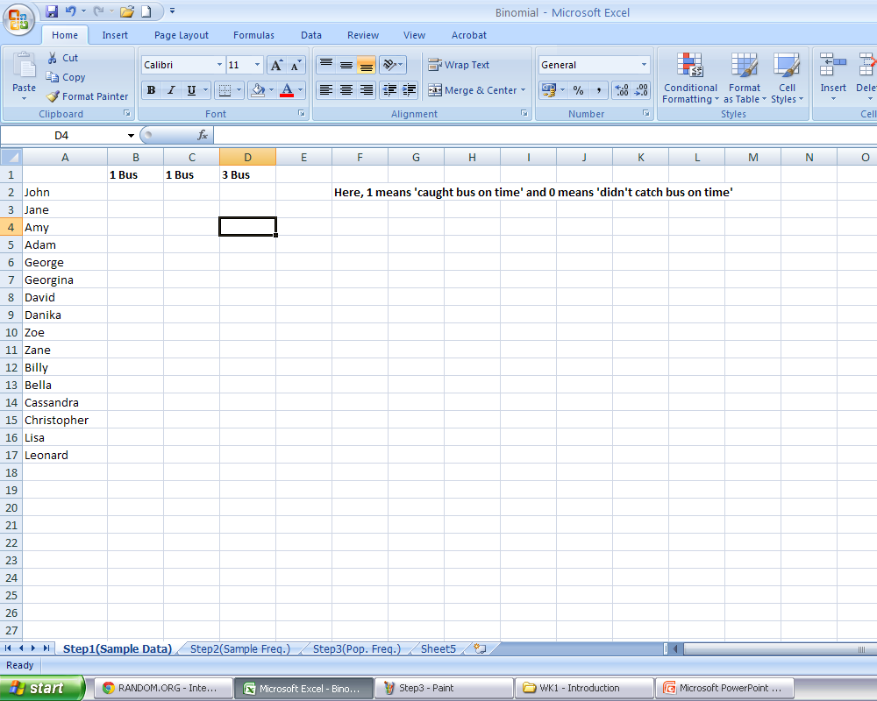
Step 3: Collecting Data
Next, I make a table in Excel to store the data including names…
I also make a note so that I remember what my coding means.

Slide 12
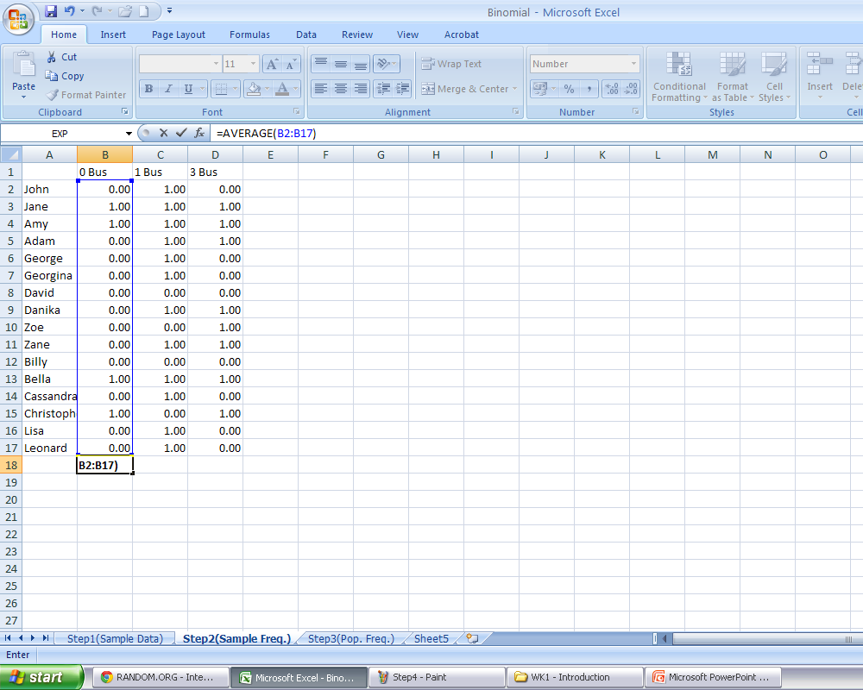
Step 4: Collecting Data
Right click, and select ‘paste special’ to paste in the information from random.org.
Now, I obtain a mean so that I can see what the average is for each scenario, e.g., how many times the first bus is missed.

Slide 13
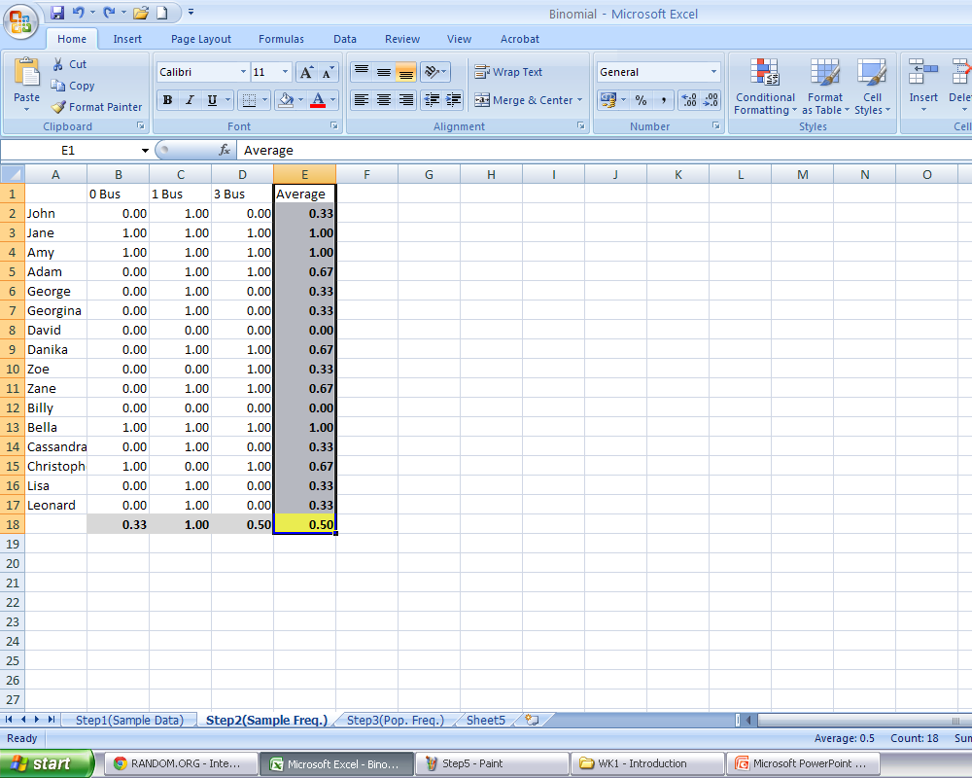
Step 5: Collecting Data
Next, I obtain a average for each person. This allows me to see how ‘lucky’ they were.
Note that:
0 means that she didn’t catch any bus on time;
0.33 means that she only caught 1 out of 3 buses (33.33%);
1 means that caught 3 out of 3 buses (100%).
Notice that, with a sufficiently large sample, we obtain back the probability for the events’ occurrence.

Slide 14
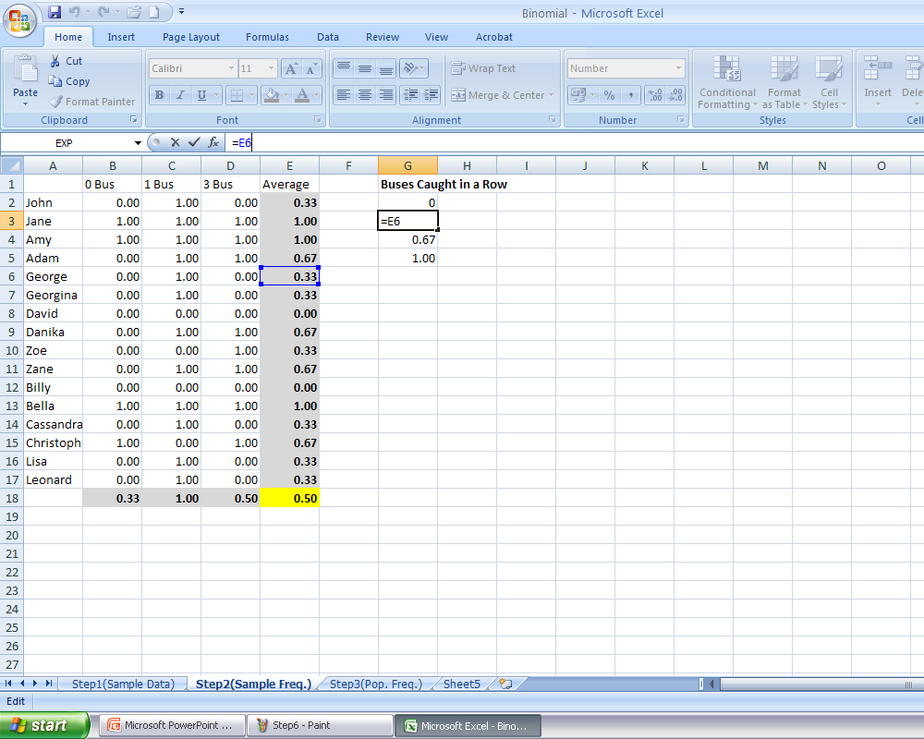
Step 6: Collecting Data
To obtain frequencies for each sequence of events, we first need to make ‘bins’ for each type of event.
Notice that although we could simply type in 0.33, the reality is that its better to take this value from the appropriate cell.
The reason is that Excel truncates the value 0.33333. Thus, a 0.33 bin will not contain anything because 0.33333 values will get rounded up into the next bin.

Slide 15
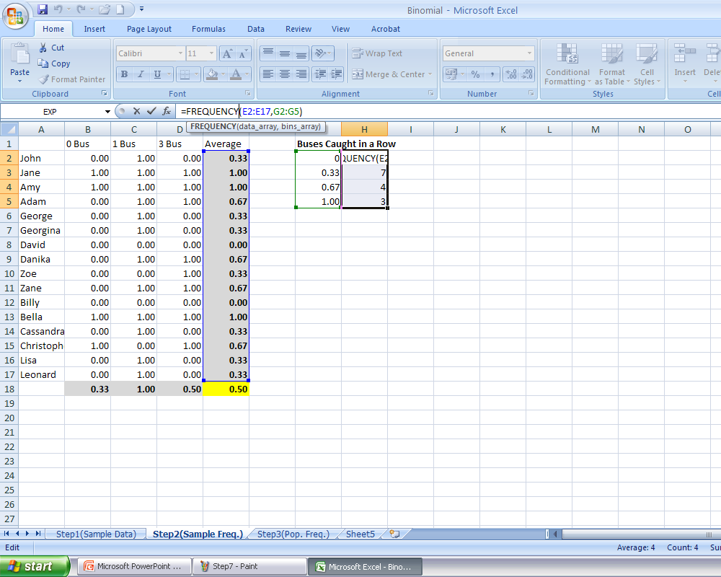
Step 7: Collecting Data
Here’s the tricky part. To obtain frequencies, you need to select the ‘FREQUENCY’ function. It requires you to select the column containing ALL responses (i.e., ‘E’), and the column containing the frequency bins you’ve initialized in the last step.
Then, you will need to press Ctrl+Shift+Enter. The resulting column will contain the frequencies.

Slide 16
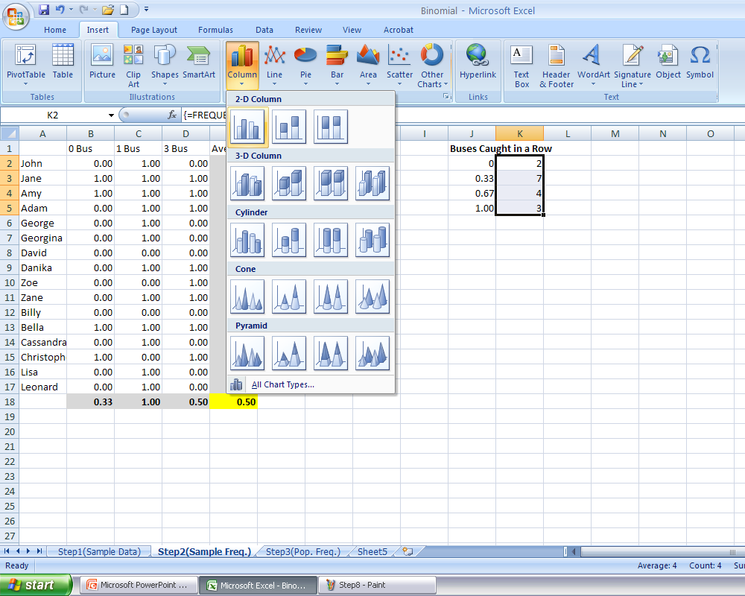
Step 8: Creating a Figure
With the frequencies ready, we can create a figure containing the frequencies.
In this case, we will simply select the bar graph option to create a histogram.

Slide 17
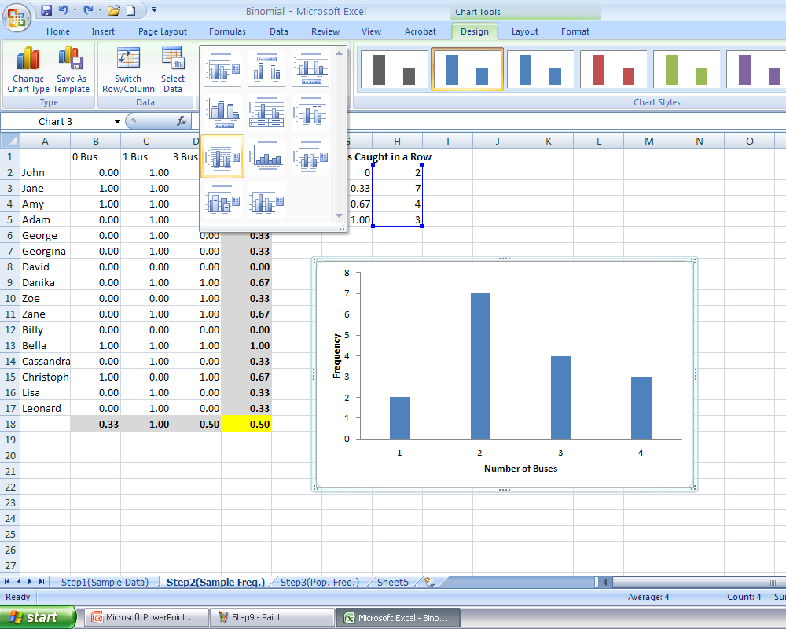
Step 9: Creating a Figure
Finally, we want to ensure that the x- and y-axis labels are meaningful.
After clicking on the figure, a new menu: ‘Chart Tools’.
(This will become important for the next step).
Next, rename the x- and y-axis titles.

Slide 18
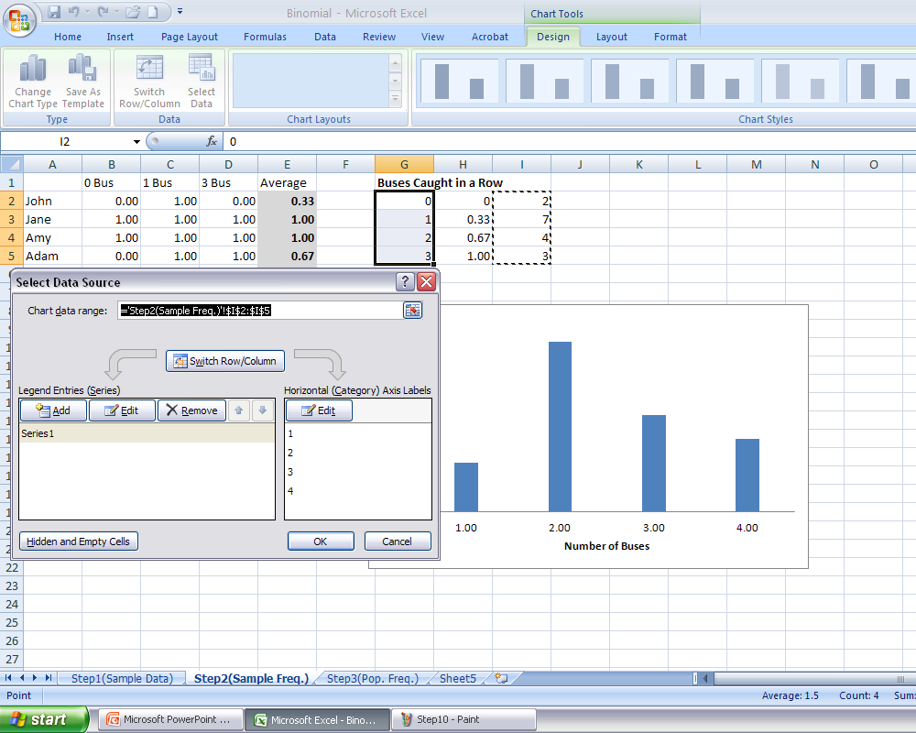
Step 10: Creating a Figure
To change all the labels on the x-axis with values in a column, go to ‘Select Data’ in the ‘Cart Tools’ menu.
The editor window will open.
Then, click ‘Edit’ to change the x-label values.

Slide 19
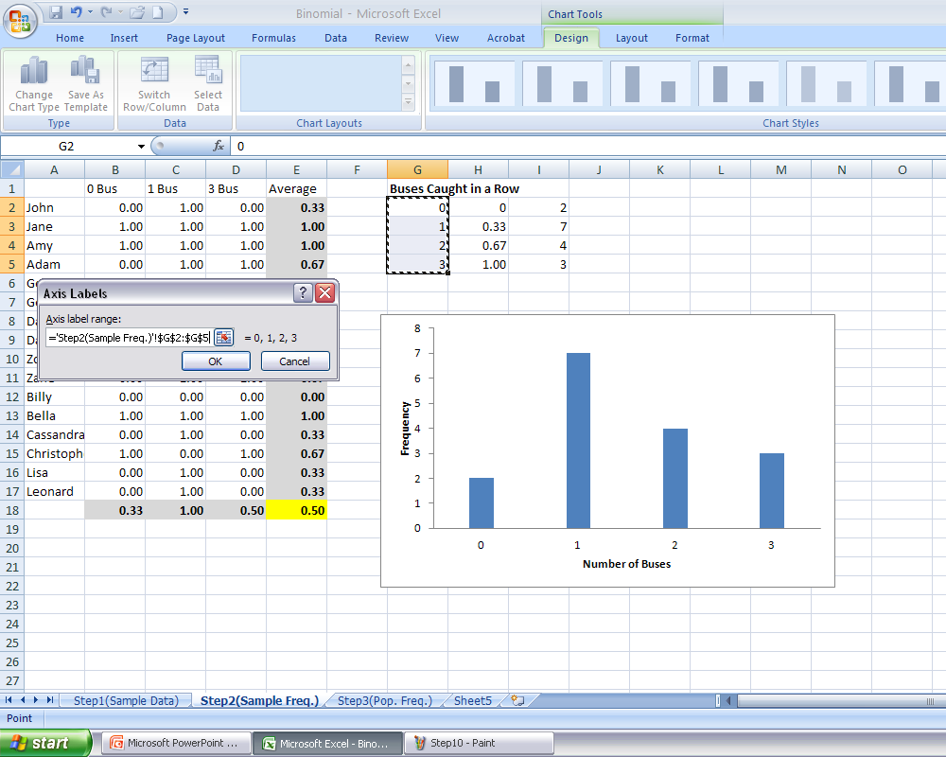
Step 11: Creating a Figure
After selecting edit, this window will appear.
Select the appropriate column.
Once ‘OK’ is pressed, the x-axis labels will change.

Slide 20
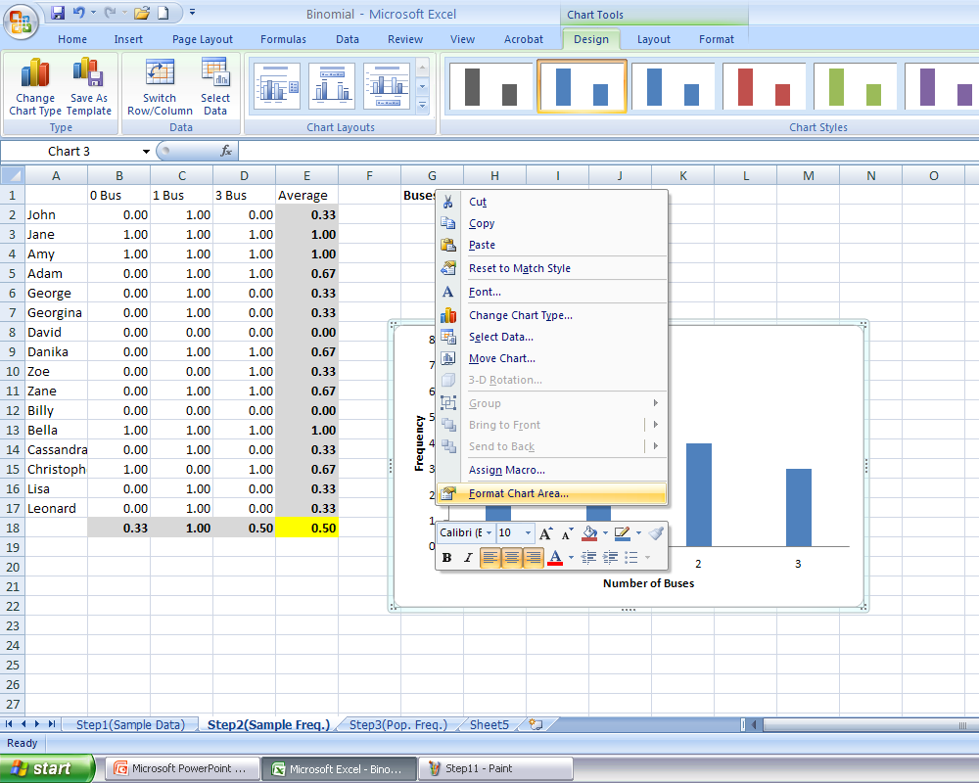
Step 12: Creating a Figure
Sometimes we want to change the range of an axis, e.g., instead of y-axis values running from 0 to 8, we want to change the range from 1 to 10.
To do this, click on the numbers on the y-axis. From the menu, select ‘Format Chart Areas’.

Slide 21
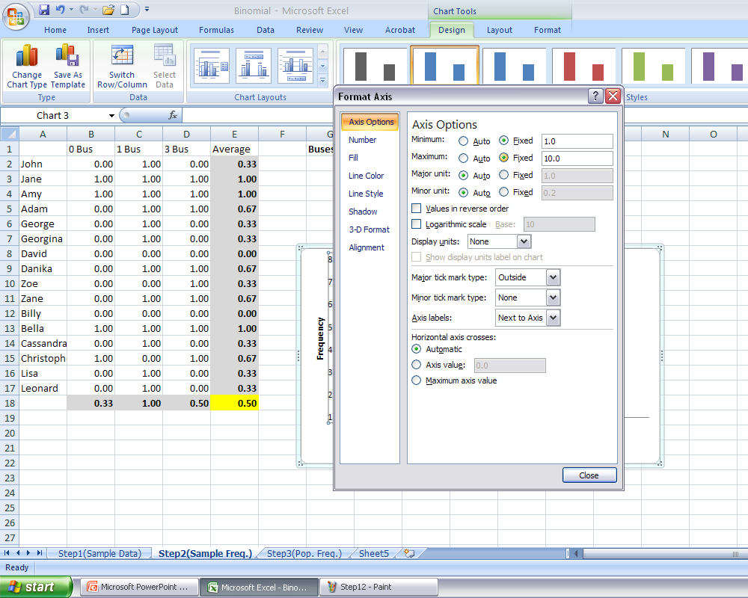
Step 13: Creating a Figure
Finally, change the values from a minimum of 0.0 to 1.0 and the maximum from 8.0 to 10.0.

Slide 22
Step 14: You’re Done!
Now that you have your figure, you can insert it into your paper, presentation, etc.
Notice that you can focus on obtaining results without getting bogged down in calculations.
For the Excel assignments, you will need to do similar processing: e.g., obtain a mean

Slide 23
Generalizing to a Larger Sample
Importantly, however, this task also demonstrates some property of frequency data.
  Run 144 students using the same procedure
  Running more students yields a similar distribution.
Provided that we have an appropriate sample population, its properties match those of the general population.
n = 16

Slide 24
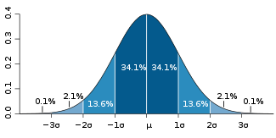
Properties of the Normal Distribution
More importantly, given enough intervals and a sufficient sample size we obtain a normal distribution.
Normal distribution is described by a few basic properties:
  Mean (μ): the average
  Standard Deviation (σ²): the extent to which data varies from the average
  Skewedness: The extent to which the distribution is moved to the left or the right

Slide 25
Tips for Figures

Slide 26
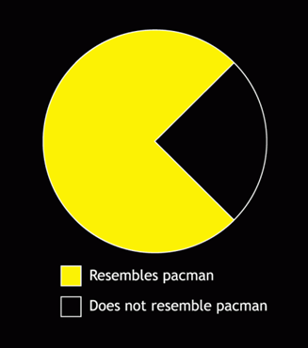
Figure Selection: Tips
The way we choose to report data is also determined by certain conventions
If we are reporting a categorical independent variable along the x-axis (e.g., male v. female) a bar graph is typically used
  Nominal or Ordinal scale
When reporting continuous independent variables (e.g., difficulty, ratings) a line graph or scatter plot is used
  Ordinal, Interval or Ratio Scale

Slide 27
Figure Selection: Tips
As I mentioned previously, methods from data representations are selected in order to help the reader decode information from a figure
If you have 2 or 4 means, you could simply report them in a paragraph
>3 means, should probably use a figure

Slide 28
Figure Selection
Cleveland and McGill (1985) ranked features in terms of an individual's ability to decode information from graphs:
  Position along a common scale
  Length
  Angle & Slope
  Area
  Volume, Density, & Colour Saturation; Colour Hue

Slide 29
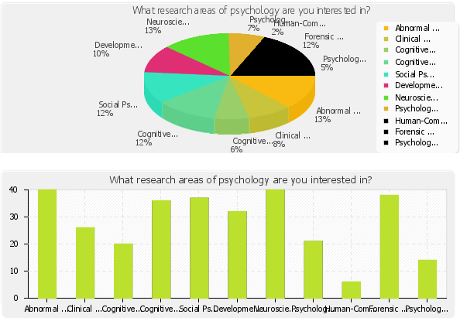
Your Disciplinary Interests
Let’s examine your data!
Pie graph is more difficult to read compared to bar graph

Slide 30
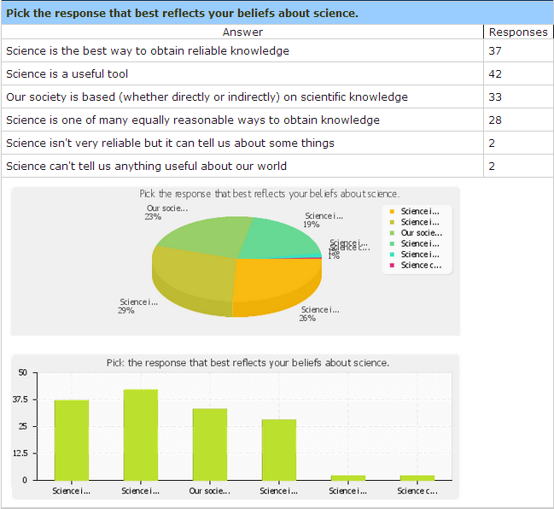
Beliefs About Science

Slide 31

Save that Data
Remember: When you are doing any data analysis, save your progress at EACH step
It is easier to delete a file once you are done then it is to redo a project!
It is also best to document what you did at each step so that, if you made a mistake, you can go back
Notes:
http://www.snorgtees.com/t-shirts/back-that-thing-up

Slide 32
‘In-Class’ Experiment: Online

Slide 33
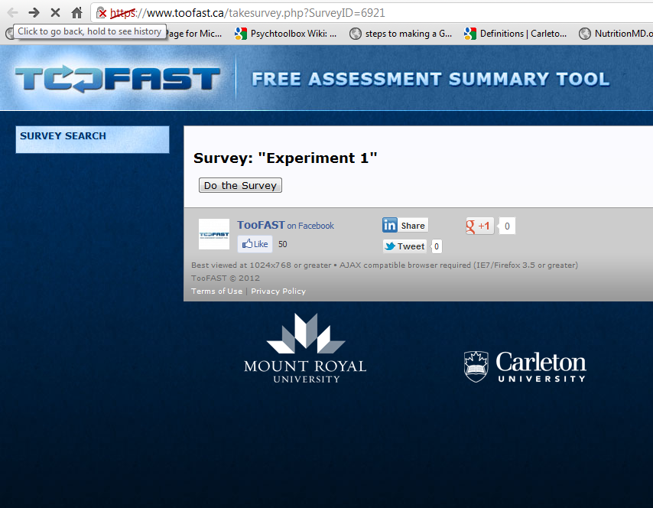
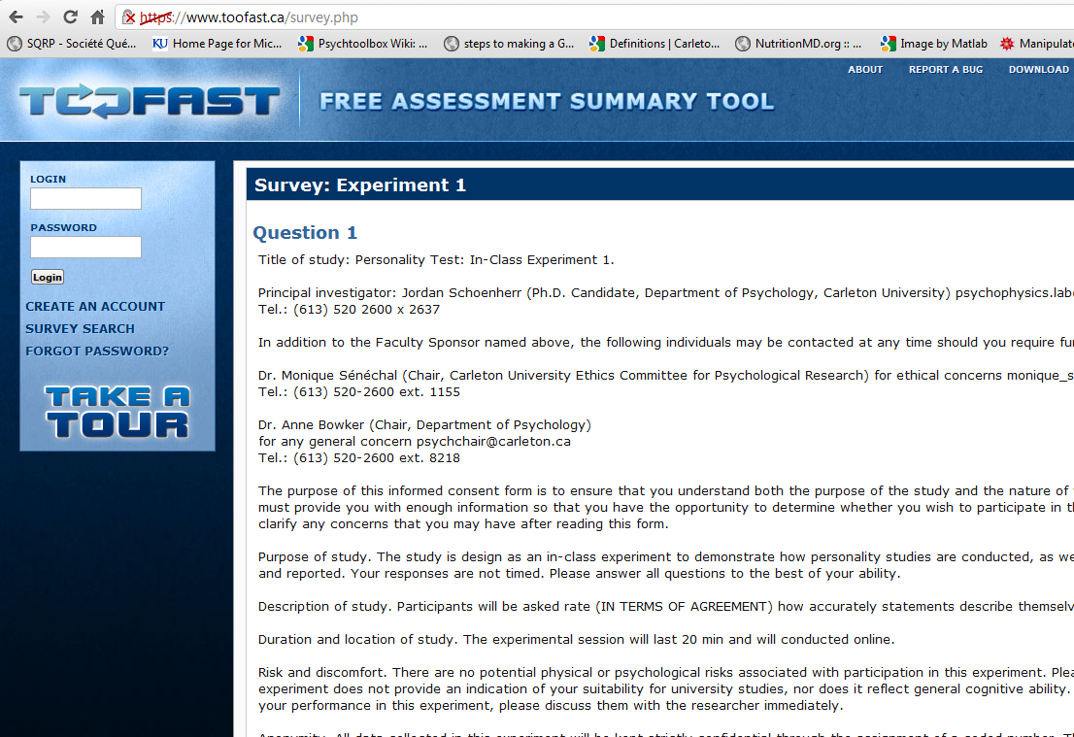
First Experiment
The experiment can be found here. Choose YOUR section:
  Section A &T: https://www.toofast.ca/takesurvey.php?SurveyID=6925
Simply click on ‘Do the Survey’ tab. Read through the informed consent and click ‘Yes’ to do the personality test.

Slide 34
First Experiment
You will be provided with statements about you. Simply rate the extent to which you agree with them. At the end of the survey, there will also be three questions about you (e.g., gender, activities).
The survey should take 10-15 min
You must complete it by this Friday, 23:59

